Slide 1
Topics of today’s class
Last class:
  Chapter 5
    A Closed Economy One-Period Macroeconomic Model
Today’s class:
  Chapter 7
    Economic growth facts
    Malthusian model of economic growth
1-<number>

Slide 2
Chapter 7
Economic Growth:
Malthus and Solow

Slide 3
Chapter 6 Topics
Economic growth facts
Malthusian model of economic growth
Solow growth model
Growth accounting
6-<number>

Slide 4
Growth: Why should we care?
In which country:
  life expectancy at birth is under 50 years
  1 out of 10 infants dies before reaching a first birthday
  90 percent of households have no electricity
  less than 10 percent of young adults have graduated from high school
6-<number>

Slide 5
Growth: Why should we care?
In which country:
  life expectancy at birth is under 50 years
  1 out of 10 infants dies before reaching a first birthday
  90 percent of households have no electricity
  less than 10 percent of young adults have graduated from high school
It is the U.S. in 1900.
There are large variations over time in a country standards of living
  GDP per capita in U.S. was about $2800 in 1870
  rose to more than $42,000 by 2009, almost a 15-fold increase.
6-<number>

Slide 6
Growth: Why should we care?
There are large variations across countries in standards
of living.
  Ratio of GDP per capita USA/Congo: 91
  Life expectancy in rich countries is 77 years, 67 years in middle income countries, and 53 years in poor countries.
  Out of 6.4 billion people in the world, 0.8 do not have access to enough food, 1 to safe drinking water, and 2.4 to sanitation.
6-<number>

Slide 7
Growth: Why should we care?
Economic Growth is correlated with long-run standards of living.
Striking example:
  Real GDP per capita in Argentina and Canada were the same in 1900: $2,750.
  Argentina’s average growth rate in 1900-2009 was around 1.605%. Canada’s average growth rate in 1900-2009 was around 2.463%.
  In 2009 the per capita GDP of Canada was $39,000, while Argentina’s GDP was $16,000.
6-<number>

Slide 8
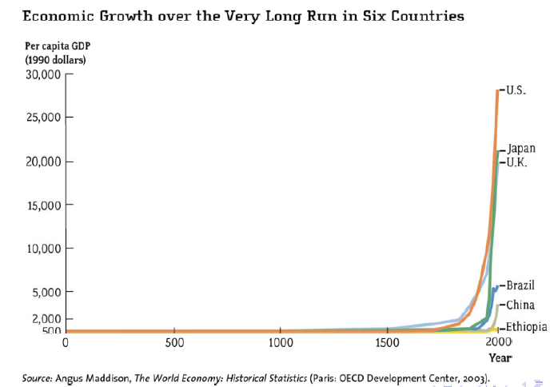
Growth: Why should we care?
6-<number>

Slide 9
Economic Growth Facts
Growth is remarkably a recent phenomenon.
Before the Industrial Revolution around 1800, standards of living differed little over time and across countries.
Since the Industrial Revolution, per capita income growth has been sustained in the richest countries.
6-<number>

Slide 10
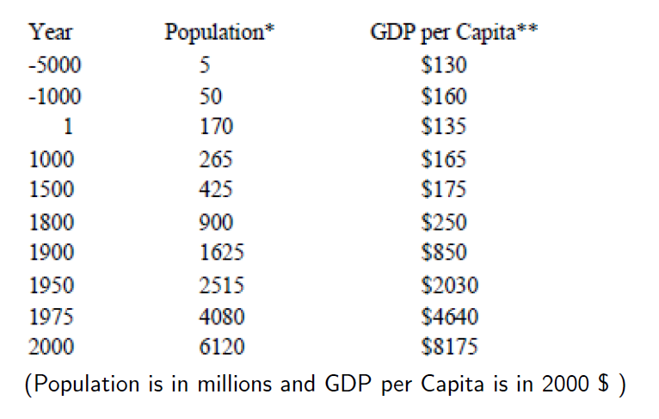
World Population and GDP
6-<number>

Slide 11
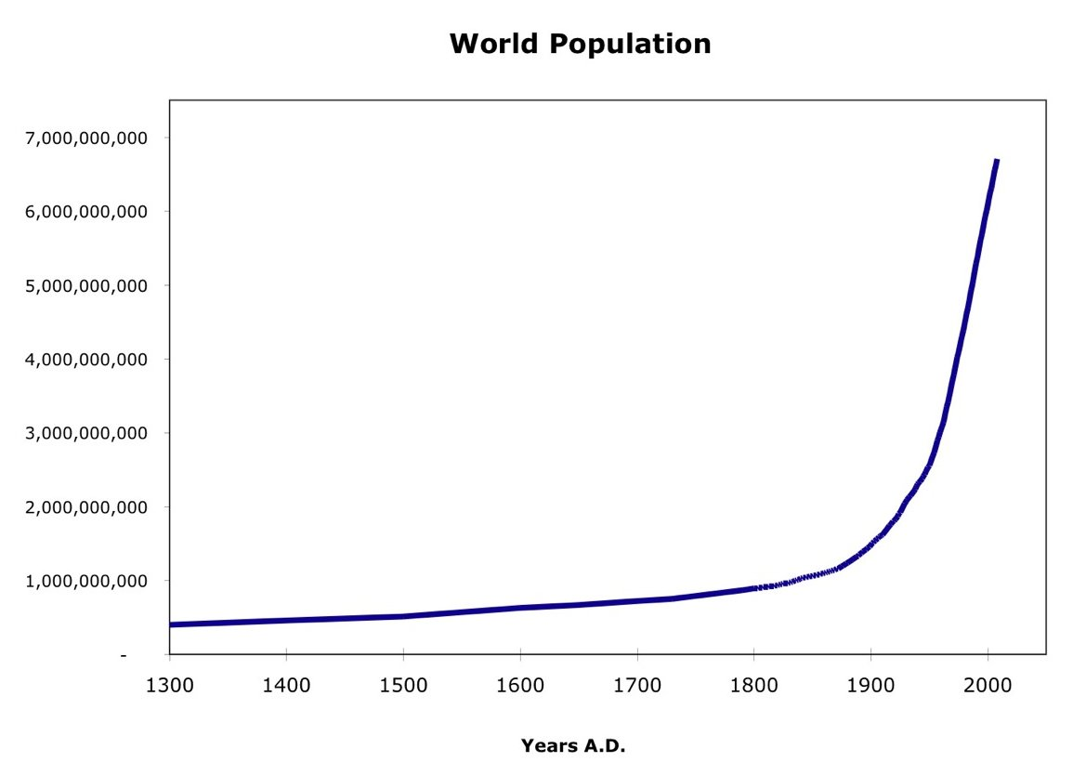
World Population
6-<number>

Slide 12
Malthus
Thomas Malthus: An essay on the Principle of Population (1798).
Population growth has a negative impact on the standard of living, because increases in population dilute any gains in productivity.
He argues in favor of population control or “forced family planning”.
6-<number>

Slide 13
Malthusian model of economic growth
Predicts that a technological advance will only increase population, with no long-run change in the standard of living.
6-<number>

Slide 14
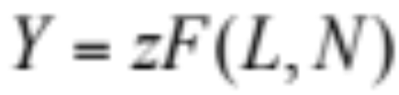
Production Function
Output is produced from land and labor inputs.
L: land instead of capital
Y: food
6-<number>

Slide 15
Dynamic Model
before: static models
now: dynamic model
no-investment: there is no way to store food from one period to the other.
6-<number>

Slide 16
Evolution of the population
N’ = N + Births − Deaths
N’ = N + N×(birth rate − death rate)
6-<number>

Slide 17

Evolution of the Population
Higher population growth, the higher is per-capita consumption.
Birth rate increases with consumption per capita
  people will have more children by choice.
  better nutrition increases fertility.
Death rate decreases with consumption per capita
  decreases infant mortality.
  population healthier, increasing the average lifespan.
6-<number>

Slide 18
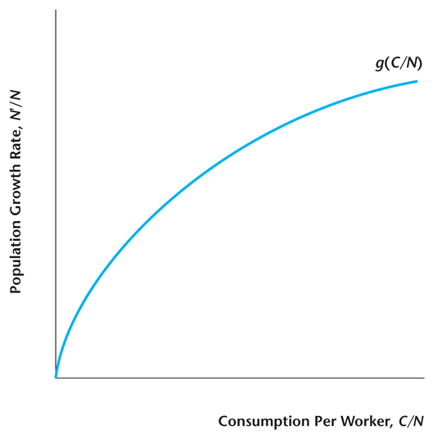
Figure 6.5
Population Growth Depends on Consumption per Worker in the Malthusian Model
6-<number>

Slide 19
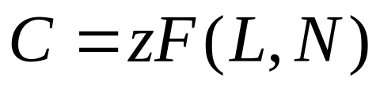
Equilibrium Condition
In equilibrium, consumption equals output produced.
income expenditure identity for this economy
6-<number>

Slide 20
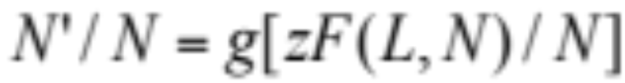
Equilibrium Evolution of the Population
This equation describes how the future population depends on current population.
6-<number>

Slide 21

How Population Evolves in Equilibrium
6-<number>

Slide 22
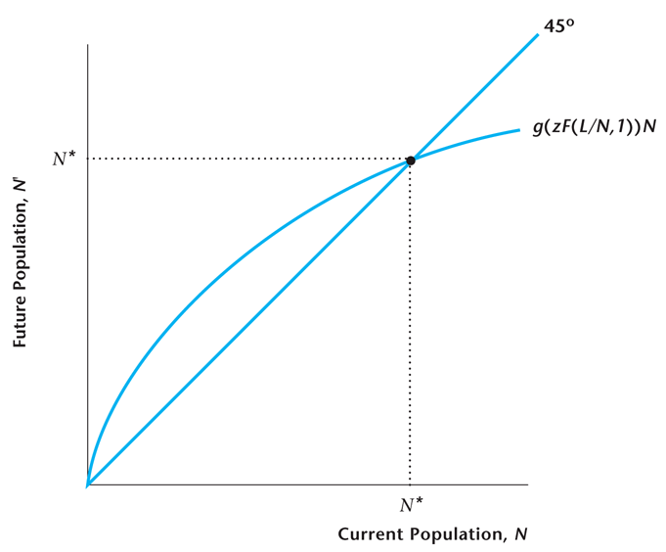
Figure 6.6
Determination of the Population in the Steady State
6-<number>

Slide 23
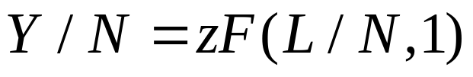
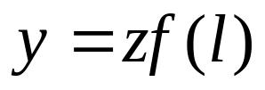
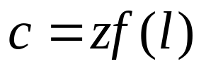
Steady state of the model
or
where y: output per worker, l: land per worker
Since consumption equals output, consumption per worker c is:
6-<number>

Slide 24
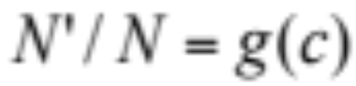
A Steady State Condition
Population growth is increasing in consumption per worker, c
6-<number>

Slide 25
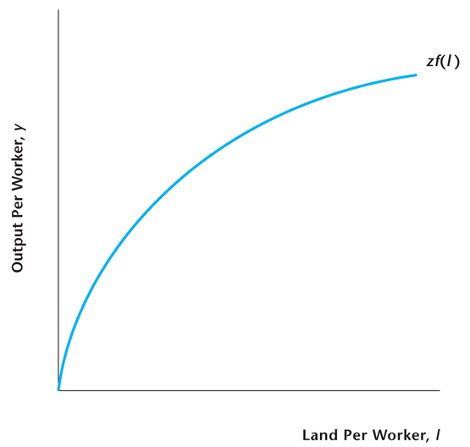
Figure 6.7
The Per-Worker Production Function
6-<number>

Slide 26
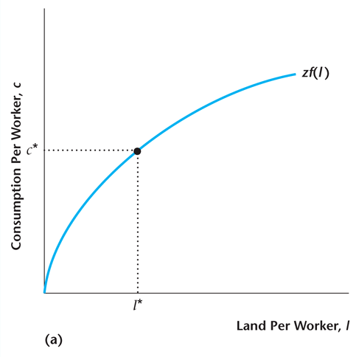
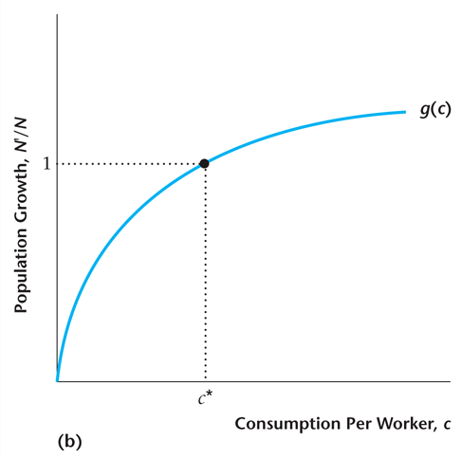
Figure 6.8
Determination of the Steady State in the Malthusian Model
6-<number>

Slide 27
An Increase in z in the Malthusian Model
If z increases, this shifts up the per-worker production function.
In the long run, the population increases to the point where per capita consumption returns to its initial level.
There is no long-run change in living standards.
6-<number>

Slide 28
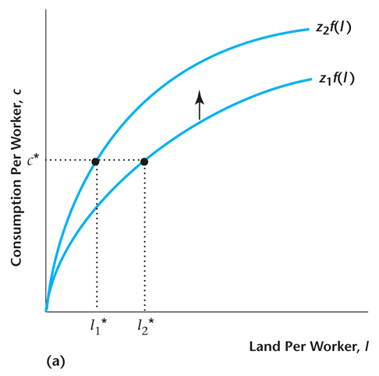
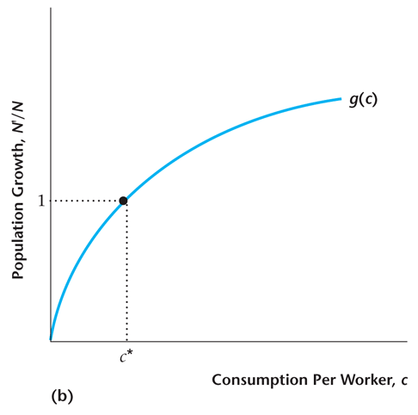
Figure 6.9
The Effect of an Increase in z in the Malthusian Model
6-<number>

Slide 29
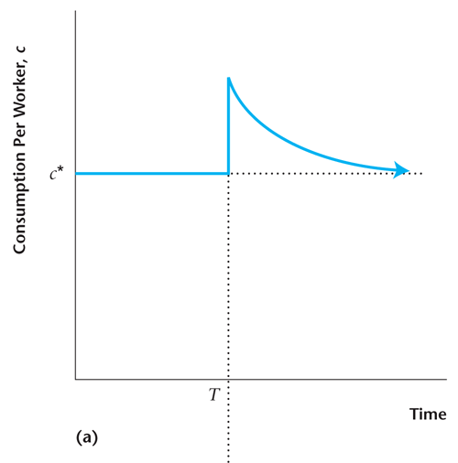
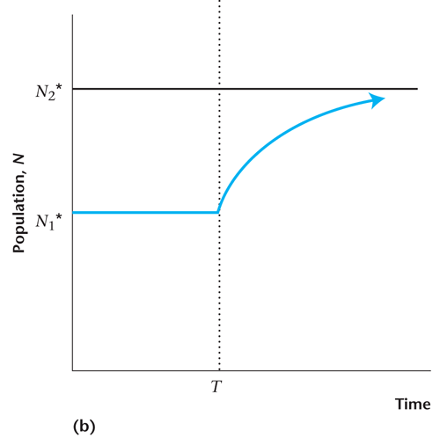
Figure 6.10
Adjustment to the Steady State in the Malthusian Model when z Increases
6-<number>

Slide 30
An increase in TFP
Immediate Effect of an Increase in TFP
  increase in the productivity of labor
  and so, an increase in consumption per capita
But increase in consumption per capita leads to:
  an increase in population size
  a decrease in the productivity of labor (decreasing marginal return to labor)
In the long-run:
  consumption per worker is unchanged
  population increases
Pessimistic View: improvements in technology do not improve standard of living in the long run.
6-<number>

Slide 31
Population Control in the Malthusian Model
Population control alters the relationship between population growth and per-capita consumption.
In the long run, per capita consumption increases, and living standards rise.
6-<number>

Slide 32
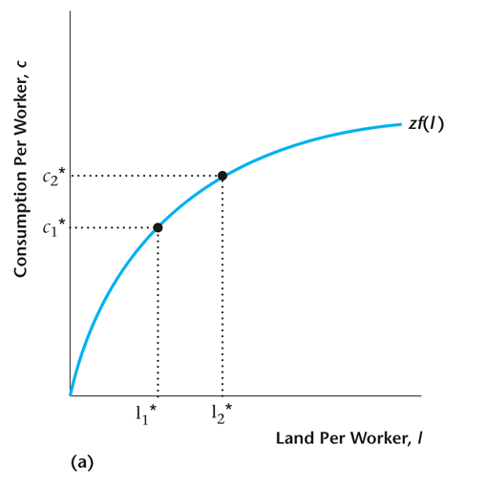
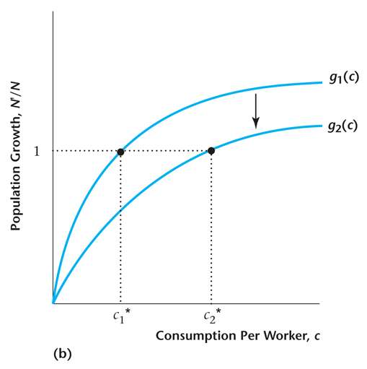
Figure 6.11a
Population Control in the Malthusian Model
6-<number>

Slide 33
How Useful is the Malthusian Model?
Model provides a good explanation for pre-1800 growth facts in the world.
Malthus did not predict the effects of technological advances on fertility.
Malthus did not understand the role of capital accumulation in growth.
6-<number>

