Slide 1
Topics of today’s class
Last class:
  Chapter 7
    Economic growth facts
    Malthusian model of economic growth
Today’s class:
  Chapter 7
    Solow growth model
    Growth accounting
1-<number>

Slide 2
Solow Growth Model
This model is the basis for the modern theory of economic growth.
A key prediction is that technological progress is necessary for sustained increases in standards of living.
6-<number>

Slide 3
South Korea and the Philippines
In 1960, South Korea and the Philippines were quite similar
  Per capita GDP: Korea=$1800, Philippines=$2200
  Population: Both about 25 million, 1/2 working age
  Similar sectorial composition (industry, agriculture)
  College enrollment: Korea=5%, Philippines=13%
Between 1960 and 2007, macroeconomic performance diverged sharply:
  Growth: Korea=5.5%, Philippines=1.7%
  Per capita GDP in 2007: Korea=$24,000, Philippines=$5,000
Why?
6-<number>

Slide 4
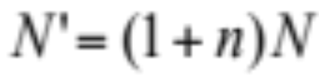
Population Growth
In the Solow growth model, population is assumed to grow at a constant rate n.
6-<number>

Slide 5
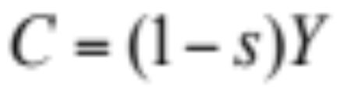
Consumption-Savings Behavior
Consumers are assumed to save a constant fraction s of their income, consuming the rest.
6-<number>

Slide 6

Representative Firm’s Production Function
6-<number>

Slide 7
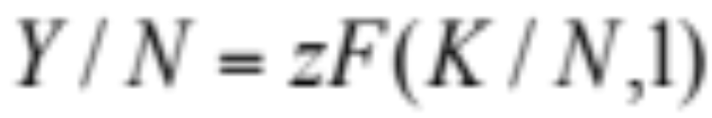
Constant Returns to Scale
Constant returns to scale implies:
6-<number>

Slide 8
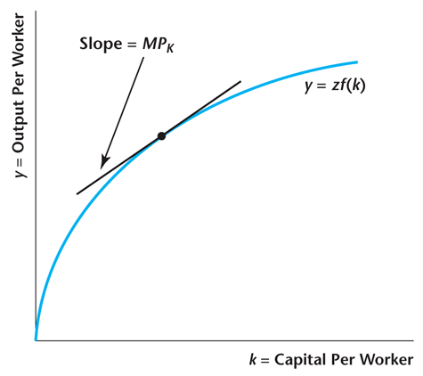
Figure 6.12
The Per-Worker Production Function
6-<number>

Slide 9
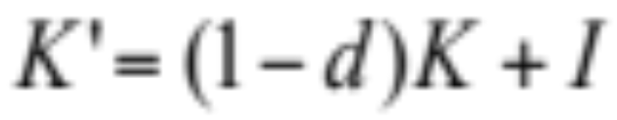
Evolution of the Capital Stock
Future capital equals the capital remaining after depreciation, plus current investment.
6-<number>

Slide 10
Solving for the Solow model
Exogenous Variables: s, d, n, z
Endogenous Variables: Y, K, N, C, I
  The income expenditure identity:
  Y = C + I
  combined with the household budget constraint:
  Y = C + S
  Saving = Investment
  S = I
6-<number>

Slide 11
Solving for the Solow model
Replacing in the capital accumulation equation
K’ = K(1 - d) + S
= K(1 - d) + sY
= K(1 - d) + szF(K)
Rewrite in per-worker form:
k’(1 + n) = (1- d)k + szf(k)
This equation governs the dynamics of the Solow Model.
6-<number>

Slide 12
Dynamics of capital per worker
There are two opposing forces driving capital per worker:
investment
  consumer saves a constant fraction of her income which is used for investment.
  diminishing returns: each addition to the capital stock increases production and therefore investment by less and less.
the growth of the population n and depreciation of existing capital d.
6-<number>

Slide 13
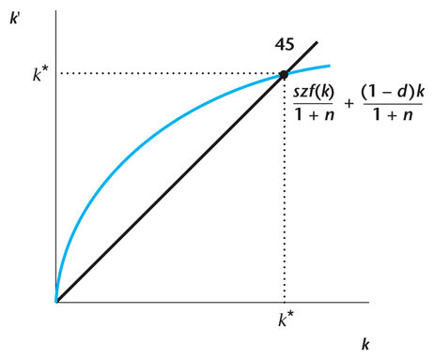
Figure 6.13
Determination of the Steady State Quantity of Capital per Worker
6-<number>

Slide 14
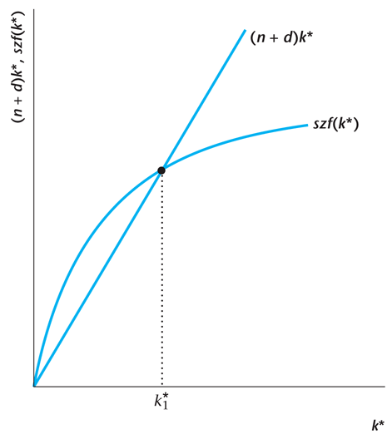
Figure 6.14
Determination of the Steady State Quantity of Capital per Worker
6-<number>

Slide 15
Dynamics of Capital per Worker
Imagine initially low k₀:
productivity of capital is very high
the stock of capital increases
until the economy reaches the steady state k*
Why does the economy settle down to a steady state?
Because investment exhibits diminishing returns: as we increase capital, output rises by a smaller and smaller amount.
But a constant fraction of capital depreciates.
6-<number>

Slide 16
What is the source of Long Term Growth?
Zero! There is no long-run growth in GDP per capita in Solow!!
  Diminishing returns to capital is at the heart of why growth eventually ceases in the Solow Model.
Despite this negative result on long-run growth, the Solow framework is extraordinary helpful: see “Nobel Prize” :-)
The reason is related to Transition Dynamics.
6-<number>

Slide 17
The Principle of Transition Dynamics
A key prediction of the Solow framework is
  The Principle of Transition Dynamics: the farther below its steady state an economy is, the faster it will grow; similarly, the farther above its steady state, the slower it will grow.
Differences in growth rates across countries largely reflect how near or far countries are from their steady state.
6-<number>

Slide 18
Example: The United States and China
United States
  Growth at a constant rate of 2% per year for more than a century.
  In some sense, this reflects the fact that the U.S. is close to its steady state.
  We’ll understand this more soon.
China
  Rapid growth at more than 8% per year during the period of 1980-2010.
  Suggests China is below its steady state and therefore growing rapidly.
6-<number>

Slide 19
An Increase in the Savings Rate s
In the steady state, this increases capital per worker and real output per capita.
In the steady state, there is no effect on the growth rates of aggregate variables.
6-<number>

Slide 20
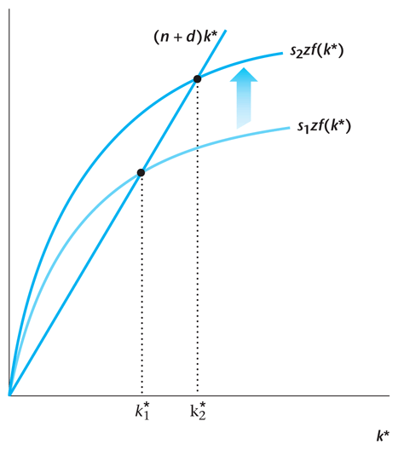
Figure 6.15
Effect of an Increase in the Savings Rate on the Steady State Quantity of Capital per Worker
6-<number>

Slide 21
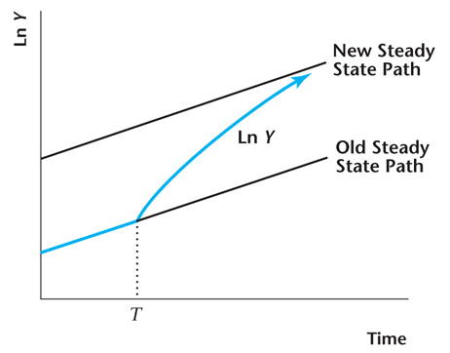
Figure 6.16
Effect of an Increase in the Savings Rate at Time T
6-<number>

Slide 22
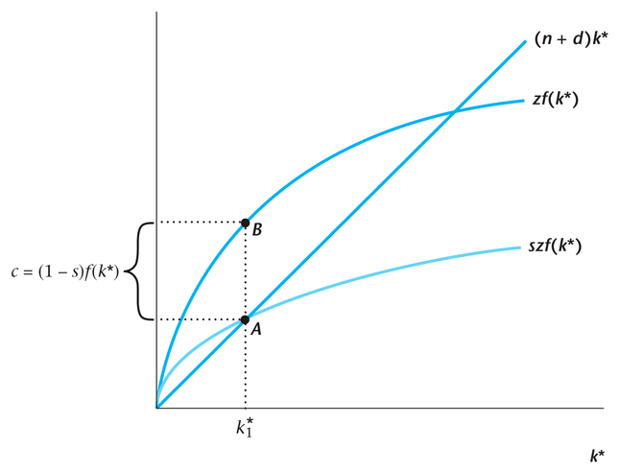
Figure 6.17
Steady State Consumption per Worker
6-<number>

Slide 23
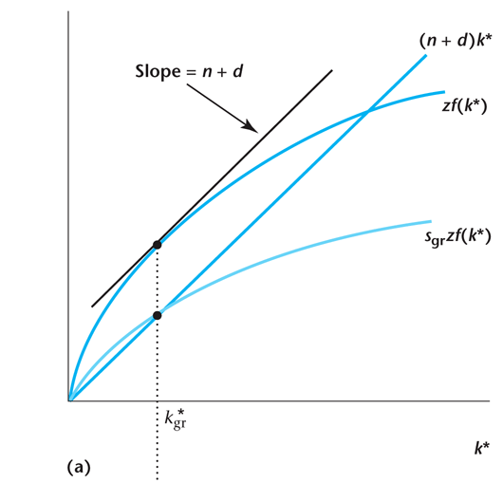
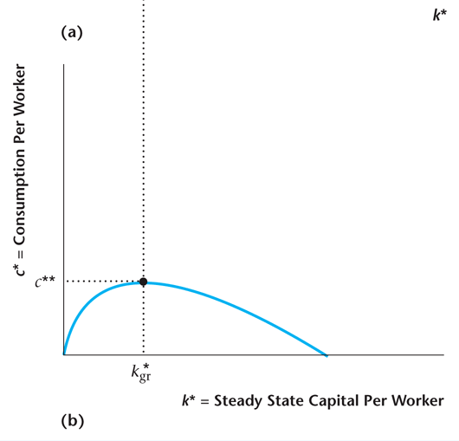
Figure 6.18
The Golden Rule Quantity of Capital per Worker
6-<number>

Slide 24
An Increase in the Population Growth Rate n
Capital per worker and output per worker decrease.
There is no effect on the growth rates of aggregate variables.
6-<number>

Slide 25
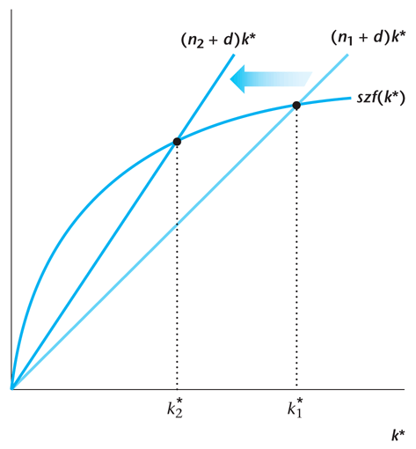
Figure 6.19
Steady State Effects of an Increase in the Labor Force Growth Rate
6-<number>

Slide 26
Predictions of The Solow Model
Richer Countries have a high saving rate.
Richer Countries have a low population growth rate.
6-<number>

Slide 27
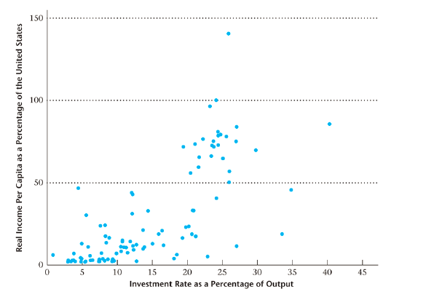
Investment rate and GDP
6-<number>

Slide 28
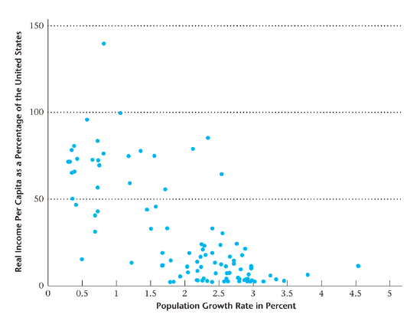
Population growth rate and GDP
6-<number>

Slide 29
Case Study: S. Korea and Philippines
In 1960, South Korea and the Philippines were quite similar
  Per capita GDP: S. Korea=$1800, Philippines=$2200
  Population: Both about 25 million, 1/2 working age
  Similar sectorial composition (industry, agriculture)
  College enrollment: S. Korea=5%, Philippines=13%
Between 1960 and 2007, macroeconomic performance diverged sharply:
  Growth: S. Korea=5.5%, Philippines=1.7%
  Per capita GDP in 2007: S. Korea=$24,000, Philippines=$5,000
Why?
6-<number>

Slide 30
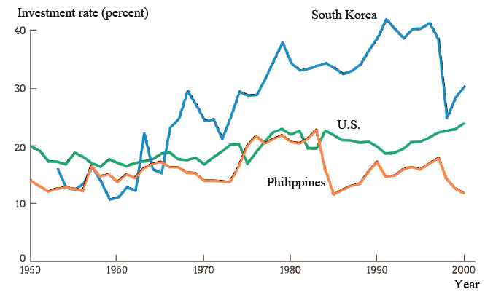
Investment in S. Korean and Philippines
6-<number>

Slide 31
What is the source of Long Term Growth?
NOT the savings rate: it must always be below 1.
NOT decreasing population size: it cannot fall indefinitely.
6-<number>

Slide 32
Increases in Total Factor Productivity z
Sustained increases in z cause sustained increases in per capita income.
6-<number>

Slide 33
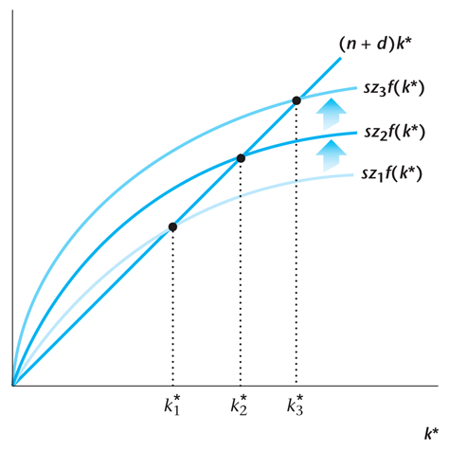
Figure 6.20
Increases in Total Factor Productivity in the
Solow Growth Model
6-<number>

Slide 34
Strengths and Weaknesses of the Solow Model
Strengths:
  it provides a theory that determines how rich a country is in the long run.
  the principles of transition dynamics allows for an understanding of differences in growth rates across countries.
Weaknesses:
  it focuses on investment and capital, while the much more important factor of TFP is still unexplained.
  It does not explain why different countries have different investment and productivity rates.
  It does not provide a theory of sustained long-run economic growth.
6-<number>

Slide 35
Convergence
If two countries are initially rich and poor, but identical in all other respects, they will converge in the long run to the same level and rate of growth of per-capita income.
Differences in income level across countries explained by differences in s, n, d, z.
Differences in growth rate across countries explained by:
  Transition dynamics (how far is an economy from its steady state).
  Differences in the growth rates of TFP, z.
6-<number>

Slide 36
Practice Questions
Problem 1
In the Malthusian model, suppose that there is a technological advance that reduces the death rate for each level of standard of living. Using diagrams determine the effects of this on the long-run steady state and explain your results.
Problem 2
Suppose that the depreciation rate decreases. In the Solow growth model, determine the effects of this on the quantity of capital per worker and on output per worker in the steady state. Explain the economic intuition behind your results.
6-<number>

Slide 37
Practice Questions
Problem 3
Consider the Solow model. Suppose an economy begins in steady state and is characterized by the following parameter values: s=0.2, d=0.1, z=1, N=100, n=0 and with the production function Y=zK^{1/2}N^{1/2}. Calculate the growth rate of per capita GDP in the period immediately following each of the changes listed below:
  The saving rate doubles.
  The productivity level rises by 10%.
  An earthquake destroys 75% of the capital stock.
6-<number>

Slide 38
The Solow Growth Model and the 2008-09 Recession
Attempt to use the Solow growth model to replicate what occurred in the 2008-09 recession in the U.S.
Model the recession as being caused by a drop in total factor productivity.
While we know that financial factors played an important role in the recession, it is not outlandish to represent this as a drop in TFP.
6-<number>

Slide 39

Setup of the Recession Experiment in the Solow Model
Assume reasonable values for the parameters in the Solow model: d = 0.1; n = 0.01; s = 0.14.
Assume 1 period is a year.
Assume the production function is Cobb Douglas with capital share parameter 0.36:
6-<number>

Slide 40
Experiment in the Calibrated Model
Temporary (1): TFP falls for one year by 5%, then returns to normal.
Temporary (2): TFP falls for two years by 5%, then returns to normal.
Permanent: Permanent decrease of 5% in TFP.
6-<number>

Slide 41
Results
The longer the drop in TFP persists, real output per capita drops more.
Why does this occur? The longer the drop in TFP persists, the more investment is foregone, the more the capital stock drops, and the less output there is.
A persistent shock reduces investment and the capital stock, and this has a lingering effect, even after TFP has returned to normal.
6-<number>

Slide 42
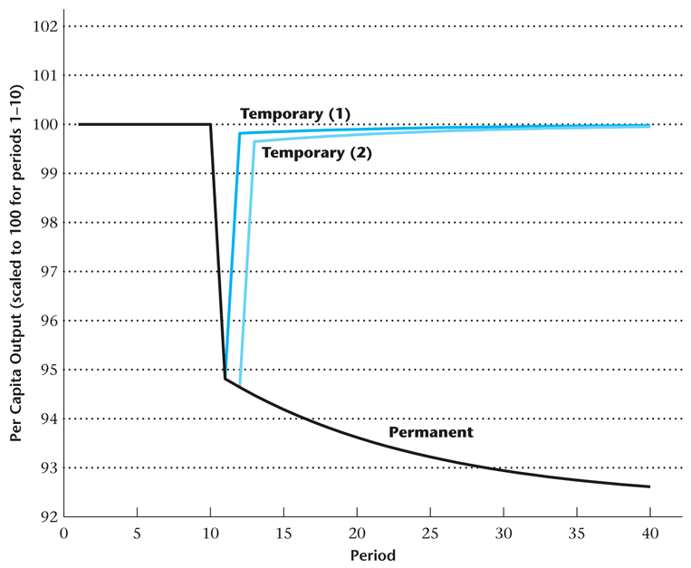
Figure 6.21
Simulation of a Calibrated Solow Growth Model: Temporary and Permanent Declines in TFP
6-<number>

Slide 43
Growth Accounting
An approach that uses the production function and measurements of aggregate inputs and outputs to attribute economic growth to:
  growth in factor inputs;
  total factor productivity growth.
6-<number>

Slide 44
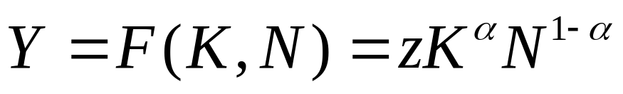
Cobb-Douglas Production Function
6-<number>

Slide 45
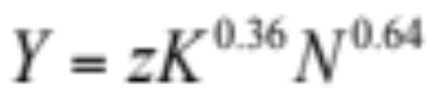
Cobb-Douglas Production Function
A labor share in national income of 64% gives:
6-<number>

Slide 46
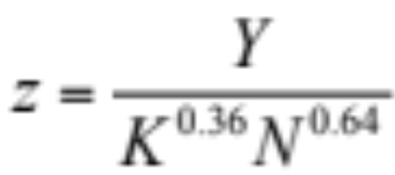
Solow Residual
The Solow residual is calculated as:
6-<number>

Slide 47
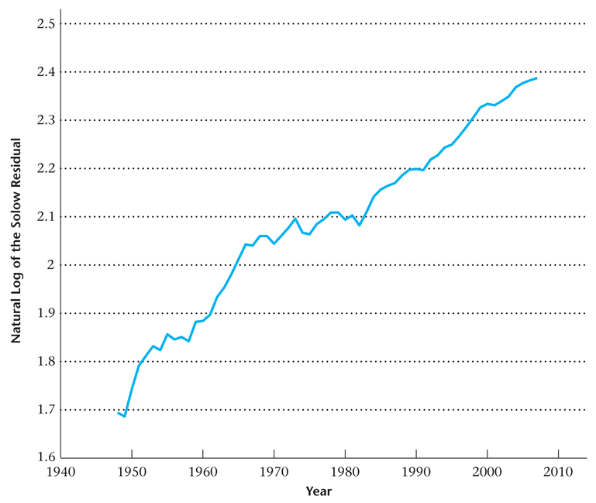
Figure 6.22
Natural Log of the Solow Residual, 1948–2007
6-<number>

Slide 48
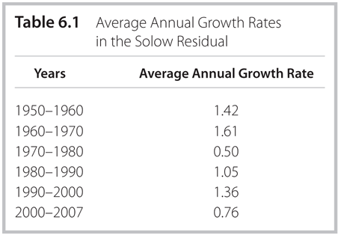
Table 6.1
Average Annual Growth Rates in the Solow Residual
6-<number>

Slide 49
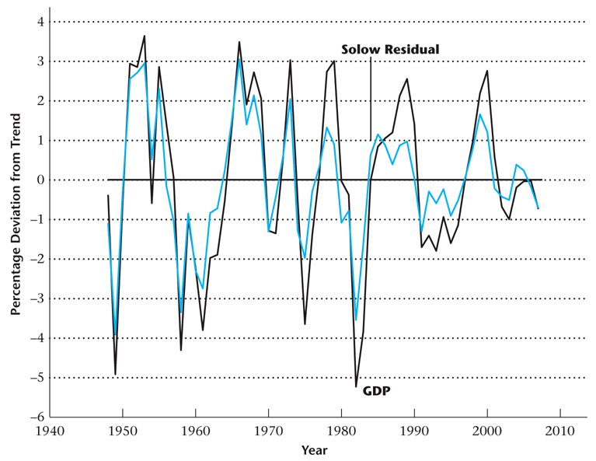
Figure 6.23
Percentage Deviations from Trend in Real GDP and the Solow Residual, 1948–2007
6-<number>

Slide 50
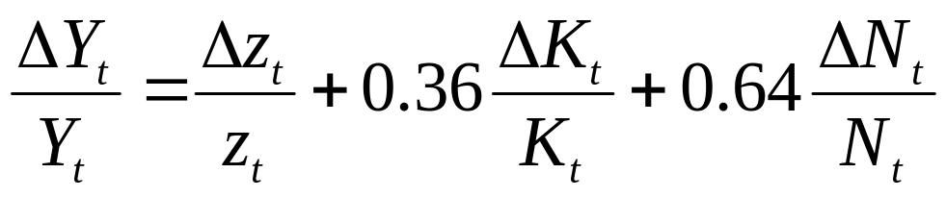
Growth Accounting
The production function can be written in terms of growth rates:
What is the economic interpretation of this equation?
The growth rate of output is the sum of TFP growth and inputs growth.
6-<number>

Slide 51
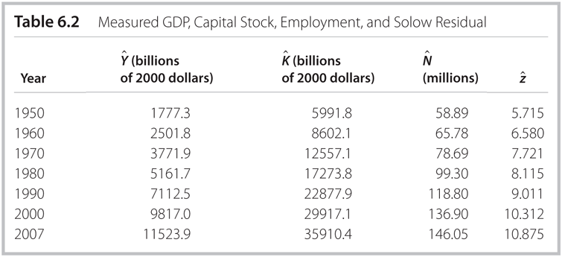
Table 6.2
Measured GDP, Capital Stock, Employment, and Solow Residual
6-<number>

Slide 52
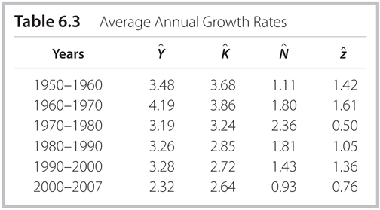
Table 6.3
Average Annual Growth Rates
6-<number>

Slide 53
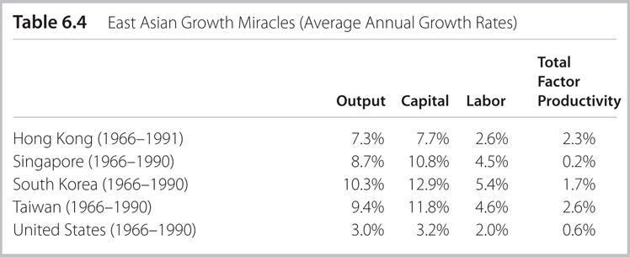
Table 6.4
East Asian Growth Miracles
(Average Annual Growth Rates)
6-<number>

