Slide 1
Topics of today’s class
Last class:
  Chapter 7
    Economic growth facts
    Malthusian model of economic growth
    Solow growth model
Today’s class:
  Chapter 8
    Income disparity among countries
    Endogenous growth model
1-<number>

Slide 2
Chapter 8
Income Disparity Among Countries and Endogenous Growth

Slide 3
Chapter 8 Topics
Convergence
Endogenous growth: a model of human capital accumulation
7-<number>

Slide 4
Convergence in the Solow Growth Model
If two countries are initially rich and poor, but identical in all other respects, they will converge in the long run to the same level and rate of growth of per-capita income.
7-<number>

Slide 5
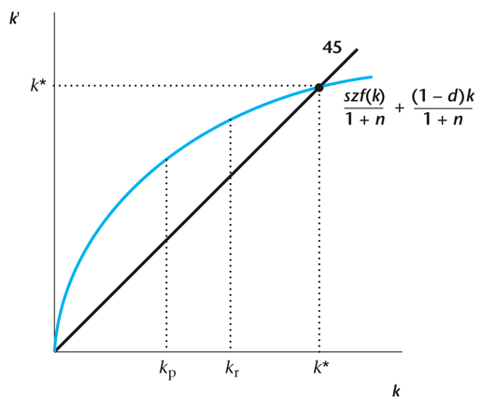
Figure 8.1
Rich and Poor Countries and the Steady State
7-<number>

Slide 6
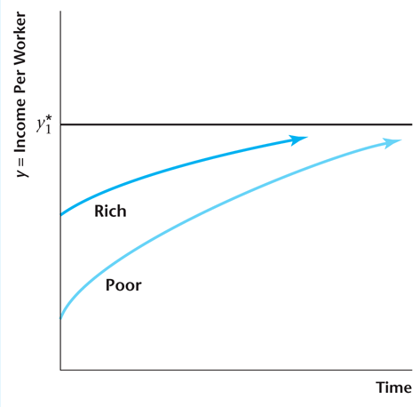
Figure 8.2
Convergence in Income per Worker Across Countries in the Solow Growth Model
7-<number>

Slide 7
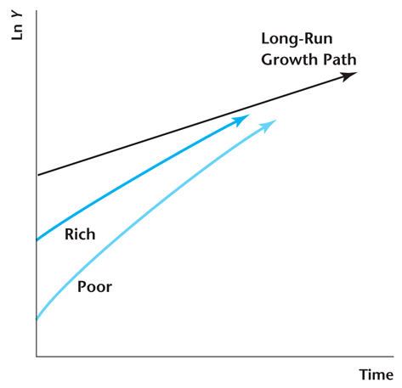
Figure 8.3
Convergence in Aggregate Output Across
Countries in the Solow Growth Model
7-<number>

Slide 8
TFP may differ across countries
There exist barriers to the adoption of new technology, and these barriers can differ across countries.
  Labor unions
  Barriers to entry
Economies may differ in how efficiently factors of production are allocated across firms in the economy
  Corruption
  Financial imperfections
7-<number>

Slide 9
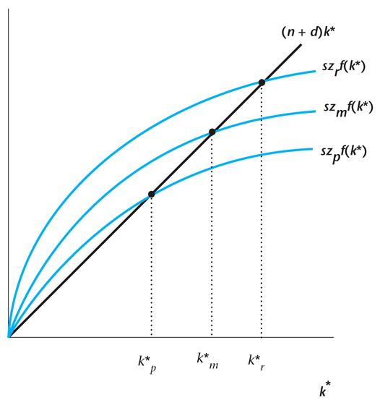
Figure 8.4
Differences in Total Factor Productivity Can Explain Disparity in Income per Worker Across Countries
7-<number>

Slide 10
Case study: Growing like China
High output growth.
Sustained returns on capital:
  In spite of very high investment rates (39 percent on average), the rate of return to capital has remained stable.
7-<number>

Slide 11
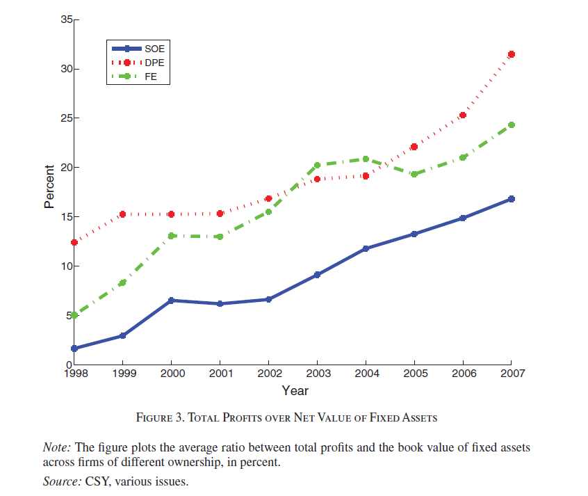
Case study: Growing like China
7-<number>

Slide 12
What the government can do to promote TFP Growth
Promote competition.
Promote free trade.
Privatization.
Enforcement of laws.
7-<number>

Slide 13
Endogenous Growth: A Model of
Human Capital Accumulation
A model with endogenous TFP growth.
We are interested in the following questions:
  How does TFP growth respond to the quantity of public funds spent on public education?
  How is TFP growth affected by subsidies to research and development?
  Does it make sense to have the government intervene to promote economic growth?
7-<number>

Slide 14
Human Capital
Human capital: the accumulated stock of skills and education that a worker has at a point in time.
Human capital
  It is an investment;
  The knowledge, the key input of human capital, is nonrivalry;
  Human capital investment has constant return to scale.
7-<number>

Slide 15
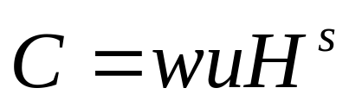
Consumer Behavior
Consumption is equal to total wage income.
7-<number>

Slide 16
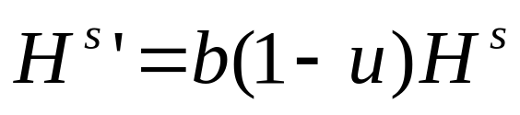
Human Capital Accumulation
Future human capital depends on current human capital and time devoted to training and education.
7-<number>

Slide 17

Production Function
7-<number>

Slide 18
Firm’s Profits
7-<number>

Slide 19
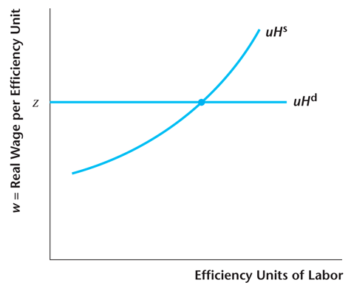
Figure 8.5
Determination of the Equilibrium Real Wage in the Endogenous Growth Model
7-<number>

Slide 20
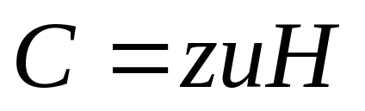
Equilibrium Consumption
7-<number>

Slide 21
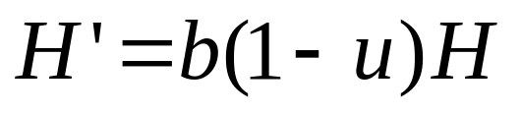
Human Capital Growth
Human capital evolves in equilibrium according to:
7-<number>

Slide 22
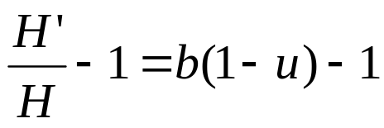
Equilibrium Human Capital Growth
Equilibrium growth rate of human capital:
7-<number>

Slide 23
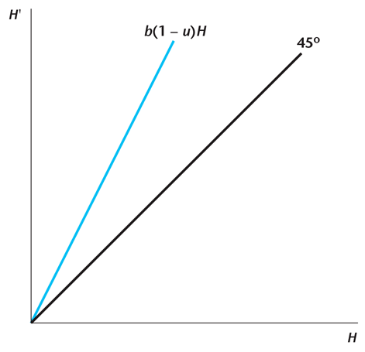
Figure 8.6
Human Capital Accumulation in the
Endogenous Growth Model
7-<number>

Slide 24
Economic Policy and Growth
Change b:
  Make the education system more efficient.
  Provide incentive into the school system.
Change u:
  Provide taxes or subsidies to education
7-<number>

Slide 25
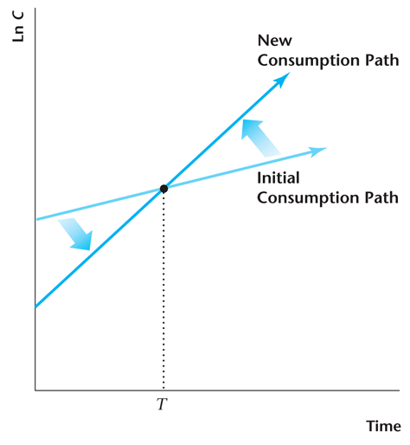
Figure 8.7
Effect of a Decrease in u on the Consumption Path in the Endogenous Growth Model
7-<number>

Slide 26
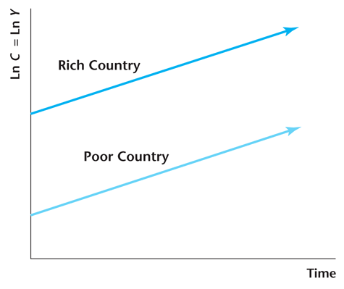
Figure 8.8
No Convergence in the Endogenous Growth Model
7-<number>

Slide 27
Practice Question
Introduce government activity in the endogenous growth model as follows. In addition to working u units of time in producing goods, the representative consumer works v units of time for the government and produces gvH goods for government use in the current period, where g>0. The consumer now spends 1-u-v units of time each period accumulating human capital.
Suppose that v increases with u decreasing by an equal amount. Determine the effects on the level and the rate of growth of consumption. Draw a diagram showing the initial path followed by the natural log of consumption and the corresponding path after v increases.
Suppose that v increases with u held constant. Determine the effects on the level and the rate of growth of consumption. Draw a diagram showing the initial path followed by the natural log of consumption and the corresponding path after v increases.
7-<number>

Slide 28
Reconcile with the data
Incomes per capita among richer countries have converged.
Human capital externalities and labor, capital mobility, eliminate the possibilities of large difference in the levels of human capital across regions .
Brain Drain will create huge differences in human capital across very rich and very poor countries.
7-<number>

Slide 29
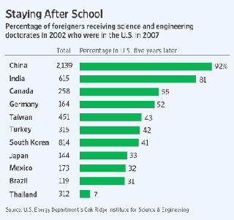
Reconcile with the data
7-<number>

