Slide 1
Topics of today’s class
Last class:
  Chapter 8
    Income disparity among countries
    Endogenous growth model
Today’s class:
  Chapter 9
    Consumer’s consumption/savings decision
    Responses of consumer to changes in income and interest rates.
1-<number>

Slide 2
Chapter 9
A Two-Period Model:
The Consumption-Savings Decision and Government Deficits

Slide 3
Chapter 9 Topics
Consumer’s consumption/savings decision – responses of consumer to changes in income and interest rates.
Government budget deficits and the Ricardian Equivalence Theorem.
8-<number>

Slide 4
Consumption
Y = C + I + G + NX
Consumption accounts for more than 2/3 of GDP.
What key economic forces shape consumption/savings decisions?
Will allow us to address several key issues:
  Government Debts and Deficits
  Financial Markets Imperfections / Financial Crisis
  Social Security
8-<number>

Slide 5
Consumption
So far:
Solow Model: C = sY
Where does it come from? Why don’t households optimize?
With household optimization it becomes clear that:
  expectations matters
  the distinction between current and permanent income is crucial
  real interest rate is a key variable
8-<number>

Slide 6
Dynamic Decision
Previous micro-founded model of consumption and leisure is static.
Life is full of inter-temporal choices:
  Should I go to college or start working immediately?
  Should I save or should I consume now?
8-<number>

Slide 7
The Model
Representative household lives 2 periods:
  “today” is period 1.
  “all future periods” are period 2.
Households receive exogenously
  income y in first period.
  income y’ in second period (no labor supply choice).
Utility Function U(c, c’)
  c: first (current) period of life.
  c’: consumption in second (future) period of life.
8-<number>

Slide 8
Assumptions on preference
Monotonicity: more is always preferred to less.
Preference for Diversity also called Consumption smoothing.
Current consumption and future consumption are normal goods.
8-<number>

Slide 9
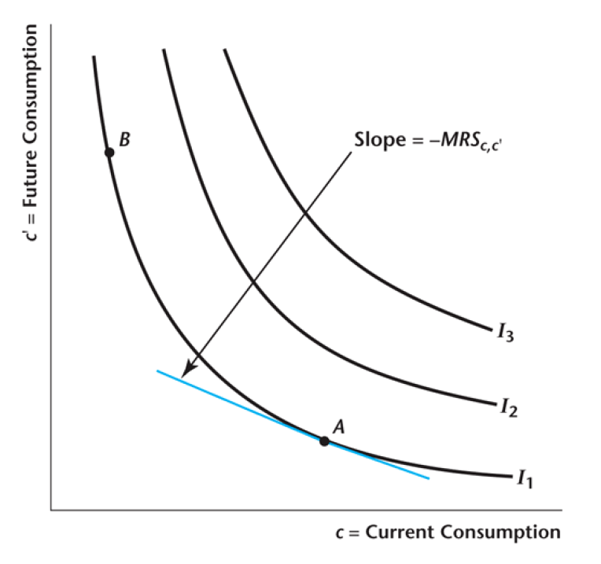
Indifference curve
8-<number>

Slide 10
Inter-temporal Marginal Rate of Substitution
The inter-temporal marginal rate of substitution is the rate at which the consumer is just willing to substitute current consumption for future consumption MRS_{c,c’}
Inter-temporal marginal rate of substitution measures willingness to substitute consumption over time.
It decreases with current consumption.
8-<number>

Slide 11
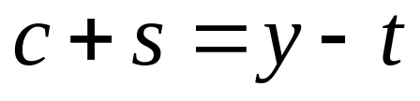
Budget Constraints
The consumer’s current-period budget constraint:
8-<number>

Slide 12
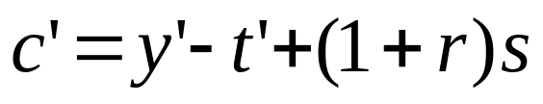
Budget Constraints
The consumer’s future-period budget constraint:
8-<number>

Slide 13
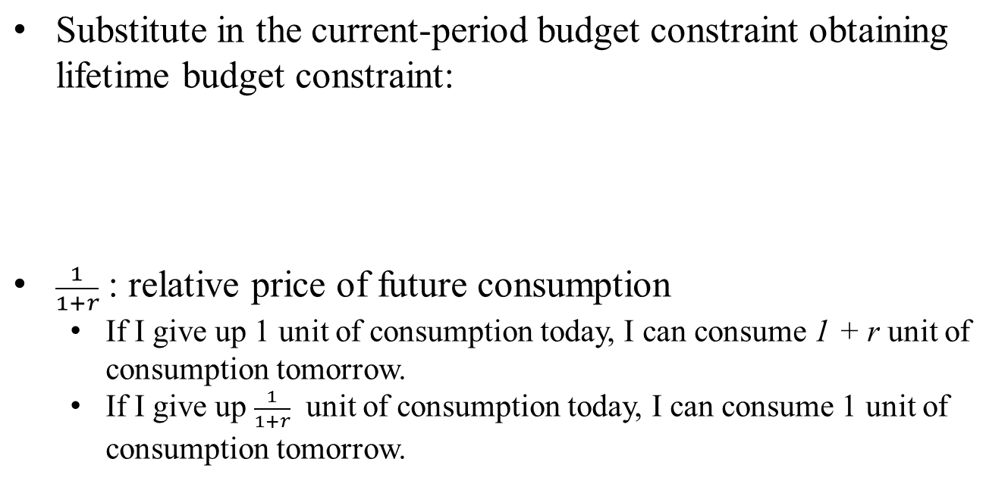
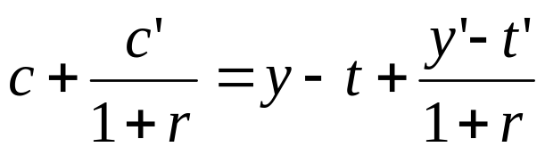
Consumer’s Lifetime Budget Constraint
8-<number>

Slide 14
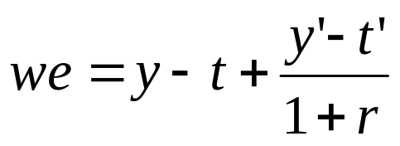
Consumer’s Lifetime Wealth
8-<number>

Slide 15
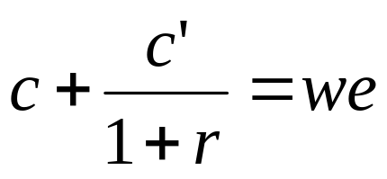
Simplified Lifetime Budget Constraint
8-<number>

Slide 16
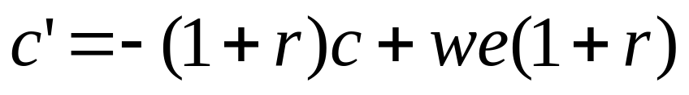
Simplified Lifetime Budget Constraint: Slope-Intercept
8-<number>

Slide 17
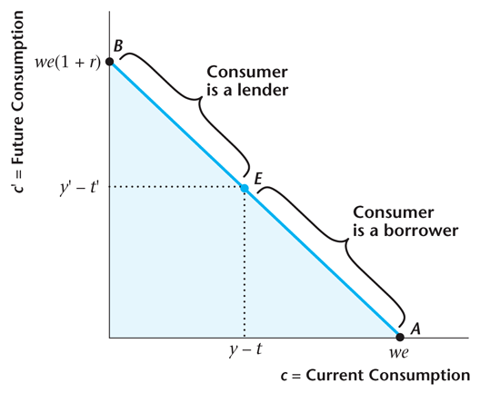
Figure 8.1
Consumer’s Lifetime Budget Constraint
8-<number>

Slide 18
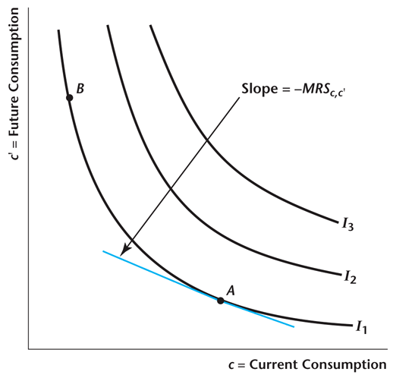
Figure 8.2
A Consumer’s Indifference Curves
8-<number>

Slide 19
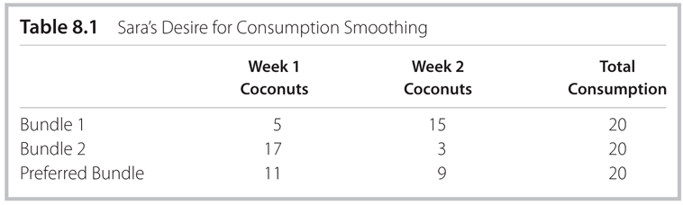
Table 8.1
Sara’s Desire for Consumption Smoothing
8-<number>

Slide 20
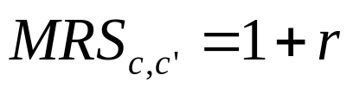
Optimization
Marginal condition that holds when the consumer is optimizing:
Market: 1 unit of c in exchange of 1 + r unit of c’.
Preferences: 1 unit of c in exchange of MRSc,c’ unit of c’.
8-<number>

Slide 21
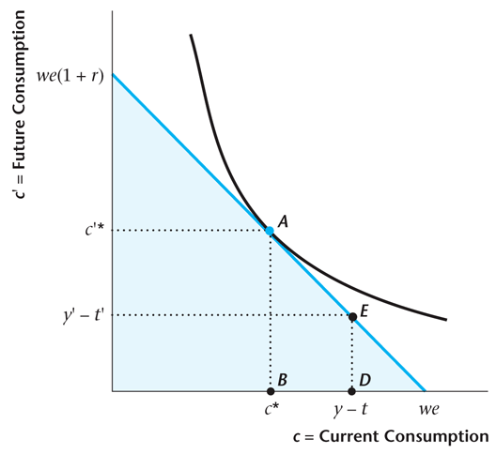
Figure 8.3
A Consumer Who Is a Lender
8-<number>

Slide 22
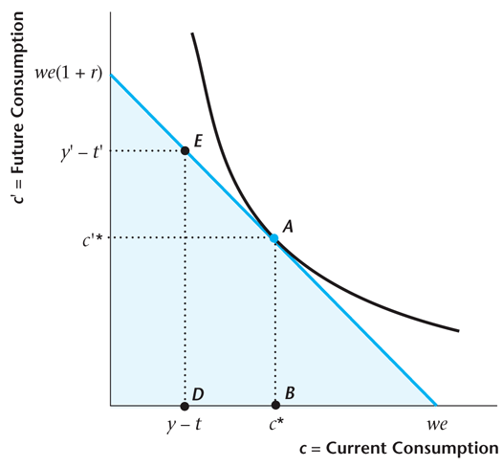
Figure 8.4
A Consumer Who Is a Borrower
8-<number>

Slide 23
Consumer Optimization
Consumption Smoothing
  The ability to borrow or lend creates a trade-off between current and future consumption.
  c and c’ depend only on lifetime wealth, we, not its composition.
But saving does depend on composition of lifetime wealth:
  Consumers with high first-period income are more likely to be savers (lenders).
  Consumers with high second-period income are more likely to be borrowers, using future income to fund current consumption.
Key assumption: Saving (borrowing) markets work perfectly.
8-<number>

Slide 24
An Increase in Current Period Income
Example: Winning at the lottery. The consumer acts to smooth consumption over time:
  Current and future consumption increase.
  Saving increases because the increase in consumption is smaller than the increase in income.
8-<number>

Slide 25
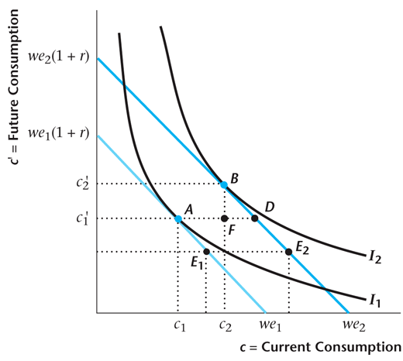
Figure 8.5
The Effects of an Increase in Current Income for a Lender
8-<number>

Slide 26
Observed Consumption-Smoothing Behavior
Aggregate consumption of non-durables and services is smooth relative to aggregate income, but the consumption of durables is more volatile than income.
This is because durables consumption is economically more like investment than consumption.
8-<number>

Slide 27
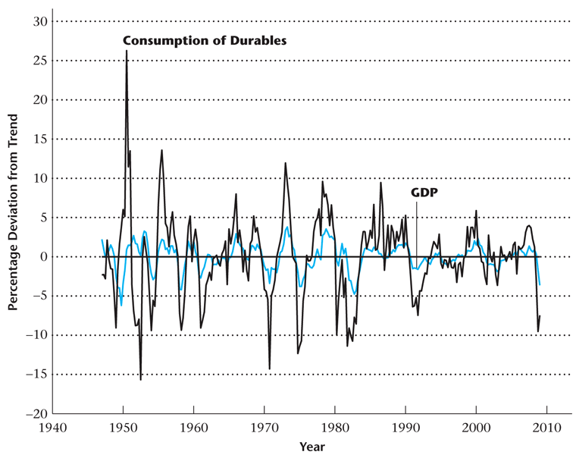
Figure 8.6
Percentage Deviations from Trend in
Consumption of Durables and Real GDP
8-<number>

Slide 28
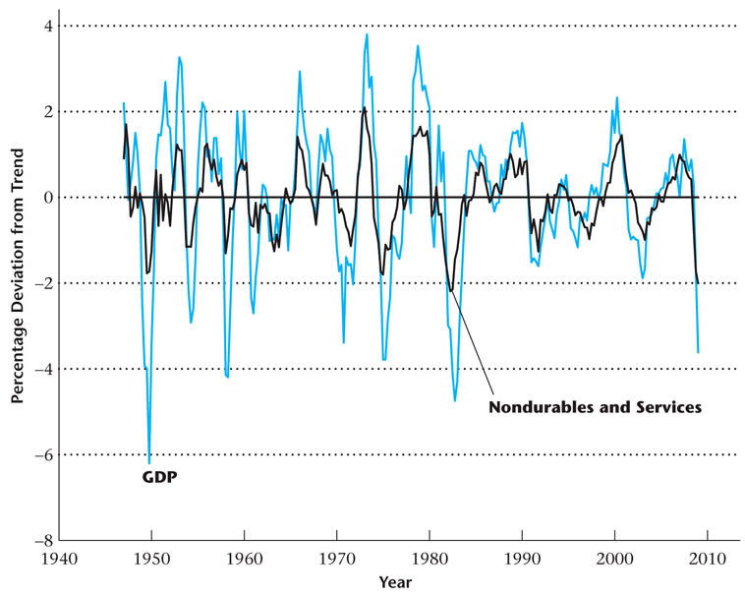
Figure 8.7
Percentage Deviations from Trend in Consumption of Nondurables and Services and Real GDP
8-<number>

Slide 29
An Increase in Future Income
Example: Changing Major: from philosophy to business
  c and c’ : depend only on lifetime wealth, we, not its composition
  so, effects of an increase in y is the same as an increase of y’/(1+r)
Then,
  c and c’ increase
  s decreases
8-<number>

Slide 30
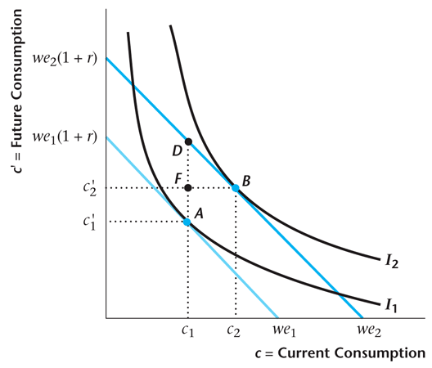
Figure 8.8
An Increase in Future Income
8-<number>

Slide 31
Increase in the Real Interest Rate
Substitution Effects
Wealth Effects
Recall: 1/(1+r) : relative price of c’
decrease in the relative price of c’, consumption today become relatively more expensive
higher return to saving induces more saving
8-<number>

Slide 32
Increase in the Real Interest Rate
Substitution Effects
Wealth Effects
Recall:
we = y – t + (y’ - t’)/(1 + r)
(1 + r )we = (1 + r) (y – t) + y’ – t’
Increasing r:
  decreases we lifetime wealth
  increases we(1 + r )
8-<number>

Slide 33
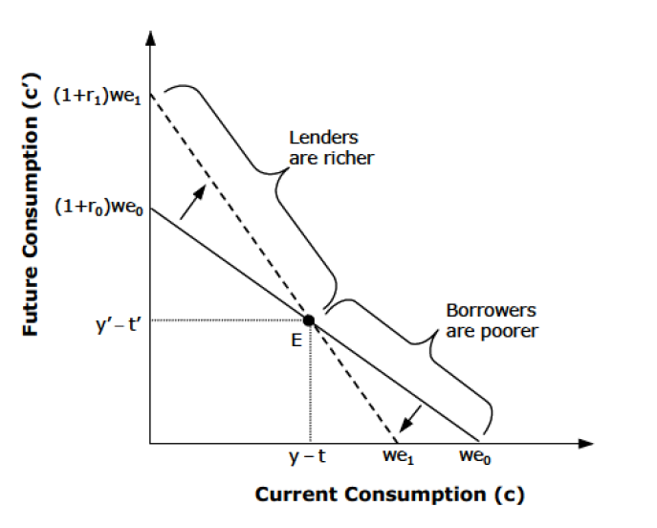
Figure 8.12
An Increase in the Real Interest Rate
8-<number>

Slide 34
An Increase in the Market Real Interest Rate
Substitution Effects
Wealth Effects
Lenders (savers): lenders are richer: both c and c’ increase.
Borrowers: c decreases and c’ decreases
8-<number>

Slide 35
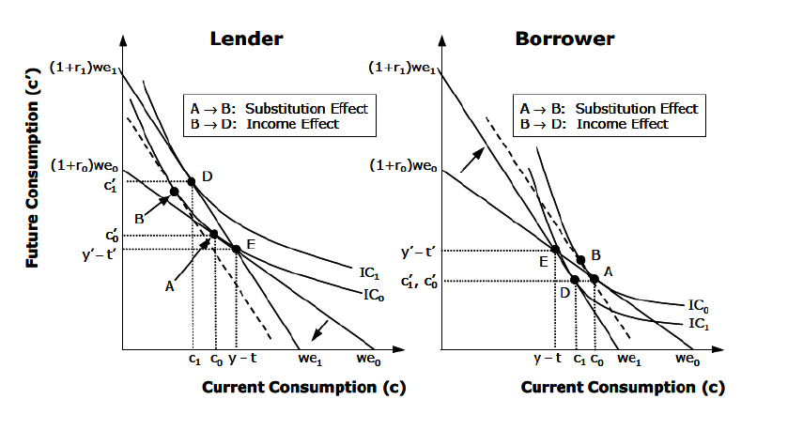
8-<number>

Slide 36
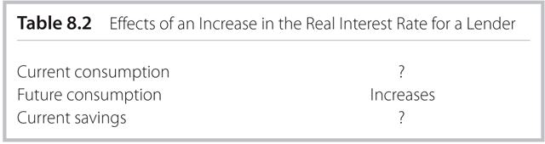
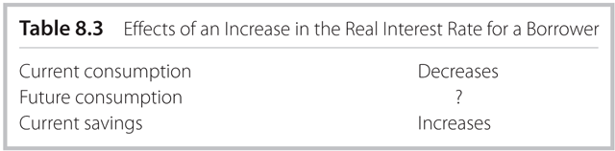
Effects of an Increase in the Real Interest Rate
8-<number>

Slide 37

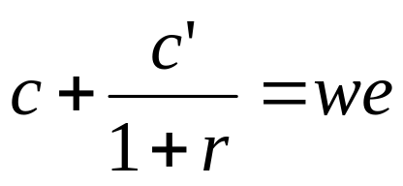
Perfect Complements Example
With perfect complements, the ratio of future consumption to current consumption is constant.
The consumer’s budget constraint must hold.
8-<number>

Slide 38
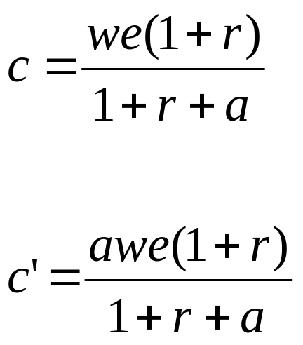
Perfect Complements Example
With perfect complements we can solve explicitly for current and future consumption:
8-<number>

Slide 39
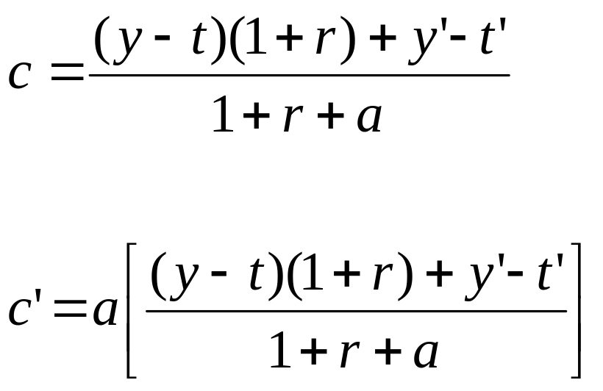
Perfect Complements Example
Substituting for lifetime wealth gives:
8-<number>

Slide 40
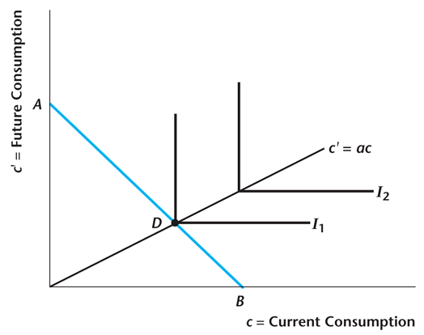
Figure 8.15
Example with Perfect Complements Preferences
8-<number>

