Slide 1
Topics of today’s class
Last class:
  Chapter 9
    Consumer’s consumption/savings decision
    Responses of consumer to changes in income and interest rates.
Today’s class:
  Chapter 9
    Government budget deficits
    The Ricardian Equivalence Theorem.
1-<number>

Slide 2
Chapter 9
A Two-Period Model:
The Consumption-Savings Decision and Government Deficits

Slide 3
Government Budget Constraints
First period budget constraint:
G = T + B
G: government expenditures
T: lump-sum taxes
B: government debt: or “treasury security” in the US
Second Period budget constraint:
G’ + (1 + r )B = T’
G’,T’: government expenditures and lump-taxes in period 2
(1 + r )B: government must pay off the debt in period 2
8-<number>

Slide 4
Government Budget Constraints
Combining
G = T + B
G’ + (1 + r )B = T’
Present value budget constraint:
G +G’/(1 + r) = T + T’/(1 + r)
Interpretation:
In the long run, all government purchases must be paid for by taxes
Present value of governement purchases = present value of taxes
8-<number>

Slide 5
Government Budget Constraints
There are N consumers in the economy each pay current tax of t, so that
T = tN
In Period 2, consumers pay
T’ = t’N
8-<number>

Slide 6
Credit Market Equilibrium
Total private savings is equal to the quantity of government bonds issued in the current period.
S^{P} = B
8-<number>

Slide 7
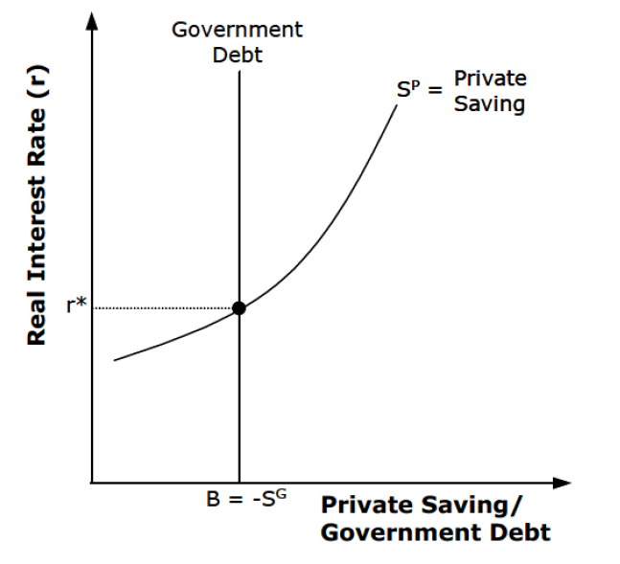
8-<number>

Slide 8
Competitive Equilibrium
3 conditions must hold:
Given r : c, c’ and s are optimal quantities for the consumer
The government present value budget constraint holds
The credit market clears: S^{P} = B
8-<number>

Slide 9
Ricardian Equivalence Theorem
Theorem: Tax changes have no effects on consumption
Intuition: Consider a government that cut taxes today
lower taxes today require higher taxes tomorrow to satisfy the government present value budget constraint
a tax cut today has no effect on the present value of taxes and on the lifetime wealth of the consumer
Consumer cares only about its lifetime wealth
8-<number>

Slide 10
Proof of Ricardian Equivalence Theorem
T and T’ must satisfy:
G + G’ / (1 + r) = T + T’ / (1 + r)
Any increase in T must be offset by an increase in T’
Using this result, rewrite the consumers lifetime wealth as:
we = y + y’ / (1+r) – (t + t’ / (1+r))
to be continued….
8-<number>

Slide 11
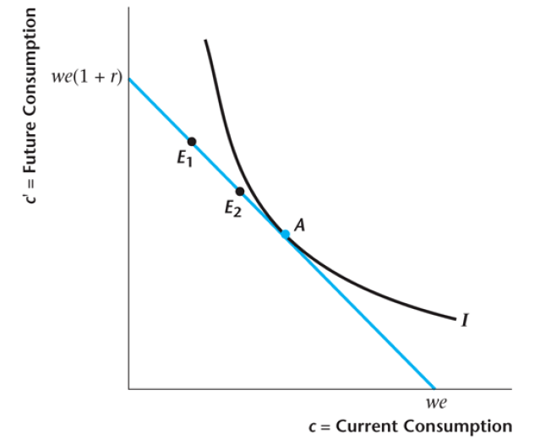
Ricardian Equivalence – Consumer Decisions
8-<number>

Slide 12
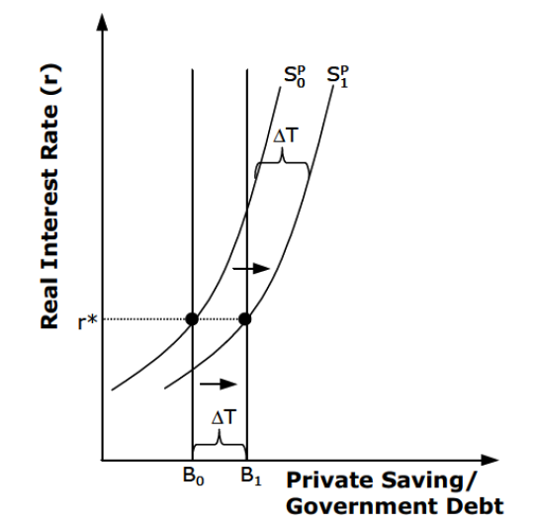
Ricardian Equivalence – Consumer Decisions
8-<number>

Slide 13
Ricardian Equivalence Theorem
Ricardian equivalence shows that:
tax cut today is not a free meal, it comes at a cost of higher taxes tomorrow
  The government might put the tax increase off for two, three, or more years. Nevertheless, the current tax cut must be offset by future tax increases
Under some conditions, rational agents should foresee that, and it should not have any welfare effects
8-<number>

Slide 14
Ricardian Equivalence Theorem
The two more persuasive arguments against the Theorem are:
  1. finiteness of life
  2. imperfections of credit markets
If tax cuts today, government can postpone the increase in taxes until long in the future: after the death of typical person alive during the tax cuts.
➔ reduction in the present value of taxes
Some of the burden of public debt is passed on to future generations
8-<number>

Slide 15
Government Deficits, Taxes and Government Debt
If the U.S. government run a deficit of from 5% to 10% of GDP for a long period of time, what would be the consequences for the government debt?
How would this matter in the future for the level of taxation faced by the average American?
8-<number>

Slide 16
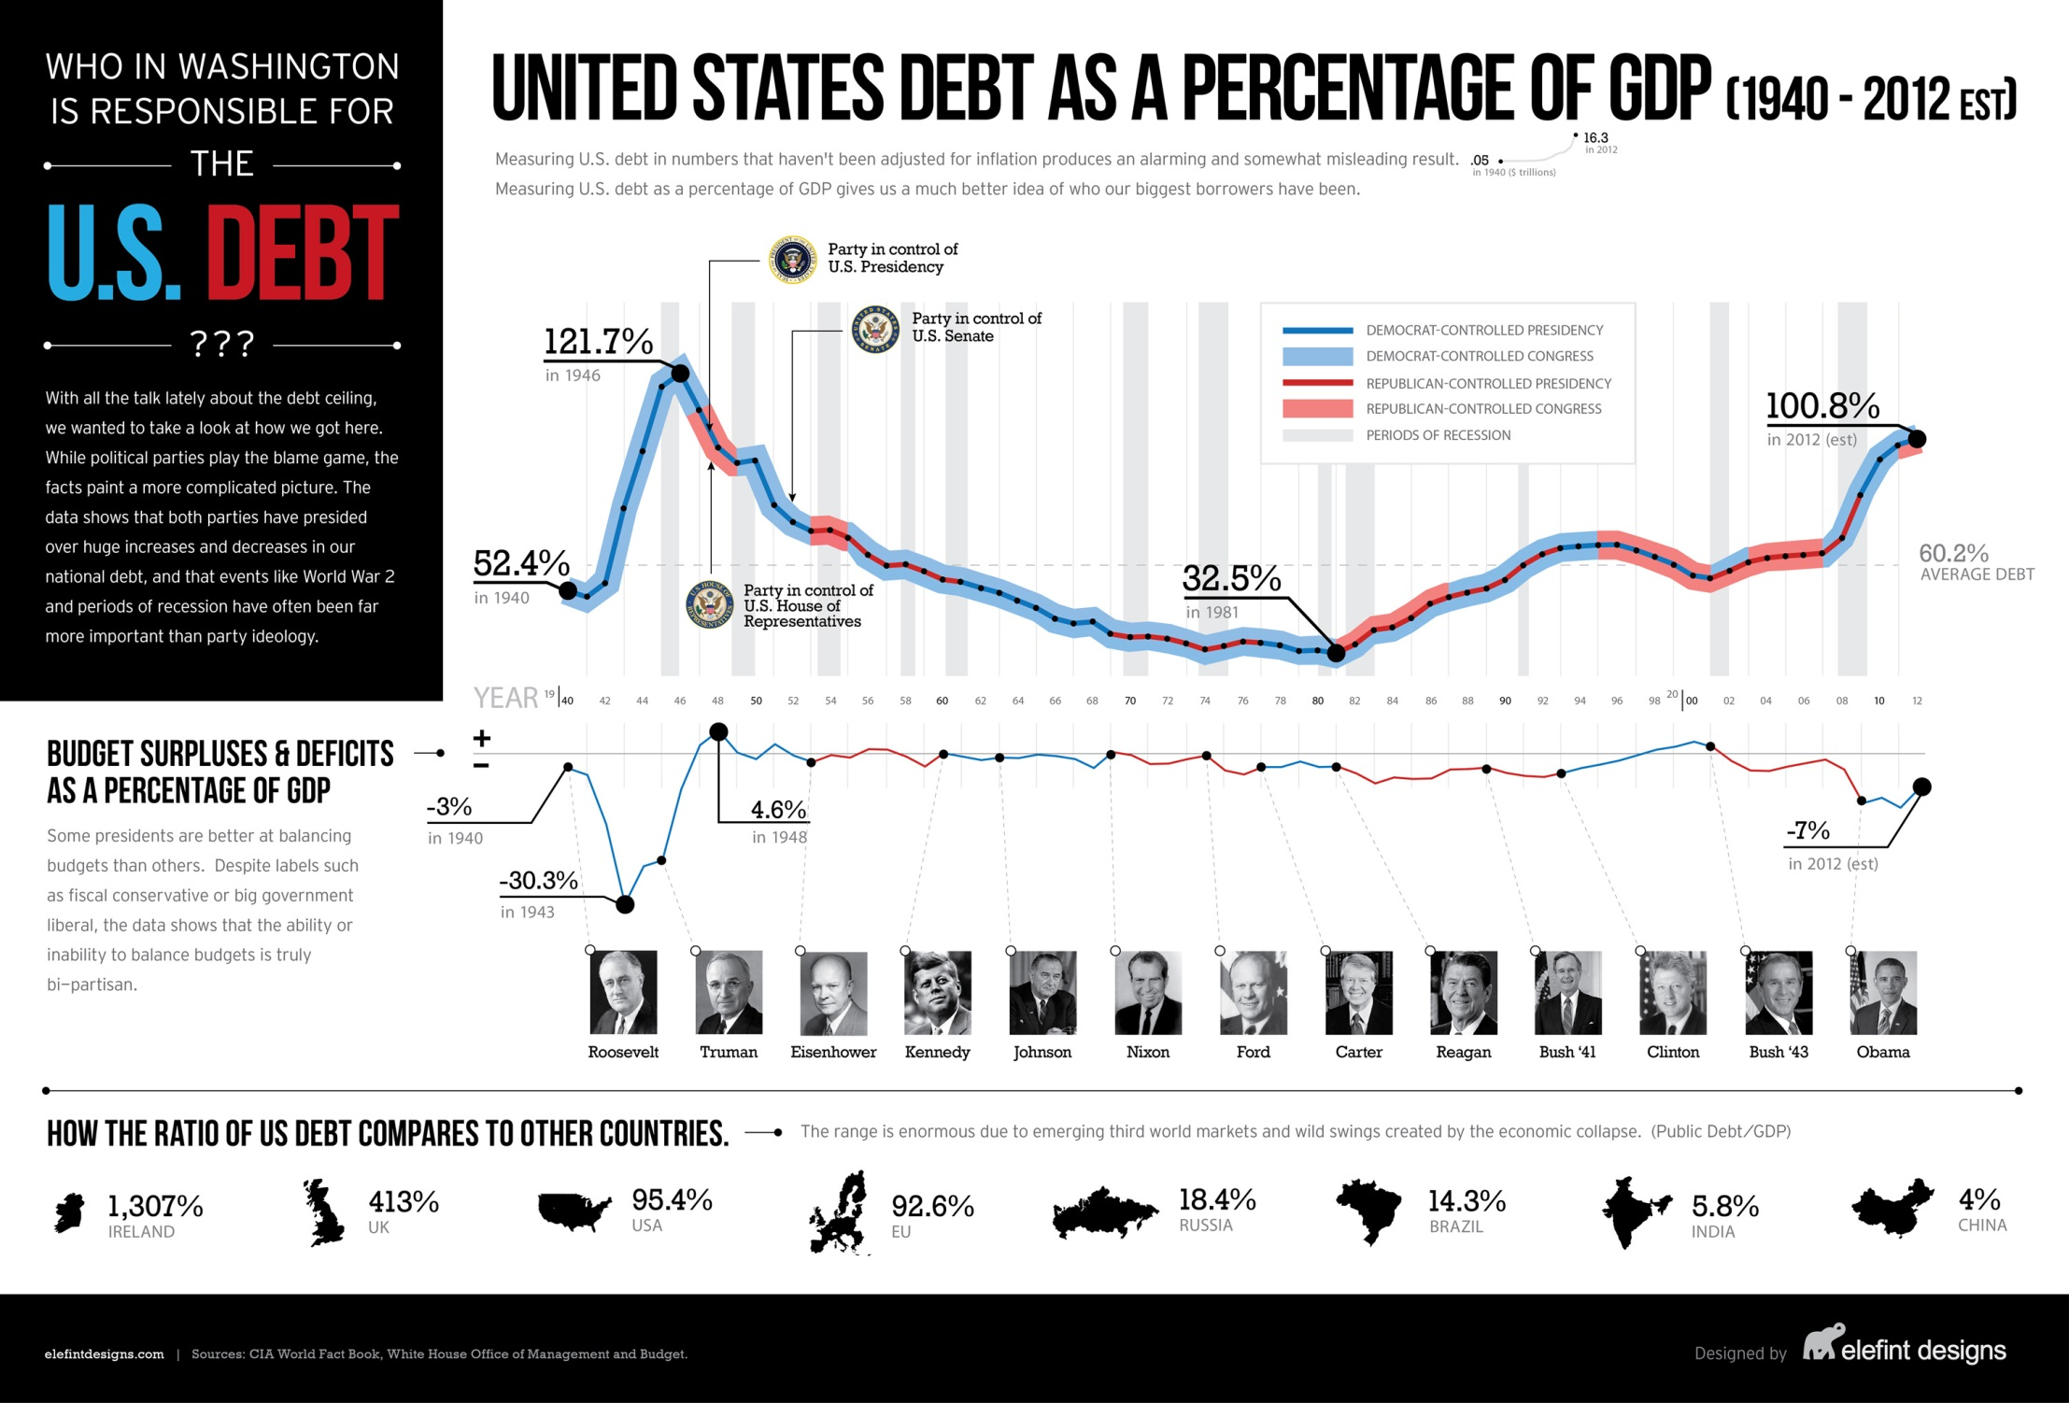
8-<number>

Slide 17
Government Deficits, Taxes and Government Debt
Suppose that
  GDP grows at a constant rate g;
  Government needs to finance a primary deficit of dY each period;
  The market interest rate r is constant forever.
8-<number>

Slide 18
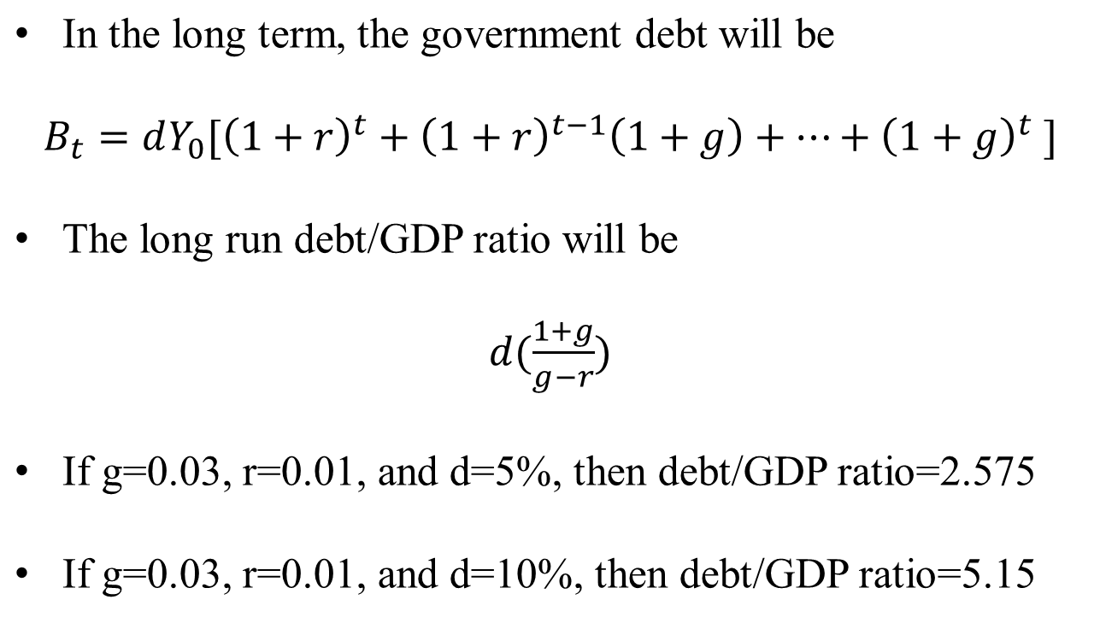
Government Deficits, Taxes and Government Debt
8-<number>

Slide 19
Social Security
Introduced after the Great Depression: Pay-As-You-Go Social Security:
  currently working generation pays payroll taxes, whose proceeds are used to pay the pensions of the currently retired generation
  current tax rate is 15.3% (you pay half and your employer pay the other half)
Population Ageing:
  more retirees to whom benefits are owed
  fewer workers to pay for these benefits
Every US Presidents (since Jimmy Carter) understood the problem but failed to reform the system
8-<number>

Slide 20
Social Security
Overlapping Generations Model
  Each agent lives two periods: Young and Old
  In any period, there are people of different generations alive
Population Evolution:
N’ = N(1 + n)
8-<number>

Slide 21
Pay-As-You-Go Social Security
Introduce Pay-As-You-Go Social Security:
  Old: Social security payments b
  Young: tax t
Budget Equilibrium:
Nb = N’t
Total social security benefits must equal total taxes on the young
b / (1 + n) = t
Social Security is a forced savings program.
8-<number>

Slide 22
Pay-As-You-Go Social Security
When Pay-As-You-Go Social Security was introduced, The First Generation of Old Consumer clearly benefited from the program:
  they did not pay taxes when they were young
  they now have an additional source of income
For everyone else, the effect on welfare is less obvious
8-<number>

Slide 23
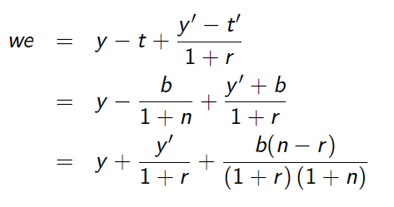
Pay-As-You-Go Social Security
Lifetime wealth of the consumer:
8-<number>

Slide 24

Pay-As-You-Go Social Security
Lifetime wealth of the consumer:
If n > r : Pay-As-You-Go Social Security improves welfare
If n < r : Pay-As-You-Go Social Security decreases welfare
Intuition:
  If people save by themselves for retirement, return on their savings equals 1 + r
  If people save via a social security system return equals: 1 + n
8-<number>

Slide 25

Current Issues with Pay-As-You-Go Social Security
Population Ageing:
  more retirees to whom benefits are owed
  fewer workers to pay for these benefits
Evolution of the Workforce:
  1940: ratio of workers to retirees=8
  2000: ratio of workers to retirees=4
  2040: ratio of workers to retirees=2
But the problem is less severe than in most Europeans and Asian Countries
8-<number>

Slide 26
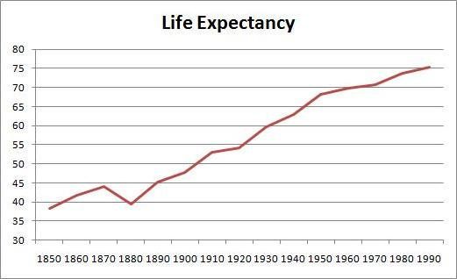
Social Security
8-<number>

Slide 27
Current Issues with Pay-As-You-Go Social Security
Over the past 70 years, contribution of the worker is more than the benefits claimed of the retired
  increase in the participation rate of women’s, baby boomers' generation, strong growth, immigration
This extra money has been placed in a trust fund that earns interest: $2.5 Trillion (invested in US government securities)
Social Security ran a surplus every year until 2021. Starting in 2021, Social Security’s total cost exceeded its total income.
Trust funds will be exhausted by 2035
8-<number>

Slide 28

Current Issues with Pay-As-You-Go Social Security
Three main possibilities to balance the budget
1. raising retirement age
  because life expectancy is increasing
  with “hardship exemption“
8-<number>

Slide 29
Current Issues with Pay-As-You-Go Social Security
Three main possibilities to balance the budget
2. reducing benefits
  decrease for the high levels of income
  increase for the poorest
  adjust the cost-of-living index
8-<number>

Slide 30
Current Issues with Pay-As-You-Go Social Security
Three main possibilities to balance the budget
3. more progressive payroll taxes
  there is a maximum earnings level to which tax apply
  increasing this maximal taxable level
8-<number>

Slide 31
Social Security
Fully Funded Social Security :
  George W. Bush had proposed a transition to this system in 2005
  no taxes on the young and no transfers to the old
  The current worker’s contribution is invested and used to pay their own benefits in the future
Two different methods:
  Privatization: putting workers’ contribution into individual accounts and managed by individual workers
  Government can pool all the accounts and designate a management agency
Funds can be invested in
  government bonds only (safe!)
  diversified portfolio (but more financial risk!)
8-<number>

Slide 32
Transition to Full Funding
There is one main problem: Costly transition from pay-as-you-go to full funding. Missing generation:
  at the introduction of the system there was one generation that received social security but never paid taxes.
  if pay-as-you-go disappears, there will be one generation that paid taxes but will not receive social security
  Dilemma:
    Currently young pay double
    Default on the promises for the old
    Increase government debt, financed by higher taxes in the future, i.e., by currently young and future generations. (Tax those who would benefit from switch.)
8-<number>

