Slide 1
International Economic Development
ECON 4660/8666
Lecture 2: Concept and Patterns

Slide 2
Economic Growth: Concepts & Patterns
  Divergent Patterns of Economic Growth since 1960
  Characteristics of Rapidly Growing Countries
  Factor Accumulation, Productivity Growth, Econ. Growth
  Sources of Growth Analysis

Slide 3
Divergent Patterns of
Economic Growth since 1960
After 1960s LDCs begin to diverge.
  For example, per capital income in Thailand was $1100 and that of Zambia was $1200
  Thailand now has per capita income of $7000, but Zambia is about $900?
What happened? Growth difference Thailand grew over 4.5% and Zambia growth was -0.6% (negative)

Slide 4
Growth Rates across Countries
1960-2003:
Negative growth (Nigeria, Zambia, Chad, etc) < 0
Slow growth (Kenya, Ghana, Rwanda, Argentina) 0.12<g<1.3
Moderate growth (Lesotho, Egypt, Brazil, India): 2.1<g< 2.75
Rapid growth (Botswana, Malaysia, South Korea, Singapore): 3.32<g< 6.3
Industrial countries (Japan USA, Canada, UK), Japan=4.11, USA=2.42

Slide 5
Characteristics of Rapidly Growing Countries
Macroeconomic stability
Investment in Health and Education
Effective Governance and Institutions
Favorable Environment to Private Enterprise
Favorable Geography or location?
Notes:
1. Macroeconomic Stability: Macroeconomic stability, which includes factors like low and stable inflation, sustainable fiscal policies, and a well-managed public debt, provides a conducive environment for economic growth. It reduces uncertainties for businesses and individuals, encouraging them to invest, spend, and stimulate economic activity.
2. Investment in Health and Education: Investment in health and education, often referred to as human capital development, is crucial for sustained economic growth. A healthier and better-educated workforce is more productive and innovative. Moreover, improvements in health and education can have far-reaching effects on social and economic outcomes, from reduced poverty to increased political stability.
3. Effective Governance and Institutions: Strong institutions and good governance, which encompass elements such as rule of law, property rights, and transparency, are key determinants of economic growth. They provide the framework within which economic activities take place and significantly impact a country's ability to effectively manage its resources, implement policies, and ensure social and economic stability.
4. Favorable Environment for Private Enterprise: A business-friendly environment that encourages entrepreneurship, innovation, and competition can significantly boost economic growth. This includes elements like ease of doing business, access to credit, protection of property rights, and a reasonable regulatory framework.
5. Favorable Geography or Location: Geography and location can also play a role in a country's growth prospects. For instance, being close to large markets or having access to the sea (which can facilitate trade) can be advantageous. Natural resources, climate, and susceptibility to natural disasters are also aspects of geography that can impact economic performance.
Each of these elements contributes to the conditions conducive to rapid economic growth. However, it's important to note that the exact mix of these factors can vary from one country to another, and what works best often depends on a country's specific circumstances.

Slide 6
Macroeconomic stability
Avoiding inflation and recession.
  an extreme case of high inflation: Zaire/Congo=2800%
  more recently Zimbabwe 4000%! Primarily by printing too much money to pay for deficit.
Political instability in the form of civil war, military coups, cross-border wars are rampant in Africa.
  2/3 of African states suffer from conflict.
  See figures 3.2, 3.3
Notes:
Macroeconomic Stability: Macroeconomic stability, which includes factors like low and stable inflation, sustainable fiscal policies, and a well-managed public debt, provides a conducive environment for economic growth. It reduces uncertainties for businesses and individuals, encouraging them to invest, spend, and stimulate economic activity.

Slide 7
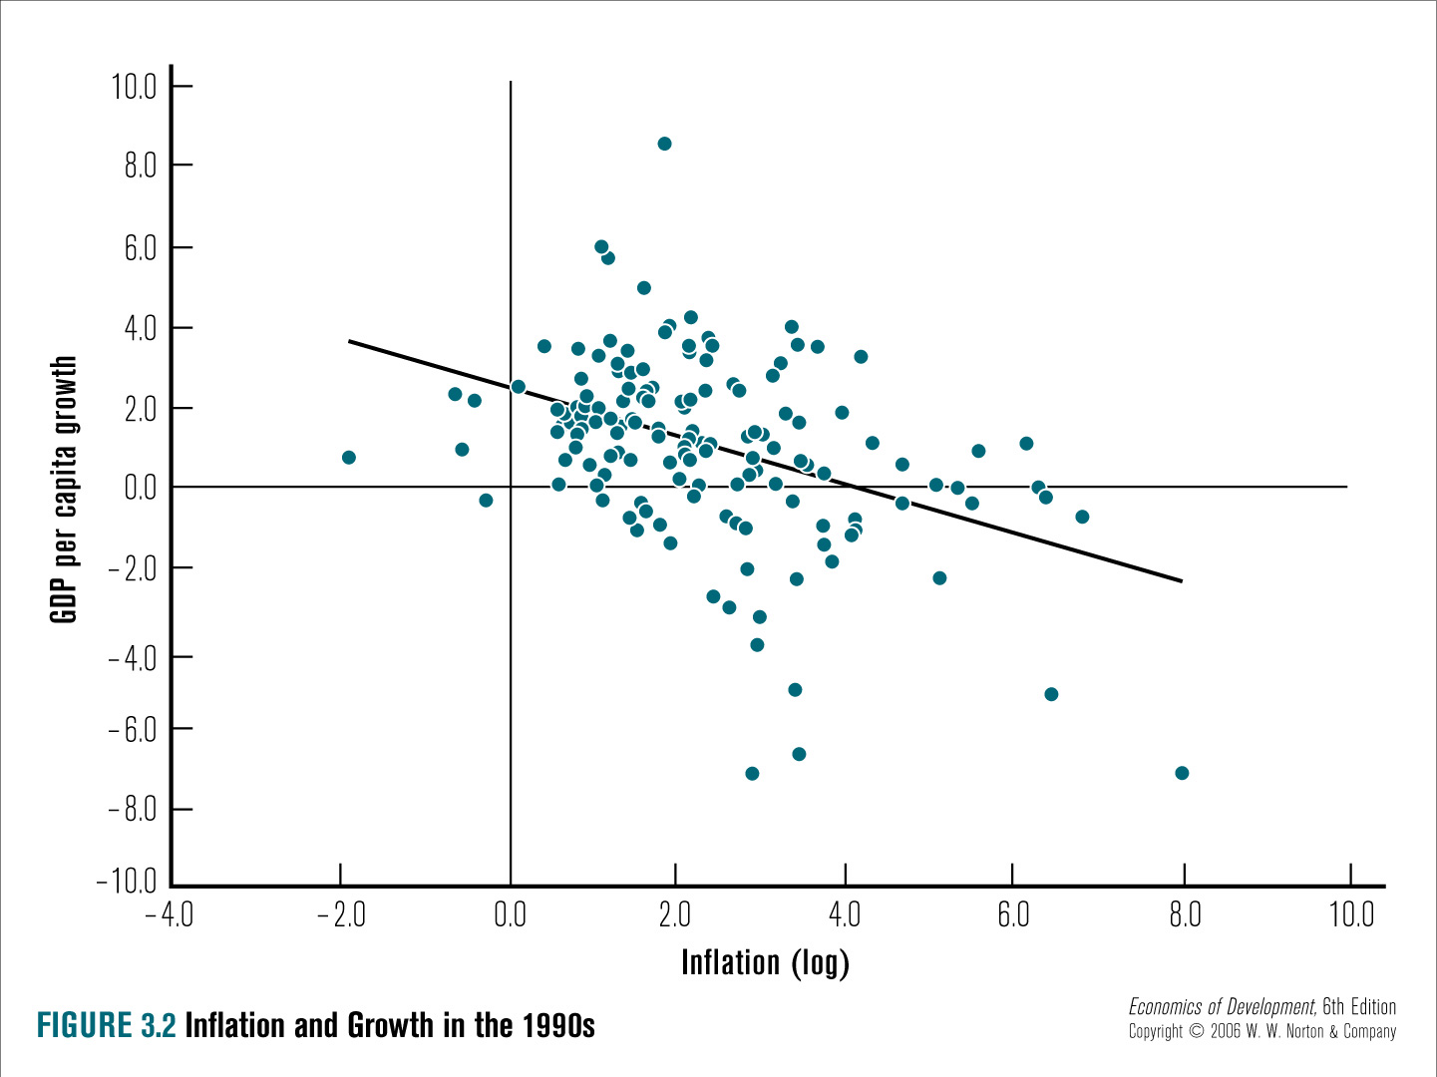

Slide 8
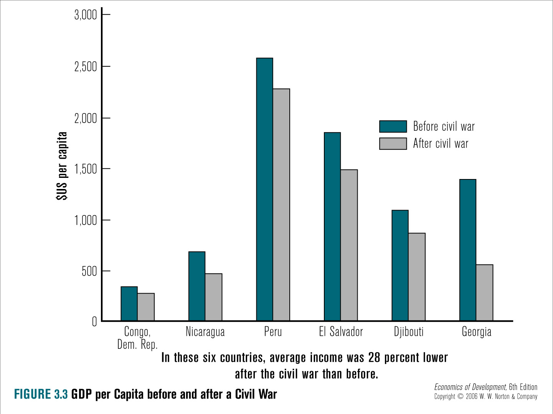

Slide 9
Investment in Education and Health
( Human Capital)
Investment on human capital is a key as it translates to longer life, healthier and productive population.
Health and education are both input/means and outcome (goal) of development.
Increase in the level and quality of education and health is crucial.
Notes:
Investment in Health and Education: Investment in health and education, often referred to as human capital development, is crucial for sustained economic growth. A healthier and better-educated workforce is more productive and innovative. Moreover, improvements in health and education can have far-reaching effects on social and economic outcomes, from reduced poverty to increased political stability.

Slide 10
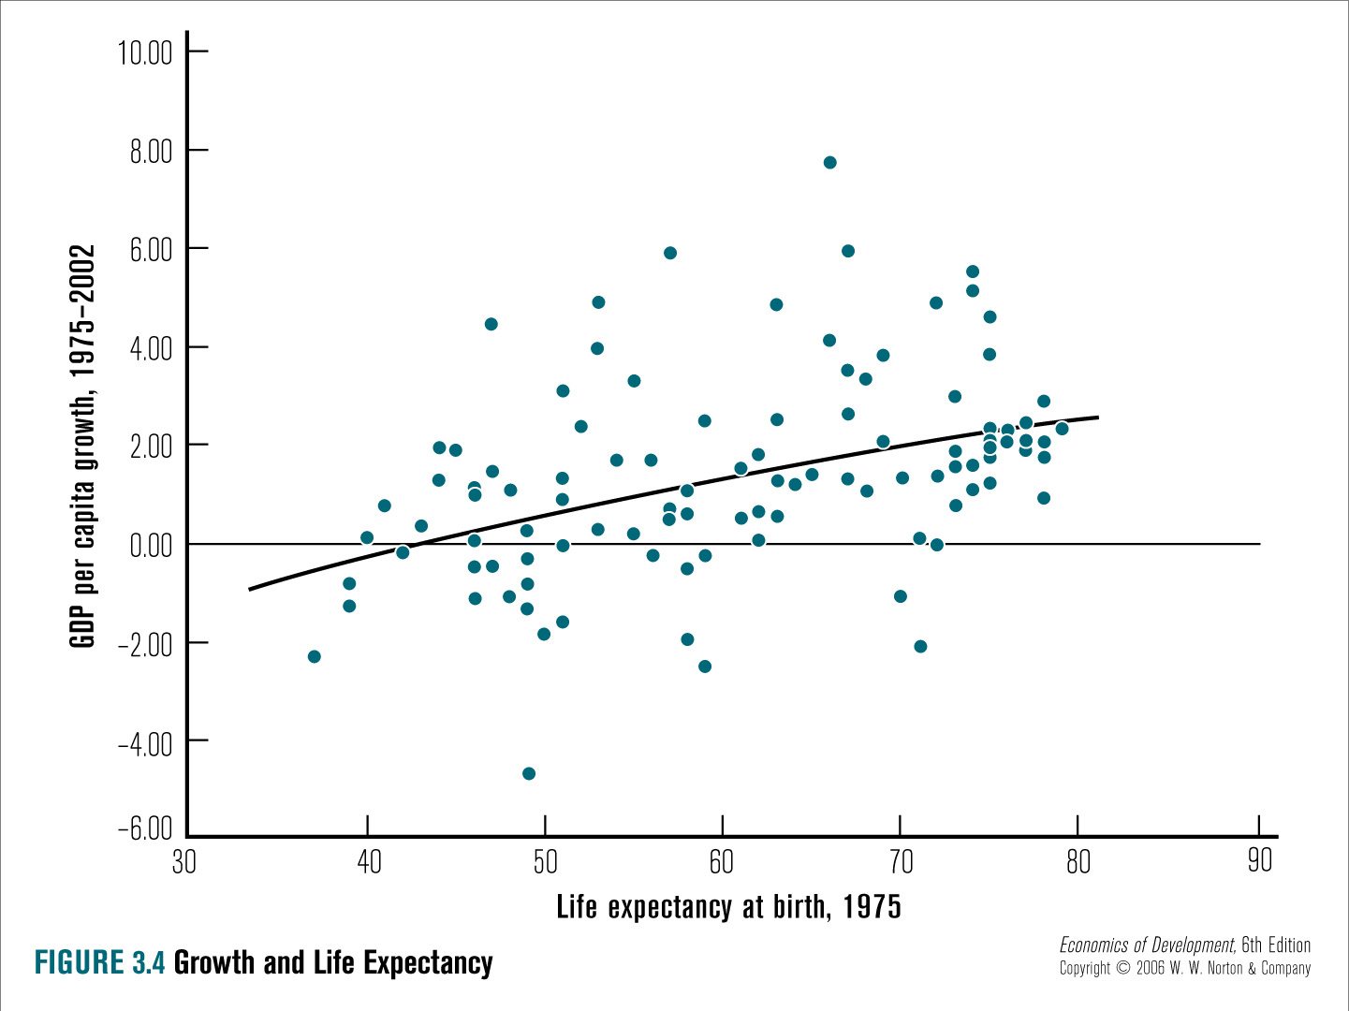

Slide 11
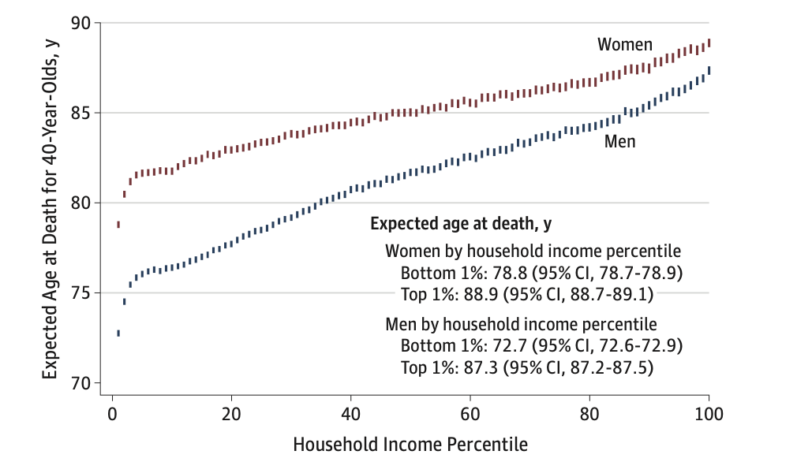
The Association Between Income and Life Expectancy
in the United States, 2001-2014, by Chetty et. al.

Slide 12
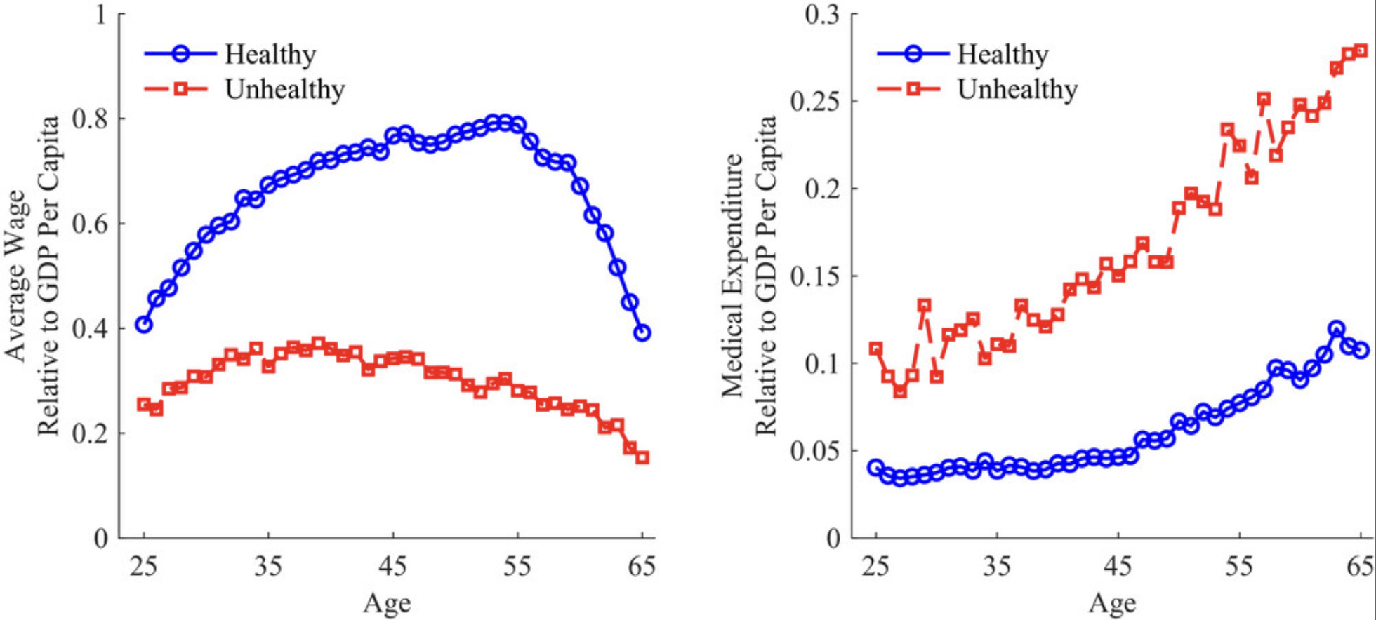

Slide 13
Effective Governance and Institutions
Douglas North study shows relationship between economic growth, the rule of law, extent of corruption, property rights and quality of government bureaucracy, and other measures of institutional quality
  Economic Growth = F( Institutions..)
Other factors: effective private sector, civil society groups, and free press, political competition, etc..
Notes:
Effective Governance and Institutions: Strong institutions and good governance, which encompass elements such as rule of law, property rights, and transparency, are key determinants of economic growth. They provide the framework within which economic activities take place and significantly impact a country's ability to effectively manage its resources, implement policies, and ensure social and economic stability.

Slide 14
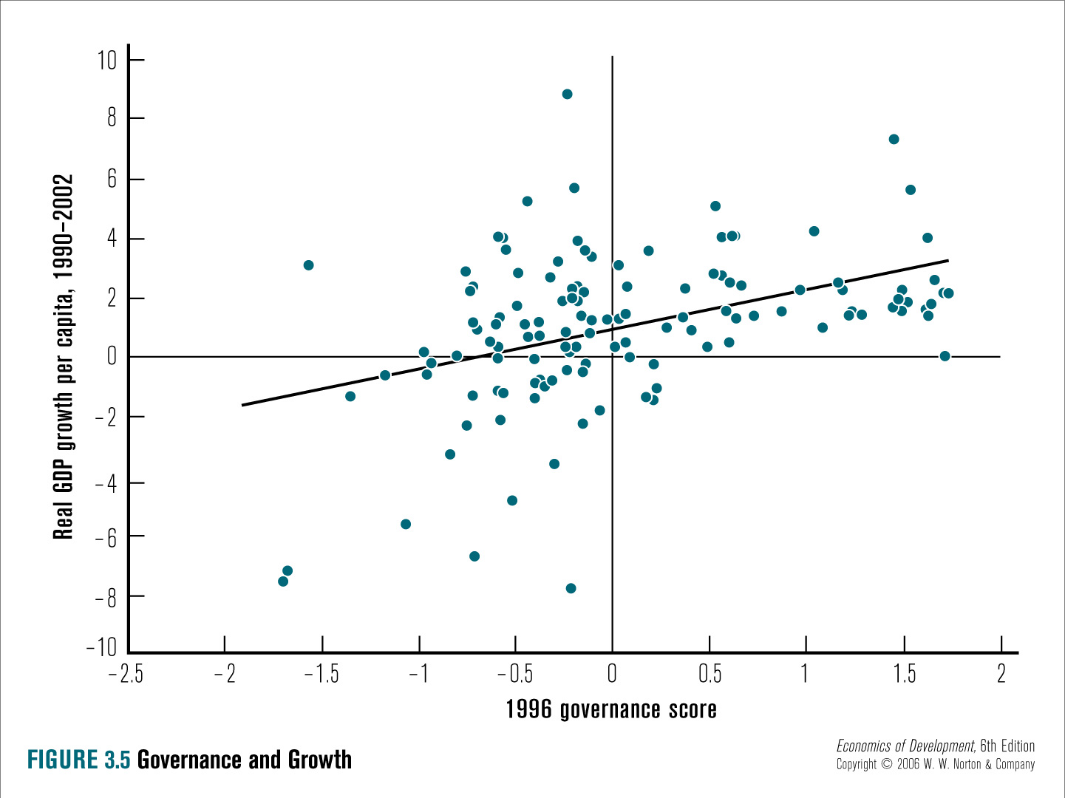

Slide 15
Institutions, Governance & Growth
(box 3.2)
Five institutions are necessary according to Rodrik and Sumbramanian (2003-Finance & Development)
  Market institutions that protect property rights
  Market regulating institutions that deal with market failure
  Market stabilizing institutions to control inflation
  Market legitimizing institutions such as social protection and insurance
  Political institutions determine how a country is governed: level of democracy, transparency, free press, participatory politics, and competitive parties. See Figure 3.5 Governance and Growth

Slide 16
Favorable Environment for Private Enterprise
Growth depends on millions of private citizens making decision to save, invest, work, educate, etc
Agricultural policies are central in Africa since 70-80% of the population lives from agriculture
Heavy business regulation and weak property rights undermine or kill businesses
The degree of openness to international trade and influence matters see Figure 3.6
Notes:
Favorable Environment for Private Enterprise: A business-friendly environment that encourages entrepreneurship, innovation, and competition can significantly boost economic growth. This includes elements like ease of doing business, access to credit, protection of property rights, and a reasonable regulatory framework.

Slide 17
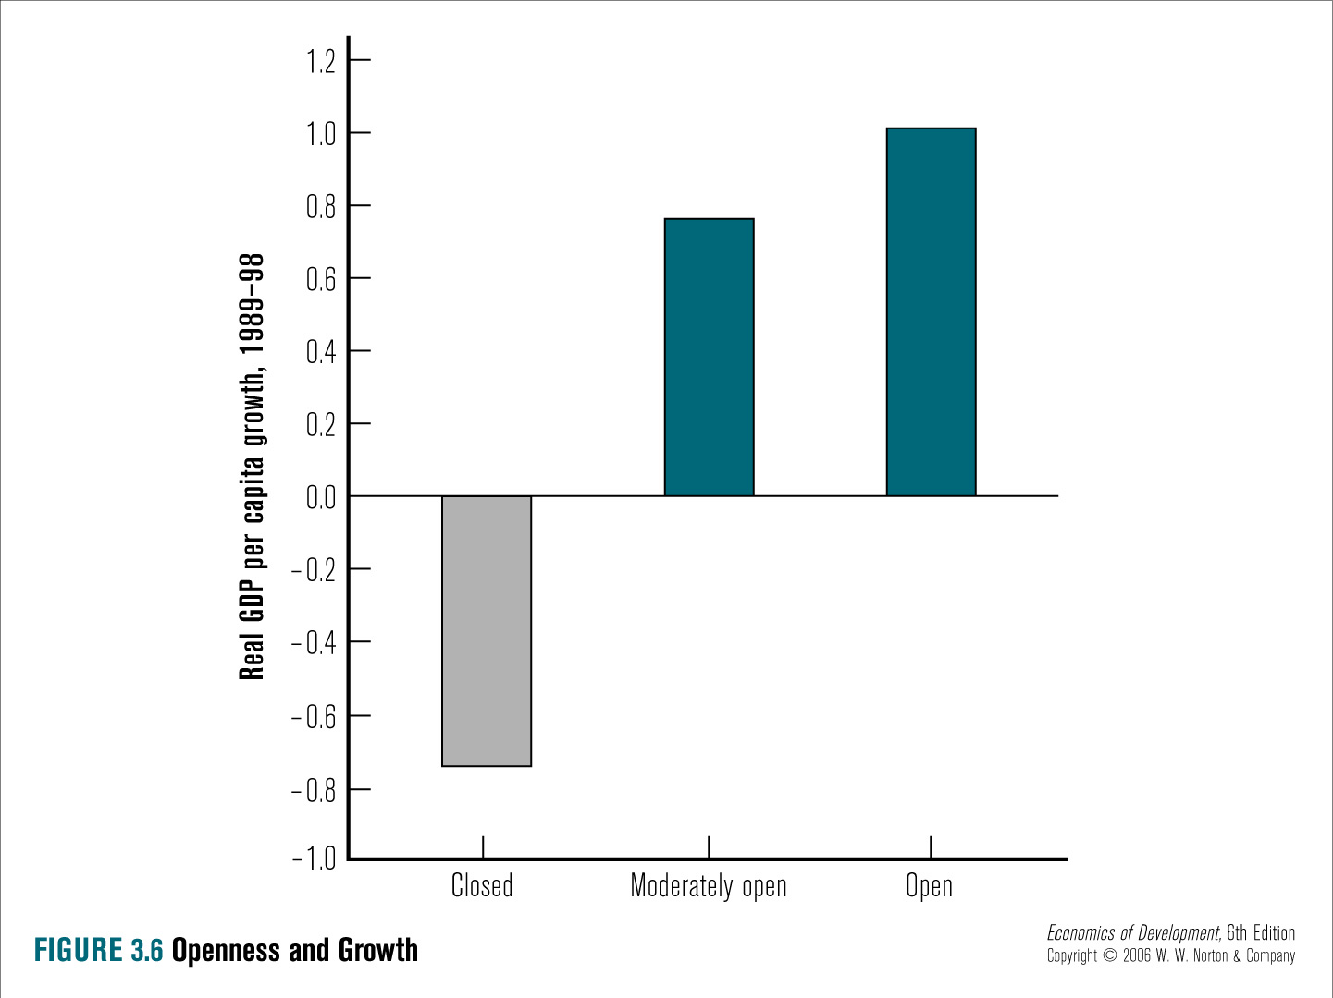

Slide 18
Does Geography Matter?
Most economically developed states are in Temperate climate Zone. Most developing countries are in the tropics. “The effect of climate”: Andrew Kamrack argument.
Does being land locked matter? (no coast line). Yes and no
  Botswana is land locked but it is most successful African Economy
  Switzerland and Austria are land locked yet they are wealthy countries.
Notes:
Favorable Geography or Location: Geography and location can also play a role in a country's growth prospects. For instance, being close to large markets or having access to the sea (which can facilitate trade) can be advantageous. Natural resources, climate, and susceptibility to natural disasters are also aspects of geography that can impact economic performance.

Slide 19
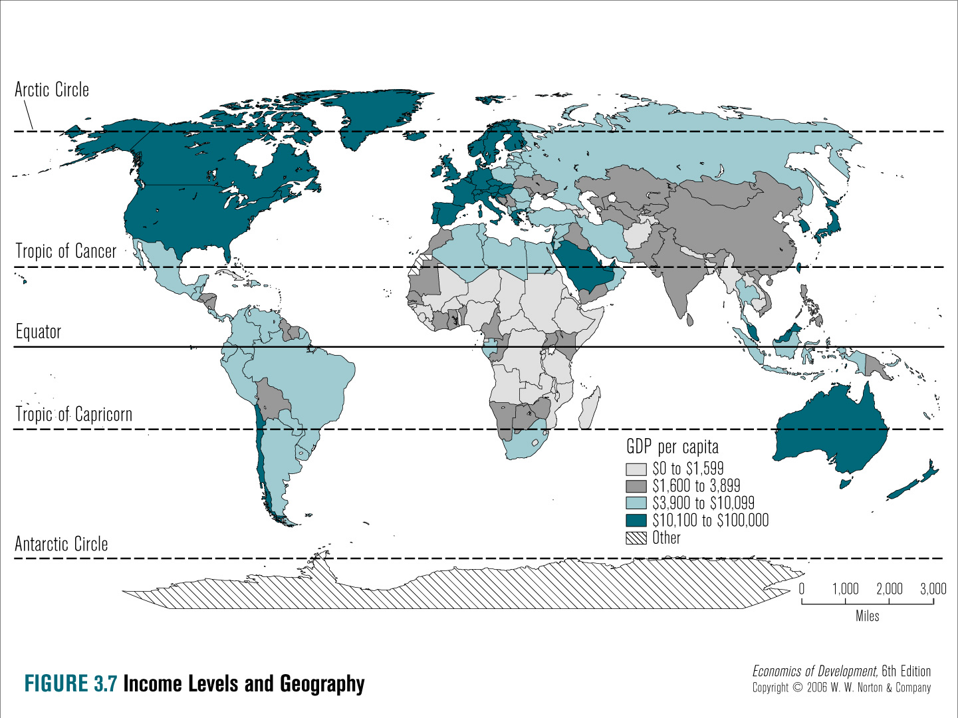

Slide 20
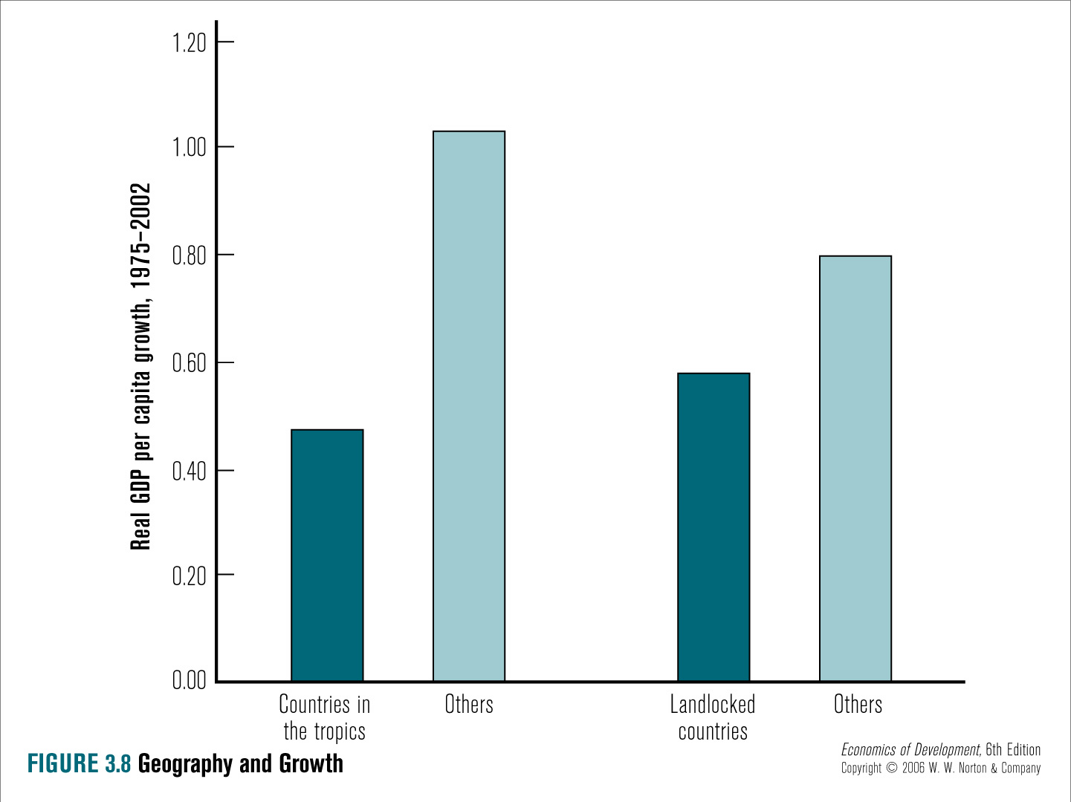

Slide 21
Why is Botswana Successful
(Box 3.1)
Between 1970-90, Botswana was the fastest growing country in the world at about 8% per year.
But at independence in 1965, it was poor and had 100 high school graduates and 22 college graduates.
What is the main source of success: Good policies and strong institution and democratic government
Protection of property rights and minimal corruption including civil service base on merit not on patronage
These has led to highest per capital income and best HDI
Recent challenge: High HIV/AIDS infection rate has reversed this.
Notes:
Botswana's economic success story is unique and provides valuable insights.
1. Good Policies and Strong Institutions: Botswana has developed and implemented economic policies that support economic growth and have been characterized by a commitment to free trade and open markets. It has also built strong, effective institutions that enforce laws, maintain order, and reduce corruption, which in turn build investor confidence and encourage economic activity.
2. Democratic Government: Botswana is one of Africa's most stable democracies, which has brought about consistency in economic policies and reduced uncertainties that can hinder investment and economic growth. It has allowed for peaceful transitions of power, maintained political stability, and promoted a healthy respect for human rights and the rule of law.
3. Protection of Property Rights: Botswana has strong property rights, which encourage individuals and businesses to invest since they can be confident that their investments will be protected. This has resulted in increased investment in all sectors of the economy, which contributes to economic growth.
4. Minimal Corruption: Botswana has been recognized internationally for its low levels of corruption, which creates a favorable business environment. This boosts investor confidence and facilitates economic activities, leading to growth and development.
5. Civil Service Based on Merit: Botswana's civil service recruits and promotes its staff based on merit rather than political patronage. This has resulted in a highly skilled, efficient, and professional civil service that is capable of implementing government policies and programs effectively.
6. Human Development: Botswana has the highest per capita income in sub-Saharan Africa and is classified as an upper-middle-income country. Despite this, it faces significant development challenges, particularly in terms of health, education, and social protection.
However, the country is now faced with the challenge of a high HIV/AIDS prevalence rate, which has started to negatively impact its human capital and consequently, its economic growth. The government is actively working to address this issue through various policies and interventions. Despite this setback, Botswana's economic success story remains a model for other African countries.
To tackle these challenges and sustain its economic growth, Botswana will need to continue to invest in its institutions, maintain its commitment to good governance and economic openness, and effectively manage its resource wealth. It will also need to effectively address its health challenges, particularly HIV/AIDS, and continue to invest in education and skills development to build a productive and resilient workforce.

Slide 22
Factor Accumulation, Productivity Growth, Econ. Growth
Factor Accumulation: increase in the size of capital stock and labor force.
  More machines, factories, buildings, roads, electricity, computers and tools along with better trained workers
Productivity Growth: Amount of output per unit of machine or worker: increases in 2 ways by
    greater efficiency-specialization, and
    technological change.
This can be explained using production function
    Q = f (Labor, Capital, etc…)

Slide 23
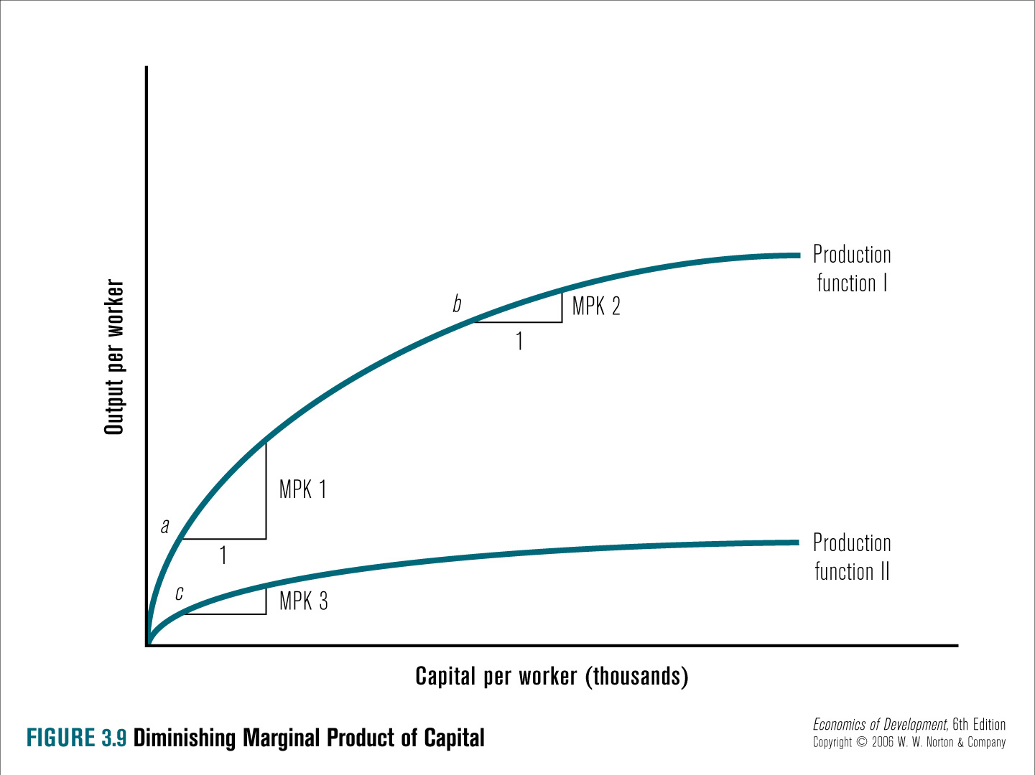

Slide 24
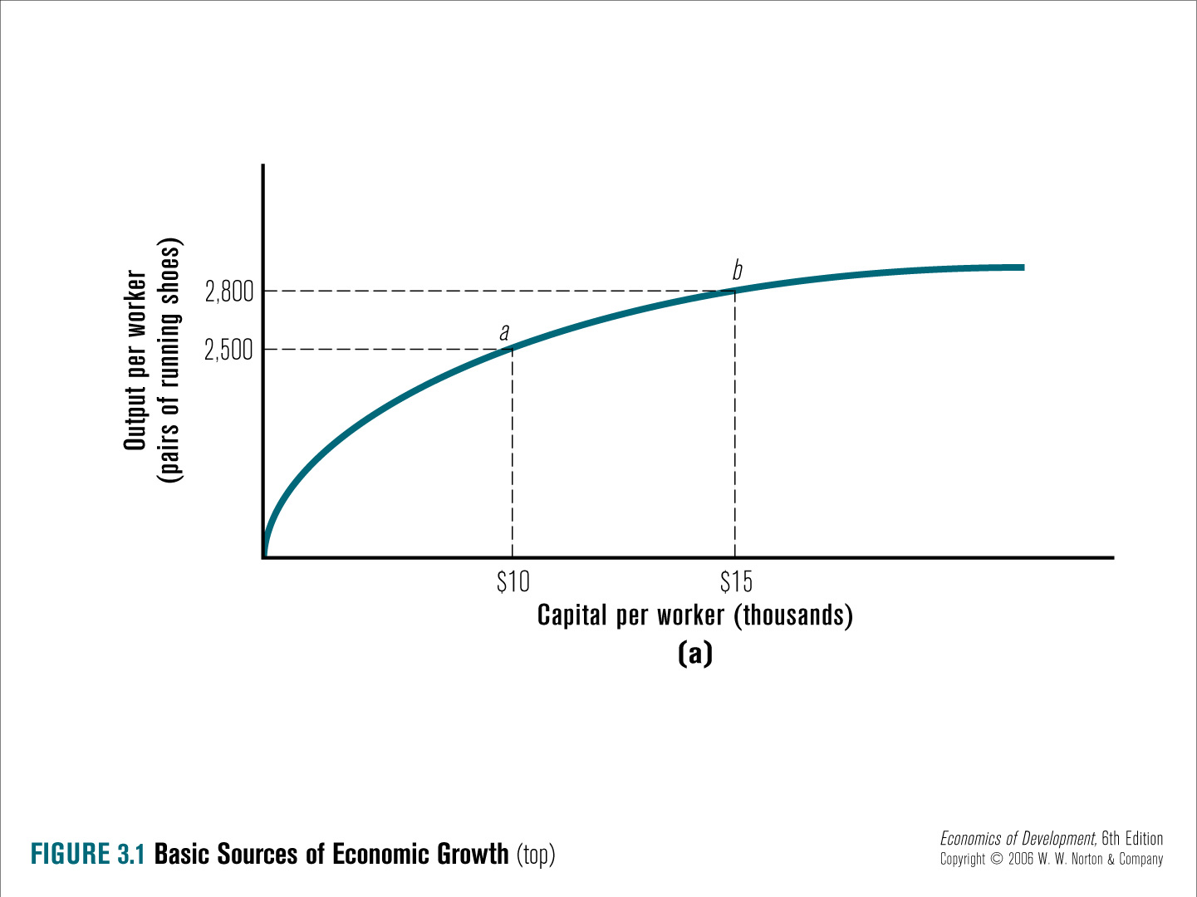
Production function Q=f(K)

Slide 25
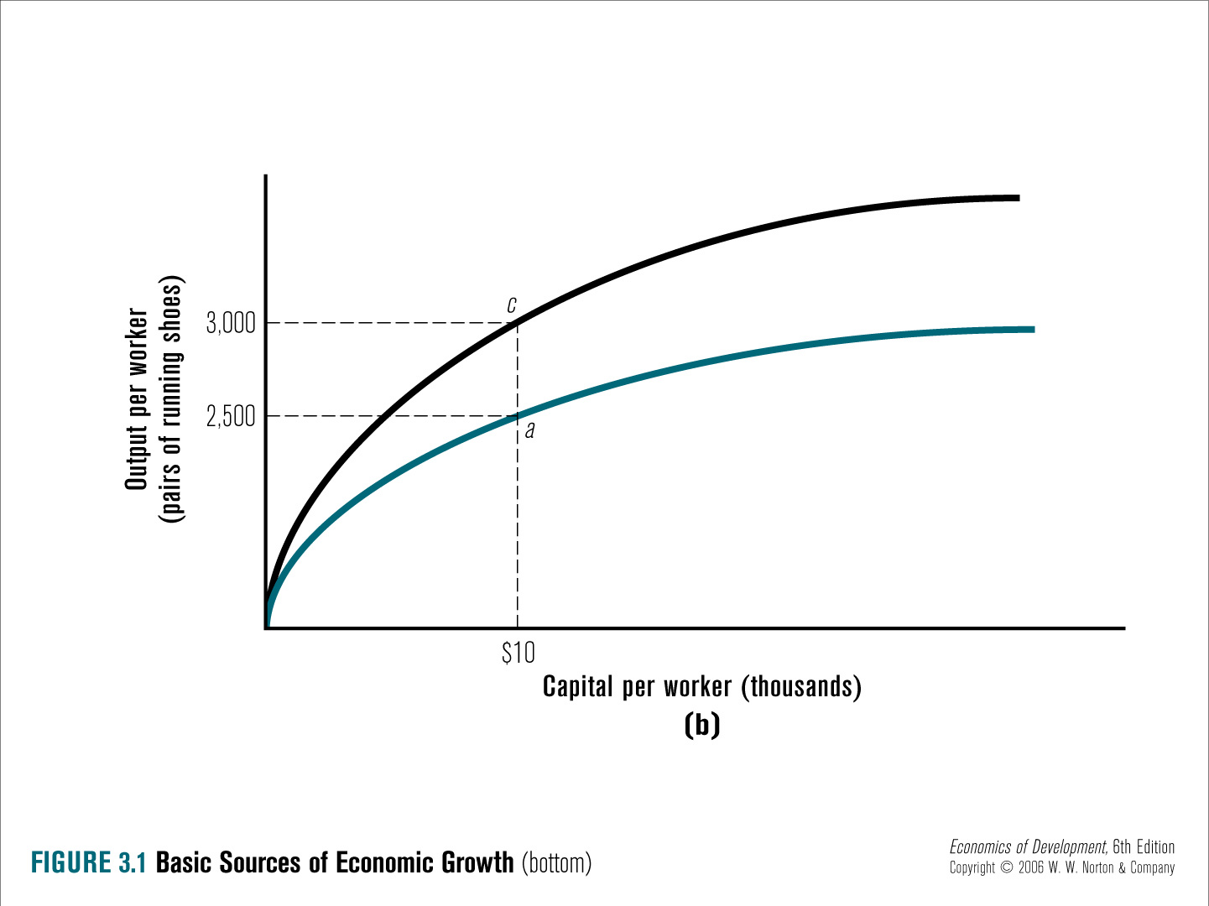
Productivity Gains

Slide 26
Implications of Diminishing marginal product of Capital
Poor countries have a potential to grow more rapidly since they face capital scarcity
Richer countries with capital abundant grow slowly
Since poor countries have more potential to grow faster, they can catch up with rich countries
Examples: China, India, etc.

Slide 27
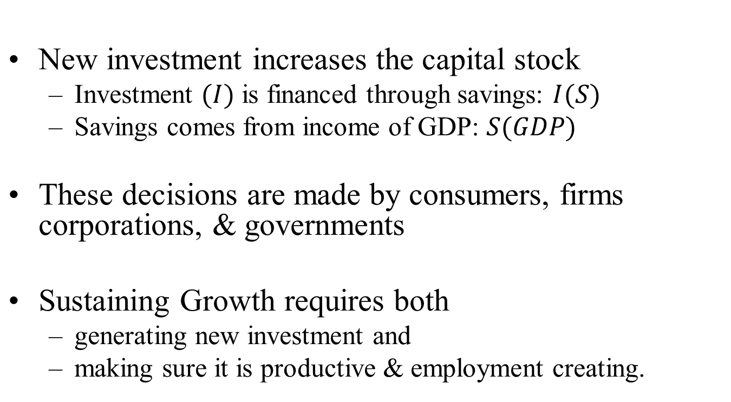
Key Elements of Economic Growth:

Slide 28
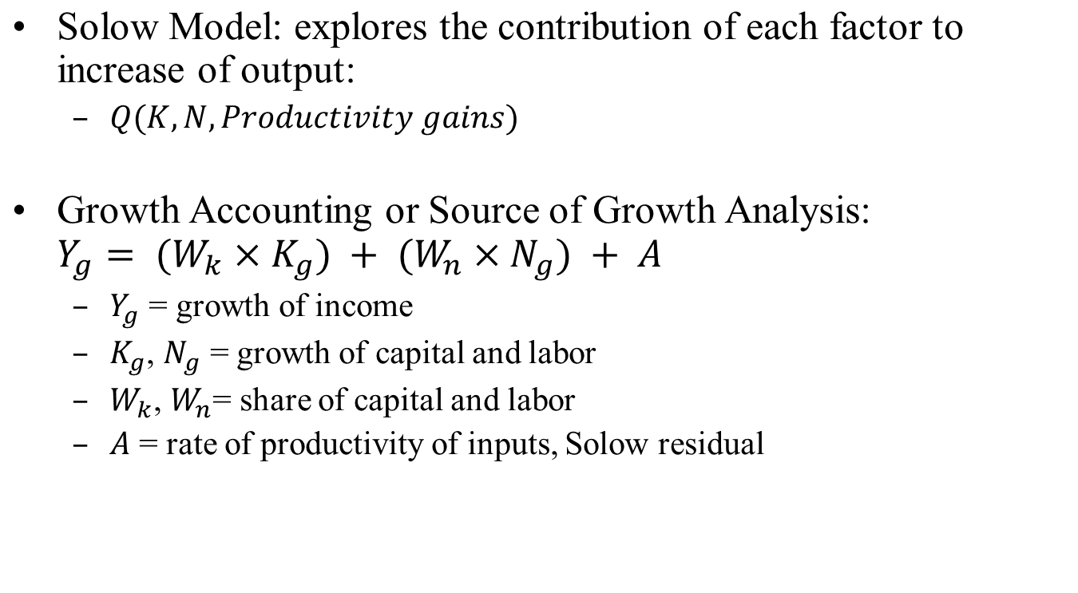
Sources of Growth Analysis

Slide 29
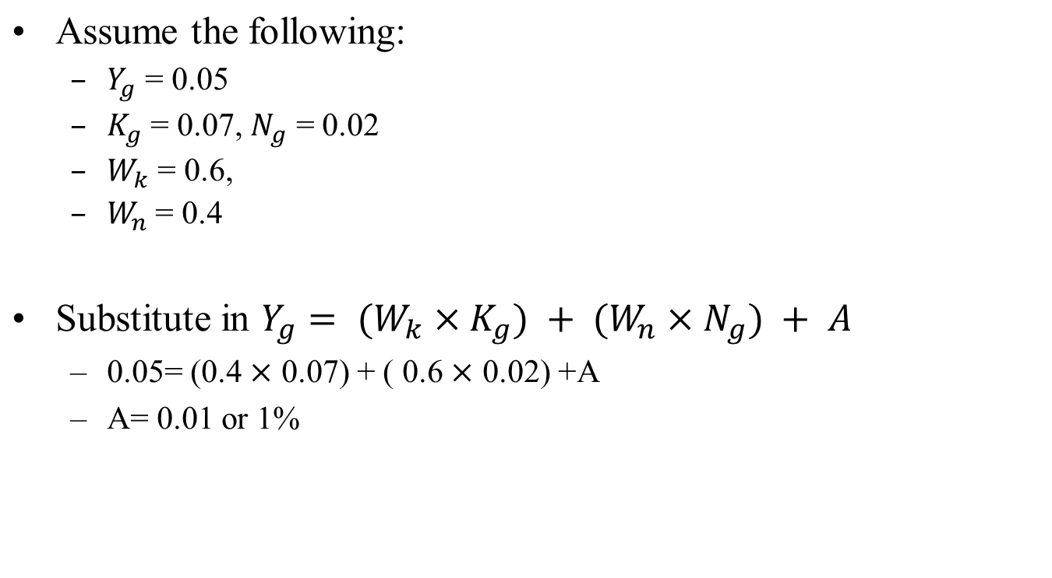
Example of Growth Accounting

Slide 30

Cobb-Douglas Production Function

Slide 31

From the Data
A labor share in national income of 64% gives:

Slide 32
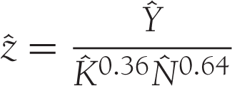
Z – the Solow Residual
The Solow Residual is calculated as:

Slide 33
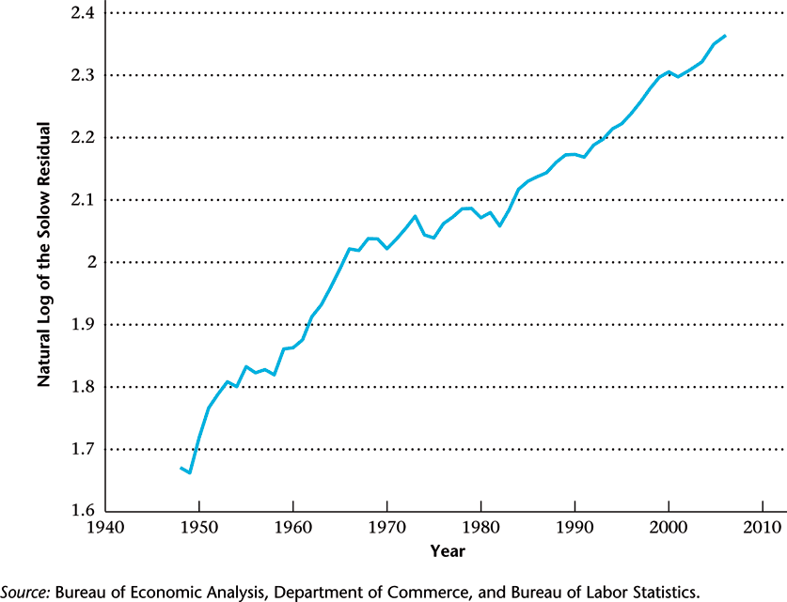
Natural Log of the Solow Residual

Slide 34
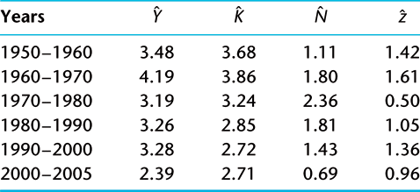
Average Annual Growth Rates

Slide 35
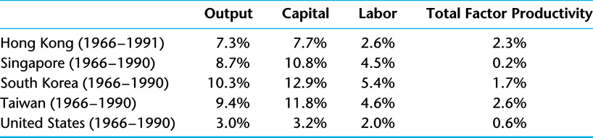
East Asian Growth Miracles
(Average Annual Growth Rates)

Slide 36
Case Study: Growing like China
Over the last 30 years, China has undergone a spectacular economic transformation involving
  fast economic growth and sustained capital accumulation,
  major shifts in the sectoral composition of output, increased urbanization
  a growing importance of markets and entrepreneurial skills
The rate of return on investment has remained well above 20 percent, higher than in most industrialized and developing economies.
In the last 15 years, China has experienced a growing net foreign surplus: its foreign reserves swelled from 21 billion USD in 1992 (5 percent of its annual GDP) to 2,130 billion USD in June 2009 (46 percent of its GDP)
The combination of high growth and high return to capital, on the one hand, and a growing foreign surplus, on the other hand, is puzzling.

Slide 37
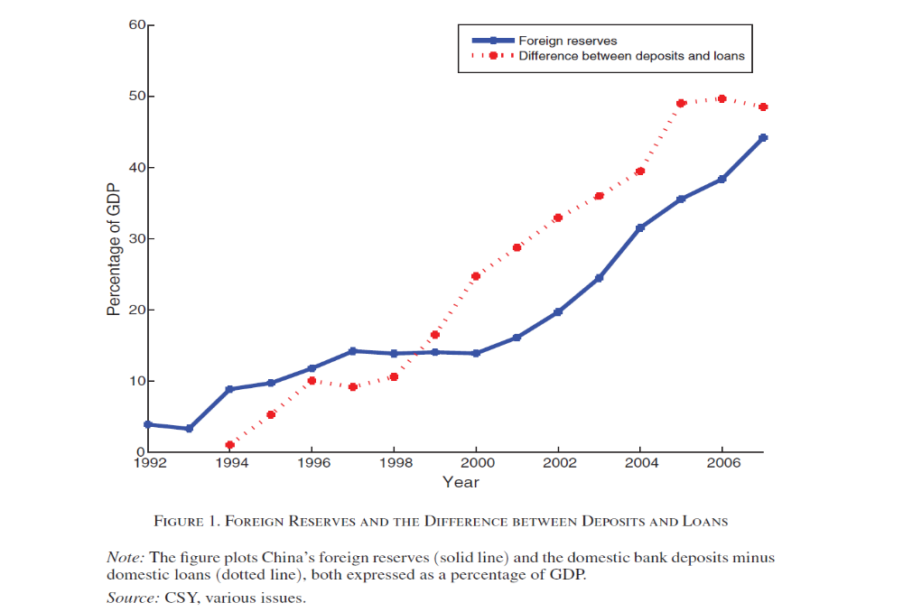

Growing like China

Slide 38
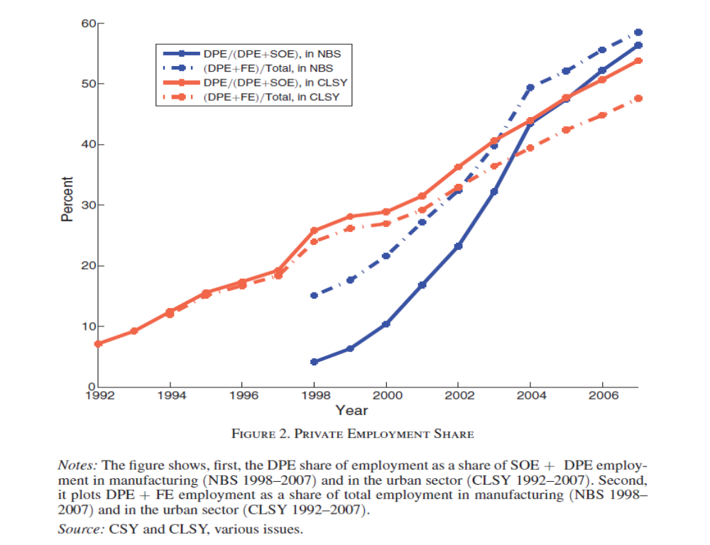
Growing like China

Slide 39
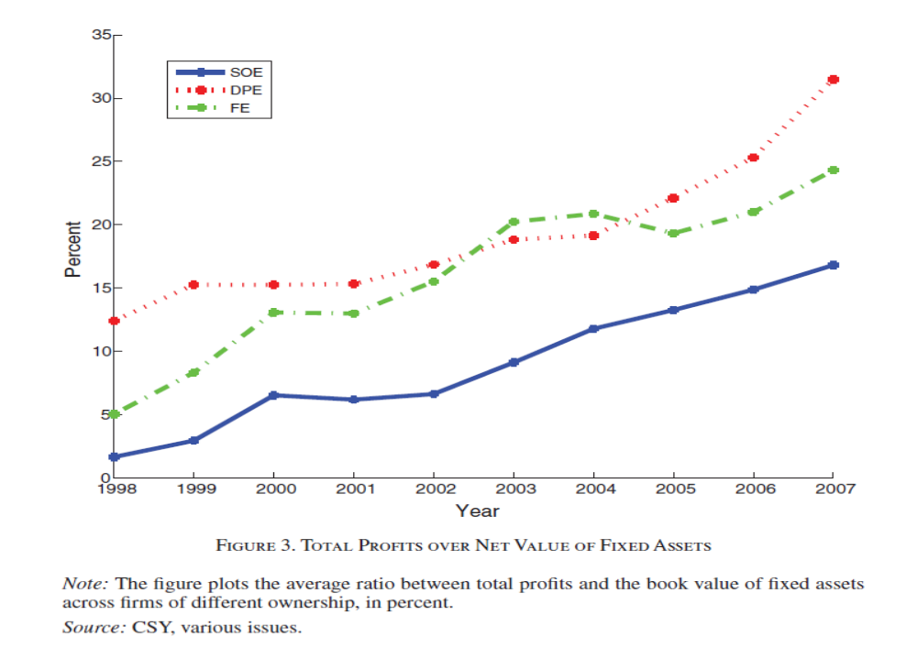
Growing like China

