Slide 1
International Economic Development
ECON 4660/8666
Lecture 4. Inequality and poverty

Slide 2
Main Questions:
How can we best measure inequality and poverty?
What is so bad about extreme inequality? What is the extent of relative inequality in developing countries; how is this related to the extent of poverty?
Who are the poor, and what are their economic characteristics?
What kinds of policies are required to reduce the magnitude and extent of absolute poverty?

Slide 3
I. Growth and the living standards:
1. Growth is a necessary condition for improving living standards.
Economic growth can make some or all people better off without making anyone worse off. (Pareto improvement)
2. Growth is not a sufficient condition for improving living standards.

Slide 4
2. Growth is not a sufficient condition for improving living standards.
A. The increased output is used to increase the power of the rulers.
B. Increased output is used for reinvestment.
C. The rich gets richer, the poor gets poorer.
https://www.youtube.com/watch?v=hVimVzgtD6w

Slide 5
II. Measuring Inequality and Poverty
1. Income distribution.
A. Functional distribution of income. Income distributed according to the function performed by the income receivers.
Labor 75%
Capital 15%
Others 10%
B. Personal distribution of income.
Income distributed among households.
Poorest 20% …… 5%
Richest 20% …… 45%

Slide 6
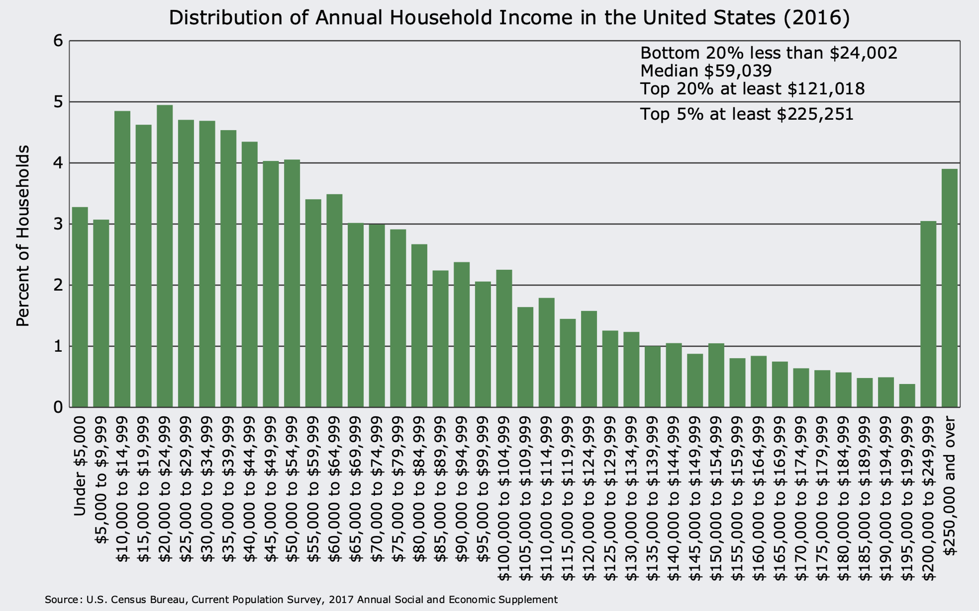

Slide 7
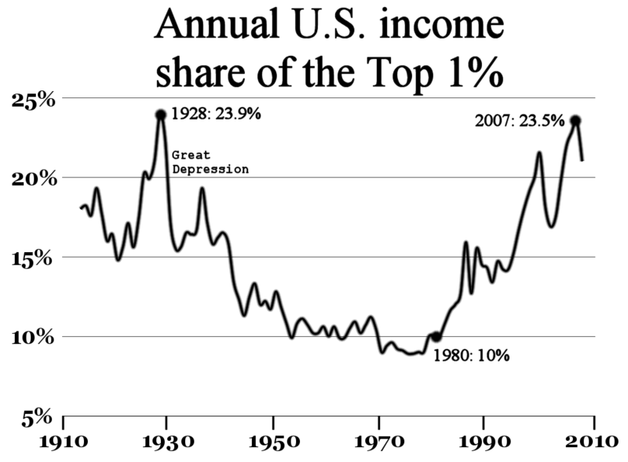
Frederick E. Allen, Forbes http://www.forbes.com/sites/frederickallen/2012/10/02/how-income-inequality-is-damaging-the-u-s/

Slide 8
Income Distribution
 | percentage of people | percentage of income | cumulative % of people from poor to rich | cumulative % of income
Poorest | 25% | 10% | 25% | 10%
 | 25% | 15% | 50% | 25%
 | 25% | 25% | 75% | 50%
Richest | 25% | 50% | 100% | 100%

Slide 9
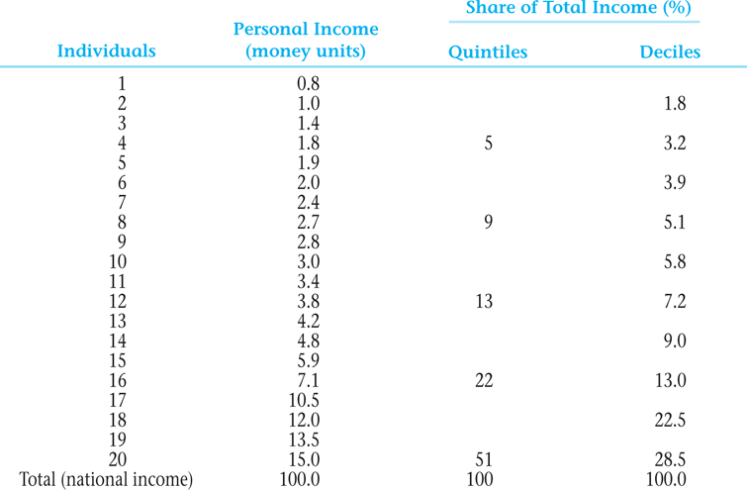
Typical Size Distribution of Personal Income in a Developing Country by Income Shares—Quintiles and Deciles

Slide 10
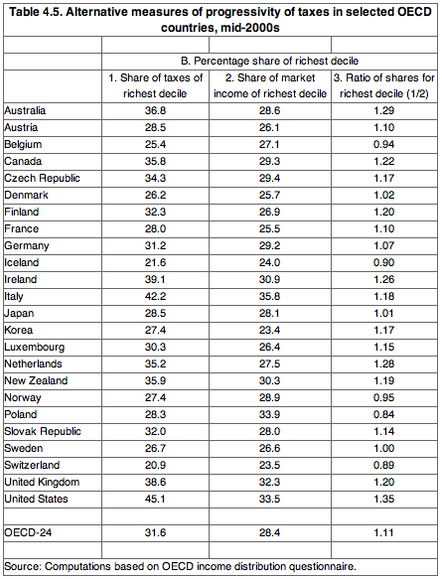
http://gregmankiw.blogspot.com/2011/03/what-nation-has-most-progressive-tax.html

Slide 11
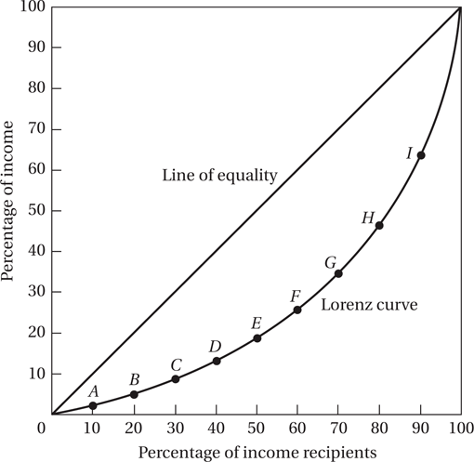
The Lorenz Curve

Slide 12
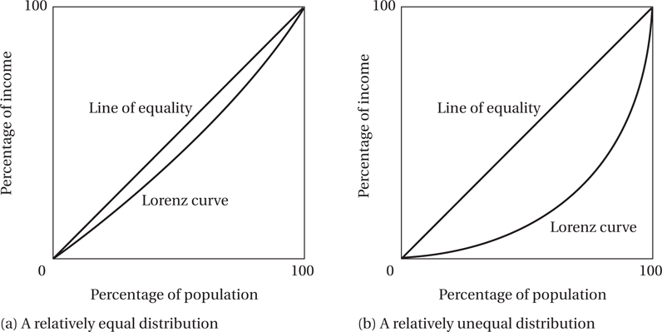
The Greater the Curvature of the Lorenz Line, the Greater the Relative Degree of Inequality

Slide 13

2. Inequality
Gini concentration ratio: A single number indicating overall inequality.
100
75
line
Lorenz curve
A
50
25
B
0 25 50 75 100

Slide 14
Same Gini coefficient may represent different income distribution.
 |  | Country 1 | Country 2
Lowest | 25% | 5 | 15
Next | 25% | 5 | 15
Next | 25% | 45 | 15
Highest | 25% | 45 | 50
Example:
Cumulative
% of income
100
line
75
Country 1
50
Country 2
25
0 25 50 75 100
Cumulative
% of Population

Slide 15


Gini coefficient:
Country 1:
Area A: 5000- [(50×10) ÷2 +50×10+(50×90) ÷2 ] = 5000-3000=2000
Country 2:
Area A: 5000- [(75×45) ÷2 +25×45+(25×55) ÷2 ] = 5000-3500=1500

Slide 16
Income GINI Coefficients in Selected Regions (2000-2010)
Country | GINI | Country | GINI
Hungary | 30.0 | USA | 40.8
Japan | 24.9 | China | 41.5
Sweden | 25.0 | Singapore | 42.5
Germany | 28.3 | Russia | 43.7
France | 32.7 | Hong Kong | 43.4
UK | 36.0 | Mexico | 51.6
India | 36.8 | Brazil | 55.0
Sources：United Nations: Human Development Report 2010

Slide 17
3. Poverty
Desirable properties for poverty measures:
Anonymity
Population independence
Monotonicity
Distributional sensitivity
Notes:
These properties reflect different aspects of poverty and can help ensure that the measures provide a comprehensive and fair assessment of poverty. Here is an elaboration of each property:
1. **Anonymity**: This property states that the poverty measure should not depend on the identities of the individuals. In other words, if you were to rearrange individuals' incomes, the measure of poverty should remain the same. This ensures that the measure is solely based on income levels and not on who specifically is earning those incomes.
2. **Population Independence**: This property indicates that the poverty measure should not change if the size of the population changes but the distribution of income remains the same. For example, if a country's population doubles but everyone's income also doubles, the measure of poverty should remain the same.
3. **Monotonicity**: This property requires that if the income of a poor person decreases (with all other incomes remaining the same), the measured poverty should increase. This is a fundamental requirement for a poverty measure to accurately reflect changes in the welfare of the poor.
4. **Distributional Sensitivity**: This property states that the poverty measure should be sensitive to changes in the distribution of income among the poor. For example, if income is transferred from a poorer person to a less poor person (both still being poor), the poverty measure should increase. This property ensures that the measure captures not only the incidence of poverty but also its depth and severity.
These properties help ensure that poverty measures provide a meaningful and fair representation of poverty, which is crucial for designing and evaluating poverty alleviation policies.

Slide 18
A condition below the minimum acceptable standard.
Poverty line measured by income level.
Example: The official poverty level for a family of three $ 13,860 in 2000 in the U.S..
$ 15,720 in 2005
$ 18,310 in 2009 22,890 Alaska 21,060 Hawaii
$ 19,090 in 2012 23,870 21,960
48 States and District Columbia
The official poverty level are updated each year to reflect the price change.

Slide 19
The US Census declared that, in 2011, the official poverty rate was 15.0 percent. There were 46.2 million people in poverty.
The poverty rate in 2011
for children under age 18 was 21.9%
for people aged 18 to 64 was 13.7%
for people aged 65 and older was 8.7%

Slide 20
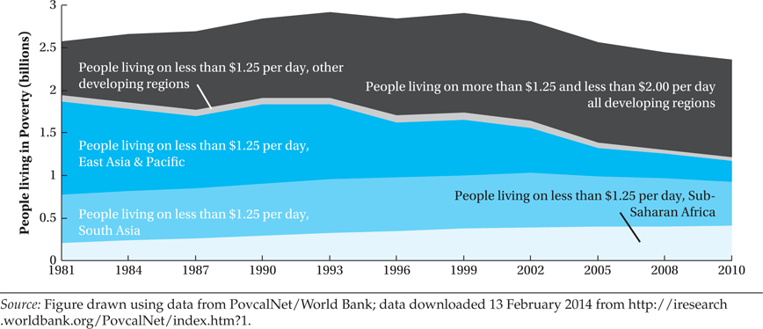
Global and Regional Poverty Trends, 1981–2010

Slide 21
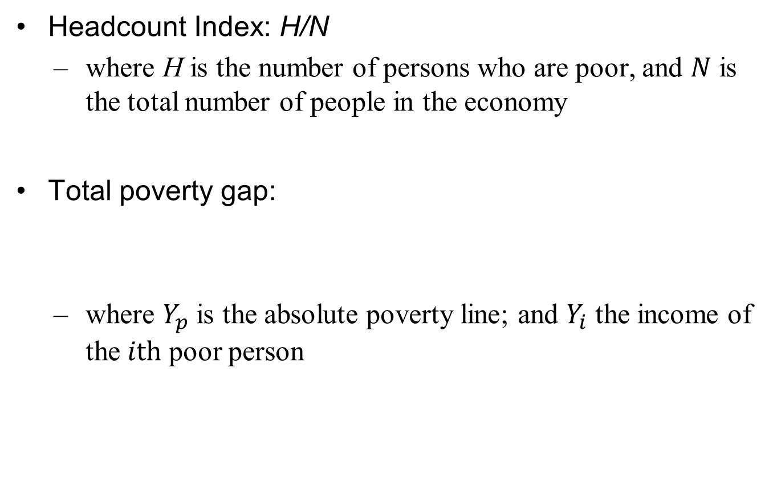
Measuring Absolute Poverty

Slide 22
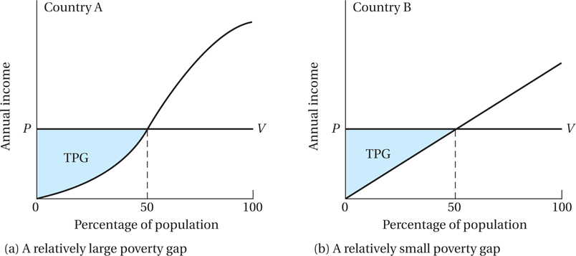
Measuring the Total Poverty Gap

Slide 23
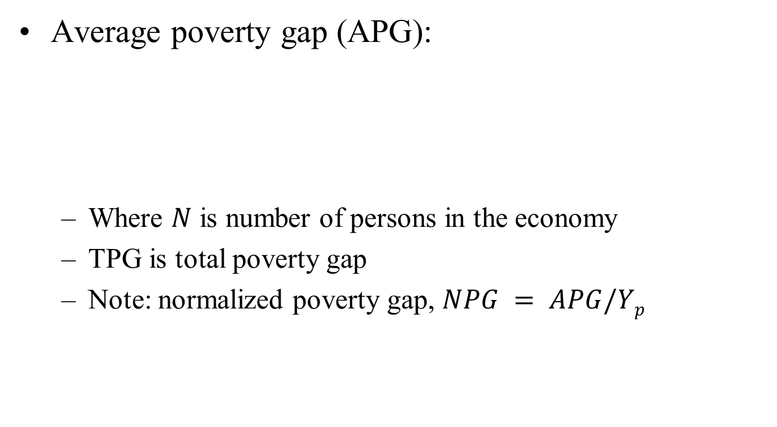
Measuring Absolute Poverty

Slide 24
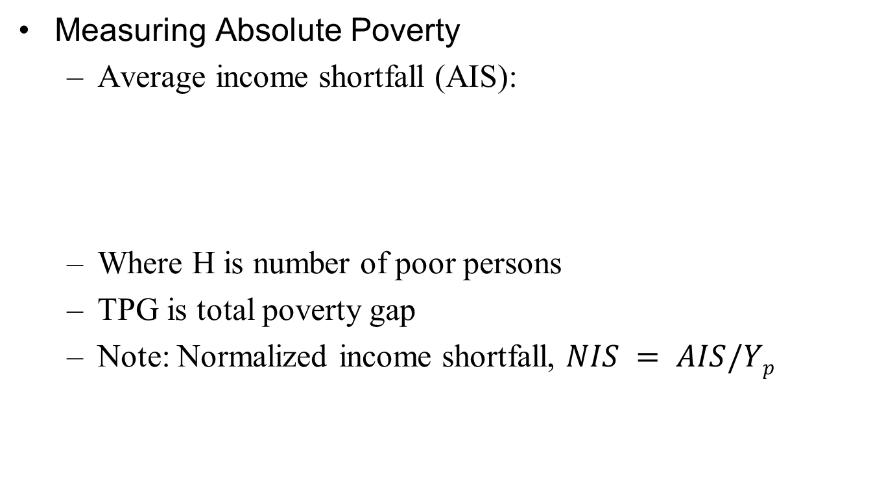
Measuring Absolute Poverty

Slide 25
Measuring Absolute Poverty
The Foster-Greer-Thorbecke (FGT) index:
N is the number of persons, H is the number of poor persons, and α ≥0 is a parameter
When α=0, we get the headcount index measure
When α=2, we get the “P₂” measure
Notes:
When α=0, the FGT index measures the incidence of poverty, or the headcount ratio. It simply counts the number of people who are below the poverty line.
When α=1, the FGT index measures the depth of poverty, or the poverty gap. It looks at how far, on average, the poor are from the poverty line.
When α=2, the FGT index measures the severity of poverty. It takes into account not just the distance from the poverty line, but also the inequality among the poor.

Slide 26
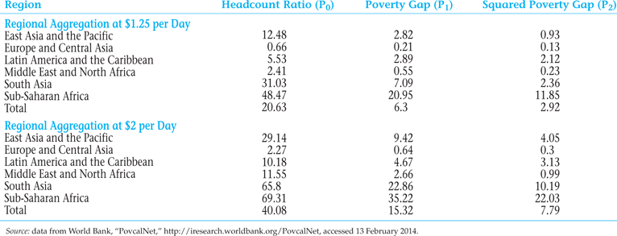
Regional Poverty Incidence, 2010

Slide 27
Ⅲ. Poverty, inequality and social welfare
Why should inequality be a concern?
Extreme income inequality leads to economic inefficiency.
Financial constraint, capital flight, limited saving / investment.
Extreme income disparities undermine social stability and solidarity.
Rent seeking
Extreme inequality if generally viewed as unfair.
Notes:
Income inequality can have significant economic, social, and political implications, and thus should be a major concern for policymakers. Here's a deeper look at the reasons you've mentioned:
1. **Economic Inefficiency**: High levels of income inequality can lead to economic inefficiency. Those with lower incomes often lack the necessary resources for education or healthcare, which can reduce their potential productivity and thus the overall productivity of the economy.
2. **Financial Constraints and Limited Saving/Investment**: When income is heavily concentrated, those at the bottom end of the distribution may not have sufficient resources to invest in their businesses or education, limiting economic growth. Conversely, those at the top of the distribution may have more money than they can productively invest, which can lead to speculative bubbles or capital flight if they seek investment opportunities elsewhere.
3. **Undermining Social Stability and Solidarity**: High levels of income inequality can lead to social unrest and increased crime rates, as those who feel excluded from the benefits of economic growth may resort to illegal means to improve their economic situation. It can also undermine social cohesion and trust, which are essential for a well-functioning society.
4. **Rent-Seeking**: When income and wealth are concentrated, the wealthy may use their resources to influence government policies in their favor, a process known as rent-seeking. This can lead to policies that perpetuate income inequality and are not in the best interest of the overall economy.
5. **Perception of Unfairness**: High levels of income inequality are often perceived as unfair, especially when they result from factors beyond an individual's control such as discrimination or inheritance. This perception can lead to social unrest and undermine the legitimacy of economic and political institutions.
These reasons illustrate why reducing income inequality should be a key objective for policymakers, as it can lead to more stable and efficient economies, healthier societies, and fairer political systems.

Slide 28
1. Kuznets’ Inverted U.
Simon Kuznets, 1955 “ Economic Growth & Income Inequality”, AER 45, PP.1-28. Date from U.S., U.K. & Germany.
As GNP ↑, Inequality initially ↑, then reach maximum, then↓.
This theory received some support, especially from cross - section analyses. (or cross - country analyses)
Inequality (Gini coefficient)
Per capita GNP
Notes:
The Kuznets Curve is a graphical representation of the path of economic inequality in relation to economic development. The curve is an inverted "U" shape, indicating that as a nation undergoes economic development, it may initially experience an increase in economic inequality, but after a certain point of development, the trend reverses, and economic inequality starts to decrease.
Kuznets proposed this theory based on data from developed countries like the United States, the United Kingdom, and Germany. According to Kuznets, as a country industrializes, a large portion of the population moves from low-productivity agriculture to higher-productivity industry work, leading to initial increases in inequality. However, as a country continues to develop and its industrial sector matures, social welfare measures are put in place and education becomes widespread, which decreases income disparities.
However, it's important to note that the Kuznets Curve is a theory and doesn't hold true for all countries at all times. In fact, many developing and developed countries today exhibit high levels of income inequality, despite their level of economic development. Therefore, the applicability of Kuznets' hypothesis remains a subject of ongoing debate in the field of economics.

Slide 29
Gini coefficient
Per capita GDP

Slide 30
Klaus Deininger & Lyn Squir, 1996
“Measuring Income Inequality: A New Data Base,” World Bank Econ. Review 10, 1996.
Little evidence of a Kuznets Curve in the data. 88 countries with decade- long growth, inequality improved in 45 and worsened in 43. In most cases, the changes in inequality were relatively small & uncorrelated with initial income.

Slide 31
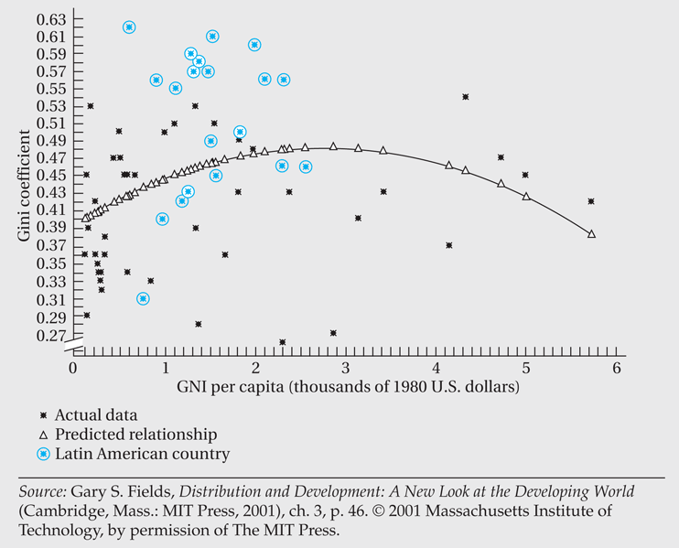
Kuznets Curve with Latin American Countries Identified

Slide 32
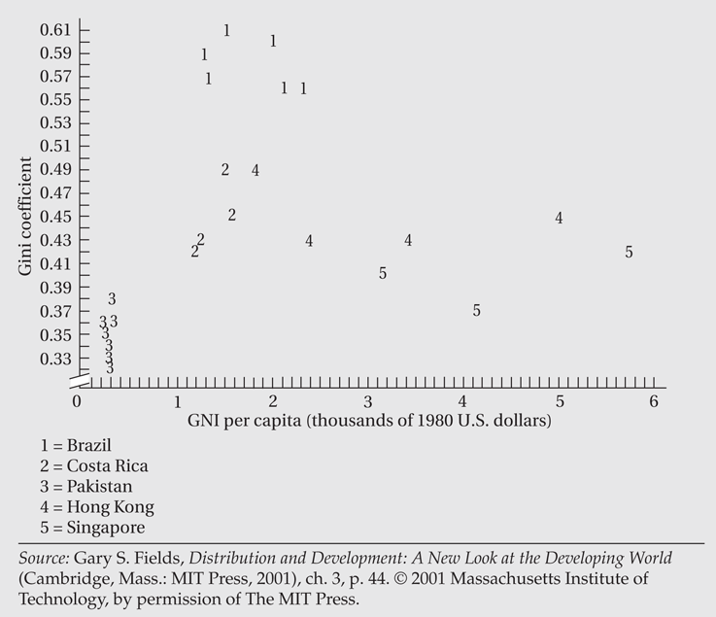
Plot of Inequality Data for Selected Countries

Slide 33
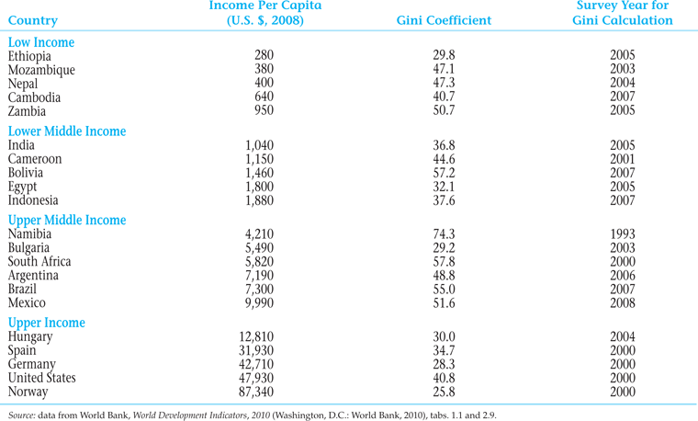
Income and Inequality in Selected Countries

Slide 34
2. The Effect of Inequality on Income & Growth
A. Inequality, Saving, and Capital Accumulation.
The rich have lower marginal propensity to consume,
Greater inequality leads to greater savings, and thus greater capital accumulation & growth.
Friedman (1957) showed that consumption depends on permanent income, & MPC is constant. Thus, distribution of income has no effect on saving.
Evidence from East Asia shows no relationship between inequality & savings.
B. Inequality, Fiscal policy, and Growth.
Greater inequality leads to higher taxes & low growth.
Alesina & Rodrik (1994), “Distributive Politics & Economic Growth”, QJE 109, 465-90.
Notes:
The theory of inequality, saving, and capital accumulation posits that wealthier individuals tend to save more than less affluent ones, as they have a lower marginal propensity to consume (MPC). The marginal propensity to consume is the increase in consumer spending due to an incremental increase in income. A lower MPC means that as income increases, consumption does not rise proportionately, leading to higher savings. This could potentially lead to higher capital accumulation and economic growth, as savings can be invested to increase productive capacity.
This theory assumes that the distribution of wealth in a society impacts the overall rate of saving and investment. A society with more wealth concentrated in the hands of a few may have a higher overall savings rate than a more egalitarian society, because the wealthy save a larger portion of their income.
However, economist Milton Friedman challenged this notion in 1957 with his Permanent Income Hypothesis. According to Friedman, consumption depends on what he referred to as "permanent income," or an individual's normal or average income over a long period. This suggests that consumers smooth consumption over their lifetime, spending a constant portion of their permanent income. Thus, under this theory, the distribution of income would not impact the overall savings rate because everyone's marginal propensity to consume remains constant.
Lastly, the relationship between income inequality and savings isn't universally applicable. For instance, empirical evidence from East Asian economies doesn't show a clear relationship between income inequality and savings rates. While these countries have high savings rates, they've exhibited different levels of income inequality. This suggests that other factors like cultural norms, financial systems, and government policies may play a critical role in determining savings behavior.

Slide 35
C. Inequality & Political Stability
Greater inequality leads to more political instability and lower growth.
Overall, there is no evidence about the relationship between inequality & growth from time–series data for individual countries.
There exists cross-country evidence that inequality and growth are negatively related.
Notes:
The relationship between inequality and political stability is complex and multifaceted. While there isn't a one-size-fits-all answer, some researchers propose that higher levels of income inequality can lead to increased political instability and, subsequently, lower economic growth.
The theory goes that when income and wealth are highly concentrated, it can breed resentment among the less affluent majority. This resentment can translate into social unrest, political upheaval, and even violence, all of which can harm economic stability and growth.
Moreover, in highly unequal societies, political power often concentrates in the hands of a wealthy few, who may enact policies that further their own interests rather than those of the broader population. This can impede the development of institutions and policies that support economic growth.
On the empirical side, time-series data (data collected over time from a single country) often do not show a clear relationship between inequality and growth. This might be due to many factors influencing growth over time within a single country, making it difficult to isolate the effect of inequality.
However, when examining cross-country data (data from multiple countries at a single point in time), some studies have found a negative correlation between inequality and growth. In other words, countries with higher levels of income inequality tend to have lower economic growth rates.
But it's important to note that these are correlations, not causations, and they do not account for all other potential factors influencing growth. The relationship between inequality and growth is complex and can be influenced by many factors, including the structure of the economy, political institutions, cultural values, and historical circumstances.

Slide 36
IV. Characteristics of high-poverty groups
Rural poverty
Women and poverty
Ethnic minorities, indigenous populations and poverty
Notes:
Poverty often manifests differently across various social groups and geographical areas due to factors like access to resources, discrimination, political representation, and educational opportunities. Here are the characteristics of some high-poverty groups:
1. **Rural Poverty:** In many parts of the world, rural areas have higher poverty rates than urban areas. This is due to several factors:
- Limited access to credit and capital: Rural inhabitants often lack the financial resources or collateral to invest in income-generating activities.
- Lack of infrastructure: This includes physical infrastructure like roads and electricity, as well as social infrastructure like schools and hospitals.
- Limited access to markets: Poor transportation networks and the physical distance from major markets can prevent rural inhabitants from selling their goods and services at competitive prices.
- Dependence on agriculture: Many rural economies depend heavily on agriculture, which can be unpredictable and vulnerable to shocks like bad weather or crop diseases.
2. **Women and Poverty:** Women globally face higher rates of poverty due to factors like:
- Gender wage gap: Women often earn less than men for the same work.
- Unpaid work: Women tend to do a larger share of unpaid work, such as childcare and housework, which limits their ability to earn income.
- Limited access to education: In many parts of the world, women have less access to education, which limits their employment opportunities.
- Discrimination and social norms: Discriminatory laws and social norms can limit women's access to job opportunities, property ownership, and financial services.
3. **Ethnic Minorities and Indigenous Populations:** These groups often face higher rates of poverty due to:
- Discrimination: Ethnic and indigenous groups often face systemic discrimination, which can limit their access to education, employment, and other resources.
- Geographical isolation: These populations often live in remote or marginalized areas with limited access to infrastructure and services.
- Cultural differences: Differences in language, traditions, and social norms can create barriers to integration and economic opportunity.
- Dispossession of land: Many indigenous groups have been dispossessed of their ancestral lands, depriving them of a key source of income and cultural identity.
Addressing poverty in these groups requires tailored policies that take into account their specific circumstances and challenges.

Slide 37
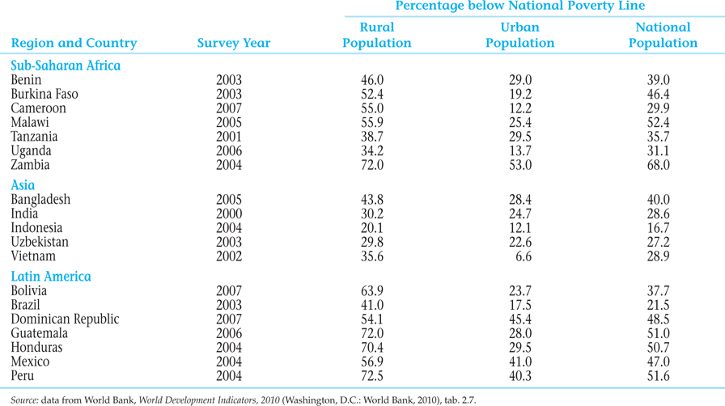
Poverty: Rural versus Urban

Slide 38
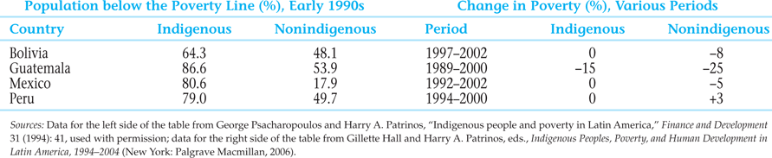
Indigenous Poverty in Latin America

Slide 39
V. Policy options on income inequality and poverty
Areas of Intervention:
Altering the functional distribution
Mitigating the size distribution
Moderating (reducing) the size distribution at upper levels
Moderating (increasing) the size distribution at lower levels
Notes:
Altering the Functional Distribution: This involves changing the distribution of income before taxes and transfers, primarily through interventions in labor markets and capital markets. Strategies may include:
Promoting education and skills training: These efforts can help equip workers with the skills they need to compete for higher-paying jobs.
Strengthening labor market institutions: This can include measures such as supporting unions, promoting collective bargaining, and enforcing minimum wage laws.
Regulating financial markets: This can help ensure that capital returns are not excessively concentrated among a small segment of the population.
Mitigating the Size Distribution: This involves redistributing income through taxes and transfers. Strategies may include:
Progressive taxation: This involves taxing higher incomes at higher rates, which can help reduce income inequality.
Transfer programs: These can include things like welfare payments, unemployment insurance, and child benefits, which can help lift individuals and families out of poverty.
Moderating the Size Distribution at Upper Levels: This involves reducing the concentration of wealth at the top of the income distribution. This can be achieved through strategies such as:
Wealth taxation: Taxes on wealth, such as property taxes or inheritance taxes, can help reduce wealth concentration.
Regulating executive compensation: This can help ensure that income is not excessively concentrated among top executives.
Promoting corporate governance reforms: This can help ensure that profits are shared more equitably among all stakeholders, not just shareholders.
Moderating the Size Distribution at Lower Levels: This involves increasing income at the bottom of the distribution. Strategies may include:
Minimum wage laws: These can help ensure that workers earn a living wage.
Social protection programs: These can help protect vulnerable groups from falling into poverty.
Promoting inclusive growth: This involves promoting economic policies that ensure the benefits of growth are shared widely, rather than concentrated among a small segment of the population.

Slide 40
Policy options
Changing relative factor prices
Progressive redistribution of asset ownership
Progressive taxation
Transfer payments and public provision of goods and services
Notes:
1. **Changing Relative Factor Prices:** This policy seeks to alter the prices of the factors of production (e.g., labor, capital) in a way that benefits the less advantaged. For instance, increasing the wages for low-skilled work could help lift workers out of poverty. This could be achieved through minimum wage laws, collective bargaining, or other labor market interventions. However, care must be taken to avoid unintended consequences, such as job losses if wages are set too high.
2. **Progressive Redistribution of Asset Ownership:** This policy is about redistributing assets (e.g., land, capital) from the rich to the poor. This could be done through land reform programs, worker ownership or co-op initiatives, or policies encouraging broader stock ownership. The idea is to give the less advantaged a stake in the economy and a source of wealth and income.
3. **Progressive Taxation:** Progressive tax systems tax higher incomes at higher rates. This can help redistribute income from the rich to the poor and reduce income inequality. In addition, wealth taxes, inheritance taxes, or capital gains taxes can be used to reduce the concentration of wealth.
4. **Transfer Payments and Public Provision of Goods and Services:** Transfer payments, such as welfare benefits, unemployment insurance, and pensions, can provide a safety net for the less advantaged. The public provision of goods and services, such as education, healthcare, and housing, can also play a crucial role. By providing these goods and services publicly, governments can ensure that everyone has access to them, regardless of income.
While each of these policy options can play a role in addressing income inequality and poverty, they each have potential drawbacks and trade-offs. Therefore, it's important for policy makers to carefully consider the implications and potential unintended consequences of each policy.

Slide 41
Case Study: Ghana and Cote dIvoire
Ghana and Cote d’Ivoire
Land area: 92,456 and 124,502 sq miles.
Population in 2012: 25.5 and 20.6 millions.
Colonial history: 1821-1957 by Britain and 1842-1960 by France.
Poverty and human development in 1990: 0.393 and 0.360
Poverty and human development in 2013: 0.558 and 0.432
GDP in 1960: $594 and $ 1675
GDP in 2007: $1653 and $2228
Life expectancy in 1960: 46 and 51
Life expectancy in 2012: 64 and 55
Poverty in 1987: 46.51% and 3.28%
Poverty in 2006: 28.6% and 23.8%

Slide 42
Case Study: Ghana and Cote dIvoire
Ghana and Cote d’Ivoire
Colonial impact and the legacy of institutions
Institutional quality
Ethnoliguistic fractionalization
Population
Extreme inequality
Common law vs civil law
French vs British rule
Education
Development policies

