Slide 1
International Economic Development
ECON 4660/8666
Lecture 5. Population

Slide 2
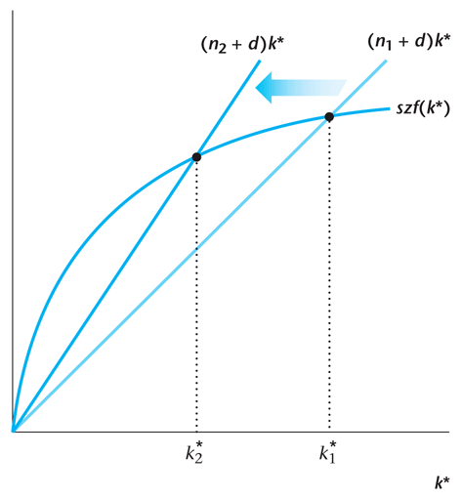
Population growth and economic growth

Slide 3
Aging population and pension
Overlapping Generations Model
Each agent lives two periods: Young and Old
In any period, there are people of different generations alive
Population Evolution:
N’ = N(1 + n)

Slide 4



pay tax, t
young (size ${(1+n)}^{3}$)
young (size ${(1+n)}^{2}$)
old (size ${(1+n)}^{2}$)
young (size 1+n)
old (size 1+n)
old (size 1)
collect benefit, b
T
T+1
T+2
T+3

Slide 5
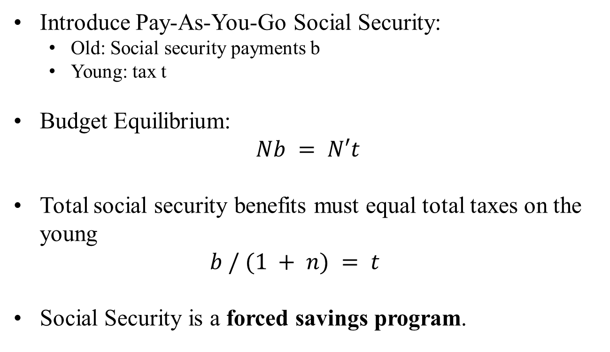
Aging population and pension

Slide 6
Aging population and pension
When Pay-As-You-Go Social Security was introduced, The First Generation of Old Consumer clearly benefited from the program:
they did not pay taxes when they were young
they now have an additional source of income
For everyone else, the effect on welfare is less obvious
Notes:
**Pay-As-You-Go (PAYG) Social Security System**
**1. Definition:**
The "Pay-As-You-Go" or "PAYG" social security system is a type of social insurance scheme where current workers finance the benefits of current retirees. In essence, today's workers pay for today's retirees, and when today's workers retire themselves, the next generation of workers will pay for them.
**2. How it Works:**
- In a PAYG system, workers pay social security taxes or similar contributions.
- These funds are not saved or invested for future retirees but are directly transferred to current retirees as their pension.
- When the workers retire, they expect a similar support from the next generation of workers.
**3. Advantages:**
- **Simplicity and Directness:** The PAYG system doesn't require intricate investment strategies or fund management.
- **Economic Stimulus:** As retirees often spend their pensions on consumption, this can drive economic activity.
- **Addresses Population Imbalances:** In its early stages, the system can be more efficient when there are fewer retirees and many workers.
**4. Disadvantages:**
- **Risk of Aging Population:** The system can run into funding issues when the number of workers decreases and the number of retirees increases.
- **Dependence on Future Workers:** The PAYG system is highly dependent on future workers and their contributions.
- **Potential Political Risks:** Policymakers might increase tax rates or decrease benefits to ensure the system's continuity.
**5. Conclusion:**
The PAYG social security system is the cornerstone of social security systems in many countries. However, with aging populations in many parts of the world, the sustainability of this system is being questioned. To ensure its long-term viability, many countries are considering reforms to their social security systems, including introducing capitalized elements where part of the funds are invested and earn returns for future retirees.

Slide 7
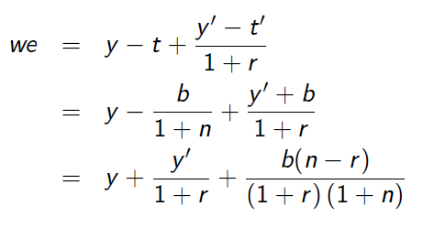
Aging population and pension
Lifetime wealth of the consumer:

Slide 8
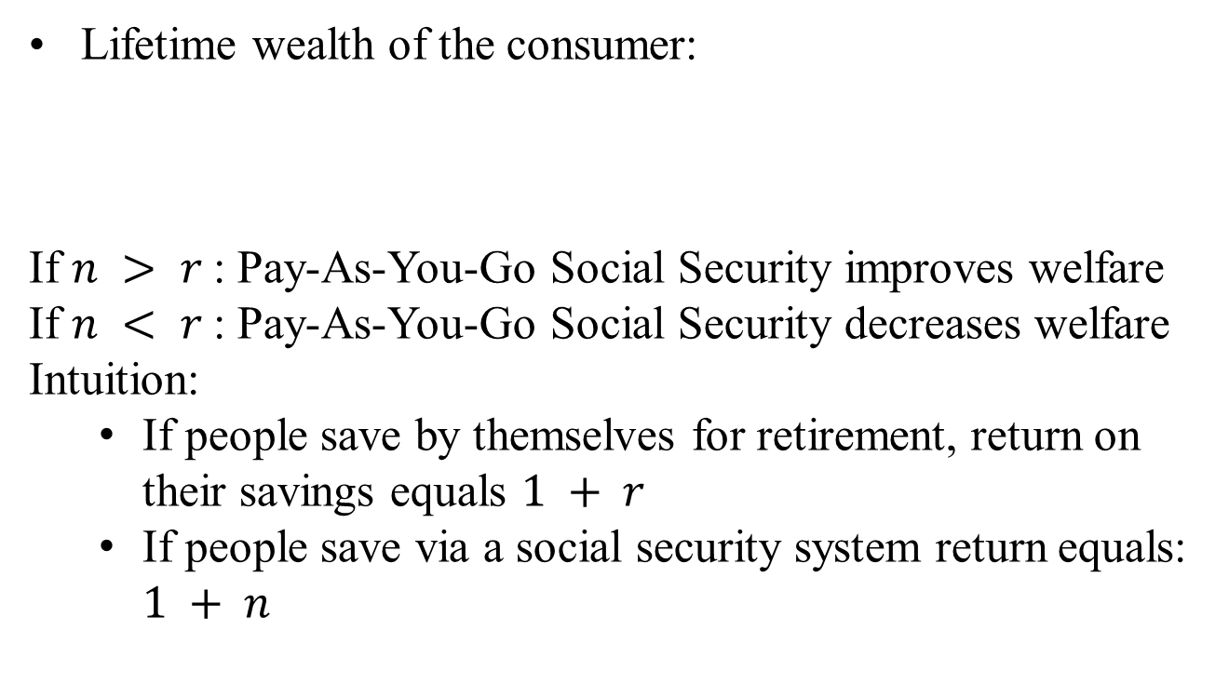

Aging population and pension

Slide 9
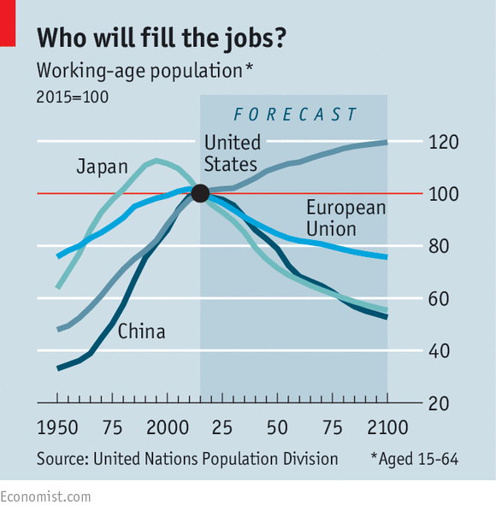
Vanishing workers
http://www.economist.com/news/finance-and-economics/21702477-can-debt-fuelled-model-growth-cope-ageing-populations-vanishing

Slide 10


Demographic Measures
Birth rate ( crude birth rate ) : Birth per thousand of population.
Death rate ( crude death rate ) : deaths per thousand of population.
The rate of natural increase: Birth rate – Death rate
Example: 99 million at the start
5 million births
3 million deaths
101 million at the end

Slide 11




Years required to double population:
Example: growth rate 2%.
Infant death rate: deaths in the first year of life per thousand live births.
Example: 10,000 born
1,000 deaths before birthdays

Slide 12
Rate of Natural Increase in Population
Country | 2005- 2010 | 2010- 2015 | Country/ region | 2005- 2010 | 2010- 2015
Hungary | -0.4 | -0.2 | UK | 0.2 | 0.6
Japan | -0.1 | -0.1 | USA | 0.6 | 0.9
Sweden | 0.2 | 0.6 | China | 0.7 | 1.2
Germany | -0.2 | -0.2 | Russia | -0.4 | -0.1
India | 1.4 | 1.3 | Hong Kong | 0.2 | 1.0
France | 0.4 | 0.5 | Mexico | 1.4 | 1.1
Iraq | 3.1 | 3.1 | Yemen | 4.7 | 3.0
Afghanistan |  | 3.1 | Malawi |  | 3.2
Sources：United Nation: Human Development Report 2009，2011

Slide 13
China’s population increased rapidly beginning from the Ching Dynasty
In 2010
In the late 1970th ，one-child policy
near 1.4 billion
In 1970
economic development
government’s encouragement
830 million
In middle of 19th century
430 million
In middle of 17th century
160 million

Slide 14
The Population in China 1–2008
(Unit:1000s)
year (AD) | Western Europe | China | Other | Total Asia (excluding ) | World | /World (%)
1 | 24700 | 59600 | 36600 | 171200 | 230820 | 25.82
1000 | 25413 | 59000 | 41400 | 175400 | 267573 | 22.05
1300 | 58353 | 100000
1400 | 41500 | 72000
1500 | 57268 | 103000 | 55400 | 268400 | 438428 | 23.49
1600 | 73778 | 160000 | 65000 | 360000 | 556148 | 28.77
1700 | 81460 | 138000 | 71800 | 374800 | 603490 | 22.87
1820 | 133040 | 381000 | 89400 | 679400 | 1041834 | 36.57
1870 | 187504 | 358000 | 119792 | 730792 | 1271915 | 28.15
1913 | 260975 | 437140 | 184849 | 925689 | 1791091 | 24.41
1950 | 304941 | 546815 | 392827 | 1298642 | 2524324 | 21.66
1973 | 358825 | 881940 | 677613 | 2139553 | 3916489 | 22.52
2001 | 392101 | 1275392 | 1227630 | 3526612 | 6149006 | 20.74
2007 |  | 1318000 | 1560100 | 4010000 | 6625000 | 19.89
2008 |  | 1324655 |  |  | 6697254 | 19.78
Sources: Maddison, Angus;
The World Economy: A Millennial Perspective Table 1–8a.
Notes:
The population decline from 1300 to 1400, particularly in China, was largely driven by a combination of major historical events, natural disasters, and social upheavals. Several key factors contributed to this population decline:
### 1. **The Black Death (Plague)**
- While the Black Death is often associated with Europe, its effects were felt across the entire Eurasian continent, including China. The plague spread along the Silk Road, with estimates suggesting that it significantly impacted population centers in China during the 14th century. Some sources estimate that China lost up to **25 to 50 percent** of its population during this time due to the plague.
### 2. **Mongol Rule and Decline**
- The **Mongol Empire**, particularly under the Yuan Dynasty in China, controlled much of Asia during the 13th and early 14th centuries. However, by the mid-14th century, the empire began to weaken, and the Yuan Dynasty faced severe internal problems, including corruption, rebellion, and economic instability.
- The decline of Mongol control led to widespread **civil unrest** and **rebellions**, culminating in the **Red Turban Rebellion** (1351–1368), which was instrumental in overthrowing the Yuan and establishing the **Ming Dynasty**. The civil wars and rebellions further exacerbated population losses.
### 3. **Famine and Natural Disasters**
- Natural disasters such as **droughts, floods**, and **famine** were frequent in 14th-century China. The Yellow River frequently flooded, displacing large numbers of people and destroying agricultural land. In particular, famines were exacerbated by the breakdown of governmental infrastructure during the fall of the Yuan Dynasty.
- Poor harvests and food shortages worsened the already challenging conditions, leading to widespread starvation and a further reduction in the population.
### 4. **Political Instability**
- The Yuan Dynasty, controlled by the Mongols, struggled to maintain its grip on China. Ethnic tensions between the ruling Mongols and the Chinese population increased, and the widespread corruption and mismanagement of the Yuan court led to rebellion.
- The transition from the Yuan to the **Ming Dynasty** was marked by decades of warfare and destruction, contributing to population loss through violence, forced migration, and disruption of agricultural production.
### Population Impact:
The combined effects of the **plague**, **natural disasters**, **political upheaval**, and **civil wars** led to a significant decline in China's population between 1300 and 1400. While exact figures are difficult to determine, some estimates suggest that China’s population might have been reduced by up to **40 million people** during this century, falling from an estimated **120-130 million in 1300** to **about 80-90 million by 1400**.
This decline was part of a broader trend of population loss across the globe, particularly in Eurasia, where the Black Death and related crises had a devastating impact.

Slide 15
Proportion of the Population Age 65 or over (1950-2100)
 | China | India | Japan | UK | USA | Russia
1950 | 4.512 | 3.137 | 4.947 | 10.832 | 8.265 | 6.186
1970 | 4.025 | 3.251 | 7.032 | 13.028 | 9.836 | 7.689
1990 | 5.942 | 3.786 | 11.948 | 15.703 | 12.489 | 10.200
2000 | 7.006 | 4.230 | 17.182 | 15.810 | 12.380 | 12.407
2010 | 8.189 | 4.922 | 22.687 | 16.588 | 13.059 | 12.799
2020 | 11.992 | 6.306 | 28.390 | 18.713 | 16.213 | 15.211
2030 | 16.470 | 8.271 | 30.282 | 21.113 | 19.907 | 19.137
2035 | 20.209 | 9.368 | 31.607 | 22.429 | 20.598 | 19.407
2040 | 23.300 | 10.545 | 33.803 | 23.030 | 20.912 | 20.117
2060 | 29.474 | 16.732 | 35.067 | 25.104 | 21.917 | 24.787
2065 | 30.223 | 18.212 | 34.488 | 25.546 | 22.118 | 23.391
2070 | 30.241 | 19.542 | 33.743 | 25.800 | 22.598 | 22.399
2075 | 30.185 | 20.848 | 33.017 | 26.320 | 23.200 | 22.374
2080 | 30.080 | 22.048 | 32.546 | 26.699 | 23.716 | 22.830
2085 | 29.670 | 23.109 | 32.180 | 27.003 | 24.254 | 23.273
2090 | 29.121 | 24.016 | 31.893 | 27.279 | 24.785 | 23.353
2095 | 28.617 | 24.779 | 31.700 | 27.523 | 25.276 | 23.093
2100 | 28.222 | 25.423 | 31.600 | 27.711 | 25.772 | 22.922

Slide 16
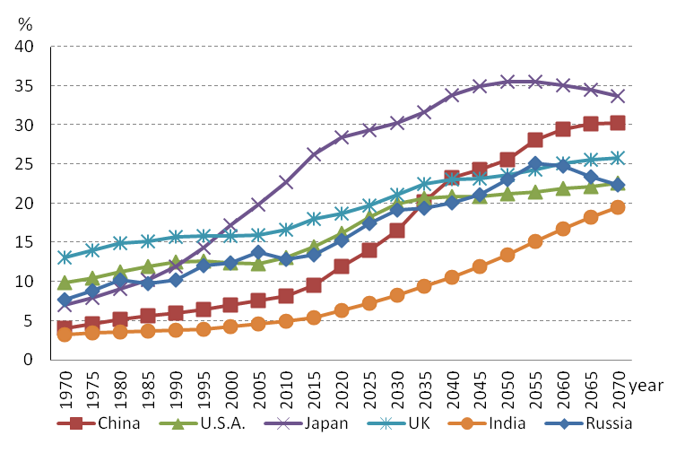
The Trend of Population above 65 for Selected Countries (1970-2070)

Slide 17
Life expectancy:
Number of additional years that the average person of a given age will live age – specific death rates remain unchanged.
Life expectancy at birth:
Number of years that an average new born person will live.
Total Fertility rate:
Number of children the average woman will have in her lifetime. Age - specific fertility rate.

Slide 18
II. World population growth through history
Year | Estimated population (in millions) | Estimated Annual growth rate(%)
10,000 B.C | 5
1650 | 545 | 0.04
1850 | 1,171 | 0.53
1900 | 1,608 | 0.65
1950 | 2,576 | 0.91
1970 | 3,698 | 2.09
1980 | 4,448 | 1.76
1990 | 5,292 | 1.73
2000 | 6,260 | 1.70

Slide 19
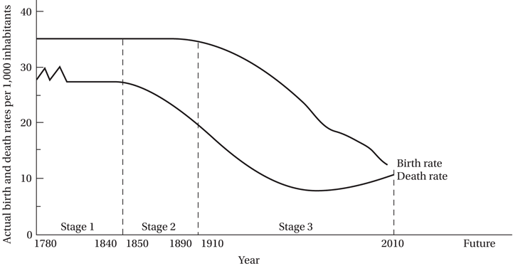
The demographic transition:
The process by which fertility rates eventually decline.
Stage I: high birth rate, high death rate.
Stage II: beginning of the transition.
Stage III: decline in the birth rate.
Stage IV: population growth zero/negative.
Notes:
Stage I: High Birth Rate, High Death Rate
Characteristics:
Both birth and death rates are high, so the population size remains fairly stable but can have minor fluctuations.
High birth rates due to lack of family planning, cultural factors, and economic benefits of having more hands to work.
High death rates due to diseases, famine, lack of clean water and sanitation, lack of healthcare.
Examples: Pre-industrial societies, few countries are in this stage today.
Stage II: Beginning of the Transition
Characteristics:
Death rates begin to fall rapidly, but birth rates remain high, leading to a surge in population.
Improvements in healthcare, sanitation, and food supply lead to reduced mortality.
Birth rates remain high due to cultural values and lack of access to family planning.
Examples: Many sub-Saharan African countries are currently in this stage.
Stage III: Decline in the Birth Rate
Characteristics:
Birth rates start to decline, but the population continues to grow because the base number of young people is already large.
The decline in birth rate can be attributed to increased access to contraception, improved status and education of women, urbanization, and the desire for smaller families.
Death rates continue to fall, but at a slower rate than in Stage II.
Examples: Countries like India and Brazil have characteristics of this stage.
Stage IV: Population Growth Zero/Negative
Characteristics:
Both birth and death rates are low, leading to an aging population and, in some cases, a shrinking population.
Birth rates are low due to urbanization, greater access to contraception, and shifts in values where smaller families are preferred.
Death rates are low due to advanced healthcare facilities and better living conditions.
Examples: Many developed countries, such as Japan, Germany, and Italy, are in this stage.

Slide 20
III. Theory of Population Growth
A. Multhus’ population trap: “Essay on the Principle of Population”, 1798.
The passion between the sexes would cause population to expand as long as food supplies permitted. Population would grow at a geometric rate.
Land is fixed, marginal product of labor will decrease. Food would grow at an arithmetic rate.
c. Low income and a stable population growth.
Famines, wars, and epidemics reduce population.
“positive check”
A later marriage, “preventive check”
He was a minister, did not mention birth control, did mention “moral restraint”.

Slide 21
Higher population growth, the higher is per-capita consumption.
Birth rate increases with consumption per capita
people will have more children by choice.
better nutrition increases fertility.
Death rate decreases with consumption per capita
decreases infant mortality.
population healthier, increasing the average lifespan.

Slide 22
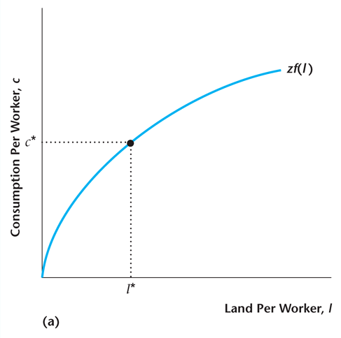
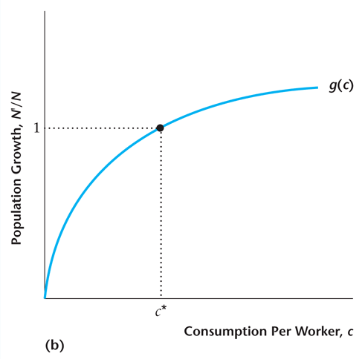
Determination of the Steady State in the Malthusian Model

Slide 23
If z increases, this shifts up the per-worker production function.
In the long run, the population increases to the point where per capita consumption returns to its initial level.
There is no long-run change in living standards.

Slide 24
High yield,
more food,
Higher living standard,
z increases
more food,
higher population growth,
Less land per capita,
Lower yield per capita

Slide 25
Criticisms of the Malthusian Model
Impact of technological progress
Currently no positive correlation between population growth and levels of per capita income in the data
Microeconomics of family size; turns focus to individual rather than aggregate variables
Notes:
Over time, various criticisms have been leveled against the Malthusian model:
1. Impact of Technological Progress:
Malthus did not anticipate the scale and impact of technological and agricultural innovations in increasing food production.
Green Revolution: In the 20th century, the introduction of high-yield crop varieties, synthetic fertilizers, and improved irrigation techniques significantly boosted food production in many parts of the world.
Technological Advancements: Innovations in transportation, refrigeration, and other technologies have made it easier to distribute food more efficiently and reduce wastage.
Biotechnology: Genetic modification and other biotechnological advancements have further enhanced crop yields and resistance to pests and diseases.
2. No Positive Correlation Between Population Growth and Levels of Per Capita Income:
Counterexamples: Many countries with high population growth in the 20th century, like China and India, have seen significant economic growth and rises in per capita income. Conversely, some countries with low or negative population growth have faced economic stagnation.
Role of Institutions: Modern economists argue that the quality of institutions—like rule of law, property rights, and effective governance—play a more significant role in determining economic outcomes than just population growth.
Human Capital: An increasing population, when equipped with education and training, can lead to a "demographic dividend" where the workforce grows faster than the dependent population, leading to rapid economic growth.
3. Socio-cultural Changes:
Malthus did not anticipate socio-cultural changes that would influence birth rates. With urbanization, increased education, especially of women, and the availability of contraceptives, birth rates in many parts of the world have declined significantly.
4. Adaptability of Humans:
Humans have shown a remarkable ability to adapt to changing circumstances. Whether through migration, changes in dietary habits, or other social adjustments, societies have managed to stave off the kind of Malthusian crises that the model predicts.
5. Overemphasis on Food:
While Malthus focused primarily on food, he did not consider other resources that might become scarce with overpopulation, nor did he consider the impact of overconsumption on the environment.

Slide 26
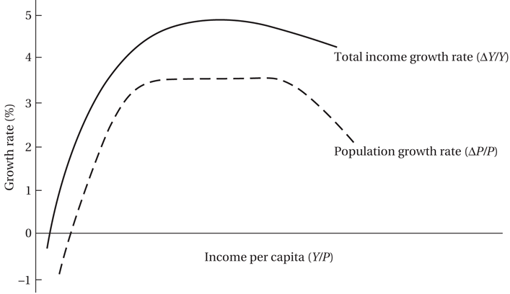
How Technological and Social Progress Allows Nations to Avoid the Population Trap

Slide 27
B. Becker’s “New Household Economics”
People are rational.
Children are durable consumption goods.
Couples maximize utility by choosing quantity of children.
Utility depends on :
number of children,
quality of each child.
cost: time spent on rearing children.
some argued that parents’ utility is equal to the worst child’s utility.
Notes:
People are Rational:
This is a fundamental assumption in many economic models. In the context of household decisions, Becker posits that individuals and families make choices that maximize their utility or happiness, given their constraints (like income and time).
Decisions about marriage, having children, and investing in their education are all made by weighing the benefits against the costs, just as one might decide to buy a car or take a job.
Children as Durable Consumption Goods:
This is a provocative way to think about children. In traditional economic terms, a "durable good" is something that provides utility over a long period, like a house or a car.
In Becker's view, children provide utility to their parents in many ways: they offer companionship, they might provide economic support in old age, and they carry on the family's legacy. But they also come with costs: they require time, money, and other resources.
Importantly, children differ from typical consumption goods because they also provide "psychic income" — non-tangible benefits like love, joy, and fulfillment.
Couples Maximize Utility by Choosing Quantity of Children:
According to Becker, couples decide on the number of children in much the same way they might decide on how many cars to buy or how large a house to purchase. They consider their budget (both in terms of money and time) and choose the number of children that maximizes their utility.
This decision is also influenced by the "price" of children in terms of direct costs (like food, clothing, and education) and indirect costs (like foregone wages if a parent stays home from work). As the "price" of having more children rises, either due to increased economic costs or due to changes in societal norms and values, families may choose to have fewer children.
Becker's model also predicts that wealthier and more educated couples might choose to have fewer children but invest more in each child's education and well-being, a phenomenon observed in many developed countries.

Slide 28
The Microeconomic Household Theory of Fertility
The Demand for Children in Developing Countries
First two or three as “consumer goods”
Additional children as “investment goods”:
Work on family farm, microenterprise
Old age security motivation
Notes:
1. Children as “Consumer Goods”:
This perspective views the first two or three children as sources of immediate personal, emotional, or social satisfaction for the parents. These children are seen as:
Joy and Emotional Satisfaction: The intrinsic joy of parenthood, the happiness and love children bring into a family, are primary reasons for having kids, irrespective of any economic considerations.
Social Norms and Status: In many societies, having children is an expected social norm, and the inability or choice not to have children can sometimes lead to social ostracization or pity.
Cultural and Religious Imperatives: Some religious and cultural beliefs emphasize the importance of procreation, viewing children as blessings or gifts from the divine.
2. Additional Children as “Investment Goods”:
Beyond the immediate joy and social reasons, any additional children are often perceived from a more utilitarian perspective. They are seen as potential contributors to the family's economic well-being. In this context, children can be:
Labor Force in Agriculture: In agrarian societies, larger families mean more hands to work on the family farm. Children can help in sowing, harvesting, tending to livestock, and other agricultural activities, contributing directly to the family's livelihood.
Contributors to Family Microenterprises: In urban settings or areas with small family businesses, children might assist in family-run shops, crafts, or other microenterprises, either by directly working or by freeing up adult family members to work.
Old Age Security: In the absence of formal and reliable pension systems, parents often see children as a form of old-age insurance. They expect and rely on their children to take care of them financially and physically in their twilight years. This is particularly true in societies where institutional support systems for the elderly are weak or non-existent.
Reducing Mortality Risk: In areas with high child mortality rates, having more children is sometimes a strategy to ensure that some of them survive to adulthood.
Influence on Family Size Decisions:
The decision to have more children as "investment goods" can be influenced by various factors:
Economic Conditions: In harder economic times or in poorer regions, the perceived economic benefits of having more children might outweigh the costs.
Mortality Rates: As mentioned, higher child mortality rates can lead to larger family sizes.
Access to Education: Families with access to education, especially female education, often prioritize quality of life and have fewer children.
Access to Healthcare and Family Planning: Availability of and knowledge about contraceptives and reproductive health can influence family size decisions.

Slide 29
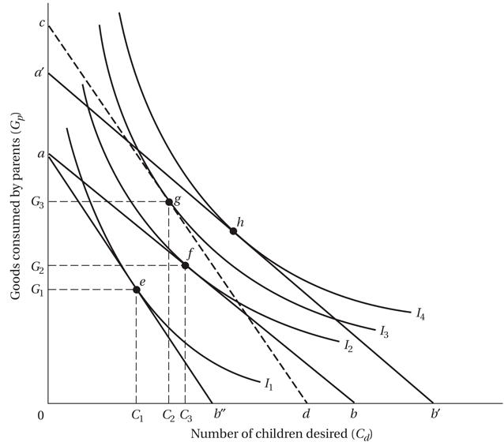
Microeconomic Theory of Fertility: An Illustration

Slide 30
Demand for Children Equation
where
C_{d} : is the demand for surviving children
Y : is the level of household income
P_{c} : is the “net” price of children
P_{x} : is price of all other goods
t_{x} : is the tastes for goods relative to children

Slide 31
The higher the household income, the greater the demand for children.
The higher the net price of children, the lower the quantity demanded.
The higher the prices of all other goods relative to children, the greater the quantity of children demanded.
The greater the strength of tastes for goods relative to children, the fewer children demanded.

Slide 32
Lessons from Microeconomic Household Models
Fertility may be lowered with:
Improved women’s education, role, and status
Female nonagricultural wage employment
Rise in family income levels through shared growth
Reduction in infant mortality, better health care
Development of old-age and social security plans
Expanded schooling opportunities, lowered real costs
Lowered prices and better information on contraceptives
Direct incentives such as subsidy benefits
Policies that have the effect of reducing boy preference
The above list provides a framework for policy.

Slide 33
Some conflicting perspectives
Population growth: “It’s Not a Real Problem”:
The real problem is not population growth but the following,
Underdevelopment
World resource depletion and environmental destruction
Population Distribution
Subordination of women
“Overpopulation is a Deliberately Contrived False Issue”
“Population Growth is a Desirable Phenomenon”
Notes:
Population growth: “It’s Not a Real Problem”: This perspective argues that the sheer number of people in the world isn't the core problem. Instead, other interconnected issues are of primary concern.
Underdevelopment.
World resource depletion and environmental destruction.
Population Distribution.
Subordination of women.
“Overpopulation is a Deliberately Contrived False Issue”: This perspective suggests that concerns about overpopulation are exaggerated or manufactured, perhaps to divert attention from other pressing issues or to serve particular political or economic agendas. By focusing on overpopulation, blame might be shifted onto specific regions or groups, rather than addressing broader systemic or structural issues.
“Population Growth is a Desirable Phenomenon”: This perspective views population growth in a positive light, suggesting that a growing population can lead to a larger workforce, greater innovation, and economic growth. Historically, many nations have encouraged population growth to increase their geopolitical influence, boost the economy, or address labor shortages.

Slide 34
Some conflicting perspectives
“Population Growth Is a Real Problem”
Extremist arguments
Theoretical arguments
Empirical arguments
Lower economic growth
Poverty
Adverse impact on education
Adverse impact on health
Food constraints
Impact on the environment
Frictions over international migration
Notes:
“Population Growth Is a Real Problem”: This overarching perspective asserts that increasing population numbers pose significant challenges for societies, economies, and the environment.
Extremist arguments: These are arguments that often paint a very dire or bleak picture of the consequences of population growth, sometimes even suggesting drastic measures to control it. Think of the "Malthusian catastrophe" idea where unchecked population growth leads to resource depletion and subsequent societal collapse.
Theoretical arguments: These are rooted in formal academic theories and models. For instance, in economics, there's the idea that rapid population growth might dilute capital, meaning there's less capital (like machinery or infrastructure) available per worker, leading to decreased productivity and economic growth.
Empirical arguments: These are based on observed data and real-world examples. For instance, examining countries with rapid population growth and noting correlations with certain challenges like strained healthcare systems or increased unemployment.
Lower economic growth: The argument here is that rapid population growth can lead to reduced GDP per capita growth. More people might mean a larger workforce, but without corresponding opportunities and resources, it can lead to unemployment, underemployment, and increased poverty.
Poverty: Rapid population growth can strain limited resources, leading to increased poverty levels, especially if the economy cannot grow quickly enough to accommodate the increased population.
Adverse impact on education: With more children and not enough educational infrastructure or resources, it can lead to overcrowded classrooms, reduced quality of education, and higher dropout rates.
Adverse impact on health: Healthcare systems can become overwhelmed with rapid population growth, leading to reduced quality of care, longer waiting times, and increased disease spread.
Food constraints: More people require more food. Rapid population growth can strain agricultural systems, leading to food scarcity, increased prices, and malnutrition.
Impact on the environment: Larger populations can lead to increased waste, pollution, and deforestation. Overpopulation can strain water resources, lead to loss of biodiversity, and exacerbate climate change.
Frictions over international migration: As populations grow and resources become scarce, there might be increased migration to countries with better opportunities. This can lead to geopolitical tensions, cultural clashes, and issues related to refugee and migrant integration.

Slide 35
Toward a Consensus
Despite the conflicting opinions, there is some common ground on the following:
Population is not the primary cause of lower living levels, but may be one factor
Population growth is more a consequence than a cause of underdevelopment
It’s not numbers but quality of life
Market failures: potential negative social externalities
Voluntary decreases in fertility is generally desirable for most developing countries with still-expanding populations
Notes:
Population is not the primary cause of lower living levels, but may be one factor: While a growing population can strain resources and services, it's not the sole determinant of living standards. Economic policies, governance, technology, infrastructure, and global trade dynamics play pivotal roles in determining living standards.
Population growth is more a consequence than a cause of underdevelopment: This perspective argues that underdevelopment can lead to higher population growth rates. Factors like lack of access to education (especially for women), inadequate healthcare and family planning services, and cultural norms valuing larger families can lead to higher birth rates in underdeveloped regions.
It’s not numbers but quality of life: The focus shouldn't be solely on controlling population numbers but ensuring a good quality of life for all. This includes access to education, healthcare, clean water, food, and opportunities for economic advancement.
Market failures: potential negative social externalities: Unchecked population growth can lead to social externalities or unintended consequences that aren't addressed by the market. For instance, overpopulation can lead to environmental degradation, which affects everyone, not just those contributing to population growth.
Voluntary decreases in fertility is generally desirable for most developing countries with still-expanding populations: The key word here is "voluntary." Many experts believe that it's beneficial for developing nations to reduce fertility rates, but it should be achieved through education, access to family planning, and empowerment of women rather than coercive measures. Lower fertility rates can lead to a "demographic dividend" where the working-age population is larger relative to the young and elderly, potentially spurring economic growth.

Slide 36
IV. Some policy approach
What Developing Countries Can Do
Persuasion through education
Family planning programs
Address incentives and disincentives for having children through the principal variables influencing the demand for children
Coercion is not a good option
Raise the socioeconomic status of women
Increase employment opportunities for women (increases opportunity cost of having more children, as in microeconomic household theory)
Help facilitate genuine and faster development of developing countries that still have high fertility rates
Notes:
Persuasion through education:
Rationale: Education, especially of young girls and women, is one of the most effective ways to reduce fertility rates. An educated woman is more likely to have fewer children because she tends to marry later and prioritize her own education and career.
Implementation: Governments can invest in building schools, training teachers, and ensuring free or affordable education for all, with an emphasis on female education.
Family planning programs:
Rationale: Access to contraception and reproductive health services enables couples to decide the number and spacing of their children.
Implementation: This can be achieved by increasing the budget for health services, ensuring widespread distribution of contraceptives, and running awareness campaigns.
Address incentives and disincentives for having children:
Rationale: Cultural, economic, and social factors play a role in the decision to have more children. By understanding and addressing these factors, governments can influence family size decisions.
Implementation: This could include social security systems that don't rely on having many children to care for parents in old age, or promoting the benefits of smaller family sizes.
Coercion is not a good option:
Rationale: History has shown that coercive measures, like forced sterilizations or one-child policies, can lead to human rights abuses and unintended demographic problems.
Implementation: Policies should focus on choice and empowerment rather than force.
Raise the socioeconomic status of women:
Rationale: Empowered women tend to have fewer children as they are more likely to be informed about family planning and can make independent decisions.
Implementation: This can be achieved by enforcing laws that protect women's rights, promoting female entrepreneurship, and ensuring equal opportunities in all sectors.
Increase employment opportunities for women:
Rationale: When women work, the opportunity cost of having more children increases, leading to smaller families. This is a concept rooted in microeconomic household theory.
Implementation: Governments can create policies that encourage businesses to hire women, offer maternity benefits, and ensure safe workplaces.
Help facilitate genuine and faster development:
Rationale: As countries develop, fertility rates naturally decline. This phenomenon, known as the demographic transition, suggests that with industrialization and urbanization, birth rates drop.
Implementation: By focusing on overall economic development, improving infrastructure, and fostering industries, countries can accelerate their demographic transition.

Slide 37
What the Developed Countries Can Do Generally
Address resources use inequities
More open migration policies
How Developed Countries Can Help Developing Countries with Their Population Programs
Research into technology of fertility control
Financial assistance for family planning programs
Notes:
What the Developed Countries Can Do Generally:
Address Resource Use Inequities:
Rationale: Developed countries, while having a smaller population compared to developing countries, often have a disproportionately high consumption rate. This high per capita consumption leads to resource depletion and environmental degradation at a global scale.
Implementation: Implementing sustainable consumption practices, investing in green technologies, recycling, and waste management can reduce the ecological footprint. Policies promoting sustainable agriculture, fisheries, and forestry can also address resource inequities.
More Open Migration Policies:
Rationale: Migration can alleviate some of the pressures of overpopulation in developing countries. Moreover, many developed countries with aging populations can benefit from younger immigrants who can contribute to the economy and support social security systems.
Implementation: Relaxing visa restrictions, offering work permits, creating integration programs for immigrants, and providing pathways to citizenship can foster more open migration. Collaboration between countries can also lead to well-structured migration agreements that benefit both parties.
How Developed Countries Can Help Developing Countries with Their Population Programs:
Research into Technology of Fertility Control:
Rationale: The need for safe, effective, and accessible fertility control methods is paramount in population management.
Implementation: Investing in research and development of new contraceptive methods, enhancing the efficiency of existing ones, and sharing this technology with developing nations can make a significant impact.
Financial Assistance for Family Planning Programs:
Rationale: Many developing countries lack the funds to run comprehensive family planning programs.
Implementation: Developed countries can allocate a portion of their foreign aid budget to support family planning initiatives in developing countries. This can be done directly or through international organizations like UNFPA (United Nations Population Fund). Additionally, Public-Private Partnerships can be encouraged where private entities contribute to these initiatives.
Capacity Building and Training:
Rationale: Simply providing resources might not be effective if there's a lack of trained professionals in developing countries.
Implementation: Organizing training programs for healthcare workers, counselors, and community leaders from developing countries can enhance the effectiveness of population programs. Collaboration between universities and institutions can also help in knowledge transfer.

Slide 38
Case Study: China and India
China and India are the world’s two most populous nations, with 1.4 and 1.3 billion people respectively.
It is projected that their population will be 1.28 and 1.64 billion in 2065.
Population policy in China
In 1980s, China initiated “one child policy”.
By the mid-1990s, China’s fertility rate reached 1.9 births per woman, and it fell further to below 1.6 by 2013.
It is estimated that in 2010, there were 106 males for every 100 females.
By 2050, China will have almost twice as many people above age 50 as below age 20.
Population policy in India
Prime Minister Indira Gandhi tried to implement drastic population control in 1975-1977, with little success.
However, family planning did become more widely practiced due to: rising income, policy incentive to encourage smaller family.
A preference for boys over girls developed, particularly in the “Hindi Belt”.

