Slide 1
International Economic Development
ECON 4660/8666
Lecture 6 Education

Slide 2
Human Capital
Human capital: the accumulated stock of skills and education that a worker has at a point in time.
  Human capital refers to the intangible assets of an individual, distinct from physical assets such as machinery or buildings.
  It is the collective sum of an individual's knowledge, skills, experiences, and abilities, which can be applied to produce economic value.
  Unlike physical capital which depreciates over time (e.g., machinery wearing out), human capital can appreciate with experience and further education.
7-<number>

Slide 3
Human Capital
It is an investment:
  just like investing in stocks or real estate, investing in human capital (through education, training, or acquiring new skills) can yield returns in the form of higher income, better job opportunities, or improved job performance.
The knowledge, the key input of human capital, is nonrivalry;
  A good is considered "nonrivalrous" when its consumption by one individual does not reduce its availability to others. In the context of knowledge, this means that when one person learns or acquires knowledge, it doesn't diminish the ability of others to learn or access that same knowledge.
Human capital investment has constant return to scale.
7-<number>

Slide 4
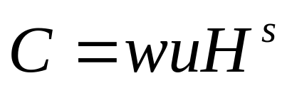
A simple model of human capital
Consumption is equal to total wage income.
7-<number>

Slide 5
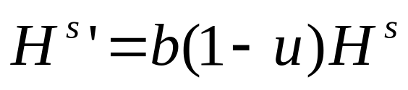
Human Capital Accumulation
Future human capital depends on current human capital and time devoted to training and education.
7-<number>

Slide 6

Production Function
7-<number>

Slide 7
Firm’s Profits
7-<number>

Slide 8
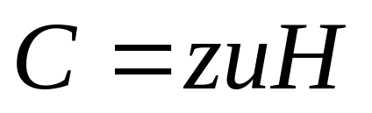
Equilibrium Consumption
7-<number>

Slide 9
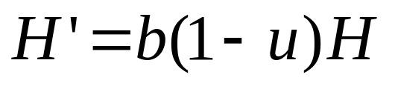
Human Capital Growth
Human capital evolves in equilibrium according to:
7-<number>

Slide 10
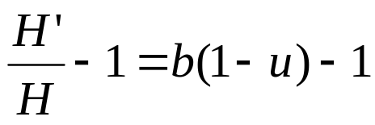
Equilibrium Human Capital Growth
Equilibrium growth rate of human capital:
7-<number>

Slide 11
Economic Policy and Growth
Change b:
  Make the education system more efficient.
  Provide incentive into the school system.
Change u:
  Provide taxes or subsidies to education
7-<number>

Slide 12
I. Education
Definition: All forms of human learning or narrowly, schooling.
  Education encompasses a wide range of learning experiences, from formal settings like schools and universities to informal settings like learning from experiences, mentorships, or self-study.
Some Facts
  Demand for education is high
  Education and income are positively related
    Additionally, a more educated workforce can drive innovation and productivity, leading to economic growth and, consequently, higher wages.
  Education expenditure is large in government budget. 5% GDP, world average

Slide 13
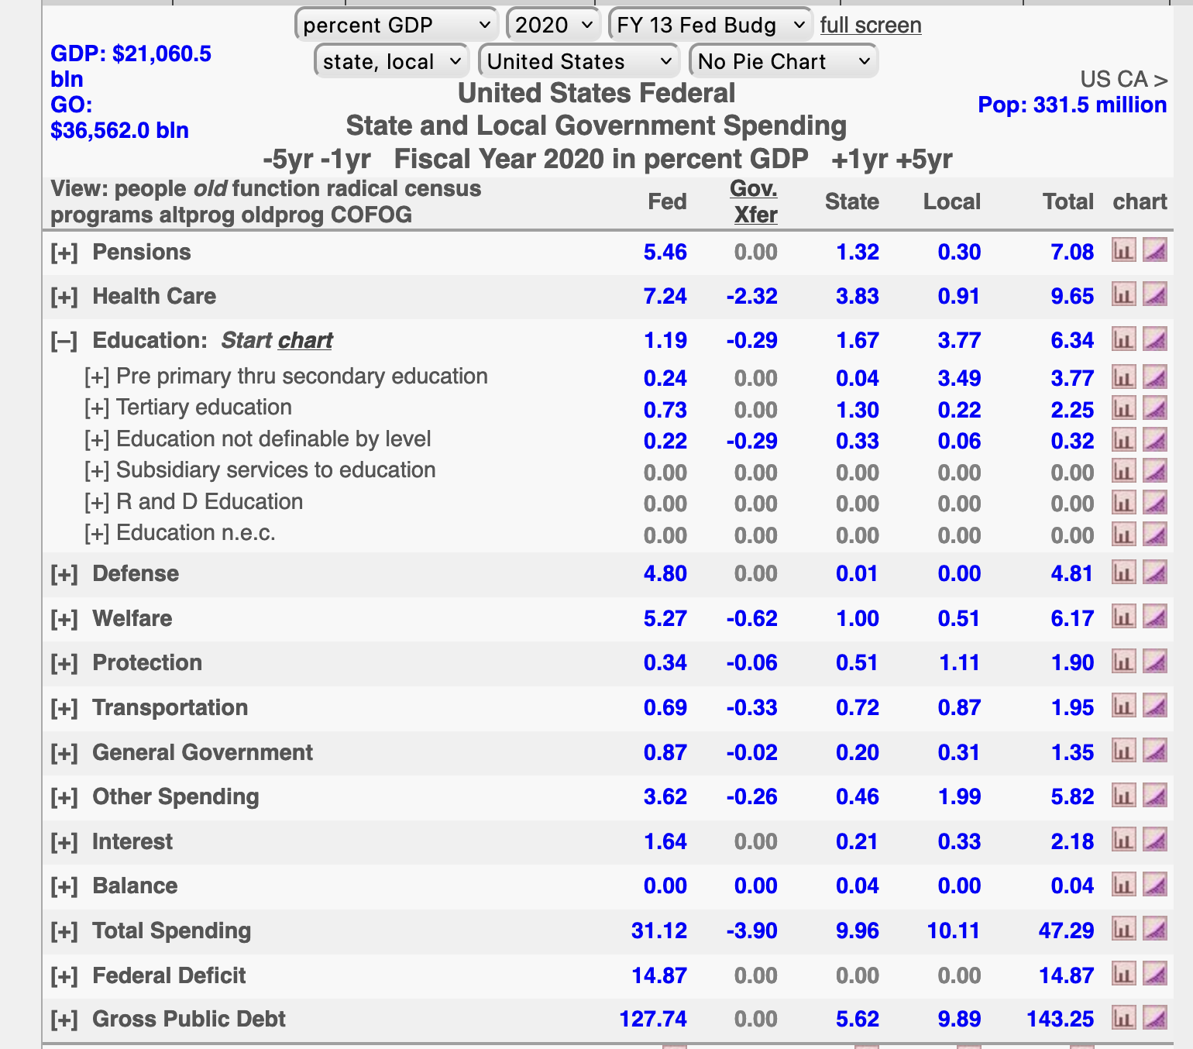
United States Federal, State and Local Government Spending

Slide 14
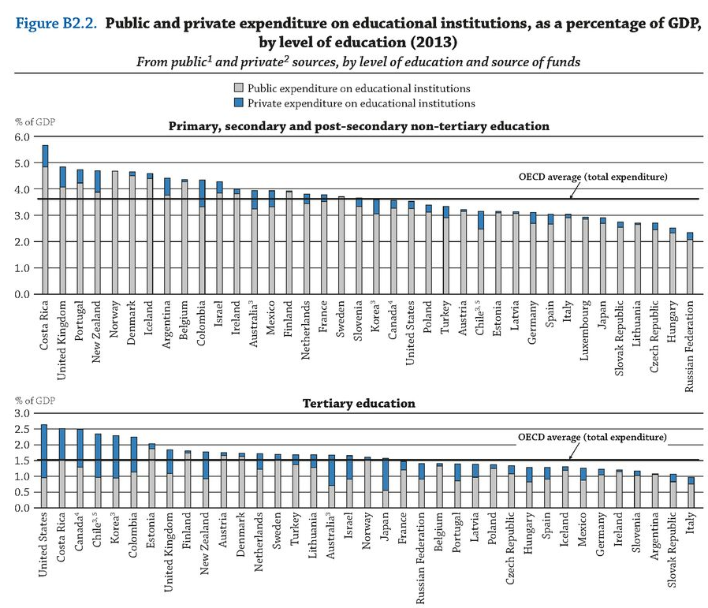

Slide 15
Public Spending on Educational Institutions
Primary Education:
  Typically, countries invest heavily in primary education, recognizing its foundational importance. It's not uncommon for countries, especially developing ones, to allocate a significant portion of their education budget to primary education.
  In many countries, public expenditure on primary education can range from 1% to 3% of GDP.
Secondary Education:
  Secondary education also receives significant investment, though the exact percentage can vary widely based on the country's education system structure and priorities.
  On average, countries might spend between 1% and 2.5% of their GDP on secondary education.
Tertiary Education:
  Public expenditure on tertiary education varies considerably across countries. In nations with publicly funded higher education systems, this percentage can be relatively high.
  On average, public expenditure on tertiary education can range from 0.5% to 1.5% of GDP, though this is a broad estimate. as a percentage of GDP by level of education

Slide 16
Private Spending on Educational Institutions
Primary Education:
  Private expenditure on primary education is generally lower than secondary and tertiary levels, especially in countries where primary education is predominantly publicly funded.
  It might range from 0.1% to 1% of GDP, with higher figures in countries with robust private primary education sectors.
Secondary Education:
  The private sector's role in secondary education varies by country. In some nations, private high schools or secondary institutions play a significant role.
  Private expenditure might range from 0.5% to 2% of GDP.
Tertiary Education:
  Tertiary education often sees a more substantial private sector role, especially in countries with private universities and colleges.
  Private expenditure on tertiary education can range widely, from 0.5% to 3% of GDP or even more, especially in countries where higher education is predominantly private.

Slide 17
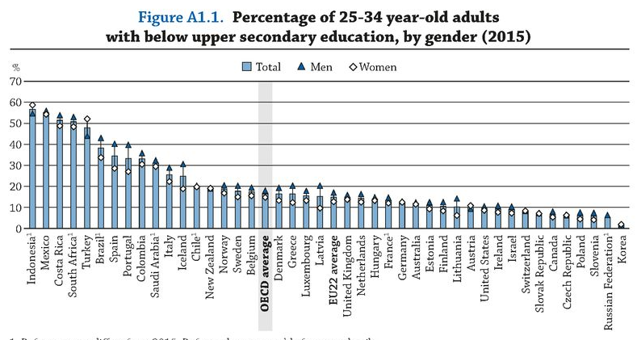

Slide 18
Percentage w/ Below Upper Secondary Education
Globally, there has been a trend of increasing educational attainment over the past few decades.
The increase in educational attainment can be attributed to factors such as global initiatives promoting education, increased investment in education by governments, and societal recognition of the importance of education.
By Gender:
  Males: In many regions, especially in developed countries, the percentage of young males with below upper secondary education has been decreasing. However, there can be disparities based on regions and individual countries. For example, in some areas, male dropout rates in secondary education might be higher, leading to a larger percentage with below upper secondary education.
  Females: Historically, in many parts of the world, females had lower educational attainment than males. However, there has been a significant push in recent decades to promote female education. As a result, in many countries, young females have caught up or even surpassed their male counterparts in terms of educational attainment. This trend means that in several regions, the percentage of young females with below upper secondary education has been decreasing at a faster rate than for males. However, disparities still exist in some areas due to cultural, societal, or economic factors.

Slide 19
Percentage w/ Below Upper Secondary Education
Regional Variations:
  The percentage of 25-34 year-olds with below upper secondary education can vary significantly by region.
  Developed countries: In many developed nations, the majority of this age group has at least an upper secondary education, with relatively small percentages not achieving this level.
  Developing countries: The picture can be more varied, with some nations seeing significant portions of this age group without upper secondary education, especially in regions where access to secondary education is still a challenge.

Slide 20
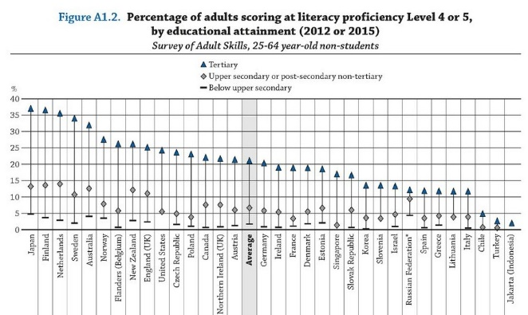

Slide 21
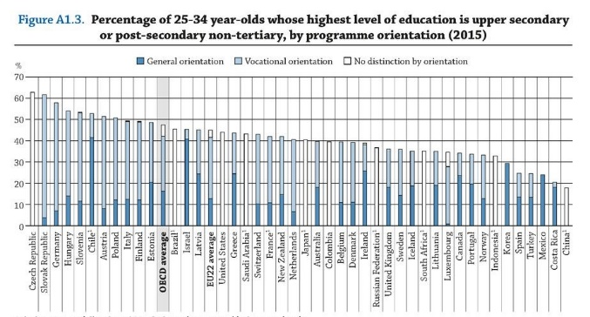

Slide 22
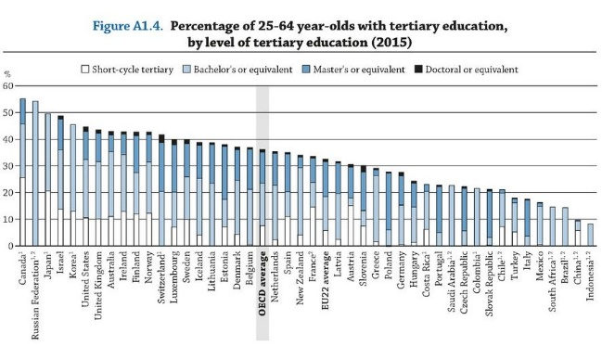

Slide 23
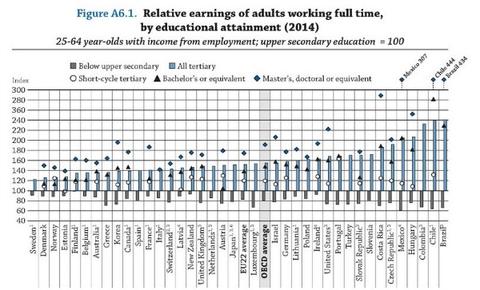

Slide 24
Relative Earnings by Educational Attainment:
Below Upper Secondary Education:
  Adults with below upper secondary education usually have the lowest earnings compared to those with higher educational attainment.
  They may also face a higher risk of unemployment or underemployment, which can further affect their earnings potential.
Upper Secondary Education:
  Individuals with upper secondary education generally earn more than those with less than upper secondary education.
  The earnings premium for this group, compared to those with below upper secondary education, can be significant, but it's often less than the premium for tertiary education.

Slide 25
Relative Earnings by Educational Attainment:
Tertiary Education (Bachelor's degree or equivalent):
  Earnings tend to jump considerably for those with a bachelor's degree or equivalent when compared to those with only upper secondary education.
  In many countries, the earnings premium for having a bachelor's degree can be substantial, reflecting the higher skills and expertise associated with tertiary education.
Advanced Degrees (Master's, Doctorate, or equivalent):
  Individuals with advanced degrees usually earn even more than those with a bachelor's degree, though the exact premium can vary.
  The earnings differential between bachelor's degree holders and advanced degree holders can depend on fields of study, labor market conditions, and the specific demands of certain professions.

Slide 26
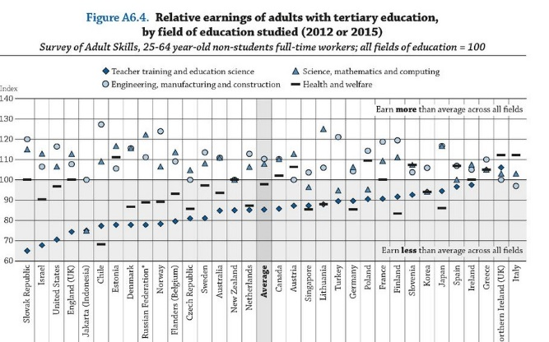

Slide 27
Relative Earnings by Fields of Tertiary Education:
Teacher Training and Education Science:
  Graduates typically earn around or slightly above the average for tertiary-educated individuals. Earnings vary based on the level of education they teach (primary, secondary, tertiary) and regional pay structures.
Science, Math, and Computing:
  Graduates in these fields often command earnings above the average for tertiary-educated individuals. Those in specialized roles or sectors with high demand, like technology or data analysis, can have particularly high earnings.
Engineering, Manufacturing, and Construction:
  These graduates typically have some of the highest earnings among tertiary-educated adults. The demand for engineering and specialized manufacturing skills, especially in regions with strong industries or infrastructure projects, drives these higher earnings.
Health and Welfare:
  Health professionals, especially doctors and pharmacists, generally have high earnings. However, those in caregiving or welfare roles might earn less relative to other tertiary-educated peers, though still often above the average for all tertiary fields.

Slide 28
Ⅱ. Types of Education
1. Formal education: structured and organized, often leading to a recognized certification or degree. It follows a specific curriculum and is guided by institutional rules and regulations.
  Schools
2. Nonformal education: organized and can be short- or long-term, but it doesn't typically lead to formal qualifications. It's more flexible than formal education and caters to specific learning needs or skill sets.
  Adult education
  Training

Slide 29
Ⅱ. Types of Education
3. Informal education: a lifelong process where individuals acquire knowledge, skills, attitudes, and values from daily experiences and exposure to their surroundings.
  Self study: involve reading books, online courses, or using various resources to acquire knowledge;
  learn at home or in community;
  on the job learning: experiential and happens as individuals tackle work tasks, solve problems, or engage with colleagues.

Slide 30
Ⅲ. Education and Development
Education produces:
A. Durable consumption good
  (e.g., ability to enjoy a novel)
  B. Human Capital
  bring returns in the future
Notes:
Durable Consumption Good:
Definition: A durable consumption good provides utility or satisfaction over an extended period, rather than being consumed or used up immediately. In the context of education, it means that the knowledge or skills acquired can be enjoyed repeatedly over time.
Example: The ability to enjoy a novel highlights the idea that with education, individuals can derive sustained pleasure from various activities throughout their lives. Reading and comprehending a novel, appreciating its nuances, and engaging in critical thinking about its content are skills often cultivated through education. These skills don't "wear out" but can be used repeatedly, providing ongoing value and enjoyment.
Human Capital:
Definition: Human capital refers to the skills, knowledge, experience, and abilities possessed by individuals, which can be utilized to produce economic value.
Future Returns: Education is an investment in human capital. By acquiring education, individuals enhance their potential to earn higher incomes, secure better job opportunities, and contribute productively to society. The returns from this investment manifest over time. For instance, a person with a tertiary degree might earn significantly more over their lifetime than someone with only primary education.

Slide 31
Ⅲ. Education and Development
Numerous studies have shown that education and economic growth are positively related
  Skilled Workforce.
  Innovation and Research.
  Social Benefits.
  Attracting Investments.
Notes:
Skilled Workforce: Education equips individuals with skills that make them more productive. A more educated workforce can lead to increased output and efficiency, driving economic growth.
Innovation and Research: Higher education levels, especially in tertiary sectors, often lead to advancements in technology, research, and innovation. Such advancements can result in new industries, improved productivity, and economic expansion.
Social Benefits: Education has several societal benefits, such as reduced crime rates, improved health outcomes, and more civic engagement. These indirectly contribute to economic stability and growth by reducing costs and fostering a conducive environment for economic activities.
Attracting Investments: Countries with a well-educated workforce can attract foreign investments, as companies often seek regions where skilled labor is available.

Slide 34

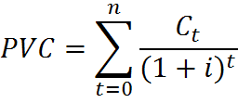
Ⅳ. Invest in Education
1. Cost. The PV of cost in any future yeart:
Ct includes explicit & implicit costs.
PVC from year 0 to year n:
n =0,1,2 ……
i = rate of interest

Slide 35

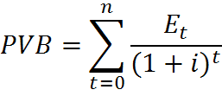
2. Benefit
PV of benefits in any future yeart:
Et benefit in t,
t =0,1,2, ……n
PVB from year 0 to year n:
n = 0,1, ……

Slide 36


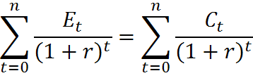
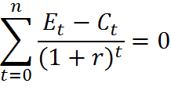
If discounted benefits > discounted costs, then investment should be made.
Otherwise, no.
Internal rate of return: r satisfies.
Or
If r > i, invest;
r < i, no.

Slide 37



Example:
Setting
i.e.,
110 = 100(1+r)
1+r = 1.1
r = 0.1=10%
 | year 0 | year 1 | PV Total
Returns (Et) | 0 | 110
Costs (Ct) | 100 | 0 | 100

Slide 38





Example:
r: internal rate of returns
Setting
1+r = 1.1
r = 0.1=10%
 | year 0 | year 1 | year 2 | PV Total
Returns (Et) | 0 | 110 | 121
Costs (Ct) | 100 | 110 | 0

Slide 39
Social or economic rate of return using :
  all costs, public & private
  all benefits, private & social

Slide 40


Private rate of return versus social rate of return:
Example:
The present value of the gain from schooling
i = discount rate.
if i = 10%, then
Earnings ($)
 | period 1 | period 2
No school | $15,000 | $25,000
With school | $0 | $45,000
Gain from schooling | -$15,000 | $20,000

Slide 41


Costs:
Earnings forgone: opportunity Cost $ 15,000
Explicit Cost: $3,000 $1,000 private
$2,000 govt
The private internal rate of return: The discount rate for which the present value of net benefits equals zero.
Net Benefits = V-$1,000
= - $15,000 - $1,000
= - $ 16,000
Setting Net Benefits = 0
1+r = =1.25
r = 25%

Slide 42

The Social Rate of Return: The discount rate for which the present value of net social benefits equals zero.
Net Social Benefits = V - $ 3,000
= - $15,000 - $3,000
= - $ 18,000
Net Social Benefits = 0
1+r = = 1.111
Thus, r = 11.1%

Slide 43
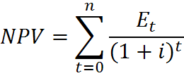
The value of human Capital:

Slide 44
How to make schooling more productive
Making Schooling Productive: The Hurdles
  Uneven quality of education
  Outdated curricula
  Lack of resources and infrastructure
  Teacher shortages and unprepared educators
Notes:
Skilled Workforce: Education equips individuals with skills that make them more productive. A more educated workforce can lead to increased output and efficiency, driving economic growth.
Innovation and Research: Higher education levels, especially in tertiary sectors, often lead to advancements in technology, research, and innovation. Such advancements can result in new industries, improved productivity, and economic expansion.
Social Benefits: Education has several societal benefits, such as reduced crime rates, improved health outcomes, and more civic engagement. These indirectly contribute to economic stability and growth by reducing costs and fostering a conducive environment for economic activities.
Attracting Investments: Countries with a well-educated workforce can attract foreign investments, as companies often seek regions where skilled labor is available.

Slide 45
How to make schooling more productive
Strategies for More Productive Schooling:
  Curricular Reforms: Modern, relevant, and inclusive syllabi
  Teacher Training: Continuous professional development
  Technological Integration: Digital tools and online resources
  Personalized Learning: Catering to individual student needs
Notes:
Skilled Workforce: Education equips individuals with skills that make them more productive. A more educated workforce can lead to increased output and efficiency, driving economic growth.
Innovation and Research: Higher education levels, especially in tertiary sectors, often lead to advancements in technology, research, and innovation. Such advancements can result in new industries, improved productivity, and economic expansion.
Social Benefits: Education has several societal benefits, such as reduced crime rates, improved health outcomes, and more civic engagement. These indirectly contribute to economic stability and growth by reducing costs and fostering a conducive environment for economic activities.
Attracting Investments: Countries with a well-educated workforce can attract foreign investments, as companies often seek regions where skilled labor is available.

Slide 46
How to make schooling more productive
Strategies for More Productive Schooling:
  Curricular Reforms: Modern, relevant, and inclusive syllabi
  Teacher Training: Continuous professional development
  Technological Integration: Digital tools and online resources
  Personalized Learning: Catering to individual student needs
Notes:
Skilled Workforce: Education equips individuals with skills that make them more productive. A more educated workforce can lead to increased output and efficiency, driving economic growth.
Innovation and Research: Higher education levels, especially in tertiary sectors, often lead to advancements in technology, research, and innovation. Such advancements can result in new industries, improved productivity, and economic expansion.
Social Benefits: Education has several societal benefits, such as reduced crime rates, improved health outcomes, and more civic engagement. These indirectly contribute to economic stability and growth by reducing costs and fostering a conducive environment for economic activities.
Attracting Investments: Countries with a well-educated workforce can attract foreign investments, as companies often seek regions where skilled labor is available.

Slide 47
How to make schooling more productive
Engaging All Stakeholders:
  Governments: Policies, funding, and regulations
  Educators: Implementing best practices and innovations
  Parents & Communities: Participation and support
  Private Sector: Investments, partnerships, and technological solutions
Notes:
Skilled Workforce: Education equips individuals with skills that make them more productive. A more educated workforce can lead to increased output and efficiency, driving economic growth.
Innovation and Research: Higher education levels, especially in tertiary sectors, often lead to advancements in technology, research, and innovation. Such advancements can result in new industries, improved productivity, and economic expansion.
Social Benefits: Education has several societal benefits, such as reduced crime rates, improved health outcomes, and more civic engagement. These indirectly contribute to economic stability and growth by reducing costs and fostering a conducive environment for economic activities.
Attracting Investments: Countries with a well-educated workforce can attract foreign investments, as companies often seek regions where skilled labor is available.

Slide 48
How to make schooling more productive
Successful Interventions:
  Finland's holistic education model
  Singapore's focus on teacher quality
  Tech-driven solutions in South Korea
  Community schools in rural Africa
Notes:
Skilled Workforce: Education equips individuals with skills that make them more productive. A more educated workforce can lead to increased output and efficiency, driving economic growth.
Innovation and Research: Higher education levels, especially in tertiary sectors, often lead to advancements in technology, research, and innovation. Such advancements can result in new industries, improved productivity, and economic expansion.
Social Benefits: Education has several societal benefits, such as reduced crime rates, improved health outcomes, and more civic engagement. These indirectly contribute to economic stability and growth by reducing costs and fostering a conducive environment for economic activities.
Attracting Investments: Countries with a well-educated workforce can attract foreign investments, as companies often seek regions where skilled labor is available.

Slide 49
Randomized Control Trials and how to reduce the cost of going to school
Notes:
Skilled Workforce: Education equips individuals with skills that make them more productive. A more educated workforce can lead to increased output and efficiency, driving economic growth.
Innovation and Research: Higher education levels, especially in tertiary sectors, often lead to advancements in technology, research, and innovation. Such advancements can result in new industries, improved productivity, and economic expansion.
Social Benefits: Education has several societal benefits, such as reduced crime rates, improved health outcomes, and more civic engagement. These indirectly contribute to economic stability and growth by reducing costs and fostering a conducive environment for economic activities.
Attracting Investments: Countries with a well-educated workforce can attract foreign investments, as companies often seek regions where skilled labor is available.

