Slide 1
International Economic Development
ECON 4660/8666
Lecture 8 Capital and Saving

Slide 2
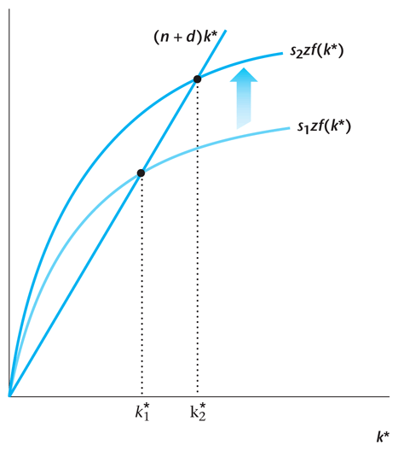
Saving and growth
6-<number>

Slide 3
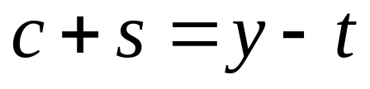
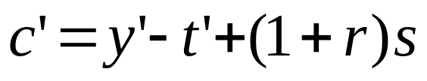
Inter-temporal choices
The consumer’s current-period budget constraint:
The consumer’s future-period budget constraint:
8-<number>

Slide 4
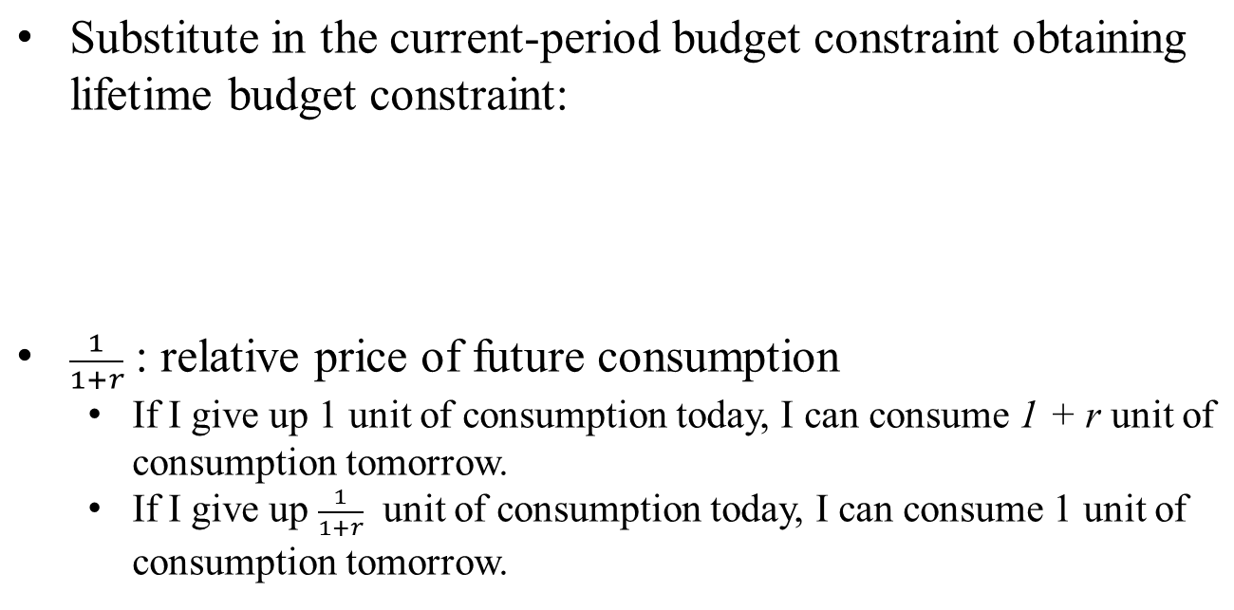
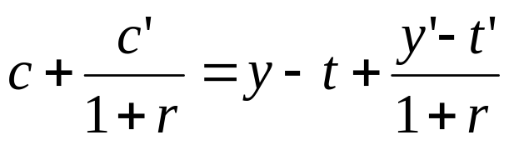
Consumer’s Lifetime Budget Constraint
8-<number>

Slide 5
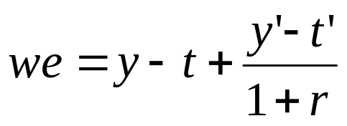
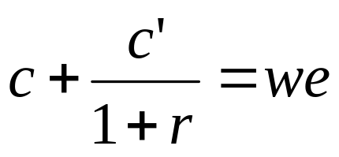
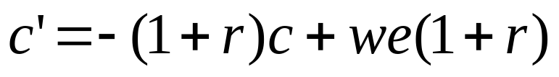
Simplified Lifetime Budget Constraint
8-<number>

Slide 6
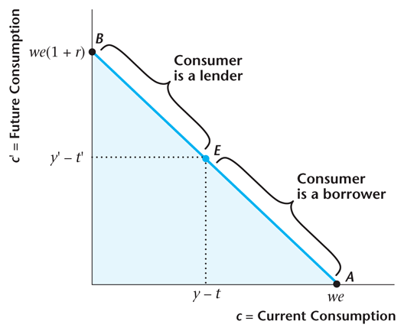
Consumer’s Lifetime Budget Constraint
8-<number>

Slide 7
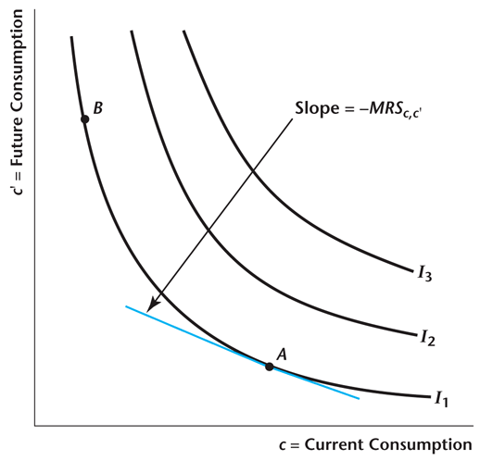
A Consumer’s Indifference Curves
8-<number>

Slide 8

Optimization
Marginal condition that holds when the consumer is optimizing:
Market: 1 unit of c in exchange of 1 + r unit of c’.
Preferences: 1 unit of c in exchange of MRSc,c’ unit of c’.
8-<number>

Slide 9
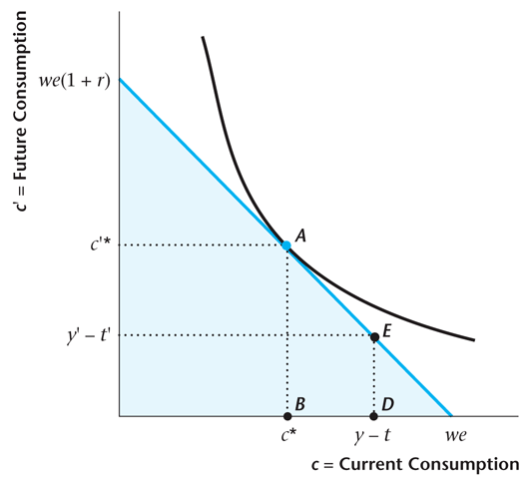
A Consumer Who Is a Lender
8-<number>

Slide 10
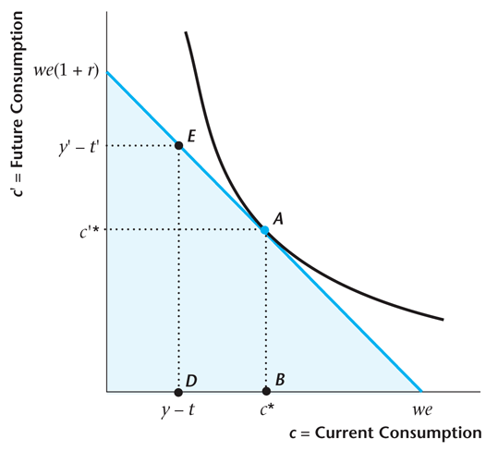
A Consumer Who Is a Borrower
8-<number>

Slide 11
Inter-temporal choices
Consumption Smoothing
  The ability to borrow or lend creates a trade-off between current and future consumption.
  c and c’ depend only on lifetime wealth, we, not its composition.
But saving does depend on composition of lifetime wealth:
  Consumers with high first-period income are more likely to be savers (lenders).
  Consumers with high second-period income are more likely to be borrowers, using future income to fund current consumption.
Key assumption: Saving (borrowing) markets work perfectly.
8-<number>

Slide 12
Capital and Saving
Capital: machinery, equipment, tools, ……
Capital fundamentalism:
  Capital is the key to economic growth.
Notes:
Capital fundamentalism is a term often used in economics to critique the idea that economic growth and development are driven primarily or solely by the accumulation of physical capital (like machinery, infrastructure, and technology). This concept suggests an overemphasis on physical capital as the key to economic progress, while potentially underestimating the roles of human capital (education, skills, health), institutional quality, innovation, and productivity improvements.
Historically, many economic models and policies emphasized capital accumulation as a primary driver of growth. However, critics argue that focusing only on physical capital is overly simplistic and ignores important complementary factors, such as:
1. **Human Capital:** Education and skill levels of the workforce, which can enhance productivity.
2. **Institutions and Governance:** The legal, social, and political frameworks that can influence investment, innovation, and economic stability.
3. **Technology and Innovation:** Advances that can increase productivity and efficiency beyond just adding more capital.
4. **Productivity Growth:** Improvements in how resources (including capital) are used can have a significant impact on growth.
Modern economic thought acknowledges that while capital accumulation is important, sustainable growth often depends on a broader set of factors. Capital fundamentalism, then, is criticized for being a narrow view, which might lead policymakers to overlook these complementary aspects that can drive long-term economic prosperity.

Slide 13
Capital and Saving
Ⅰ. Investment and Growth
  Investment is positively related to the growth rate of per capita GDP.
  Ross Levine and David Renelt: American Economic Review, 1992. “A Sensitivity Analysis of Cross – Country Growth Regressions.”
Notes:
Levine and Renelt (1992): One of the key findings of the paper was that investment was one of the few variables that consistently had a positive and significant relationship with economic growth across different models and specifications. This bolstered the argument that investment plays a crucial role in driving economic growth.
Implications: The findings suggest that policies which encourage investment (be it domestic or foreign) could be beneficial for economic growth. This could be in the form of tax incentives for businesses, stable political environments, or infrastructure development that makes investment more attractive.

Slide 14

Harrod - Domar Model:
g- growth rate,
s- saving rate,
ICOR- Incremental capital- output ratio.
The lower the ICOR is, the smaller the saving rate will be required for sustained growth.

Slide 15


  Example:
  Two countries, A and B, identical initially.
  2000 Per capita income:$400
  Population: 2.5 million
  Investment ratio: 15%,
  1990-2000 ICOR: 3.5
  Annual growth rate: 4.3% (= )
  Policy changes
  2000- A: capital-intensive investment ICOR: 4
  Steel mills, oil refining
  B: Labor-intensive investment ICOR: 3
  Shoe manufacturing

Slide 16






Annual growth rate of GDP:
GDP =1000
A: ICOR = 4, assume that the growth rate of investment = 5%
2000:
2001:
……
2005:
assume that the growth rate of investment = 10%
2000:
2001:
……
2005:

Slide 17





B: ICOR = 3, assume growth rate of investment = 5%
2000:
2001:
2005:
ICOR = 3, growth rate of investment = 10%
2000:
2001:
2005:
With lower ICOR, Country B grows faster even with lower growth rate of investment.

Slide 18
Allocation of Investment Matters
Example 1:
Song, Storesletten and Zilibotti, AER 2011,
-- Reallocating resource from low productivity State-owned firms to high productivity private firm explains the high output growth, sustained returns on capital
Example 2:
J. Bradford De Long and Lawrence Summers, QJE, 1991
-- Equipment investment is positively related to economic growth.
Notes:
De Long and :Summers (1991): One of the significant findings of their research was that equipment investment, in particular, has a strong positive correlation with economic growth. In other words, countries that invested more in equipment (relative to their GDP) tended to experience higher economic growth rates than countries that invested less.
Implications:
Mechanism: The positive relationship between equipment investment and growth can be understood through several mechanisms. Investing in modern machinery and equipment can increase the productivity of labor. When workers have better tools at their disposal, they can produce more output in the same amount of time.
Spillover Effects: There can also be positive spillover effects. For instance, when one firm in a country adopts new technology, other firms might also benefit either by copying that technology or through increased competition.
Policy Recommendations: The findings suggest that policies aimed at encouraging equipment investment, such as tax incentives for purchasing new machinery or reducing import tariffs on equipment, could be beneficial for economic growth.

Slide 19
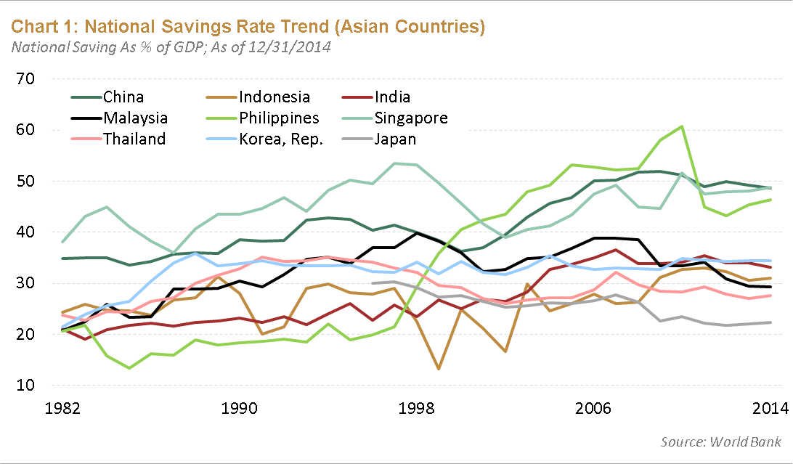

Slide 20
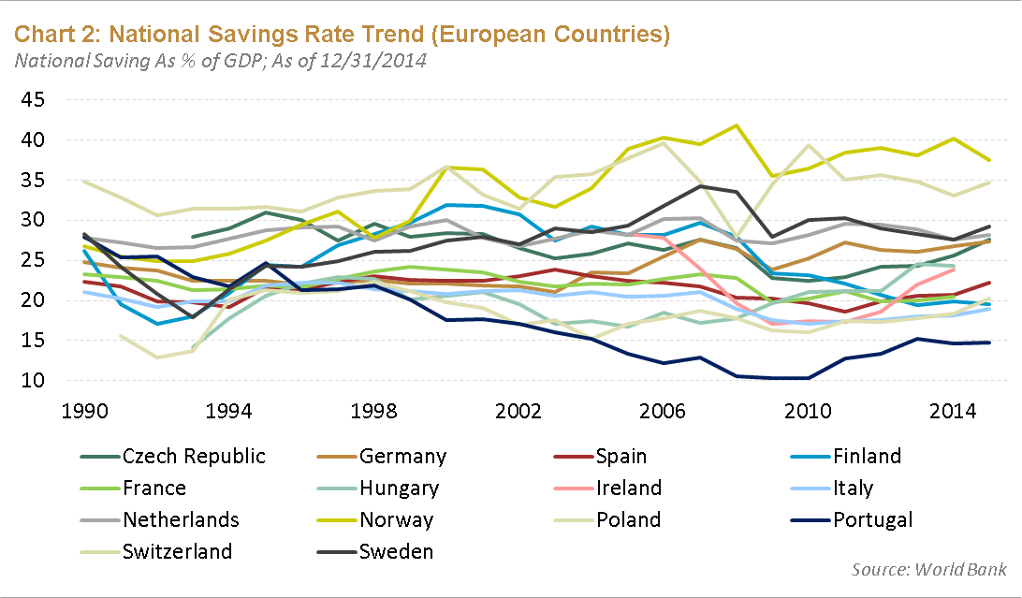

Slide 21
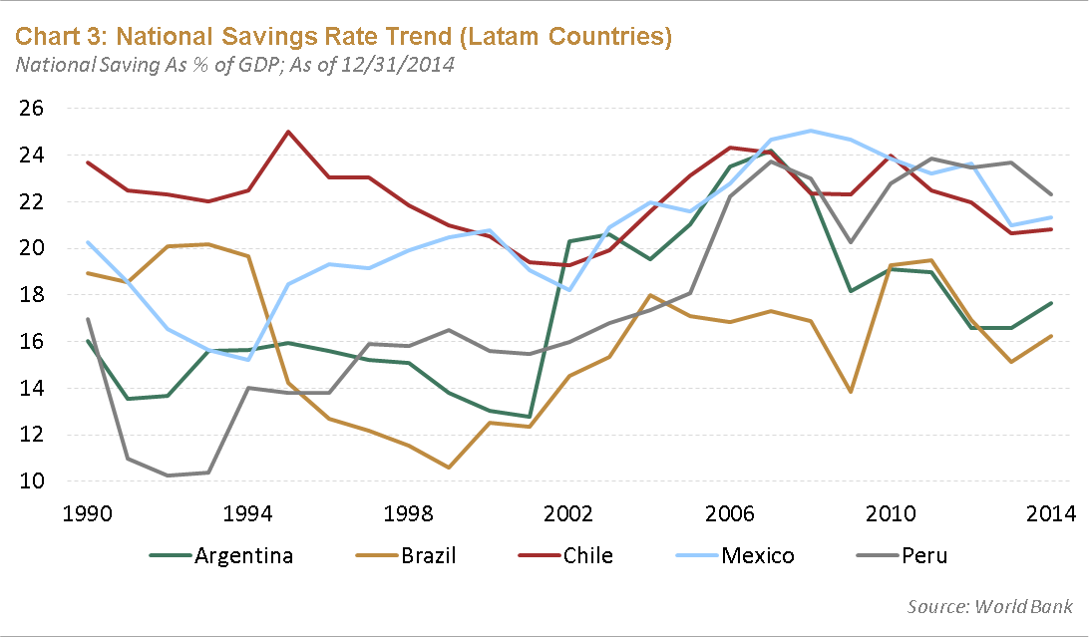

Slide 22
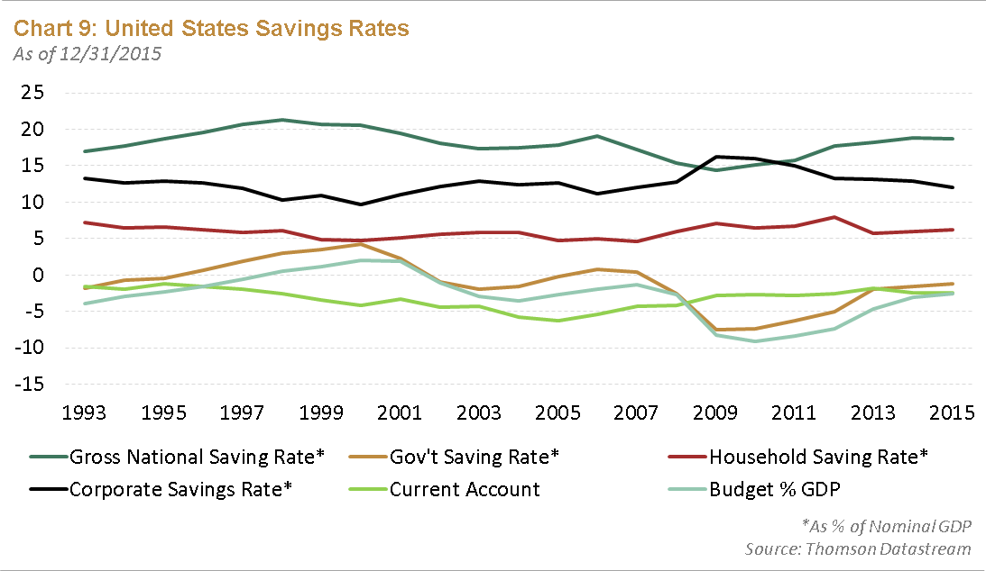

Slide 23
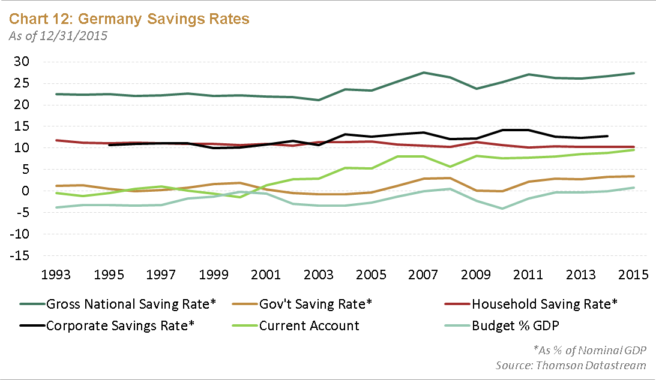

Slide 24
Ⅱ. Sources of Savings
S = S_{d}+ S_{f}
S_{d}= domestic savings.
S_{f} = foreign savings.
S_{d} = S_{g}+ S_{p}
S_{g}= government savings.
S_{p} = private savings.
S_{g} = S_{gb}+ S_{ge}
S_{gb} = budgetary savings, which is equal to government revenues minus government expenditures (including military expenditures).
S_{ge} = government enterprises’ savings.

Slide 25
S_{p} = S_{pc}+ S_{ph}
S_{pc} = corporate savings, which is after-tax corporate income
minus dividends paid to stockholders.
S_{ph} = household savings, which is disposable income minus
consumption.
S_{f} = S_{fo}+ S_{fp}
S_{fo} = foreign official savings, or foreign aid.
S_{fp} = foreign private savings.
S_{fp} = S_{fpd}+ S_{fpe}
S_{fpd} = external commercial borrowing, or debt finance.
S_{fpe} = foreign direct investment, equity finance.
S = [(S_{gb} + S_{ge}) + (S_{pc} + S_{ph})] + (S_{fo} + S_{fpd} + S_{fpe})

Slide 26
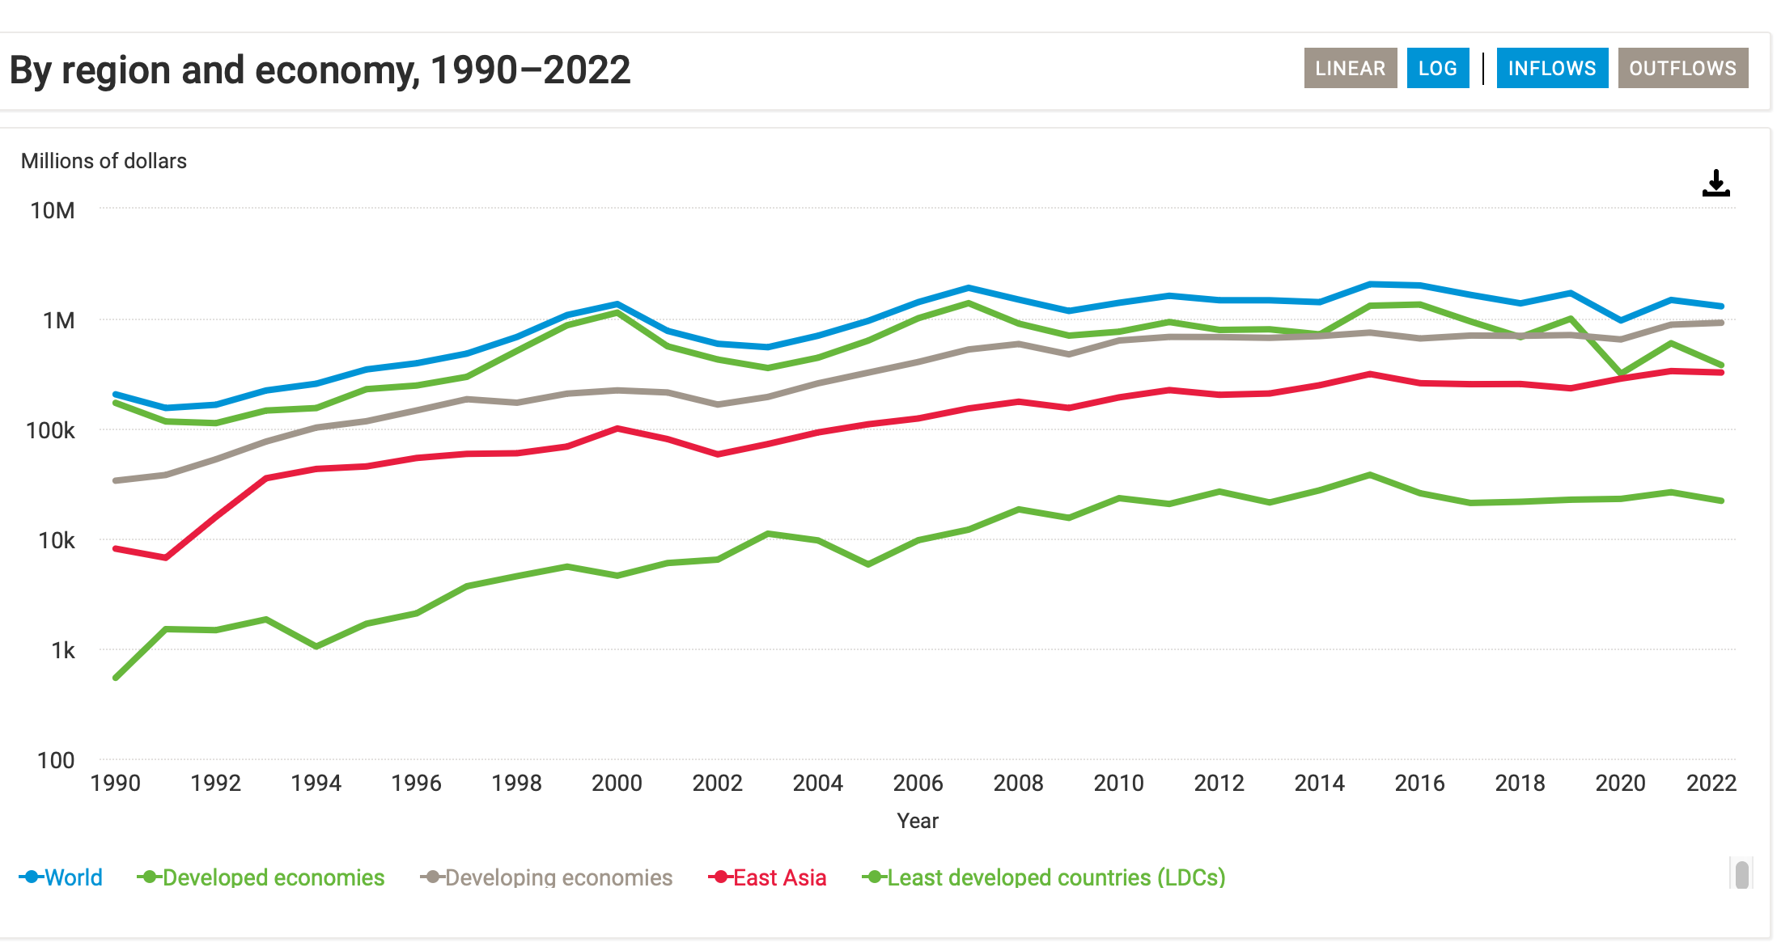
Notes:
Source:
https://unctad.org/data-visualization/global-foreign-direct-investment-flows-over-last-30-years

Slide 27
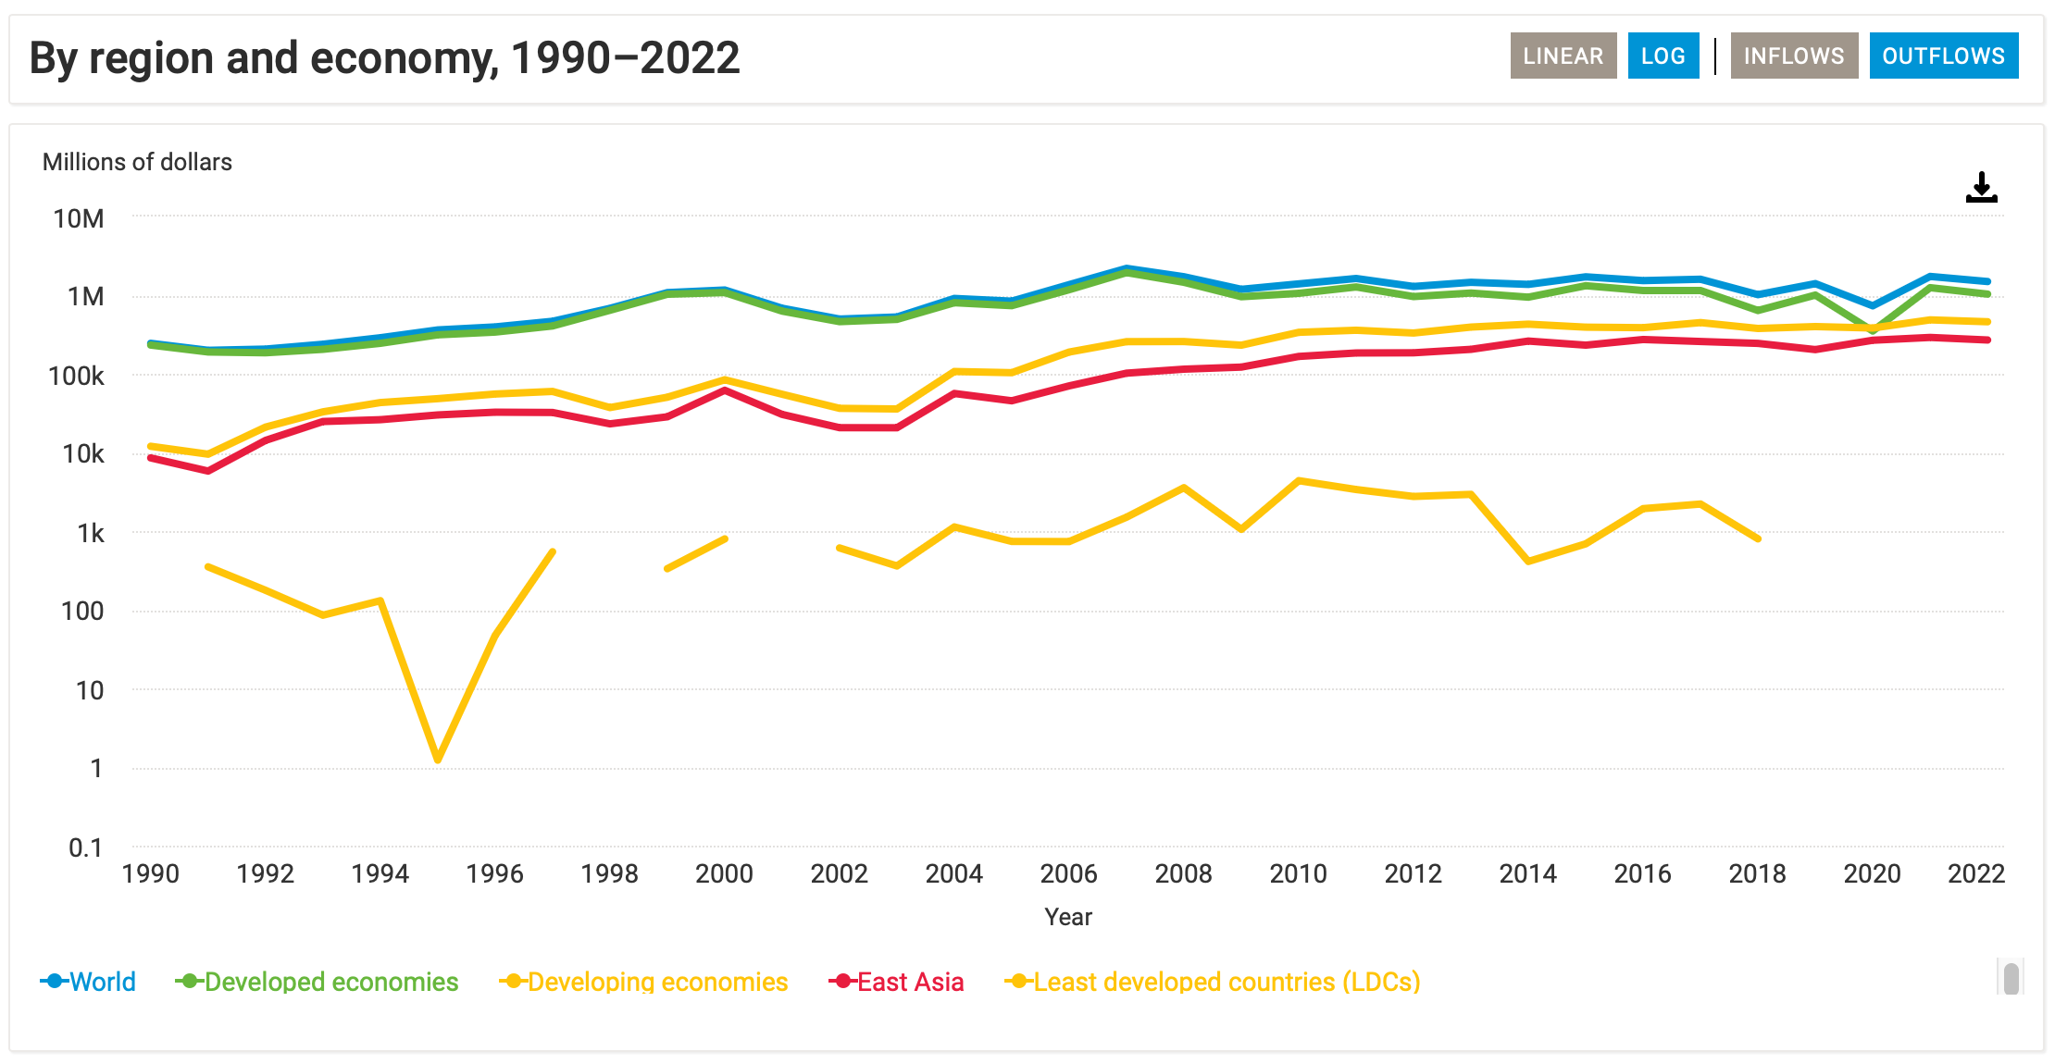

Slide 28
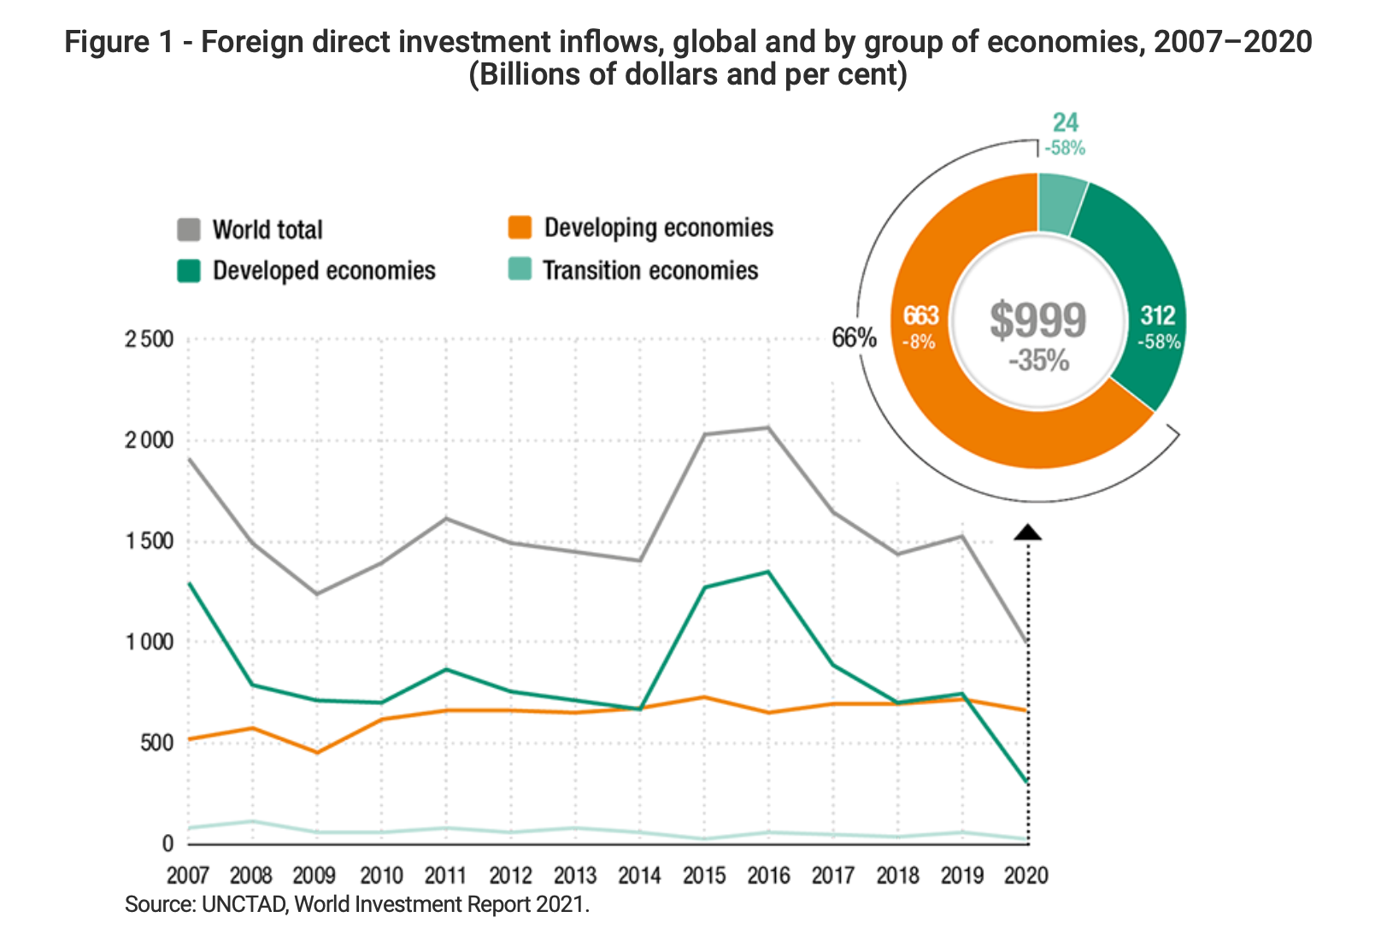

Slide 29
Ⅲ. Determinants of private savings.
A. Household savings, some Stylized facts
  High-income households tend to save larger fractions of their income in a given country.
  Overtime, household savings ratios tend to be constant, particularly in industrial countries.
  Across countries, savings ratios are not related to income.

Slide 30



(1) Keynesian absolute – income hypothesis
Three models:
S = a + sY^{d}
S = savings,
a = constant, negative,
s = marginal propensity to save, 0<s<1,
Y^{d} = current disposable income.
Example: a = -100,
s = 0.3,
If Y^{d} =1000, then S = -100+300=200
If Y^{d} =2000, then S = -100+600=500
S = Y^{d} - C
Notes:
The basic idea behind the Absolute Income Hypothesis is straightforward: a person's consumption is a function of their current disposable income. In other words, as one's income increases, consumption also increases, but not necessarily at the same rate.
Limitations and Criticisms:
Constant MPC: One of the primary criticisms of the Absolute Income Hypothesis is the assumption of a constant MPC. Empirical studies have shown that MPC can vary across income levels and over time.
Relative Income Consideration: Later theories of consumption, like the Relative Income Hypothesis, argue that individuals' consumption decisions are influenced not just by their absolute income but also by their income relative to others.
Exclusion of Wealth: The Absolute Income Hypothesis focuses solely on current income and ignores the role of wealth in determining consumption. This was addressed in later theories, especially the Life-Cycle Hypothesis and the Permanent Income Hypothesis.

Slide 31
APS (or savings ratio)↑ as income ↑ .
This may be true in S.R. but not in L.R.

Slide 32

(2) The relative income hypothesis
James Duesenberry,
C₁ – consumption in period 1,
a – positive, constant,
Y₁^{d} – disposable income in period 1,
C_{n} – previous high level of consumption.
0<s<1,0<b<1.
The SR consumption moves upward overtime,
“Rachet effect”
C₁ = a+ (1-s) Y₁^{d} + bC_{n}
S₁ = Y₁^{d} – C₁
MPC: c=1-s
Notes:
Consumption Ratcheting Effect: A distinctive feature of Duesenberry's theory is the idea that consumption habits are sticky downwards. That is, once people elevate their consumption standards due to an increase in income, they are reluctant to reduce their consumption, even if their income falls later. This is because reducing consumption might imply a loss of social status or a perceived reduction in their standard of living.
Implications:
Savings Function: One implication of the Relative Income Hypothesis is that the savings rate might not increase with the level of income in an economy. This is in contrast to the predictions of the Absolute Income Hypothesis. If people in higher income brackets are trying to emulate the consumption patterns of even wealthier individuals, they might save at a lower rate.
Consumer Debt: The desire to maintain or elevate one's social status through consumption can lead to increased borrowing and consumer debt, especially if individuals are trying to emulate the consumption patterns of those with higher incomes.
Economic Inequality: In societies with high levels of income inequality, the effects of relative income on consumption can be pronounced. If lower or middle-income individuals attempt to emulate the consumption patterns of the rich, it could lead to lower savings rates and higher debt levels among these groups.
Criticisms and Limitations:
While the Relative Income Hypothesis introduces interesting dynamics into the understanding of consumption behavior, it has been critiqued for being difficult to test empirically. It's challenging to quantify the effects of relative income and societal pressures on individual consumption choices. Furthermore, other theories, like the Life-Cycle Hypothesis and the Permanent Income Hypothesis, have provided alternative explanations for consumption behavior that consider factors like future income expectations and intertemporal choices.

Slide 33
(3) Permanent–Income Hypothesis
Milton Friedman, 1950s
S = savings, a = constant, Y_{p} =permanent income shock,
Y_{t} = transitory income shock.
Permanent income:
Yield from assets ( physical and human capital),
stable over time
Transitory income:
Unexpected income, changes in asset values,
lottery winnings, etc.
Extreme version: S= a + Y_{t}
Modified version: 0 < b₁ < b₂ <1
S= a+ b₁Y_{p}+ b₂Y_{t}
Notes:
Criticisms and Limitations:
Liquidity Constraints: Not all individuals can adjust their consumption easily in the face of income fluctuations. Some might face liquidity constraints, meaning they can't borrow easily when their income falls, leading them to reduce consumption.
Precautionary Savings: The PIH doesn't account for precautionary savings, where individuals save more due to uncertainty about future income or potential emergencies.
Behavioral Factors: Behavioral economics suggests that individuals might not always act as rationally as the PIH assumes. For instance, some might have a high propensity to consume out of unexpected income gains, contrary to the PIH's predictions.

Slide 34
(4) The Class Theory
Nicholas Kaldor
S= S_{w} L+ S_{c} P
S _{w}– workers’ saving propensity, L – labor income,
S_{c} – capitalists savings propensity,
P– property income (profits, interests, rents).
0< S_{w}< S_{c}< 1
This theory can explain fact (1) and fact (3) given that factor shares are different across countries.
Other determinants of savings include: interest rate, age, structure of population, locations ( rural save more than urban).
Notes:
Kaldor's Class Theory of saving:
Different Classes, Different Saving Habits: Kaldor believed that in an economy, there are different classes of people, each with its propensity to consume and save. The working class, for instance, might consume a larger fraction of their income compared to the capitalist class.
Capitalist Class and Saving: The capitalist class, according to Kaldor, has a higher propensity to save. This is because as their income rises, their consumption requirements do not increase proportionally, leading to a larger fraction of their income being saved.
Implications for Growth: Kaldor argued that the high propensity to save among the capitalist class could be a significant driver for economic growth. This is because higher savings can lead to higher investments, driving capital accumulation and, subsequently, economic growth.
Distribution of Income and Aggregate Savings: Kaldor suggested that the distribution of income between the working class and the capitalist class could influence the aggregate saving rate in the economy. A higher share of income for the capitalist class could lead to higher overall savings, given their higher propensity to save.
Policy Implications: The class theory of saving implies that policies that alter the income distribution can have effects on the overall saving rate and thus on economic growth. Redistribution of income towards the capitalist class might increase overall savings and investments.
Some of the criticisms to this theory include:
Homogeneous Classes Assumption: Critics argue that Kaldor's theory oversimplifies by assuming that all members within a class (e.g., the capitalist class) have the same saving habits. In reality, there's a lot of heterogeneity even within classes, and not everyone in the same income bracket necessarily has the same propensity to save.
Static Income Distribution: Kaldor's theory assumes a relatively static distribution of income between the classes. Critics point out that income distribution can change over time due to various factors like technological advancements, globalization, and government policies, which can, in turn, affect saving patterns.
Capitalist Consumption Patterns: The idea that the capitalist class has a lower propensity to consume and a higher propensity to save is not universally accepted. Some believe that the capitalist class might indulge in luxury consumption, reducing their overall saving rate.
Economic Growth Link: While Kaldor linked higher savings (especially from the capitalist class) to higher economic growth, critics point out that saving alone doesn't guarantee growth. Investment effectiveness, technology adoption, human capital, and other factors also play crucial roles in determining growth rates.
Modern Financial Instruments: With the evolution of financial markets and instruments, the relationship between saving and investment has become more complex. It's possible for countries to have low domestic savings but high investments due to foreign direct investment or borrowing.
Behavioral Economics Insights: Behavioral economics has shown that individual saving decisions can be influenced by a plethora of factors like psychology, cognitive biases, and heuristics. This adds another layer of complexity that might not be fully captured by Kaldor's class-based approach.
Empirical Evidence: Some empirical studies have found mixed evidence regarding the relationship between income distribution and aggregate savings, challenging the direct relationship proposed by Kaldor.
Policy Implications: Critics argue that if policymakers took Kaldor's theory at face value and tried to redistribute income towards the capitalist class to boost savings, it might lead to increased income inequality without the guaranteed benefits of higher overall savings or growth.

Slide 35
B. Corporate Savings
Corporate savings as percentage of total income: 5% in industrial countries.
Corporate Savings is relatively small in most developing countries since corporate sector is small.

Slide 36
IV. Determinants of foreign savings
A. Foreign Private Investment
1. Portfolio investment : Purchases of stocks, bonds but not involving a controlling ownership (<10 %)
LDCs $4 billion 1990
$30 billion 1997
Less than 20% of FDI.

Slide 37
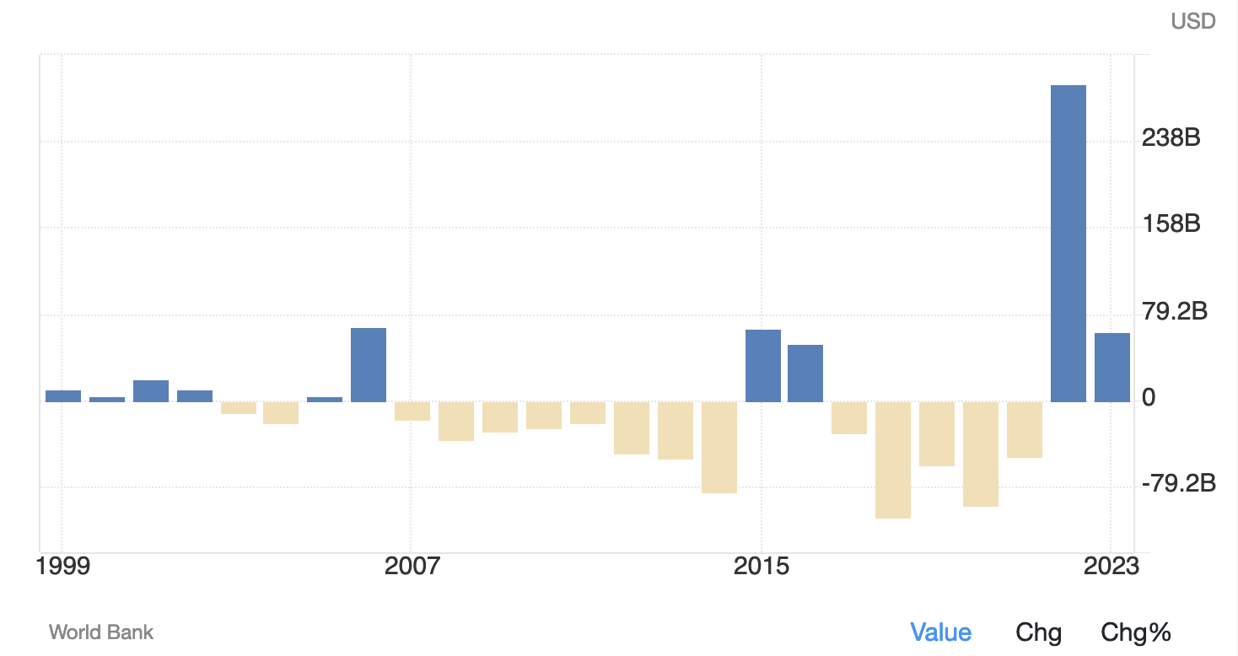
Portfolio Investment, net (BoP, current US$) in China

Slide 38
2. Direct Investment (FDI):
1980s-1990s: This period saw a significant surge in FDI, especially to developing countries. The reasons included liberalization policies, the end of the Cold War, and the opening up of many large economies like China and India.
2000s: The early 2000s saw a continuation of the upward trend in FDI. However, the global financial crisis in 2007-2008 led to a sharp decline in FDI flows worldwide in 2008 and 2009.

Slide 39
2. Direct Investment (FDI):
2010s: Recovery and Surge (2010-2015): After the global financial crisis, there was a recovery in FDI, reaching new peaks around 2015.
Decline (2016-2019): From around 2016, global FDI began to decline, due to factors such as increasing trade tensions, especially between the U.S. and China, and an overall slowdown in the global economy.
2020: The COVID-19 pandemic led to a dramatic drop in FDI. The onset of the pandemic and the associated global economic downturn resulted in significant disruptions to FDI. Many multinational enterprises delayed or canceled investment plans.

Slide 40
3. Commercial bank lending
Infrastructure and Public Goods: Developing countries often require substantial investments in infrastructure, such as roads, electricity, water supply, and public health. Commercial bank loans to governments can finance these projects, which are crucial for economic development.
Private Sector Development: Lending to enterprises, especially small and medium-sized enterprises (SMEs), can stimulate private sector growth. SMEs often face difficulties accessing finance, so bank loans can be a lifeline for them.
Job Creation: Investments in both public projects and private enterprises can lead to job creation, helping reduce unemployment and underemployment in developing countries.

Slide 41
4. Export credits
Import of Essential Goods: Developing countries often need to import capital goods, technology, or inputs not available domestically. Export credits make these imports affordable and accessible.
Technology Transfer: Importing advanced technology or machinery can lead to technology transfer, helping domestic industries become more competitive and innovative.
Stimulating Trade: By making it easier for countries to import, export credits can stimulate bilateral trade, which can lead to economic growth.
Currency Conservation: Delayed payments mean that developing countries don't have to use their foreign exchange reserves immediately. This can be beneficial in managing their balance of payments.

Slide 42
B. Multinational Corporations (MNCs)
MNCs: Corporations or enterprises that conduct and
control productive activities in more than one
country. FDI
Most in North America, Europe, Japan, South Korea,
GM, Ford, Sony.
Objective: Profit opportunities, unconcerned with issues such as poverty, inequality, unemployment.
Countries received FDI form MNCs:
Most investment directed toward DCs. These countries offer a combination of advanced infrastructure, skilled labor, stable political and economic environments, and large consumer markets.
Notes:
Objectives of MNCs:
Profit Maximization: The primary objective of most MNCs is to maximize profit. They venture into international markets to tap into new consumer bases, access cheaper production inputs (like labor and raw materials), and sometimes to benefit from more favorable regulatory environments.
Unconcerned with Socio-Economic Issues: While MNCs might engage in corporate social responsibility (CSR) initiatives, critics argue that their primary focus remains profit. Issues like poverty, inequality, and unemployment in host countries might not be their main concern unless they directly affect their profitability or public image.
MNCs and Developing Countries:
FDI in Developing Countries (DCs): MNCs often invest in developing countries to take advantage of lower production costs, especially labor, and to access new markets. However, as noted, a significant portion of FDI still goes to developed countries due to their stable economic environments, advanced infrastructures, and large consumer markets.
Impacts on Developing Countries:
Positive:
Economic Growth: MNCs can boost economic growth by introducing new technologies, creating jobs, and increasing productivity.
Skill Transfer: Local employees can acquire new skills and knowledge.
Tax Revenues: Governments can benefit from tax revenues from MNC operations.
Negative:
Exploitation Concerns: MNCs might exploit local resources, including cheap labor, without adequate compensation.
Environmental Issues: Some MNCs might not adhere to stringent environmental standards, leading to environmental degradation.
Capital Flight: Profits generated in the host country might be repatriated to the home country of the MNC, leading to capital flight.
Dependency Issues: Over-reliance on MNCs can lead to dependency issues, where the local economy becomes heavily reliant on the operations of a few major corporations. If these corporations decide to move operations, it can have significant adverse effects on the local economy.

Slide 43
Policies toward MNCs:
LDCs try to keep as much as possible benefits from FDI of MNCs.
1. Performance requirements
Use local materials.
Import only most – advanced technology.
2. Joint Ventures
Require MNCs to sell 51% of equity to local partners
3. Restrictions on profit repatriation
Example: Brazil at times limit profits sent by a firm
to a parent to 10%
Notes:
Performance Requirements:
Purpose: LDCs sometimes impose conditions on MNCs to ensure that their operations align with the country's developmental goals.
Use Local Materials: By requiring MNCs to source local materials, countries can boost their domestic industries, create local jobs, and reduce foreign exchange expenditures on imports.
Import only most-advanced technology: This ensures that the country is receiving state-of-the-art technology which can enhance the skillset of the local workforce, improve productivity, and potentially spur innovation locally.
Joint Ventures:
Purpose: Joint ventures (JV) involve collaboration between MNCs and local firms. They can be an effective way to ensure that a significant portion of the benefits from the MNCs' operations stay within the host country.
51% Equity to Local Partners: By requiring MNCs to sell a majority stake to local partners, LDCs ensure that control remains in the hands of local entities. This often means more of the profits remain in the country and can be reinvested locally.
Restrictions on Profit Repatriation:
Purpose: Profit repatriation refers to the return of profits made by MNCs in a host country back to the parent company's home country. LDCs might restrict this to ensure that a significant portion of the profits is reinvested in the host country, fostering local economic growth.
Example - Brazil: As given, Brazil, at certain times, has limited the profits that a firm can send back to its parent company to only 10%. Such a policy can encourage MNCs to reinvest their profits locally, either by expanding their operations, investing in local ventures, or through other avenues beneficial to the local economy.

Slide 44
4. Limit the tax holidays:
temporary reductions or eliminations of taxes, particularly corporate taxes, granted by governments. They are often used as incentives to attract foreign direct investment (FDI) or to promote the establishment and growth of new businesses within a country.
Purpose of tax holidays: Attract FDI, Promote domestic industry growth
Reasons to limit tax holidays: loss of revenue, short-term incentive, potential for misuse
Notes:
Purpose of Tax Holidays:
Attract FDI: Many LDCs use tax holidays as a tool to entice multinational corporations to invest. By offering a period where MNCs would be exempted from certain taxes, these countries aim to make their market more attractive compared to others.
Promote Domestic Industry Growth: Apart from attracting FDI, tax holidays can also be used to encourage the establishment of new domestic industries or sectors.
Reasons to Limit Tax Holidays:
Loss of Revenue: Extended tax holidays can result in significant revenue losses for the government. This can strain the country's budget, especially if the expected benefits of the investments (like job creation or technology transfer) don't materialize.
Unfair Advantage: Local businesses that don't enjoy these tax breaks might be at a competitive disadvantage compared to the foreign firms, leading to potential distortions in the market.
Short-Term Incentive: Companies might only invest for the duration of the tax holiday and then leave once they have to start paying taxes. This leads to short-term, rather than long-term, economic benefits.
Potential for Misuse: In some cases, companies might use strategies to continually enjoy tax benefits, like rebranding or slightly changing their business model after the end of one tax holiday to qualify for another.
Benefits of Limiting Tax Holidays:
Stable Revenue Stream: Governments can ensure a more consistent revenue stream by limiting the duration and extent of tax holidays.
Long-Term Investment: By ensuring that tax incentives aren't the primary reason for investment, governments can aim to attract businesses genuinely interested in long-term operations in the country.
Level Playing Field: Ensuring that all businesses, domestic or foreign, operate under similar tax regimes can help in creating a fair competitive environment.
Challenges:
Competitiveness: LDCs often compete with each other to attract FDI. Limiting tax holidays might make a country less attractive compared to others offering more generous terms.
Transition: Companies already operating under a tax holiday might resist changes, especially if they affect their projected profits.

Slide 45
Benefits of MNC:
Consumers gain because of better quality, larger quantity products;
Govt. receives more taxes;
Domestic firms get technological knowledge;
Increase employment;
Transfer of capital
Managerial capacity
Access to world markets
MNCs control 70% of trade

Slide 46
Arguments against MNCs:
A. Widen wage differentials,
B. Use capital intensive technology,
C. Influence government policies in the directions unfavorable to development.
Tax rebates, cheap services.
Notes:
A. Widen Wage Differentials:
Exploitation of Labor: One of the main criticisms against MNCs, especially those operating in less developed countries (LDCs), is that they often pay local workers much less than what they would pay workers in their home country for similar work. This is because they capitalize on the surplus of labor in LDCs, driving wages down.
Increased Inequality: By offering higher wages than local companies but lower than global standards, MNCs can create a two-tier wage system. While they may provide better wages than some local companies, this can result in greater wage disparity within the country.
Skewed Rewards: MNCs may offer high salaries to a small group of top executives or specialists, further exacerbating income inequalities.
B. Use Capital Intensive Technology:
Limited Job Creation: Capital intensive technology, which focuses on machines and technology over human labor, may not create as many jobs as expected, especially in LDCs where job creation is crucial.
Skills Mismatch: The technologies used might require skills that the local workforce doesn't possess, leading MNCs to either bring in foreign workers or invest heavily in training, which might not always be feasible.
Negative Impact on Local Industry: Local industries that rely on labor-intensive techniques might find it hard to compete with the more efficient, capital-intensive MNCs, leading to potential job losses in these traditional sectors.
C. Influence Government Policies in Directions Unfavorable to Development:
Lobbying and Influence: With their vast resources, MNCs can exert considerable influence over local governments. They might lobby for policies that favor them, potentially at the expense of local businesses and the broader population.
Tax Incentives: As you mentioned, many governments offer tax breaks and rebates to attract MNCs. While this might bring in investment, it can also lead to significant revenue losses for the country. If these benefits don't translate to broader economic gains (like technology transfer, skills development, and job creation), the country might end up losing more than it gains.
Provision of Cheap Services: Some MNCs negotiate deals to get resources like water, electricity, and infrastructure at below-market rates. While this reduces operational costs for the corporation, it can strain local resources and lead to underfunding of essential services.
Dependency: Over-reliance on MNCs can make a country's economy vulnerable. If an MNC decides to leave or reduce its operations, it can have significant economic repercussions, especially if the local economy is heavily dependent on that corporation.

Slide 47
C. Foreign Aid
(Chapter 14)
Any flow of capital to LDCs that meets two criteria:
(1) its objective should be noncommercial from the point of view of the donor;
(2) it should be characterized by concessional: low interest rate, longer repayment period.

Slide 48
1. Aid institutions
United Stated Agency for International Development (USAID).
The World Bank (International Bank for
Reconstruction and Development) established in
1944 .
Borrow at mkt rates, lend at lower rates.
The International Monetary Fund (IMF)
Monitor exchange rate and balance of payments
policies and encourage trade.
Regional development bank
Asian Infrastructure Investment Bank

Slide 49
2. Aid Instruments
Project aid:
Infrastructure, dams, roads, rural development.
Program loans:
Used to finance imports and support for balance of payment.
Structural adjustment loans: (World Bank)
Support economic reforms.
Food aid:
Commodities, grains.
Notes:
1. Project Aid:
Definition: Project aid refers to financial assistance provided by donor countries or organizations specifically for the completion of certain projects.
Examples:
Infrastructure Projects: These include the construction of roads, bridges, and ports which can facilitate trade, transportation, and overall connectivity.
Dams: These projects can serve multiple purposes including irrigation for agriculture, drinking water supply, and electricity generation.
Rural Development: This encompasses a range of projects aimed at improving the living conditions in rural areas. It might include building schools, health clinics, or bringing in modern agricultural techniques.
Benefits:
Directly addresses specific needs or gaps in the recipient country.
Tangible results which can often be measured.
2. Program Loans:
Definition: Program loans are provided to countries to support their budget and balance of payments. They are not tied to a specific project but are aimed at helping a country meet its financial obligations and stabilize its economy.
Usage:
Finance Imports: This helps countries purchase essential goods from abroad when they have a trade deficit.
Support for Balance of Payment: Assists countries in maintaining stability in their currency and foreign exchange reserves.
Benefits:
Provides flexibility to the recipient country in how the funds are used.
Can help stabilize an economy during times of crisis.
3. Structural Adjustment Loans (World Bank):
Definition: These are loans provided, often by institutions like the World Bank, to countries to implement economic reforms. They are often conditional upon the country undertaking certain policy measures.
Purpose:
Support Economic Reforms: This can include reforms to liberalize the economy, reduce corruption, increase fiscal discipline, and more.
Benefits:
Aimed at long-term sustainable growth.
Can bring in best practices and policy measures that have been successful elsewhere.
Criticism:
Sometimes these loans are criticized for imposing one-size-fits-all solutions or for promoting policies that might not be in the best interest of all segments of the recipient country's population.
4. Food Aid:
Definition: Food aid involves the direct donation of food commodities to countries facing food shortages due to reasons like famines, conflicts, or natural disasters.
Types:
Commodities: This can be in the form of grains, pulses, or other staples.
Benefits:
Directly addresses immediate hunger and malnutrition.
Can save lives in emergency situations.
Criticism:
If not managed correctly, it can sometimes undermine local farmers by depressing local food prices.

Slide 50
Bilateral aid:
  Given directly by one government to another.
  Direct Interaction
  Specific Purpose.
  Political and Economic Ties.
Multilateral aid:
  Funds flow into international agencies which in turn grant or lend the funds to LDCs
  International Agencies.
  Broad Objectives.
  Diverse Sources
Notes:
Bilateral Aid
Definition: Bilateral aid is financial or material assistance given directly by one country's government to another country's government.
Characteristics:
Direct Interaction: Bilateral aid involves a direct relationship between two countries, with the donor country often having a say in how the aid is used.
Specific Purpose: This type of aid is often earmarked for particular projects or objectives, such as building infrastructure, improving healthcare, or supporting education.
Political and Economic Ties: Bilateral aid can sometimes be influenced by the political and economic relationships between the donor and recipient countries. For example, it might be used to strengthen diplomatic ties or promote trade.
Benefits:
Tailored to the specific needs of the recipient country.
Often quicker to disburse than multilateral aid.
Criticism:
Sometimes seen as promoting the donor country's interests more than those of the recipient.
May come with conditions attached, such as buying goods or services from the donor country.
Multilateral Aid
Definition: Multilateral aid involves multiple countries pooling their resources and providing aid through international organizations, such as the United Nations, the World Bank, or the International Monetary Fund.
Characteristics:
International Agencies: Funds are directed to international bodies, which then distribute them to Less Developed Countries (LDCs) based on need and priorities.
Broad Objectives: Multilateral aid often targets broader developmental or humanitarian objectives, like poverty reduction, global health crises, or climate change mitigation.
Diverse Sources: The funding for multilateral aid comes from multiple countries, reflecting a collective international effort.
Benefits:
Decisions on aid allocation are often based on technical expertise and global priorities rather than political considerations.
Risks are spread among multiple donor countries, allowing for more substantial and impactful projects.
Can address global challenges that transcend national boundaries, such as pandemics or climate change.
Criticism:
The decision-making process can be slower due to the involvement of multiple stakeholders.
Some argue that large international organizations are more detached from on-the-ground realities.

Slide 51
Source: World Development Report 2008 | 2005 Official Aid per capita ($)
World | 17
Low Income Countries | 17
Middle Income | 15
low diddle income | 19
uper middle income | 3
Low and Middle Income | 20
East Asia and Pacifica | 5
Europe and Central Asia | 12
Latin America and Caribbean | 11
Middle East & North Africa | 88
South Asia | 6
Sub-Saharan Africa | 43
High Income Countries | 0
Selected Countries: Russia | 9
Korea | -1
China | 1
India | 2
Congo, Republic | 362
Georgia | 69
Kuwait | 1

Slide 52
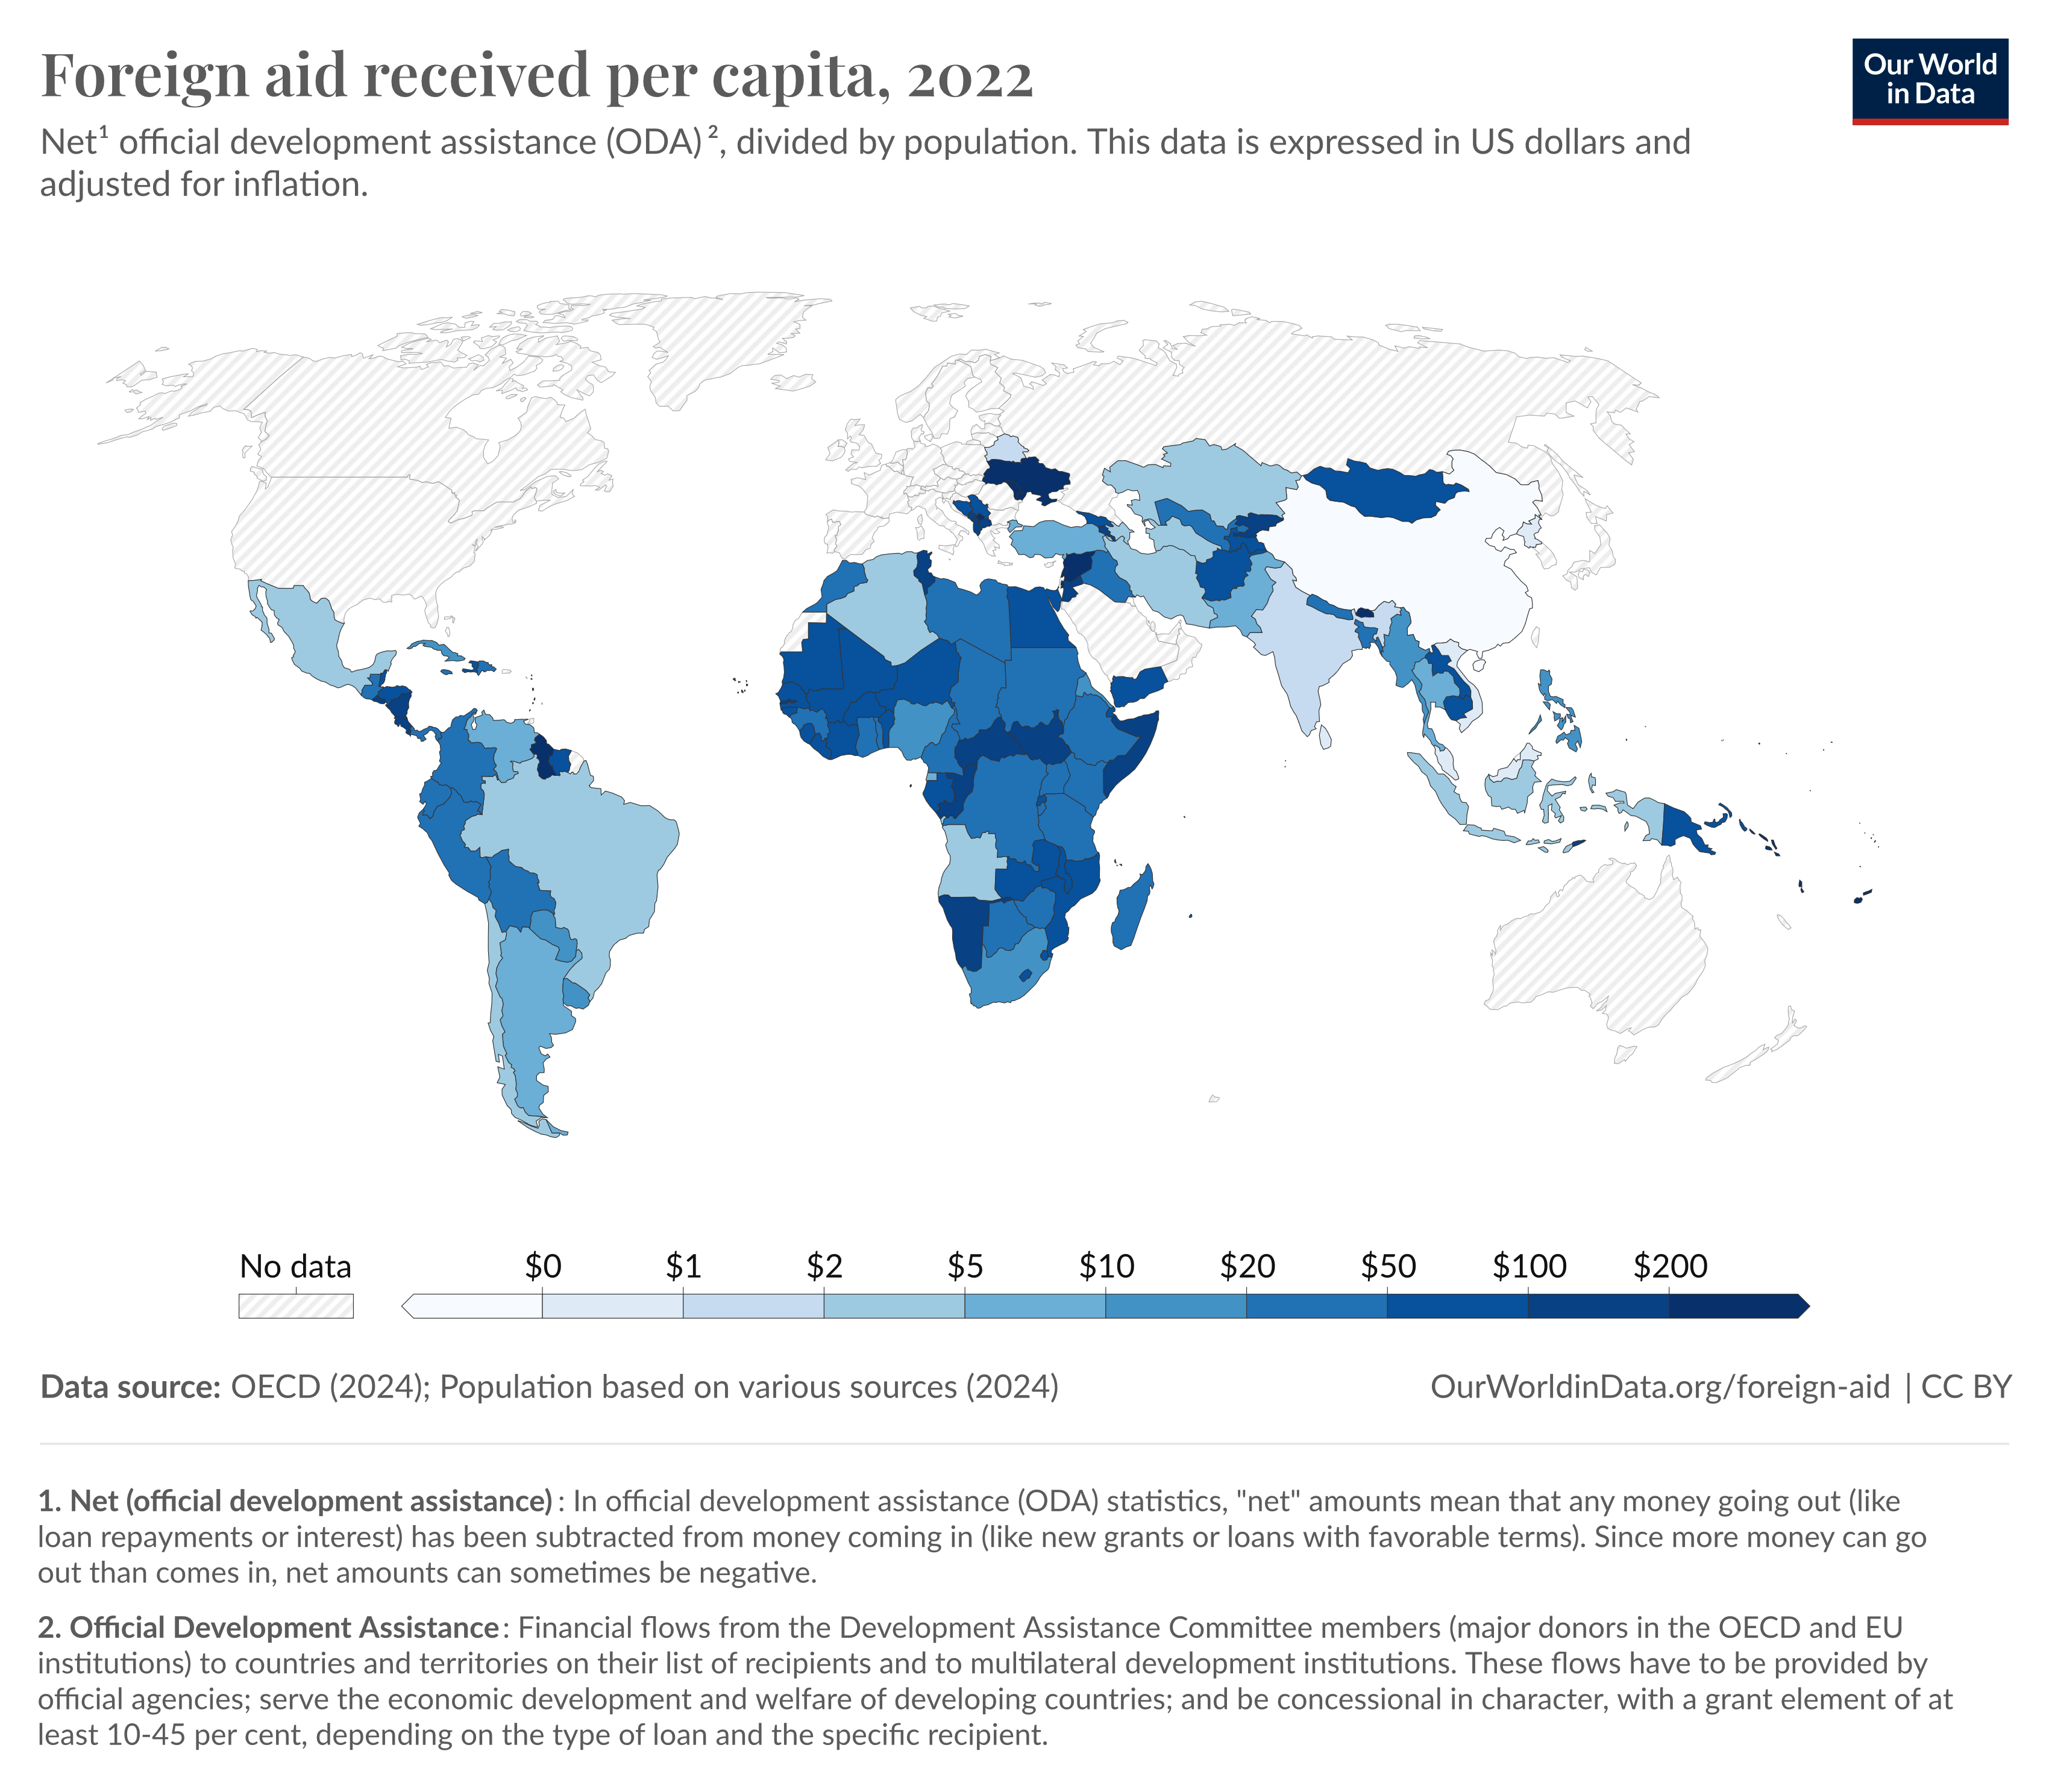

Slide 53
3. Aid and Economic Development
Foreign Aid = AB
Actual Investment = ∆I
Aid may be used to finance consumption
There is not clear evidence that aid increases growth rate.
Investment goods
B
D
ΔI
u2
A
u1
PPF
Consumption goods
Notes:
Efficacy of Aid:
Pros:
Gap Filling: Aid can help fill the savings-investment gap or the foreign exchange gap in developing countries.
Infrastructure: It can be crucial for big infrastructure projects that the country might not be able to afford on its own.
Technical Expertise: Along with financial aid, countries often receive technical expertise and training.
Cons:
Dependency: Prolonged aid can lead to dependency, where a nation might not take initiatives on its own for development.
Misallocation: Aid might not always be allocated efficiently. Corruption can divert aid away from those who need it most.
Debt Burden: If aid is in the form of loans, it can lead to significant debt burdens.
Aid Effectiveness: Several factors can influence the effectiveness of aid:
Good Governance: Aid tends to be more effective in environments where there is good governance, less corruption, and sound economic policies.
Absorptive Capacity: The recipient country should have the ability to efficiently utilize the aid.
Type of Aid: Grants are usually preferable over loans to prevent future debt problems. Also, targeted aid (for health, education) might have more direct impacts compared to general budget support.

Slide 54
Aid affects development through:
1. Capital assistance (project aids)
“Green Revolution” delivered new seeds and fertilizers to LDCs such as India & Indonesia.
Green Revolution refers to the transformation of agriculture started in 1945. Mexican government's request to establish an agricultural research station to develop more varieties of wheat to feed the growing population.
In 1943, Mexico imported half its wheat, but by 1956, self-sufficient; by 1964, Mexico exported half a million tons of wheat. The programs of agricultural research, extension, and infrastructural development were instigated and largely funded by the Rockefeller Foundation and the Ford Foundation, and others.
2. Technical assistance
Send experts to LDCs.
Notes:
Technical Assistance: By providing technical assistance, developed countries or international organizations send experts to LDCs to transfer skills, knowledge, and technologies. This not only helps in building capacity in the short term but also has long-lasting benefits as it empowers local communities and professionals. Over time, this can lead to self-sufficiency as these countries can build and maintain their own infrastructures and systems without external help.

Slide 55
3. Conditionality
Offer aid to friends & allies,
Tie aid to imports,
Some conditions may not help development.
4. Changing the minds of policymakers
Send experts, scholars, officials to LDCs promote new ways of thinking
Notes:
Conditionality: While aid can be a boon for many LDCs, it often comes with strings attached. Donor countries might offer aid to nations that align with their political or economic interests, thereby influencing the foreign policy decisions of the recipient countries. Additionally, tying aid to imports ensures that the donor country benefits economically from the aid they provide. This can sometimes be counterproductive, especially if the conditions imposed do not align with the development goals of the recipient country. For instance, if a condition requires opening up markets prematurely, it might harm local industries that aren't ready to compete with international counterparts.
Changing the Minds of Policymakers: Changing entrenched ways of thinking and working is crucial for sustainable development. Sending experts, scholars, and officials to LDCs can promote new paradigms of governance, economic planning, and social welfare. By interacting with local policymakers and influencers, these experts can introduce novel ideas, best practices, and success stories from other parts of the world. This kind of intellectual exchange is invaluable in shaping policies that are progressive and aligned with global standards.

Slide 56
Cons of Aid:
Dependency: Prolonged aid can lead to dependency, where a nation might not take initiatives on its own for development.
Misallocation: Aid might not always be allocated efficiently. Corruption can divert aid away from those who need it most.
Debt Burden: If aid is in the form of loans, it can lead to significant debt burdens.
Notes:
Criticism of Aid:
Political Motives: Often, aid comes with strings attached, serving the political or strategic interests of the donor country.
Ineffectiveness: Critics argue that despite trillions in aid over decades, many countries remain mired in poverty. Some believe that aid might even be detrimental by supporting corrupt regimes or by creating a dependency culture.

Slide 57
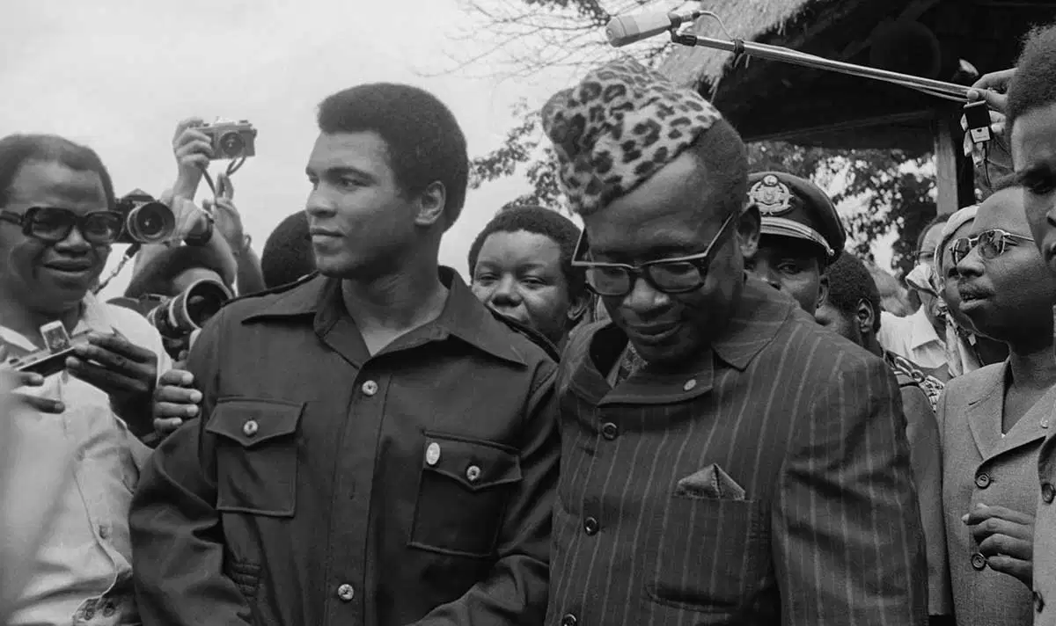
A significant example of corruption diverting foreign aid occurred in Zaire (now the Democratic Republic of the Congo) under the rule of Mobutu Sese Seko, who led the country from 1965 to 1997. During Mobutu's rule, Zaire received substantial foreign aid, primarily from Western nations, due to its strategic importance during the Cold War. However, Mobutu's administration was marred by extreme corruption, and he is believed to have diverted billions of dollars in aid and national resources into his personal accounts.

Slide 58
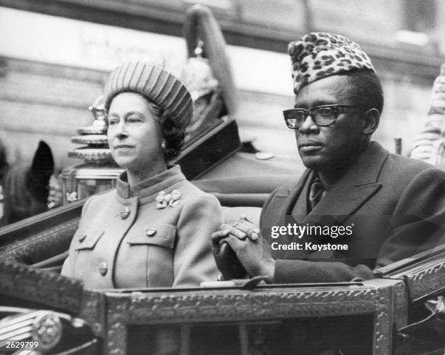
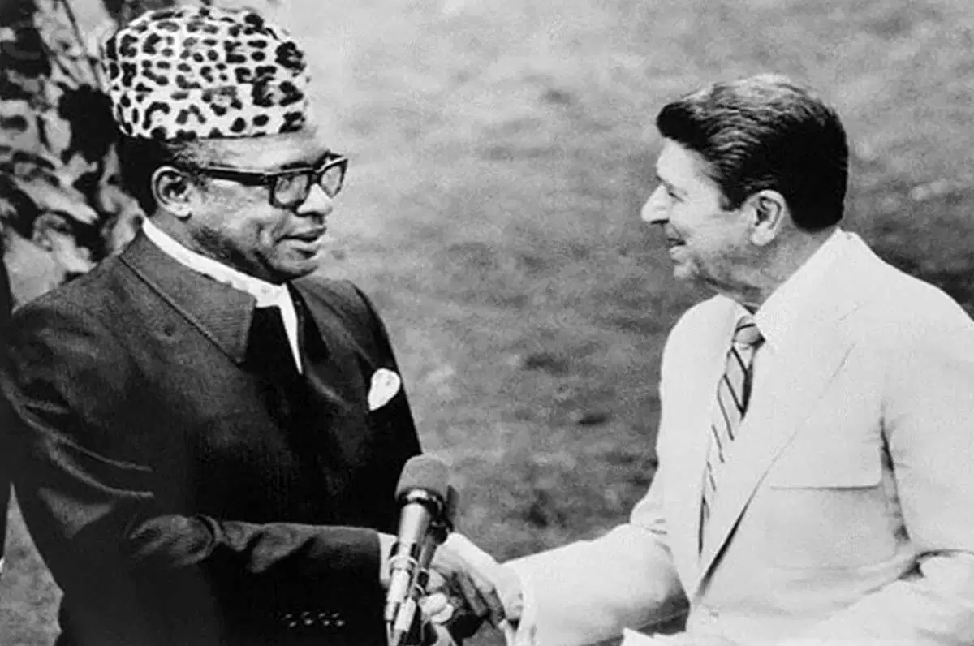

Slide 59
Criticism of Aid:
Political Motives: Often, aid comes with strings attached, serving the political or strategic interests of the donor country.
Ineffectiveness: Critics argue that despite trillions in aid over decades, many countries remain mired in poverty. Some believe that aid might even be detrimental by supporting corrupt regimes or by creating a dependency culture.

Slide 60
D. Foreign Debt
(Chapter 12)
All developing countries
2000 2008
External debt stocks 2,152,234 3,718,539
($ million)
External debt/GNI 37.2 22.1
(%)
External debt/Exports 122.2 58.7
(%)
Sources: Global Development Finance 2010

Slide 61
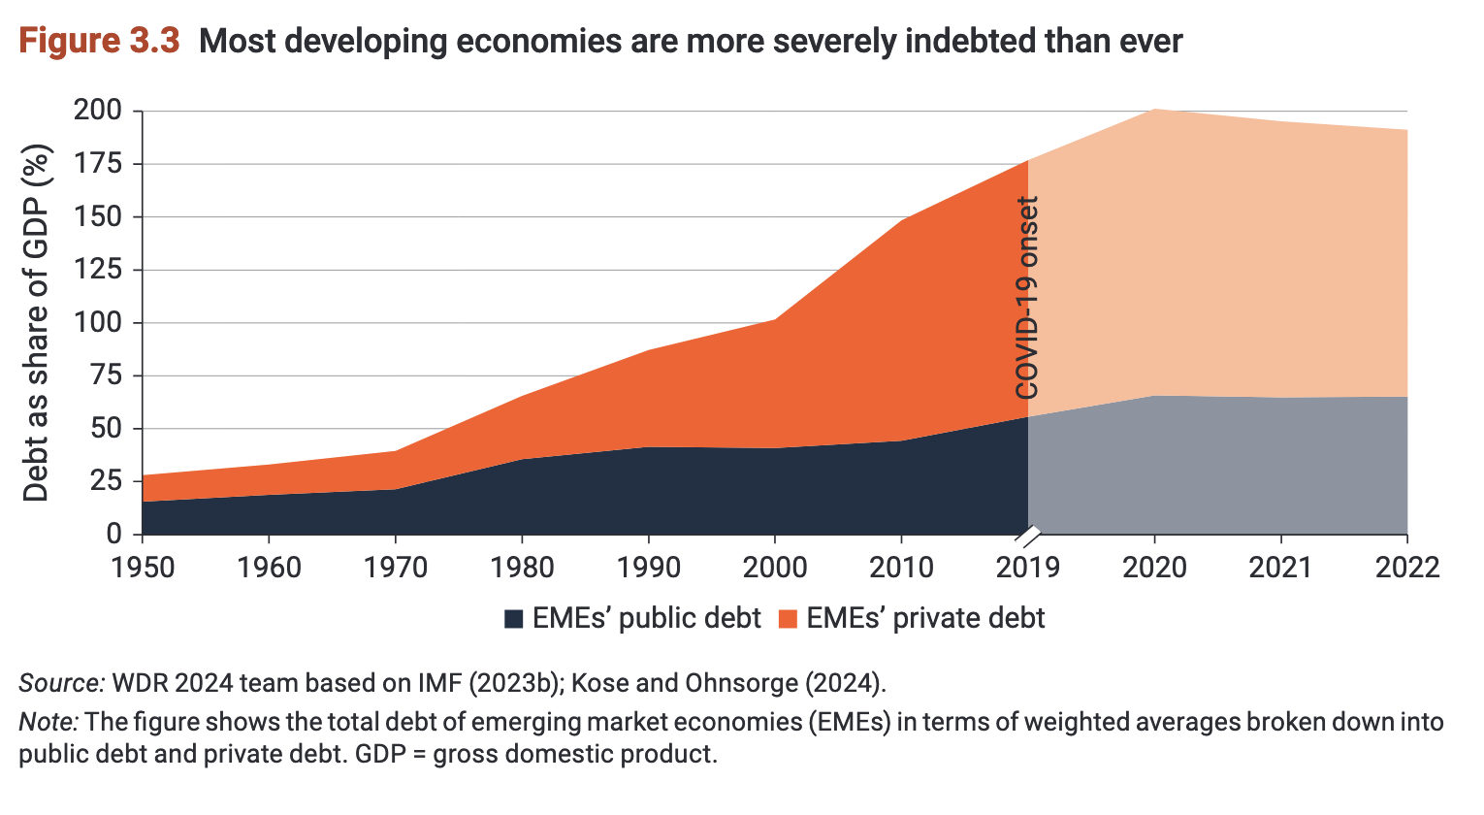

Slide 62
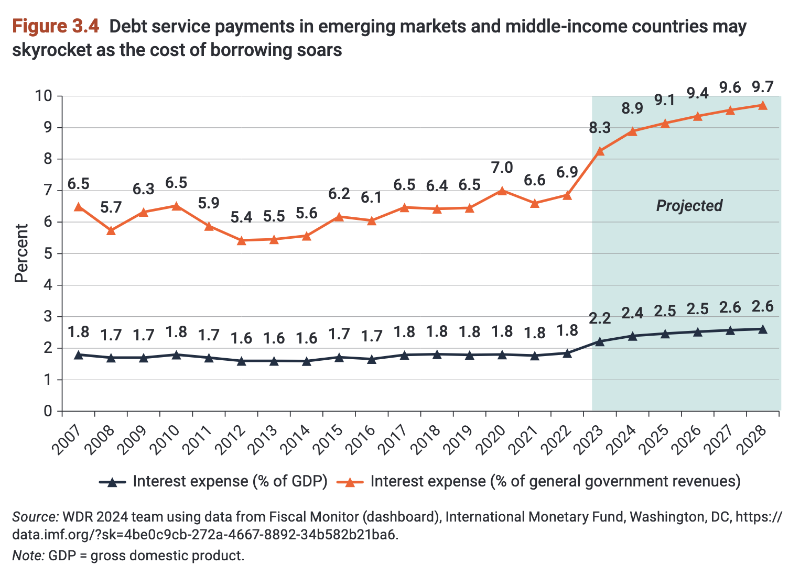

Slide 63
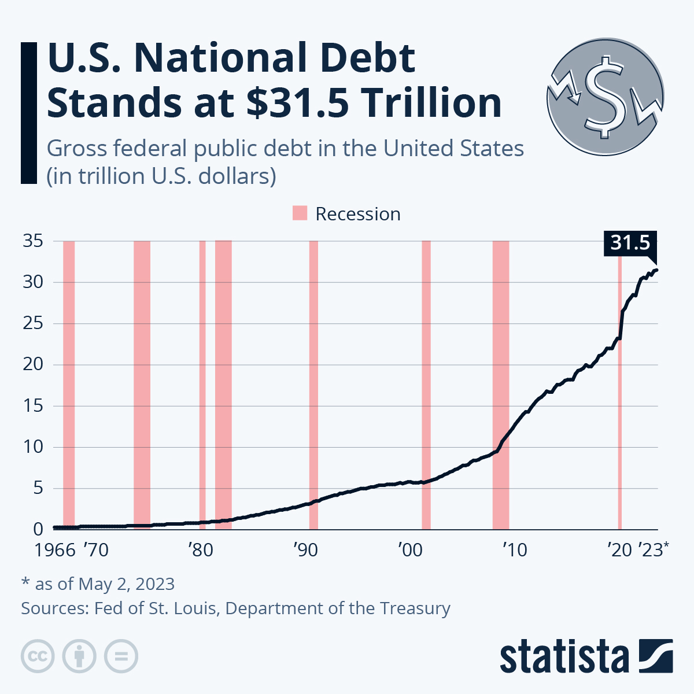

Slide 64
Sustainable Debt:
  the present value of future primary fiscal balances (government revenue minus expenditures, excluding interest payments) should be equal to the current stock of debt.
Two-gap model : a conceptual framework used to understand the barriers to economic growth in developing countries.
  The first gap refers to the difference between savings and investments,
  The second gap pertains to the difference between exports and imports.
  Both these gaps can be financed through external borrowings or foreign aid, leading to the accumulation of debt.
∆D = iD + M – E (1)
  where D = debt, ∆D = change in debt, i = interest rate,
  M = imports, E = export

Slide 65





Letting

Slide 66
If g_{E} > i, then M can be greater than E;
i.e. the country can borrow w/o raising Debt-export ratio.
D/E = 2 for developing countries in 1980s
D/E = 1.14 for developing countries in 2000
D/E = 0.59 for developing countries in 2008
If g_{E} < i, then M must be smaller than E;
i.e. the country must begin to repay the debt (see eq. (1)).
This is what happened in the high-debt LDCs.
If the growth rate of exports exceeds the interest rate, it implies that the country's earning capacity from exports is growing faster than the debt interest accumulation, which is favorable for debt sustainability.

Slide 67





The investment-saving gap:
∆D = iD + I – S_{d} = iD + vY – sY
= iD + (v-s)Y, v = I/Y
  Where Y = GNP, v= investment share, s= Marginal propensity to save, s = S_{d}/Y
Letting

Slide 68
If i > g_{Y}, then s > v to keep constant,
If i < g_{Y}, and v > s to then <0,
If i > g_{Y}, & > 0, then s > v.

Slide 69
V. The Debt Crisis
1. History of International Lending
  In 19th century, U.K. 25-40% saving went to foreign countries.
  After World War I, U.K., France, Germany owned U.S. a large amount money.
2. Debt crisis in 1930s
  In early 1930s, the world economy was in trouble. LDCs could not export enough to pay the debt.
  In 1931, Bolivia and then other Latin American Countries declared unable to pay the debt.
  Most LDCs could not get loans from DCs.
Notes:
1. History of International Lending:
19th Century: During the 19th century, the United Kingdom was the world's leading economic powerhouse and a major international lender. A significant portion of the UK's savings was invested in foreign countries, often in the form of infrastructure projects or government bonds. These investments played a crucial role in the development of many nations, especially those within the British Empire.
Post World War I: The aftermath of World War I brought a change in global financial dynamics. Countries like the UK, France, and Germany, which were traditionally creditors, became heavily indebted, particularly to the United States, due to the massive costs of the war.
2. Debt Crisis in the 1930s:
Global Economic Downturn: The 1930s was marked by the Great Depression, a severe worldwide economic depression that started in the United States with the stock market crash of 1929. This economic downturn severely impacted global trade, causing a reduction in exports for many countries.
LDCs and Debt: The economic challenges of the 1930s particularly affected LDCs. These countries often relied heavily on exports of primary commodities, whose prices plummeted during the depression. As a result, many LDCs found it increasingly difficult to earn enough foreign exchange to service their foreign debts.
Default on Debt: Bolivia was among the first to declare its inability to pay back its debt in 1931. This set a precedent, with several other Latin American countries following suit. The inability of these countries to service their debts led to a lack of trust in international lending, making it even more difficult for LDCs to secure new loans.
Impact on Lending: Given the defaults and the broader economic challenges, many developed countries (DCs) became wary of lending to LDCs. This made access to international capital markets even more challenging for these countries, exacerbating their economic problems.

Slide 70
3. LDCs debt from 1945-1970
  Loans to governments, or loans guaranteed by governments.
  “Sovereign nations don’t go bankrupt”.
4. The debt increase in 1970s
  Low real interest rates in DCs, negative in U.S..
  OPEC put a large amount of money in DCs banks.
5. The crisis in 1980s
  In 1981, Mexico announced to be unable to pay the debt, followed by Brazil and Philippines.
6. The Asian Financial Crisis
  In 1997, debt crisis occurred in Thailand, then spread to S. Korea, Philippines, Indonesia, etc.
7. Greece Debt Crisis in 2009
Notes:
LDCs debt from 1945-1970:
After World War II, many Less Developed Countries (LDCs) sought to rebuild and develop their economies. Foreign loans became a popular method to finance infrastructure projects and stimulate economic growth.
Many developed countries, international institutions, and private banks offered loans to LDCs, viewing them as stable investments due to government backing or guarantees.
The general belief was that sovereign nations don't go bankrupt, which made lending to or investing in LDCs appear less risky.
Loans to governments, or loans guaranteed by governments:
Many loans were made directly to governments or were guaranteed by them, meaning if the borrowing entity defaulted, the government would step in to pay back the loan.
This led to increased trust from international lenders, as the risk was perceived to be minimized.
"Sovereign nations don’t go bankrupt":
Traditionally, it was believed that nations, unlike businesses or individuals, wouldn't declare bankruptcy. This was because they could always levy taxes, adjust their monetary policies, or take other measures to ensure loan repayment.
This belief made countries seem like secure debtors, encouraging more lending.
The debt increase in 1970s:
During the 1970s, there was a surge in global liquidity. Developed countries (DCs) had low, and sometimes even negative, real interest rates.
Following the oil shocks, OPEC nations amassed significant wealth. They deposited much of this wealth in western banks, leading these banks to search for borrowers. Many LDCs became beneficiaries of these loans.
The crisis in 1980s:
By the beginning of the 1980s, global economic conditions started changing. Interest rates began to rise, and many LDCs found it increasingly difficult to service their debt.
Mexico's announcement in 1981 of its inability to meet its debt obligations marked the beginning of the Latin American debt crisis. This was soon followed by Brazil, the Philippines, and other countries.
The Asian Financial Crisis:
The crisis started in Thailand in 1997 when the government decided to float the Thai Baht after failing to defend it from speculative attacks.
Panic soon spread to other Asian economies, including South Korea, the Philippines, Indonesia, and Malaysia. Foreign investors lost confidence, leading to massive capital outflows and plummeting currencies.
Many of these countries had significant amounts of short-term foreign debt, making them vulnerable when investor confidence evaporated.
Greece Debt Crisis in 2009:
Greece faced a severe debt crisis starting in 2009. Its public debt was much higher than previously disclosed, leading to doubts about its ability to finance itself.
The crisis in Greece threatened the stability of the Eurozone, leading to multiple bailouts by the European Central Bank, the International Monetary Fund, and the European Commission.
Greece had to implement harsh austerity measures as a condition for receiving bailout funds, which led to significant economic and social upheaval in the country.

Slide 71
Basic options confronted the creditors:
Finance the Debt:
  This means the creditor extends the payment terms, hoping the debtor country will be in a better financial position in the future and will eventually be able to repay.
  From 1981 to 1989, this was the primary strategy adopted by U.S. policy.
Forgive the Debt:
  This involves reducing the amount owed by the debtor country to a level that they might be able to repay.
  In 1989, U.S. Treasury Secretary Nicholas Brady announced a shift in U.S. policy, favoring a debt reduction strategy.

