Slide 1
International Economic Development
ECON 4660/8666
Lecture 9 Fiscal Policy

Slide 2
Government plays an important role in providing public goods, reallocating resources, redistributing income, regulating markets, and maintaining macroeconomic stability and good business environment.
Government is involved in education, healthcare, infrastructure, national defense, social safety net provisions, capital market regulations, environmental protection, etc.
Government collects taxes and spends the tax revenues.
Fiscal policies:
Changes in government spending and taxes

Slide 3
I. Government Expenditures
Recurrent Expenditures (government consumption)
  recur year after year, e.g., wages, interest payment, health, education, subsidies, transfers
Capital Expenditures
  investment, on bridges, highways.

Slide 4
Wages and salaries of civil servants, teachers, and the military personnel
  Large fraction of government expenditures in the developing countries
  The case of Mali:
  Population: 11 million in 2002
  per capita income: $240 in 2002; Gross National Income.
  Life expectancy at birth: 48 years 2000-2005
  38 years 1970-1975
    After independence in 1960, civil service expanded rapidly. In 1983, total public sector accounted for 63% of the employment.
    Reforms: Competitive exams for entry level positions,
  voluntary early departure program,
  hiring ceiling
Notes:
In many developing countries, a significant portion of the government's budget is allocated towards the salaries and wages of civil servants, teachers, and military personnel. This can have significant implications for a country's economic health and development.
The Case of Mali:
Background: Mali, a country located in West Africa, had a population of 11 million in 2002. Its Gross National Income per capita in the same year was $240, indicating a relatively low income level. Over the years, the life expectancy in Mali has shown some improvements; it was 38 years during 1970-1975 and increased to 48 years in the 2000-2005 period.
Post-Independence Growth of Public Sector: Following its independence in 1960, there was a rapid expansion of the civil service in Mali. By 1983, the public sector was a major employer, accounting for 63% of the employment in the country. Such a large public sector can place strain on a country's budget, especially if revenues are not increasing at a similar pace.
Reforms: To manage the burgeoning public sector and ensure sustainability, the Malian government introduced a series of reforms:
Competitive Exams for Entry Level Positions: This measure aimed to ensure that only qualified individuals would be recruited into the civil service. By making the entry process competitive, the government sought to improve the quality and efficiency of its services.
Voluntary Early Departure Program: This was likely introduced to reduce the size of the workforce without resorting to forced layoffs. Employees could choose to leave their jobs in exchange for certain benefits, which would, in turn, decrease the wage bill.
Hiring Ceiling: To prevent the unchecked growth of the public sector, a hiring ceiling was introduced. This means there's a limit to how many people can be employed in the public sector at any given time, ensuring that the government doesn't take on more employees than it can afford.
Conclusion: The experience of Mali illustrates the challenges many developing countries face in managing their public sector wage bills. Large public sectors can strain government budgets and can be unsustainable if not managed properly. Reforms, like the ones introduced in Mali, can help strike a balance between providing public services and maintaining fiscal responsibility.

Slide 5
B. Government Purchases.
Goods: Computers, tables, equipment and materials for employees, military equipment.
Services: Construction, janitorial work, ……
C. Interest payments
Interests on government debt.
7.6% total expenditures in US in 2022.
D. Subsidies.
Subsidies to consumers, social welfare payment, subsidies to state enterprises.
63% total expenditures in Brazil in 1998.
E. Intergovernmental transfers.
30% total expenditure in Japan in 2001.
Central government, 65% rev. 35% exp.

Slide 6
General Government Outlays by Function for Countries with Data Available for 2006-2007 (% of Total Outlays)
Countries | Year | General Public Services | Defense | Public Order & Safety | Econo-mic Affairs | Environ-mental Protec-tion | Com-munity Ameni-ties | Health | Recrea-tion, Culture, & Religion | Edu-cation
France | 2007 | 13.28 | 3.39 | 2.41 | 5.36 | 1.66 | 3.62 | 13.72 | 2.90 | 11.24
Germany | 2007 | 13.61 | 2.41 | 3.51 | 7.23 | 1.10 | 1.93 | 14.01 | 1.36 | 9.09
Italy | 2007 | 15.98 | 3.14 | 3.89 | 10.23 | 1.83 | 2.16 | 12.57 | 3.05 | 11.22
Luxembourg | 2007 | 15.74 | 0.61 | 2.52 | 10.80 | 2.65 | 2.05 | 11.90 | 5.39 | 13.07
Netherlands | 2007 | 16.11 | 3.01 | 3.95 | 10.48 | 1.81 | 2.06 | 12.54 | 2.95 | 11.17
Slovenia | 2006 | 11.38 | 3.09 | 4.18 | 10.68 | 1.34 | 1.30 | 13.66 | 2.83 | 14.95
Spain | 2007 | 11.47 | 2.64 | 4.86 | 12.56 | 2.36 | 2.45 | 14.70 | 4.09 | 11.28
Others
Australia | 2007 | 11.43 | 4.85 | 5.02 | 12.41 | 1.61 | 2.82 | 18.02 | 2.43 | 14.27
Canada | 2007 | 12.52 | 2.86 | 4.95 | 9.09 | 1.81 | 2.04 | 19.01 | 2.62 | 15.02
Hong Kong | 2006 | 24.40 | — | 10.00 | 7.47 | 3.11 | 6.22 | 13.23 | 3.40 | 19.32
Denmark | 2007 | 12.54 | 3.08 | 1.98 | 6.63 | 1.11 | 1.34 | 14.12 | 3.07 | 14.50
Iceland | 2007 | 13.13 | 0.15 | 3.46 | 13.73 | 1.49 | 1.15 | 18.67 | 8.90 | 19.18
Israel | 2007 | 14.43 | 17.07 | 3.88 | 6.09 | 1.49 | 1.23 | 11.32 | 3.09 | 16.14
Japan | 2006 | 12.91 | 2.59 | 3.89 | 10.55 | 3.55 | 1.81 | 19.60 | 0.43 | 10.74
New Zealand | 2007 | 12.58 | 2.98 | 4.66 | 9.58 | 1.18 | 1.94 | 15.31 | 4.33 | 15.39
Norway | 2007 | 10.16 | 3.97 | 2.23 | 9.03 | 1.35 | 1.44 | 17.42 | 2.61 | 13.31
San Marino | 2002 | 14.52 | . | 2.94 | 14.32 | 3.23 | 2.34 | 18.14 | 2.30 | 9.40
Singapore | 2007 | 12.37 | 27.99 | 6.24 | 9.81 | . | 12.20 | 6.04 | 0.48 | 20.82
Switzerland | 2006 | 13.78 | 2.89 | 5.01 | 11.96 | 1.71 | 1.12 | 12.17 | 2.62 | 16.86
US | 2007 | 13.47 | 11.54 | 5.71 | 9.98 | . | 1.85 | 21.06 | 0.87 | 16.93

Slide 7
Countries | Year | General Public Services | Defense | Public Order & Safety | Econo-mic Affairs | Environ-mental Protec-tion | Com-munity Ameni-ties | Health | Recrea-tion, Culture, & Religion | Edu-cation
WAEMU
Mauritius | 2007 | 22.25 | 0.65 | 7.78 | 10.70 | 5.18 | 2.90 | 8.84 | 1.53 | 15.08
Seychelles | 2005 | 39.72 | 3.35 | 4.28 | 5.42 | . | . | . | . | 0.80
Asia
Bhutan | 2000 | 22.40 | . | 5.44 | 46.38 | . | . | . | . | 2.27
China, Mainland | 2006 | 18.20 | 5.24 | 4.98 | 37.68 | 3.21 | 0.44 | 2.51 | 1.27 | .
Macao | 2007 | 18.32 | . | 16.60 | 13.88 | 5.79 | 1.01 | 10.54 | 6.51
Maldives | 2007 | 21.89 | 5.04 | 7.24 | 8.32 | 1.13 | 24.90 | 8.12 | 4.10 | 14.22
Thailand | 2007 | 5.77 | . | . | . | . | . | . | . | .
Central and Eastern Europe
Albania | 2006 | 21.57 | 4.42 | 6.26 | 15.23 | . | 5.65 | 8.24 | 1.27 | 10.77
Bulgaria | 2007 | 12.55 | 6.01 | 8.12 | 12.50 | 0.67 | 3.17 | 12.72 | 2.26 | 10.19
Croatia | 2007 | 11.21 | 3.55 | 6.07 | 13.99 | 0.66 | 4.71 | 13.84 | 3.00 | 9.69
Czech Republic | 2007 | 11.94 | 3.26 | 5.22 | 17.01 | 2.65 | 3.57 | 14.24 | 2.61 | 9.65
Latvia | 2007 | 11.48 | 4.03 | 7.06 | 17.23 | 2.72 | 3.53 | 10.09 | 4.60 | 16.32
Lithuania. | 2007 | 9.67 | 5.21 | 4.73 | 11.65 | 2.50 | 1.45 | 15.26 | 3.23 | 15.26
Poland | 2007 | 12.58 | 3.89 | 4.72 | 10.15 | 1.40 | 1.70 | 10.62 | 2.64 | 12.72
Romania | 2006 | 12.61 | 3.56 | 7.07 | 19.36 | 0.98 | 3.96 | 9.48 | 2.63 | 12.09
Slovak Republic | 2007 | 14.15 | 3.97 | 5.50 | 13.03 | 1.95 | 2.03 | 17.86 | 2.99 | 9.55

Slide 8
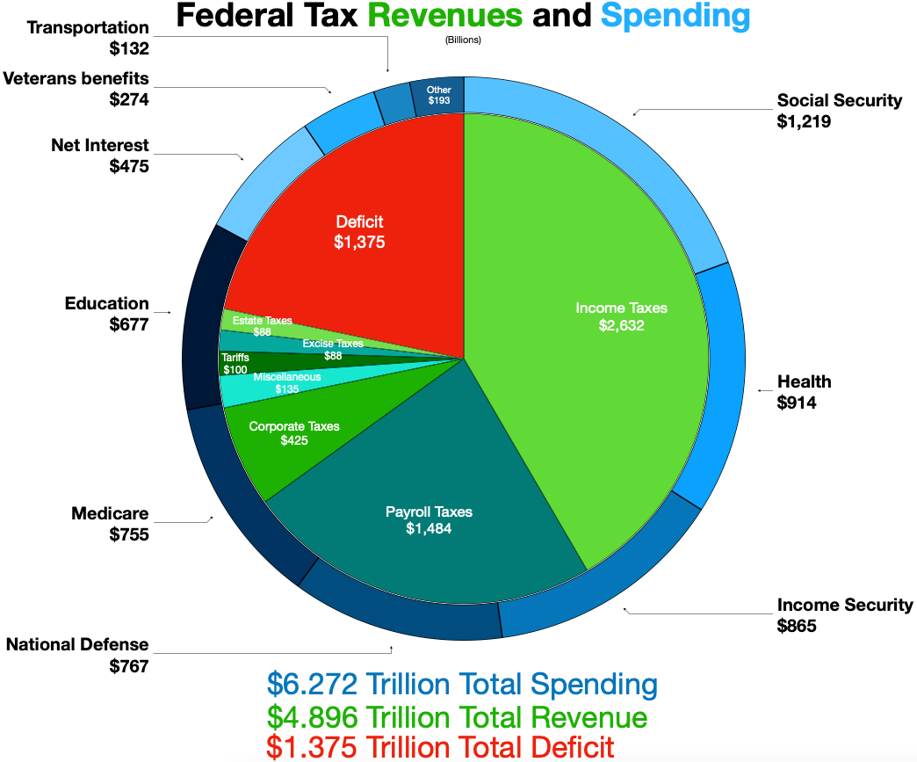


Slide 9
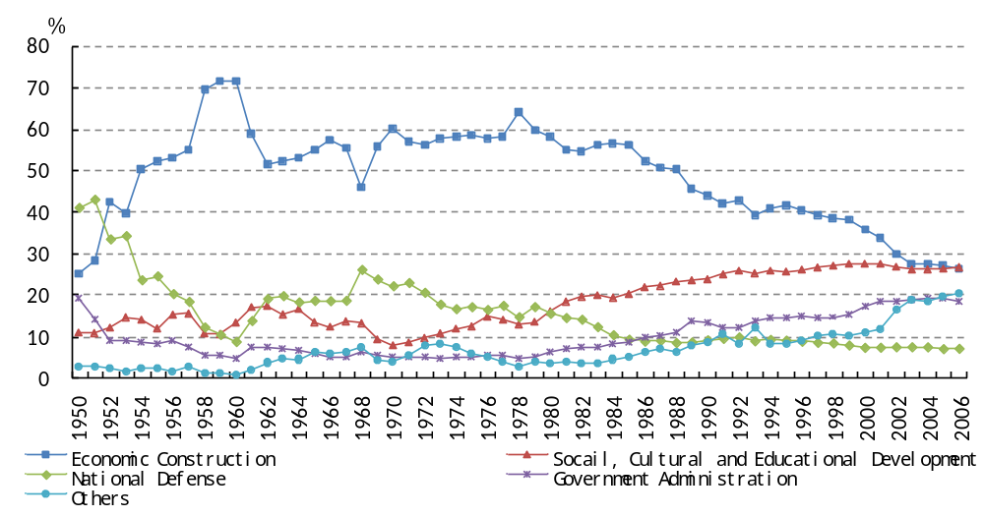
Government Budgetary Expenditures by Function 1950-2006

Slide 10
Ⅱ. Taxes
Goals of taxation:
  Efficient resource allocation,
  A satisfactory distribution of income,
  Full employment with price stability,
  A high stable growth rate of output
General Criteria to evaluate different taxes:
  Allocational efficiency
  Equity
  Administrative feasibility
  Revenue productivity
Taxes put resources in the hands of government, to carry certain investment programs good for the economy in the long run.
Notes:
Goals of Taxation:
a. Efficient Resource Allocation: This means that the resources (like labor and capital) should be used where they are most productive. Taxes can influence where and how resources are allocated. For instance, a tax on polluting industries can make them less profitable, leading to resources shifting to cleaner industries.
b. Satisfactory Distribution of Income: Through progressive taxation (where the rich are taxed at higher rates than the poor), governments aim to reduce income inequality.
c. Full Employment with Price Stability: Taxes can be used to control inflation and maintain employment levels. For instance, during an economic downturn, a reduction in taxes can boost spending and help in job creation.
d. High Stable Growth Rate of Output: Consistent economic growth is essential for improving living standards. Through strategic taxation, governments can stimulate investment and consumption, leading to economic growth.
General Criteria to Evaluate Different Taxes:
a. Allocational Efficiency: This refers to how a tax impacts the allocation of resources. An efficient tax would be one that doesn't distort the way resources would have been used in the absence of the tax.
b. Equity: Taxes should be fair. This doesn't necessarily mean everyone pays the same amount, but rather that the tax system is just and doesn't place an undue burden on certain groups.
c. Administrative Feasibility: A tax should be easy to administer. It shouldn't cost too much to collect, and it should be straightforward for taxpayers to understand and comply with.
d. Revenue Productivity: This refers to the amount of revenue a tax brings in compared to its costs. A tax that is expensive to administer but brings in little revenue would be seen as unproductive.
Role of Taxes in Government Investment: Taxes provide governments with the funds they need to invest in projects that can benefit the economy in the long run, like infrastructure, education, and research and development. Such investments can lead to long-term economic growth, create jobs, and improve the overall quality of life for citizens.

Slide 11
Raising tax revenues is always difficult in LDCs.
  underdeveloped infrastructure, rudimentary accounting systems, and prevalent tax evasion.
1. Taxes on International Trade
Tariffs: taxes on imports
In some African LDCs, Gambia, Ugada Sudan, import taxes once account for half of government revenues.
Notes:
Tariffs are taxes imposed on imported goods and services. They are used primarily to protect domestic industries from foreign competition, generate government revenue, and sometimes to control the amount of certain products coming into a country.
In the context of LDCs, tariffs can play a crucial role in generating significant revenue for the government. This is especially true when other forms of taxation might be harder to implement due to lack of infrastructure or enforcement capabilities.
Examples in African LDCs:
Gambia, Uganda, Sudan: These countries have heavily relied on import taxes, with such taxes accounting for a significant portion (in some cases up to half) of the total government revenues. This underscores the importance of international trade taxes in the fiscal landscape of many LDCs.
However, it's essential to note that while tariffs can provide a crucial source of revenue, they can also have economic consequences. High tariffs can discourage international trade, increase prices for consumers, and potentially harm domestic industries that rely on imported intermediate goods. As a result, governments must strike a balance between generating revenue and promoting economic growth.

Slide 12
Tariffs Smuggling
China, Cars
T.V.
Camera
Export taxes on raw materials.
  Example: Colombia, coffee,
  Gambia, peanuts.
  Sri Lanka, tea
Export taxes unconstitutional in the U.S.

Slide 13
2. Personal and Corporate Income Taxes
(Direct taxes)
Few LDCs can rely heavily on personal income tax.
  Underreporting of Income, Tax loopholes. Tax evasion.
Corporate income taxes also not effective in raising revenues.
  Size of the Corporate Sector, transfer pricing, tax evasion
Notes:
1. Personal Income Taxes: In many Less Developed Countries (LDCs), the government's ability to rely on personal income taxes as a primary source of revenue is limited. Here are the reasons:
Underreporting of Income: Many individuals may not report their total income, either because of informal work arrangements or deliberate evasion.
Tax Loopholes: There might be provisions in the tax code that allow for legal ways to reduce taxable income, further diminishing the potential revenue from personal income taxes.
Tax Evasion: Due to rudimentary or weak tax administration, people may not comply with tax laws, leading to significant losses in potential revenue. The lack of proper tax enforcement and auditing mechanisms can exacerbate this issue.
2. Corporate Income Taxes: Similar to personal income taxes, many LDCs also find it challenging to generate significant revenue from corporate income taxes. The reasons include:
Size of the Corporate Sector: In many LDCs, the corporate sector is relatively small, dominated by micro and small businesses, many of which operate in the informal sector. This limits the base for corporate taxation.
Tax Incentives: Governments often provide tax incentives to attract foreign investment or promote certain industries. While these incentives can spur economic activity, they can also reduce the effective tax rate and potential revenue.
Transfer Pricing: Multinational corporations operating in LDCs might engage in transfer pricing, where they set prices for transactions within their corporate group to minimize taxes. LDCs with limited resources to monitor and regulate such practices can lose significant revenue.
Tax Evasion: Just as with personal income taxes, companies might evade taxes due to weak enforcement mechanisms, lack of transparency, or corruption.

Slide 14
3. Sales and Excise Taxes (Indirect taxes), are more effective in raising tax revenues.
Sales taxes: taxes on all products except food, medicine, etc.
Excise taxes: Taxes on specified goods,
e.g. tobacco, alcoholic beverages, gas.
Both sales and excise taxes are consumption-based, meaning they are applied when a consumer purchases a product or service.
  Their effectiveness in raising revenue often stems from their broad base and the fact that they can be harder to evade than income-based taxes.
  Additionally, they can be used as a policy tool to influence consumer behavior, such as discouraging the consumption of tobacco or alcohol through higher tax rates.
Notes:
Sales Taxes:
Sales taxes are typically levied on a wide range of products and services.
They are generally applied at the point of sale and are passed on to the end consumer.
Some essential items, such as food, medicine, and other basic necessities, might be exempted to avoid burdening the economically weaker sections of society.
Excise Taxes:
These are more specific than sales taxes and are imposed on certain goods.
Goods subjected to excise taxes usually include products that are considered to be harmful or luxury items, such as tobacco, alcoholic beverages, and gasoline.
The rationale behind excise taxes is twofold: first, to discourage the consumption of certain products, especially those deemed harmful, and second, to generate revenue.

Slide 15
4.Value-added taxes: indirect taxes that are imposed on the value added to goods and services at each stage of production or distribution.
Two types of value-added taxes:
  A general consumption tax. Permits firms to subtract purchases of capital goods in computing the tax base. Total value-added is thus total retail sales of final consumer goods.
  A tax on national income. Purchase of capital goods are not deducted, instead, firms are permitted to deduct an allowance for depreciation over useful life of the asset.
  In practice, the choice between these two methods can influence the behavior of firms and individuals. For example, a general consumption tax might encourage savings and investments since it doesn't tax them, whereas a tax on national income could be seen as a broader approach to taxation, capturing more aspects of economic activity.
Notes:
A. General Consumption Tax:
This approach allows firms to deduct the cost of capital goods when calculating the tax base.
The focus is on the value added to final consumer goods.
Essentially, the total value-added under this method would equate to the total retail sales of final consumer goods.
This method emphasizes the taxation of consumption, thus it's termed as a general consumption tax. It does not tax savings or investments.
B. Tax on National Income:
Under this method, purchases of capital goods are not directly deducted from the tax base.
Instead, firms can deduct an allowance for depreciation spread over the useful life of the asset. This means the tax is levied on the income generated from the asset over time.
This approach aims to tax the national income rather than just consumption.
By allowing depreciation over the useful life of the asset, it recognizes the wear and tear of assets and how their value diminishes over time.

Slide 16
Composition of Taxes and Other Government Revenues for Countries with Data for 2008-20089(%)
Country or Region | Year | Taxes |  |  |  |  |  |  | Social Contri-butions as % of GDP | Grants as % of GDP | Other Revenue as % of GDP
 |  | Income, Profits, Capital Gains |  | Property |  | Goods and Services |  | Total Taxes as % of GDP
 |  | As % of GDP | As % of Total Tax Revenue | As % of GDP | As % of Total Tax Revenue | As % of GDP | As % of Total Tax Revenue
United States | 2009 | 9.61 | 55.74 | 3.24 | 18.79 | 4.23 | 24.54 | 17.24 | 6.91 | - | 6.67
Canada | 2009 | 14.29 | 54.65 | 3.55 | 13.58 | 6.94 | 26.54 | 26.15 | 4.82 | - | 6.95
Australia | 2009 | 16.03p | 59.44 | 2.22p | 8.23 | 6.89p | 25.55 | 26.97p | -p | -p | 6.48p
Japan | 2009 | 7.26 | 44.90 | 0.28 | 1.73 | 2.58 | 15.96 | 16.17 | 11.71 | - | 4.94
New Zealand | 2007 | 21.70p | 62.68 | 1.73p | 5.00 | 10.12p | 29.23 | 34.62p | 0.06p | -p | 6.66p
Austria | 2009 | 12.14p | 44.02 | 0.55p | 1.99 | 12.21p | 44.27 | 27.58p | 16.64p | 0.12p | 4.46p
Belgium | 2009 | 14.66p | 51.57 | … |  | … |  | 28.43p | 16.81p | … | …
Finland | 2009 | 16.86p | 54.72 | 1.11p | 3.60 | 12.84p | 41.67 | 30.81p | 12.20p | 0.21p | 10.16p
France | 2009 | 8.75 | 35.25 | 4.48 | 18.05 | 10.51 | 42.34 | 24.82 | 18.45 | … | …
Germany | 2009 | 11.91 | 50.13 | 0.79 | 3.32 | 11.05 | 46.51 | 23.76 | 17.11 | 0.14 | 3.50
Greece | 2009 | 7.69 | 39.04 | 1.03 | 5.23 | 10.78 | 54.72 | 19.70 | 13.21 | 0.22 | 5.02
Ireland | 2009 | 10.33 | 46.62 | 1.04 | 4.69 | … |  | 22.16 | 7.20 | … | …
Italy | 2009 | 14.18 | 48.80 | 1.45 | 4.99 | 11.54 | 39.71 | 29.06 | 14.14 | 0.20 | 3.24
Luxembourg | 2009 | 13.17 | 51.09 | 1.30 | 5.04 | 11.30 | 43.83 | 25.78 | 12.07 | 0.22 | 3.38
Netherlands | 2009 | 10.75 | 44.77 | 1.32 | 5.50 | 11.85 | 49.35 | 24.01 | 14.58 | 0.05 | 7.33
Portugal | 2009 | 8.64p | 39.69 | 1.01p | 4.64 | 11.28p | 51.81 | 21.77p | 11.93p | … | …
Spain | 2009 | 9.34p | 50.03 | 2.07p | 11.09 | 7.24p | 38.78 | 18.67p | 13.31p | 0.55p | 2.14p
Denmark | 2009 | 29.08p | 61.75 | 2.67p | 5.67 | 14.66p | 31.13 | 47.09p | 1.94p | … | …
Iceland | 2009 | 15.98 | 52.14 | 2.08 | 6.79 | 11.65 | 38.01 | 30.65 | 3.06 | 0.14 | 7.08
Norway | 2009 | 18.65p | 59.13 | 1.20p | 3.80 | 11.57p | 36.68 | 31.54p | 9.86p | 0.01p | 14.59p
Sweden | 2009 | 19.26 | 50.27 | 1.05 | 2.74 | 13.45 | 35.11 | 38.31 | 8.68 | 0.07 | 6.98
Switzerland | 2008 | †13.82 | 61.48 | †2.16 | 9.61 | †5.36 | 23.84 | †22.48 | †6.69 | †0.02 | †5.13
UK | 2009 | 13.24 | 47.64 | 4.38 | 15.76 | 10.10 | 36.34 | 27.79 | 8.56 | 0.42 | 3.58

Slide 17
Country or Region | Year | Taxes |  |  |  |  |  |  | Social Contri-butions as % of GDP | Grants as % of GDP | Other Revenue as % of GDP
 |  | Income, Profits, Capital Gains |  | Property |  | Goods and Services |  | Total Taxes as % of GDP
 |  | As % of GDP | As % of Total Tax Revenue | As % of GDP | As % of Total Tax Revenue | As % of GDP | As % of Total Tax Revenue
Lesotho | 2007 | 10.94 | 18.96 | - |  | 9.43 | 16.35 | 57.69 | - | 1.45 | 6.53
Mauritius | 2009 | †5.47 | 28.62 | †1.53 | 8.01 | †11.26 | 58.92 | †19.11 | †0.99 | †1.00 | †3.29
Seychelles | 2005 | 7.28 | 20.26 | - |  | 19.57 | 54.47 | 35.93 | 11.24 | 1.35 | 9.55
South Africa | 2009 | 14.70p | 55.68 | 1.45p | 5.49 | 9.18p | 34.77 | 26.40p | 0.63p | 0.07p | 7.29p
Hong Kong | 2008 | 8.83 | 66.94 | 2.45 | 18.57 | 1.73 | 13.12 | 13.19 | - | - | 6.87
Macao | 2009 | 1.66p | 5.44 | 0.46p | 1.51 | 28.23p | 92.53 | 30.51p | 0.10p | -p | 3.62p
Maldives | 2009 | 1.46p | 9.29 | 0.02p | 0.13 | 3.53p | 22.46 | 15.72p | -p | 3.57p | 15.94p
Singapore | 2009 | 6.42 | 46.93 | 0.74 | 5.41 | 4.72 | 34.50 | 13.68 | - | - | 4.33
Thailand | 2009 | 7.21p | 43.07 | 0.32p | 1.91 | 8.19p | 48.92 | 16.74p | 0.93p | 0.02p | 3.11p
Albania | 2008 | 4.15 | 21.04 | 0.15 | 0.76 | 14.22 | 72.11 | 19.72 | 4.34 | 0.39 | 2.31
Armenia | 2009 | 4.58 | 26.50 | 0.49 | 2.84 | 9.52 | 55.09 | 17.28 | 3.32 | 0.75 | 2.67
Belarus | 2009 | 7.04 | 23.31 | 1.19 | 3.94 | 14.74 | 48.81 | 30.20 | 11.55 | - | 5.72
Bulgaria | 2009 | 5.56 | 24.85 | 1.39 | 6.21 | 15.23 | 68.08 | 22.37 | 7.69 | 1.71 | 4.23
Croatia | 2009 | 5.95 | 26.94 | 0.31 | 1.40 | 14.91 | 67.50 | 22.09 | 12.01 | 0.19 | 4.17
Cyprus | 2009 | 10.43p | 39.70 | 0.57p | 2.17 | 13.79p | 52.49 | 26.27p | 8.64p | … | …
Czech | 2009 | 7.02p | 38.55 | 0.40p | 2.20 | 10.79p | 59.25 | 18.21p | 14.06p | 2.20p | 2.91p
Estonia | 2009 | 7.54 | 33.63 | 0.35 | 1.56 | 14.53 | 64.81 | 22.42 | 13.29 | … | …
Georgia | 2009 | 9.12 | 37.30 | 0.89 | 3.64 | 13.90 | 56.85 | 24.45 | - | 2.17 | 2.71
Hungary | 2009 | 9.50 | 36.29 | 0.84 | 3.21 | 15.50 | 59.21 | 26.18 | 13.10 | 1.28 | 5.55
Kazakhstan | 2009 | 5.99 | 43.69 | 0.79 | 5.76 | 3.90 | 28.45 | 13.71 | - | 7.10 | 1.47
Kyrgyz | 2009 | … |  | … |  | … |  | … | … | … | …
Latvia | 2009 | 7.04 | 39.31 | 0.56 | 3.13 | 10.14 | 56.62 | 17.91 | 8.92 | 4.04 | 4.55
Lithuania | 2009 | 5.98p | 34.23 | 0.36p | 2.06 | 11.11p | 63.59 | 17.47p | 12.84p | 2.16p | 2.40p
Malta | 2009 | 13.02p | 46.78 | 1.08p | 3.88 | 13.74p | 49.37 | 27.83p | 7.46p | 0.99p | 3.21p
Moldova | 2009 | 3.20 | 14.59 | 0.43 | 1.96 | 16.77 | 76.47 | 21.93 | 11.71 | 1.91 | 4.23

Slide 18
Country or Region | Year | Taxes |  |  |  |  |  |  | Social Contri-butions as % of GDP | Grants as % of GDP | Other Revenue as % of GDP
 |  | Income, Profits, Capital Gains |  | Property |  | Goods and Services |  | Total Taxes as % of GDP
 |  | As % of GDP | As % of Total Tax Revenue | As % of GDP | As % of Total Tax Revenue | As % of GDP | As % of Total Tax Revenue
Poland | 2009 | 6.93 | 33.97 | 1.12 | 5.49 | 11.77 | 57.70 | 20.40 | 11.32 | 0.95 | 4.33
Romania | 2008 | 6.62 | 36.04 | 0.63 | 3.43 | 10.99 | 59.83 | 18.37 | 10.10 | 0.42 | 3.26
Russia | 2009 | 7.80 | 34.98 | 1.29 | 5.78 | 6.61 | 29.64 | 22.30 | 5.98 | - | 23.28
Slovak | 2009 | †0.18p | 34.62 | †0.01p | 1.92 | †0.34p | 65.38 | †0.52p | †0.42p | †0.03p | †0.14p
Slovenia | 2009 | 7.93 | 36.54 | 0.59 | 2.72 | 13.02 | 60.00 | 21.70 | 15.93 | 1.54 | 4.66
Ukraine | 2009 | 8.68 | 38.87 | 0.31 | 1.39 | 12.54 | 56.16 | 22.33 | 12.99 | 0.07 | 6.69
Israel | 2009 | 9.58 | 37.50 | 2.87 | 11.23 | 11.51 | 45.05 | 25.55 | 6.54 | 1.06 | 6.35
Kuwait | 2008 | … |  | … |  | … |  | … | … | … | …
Argentina | 2004 | 1.29p | 22.55 | 0.66p | 11.54 | 2.74p | 47.90 | 5.72p | 0.75p | -p | 0.87p
Bolivia | 2007 | 3.08 | 12.56 | 2.89 | 11.79 | 16.68 | 68.03 | 24.52 | 1.83 | 2.65 | 7.81
Chile | 2009 | 5.64 | 33.79 | 0.57 | 3.42 | 9.98 | 59.80 | 16.69 | 1.50 | - | 3.50
Costa Rica | 2009 | … |  | … |  | … |  | … | … | … | …
El Salvador | 2009 | 4.73 | 36.30 | 0.06 | 0.46 | 7.36 | 56.49 | 13.03 | 2.20 | 0.17 | 3.28
Jamaica | 2009 | … |  | … |  | … |  | … | … | … | …
Paraguay | 2009 | 3.10 | 22.64 | 0.35 | 2.56 | 8.64 | 63.11 | 13.69 | 4.08 | 0.36 | 6.23
Peru | 2009 | 5.33 | 37.80 | 0.25 | 1.77 | 6.93 | 49.15 | 14.10 | 1.74 | 0.10 | 2.83
Source: International Monetary Fund, Government Finance Statistics Yearbook, 2010.

Slide 19
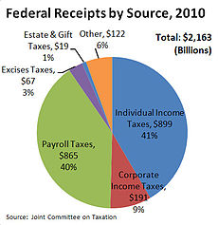

Slide 20
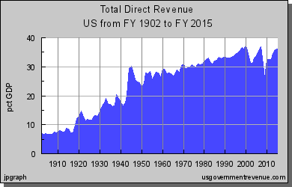


Slide 21
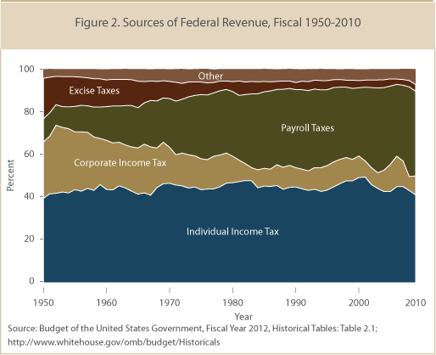

Slide 22
Year | Maximum taxable earnings | OASDI tax rate | HI tax rate
1937 | 3,000 | 2% | -
1950 | 3,000 | 3% | -
1960 | 4,800 | 6% | -
1965 | 4,800 | 7.25% | -
1966 | 6,600 | 7.7% | 0.7%
1970 | 7,800 | 8.4% | 1.2%
1971 | 7,800 | 9.2% | 1.2%
1975 | 14,100 | 9.9% | 1.8%
1980 | 25,900 | 10.16% | 2.1%
1985 | 39,600 | 11.4% | 2.7%
1990 | 51,300 | 12.4% | 2.9%
1995 | 61,200 | 12.4% | 2.9%
2000 | 76,200 | 12.4% | 2.9%
2005 | 90,000 | 12.4% | 2.9%
2006 | 94,200 | 12.4% | 2.9%
2007 | 97,500 | 12.4% | 2.9%
2008 | 102,000 | 12.4% | 2.9%
2009 | 106,800 | 12.4% | 2.9%
2010 | 106,800 | 12.4% | 2.9%
2011 | 106,800 | 10.4% | 2.9%

Slide 23
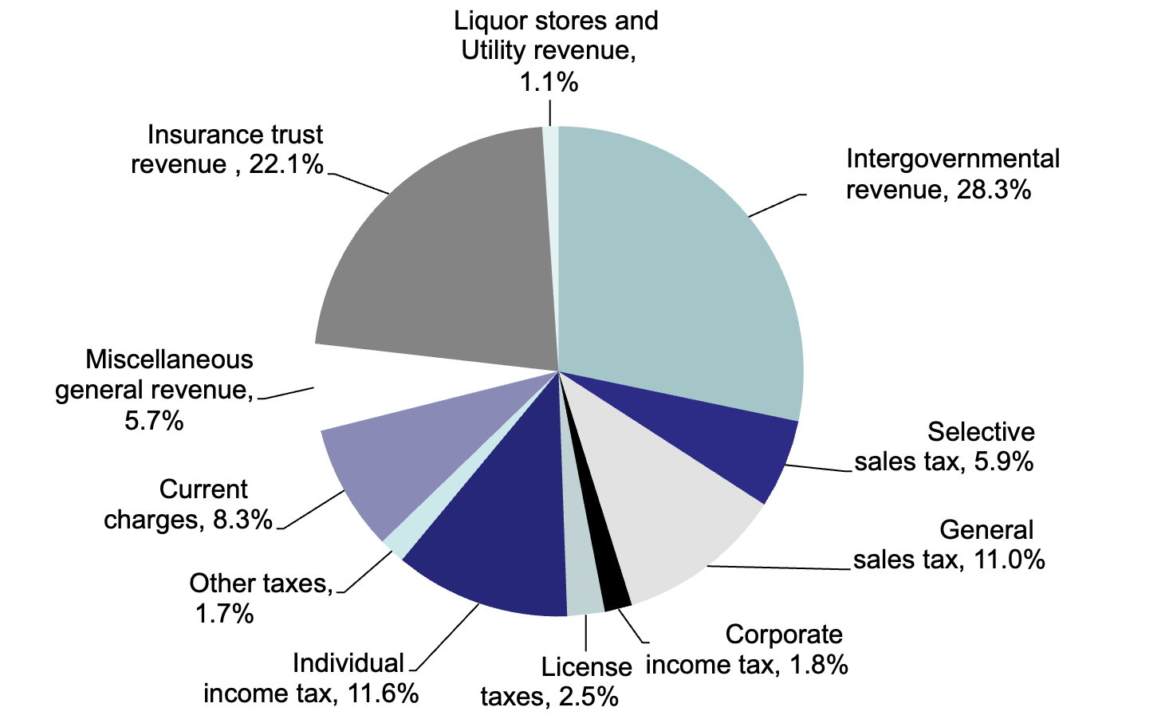

Sources of State Government Revenue

Slide 24
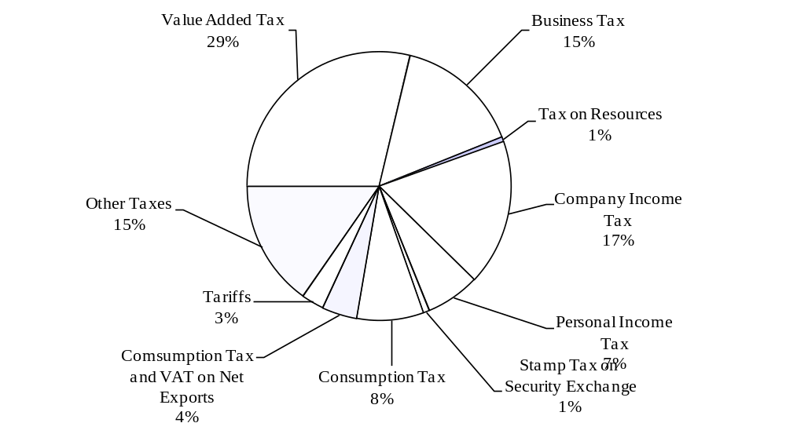
Composition of China’s Tax Revenue in 2010

Slide 25
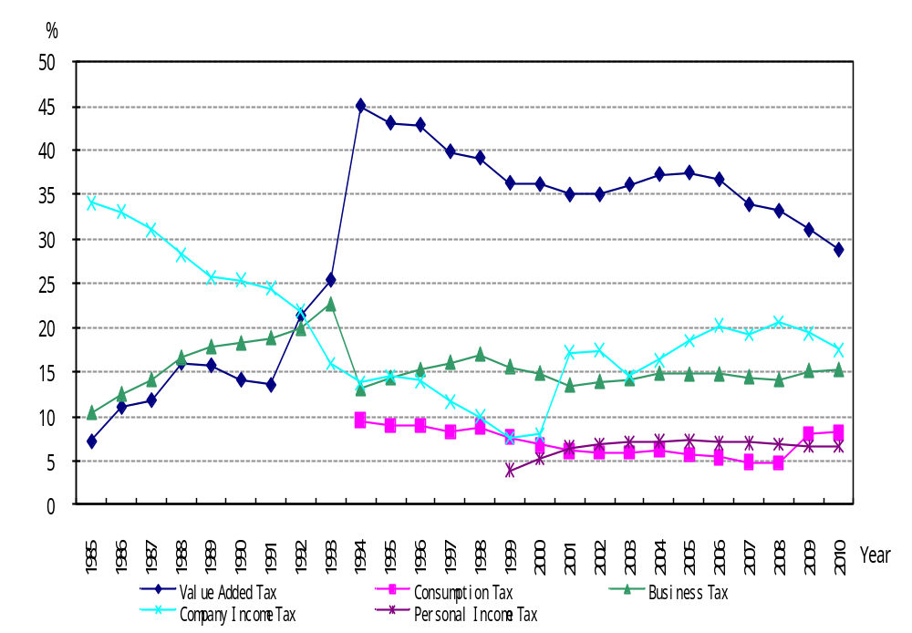
Share of China’s Major Taxes in Total Tax Revenue

Slide 26
Tax Reforms:
Widening the Tax Base:
  Advantages:
    It reduces the tax burden on any single group or individual.
    It can lead to more stable and predictable revenue streams for the government.
    Helps in reducing tax evasion as more entities are brought into the tax net.
  Disadvantages:
    It might be seen as regressive, as lower-income individuals might end up paying a higher proportion of their income in taxes.
    Implementation can be complex, especially if the tax system was previously narrow.

Slide 27
Tax Reforms:
Lower Tax Rate and Improve Tax Administration:
  Advantages:
    Lower tax rates can incentivize businesses to invest and expand, potentially leading to economic growth.
    Improved administration can reduce bureaucracy, making it easier for individuals and firms to comply.
    It can also reduce tax evasion and increase government revenue.
  Disadvantages:
    If not done correctly, lowering tax rates can lead to reduced government revenue, affecting public services.
    There's a risk of favoring certain groups or sectors over others.

Slide 28
Tax Reforms:
Adoption of Value-Added Tax (VAT):
  Advantages:
    VAT is considered more efficient than a sales tax as it reduces the cascading effect of tax, i.e., tax on tax.
    It promotes transparency in the taxation system.
    As a consumption tax, it can encourage savings and investments.
  Disadvantages:
    VAT can be seen as regressive since everyone pays the same rate regardless of their income.
    Implementation can be complex, especially if transitioning from a different system.

Slide 29
Tax Reforms:
Transition from Income Tax to Consumption Tax:
  Advantages:
    Encourages savings and investments as consumption taxes don't tax income that is saved.
    Can lead to increased capital accumulation.
  Disadvantages:
    Consumption taxes can be regressive, placing a heavier burden on lower-income individuals.
    Might discourage consumer spending, which can slow down the economy.

Slide 30
Bolivia
Economic Challenges in Bolivia in the Mid-1980s:
  Hyperinflation: One of the most significant challenges was hyperinflation, which reached a staggering 24,000% in 1985. Such high inflation rates eroded purchasing power, causing widespread poverty and reducing the real income of Bolivians.
  Unemployment: The unemployment rate was at a high of 17%, further straining the socio-economic fabric of the country.
  Currency Substitution: Given the extreme devaluation of the Bolivian peso and the lack of confidence in the national currency, Bolivians started using the US dollar as a primary store of value and medium of exchange. This phenomenon, known as "Currency Substitution" or "Dollarization," reflected the public's lack of trust in the country's economic policies.
  Low Tax Revenues: Tax revenues were extremely low, at just 1% of GDP. This figure highlighted the government's inability to collect taxes and the large informal economy that bypassed official channels.
Notes:
In the mid-1980s, Bolivia faced one of the most severe economic crises in its history. The country's economy was on the brink of collapse, with skyrocketing inflation rates, soaring unemployment, and a significant decrease in tax revenue. The situation was further exacerbated by political instability and external factors. Here's a detailed overview of Bolivia's economic situation during that period and the subsequent reforms:
Economic Challenges in Bolivia in the Mid-1980s:
Hyperinflation: One of the most significant challenges was hyperinflation, which reached a staggering 24,000% in 1985. Such high inflation rates eroded purchasing power, causing widespread poverty and reducing the real income of Bolivians.
Unemployment: The unemployment rate was at a high of 17%, further straining the socio-economic fabric of the country.
Currency Substitution: Given the extreme devaluation of the Bolivian peso and the lack of confidence in the national currency, Bolivians started using the US dollar as a primary store of value and medium of exchange. This phenomenon, known as "Currency Substitution" or "Dollarization," reflected the public's lack of trust in the country's economic policies.
Low Tax Revenues: Tax revenues were extremely low, at just 1% of GDP. This figure highlighted the government's inability to collect taxes and the large informal economy that bypassed official channels.
Reforms in 1986: To counter these challenges and stabilize the economy, the Bolivian government initiated reforms in 1986. Some of the key measures included:
Fiscal Discipline: The government implemented stringent controls on spending. One of the most significant measures was to authorize payments only to the extent of taxes collected each day. This move was aimed at living within means and ensuring fiscal discipline.
Monetary Reforms: To restore confidence in the national currency, the government undertook monetary reforms, including introducing a new currency.
Tax Reforms: Efforts were made to broaden the tax base, improve tax collection, and streamline the tax system.
Structural Reforms: These reforms included privatization of state-owned enterprises, liberalization of trade and investment, and regulatory reforms to encourage private sector participation and growth.
While the road to recovery was challenging, the reforms of 1986 played a crucial role in stabilizing Bolivia's economy and restoring investor and public confidence. Over time, the country managed to control inflation, increase tax revenues, and set the foundation for sustainable economic growth.

Slide 31
Bolivia
Reforms in 1986: To counter these challenges and stabilize the economy, the Bolivian government initiated reforms in 1986. Some of the key measures included:
  Fiscal Discipline: The government implemented stringent controls on spending. One of the most significant measures was to authorize payments only to the extent of taxes collected each day. This move was aimed at living within means and ensuring fiscal discipline.
  Monetary Reforms: To restore confidence in the national currency, the government undertook monetary reforms, including introducing a new currency.
  Tax Reforms: Efforts were made to broaden the tax base, improve tax collection, and streamline the tax system.
  Structural Reforms: These reforms included privatization of state-owned enterprises, liberalization of trade and investment, and regulatory reforms to encourage private sector participation and growth.
Notes:
In the mid-1980s, Bolivia faced one of the most severe economic crises in its history. The country's economy was on the brink of collapse, with skyrocketing inflation rates, soaring unemployment, and a significant decrease in tax revenue. The situation was further exacerbated by political instability and external factors. Here's a detailed overview of Bolivia's economic situation during that period and the subsequent reforms:
Economic Challenges in Bolivia in the Mid-1980s:
Hyperinflation: One of the most significant challenges was hyperinflation, which reached a staggering 24,000% in 1985. Such high inflation rates eroded purchasing power, causing widespread poverty and reducing the real income of Bolivians.
Unemployment: The unemployment rate was at a high of 17%, further straining the socio-economic fabric of the country.
Currency Substitution: Given the extreme devaluation of the Bolivian peso and the lack of confidence in the national currency, Bolivians started using the US dollar as a primary store of value and medium of exchange. This phenomenon, known as "Currency Substitution" or "Dollarization," reflected the public's lack of trust in the country's economic policies.
Low Tax Revenues: Tax revenues were extremely low, at just 1% of GDP. This figure highlighted the government's inability to collect taxes and the large informal economy that bypassed official channels.
Reforms in 1986: To counter these challenges and stabilize the economy, the Bolivian government initiated reforms in 1986. Some of the key measures included:
Fiscal Discipline: The government implemented stringent controls on spending. One of the most significant measures was to authorize payments only to the extent of taxes collected each day. This move was aimed at living within means and ensuring fiscal discipline.
Monetary Reforms: To restore confidence in the national currency, the government undertook monetary reforms, including introducing a new currency.
Tax Reforms: Efforts were made to broaden the tax base, improve tax collection, and streamline the tax system.
Structural Reforms: These reforms included privatization of state-owned enterprises, liberalization of trade and investment, and regulatory reforms to encourage private sector participation and growth.
While the road to recovery was challenging, the reforms of 1986 played a crucial role in stabilizing Bolivia's economy and restoring investor and public confidence. Over time, the country managed to control inflation, increase tax revenues, and set the foundation for sustainable economic growth.

Slide 32
Taxes and Economic Development
Taxes and private Investment
  Public vs. Private Savings:
    When taxes are increased, the government can accumulate more public savings, which can be used to fund public projects and services.
    However, higher taxes can decrease private savings as individuals have less disposable income.
  Investment Decisions:
    High taxes can deter private investment as they reduce potential returns on investments.
    Conversely, tax incentives or breaks can encourage private sector investments in specific industries or regions.

Slide 33
Taxes and Economic Development
Taxes and Capital Mobility
  Attracting Foreign Capital:
    Countries with competitive tax rates can attract foreign investments, leading to economic growth.
    Such investments can be in the form of Foreign Direct Investment (FDI) or portfolio investments.
  Preventing Capital Flight:
    High taxes can result in capital flight, where domestic investors move their investments abroad to countries with more favorable tax regimes.
    The example of Hong Kong investors moving to Canada post-1997 due to political uncertainties, and later returning because of HK's competitive 16.5% corporate income tax, underscores this point.

Slide 34
Taxes and Economic Development
Taxes and Income Distribution
  Ability to Pay Principle:
    This principle suggests that taxes should be levied based on an individual's ability to pay.
    Progressive taxation, where higher-income individuals are taxed at higher rates than those with lower incomes, is an example of this principle in action.
  Benefit Received Principle:
    This principle suggests that individuals should be taxed based on the benefits they receive from public services.
    For instance, if someone benefits more from public roads because they own a transportation company, they might be expected to pay more in taxes.

Slide 35
Taxes and Economic Development
Taxes on Luxury Consumption
  Taxes on luxury goods can serve multiple purposes.
    Firstly, they can be a source of additional revenue for the government.
    Secondly, such taxes can also be used to address wealth disparities by placing a higher tax burden on the affluent who consume luxury goods.
    Additionally, taxing luxury consumption can discourage excessive consumption and promote more sustainable consumption patterns.

Slide 36
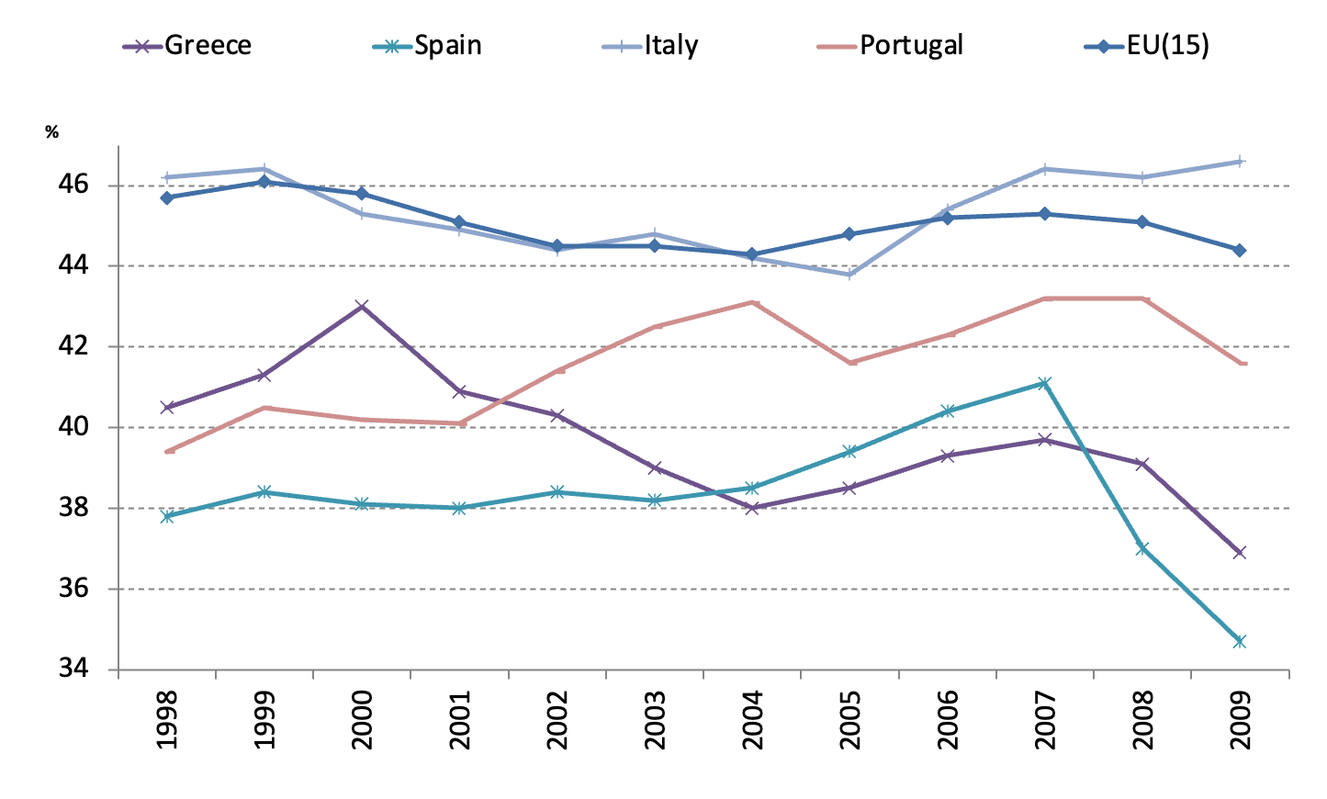
Tax Revenue-GDP Ratios (1998-2009)

Slide 37
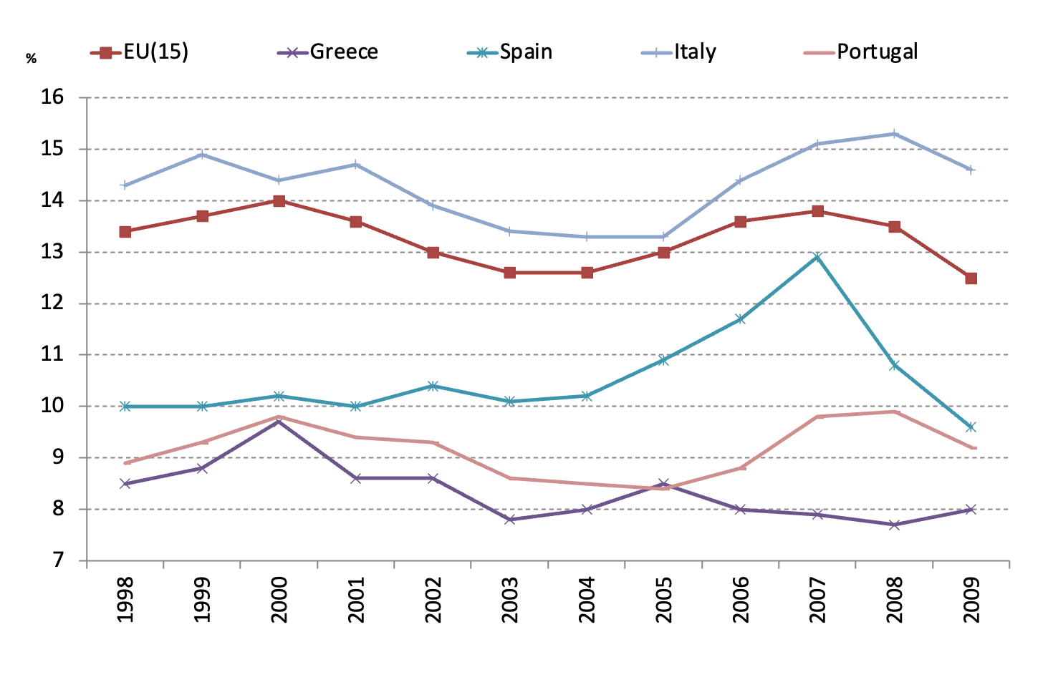
Income Tax-GDP Ratios (1998-2009)

Slide 38

III. Government and Economic Development
III.1 Economic Development and Government Size
Wagner’s law: the relative size of government tends to increase as per capita income increases
  An observation made by Adolph Wagner (1835–1917).
The law is based on three claims:
  economic growth results in an increase in complexity requiring continued introduction of new laws and development of the legal structure;
  urbanization increases negative externalities, such as congestion and crime, which necessitate intervention;
  the goods supplied by the public sector have a high income elasticity of demand. If the elasticity of demand exceeds one, public sector expenditure will consequently rise as a proportion of income.
Empirical evidence has failed to convincibly support that the elasticity is greater than one.
But government size has increased in many countries over time, and the rich countries seem to have a larger size of government.

Slide 39
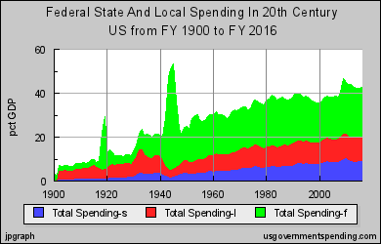
Sources: http://www.usgovernmentspending.com/us_20th_century_chart.html
At the start of the 20th century, out of a total of 7% of GDP, 4% was spent at the local level. Federal spending spiked in World War I, but in the 1920s, local government spending still accounted for half.
In the 1930s, federal spending surged to near half.
After the spike of World War II the federal share increased, and state share as a percent of GDP also increased.
By the 2010s federal spending was over 20% of GDP, state 8 to 9% of GDP, and local spending exceeded 10% of GDP.

Slide 40
III.2 Government and Economic Growth
Government spending
The share of government spending in GDP is negatively related to per capital GDP growth.
  Landau, D. (1983), Government Expenditure and Economic Growth: A Cross-Country Study, Southern Economic Journal, 49, pp.783-92.
  Landau, D. (1986),Government and Economic Growth in the Less Developed Countries: An Empirical Study for 1960-1980, Economic Development and Cultural Change, 1986
  Barro, R. (1991), “Economic Growth in a Cross Section of Countries.” Quarterly Journal of Economics, 106, May, 407-443.
The growth rate of govt spending is positively related to economic growth.
  Ram, Rati (1986), Government size and economic growth: a new framework and some evidence from cross section and time series data, American Economic Review, 76,191–203.
There exists an optimal size of government.
  If the govt size is small, and an increase in govt size will increase the rate of growth;
  If govt size is too big, and an decrease in govt size will increase the rate of growth.
  Barro, R. (1990), “Government Spending in a Simple Model of Endogenous
Growth.” Journal of Political Economy 98, s103-125.
Notes:
Government Spending and GDP Growth:
Negative Relationship: Some studies suggest that there's a negative relationship between the share of government spending in GDP and per capita GDP growth. Landau (1983 & 1986) suggests that as the proportion of government expenditure in the GDP increases, the per capita GDP growth tends to decrease. This could be attributed to inefficiencies in government spending or the crowding-out effect where government spending might be taking away resources from potentially more productive private investments.
Positive Relationship: Contrary to the above, other studies, such as Ram (1986), indicate that the growth rate of government spending is positively related to economic growth. This could be because public investments in areas like infrastructure, education, and healthcare can potentially have positive spillover effects on the private sector, leading to overall economic growth.
Optimal Size of Government: Barro (1990) introduces the concept of an optimal government size. According to this theory, there's a point where the size of the government is just right to maximize economic growth. If the government is too small, increasing its size (and thereby its role in the economy) could promote growth. On the other hand, if the government is excessively large, reducing its size could potentially lead to higher growth rates. This is because an overly large government might result in inefficiencies, bureaucratic delays, and could crowd out private investments.

Slide 41
B. Taxes
Increases in income taxes lead to permanent declines in the rate of economic growth.
  Rebelo, Sergio, 1991, “Long Run Policy Analysis and Long Run Growth,” Journal Political Economy, 99:500-521.
Tax structure matters for growth
  Lee, Young, and Roger Gordan (2005) “Tax structure and economic growth,” Journal of Public Economics, 89, 1027-1043.
  Based on cross-country data during 1970–1997, statutory corporate tax rates are significantly negatively correlated with cross-sectional differences in growth rates. The coefficient estimates suggest that a cut in the corporate tax rate by 10 percentage points will raise the annual growth rate by 1-2 percentage points.
  Jens Arnold, 2008, Do Tax Structures Affect Aggregate Economic Growth? Empirical Evidence from a Panel of OECD Countries, OECD WP 643.
  Based on panel data from 21 OECD countries, it is found that income taxes are generally associated with lower economic growth than taxes on consumption and property. More precisely, property taxes, and particularly recurrent taxes on immovable property, seem to be the most growth-friendly, followed by consumption taxes, and then by personal income taxes. Corporate income taxes appear to have the most negative effect on GDP per capita.

Slide 42
C. Government debt
The economics profession seems to increasingly endorse the existence of a strongly negative nonlinear effect of public debt on economic growth.
Reinhart and Rogoff (2010) "Growth in a Time of Debt," American Economic Review,100(2), 573-78, May. NBER Working Paper No. 15639
  A public debt-to-GDP ratio higher than 90% of GDP is associated with considerably lower economic performance in advanced and emerging economies alike.

