Slide 1
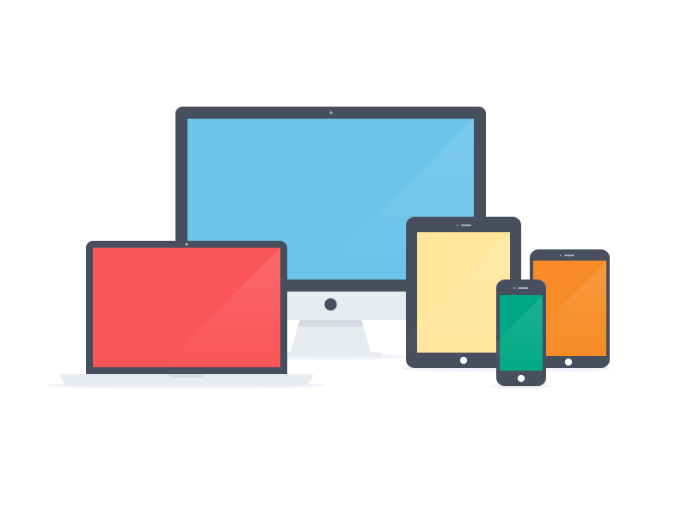




Slide 2

Don't mention the war ( of the browsers )
Web – Standardisation ?
HTML5 & CSS3
Speed of development
Proliferation of mobile devices
Device fragmentation
All with different:
    screen resolutions, screen sizes, OS's, manufacturers, hardware capabilities, softwares versions, browsers, rendering engine, javascript engines, etc.

Slide 3

Your website here

Slide 4

Why is a Device lab needed ?
Test, Test, Test
Apps, Websites, Web Apps & Hybred Apps
Emulators can only do so much
    Touch
    Device hardware [GPS, Camera, NFC etc.]
    User Experience, ergonomics
    Edge cases
    Not the same software or hardware
Need to test on real devices

Slide 5

Device labs
The rise of smart-phones
Need to test on a range of platforms
2010's Web studios, large tech companies
2012 Clearleft – Brighton communal test lab
Open Device Lab
Lab-up

Slide 6
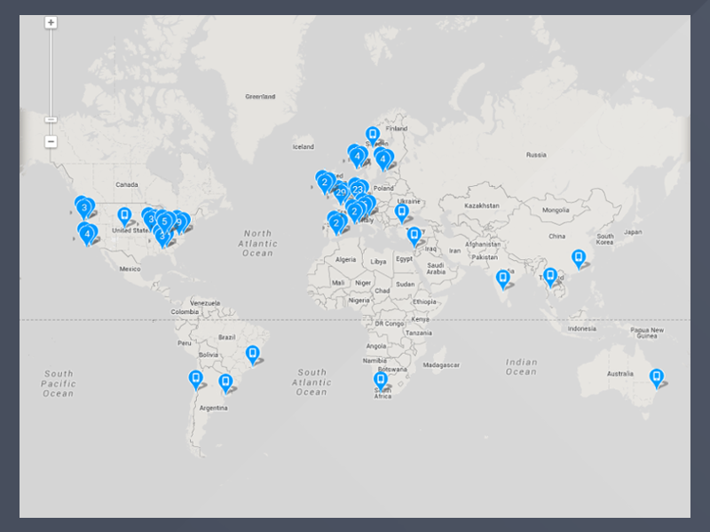
111
26
2896
Open Device Labs
countries
devices accessible

Slide 7

Why an Open Device lab ?
Access
Serve the needs of community
  ITT staff & students
  Kerry Technology Park
  Local companies
  Freelancer developers
Shared community pool of devices
Not just the hardware, also knowledge
Cost

Slide 8
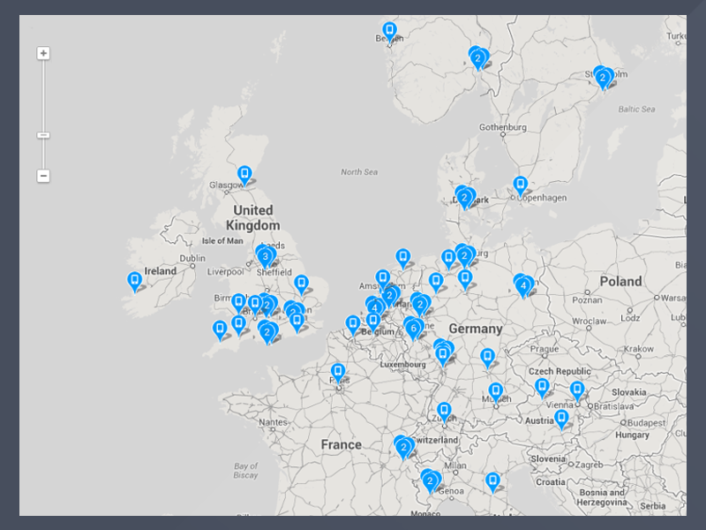
1st
Irish Open Device Lab

Slide 9

Why IT Tralee ODL ?
"To excel in teaching, research and development work, for the benefit of students, industry and the wider community"
- ITT Mission Statement

