Slide 1
CRUD APPLICATION
Manasa G
Mounika T
Pavan Kumar P
Akhil G
Adi Seshu Ch
        Guide: Mr.Srikanth Kavuri

Slide 2
INTRODUCTION
CRUD Application facilitates to
Create
Retrieve
Update
Delete
the records of the Database
CRUD function plays
a major role in
Database Management
System

Slide 3
INTRODUCTION
Technologies used:
JAVA Applets
JDBC Technology – JAVA Data Base Connection,
AWTControls,
MySQL.

Slide 4
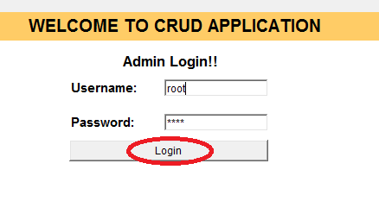
LOGIN

Slide 5
READ
Crud application read's the data from the sql database.
public CreateJDBCConnection(String user,String pass){
try{
Class.forName(JDBC_DRIVER);
conn = DriverManager.getConnection(DB_URL,user,pass);
stmt = conn.createStatement();
}
catch(Exception e){
System.out.println("SQL Error");
}
}

Slide 6
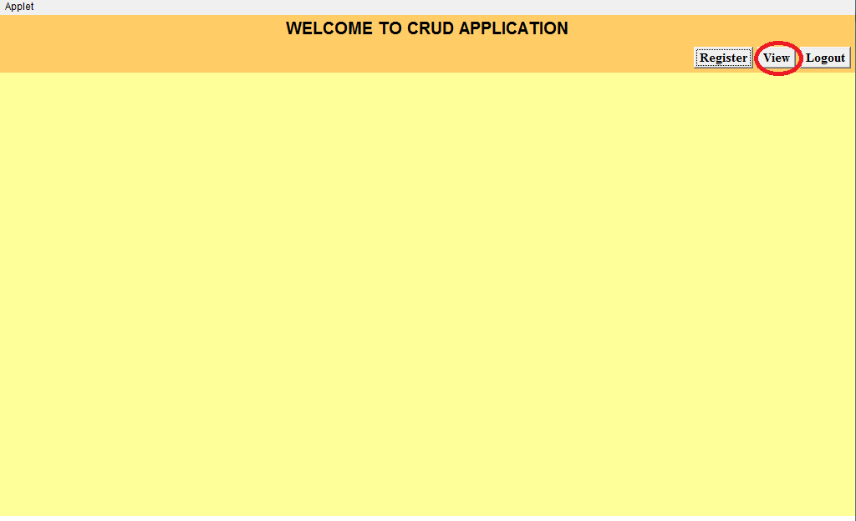
READ

Slide 7
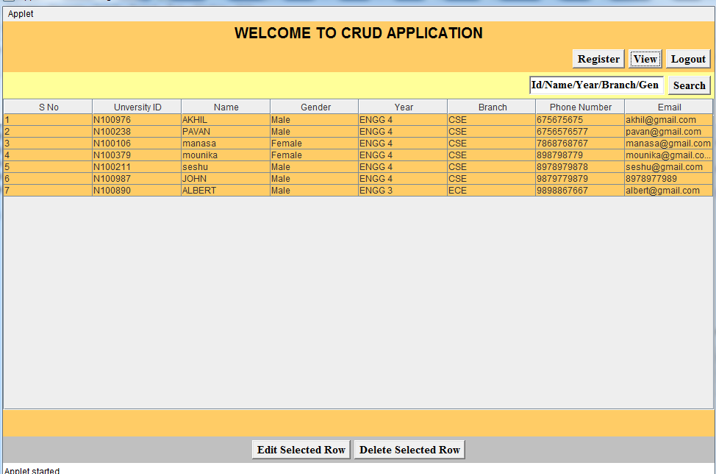
READ

Slide 8
CREATE
It is used to insert new record to database.
In CRUD we can manually create data with out using commands
stmt.executeUpdate("insert into student values('"+idno+"',
'"+name+"','"+gen+"','"+year+"','"+branch+"','"+ph+"','"+email+"')");
JOptionPane.showMessageDialog(this, name+", You Successfully Registered. THANQ");

Slide 9
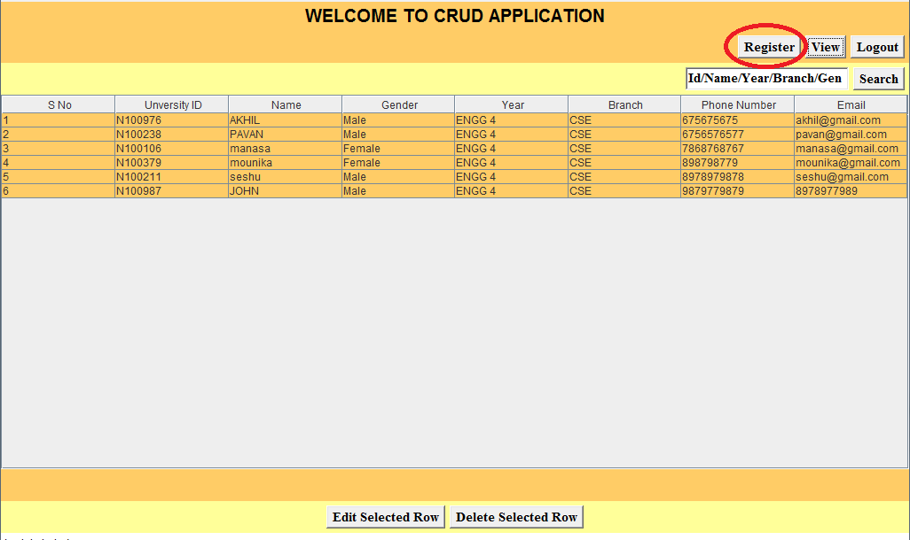
CREATE

Slide 10
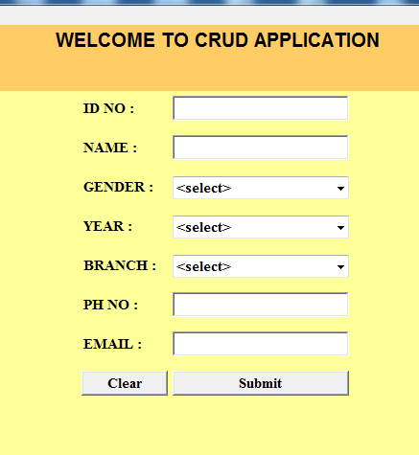
CREATE

Slide 11
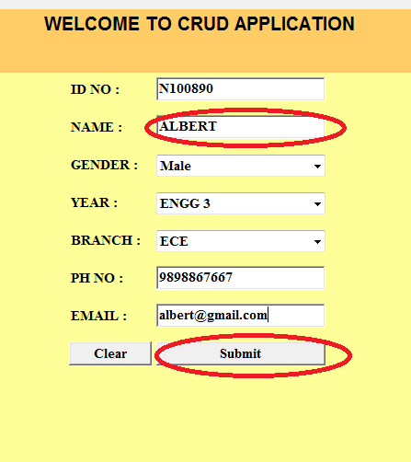
CREATE

Slide 12
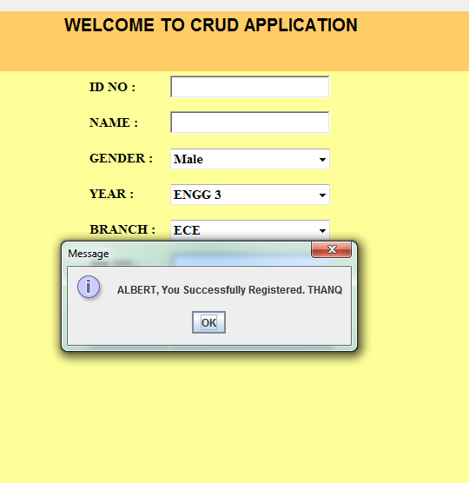
CREATE

Slide 13
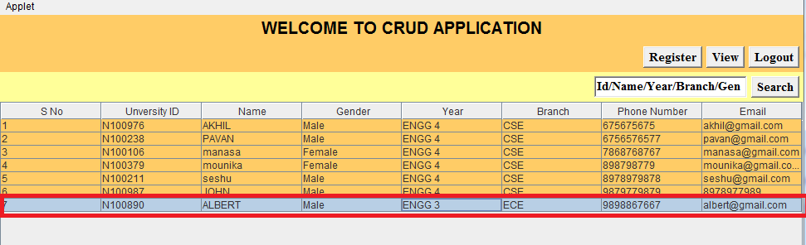
CREATE

Slide 14
UPDATE
We can edit the attribute values of a record manually
No need to use commands/program

Slide 15

UPDATE

Slide 16
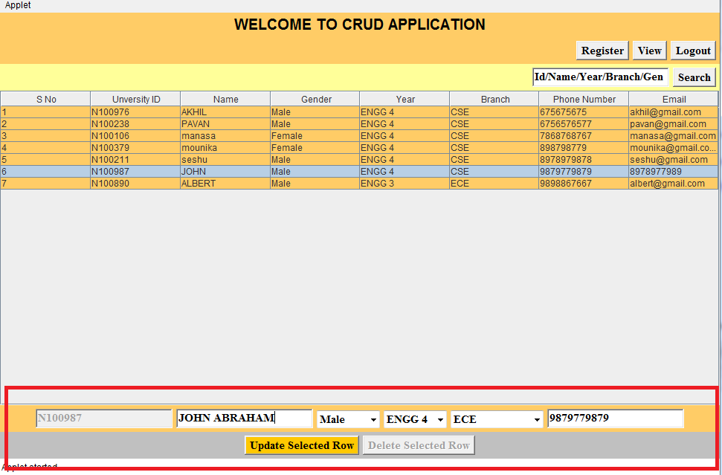
UPDATE

Slide 17
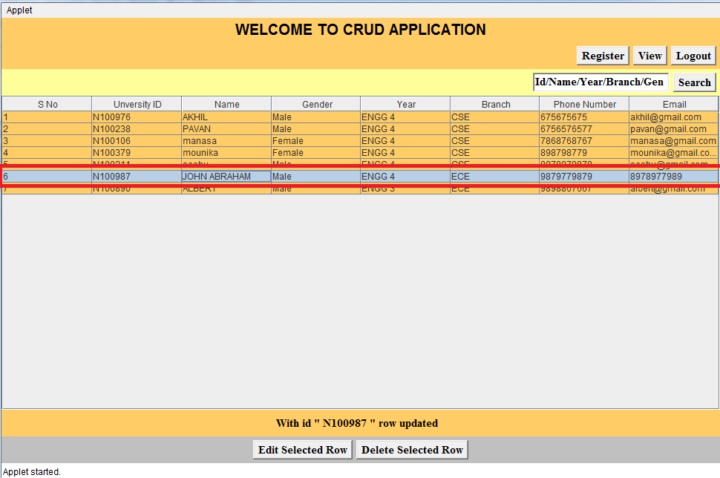
UPDATE

Slide 18
DELETE
We can simply drop the records with CRUD
stmt.executeUpdate("delete from student where idno='"+key+"'");

Slide 19
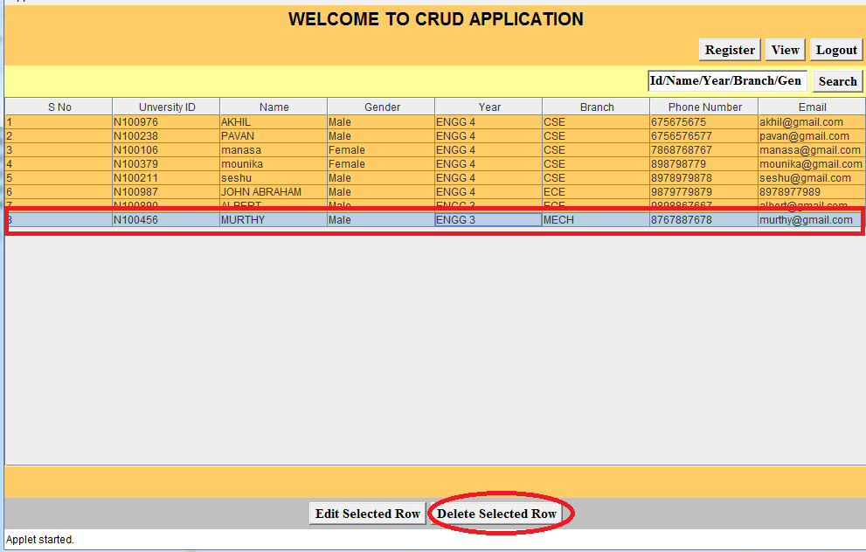
DELETE

Slide 20
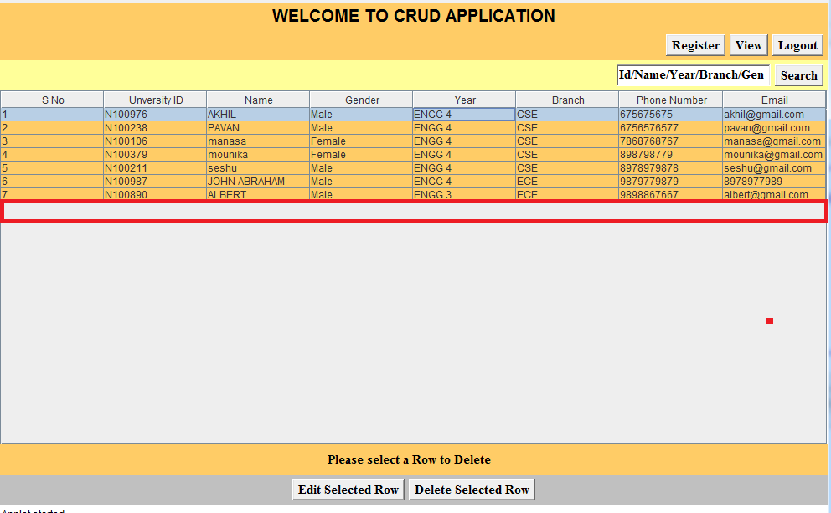
DELETE

Slide 21
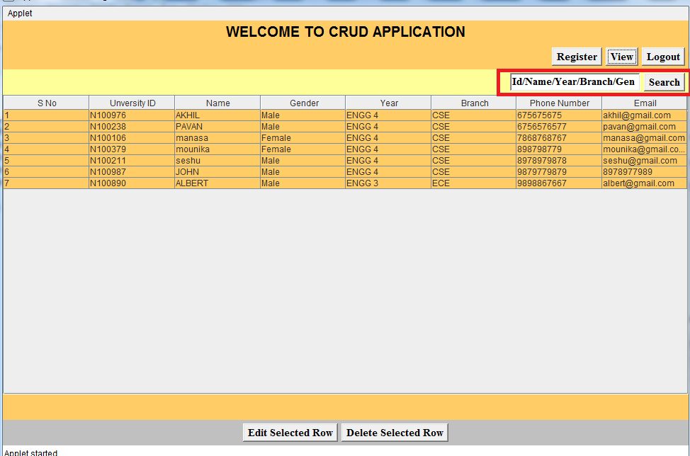
SEARCH

Slide 22
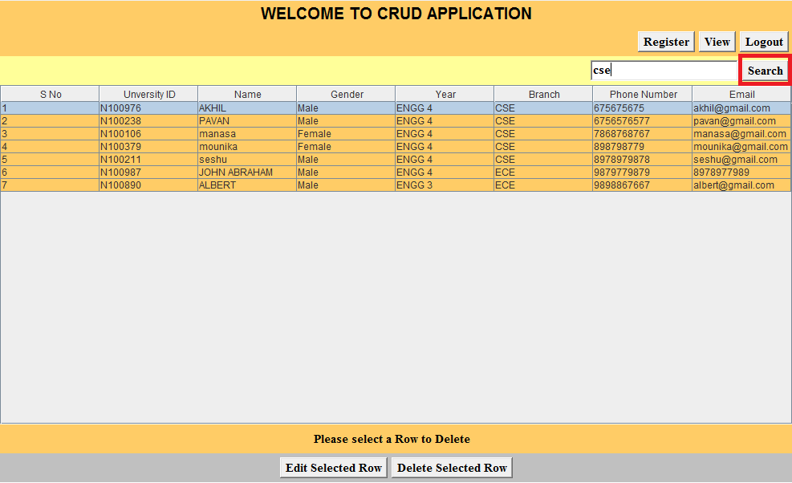
SEARCH

Slide 23
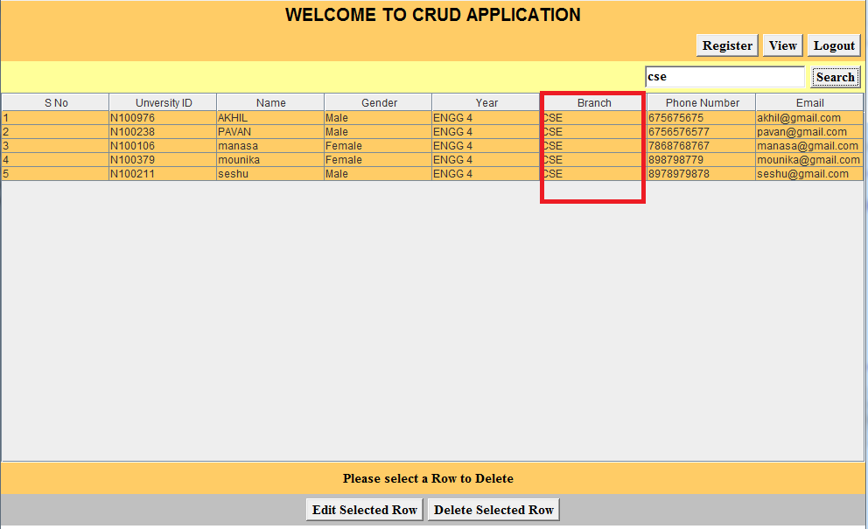
SEARCH

Slide 24
USES
User Friendly
Easy to use (Any one can use)
Super Market Management System

Slide 25
CRUD is everywhere . . .
Real time CRUD applications.
Library Management System
Online Shopping Management System
Student Information System
Retail Marketing System
Online Leave Management System
Railway Reservation System

Slide 26
References
www.tutorialspoint.com
www.javatpoint.com
Docs.oracle.com
Java Black book by Nageswara Rao

Slide 27
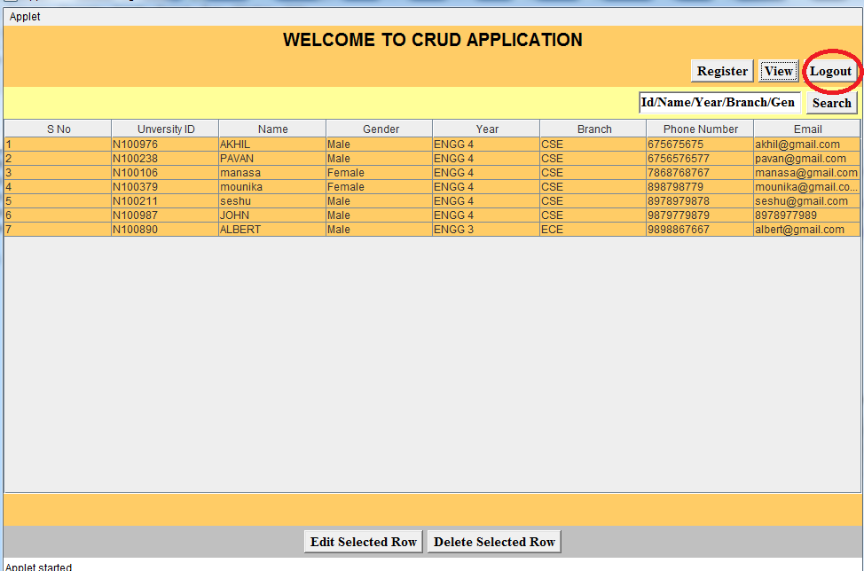
LOGOUT

Slide 28
CRUD TEAM . . . Signing off . . .
Thank You

