Slide 1




Slide 2
RGU Helping Hands
The students of RGUKT have taken much responsibility on their shoulders for a noble cause. Their budding thoughts lead them to establish a foundation Helping Hands for the welfare of the poor students in AP IIIT'S as well as the society. Tremendous efforts of the innocent dazzling minds uplifted their spirits and proved themselves that they are the towering inspiration for the forthcoming generations through their noble contribution to the people who are at the edge of the poverty line.
Every journey starts with a single step. They recognized the value of the first step and took the first step of initiation to show the strength of a rupee. Its main motive is to empower the rural poor and to construct a new world to let out their grievances from their lives. Of course they are the tiny tots of the society but their blossoming thoughts ignite the poor and disabled hearts. It mainly focuses on:
Helping the poor students, for their
→ Daily needs
→ Travelling expenses
→ Distribution of tricycles for physically challenged students
→ Meeting the expenses of washing clothes for the disabled and for the medical expenses.

Slide 3
STRUCTURE OF ORGANIZATION
There are 3 levels in the Organization of HELPING HANDS

Slide 4

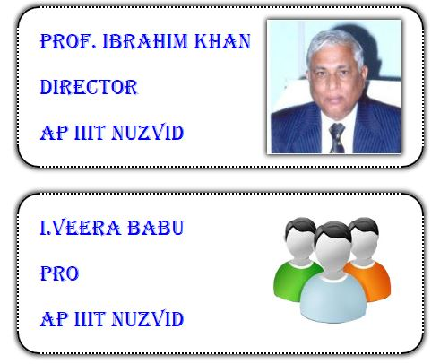
1.Advisory committee

Slide 5
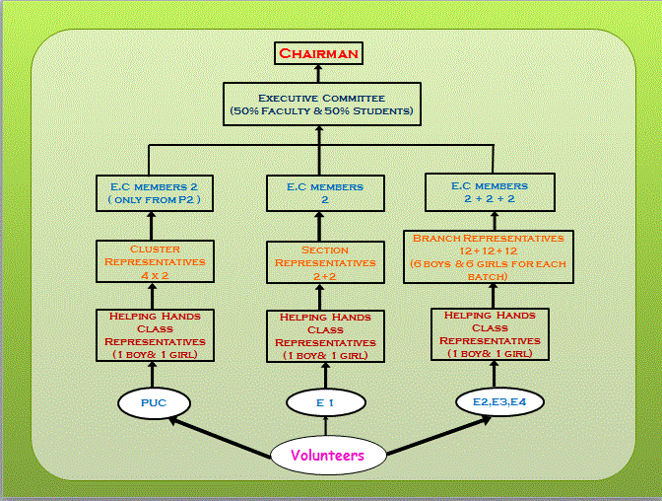
2. Executive Committee

Slide 6
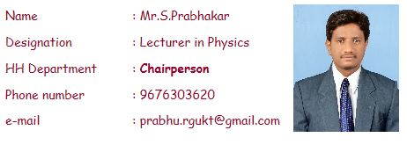
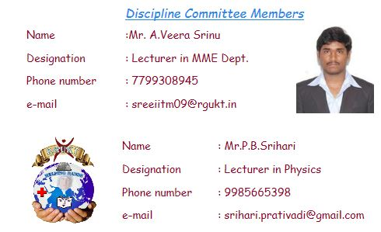
CHAIR PERSON

Slide 7
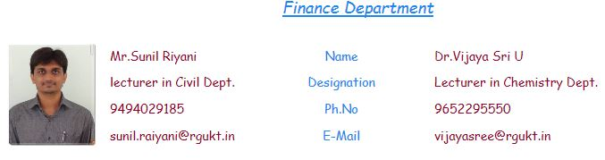

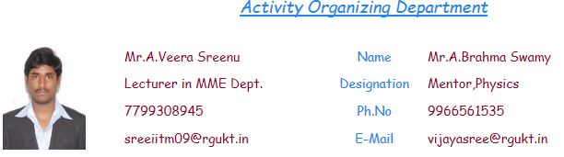

Slide 8
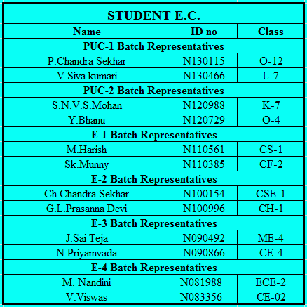
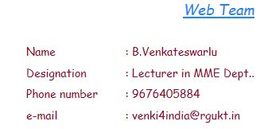

Slide 9
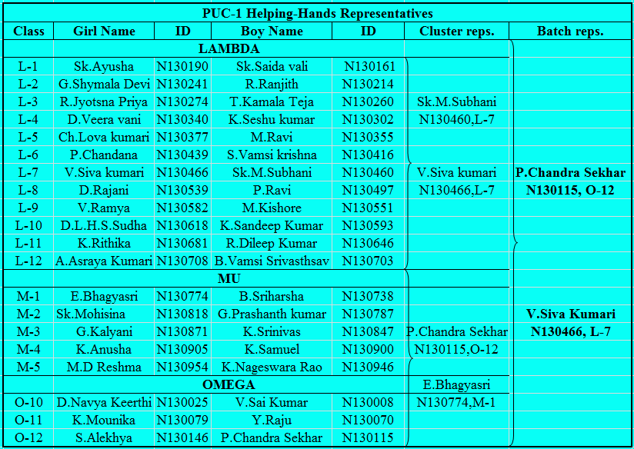
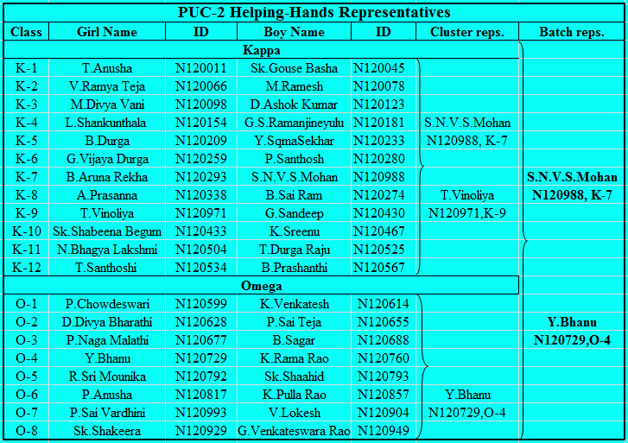
3. Representative Committee

Slide 10
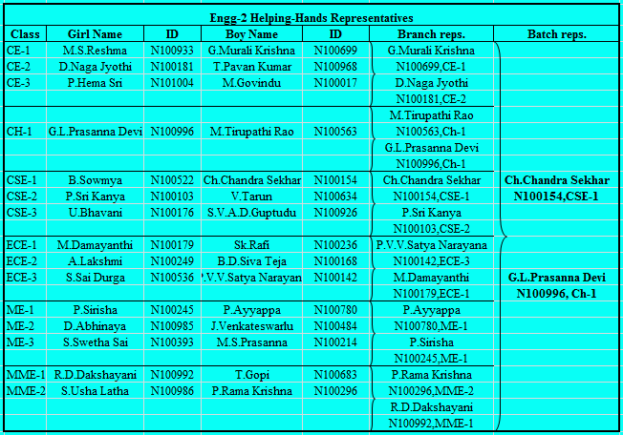

Slide 11
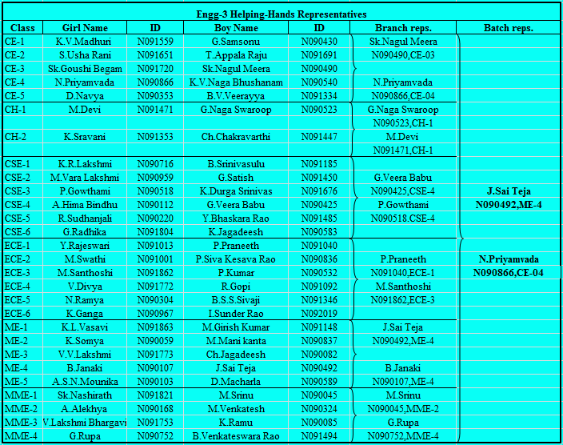

Slide 12
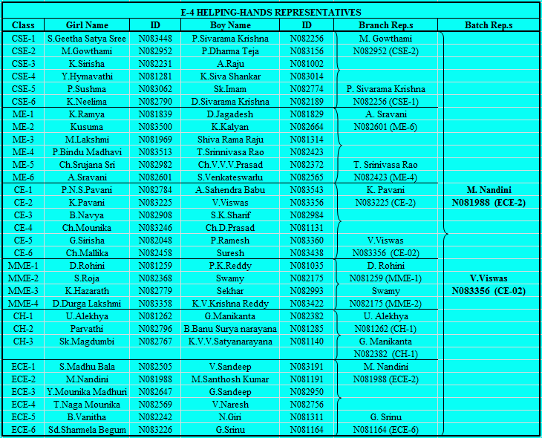

Slide 13
Functioning of Organization
1.Money Collection
Money collection is through draw boxes. The draw boxes are positioned at academic blocks of each batch (For PUC they are placed at each cluster and for Engineering batches they placed at academic blocks). Students can contribute money through these draw boxes. Money is taken and count in the presence of working committee and deposited in the SBH account. The details will be displayed in the website.
2.Gathering the Problems through Representatives
Students those who have problems can mention through enrolling in the website. Working committee will gather all the enrollments posted in a defined period. If there is any emergency they can directly consult the representatives or working committee members.
3.Executive Committee decisions
Working committee meets twice in a month. The members will make discussion on the enrolled problems and if the problem is genuine it will be served with proper contribution. The decision will be taken if the 2/3rd majority of WC supports the problem or any proposal. WC decides the amount of money will be debit from the account and distributed to each problem based on the decision.
4.Contribution
The amount of money will be served to a particular problem based on the working committee decision.

Slide 14
Money Collection
Collection of money will be happen most probably four ways.
Collection of the money from the students every week on Tuesday at study hours. If that is holiday, it will be done on the next of that day i.e. Wednesday.
Selling the used rough books by students every year
Collection of the money from the drop box.
Donations to the helping hands.
PUC Classes
Each class have HCR (Helping Hand Class Representatives – one boy and one girl, ), they have to collect the fund from the classroom students and hand over to the head of HCR ( ) by keeping the wilrecords. These head HCR are the member of HCR only.
Head HCR ( ) will collect the money from the each class HCRs.
PUC Representatives will collect the money from the head HCR and l hand over the Finance and Treasurer by keeping the records and these records will be displaced every week on website.

Slide 15
Engineering First Year(E1)
Each class have HCR (Helping Hand Class Representatives – one boy and one girl for each class in Section A and Section B ), they have to collect the fund from the classroom students and hand over to the head of HCR (Section A – 2 students and Section B – 2 students) .These head HCR are the member of HCR only.
Head HCR (Section A – 2 and Section B – 2) will collect the money from the each class HCRs.
E1 Representative will collect the money from the head HCR and will hand over the Finance and Treasurer by keeping the records and these records will be displaced every month on website.

Slide 16
E2,E3,E4
Each class have HCR Helping Hand Class Representatives-one boy and one girl
CE (E2-6,E3-10,E4-12)* CHE (E2-2,E3-4,E4-6)* CSE (E2-6,E3-12,E4-12)* ECE (E2-6,E3-12,E4-12)* MME (E2-4,E3-8,E4-8)* ME (E2-6,E3-10,E4-12)*
they have to collect the fund from the classroom students and hand over to the head of HCR (CE E2/E3/E4-22, CHE E2/E3/E4 -2, CSE E2/E3/E4-2, ECE E2/E3/E4 -2, MME E2/E3/E4-2, and ME E2/E3/E4-2) by keeping the records. These head HCR are the member of HCR only. (Record detail is given here)
Head HCR will collect the money from the each class HCR.
E2,E3,E4 Representatives will collect the money from the head HCR and will hand over the Finance and Treasurer by keeping the records and these records will be displaced every month on website.

Slide 17
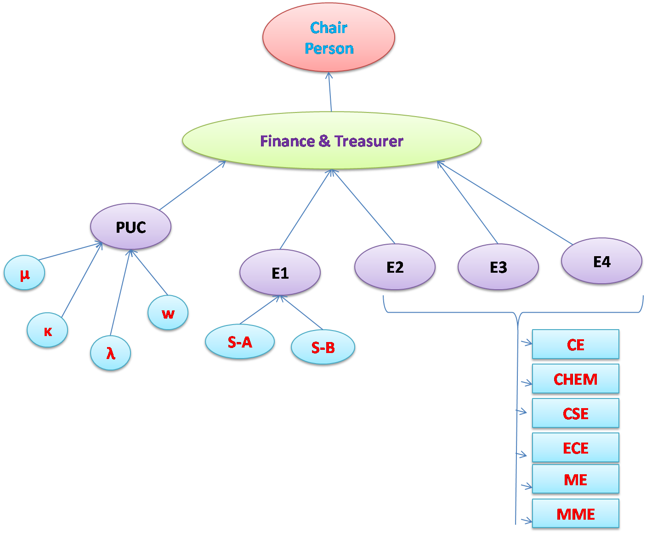
Process Description

Slide 18
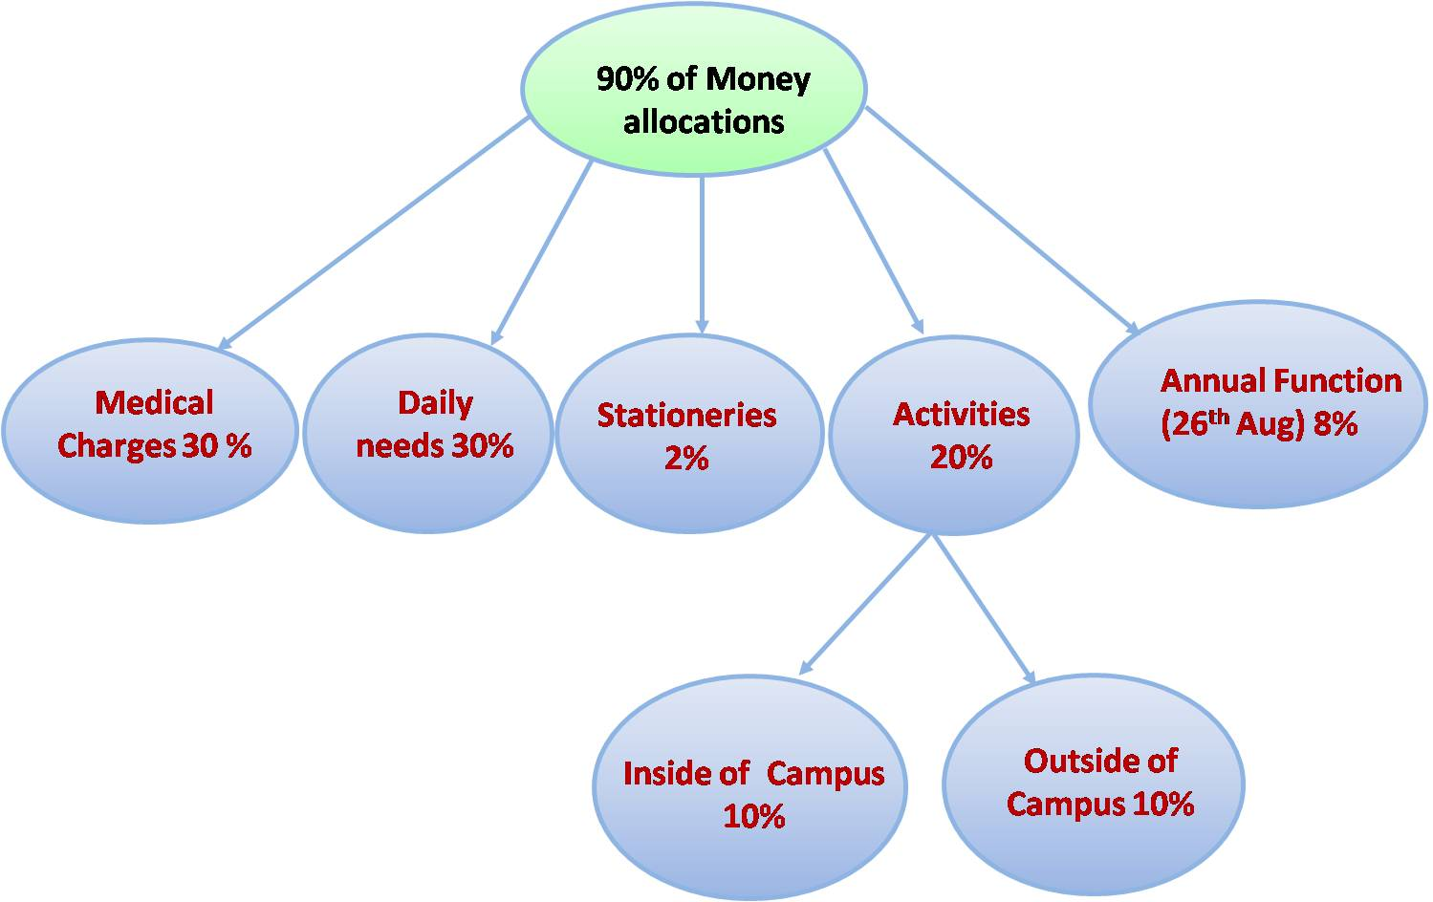
Money Issuing
Money reached from various sources like collection from the students, selling of used rough books, collection from the drop box per year, out of 100 % collection 90% money will be utilized for various activities remaining 10% money will be keep as a treasurer and will utilize at the time of most emergency only. Utilization of 90% money is the following manner:

Slide 19
Medical charges 30%
Preference is given only for the IIIT Nuzvid campus students. In this regard maximum 1/10th of total medical allocation will be provide per student, during serious case maximum limit will be change according to severity of case and it will be decide by only EC meeting.
Necessary proofs have to produce for utilizing the medical allowance. (i.e. Medical report/prescription given by M.S/M.D/highly educated Doctors).
Medical allowance sanctioned students should have to produce bills during or after the treatment and one Xerox copy of certificate and bill need to submit to committee.
Sanction money if more than 1000 Rs. then transaction should be in check form only.
5.hen money sanctioned then one Xerox of issued check should be submit to committee with back side issued and receiver sign.
6.Students, who are suffering with "long term diseases", have to renewal every academic year and separate file will be maintain for them and grant will be sanction maximum of 4 years only

Slide 20
Daily Needs 30%
1.Preference is given only for the IIIT Nuzvid campus students.
2.Student need to have at least three HRC recommendations from their departments or domes during the forms.
3.Need to submit the proof of income.
4.Need to submit the Ration Card Xerox.
5.Student need to apply through I Need Help, that is the link provided in our website. Students can approach directly the E.C. if in case of emergency.
6.Verification will be done by the respective HCR and two more HCRs of neighbor classes along with their batch representative.
7.The case should be approved by anyone of the faculty in Accounts department and Chairman along with any two students of E.C.

Slide 21
Rules & Regulations
1.Every student / faculty must enroll as volunteer, if they want to serve through RGUKT HELPING HANDS organisation. 2.Every volunteer / representative must have one year experience in this organisation. 3.Every volunteer / representative have to renewal for next year if he/she want to be in this organisation for the next year. (Every renewal is subjected to his candidature during last year.) 4.Every decision(any policy or money matters or any proposals) in helping hand organisation must be agreed by 2/3 of people in the E.C. Committee. 5.Every batch representative should pass a test conducted by the faculty members to be a member of E.C. 6.If any student is punished under disciplinary grounds, He/she is not eligible to be an active member in Helping Hands Organization.

Slide 22
Discipline Measurements
Helping Hands would like to adopt its own discipline measurements. The volunteers working in Helping Hands Organization should be self- disciplined and must act as per the rules and regulations. If anyone in the organization is seen violating the rules and regulations of Helping Hands, He/she would be suspended immediately from Helping Hands Organization. The following are some of the indisciplinary things which come under the discipline measurements and have been classified into different clauses.
Clause-I: Money oriented issues
Stealing money from the Helping Hands
Encouraging ineligible students for their personal benefits
Providing incorrect information and proofs for getting the money from helping hands (Ex: medical bills, travelling charges...etc)
Unauthorized collection of money

Slide 23
Clause-II: Behavior oriented issues
Violation of rules framed for smooth running of helping hands.
Unnecessary interactions in the name of Helping Hands
Unnecessary arguments and comments with subordinates
Spreading rumors about Helping Hands
Being inactive at the work place
Clause-III: Regularity and other issues
Not attending to the meetings or activities conducted by helping hands without prior notice and proper reason
Failing to bring to the notice of EC about the needy people without any reason even after their request to him
Clause-IV: Penalties for the members falling under above issues
The person falling under any Clause should be suspended immediately.
Subjected to the severity of the situation, he/she should be sent to the discipline committee of our campus.In case of money thefting or misusing, along with above two actions, money also should be recovered from the person

Slide 24
I Need Help
This column is strictly dedicated to address the problems of people who don’t have a direct approach with the Representatives of Helping Hands. In this column, we provide a direct platform to report your problem. Helping Hands tries to provide a solution for your problems as soon as possible.

Slide 25




