Slide 1
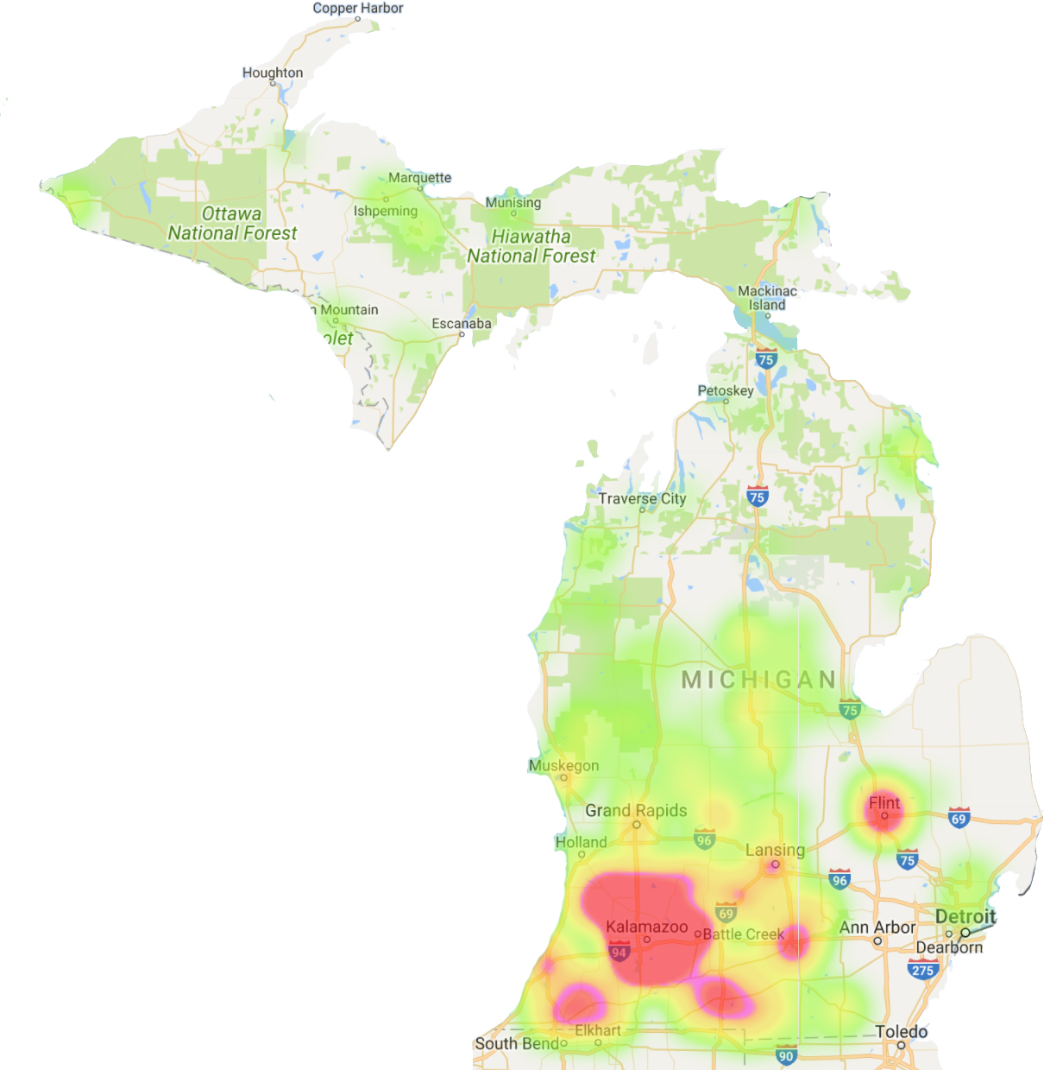
Michigan Meth Labs
And Real Estate
John Voorhess SI330 Fall 2017
Point map with addresses:
bit.ly/2BPs9Bc

Slide 2

The Process:
Convert DEA list of meth labs to csv. (https://convertio.co/pdf-csv/)
Query Google Map Geocoding API
Query Onboard API for real estate data (<500 per day)
Parse Onboard JSON and load into table for analysis
Query database for aggregate values

Slide 3
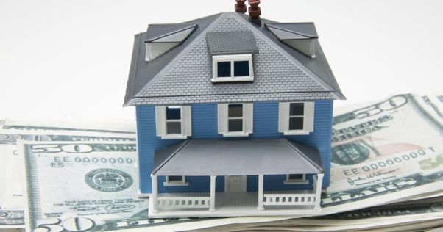
The Average Meth Lab:
$50,330
~1519 sq. ft.
~ 2.7 bedrooms
~ 1.5 bathrooms

Slide 4

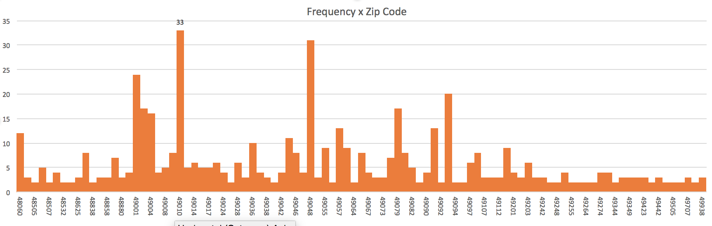
More:
Kalamazoo - 88
Allegan - 33
Portage - 21
Battle Creek - 18
Three Rivers - 16
most frequently appearing cities:

