Slide 1

AI-Based Network Intrusion Detection and Threat Intelligence Dashboard
REVIEW 1
SRIVALLI-2520090040
PAVANI-2520090041
KAVYA SREE - 250090143

Slide 2
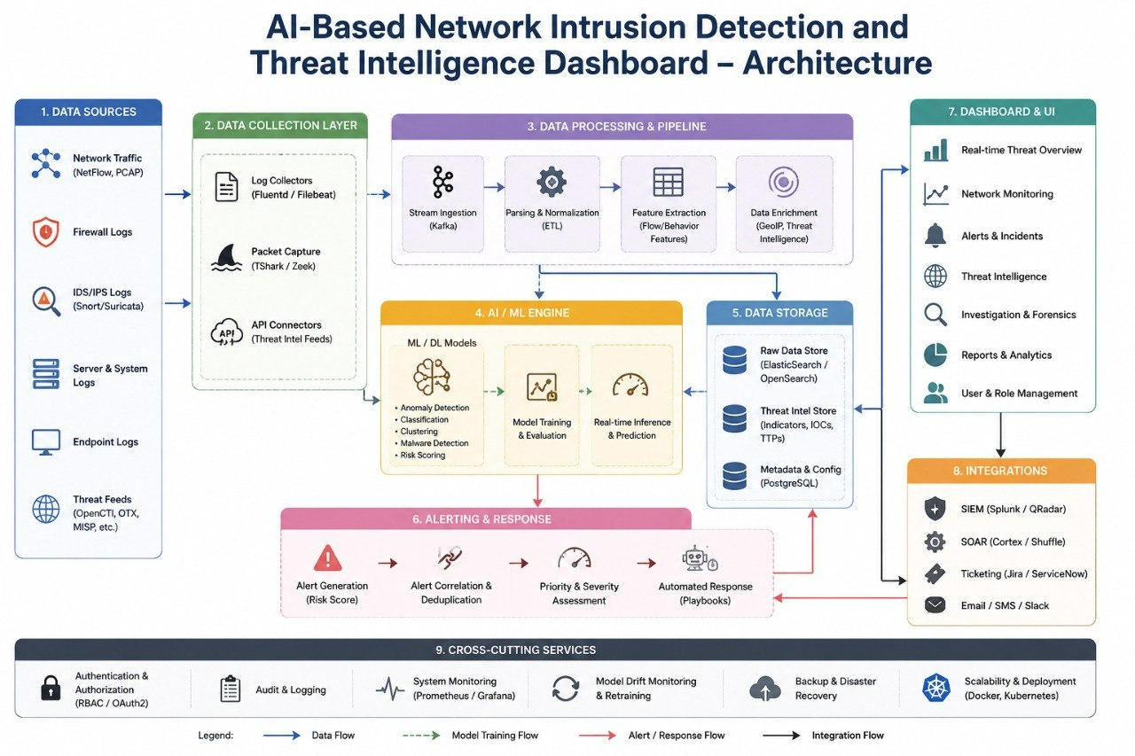

Slide 3
System Modules
• Data Collection Module: captures network traffic records and security logs
• Preprocessing Module: cleans, encodes and normalizes traffic features
• Detection Module: ML model classifies traffic as normal or malicious
• Database Module: stores traffic, alerts, attack types and threat intelligence in MySQL
• Alert Module: generates alerts with severity levels for detected intrusions
• Dashboard Module: visualizes attack statistics, trends and threat insights

Slide 4
Database Design – Tables
Table | Key Attributes
users | user_id (PK), username, email, role
network_traffic | traffic_id (PK), src_ip, dst_ip, protocol, port, packet_size, timestamp
attack_types | attack_type_id (PK), attack_name, description
alerts | alert_id (PK), traffic_id (FK), attack_type_id (FK), severity, status, detected_at
threat_intel | intel_id (PK), ip_address, reputation_score, source, last_seen
incident_logs | log_id (PK), alert_id (FK), user_id (FK), action_taken, resolved_at
- Operating System: Windows/Linux
- Frontend: HTML, CSS, JavaScript
- Backend: Python (Flask/Django)
- Database: MySQL
- Tools: VS Code, Jupyter Notebook
- Libraries: Pandas, NumPy, Scikit-learn, Matplotlib

Slide 5
Relationships & Normalization
• network_traffic → alerts: one traffic record can raise one or more alerts (1:N)
• attack_types → alerts: one attack type is linked to many alerts (1:N)
• alerts → incident_logs: each alert can have multiple response actions (1:N)
• users → incident_logs: an analyst can handle many incidents (1:N)
• Normalization: tables designed up to 3NF to remove redundancy and keep data consistent
• Integrity: primary keys, foreign keys and constraints enforce valid data

Slide 6
Sample SQL Queries
• Top attack types: SELECT attack_name, COUNT(*) FROM alerts JOIN attack_types USING(attack_type_id) GROUP BY attack_name;
• High severity alerts: SELECT * FROM alerts WHERE severity = 'High' ORDER BY detected_at DESC;
• Suspicious IPs: SELECT src_ip, COUNT(*) FROM network_traffic JOIN alerts USING(traffic_id) GROUP BY src_ip;
• Open incidents: SELECT * FROM alerts WHERE status = 'Open';

Slide 7
THANK YOU

