Slide 1

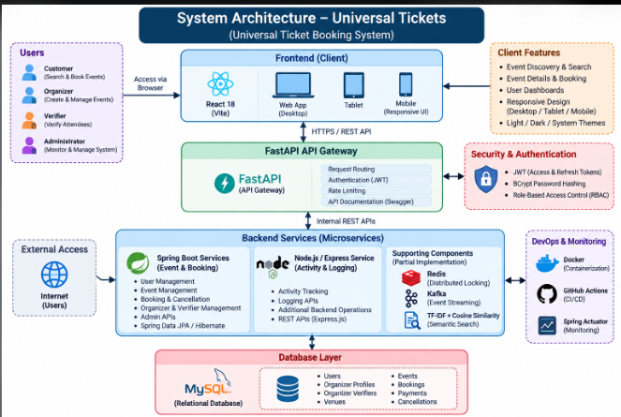
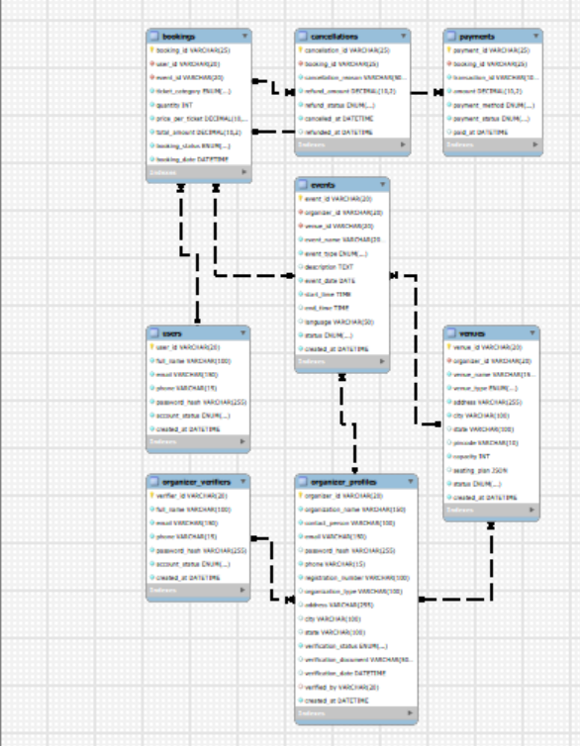
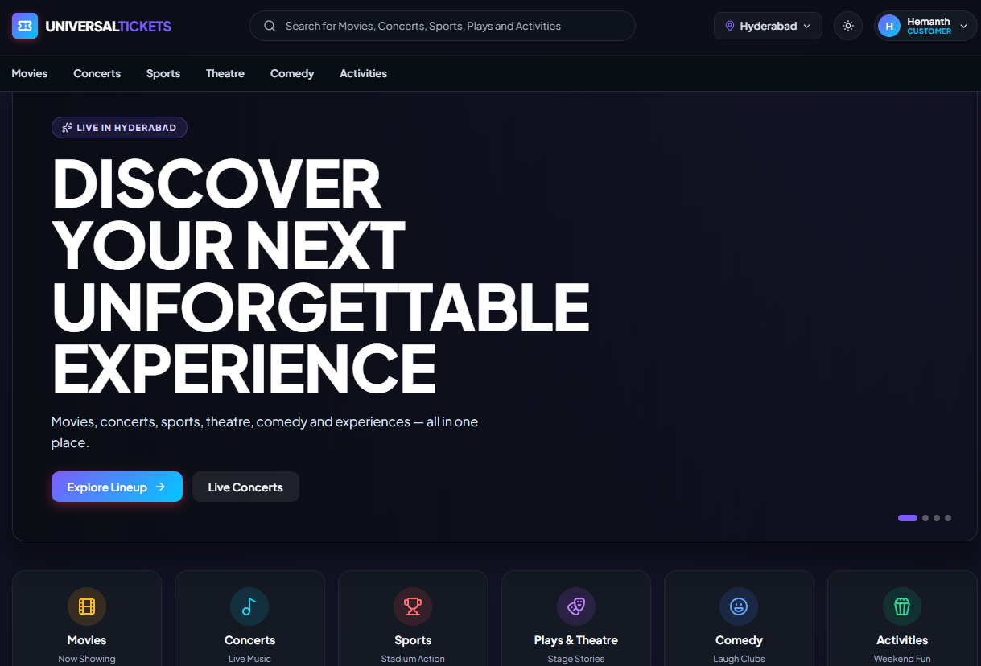
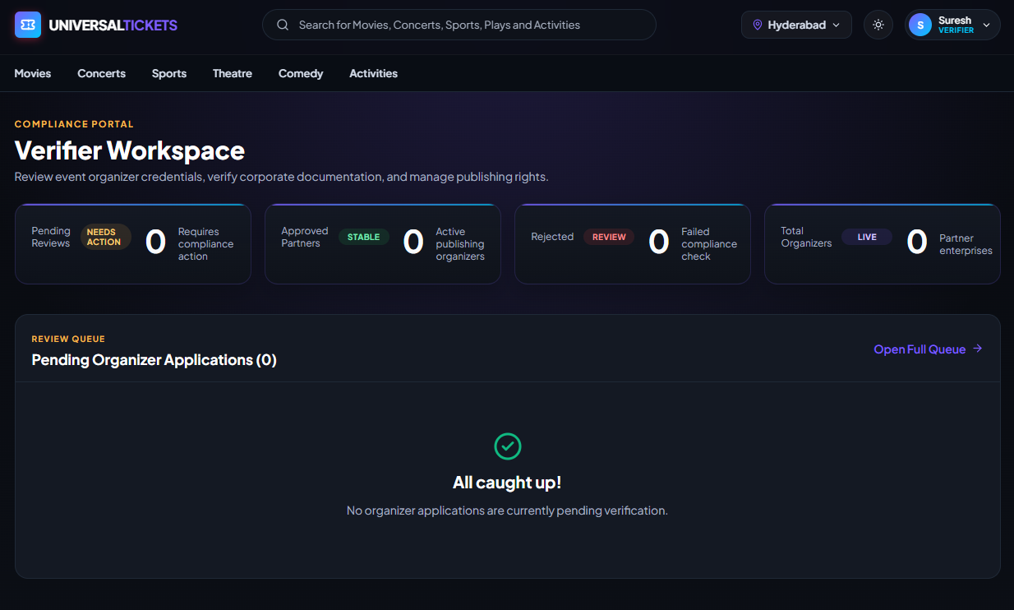

UNIVERSAL TICKETS — UNIVERSAL TICKET BOOKING SYSTEM
Team ID: 2 | Section: 9 | Members: V. Hemanth – 2520030025, K. Chaitanya – 2520030263, CH. Vivek – 2520030532 | Guide: Dr. Prasanthi
Abstract
Tools & Technologies
• A full-stack distributed ticket booking platform for customers, organizers, verifiers and administrators. It combines React, Spring Boot, FastAPI, Node.js/Express, MySQL, JWT/BCrypt, Docker and semantic search using TF-IDF + cosine similarity.
Outcome: secure event discovery, role-based access, transactional booking and cancellation, and a polished responsive user experience.
Frontend: React 18 + Vite
Backend: Java 21 + Spring Boot + FastAPI + Node.js/Express
Database: MySQL 8 + JPA/Hibernate | NoSQL: MongoDB (partial integration)
Security: JWT + BCrypt + RBAC
Search: TF-IDF + Cosine Similarity
Deployment: Docker + Docker Compose | CI/CD: GitHub Actions
API: REST + OpenAPI/Swagger | Monitoring: Spring Actuator
Problem Statement & Objectives
• Problem: Ticket platforms must coordinate secure authentication, multiple roles, event discovery and reliable booking without inconsistent data.
• Objective 1: Provide secure event discovery and ticket booking.
• Objective 2: Enforce JWT authentication and role-based access for customer, organizer, verifier and admin roles.
• Objective 3: Demonstrate relational DB engineering, REST/microservices, semantic search and containerized deployment.
• Scope: Event discovery, booking, cancellation, organizer/verifier/admin workflows and distributed backend services.
System Architecture
React + Vite
Frontend
FastAPI
Gateway
Spring Boot
Services
Node.js + Express
Activity Service
Existing vs Proposed System
MySQL 8
Relational DB
TF-IDF + Cosine
Semantic Search
Docker / Compose
JWT / Actuator
Feature | Existing | Proposed
Authentication | Basic role separation | JWT + BCrypt + backend RBAC
Booking | Limited transaction control | ACID transactional booking + compensation
Search | Keyword-oriented | TF-IDF semantic search + cosine similarity
Role Management | Limited separation | Customer / Organizer / Verifier / Admin
Architecture | Single-backend style | Gateway + Spring Boot + Node.js services
Redis locking (PARTIAL) • Kafka producer integration (PARTIAL)
ER Diagram & Database Design
ER Diagram & Database Design
ER Diagram & Database Design
Actual MySQL EER diagram — 8-table relational schema
Actual MySQL EER diagram — 8-table relational schema
USERS
PK user_id
email UNIQUE
books
EVENTS
PK event_id
FK organizer_id
organizes
ORGANIZER_PROFILES
PK organizer_id
verified_by
creates
pays/cancels
BOOKINGS
PK booking_id
FK user_id, event_id
PAYMENTS / CANCELLATIONS
booking_id FK
status + totals
Feasibility Study
Users • Organizers • Venues • Events • Bookings • Payments • Cancellations • Verifiers
Technical: Uses React, Spring Boot, FastAPI, Node.js/Express, MySQL, JWT, Docker and GitHub Actions with available development tools.
Economic: Primarily uses open-source technologies, reducing software licensing and development costs.
Operational: Provides separate role-based interfaces for customers, organizers, verifiers and administrators, making the system easy to use and maintain.
Schedule: The system is designed to be developed, tested and demonstrated within the semester PBL timeline.
Users • Organizers • Verifiers • Venues • Events • Bookings • Payments • Cancellations
Implementation Screenshots
SECURITY + ROLE WORKSPACES
• BCrypt hashing + password validation
• JWT access / refresh lifecycle
• Backend RBAC: Customer / Organizer / Verifier / Admin
• FastAPI Swagger + REST APIs
Results & Testing
Conclusion
Future Scope
• Vite build PASS • Maven PASS (3/3) • Pytest PASS (4/4) • Node smoke PASS
• MySQL 8: 30 events, 41 users, 52 bookings verified
• BCrypt + JWT + backend RBAC verified
• Responsive 375–1920 px • Light/Dark/System themes verified
• Integrates relational database engineering, secure APIs and distributed service design.
• Demonstrates CO1–CO6 concepts through database, backend, security, gateway, microservice, deployment and testing components.
• Dedicated vector database (Qdrant / Pinecone / pgvector)
• Persistent MongoDB activity storage
• Live Redis + Kafka broker deployment
• External payment gateway + Kubernetes / observability expansion
References: KLH Course Handout 25CS1302E • Spring Boot • React • FastAPI • MySQL • Docker
CO coverage: CO1 Relational DB • CO2 Semantic Search / NoSQL Concepts • CO3 FastAPI / JWT • CO4 Spring Boot / Node • CO5 Microservices • CO6 Docker / CI-CD
GitHub QR

