Slide 1
Polygenic Risk Scores (PRS) in population-based and case-control cohorts
Chronic obstructive pulmonary disease and related phenotypes
Presenter: Nguyen Le Duc Minh

Slide 2
Content
Introduction
Methods
Results
Discussions

Slide 3
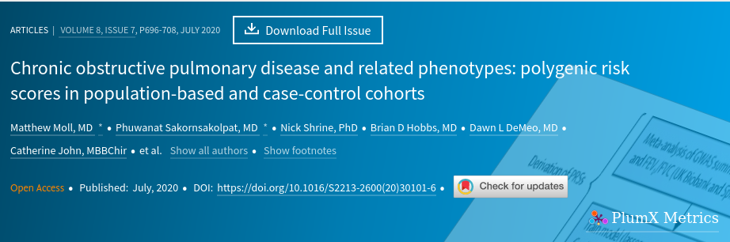

Slide 4
Background
Previous research has shown that COPD is influenced by genetic factors.
However, variants identified by GWAS are of individually small effect, and account for a modest fraction of genetic risk.
Studies combining these variants showed improved risk prediction.
https://doi.org/10.1016/S2213-2600(20)30101-6

Slide 5
Methods
A polygenic risk score was developed using a large GWAS of lung function (FEV₁ and FEV₁/forced vital capcity [FVC]) from the UK Biobank and SpiroMeta.
This polygenic risk score in nine cohorts of multiple ethnicities for an association with moderate-to-severe COPD ( FEV1/FVC <0.7 and FEV1 < 80% of predicted)
Associations were tested using logistic regression models, adjusting for age, gender, height, smoking pack-years, genetic ancestry.
Predictive performance of models were assessed by area under the curve (AUC).

Slide 6
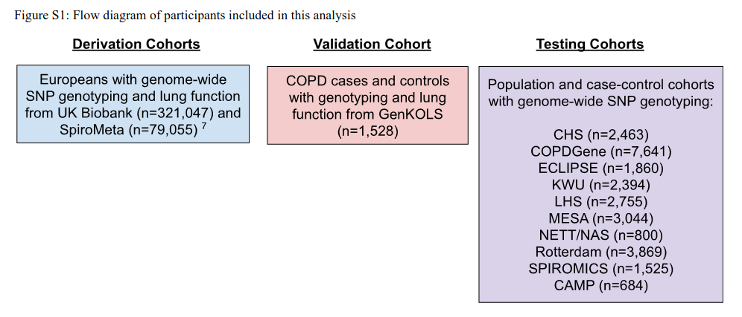
Study populations
GWAS for FEV1 and FEV1/FVC : UK BioBank and SpiroMeta.
PRS was calculated in both case-control and population based studies across a range of ethnicities.

Slide 7
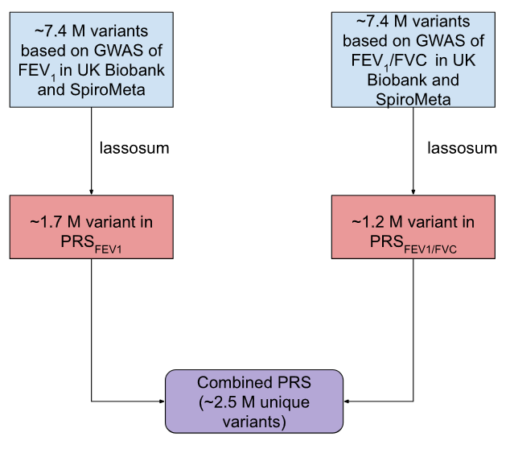
Variants included in the polygenic risk scores

Slide 8
Outcomes
Primary outcome:
Moderate-to-severe COPD (FEV1/FVC <0·7 and FEV1 <80% of predicted).
Secondary outcome:
Assessing the association of the combined PRS with smoking, occurrence of exacerbations, GOLD spirometry grades, clinical COPD phenotypes, imaging phenotypes, and lung growth patterns.
The performance of the PRS in predicting COPD compared with the clinical risk score.

Slide 9
Statistical analysis
Regression model to calculate polygenic risk scores in participants from 9 studies. For each cohort, FEV1 and FEV1/FVC PRS were centred and scaled by means and standard deviations.
Correlation of the combined polygenic risk score with smoking pack-years using Pearson correlation coefficients.
The association between the PRS and COPD was tested using logistic regression models, with some clinical adjustments.
The association between PRS and COPD-related phenotypes that were available in some cohorts was tested.
Lung-function growth pattern analysis: logistic regression to compare reduced lung growth patterns to normal growth patterns + pairwise comparisons.

Slide 10
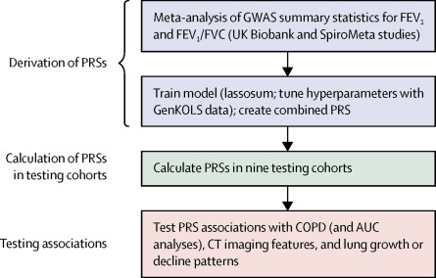
Study design

Slide 11
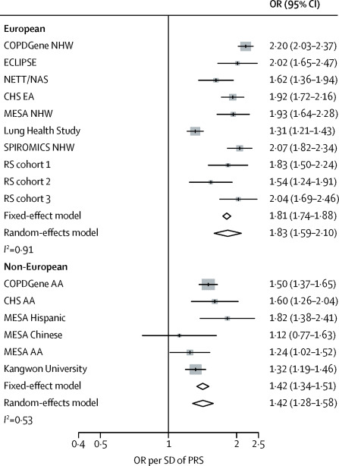
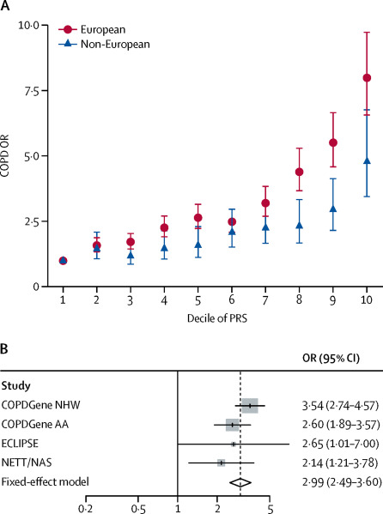
Results
PRS_{Combined}=0·43847 × PRS_{FEV1} + 0·58833 × PRS_{FEV1/FVC}

Slide 12
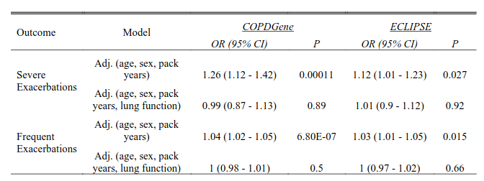
Association of PRS with frequent (> 1 exacerbation in 12 months) and severe exacerbations (exacerbation requiring emergency room visit or hospitalization).
Notes:
Logistic regression models were adjusted for age, sex, pack years of smoking, ± lung
function (FEV1 and FEV 1 /FVC).

Slide 13
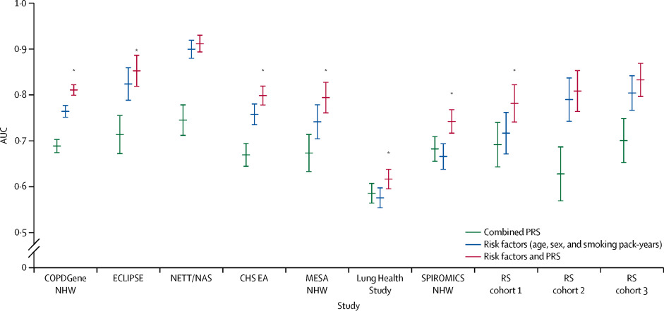
AUC for predicting COPD of models including PRS alone, clinical risk factors alone, or both.
Notes:
Combined polygenic risk score to predict COPD: AUC of 0·67 (95% CI 0·66–0·68)
The predictive ability of a model including the polygenic risk score alone was lower than that of a model including clinical COPD risk factors (age, sex, and smoking pack-years) alone
a model incorporating both the polygenic risk score and COPD risk factors performed better than a model containing clinical risk factors alone: AUC 0·80 [0·79–0·81] for polygenic risk score plus clinical factors vs 0·76 [0·75–0·76] for clinical factors alone; p=1·3 × 10⁻⁴¹

Slide 14
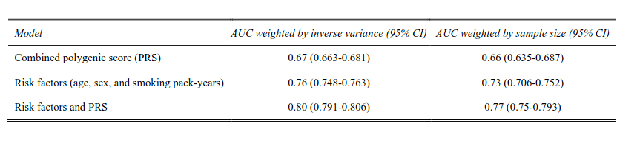
Meta-analysis of AUCs in European cohorts comparing models with only combined PRS, only clinical risk factors, and clinical risk factors with combined PRS

Slide 15
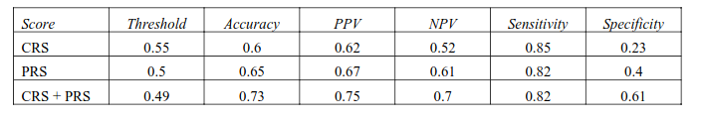
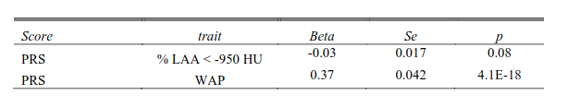
Performance characteristics of a clinical risk score (CRS) trained in UK Biobank participants with ≥ 10 pack-years of smoking history, the PRS, and both the CRS and PRS combined
The association of the PRS with % LAA < -950 HU and WAP after adjusting for baseline FEV1 % predicted.

Slide 16
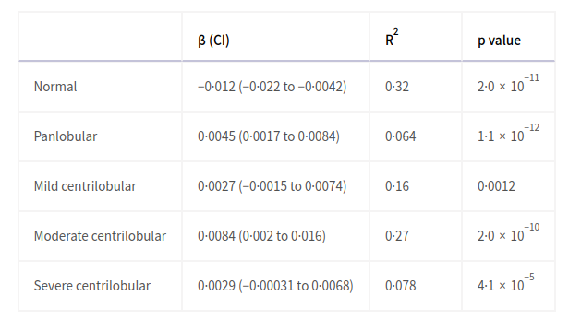
Association of the combined FEV1 and FEV1/forced vital capacity polygenic risk score with local histogram patterns of emphysema

Slide 17
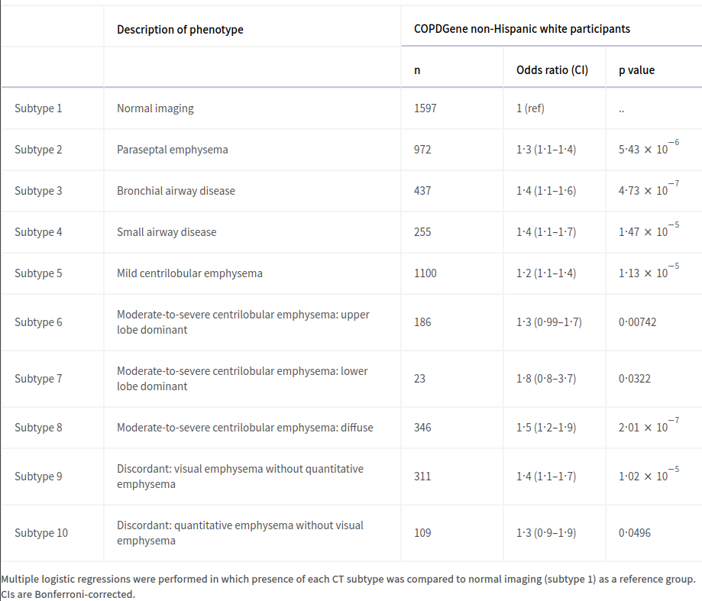
Association of the combined FEV1 and FEV1/forced vital capacity polygenic risk score with CT imaging subtypes in the COPDGene study

Slide 18
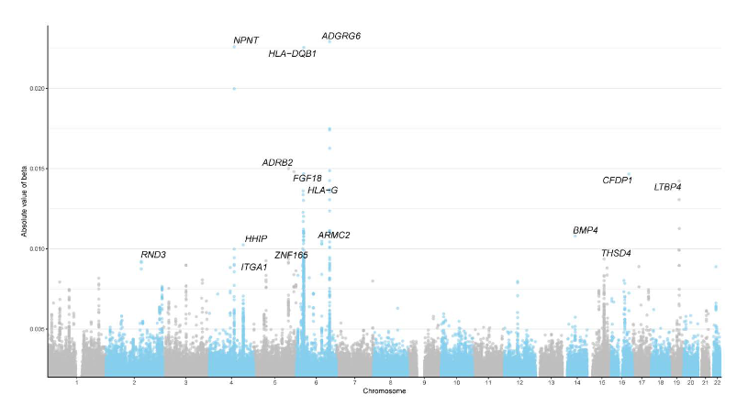
Plot showing effect sizes of genetic loci associated with FEV1 /FVC in meta-analysis of UK Biobank and SpiroMeta

Slide 19
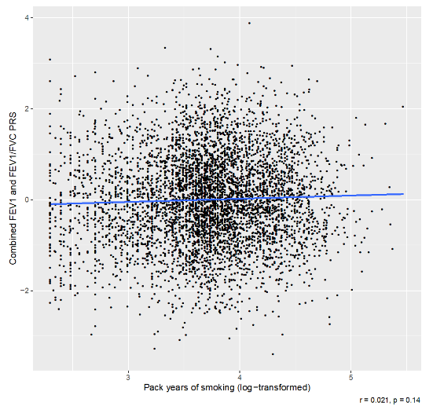
Minimal correlation between the combined FEV1 and FEV1 /FVC PRS in the COPDGene NHW population with smoking intensity
Notes:
Similar scatterplots were observed in COPDGene AA, GenKOLS, ECLIPSE, and NETT/NAS.

Slide 20
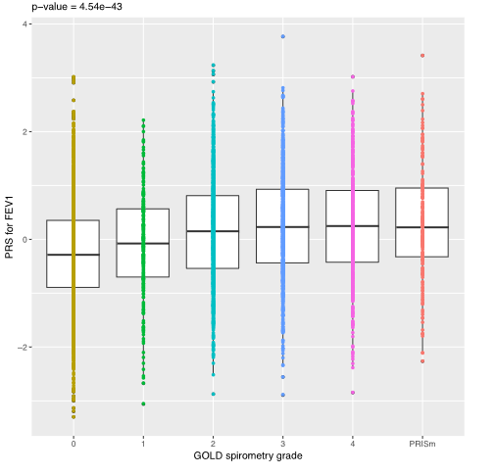
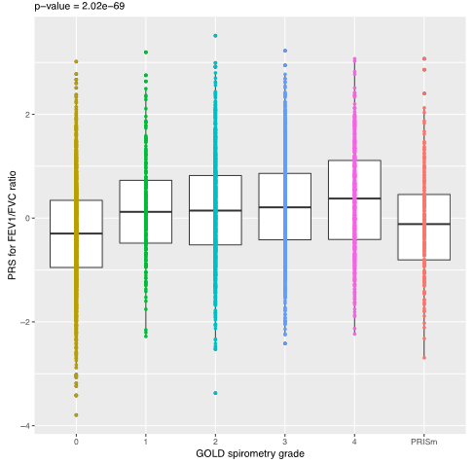
Correlation of FEV1 and FEV1/FVC PRSs with GOLD spirometry grades in COPDGene NHW population.

Slide 21
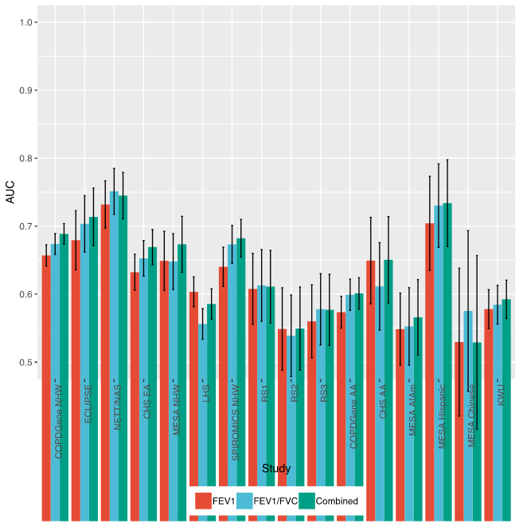
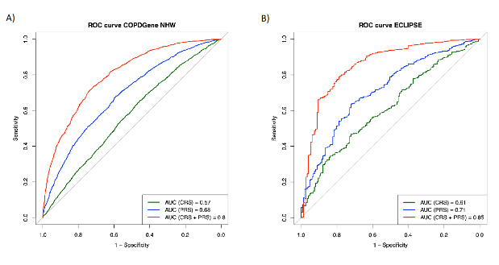
Comparison of AUCs for each of three PRSs across all cohorts

Slide 22
Discussion (1)
A larger GWAS with more accurate weights, and including more variants, improves the predictive performance of genetic risk score.
The potential to identify individuals at a markedly increased risk of COPD.
On the basis of these previous estimates of the effects of smoking on COPD risk, being in the tenth decile of polygenic risk is similar to having 84–140 pack-years of smoking history.
PRS was not correlated with smoking pack-years, suggesting that it provides information regarding COPD risk that is independent of smoking history.
7% reduction in COPD, versus 3% in the lowest polygenic risk categories was estimated when having a reduction in smoking to 20 pack-years or less.

Slide 23
Discussion (2)
The only routine genetic screening recommended in COPD is for α1 antitrypsin deficiency, which is present in about 1% of individuals with COPD.
This scoring system identifies approximately 10% of the population with roughly threefold higher chances of developing COPD compared to the middle tertile of the population, and it predicts that around 15-20% of individuals will ultimately experience COPD.
Potentially identify individuals at risk for COPD and implement strategies to optimise lung health.

Slide 24
Discussion (3)
In practical terms, generating a polygenic risk score for clinical use entails collecting a DNA sample and analyzing a specific set of genome-wide genetic markers.
This procedure is a one-time requirement and can be conducted at a cost of under $100 per person.
Direct-to-consumer testing application and genome-wide genotype data can contribute to the future medical record.
Integrating both polygenic risk score and clinical factors improve AUC.

Slide 25
Discussion (4)
Polygenic risk score provides an assessment of risk before the occurrence of environmental exposures.
An individual’s COPD risk could be altered and targeted intervention strategies could be employed as clinical risk factors change throughout lifetime.
Statistically significant association between a genetic risk score and COPD exacerbations -> suggest a shared mechanism between lung function and COPD exacerbations: low lung function is a risk factor for exacerbations.
Notes:
This association suggests a shared mechanism between lung function and COPD exacerbations, consistent both with published reports that low lung function is a risk factor for exacerbations, and with this association no longer being observed after adjustment for lung function.

Slide 26
Discussion (5)
This PRS was also associated with several CT imaging phenotypes:
Greater quantitative emphysema
Airway wall thickness
Gas trapping
Local histogram patterns of emphysema
The association between the PRS and qualitative and quantitative measures of emphysema suggests that the PRS is predictive of a wide range of early and late lung structural changes.
This finding is essential because lung structural changes detected by CT-scan might precede and be discordant with spirometry changes -> PRS could play a role in reducing the radiation and economic burden of large-scale CT phenotyping for early diagnosis.

Slide 27
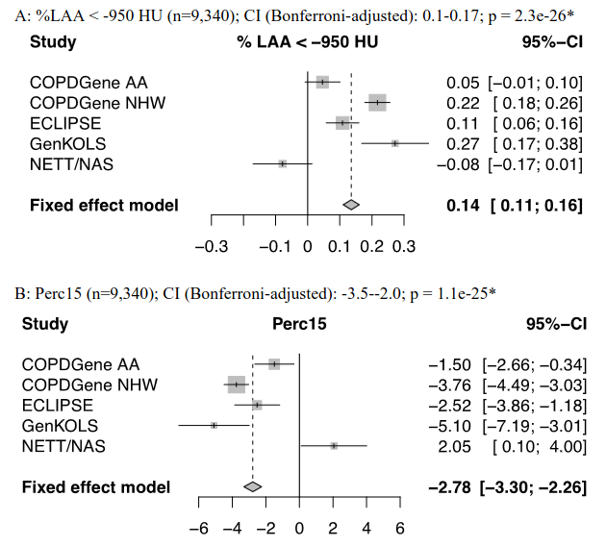
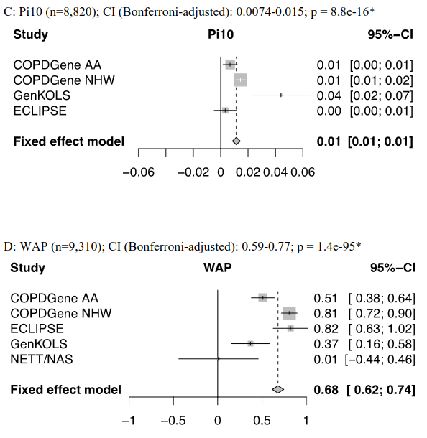

Slide 28
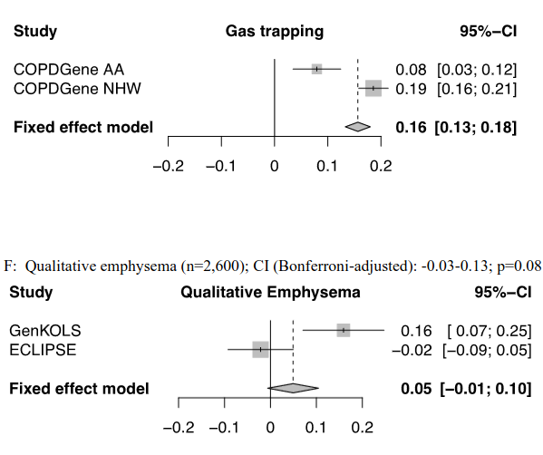

Slide 29
Discussion (6)
The PRS was associated with patterns of reduced lung growth in children with asthma and with incident COPD.
Impaired or reduced lung growth during development may predispose individuals to COPD.
In general, the polygenic risk score is capturing combinations of genetic variants responsible for impaired lung growth and susceptibility to COPD.

Slide 30
Discussion (7)
This study is based on cross-sectional lung function measures in cohorts of different ages and cigarette smoking exposure, it does not address the challenging issue of longitudinal measures.
Analytic and clinical validity of the PRS in predicting COPD: beyond the scope of this study. Future studies could evaluate whether the use of the PRS could help identify patients at greater risk of COPD and reduce underdiagnosis.

Slide 31
Discussion (8)
One major limitation to the clinical application of this PRS to COPD treatment is the lack of effective interventions to preserve lung health.
It is possible that PRS could be used for trial seletction to reduce heterogeneity.
Understanding COPD pathogenesis through the role of polygenic risk scores is also a crucial area.

Slide 32
Findings
The polygenic risk score (PRS) was associated with COPD in European (odds ratio [OR] per SD 1.81 [95% CI 1.74-1.88] and non-European (1.42 [1.34-1.51] ) populations.
The polygenic risk score was superior to previously described genetic risk scores and, when combined with clinical risk factors (ie, age, sex, and smoking pack-years), showed improved prediction for COPD compared with a model comprising clinical risk factors alone (AUC 0.8 vs 0.76).
The polygenic risk score was associated with CT imaging phenotypes.
The PRS was associated with a reduced lung growth pattern.
Notes:
The polygenic risk score was associated with CT imaging phenotypes, including wall area percent, quantitative and qualitative measures of emphysema, local histogram emphysema patterns, and destructive emphysema subtypes.

Slide 33
Interpretation
PRS score contained of genetic variants that can identify a small subset of individuals:
Increased risk for moderate-to-severe COPD.
Emphysema subtypes associated with cigarette smoking.
Patterns of reduced lung growth.

Slide 34
Reference
https://doi.org/10.1016/S2213-2600(20)30101-6
https://www.frontiersin.org/articles/10.3389/fgene.2022.818574/full

Slide 35


