Slide 1
Genome-Wide Association Studies (GWAS) Series
Genome-Wide Association Studies (GWAS)
of Quantitative Traits
Date: 18/08/2023
Presenter: Le Nhat Thong

Slide 2
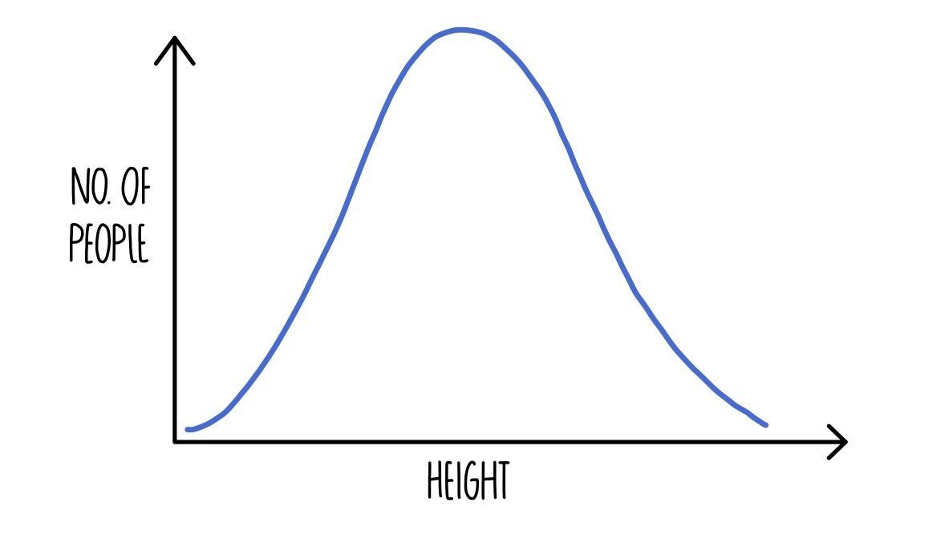
Quantitative Traits
Phenotypes of interest are often quantitative (e.g. Blood pressure, cholesterol levels, IQ, height, ...)
The field of quantitative traits is the mention of continuously measured traits
Genetic variations asociation with quantitative traits are commonly called Quantitative Traits Loci (QTL)
There generally is no simple Mendelian basis for variation of quantitative traits.
Some quantitative traits can be largely influenced by a single gene as well as by environmental factors
Short
Tall

Slide 3
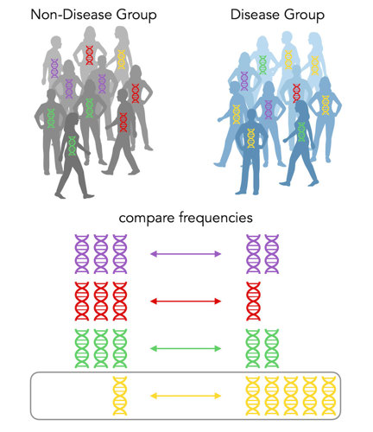
Objective
Carrying out Quantitative trait loci (QTL) mapping
→ Identifying genetic loci that influence the phenotypic variation of a quantitative trait.
Examples: We aimed to identify SNPs related to height of Vietnamese populations
AA
Short
Tall
TT
T
A
TA
?

Slide 4
QTL Mapping
Fitting a linear regression models are commonly used for QTL mapping
Linear regression models will often include a single genetic marker (e.g., a SNP) as predictor in the model, in addition to other relevant covariates (such as age, sex, etc.), with thequantitative phenotype as the response
Linear regression with SNPs including:
Additive model (Commonly used)
Dominant model (Alternative)
Recessive model (Alternative)

Slide 5
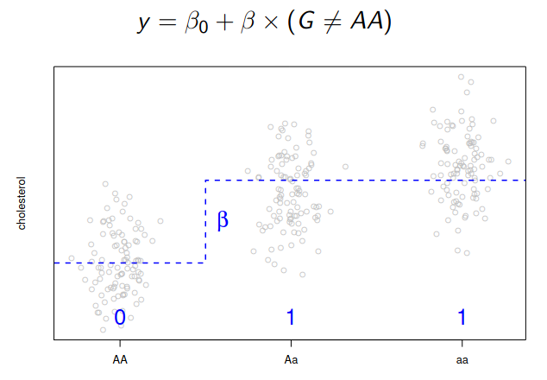
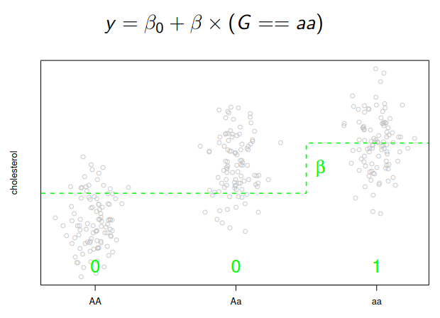
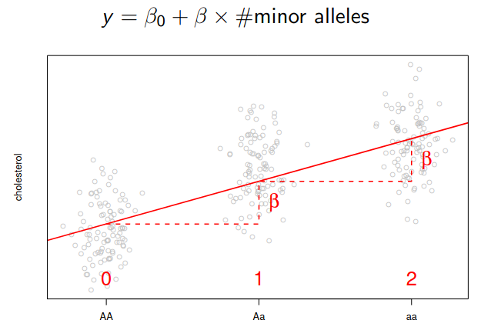
Linear regression with SNPs
Dominant model
Recessive model
Additive model
→ Many analyses fit the ‘Additive model’

Slide 6
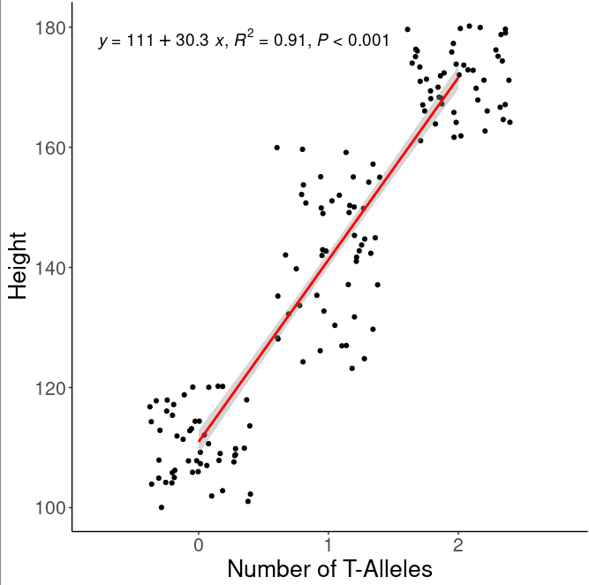
Back to our examples
TT
AA
TT
AT
TA
AA
→ Number of T-alleles associated with height

Slide 7
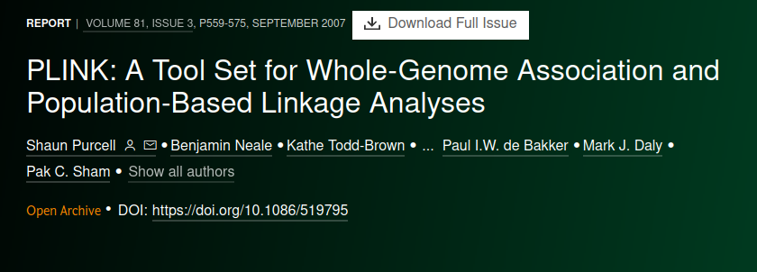
Plink - Tool for whole genome association analysis toolset
Association
Case/control
Fisher's exact
Full model
Stratified analysis
Tests of heterogeneity
Hotelling's T(2) test
Quantitative trait
Quantitative trait means
Quantitative trait GxE
Linear and logistic models
Set-based tests
Multiple-test correction
Plink usages:
Population stratification
IBS/IBD estimation
Association
Family-based association
Permutation
LD calculations
Multimarker tests
Conditional haplotype tests
Proxy association
Etc.
https://zzz.bwh.harvard.edu/plink

Slide 8
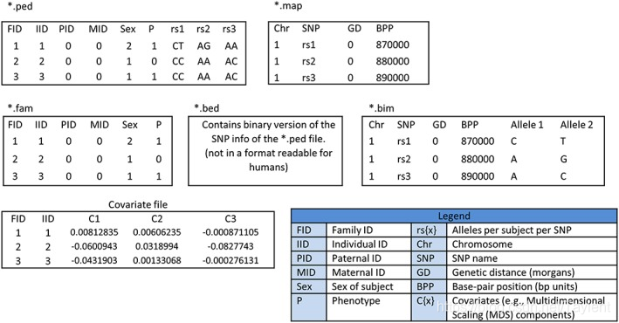
Plink - data formats

Slide 9
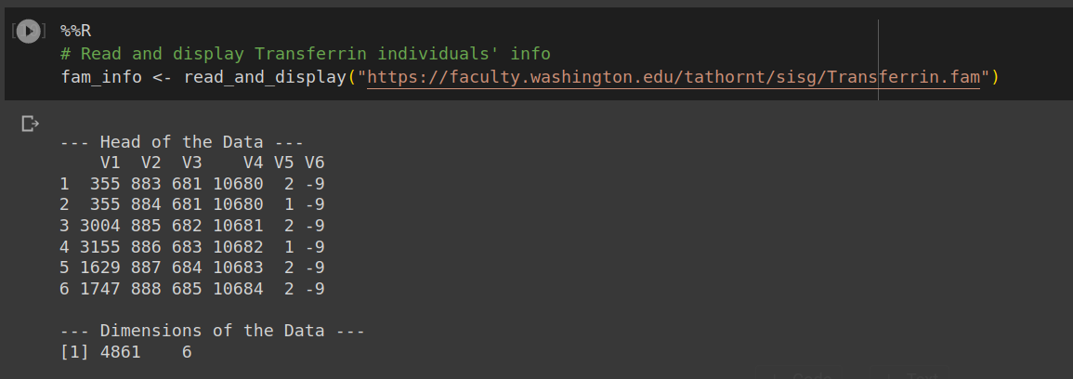
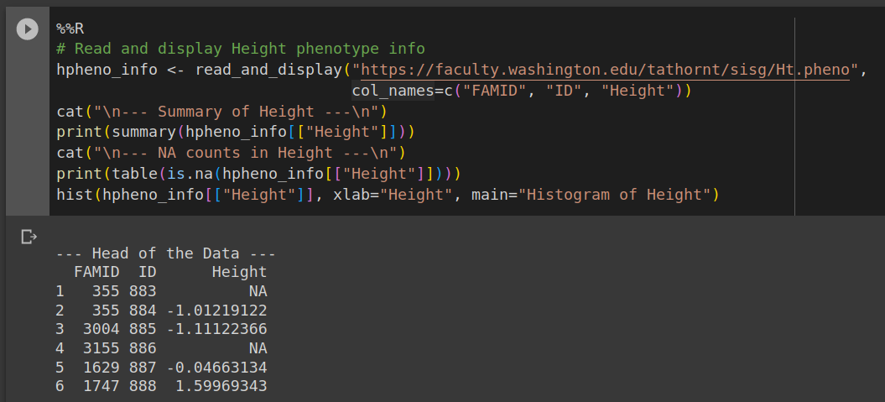
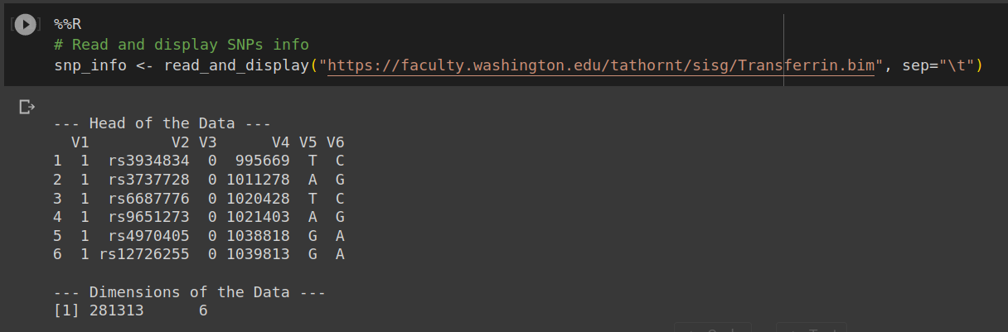
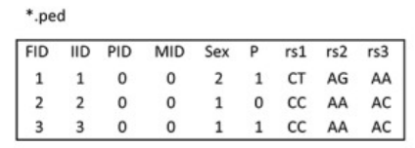
Plink - data formats (cont.)
← *.fam
← *.pheno
← *.bim
Intergrated version of *.fam and *.bim

Slide 10
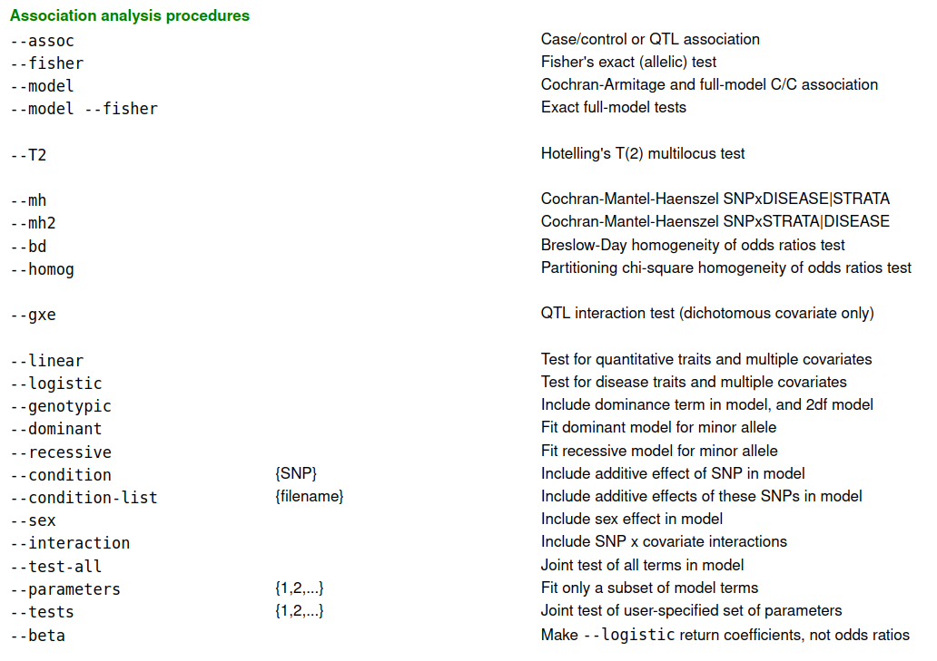
Plink - Association analysis procedures
Binary traits
Continuos traits

Slide 11
Example question and dataset
We attempt to carry out Genome Association Study for population with following information:
4,861 samples
281,313 genetic variation were observed
Phenotyopes including:
Serum transferrin levels
Height
Research Question:
Which genetic variation related to Serum transferrin levels or Height ?

Slide 12
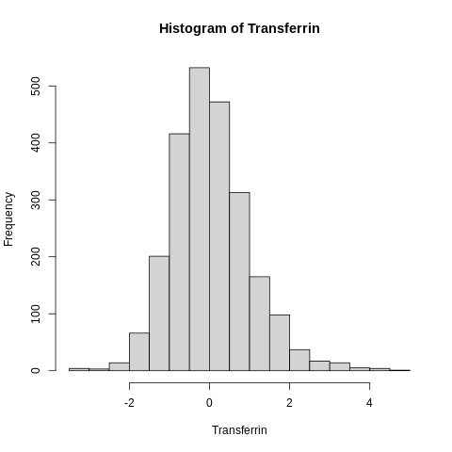
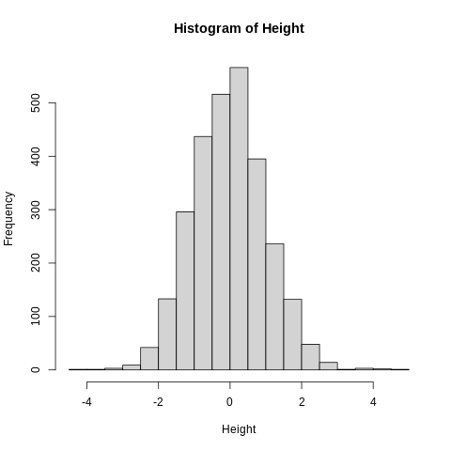
Example - Materials
Transferrin.fam
Ht.pheno
Transferrin.bim
Tr.pheno
Transferrin.bed

Slide 13
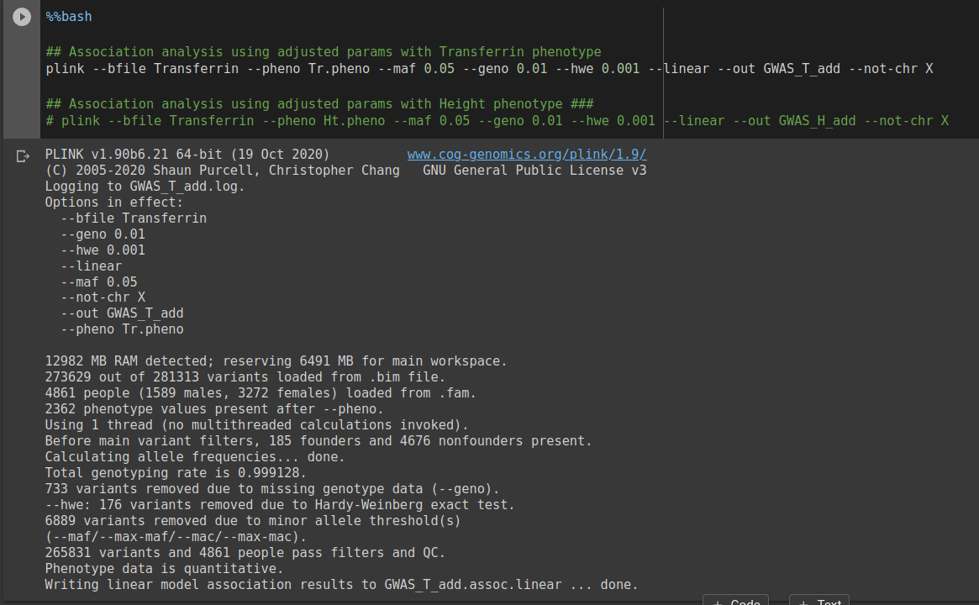
Association analysis using Transferrin/Height phenotype
Syntax explaination:
--bfile: “file name” of .bed, .bim and .fam
→ Transferrin.bed, Transferrin.bim and Transferrin.fam
--pheno: phenotype file
--maf; --geno; --hwe: population genetic parameters
--linear: using linear regression
--not-chr: exclude X
--out

Slide 14
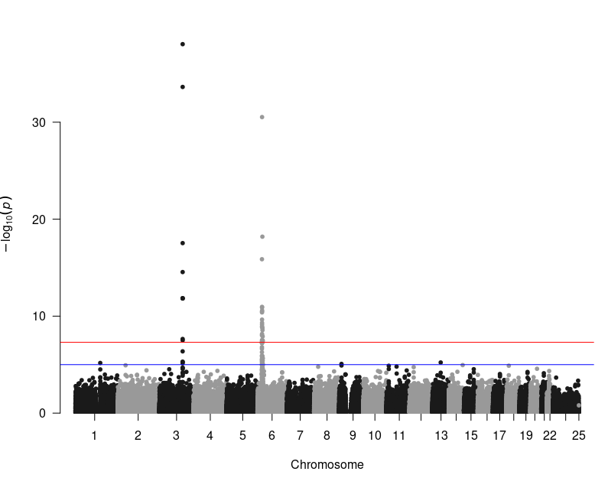
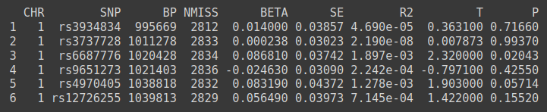
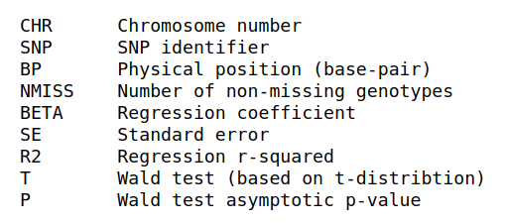
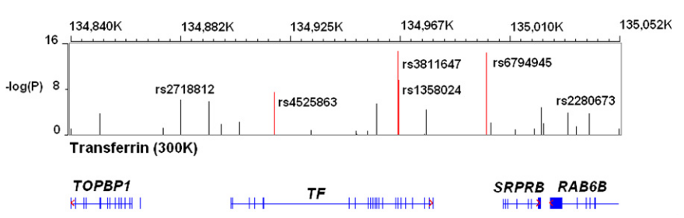
Outputs
Output file names:
GWAS_T_add.qassoc
GWAS_H_add.qassoc
With fields as follows:
rs3811647
rs6794945
Benyamin et al., 2009

Slide 15
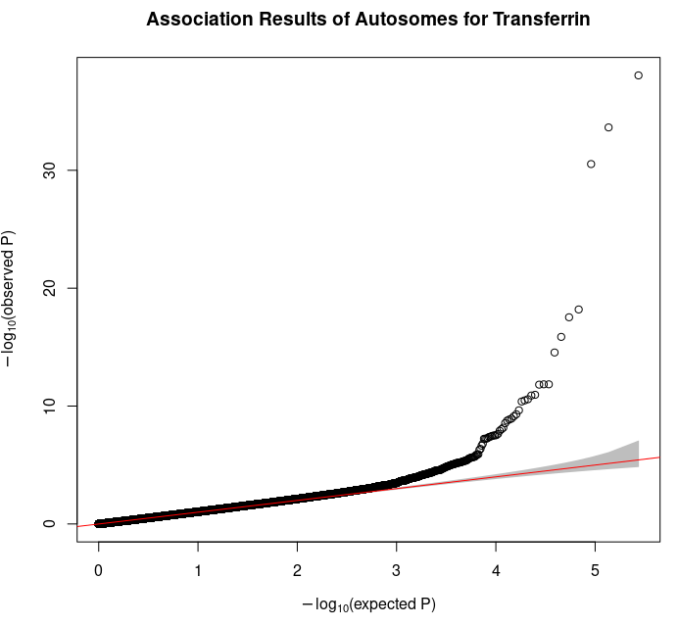
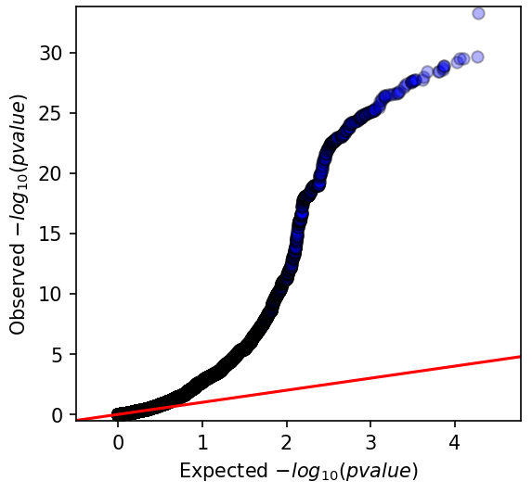
What we not cover in this sections ?
Interaction models (e.g. Genders, Ages, Environmental Factors, SNPxSNP, ...)
Confounders problems:
Batch effects controls
Population structures
Complex phenotypes
Severe inflation

Slide 16
To sum up
Carrying out a Genome-Wide Association Studies (GWAS) of Quantitative Traits
Plink for GWAS analysis
For high confident results confounder factors should be well controled

Slide 17





Acknowledgement
Dr. Luu Phuc-Loi and his Bioinformatics team (Pacific informatics)
Msc. Du Hoang Tien (Pacific informatics)
Nguyen Le Duc Minh (Pacific informatics)
Dao Khuong Duy (Pacific informatics)
Nguyen Minh Hoang (Pacific informatics)
Le Van Hieu (Pacific informatics)
Mr. Le Quang Minh Tri (DNAnexus)
Department of Science and Technology, University of Medicine and Pharmacy
Research Center for Infectious Diseases

