Slide 1
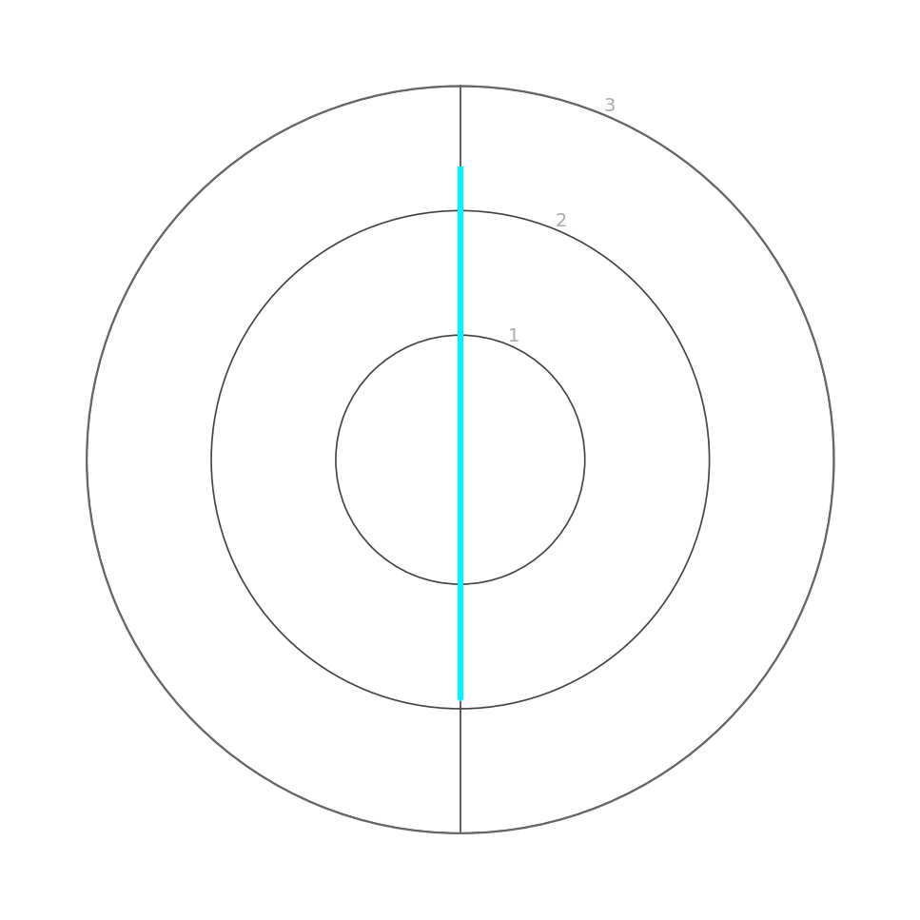
Executive Summary — Atlas Delivery Platform
Reporting period: July 2026 | Assessment Date and Time: 2026-08-01 09:00 UTC | Author: Volodymyr
Project Facts
Overall Status
Scores by group
Cadence: Monthly | Dev: 10 | QA: 2 | Jira connected: No
Ongoing/Efficiency
AMBER
Score: 2.13 / 3
General Conclusions
Overall status is AMBER.
Proceeding to release requires a short-term plan to reduce critical defect load and close P1/P2 execution gaps.
QA capacity constraints must be addressed to prevent late-cycle validation risks.

Slide 2
General Categories Scores
Reporting period: July 2026 | Assessment Date and Time: 2026-08-01 09:00 UTC | Author: Volodymyr
Testing Delivery Status (2.33/3, GREEN)
Delivery cadence is on track; primary risk is thin QA capacity relative to dev team size.
Release Readiness (1.92/3, AMBER)
Open P1/P2 defect load and incomplete manual execution coverage are the main blockers to release readiness.

Slide 3
Top 5 Items (Cross-group)
Reporting period: July 2026 | Assessment Date and Time: 2026-08-01 09:00 UTC | Author: Volodymyr
Top RED (immediate:
Top AMBER (needs attention):
1. Release Readiness — P1/P2 defects (Why: P1=1, P2=10 open)
Action: Run a focused P1/P2 burn-down before release
2. Release Readiness — Manual P1/P2 execution coverage (Why: Finished at 80%)
Action: Execute remaining P1/P2 tests or formally de-scope with explicit sign-off
3. Testing Delivery Status — QA capacity (Why: Dev:QA 15:1 (QA share ~6.3%))
Action: Add QA capacity and/or reduce scope; push shift-left testing
1. Release Readiness — P3+ defects (Why: 13 open)
Action: Triage/groom to keep backlog ≤ 10
2. Release Readiness — Automated P1/P2 execution coverage (Why: 90%)
Action: Stabilize/fix missing automation to reach 100%

Slide 4
G1 — Testing Delivery Status
GREEN
Score: 2.33 / 3 | RAG: GREEN
Conclusion & Recommendations
Key data
Delivery cadence is on track; primary risk is thin QA capacity relative to dev team size.
Key data | Value
Dev:QA ratio | 15:1 (QA share ~6.3%)
— | —
— | —
— | —
CRITICAL FINDING
AMBER FINDING
QA capacity: Dev:QA 15:1 (QA share ~6.3%) — add capacity and/or reduce scope; push shift-left testing
—

Slide 5
G2 — Release Readiness
AMBER
Score: 1.92 / 3 | RAG: AMBER
Conclusion & Recommendations
Key data
Open P1/P2 defect load and incomplete manual execution coverage are the main blockers to release readiness.
Key data | Value
Open defects P1/P2 | P1=1, P2=10
Manual P1/P2 execution coverage | 80%
Open defects P3+ | 13
Automated P1/P2 execution coverage | 90%
CRITICAL FINDING
AMBER FINDING
P1/P2 defects: P1=1, P2=10 open — run a focused burn-down before release
Manual P1/P2 execution coverage at 80% — execute remaining tests or formally de-scope with sign-off
P3+ defects: 13 open — triage/groom to keep backlog ≤ 10
Automated P1/P2 execution coverage at 90% — stabilize/fix missing automation to reach 100%

