Slide 1
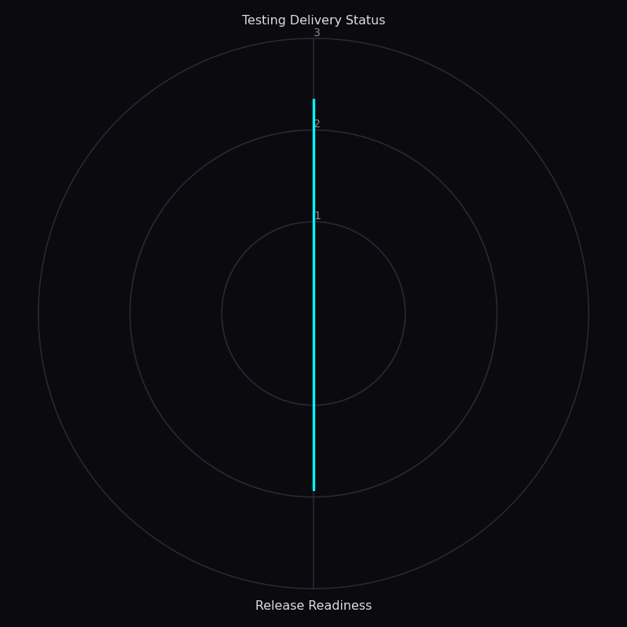
Executive Summary — [Project Name]
Reporting period: [Reporting Period] | Assessment Date and Time: [last report time] | Author: [user.name]
Project Facts
Overall Status
Scores by group
[Project entry information]
[Metrics types in scope]
[RAG STATUS]
Score: [n.nn] / 3
General Conclusions
[General conclusions about project status]

Slide 2
General Categories Scores
Reporting period: [Reporting Period] | Assessment Date and Time: [last report time] | Author: [user.name]
[Group Metric 1] ([n.nn]/3, [RAG STATUS])
[Group Metric 1 General Conclusion]
[Group Metric N] ([n.nn]/3, [RAG STATUS])
[Group Metric N General Conclusion]

Slide 3
Top 5 Items (Cross-group)
Reporting period: [Reporting Period] | Assessment Date and Time: [last report time] | Author: [user.name]
Top RED (immediate:
Top AMBER (needs attention):
1. [TOP_RED_1_GROUP] — [TOP_RED_1_ITEM] (Why: [TOP_RED_1_WHY])
Action: [TOP_RED_1_ACTION]
2. [TOP_RED_2_GROUP] — [TOP_RED_2_ITEM] (Why: [TOP_RED_2_WHY])
Action: [TOP_RED_2_ACTION]
3. [TOP_RED_3_GROUP] — [TOP_RED_3_ITEM] (Why: [TOP_RED_3_WHY])
Action: [TOP_RED_3_ACTION]
4. [TOP_RED_4_GROUP] — [TOP_RED_4_ITEM] (Why: [TOP_RED_4_WHY])
Action: [TOP_RED_4_ACTION]
5. [TOP_RED_5_GROUP] — [TOP_RED_5_ITEM] (Why: [TOP_RED_5_WHY])
Action: [TOP_RED_5_ACTION]
1. [TOP_AMBER_1_GROUP] — [TOP_AMBER_1_ITEM] (Why: [TOP_AMBER_1_WHY])
Action: [TOP_AMBER_1_ACTION]
2. [TOP_AMBER_2_GROUP] — [TOP_AMBER_2_ITEM] (Why: [TOP_AMBER_2_WHY])
Action: [TOP_AMBER_2_ACTION]
3. [TOP_AMBER_3_GROUP] — [TOP_AMBER_3_ITEM] (Why: [TOP_AMBER_3_WHY])
Action: [TOP_AMBER_3_ACTION]
4. [TOP_AMBER_4_GROUP] — [TOP_AMBER_4_ITEM] (Why: [TOP_AMBER_4_WHY])
Action: [TOP_AMBER_4_ACTION]
5. [TOP_AMBER_5_GROUP] — [TOP_AMBER_5_ITEM] (Why: [TOP_AMBER_5_WHY])
Action: [TOP_AMBER_5_ACTION]

Slide 4
G[N] — [Group Metric name N]
[RAG Status]
Score: [n.nn] / 3 | RAG: [RAG STATUS]
Conclusion & Recommendations
Key data
[General Conclusion on this metrics category and key recommendations]
Key data | Value
[Key data name 1] | [Key data name 1]
[Key data name N] | [Key data name N]
[Key data name N+1] | [Key data name N+1]
[Key data name N+2] | [Key data name N+2]
CRITICAL FINDING
AMBER FINDING
[List of RED Findings with some recommendations]
[List of AMBER Findings with some recommendations]

