Slide 1

Angular vs. React vs. Vue comparison
Author: Duoc Vo
Email: voquocduoc@gmail.com

Slide 2
Introductions
Long-term support & migrations
Comparison
Examples

Slide 3
INTRODUCTIONS
Angular is a TypeScript-based Javascript framework. Developed and maintained by Google
React is described as “a JavaScript library for building user interfaces”. Initially released in March 2013, React was developed and is maintained by Facebook
Vue is one of the most rapidly growing JS frameworks in 2016. Vue describes itself as a “Intuitive, Fast and Composable MVVM for building interactive interfaces.” It was first released in February 2014 by ex-Google-employee Evan You. Vue is used by Alibaba, Baidu, Expedia, Nintendo, GitLab

Slide 4


Slide 5
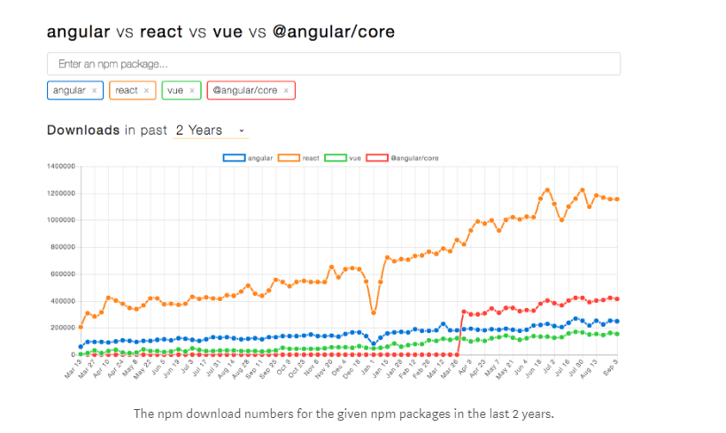
Npm Trends

Slide 6
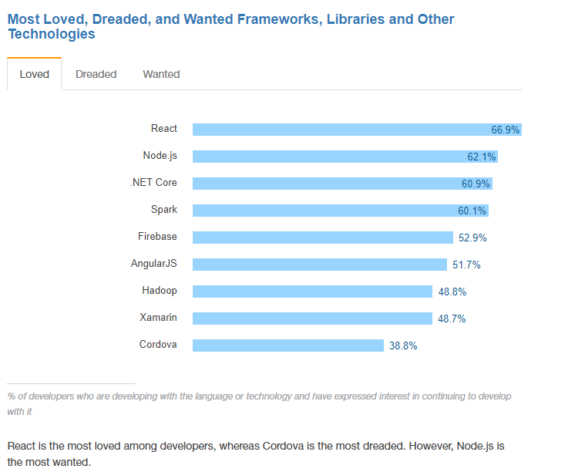
Stackoverflow 2017 survey

Slide 7
Long-term support & migrations
React
- React APIs are quite stable
- There are also some scripts to help you move from your current API to a newer one: check out react-codemod
- V14 was released in October 2015, V15 was published in April 2016, and V16 does not have a release date yet
------------------------------------------------------------------------------------------------
Angular
Starting with the v2 release.
There will be one major update every six months, and there will be a deprecation period of at least six months
The angular team has announced long-term-support versions starting with angular 4.
-----------------------------------------------------------------------------------------------
Vue
The update process for Vue 1.x to 2.0 should be easy for a small app — the developer team has asserted that 90% of the APIs stayed the same.
One developer noted that the update from v1 to v2 was still no fun in a big app. Unfortunately, there is no clear (public) roadmap about the next major version or information on plans for LTS versions.
➔ you need to take care of the corresponding updates and migrations on your own

Slide 8
Comparison of React, Angular & Vue
Components
The frameworks in question are all component-based.
React and Vue both excel at handling dumb components (very re-usable) : small, stateless functions that receive an input and return elements as output.
Typescript vs. ES6 vs. ES5
Angular relies on TypeScript.
React and Vue support ES5, ES6, or even TypeScript
Templates — JSX or HTML
JSX implies that everything in React
The Angular templates are enhanced HTML with special Angular language (Things like ngIf or ngFor)
Vue features “single-file components”

Slide 9
Framework vs. library
- Angular is a framework
- React and Vue share many similarities:
maintain focus in the core library, with concerns such as routing and global state management handled by companion libraries
Data binding
- AngularJS uses two-way binding between scopes, while Vue enforces a one-way data flow between components. This makes the flow of data easier to reason about in non-trivial applications.
- React often works bundled with Redux

Slide 10
Other programming concepts
- Angular as an MVC-framework
- React only has the V
Size & performance
- React and Vue both have a Virtual DOM , which is supposed to improve performance.
- AngularJS becomes slow when there are a lot of watchers, because every time anything in the scope changes, all these watchers need to be re-evaluated again

Slide 11
Testing
- Facebook uses Jest to tests its React code
- Jasmine as a testing framework in Angular 2
- Vue lacks testing guidance
Native apps
React and Angular both support native development.
Angular has NativeScript (backed by Telerik) for native apps and Ionic Framework for hybrid apps.
With React, you can check out react-native-renderer to build cross
plattform iOS and Android apps, or react-native for native apps.
A lot of apps (including Facebook; check the Showcase for more)
are built with react-native.

