Slide 1
Assignment 1: Analysis of Bank Filings Data – Data Wrangling and Exploratory data analysis using Tableau Case Study

Slide 2
Part 1
Process Workflow :
Getting the URL of the webpage.
Extracting the list of quarters from drop down.
Looping through the total quarters and selecting a single quarter using Rselenium. Fetching the table data for that particular quarter in a data frame.
Splitting a single column location in two columns city and state. Also adding dates in a new column for quarters
Merging the data for all quarters in a single data frame using Rbind()
Writing the data frame into a .csv file.
Using functions to stack and unstack data
Tableau - charts and dashboards

Slide 3
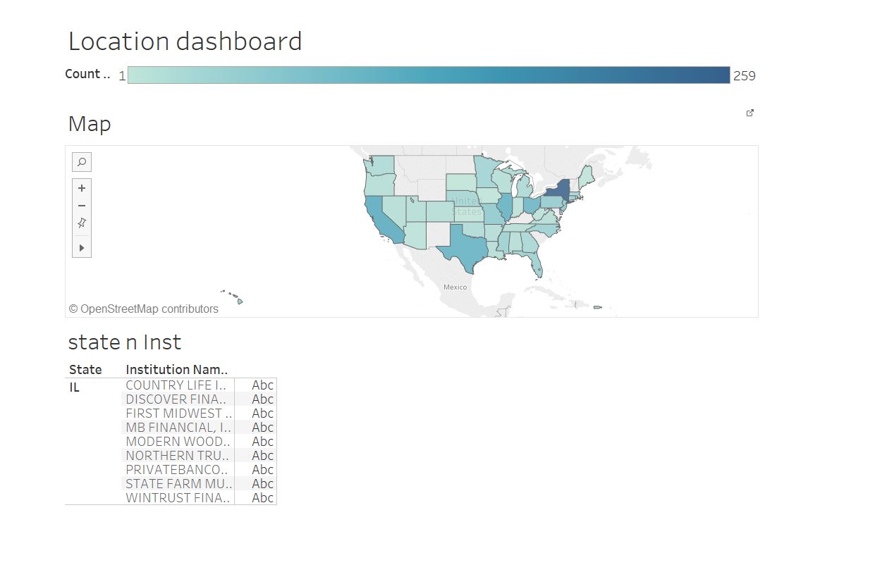
Tableau - charts and dashboards

Slide 4
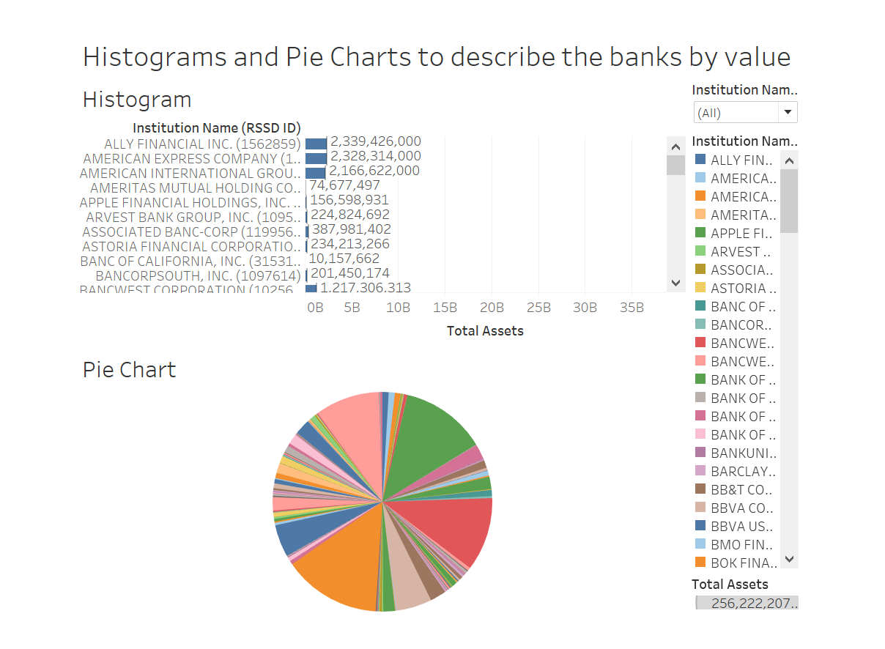
Dashboard 1

Slide 5
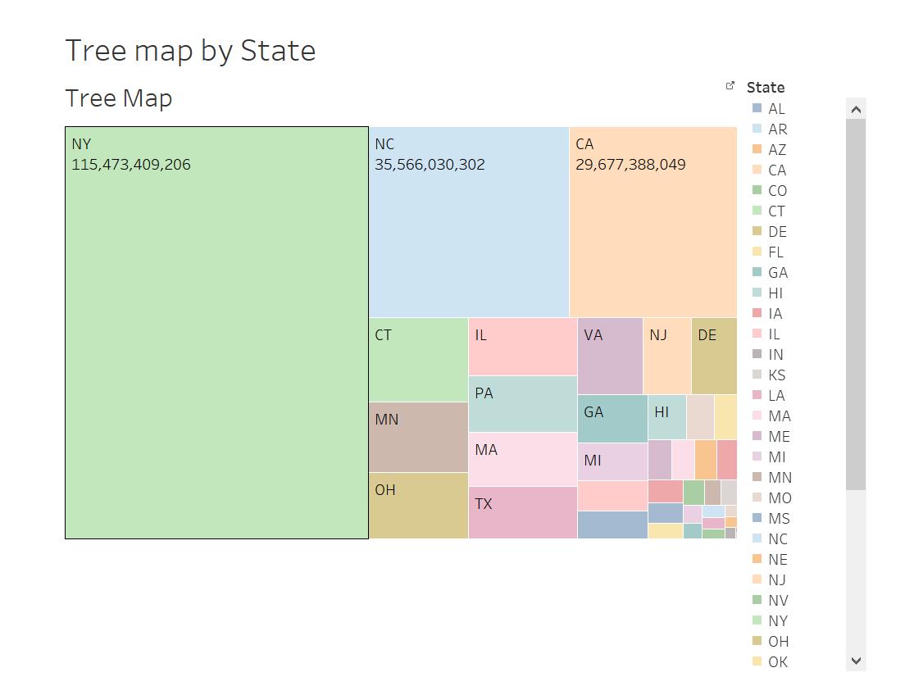
Dashboard 2

Slide 6
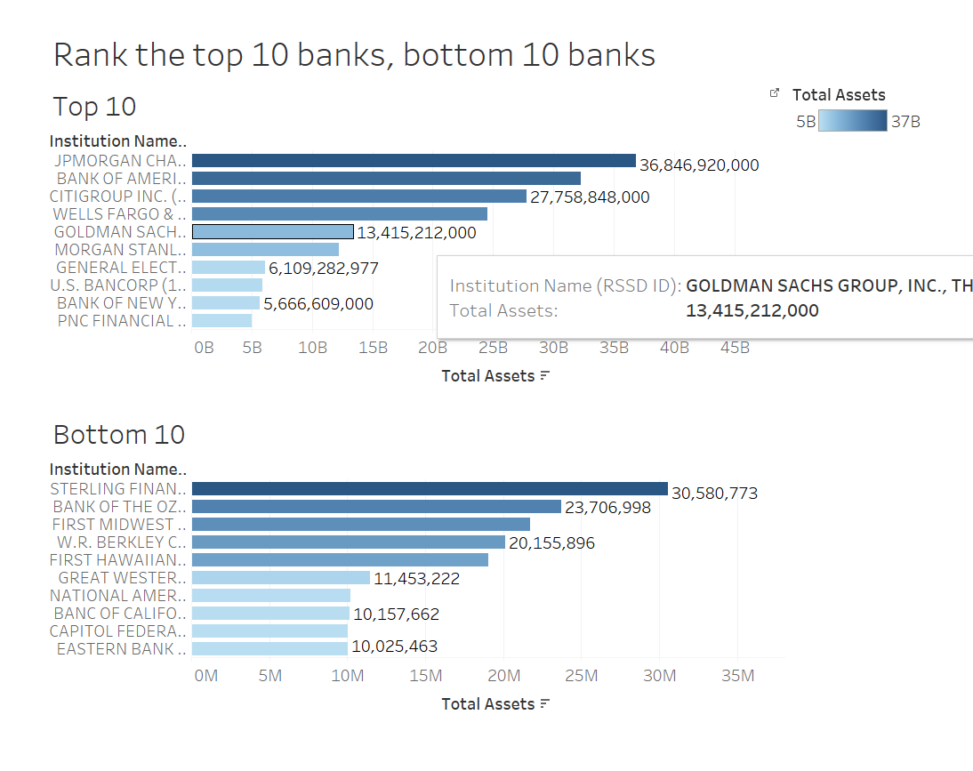
Dashboard 3

Slide 7
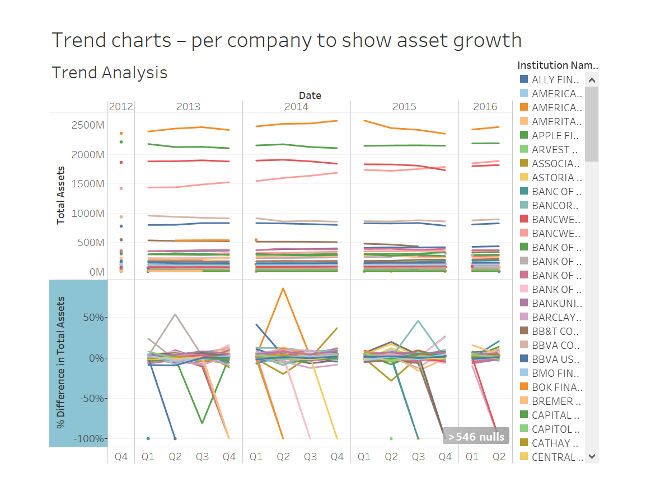
Dashboard 4

Slide 8
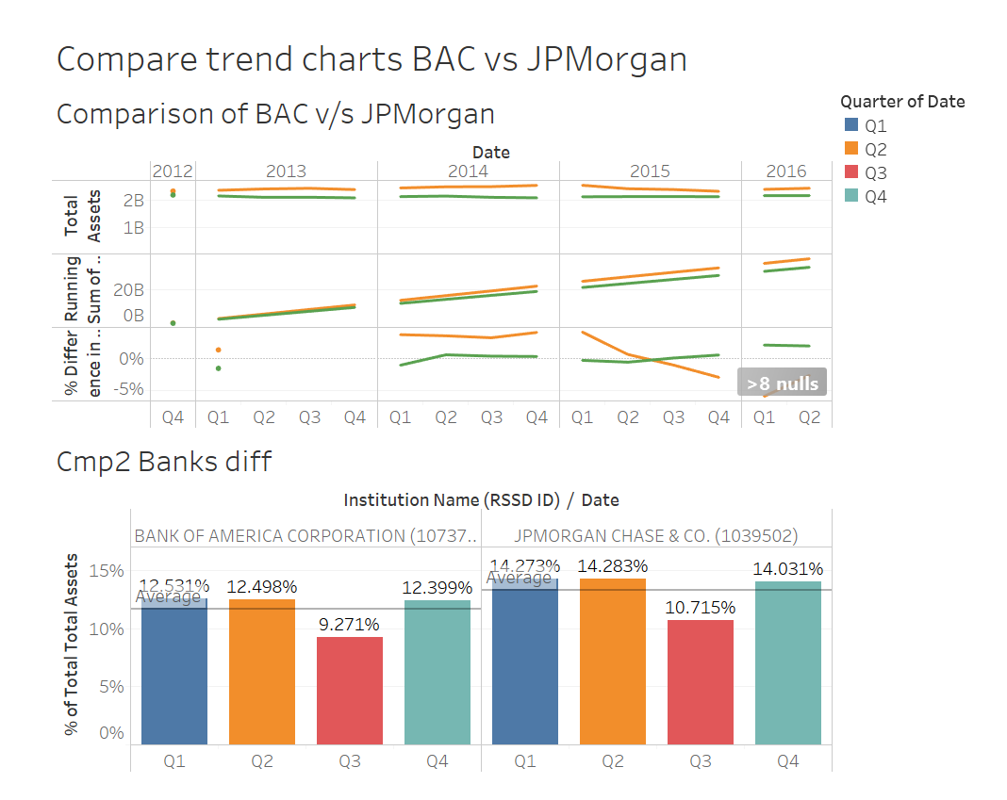
Dashboard 5

Slide 9
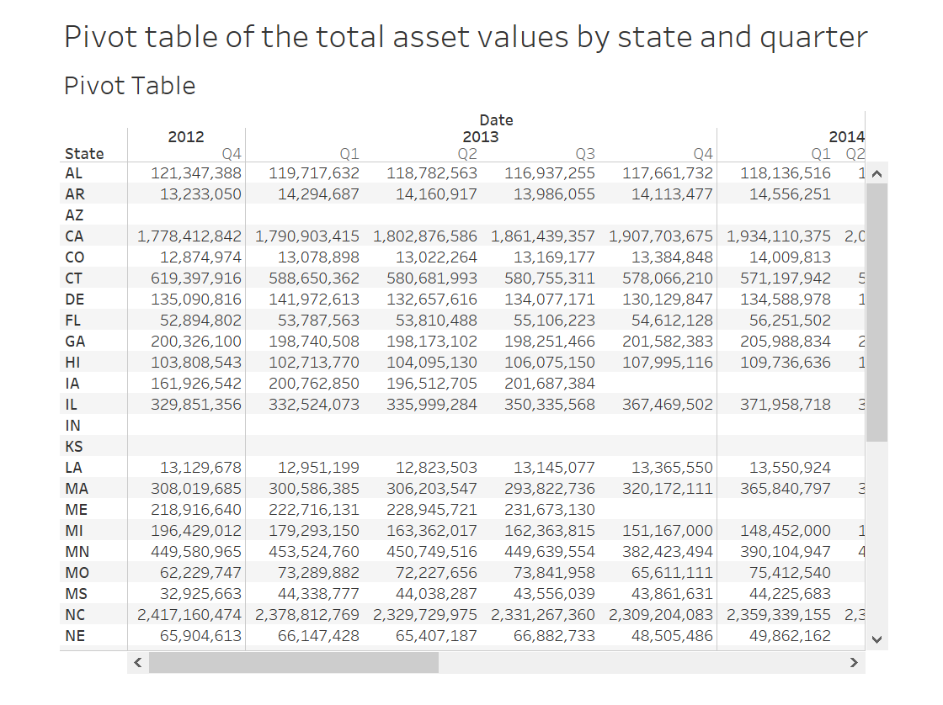
Dashboard 6

Slide 10
References:
http://stackoverflow.com/questions/25965785/scrape-values-from-html-select-option-tags-in-r
http://stackoverflow.com/questions/28076579/r-web-scraping-dynamic-form-with-inputs

Slide 11
Insights
Packages used :
Xml, Rcurl,
Comments on dashboards :
Dashboard 1 – Gives the distribution of the asset values for all the banks
Dashboard 2 – Gives the hierarchical data based on values for each state
Dashboard 3 - JPMorgan Chase has the maximum total assets and Eastern Bank Corporation has the least total assets
Dashboard 4 – Gives the company growth every year
Dashboard 5 – Comparison of total assets for the two banks and the percent difference
Dashboard 6- Gives the total asset values for each state per quarter.

Slide 12
Part 2
Process Workflow :
Getting the URL of the webpage.
Extracting the pdf links for Peer Group 1 from all the links available on the page.
Downloading the PDF files in a folder.
Reading the PDF data into a .txt file
Converting the .txt file to .csv.
Cleaning and normalizing

Slide 13
References:
https://www.r-bloggers.com/introducing-pdftools-a-fast-and-portable-pdf-extractor/

Slide 14
Insights
Packages used : RCurl,XML, stringr, pdftools
Comments on Data :
An approximate value should be calculated to be used instead of NA.

Slide 15
Part 3
Process Workflow :
Created graphs for all 3 years of data
Created other charts like bubble chart and pie chart to analyze the data.

Slide 16
References:
https://www.r-bloggers.com/introducing-pdftools-a-fast-and-portable-pdf-extractor/

Slide 17
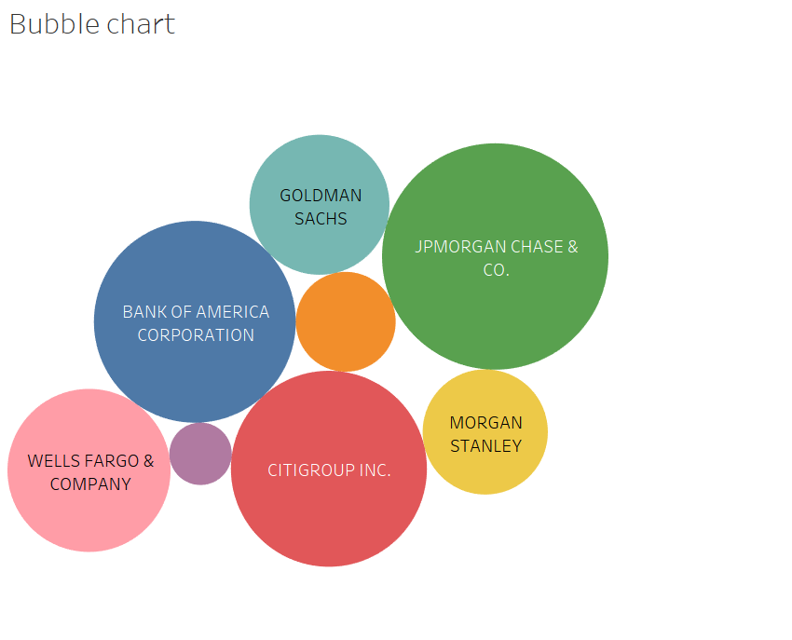
Charts

Slide 18
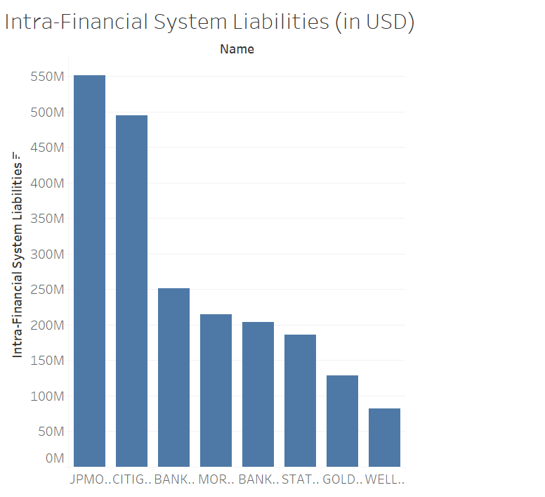
Charts

Slide 19
Insights
Packages used : RCurl,XML, stringr, pdftools
Comments on Data :
An approximate value should be calculated to be used instead of NA.

