Slide 1



Tinkerforge
Alex
Anne
Olli

Slide 2
Introduction
Who are you and who are we?

Slide 3
We
Alex
Bavaria, 33
Anne
Lower Saxony, 28
Olli
Lower Saxony, 28

Slide 4
You
How old are you?
10-11
12-13
13-15
What experience dou you have?
What‘s fascinating you?

Slide 5
Rules of the game
Questions can be asked anytime
please raise your hand
Careful with the electronics
Devices can be taken home later
It shall be fun ☺

Slide 6
The Internet of things
An introduction

Slide 7
The Internet of Things
Common devices make use of the Internet
TV
Watches
Thermometers
Fridges
Heating Control

Slide 8
The Internet of Things
Devices as part of the Internet
Abbreviation: IoT

Slide 9
IoT with Tinkerforge
How it basically works

Slide 10
IoT with Tinkerforge
Similar to Lego
Masterbrick (heart)
Sensors (ears, eyes)
Thermometer, distance sensor
Actors (arms und legs)
Engine
Output devices
Beeper, 7 segment display

Slide 11
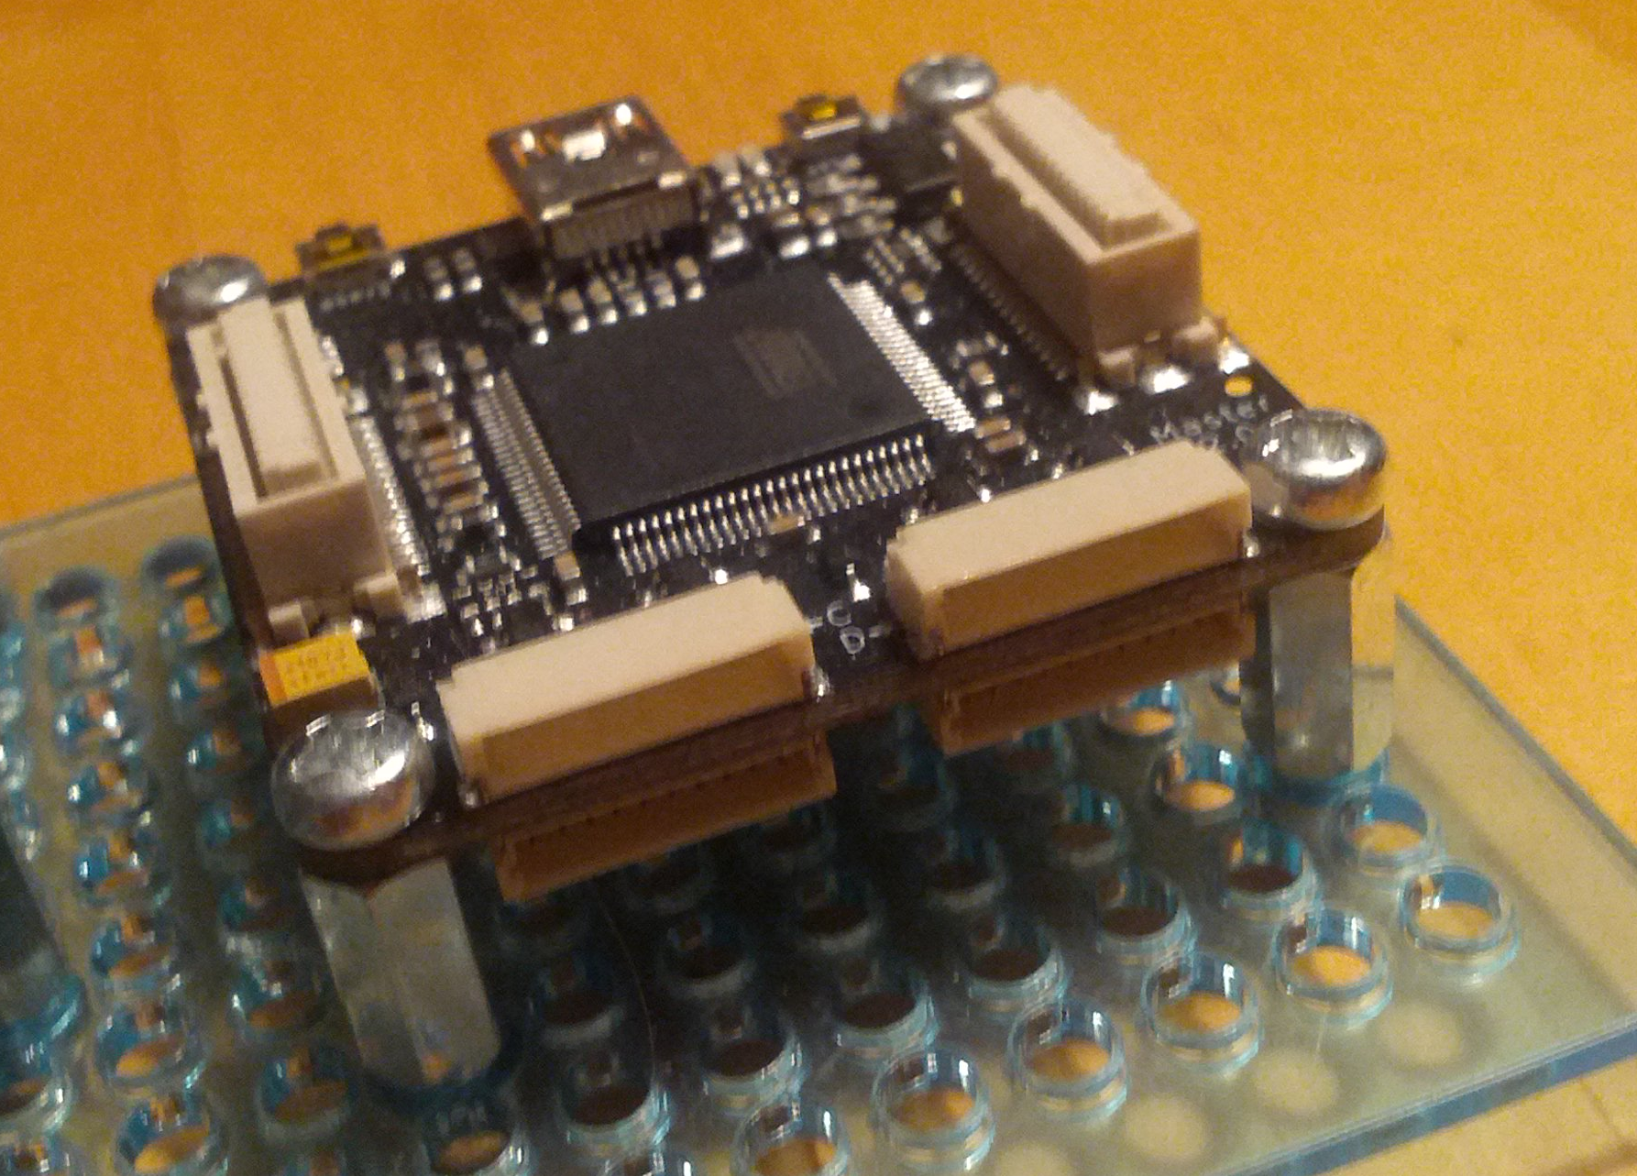
IoT with Tinkerforge
Your MasterBrick

Slide 12
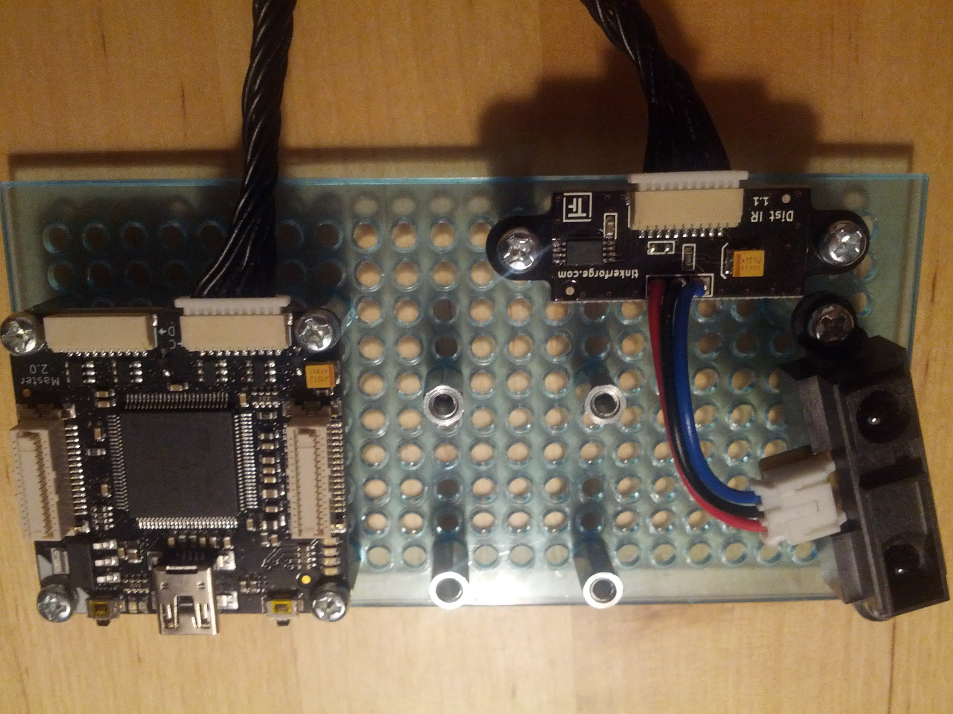
IoT with Tinkerforge
MasterBrick with IR distance bricklet

Slide 13
IoT with Tinkerforge
Power supply via USB
Control programs
Developed at PC (Java)
Transferred over USB

Slide 14
IoT with Tinkerforge
brickd
Utility program
No user interface
Runs in background
Enables us to talk to the devices

Slide 15
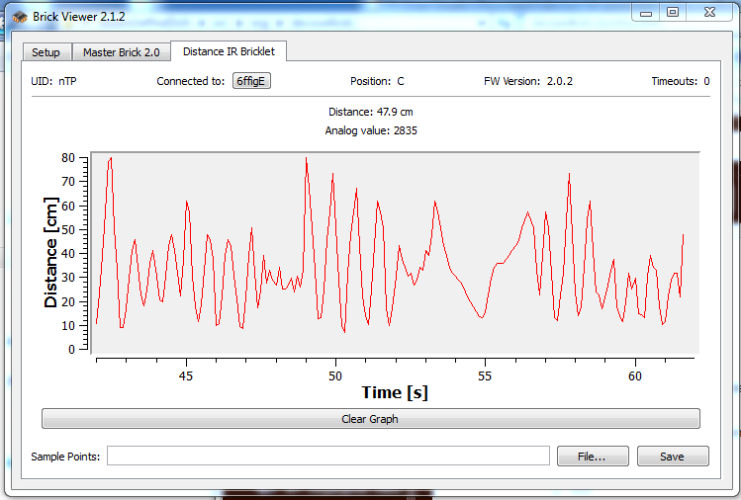
IoT with Tinkerforge
BrickViewer

Slide 16
Cheat Sheet
The Details

Slide 17
Cheat Sheet
Project setup
/home/pi/Devoxx4Kids/tinkerforge
Project
org/devoxx4kids
Main.java
src
build.sh

Slide 18

https://www.flickr.com/photos/roshanyadama/11915951346
https://creativecommons.org/licenses/by/2.0/

Slide 19
In conclusion
Prospect, questions and answers

Slide 20
Prospect: Software developer
Interest and commitment
Good grades at school
Special care in math
Apprenticeship
Study
Computer Science

Slide 21

Fragerunde
https://www.flickr.com/photos/10557450@N04/6632470867/
https://creativecommons.org/licenses/by-nc/2.0/

Slide 22
The observer pattern
How does news spread at your school?
You ask a friend
Somebody tells you news

Slide 23
The observer pattern
Imagine
You’re not keen on asking
Task a friend to inform you
Also called publish and subscribe

Slide 24
Cheat Sheet
The Details

Slide 25
Cheat Sheet
Changing program code with nano
nano /home/xy/Devoxx4Kids/Distanz/src/…
Save with strg+o
Quit with strg+x
/home/pi/Devoxx4Kids/distance/build.sh

Slide 26
Cheat Sheet
Structure of aTinkerForge program
public class main (String args) { … } ← This gets executed by your computer when running the program
BrickletReader brickletReader = new BrickletReader();
brickletReader.readBricklets(HOST, PORT);
← In order to connect to the devices, we need to find them beforehand
Bricklet segmentBricklet = brickletReader.getBrickletByDeviceId(BrickletDistanceIR.DEVICE_IDENTIFIER); ← Here we identify a bricklet

Slide 27
Cheat Sheet
Structure of aTinkerForge program
IPConnection ipcon = new IPConnection(); ← In order to talk to the bricklets we create a connection
BrickletDistanceIR dir = new BrickletDistanceIR(segmentBricklet.getUid(), ipcon); ← Here we create a representative of our bricklet in the code
ipcon.connect(HOST, PORT); ← Finally we connect to our devices now

Slide 28
Cheat Sheet
Structure of aTinkerForge program
dir.setDistanceCallbackPeriod(1000); ← Here we request to be notified once a second
dir.addDistanceListener(new BrickletDistanceIR.DistanceListener() {
@Override
public void distance(int distance) {
System.out.println(“new value: " + (distance / 10) + " cm");
}
});
← This is a lot… though only the part under “@Override” is important. Here we describe, what shall be done when we are notified of a new value.

Slide 29
Cheat Sheet
Structure of aTinkerForge program
System.out.println("Press key to exit"); ← Here we print the text between the “ “
System.in.read(); ← Here you’re program waits until you press a key
ipcon.disconnect(); ← This cancels the connection to the devices

Slide 30
Cheat Sheet
Help for later
Information and examples for all devices ofTinkerforge
e. g. Distance IR Bricklet
http://www.tinkerforge.com/de/doc/Software/Bricklets/DistanceIR_Bricklet_Java.html
or Piezo Speaker Bricklet
http://www.tinkerforge.com/de/doc/Software/Bricklets/PiezoSpeaker_Bricklet_Java.html
An overview of all devices
http://www.tinkerforge.com/de/doc/index.html#/software-java-open

