Slide 1

Wombats
Creating Games with Greenfoot

Slide 2
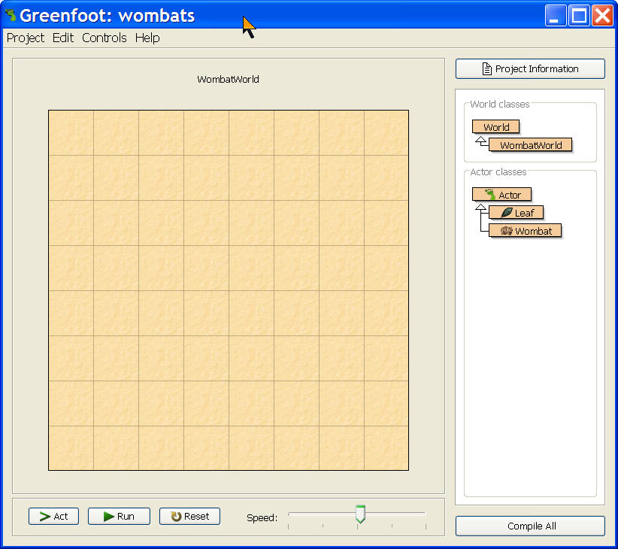
What is Greenfoot?
A free environment that makes it easy to create 2D animations, simulations, and games
While teaching object-oriented concepts in Java
Built on top of BlueJ
Created at the Un. of Kent in England and Deakin University

Slide 3
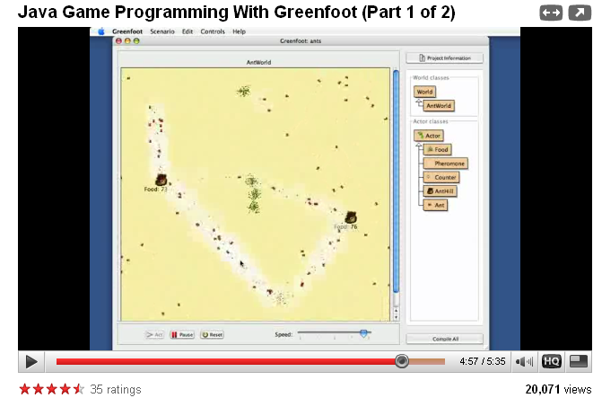
Watch – Java Programming with Greenfoot (Part I) http://www.youtube.com/watch?v=NcGe141R2yA

Slide 4
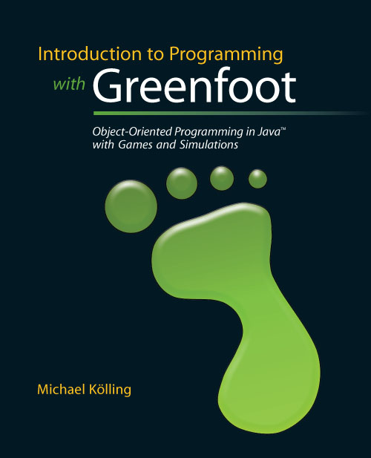
Greenfoot Resources
Web site
http://www.greenfoot.org
Scenarios
http://www.greenfoot.org/scenarios/index.html
Tutorial
http://www.greenfoot.org/doc/tutorial.html
Book: Introduction to Programming with Greenfoot by Michael Kölling

Slide 5
Getting Started
To start Greenfoot click on greenfoot.exe
Click on Project in the menu
Choose Open
Pick the wombats scenario
It starts by showing an empty WombatWorld
Which is a 2D grid of cells

Slide 6
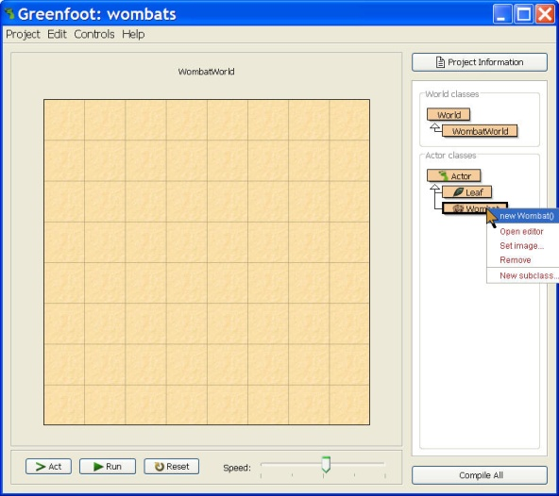
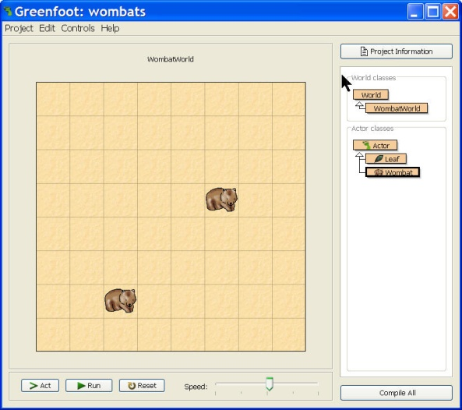
Adding Objects to the World
Right click on Wombat in the class display to see a pop-up menu
Create a Wombat by selecting
new Wombat()
A picture of a wombat will appear attached to the cursor
Click in the world to place the wombat
Shift-click to place more than one object
Class
Display

Slide 7
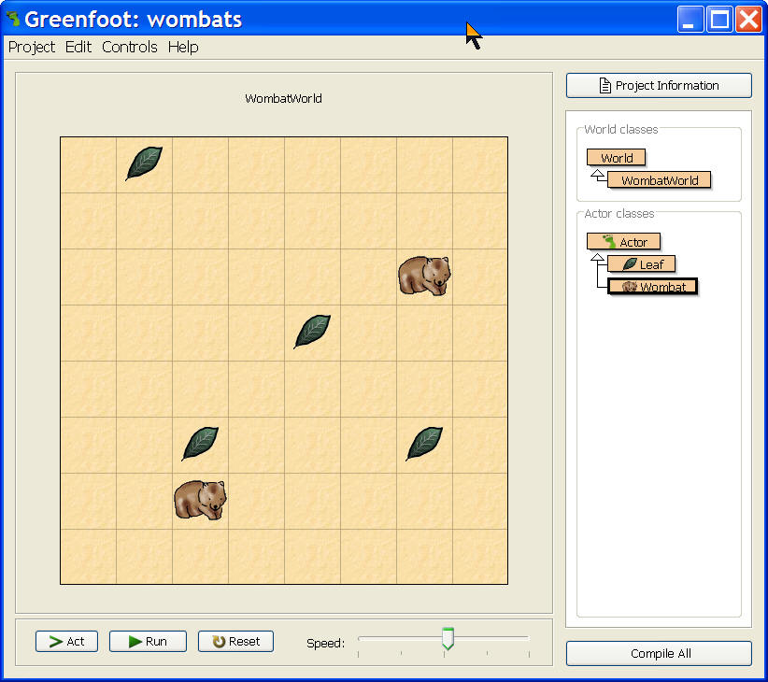
Add Leaves
Add several leaves to the world
Right click on Leaf in the class display
Hold down the shift key
Click in the grid to place each leaf

Slide 8
Greenfoot Objects
There are two basic types of things in Greenfoot
Worlds and Actors
Other objects are children (subclassses) of these
Inherit properties and behaviors from parent (superclass)
Worlds hold actors
a stage for actors
Actors can act
They may move
They may stay where they are

Slide 9
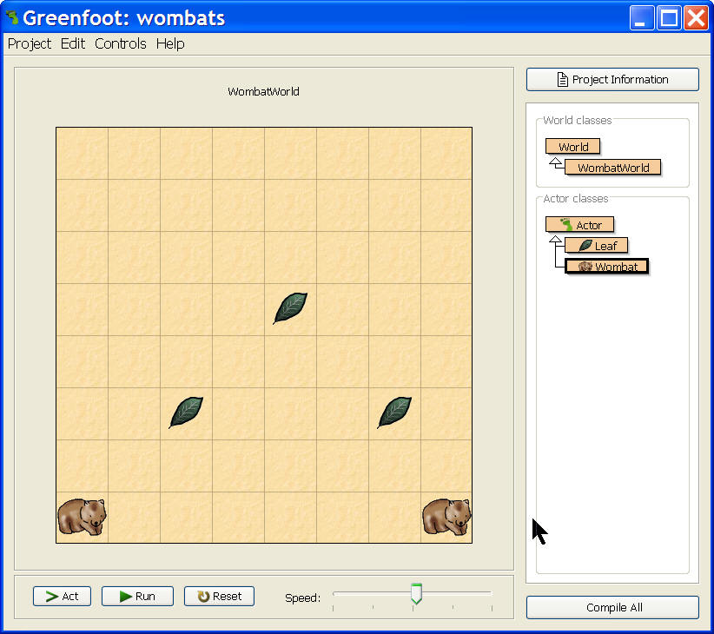
Run the Simulation
Click on act to execute one simulation time step
Act one time
Click on run to have it continuously execute time steps
Keep acting till you
Click on pause to stop
Click on reset to start over
With a new WombatWorld
Execution Controls

Slide 10
What Happened?
Questions
How did the wombats move?
Did they eat any leaves?
Did the leaves move?
What happened when a wombat reached the edge of the world?
If you don’t know the answer to any of these questions place more wombats and/or leaves in the world and run again
Or click on act to see things in slow motion

Slide 11
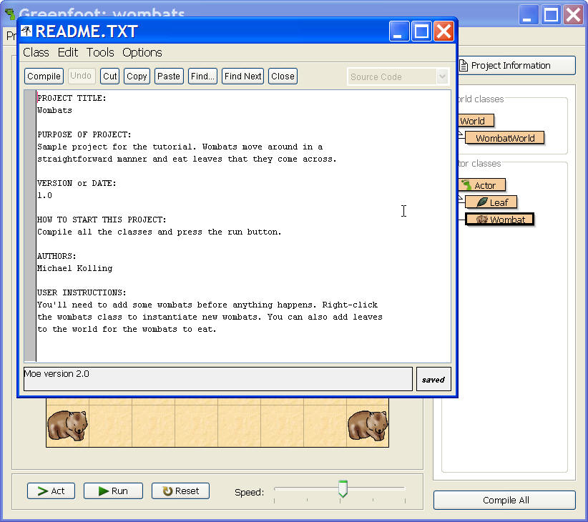
The Wombat Scenario
To get information on any scenario
Click on the Project Information button
In top right corner above the class display
Read the displayed documentation
Click close when done

Slide 12
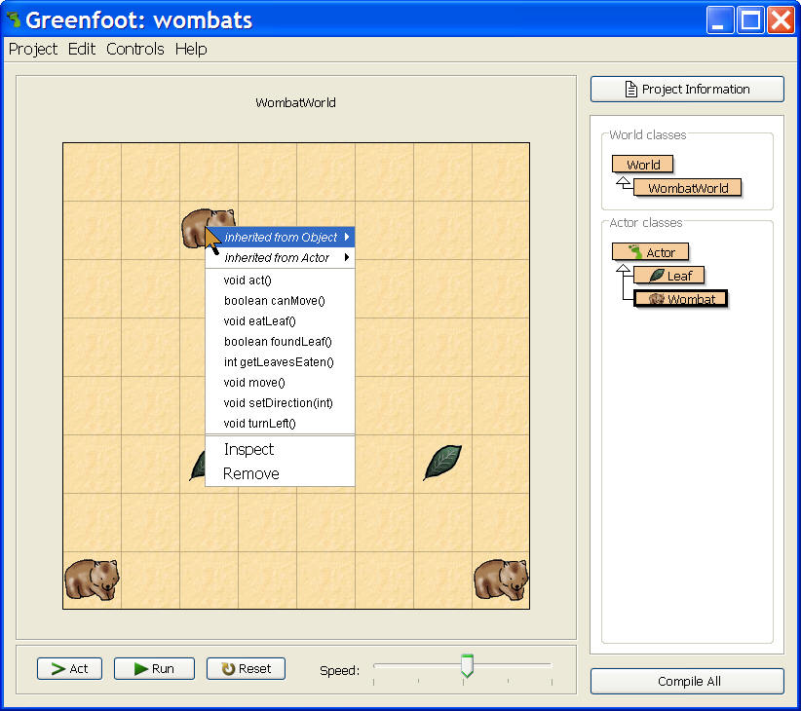
Actor Methods
You can see and execute all methods that an actor knows how to do
By right clicking on an actor in the grid
Select a method to execute it
You can invoke inherited methods as well

Slide 13
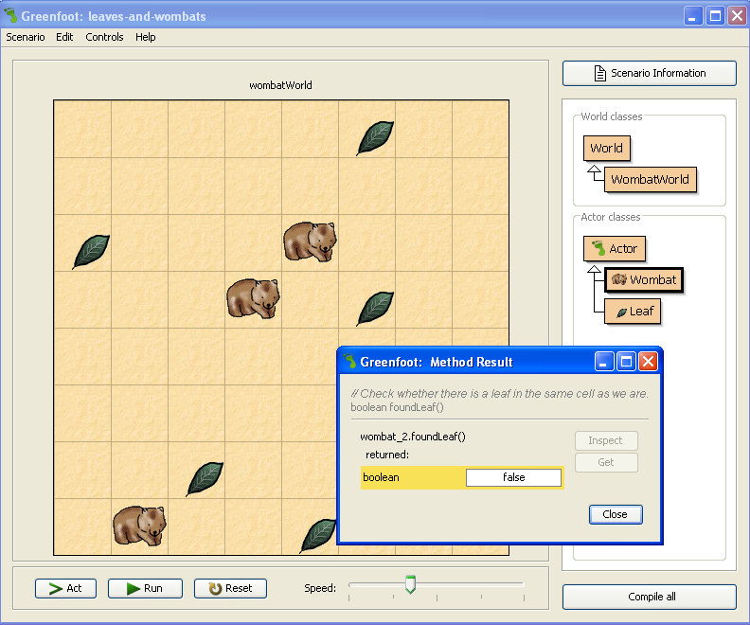
Return Types
Tells us what the method returns when we invoke it.
Methods with “void” do not return a value.

Slide 14
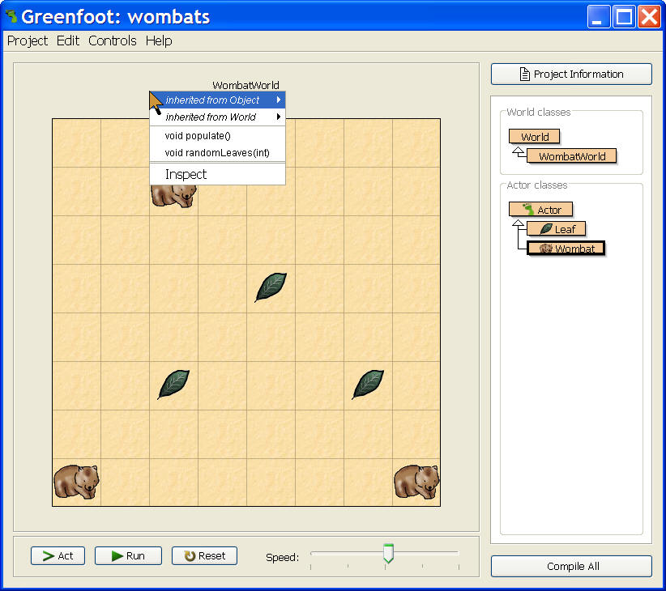
World Methods
Right click near the title of the world
To show the world menu
Select populate()
This will add wombats and leaves to the world
Then click on run
What happens?
Do all the leaves get eaten?

Slide 15
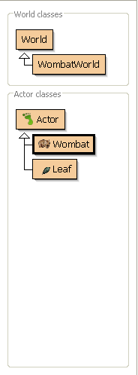
Class Diagrams
Superclasses contain methods that give functionality to subclasses.
Abstract Classes are needed but don’t create actors.
Subclasses inherit the methods of its superclass.
Superclass
Abstract Class
Subclass

Slide 16
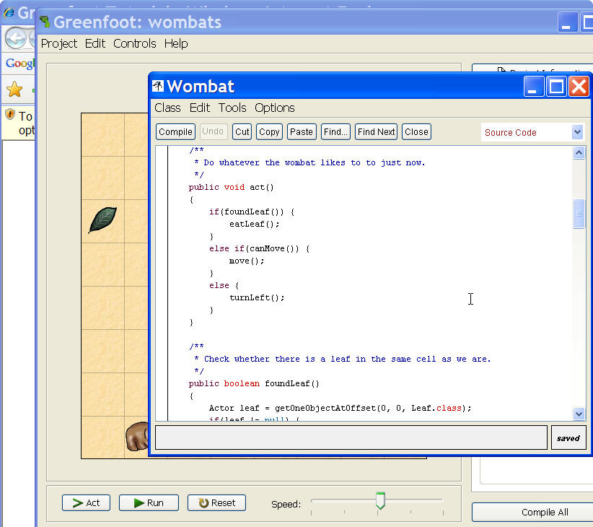
Changing Wombat Behavior
Left click on the Wombat class
To show the code for the Wombat class
Read the act method
Modify it to turn left a random number of times (0-3) if it can’t move and isn’t eating a leaf
Create a turnRandom method and call it instead
Use Greenfoot.getRandomNumber(4)

Slide 17
Attack the Problem
Establish a turnRandom() method
Establish a variable “turns” that will hold the number of turns.
Establish a loop to count the number of turns
Establish a counter, set it to zero, count up by 1

Slide 18
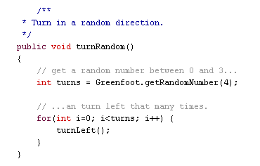
Possible Solution Part I

Slide 19
Attack the Problem Part II
Use a conditional statement to say that if the wombat is pointed in a specific direction, then change that direction randomly

Slide 20
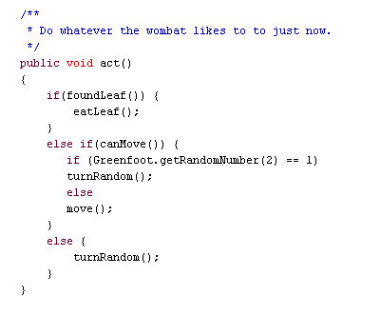
Possible Solution Part II

Slide 21
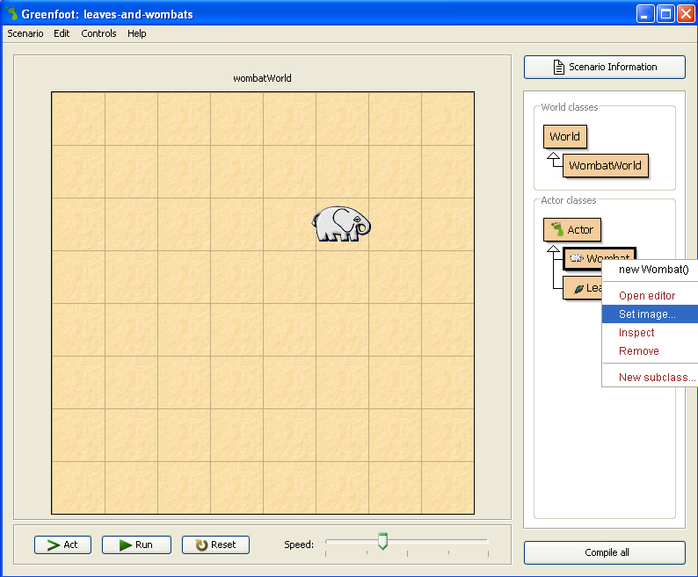
Changing Actors
Changing Actors
Right click on the actor’s class
Choose “Set Image”
Choose the image from the library
Compile the program

Slide 22

Adding Actors from the Greenfoot Image Library
Adding Actors
Navigate to the website.
Right click and download the image to your folder on the school’s network drive.
Save it to your images folder for the project.
Open the project.
Right click on the actor’s class.
Choose “Set Image”.
The image should appear in the left pane because you added it to the project image folder.
Choose the image.
Compile the program.
http://www.greenfoot.org/download/images.html

Slide 23
Open Challenge (Coding Movement)
Study the habits of how a particular character moves in real life.
How could you code these different types of movements? Look at movement in other games or check out how to create movement in video tutorials.
http://www.greenfoot.org/doc/videos.html
Videos are also on YouTube.com

