Slide 1
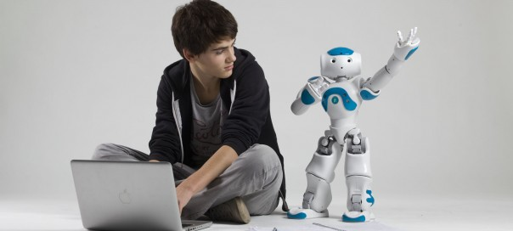
NAO
Programming a humanoid robot

Slide 2
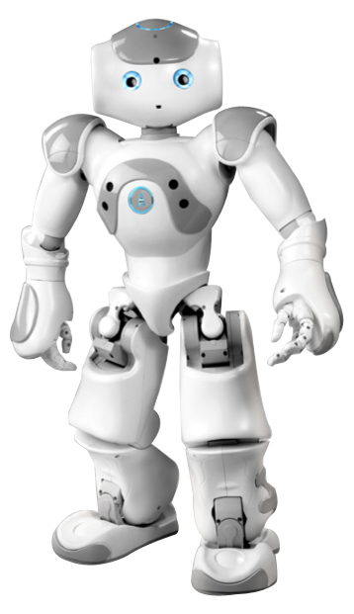
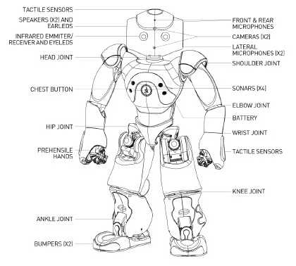
Introducing NAO
But I'll let him introduce himself!
Notes:
Play on NAO the presentation.crg Choregraphe project, make sure the translation in your language is present.

Slide 3
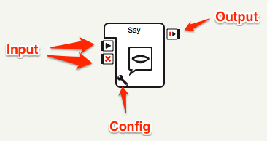

Choregraphe Software
NAO Visual Programming
Allows users of NAO to create and edit simple movements and interactive behaviors.
Demonstration

Slide 4
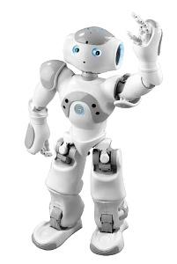
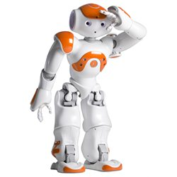
NAO's Mission
Make NAO walk towards you and stop in front of you.
NAO asks you to give him the ball and asks you where to put the ball.
NAO looks around and finds the place you identified.
NAO goes there, and places the ball down.

Slide 5
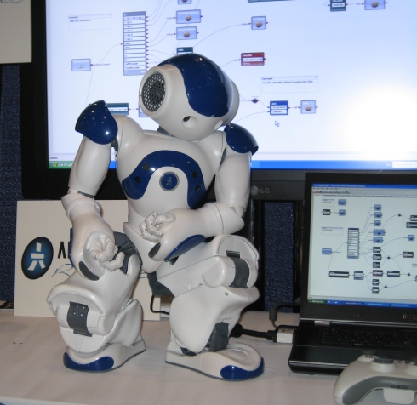
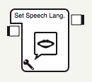
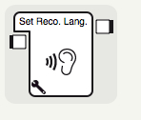
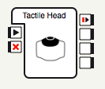
Preparation
Start Choregraphe
Create a new project
Load the Library: Devoxx4Kids.cbl
Place and configure boxes
Set Speech Language
Set Reco. Lang.
Tactile Head
Connect the boxes to the starting point.

Slide 6
Exercise 1
Make NAO walk towards you
Infrared Sensor (Eyes)
Sonar
Eye Color
Create a new box in the root plane
Change the Name: Walk to Person
Change the Image: move.png
Type: Flow Diagram

Slide 7
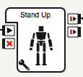
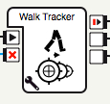
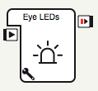
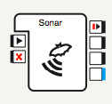
Exercise 1 (continued)
In the new box Walk to Person
Make NAO stand (Stand Up)
Walk Tracker
Green eyes when NAO finds you (Eye Leds)
Red eyes when he doesn’t find you (Eye Leds)
Use NAO’s sonar
Detect an obstacle (you)
Stop the Walk Tracker
Link the sensor on NAO’s head to the new box

Slide 8
Exercise 2
Ask the ball
Raise right arm and open the hand
Make NAO speak
Make him understand what you say
NAO ask a question with 2 possible answers
Lower the arm and close the hand

Slide 9

Exercise 2 (continued)
Create a new box in this plane
Change its name (up to you to choose)
Type: Flow Diagram
Add 2 outputs
Double-click on the new box
Click on the (top right)
Name for output 1 : Chair
Name for output 2: Box

Slide 10
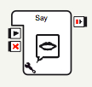
Exercise 2 (continued)
Change the color of the eyes
Raise NAO’s right hand (librairy)
Box : Raise Right Hand
Make NAO speak with the Say box
NAO must ask for the ball

Slide 11
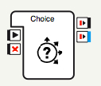
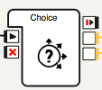
Exercise 2 (continued)
NAO asks where he should place the ball
Create a nex box
Type : Flow Diagram
Add a Choice box
Edit the output of the box
Rename the output answer into answer1
Type : Number : 1
Naturel : Punctual
Add a second output : answer2
Type : Number : 1
Naturel : Punctual
Double-click on the box to enter the question and the answers
Make NAO repeat the answer you gave him

Slide 12
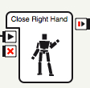
Exercise 2 (continued)
NAO lower his arm and close his hand
Go back to root plane.
Add a Close Right Hand box
Link both outputs to the box

Slide 13
Exercise 3
NAO looks for the right place where to drop the ball
Turns his head
Looks for the right NAOMARK
Says he found the right place
Says he hasn’t find the right place

Slide 14
Exercise 3 (continued)
Create a new box in the main place
Change name : Research
Type: Flow Diagram
Add 1 output
Double-click on the new box
Click the (top right corner)
Name for the output : Found

Slide 15







Exercise 3 (continued)
In the new box, add:
A NAOMark box
A Center Head box
A Move Head Left box
A Move Head Right box
An IF box
Two Say boxes
Three Wait boxes (Change timeout to 4,000000)

Slide 16
Exercise 3 (continued)
Connect the starting input of Research box to:
Center Head
NAOMark
A wait box
Make NAO’s head turn from left (Move Head Left) to right (Move Head Right)
Connect the NAOMark to the IF box
Configure the IF box :
Condition Operator : =
Value to compare : 68

Slide 17
Exercise 3 (continued)
Conect the output output_then of the IF box to the Input :
onStop of boxes Wait, Move Head Left, Move Head Right
onStart of a Say box
Use Say box to say that NAO has found a box to drop the ball
Don’t forget to make NAO say he hasn’t find any box where to drop the ball. It’s up to you to find out how to do!
Then get back to main plane and do the same thing for the chair (copy/paste + modifications).

Slide 18
Exercise 4
NAO goes to the required place to drop the ball
Walk to the box or the chair (NAOMARK)
Sfoot sensorsenseurs des pieds to avoid collision with box or chair
Drop the ball

Slide 19
Exercise 4 (continued)
Create a new box in root plane:
Edit name: Walk to NAOMark
Type: Flow Diagram

Slide 20

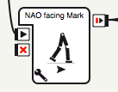

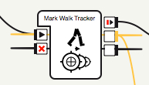
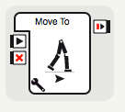
Exercise 4 (continued)
In the new box, add:
A Mark Walk Tracker box
A NAO facing Mark box
A Bumpers box
A Move To box
A Say box
2 Wait boxes (Change timeout to 0,500000)
2 Eye LEDs boxes
A Drop Ball Move Back and Sit box

Slide 21
Exercise 4 (continued)
Connect the starting point of Walk to NAOMark box to the input of NAO facing Mark
Connect the output of NAO facing Mark àto the input onStart of:
Bumpers :
NAO must walk 2 steps backward
Stop all other boxes
NAO must say he found the place « Im in! »
Mark Walk Tracker
Eyes turn to blue if NAOMark is no longer detected
Output: onLost connected to Input onStop
NAO take a step
NAO must say he has arrived « Im in »
Green eyes if NAOMark is detected

Slide 22
Exercise 4 (continued)
In the root plane, add the Drop Ball Move Back and Sit box and connect it to the Walk to NAOMark box

