Slide 1


Introduction to

Slide 2
About
What is ?
Scratch is a programming language.
We can use it to create our own interactive stories, animations, games, music, and art.

Slide 3
About
What can we learn from ?
We can learn important computational ideas.
We can learn to think creatively.
We can learn to reason systematically.

Slide 4
What is programming?
Programming is the art of making a computer do what you want it to do.
A computer program is simply a set of instructions to tell a computer how to perform a task.
It is like a recipe: a set of instructions to tell a cook how to make a dish.

Slide 5
Basic Ingredients of a Scratch project
Scratch projects are made up of a stage and objects called sprites.

Slide 6
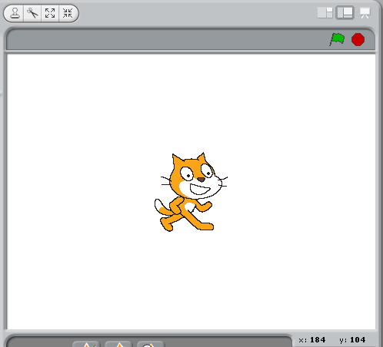
Stage and sprites
The stage is where you see your stories, games and animations come to life.
Sprites move and interact with one another on the stage.

Slide 7
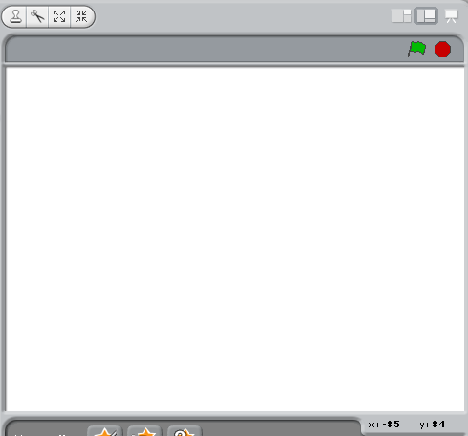
Stage
You can choose either View Mode (Small stage or large stage) or Presentation Mode to display the stage

Slide 8
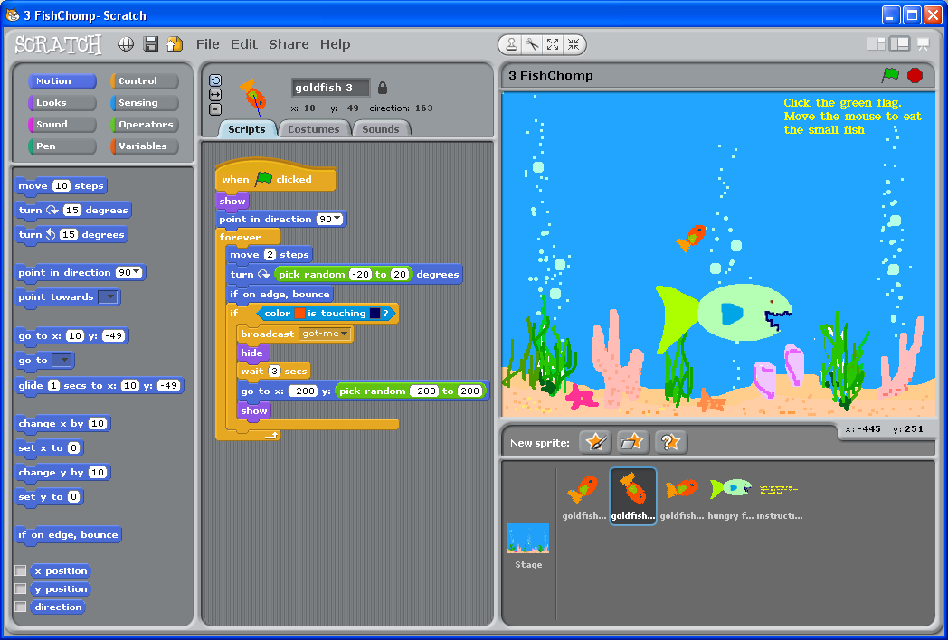
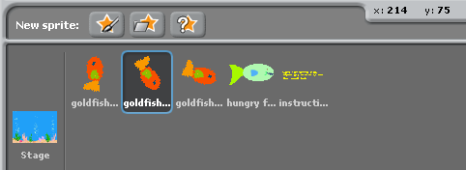
Sprites
You can create New sprites and find the sprites from the Sprite List

Slide 9

Current Sprite Info
You can find the sprite’s name, position, direction, lock state, pen color and rotation style

Slide 10
Toolbar
On using the Toolbar, you can make sprites larger or smaller
You can also duplicate or delete sprites, costumes, sounds or scripts

Slide 11


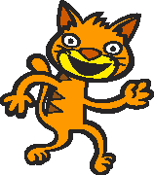

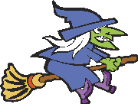
Costume
You can change how a sprite looks by giving it different costumes.
You can make a sprite look like a person, a train, a butterfly or anything else.
You can use any image as a costume.

Slide 12
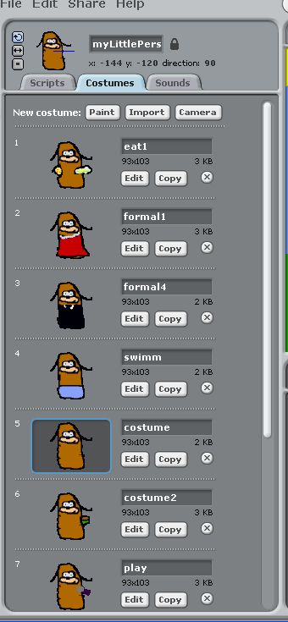
Costumes
To see different costumes of a sprite, choose the Costumes tab page

Slide 13
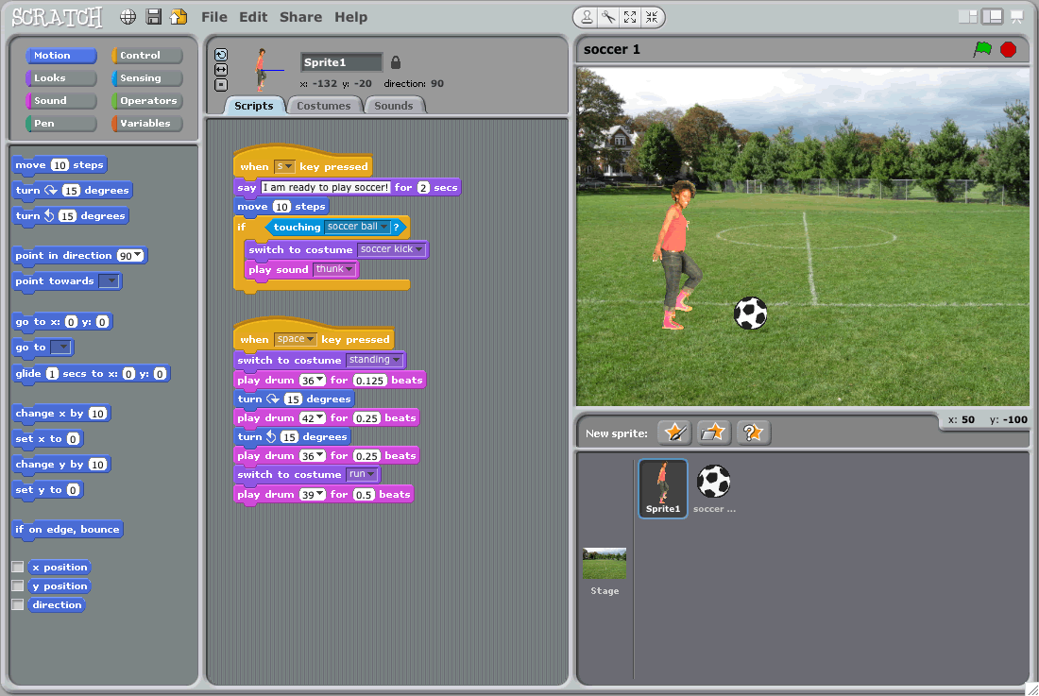
Blocks Palette and Scripts Area

Slide 14
Start and Stop Your Program
Click the Green Flag to start all scripts that have at the top.
Red Stop Sign stops all scripts

Slide 15
Scratch web
What can we get from Scratch web?
We can download Scratch installer, view tutorial videos, get support from the forums, share our projects ……

Slide 16
Try Your First Project!

