Slide 1


Let’s Create a Game

Slide 2
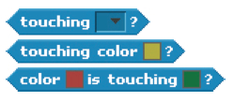

Useful Blocks for Games
Like the other genres we’ve already explored, games provide numerous opportunities to explore a variety of computational concepts and skills.
Here are some blocks that are frequently useful in games.
Touching
See if two sprites are touching or if a sprite is touching a color
Visibility
Make a sprite appear or disappear

Slide 3


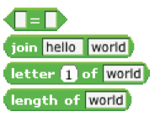
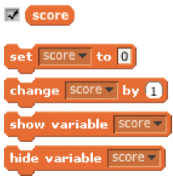
Useful Blocks for Games
Random
Get a computer-generated number from within a specified range
Timing
Have the computer keep track of time for you
Strings
Test, access, and change words and sentences
Variables
Store a number or string in a container to access later

Slide 4
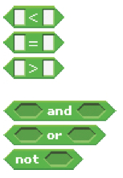
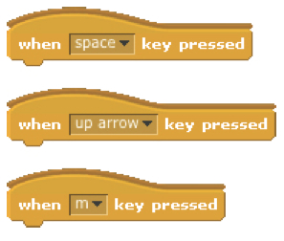
Useful Blocks for Games
Compare
Compare values to help make decisions within your game
Key Press
Make a sprite respond when different keys are pressed

