Slide 1
Scratch with LeapMotion
Inspired by Kreg Hanning’s work
(@khanning88 / http://khanning.com/)

Slide 2
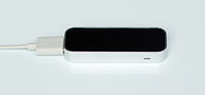
Leap Motion?
A small USB peripheral device
Observes a roughly hemispherical area
Synthesize 3D position
Perform tasks such as
navigating a website,
pinch-to-zoom gestures on maps,
high-precision drawing,
manipulating complex 3D data visualizations

Slide 3

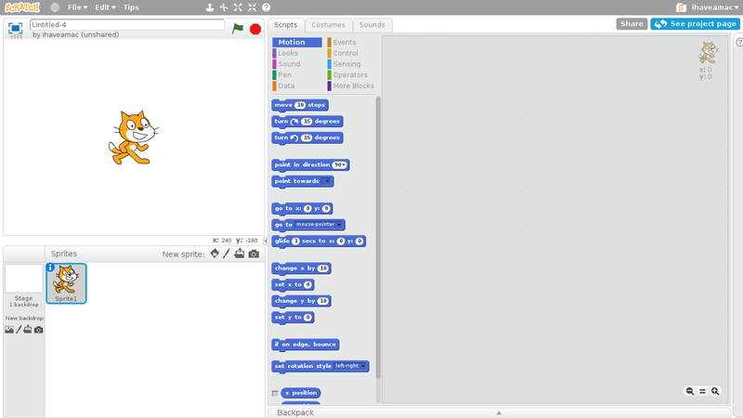
Scratch ?
A multimedia authoring tool
Event driven programming with multiple active objects
Events
Mouse
Keyboard
Webcam
Collision
Etc

Slide 4
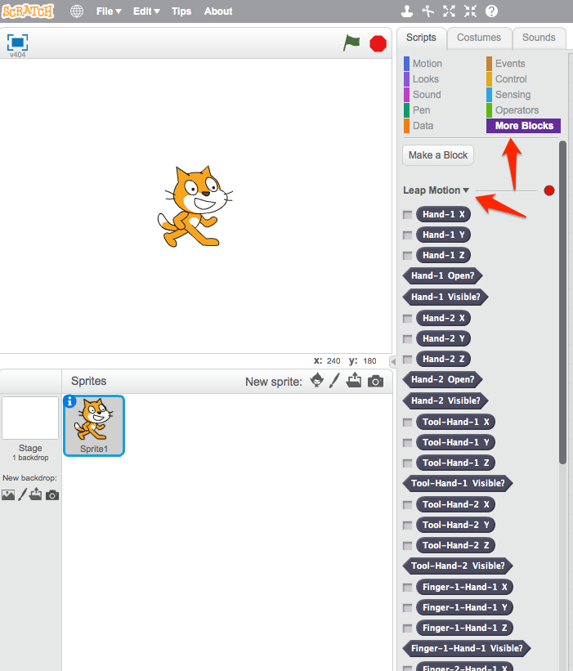
LeapMotion and Scratch
Use the Leap Motion Controller as a new set of sensors/blocks in Scratch
2 hands
10 fingers

Slide 5
Installation
Download and install the offline version of Scratch 2.0 (Adobe Air required) http://scratch.mit.edu/scratch2download/
Install the LeapMotion Software
Download and install LeapMotion driver https://www.leapmotion.com/setup
In AirSpace (LeapMotion AppStore), install the Scratch 2.0 plug-in for LeapMotion and start it https://airspace.leapmotion.com/
Connect the LeapMotion controler to USB
Save the LeapMotion.jsp file (https://github.com/khanning/LeapScratch) in your computer

Slide 6
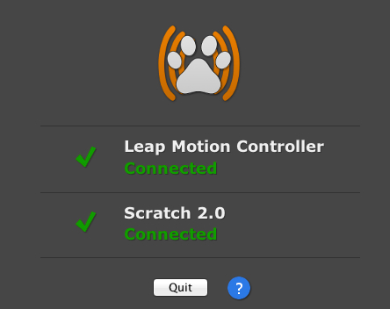
Scratch Project Prep.
Get the ‘D4K-Scratch-LeapMotion.sb2’ Scratch 2 project from our Website
http://www.devoxx4kids.org/materials/workshops/scratch/
Open the project in the Scratch 2.0 Offline Editor
The Scratch 2.0 plug-in for LeapMotion must show
Note: if you want to start from an empty Scratch Project
Hold the Shift key on your keyboard and click on the File menu at the top of your project window
Click "Import Experimental Extension”
Choose the LeapMotion.json file
Now you'll have access to the "Leap Motion" blocks under the "More Blocks" tab!
When you save your project the LeapMotion.json file is saved with it, so you only need to import it once.

Slide 7
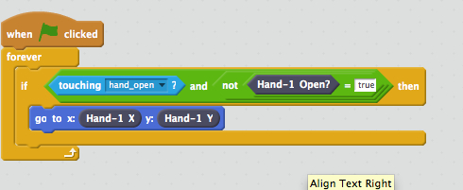
Scratch Grab Sample
The ‘D4K-Scratch-LeapMotion.sb2’ project contains all necessary sprites images
Now Children need to program the Sprites
Sprite 1 Script (the Scratch Cat)

Slide 8
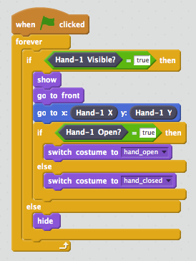
Scratch Grab Sample
Sprite 2 Script (the Hand)

Slide 9
Extend the project
You can now grab the Scratch Cat with the hand.
Open/Close your hand above the LeapMotion (See the hand image change)
Grab the Cat by closing your hand when hand image over the Cat image.
Next, children need to extend the project with additional features, such as
Creating a maze game (moving the cat through the maze)
See the other available Scratch exercises

Slide 10
Additional Samples
Check other available Scratch 2 – Leap Motion projects here:
http://scratch.mit.edu/studios/236466/

