Slide 1
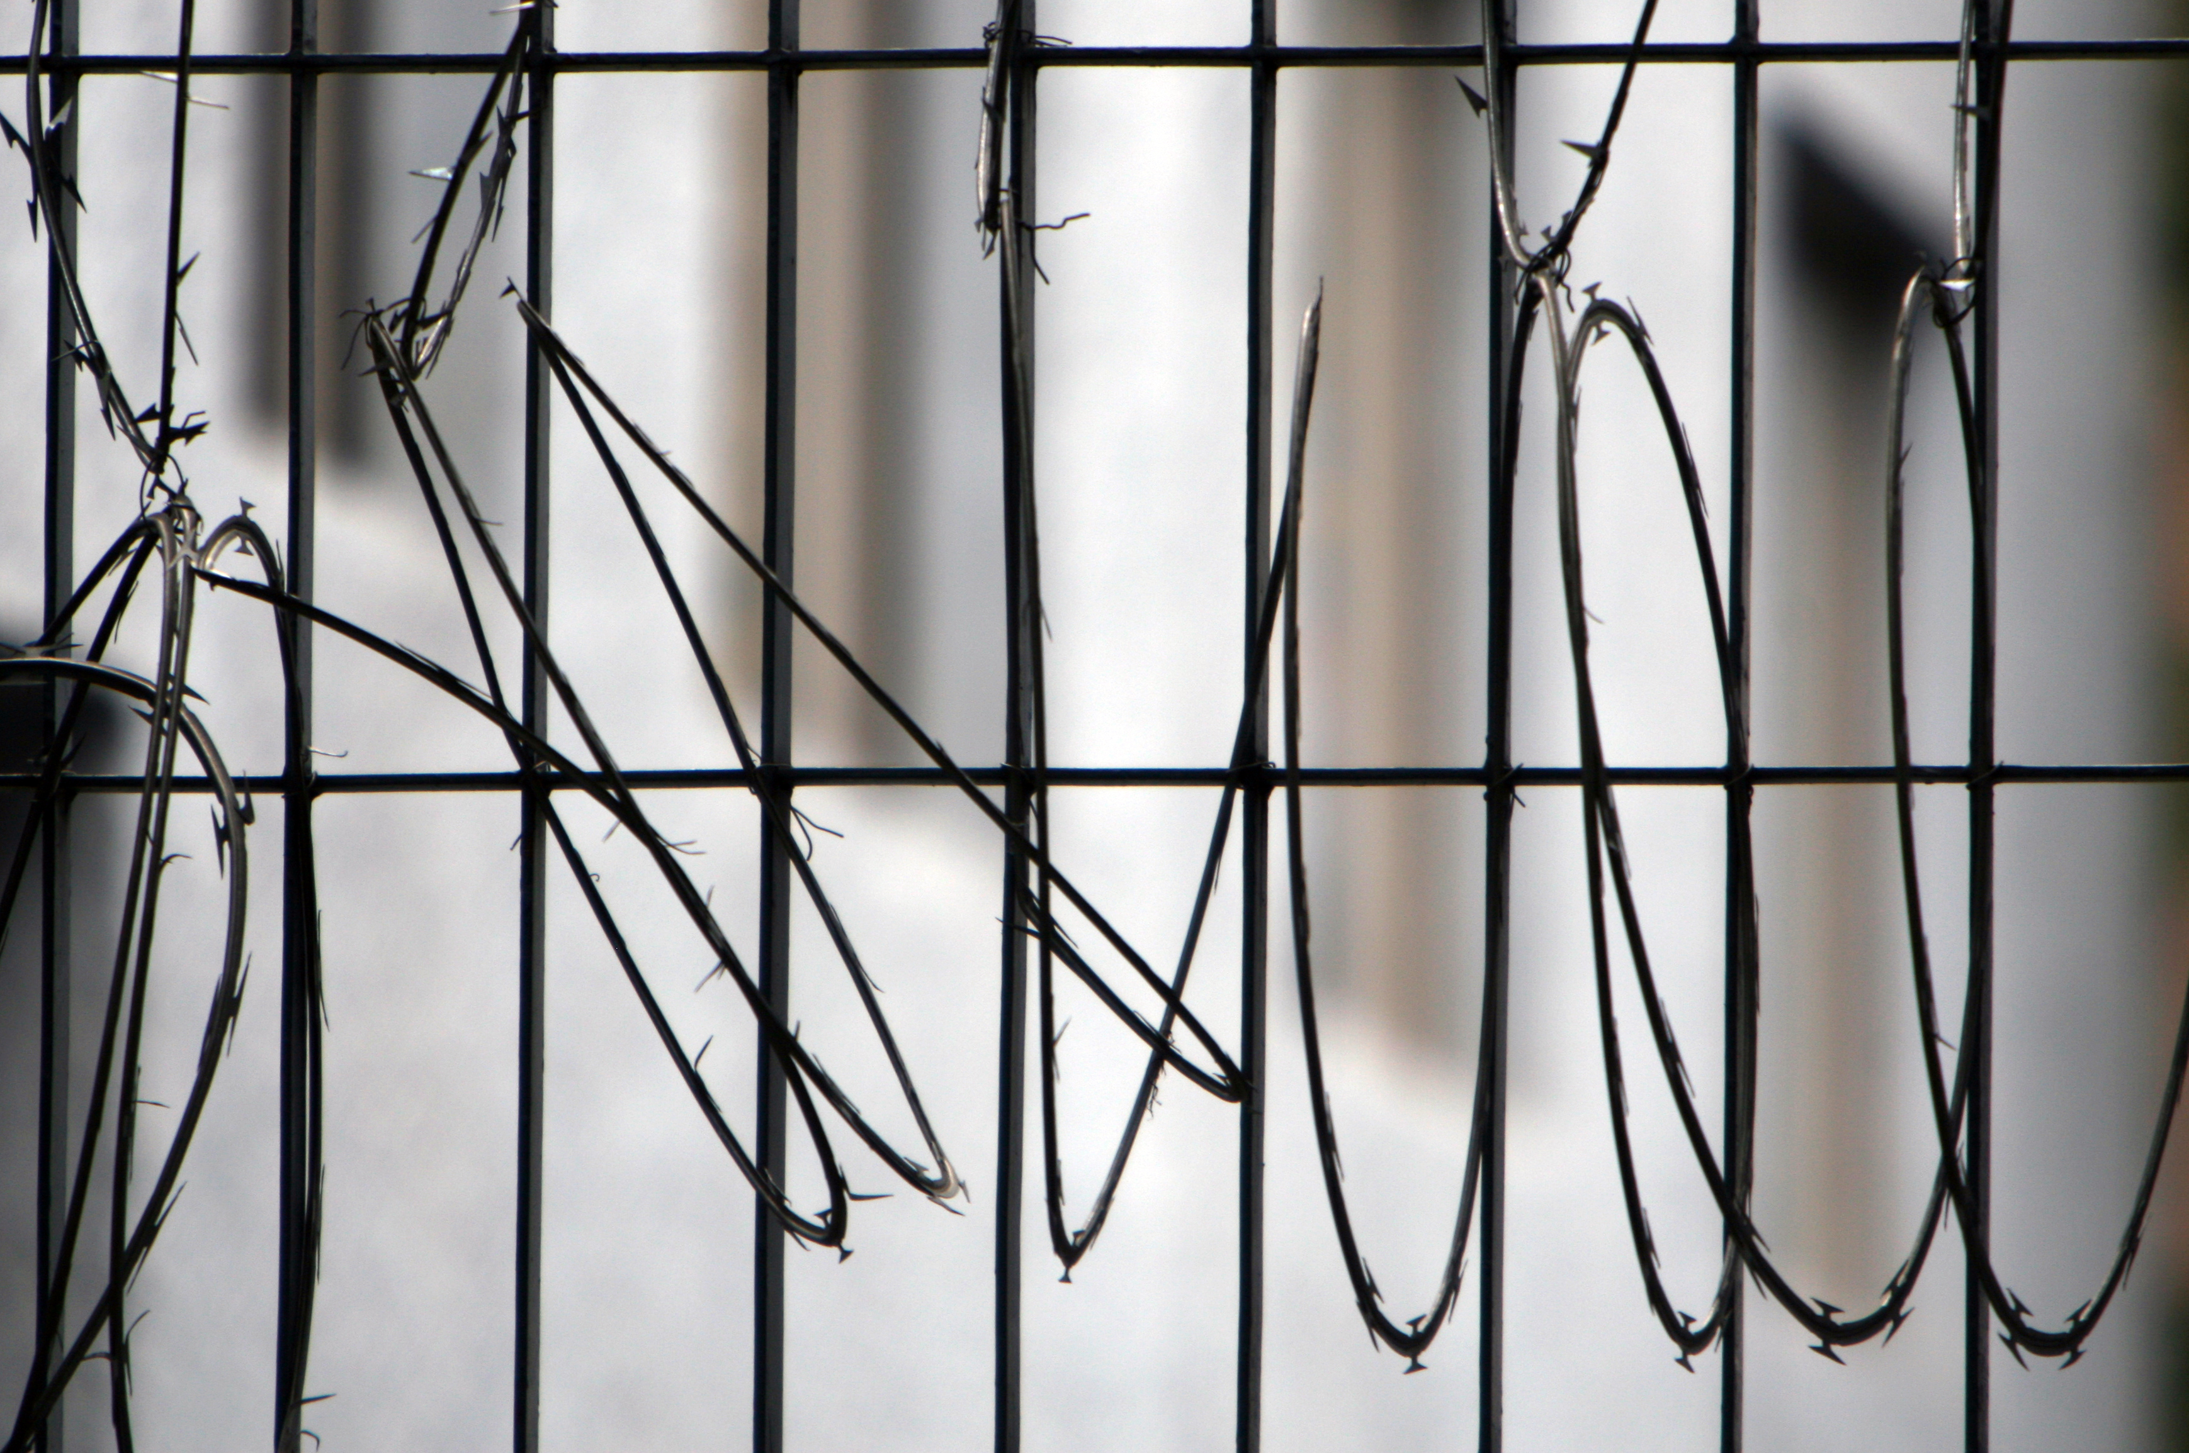
Node Access for Common Folks
With Uncommon Problems
Matt Kleve
(vordude)
http://www.flickr.com/photos/pulpolux/238355661

Slide 2

Who is this guy?
5 years of Drupal
(bad) Module Maintainer
Drupal Security Team
Senior Developer, Lullabot

Slide 3

http://www.flickr.com/photos/pulpolux/238355661

Slide 4

http://www.flickr.com/photos/pulpolux/238355661

Slide 5
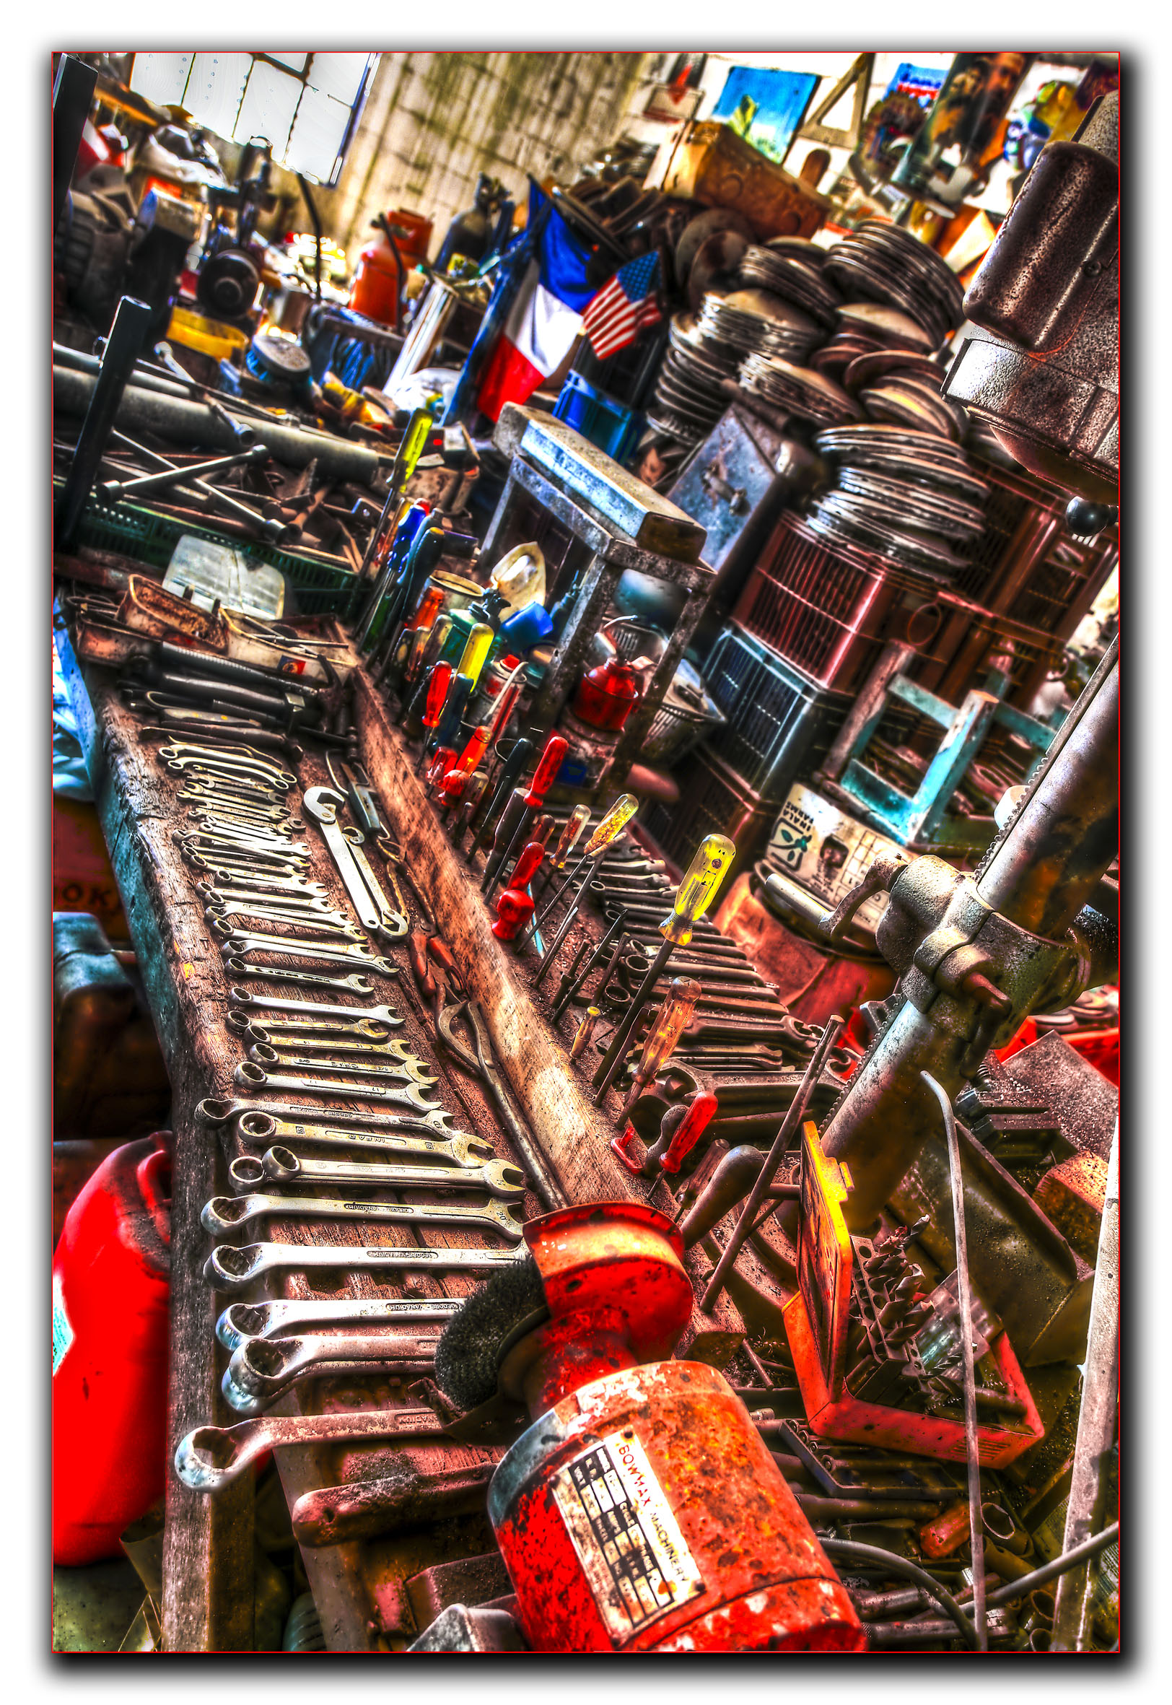
http://www.flickr.com/photos/bruce-camera/5136165983

Slide 6
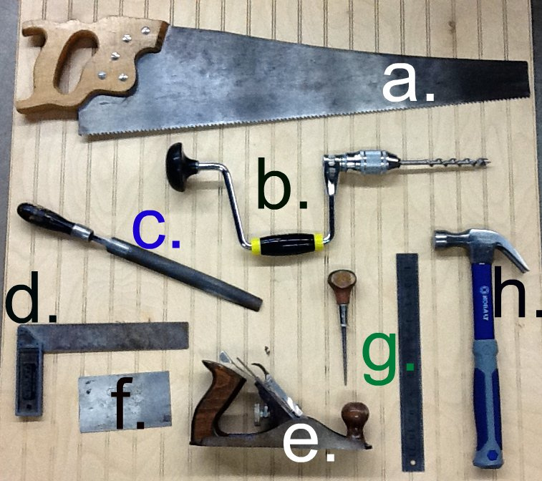
http://www.flickr.com/photos/68114781@N04/6287025846/

Slide 7
You basic Node Access Needs
Who? (The user on the site)
What are they doing? (View? Edit? Delete? Create?)
To What? (The Node They're doing it to)

Slide 8
WARNING
These first 2 tools work together, if you've never looked at this stuff before, it won't make sense until you hear about both of them.
Go with me for a moment.

Slide 9
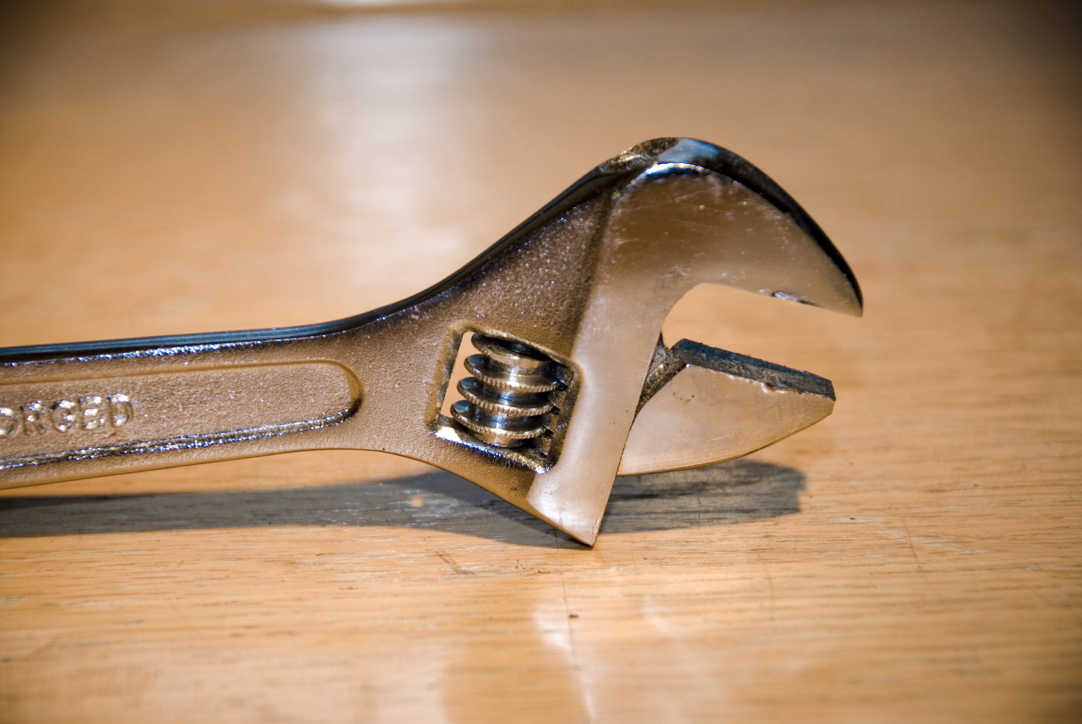
http://www.flickr.com/photos/jjay69/5041747953/

Slide 10
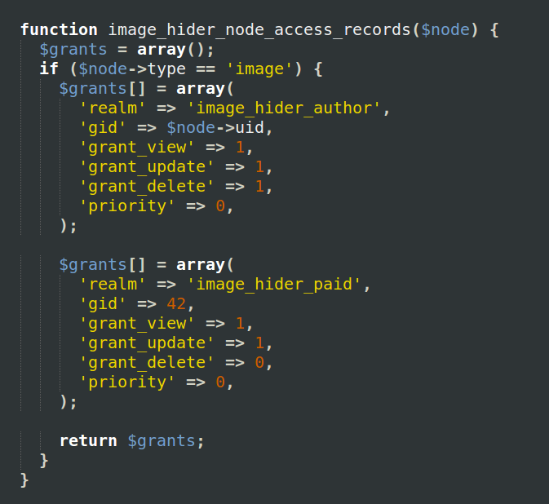
hook_node_access_records()

Slide 11
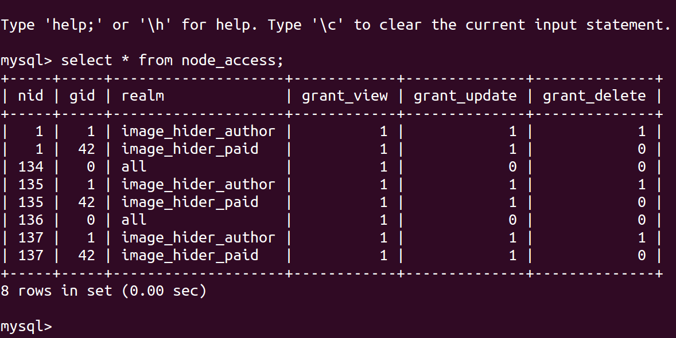
hook_node_access_records()

Slide 12
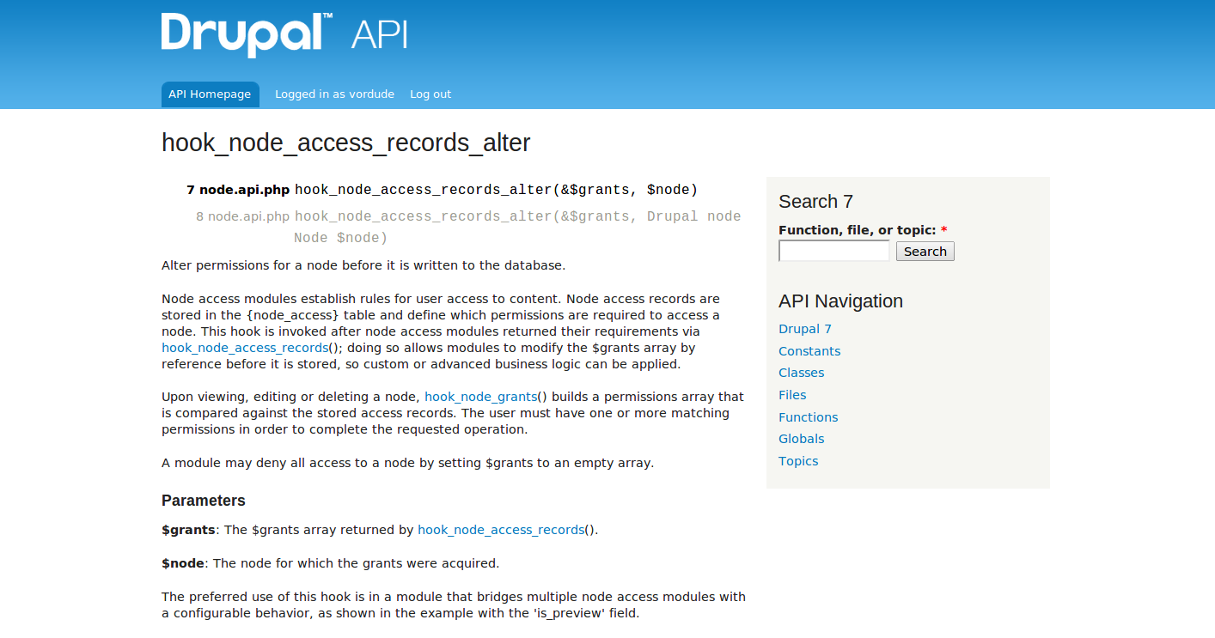

Slide 13
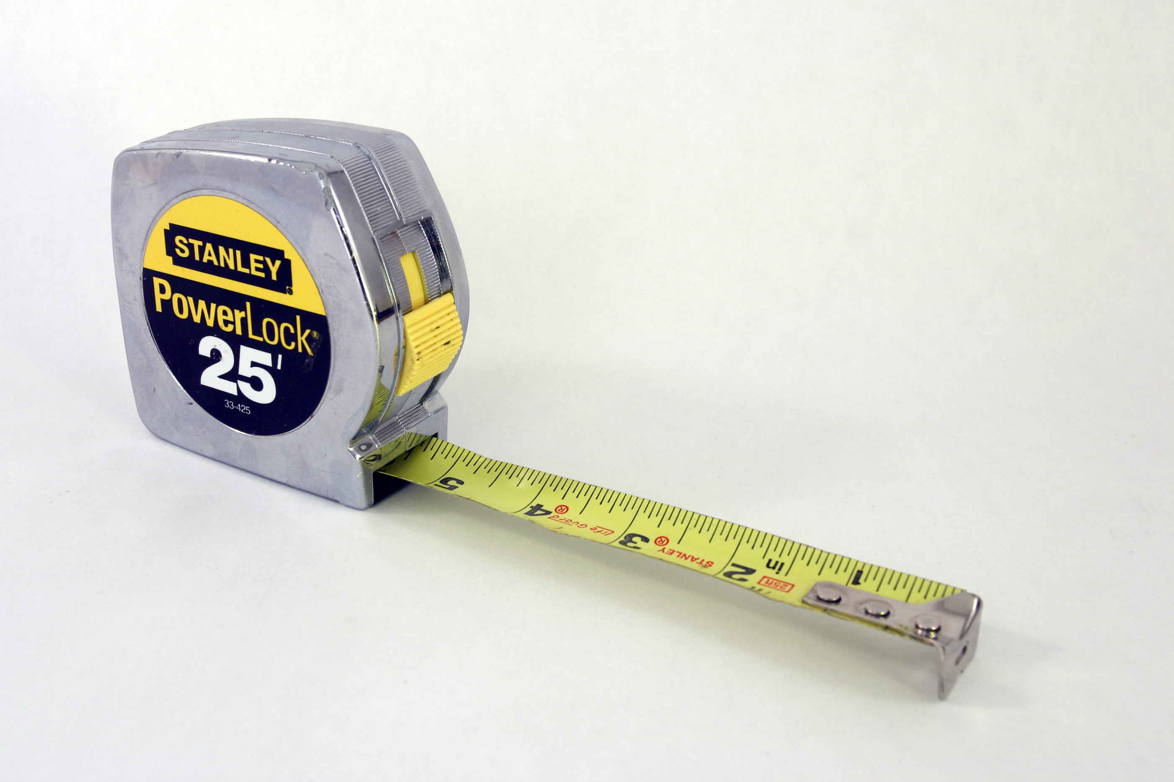
http://www.flickr.com/photos/redjar/136165399

Slide 14
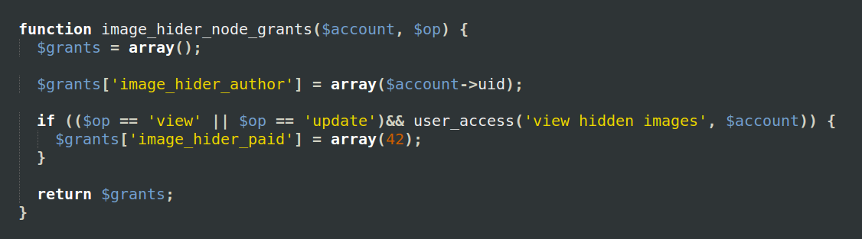
hook_node_grants()

Slide 15
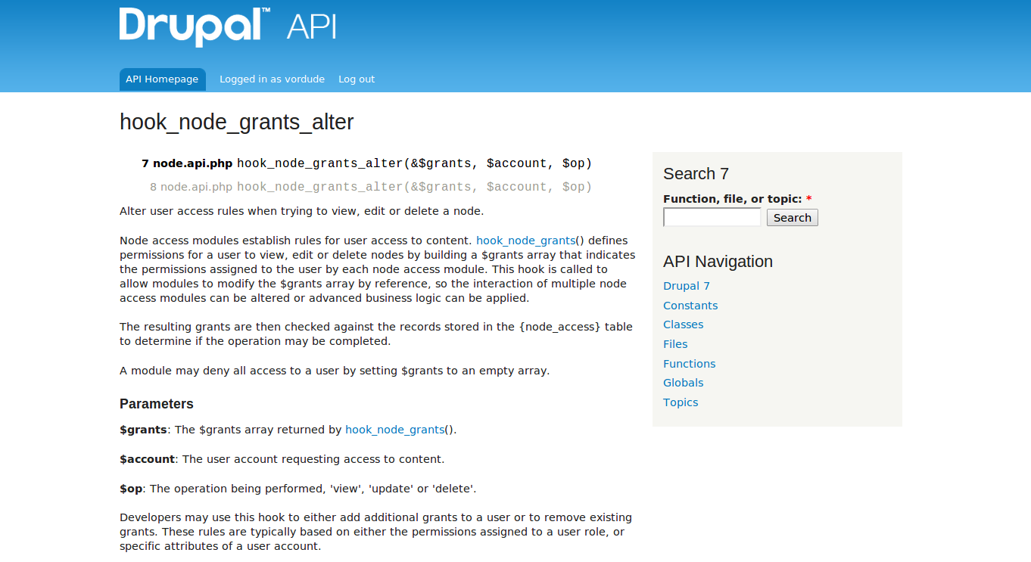

Slide 16
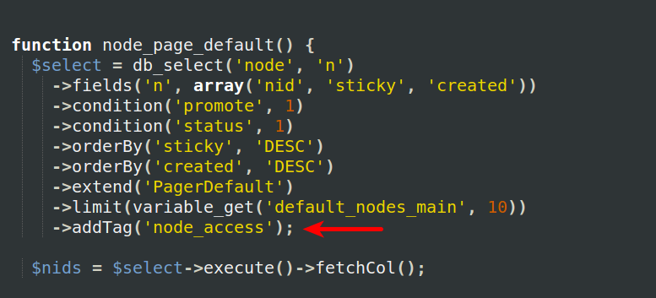
Node Access From a Query!

Slide 17
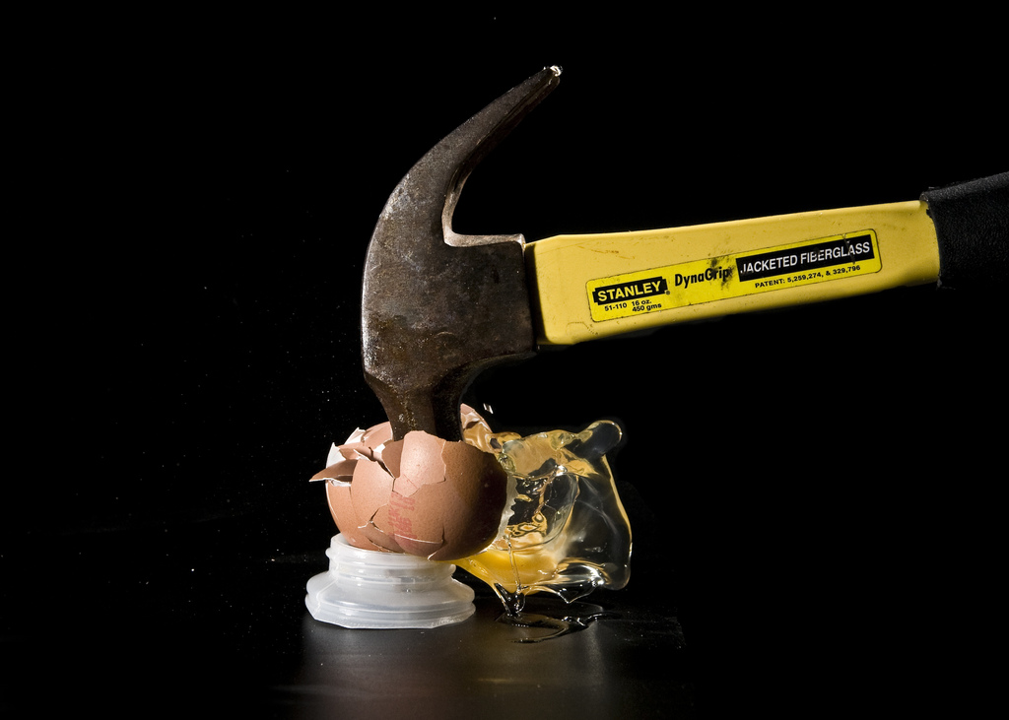
http://www.flickr.com/photos/alexfinlay/4568596446

Slide 18
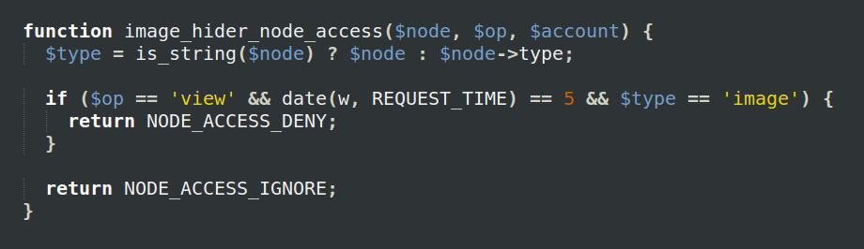
hook_node_access()

Slide 19
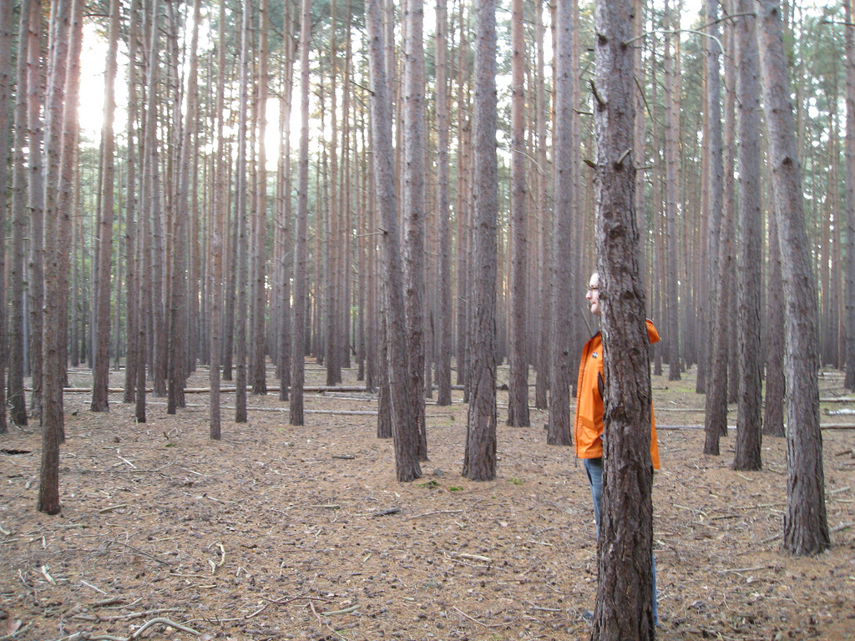
http://www.flickr.com/photos/hendry/2936838761/

Slide 20

Enough
http://www.flickr.com/photos/v-neck/6891242720

