Slide 1





Introduction to Working with the Autosalt Database
Margot Vore, MSc
June 2021

Slide 2
Three components of the workflow
Relational Database
Login (hakai.org)
Summary of data
Record of sensors
Record of barrel fills
Records of Rating Curves
Google Drive folder
Privately shared folder
(run by chrl group)
Field Sheets
Blank forms
Rating Curve documents
Discharge Salt curves
GitHub
https://github.com/voremargot/AutoSaltDilution
Code for common tasks
Database website info

Slide 3
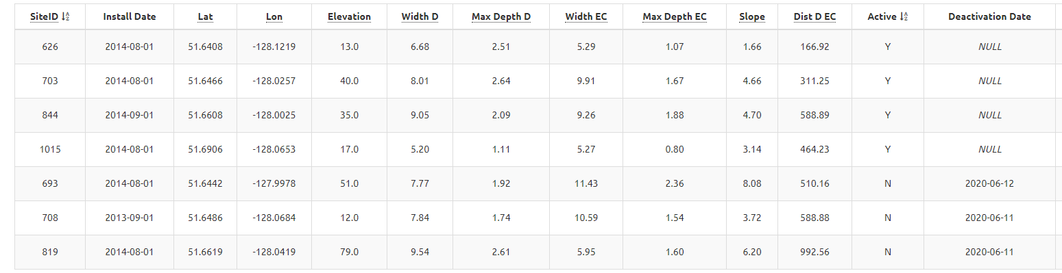
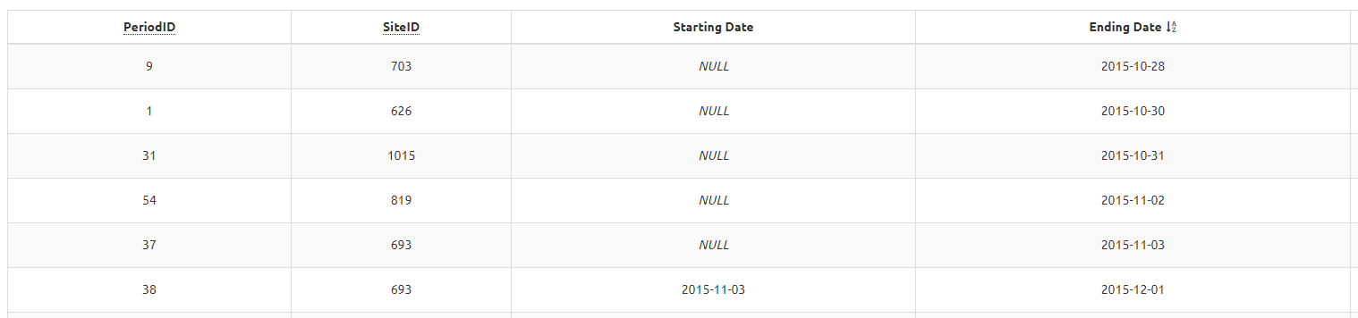
Relational Database
Tables are “related” to one another via data that is common to each
Site Description
Primary Key (PK) -> The table’s unique identifier. Unique values that make each row distinct
Foreign Key (FK) -> Column that can be related to a primary key in another table.
The primary and foreign keys are what creates the relation between tables
PK
Barrel Period
PK
FK

Slide 4
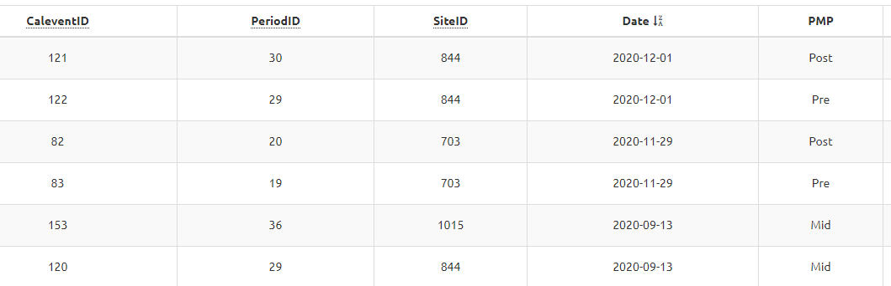
Site Description
Barrel Period
PK
FK
PK
Calibration Events
PK
FK
FK

Slide 5
What does our database contain?
EC ER Diagram Step 2: Lucidchart
https://goose.hakai.org/chrl-asd/login.php
Notes:
Make sure to make it clear how you get data into the database before doing to much explanation of the database itself!

Slide 6
Data in the Database
All data from 2015- 2020 has been added, cleaned, and recalculated (as need be)
We need to run the code from 2020 onwards and clean all data to be up to date on dump events
Needed to update nearly all discharge calculations as CF values from 1015 were used for many of the calculations
Events that need to be checked in the database (Since 01-01-2020)
17
5
Notes:
Clarify the events to add

Slide 7
How to communicate with the database
Be careful about updating and altering tables!! There is no undo in the database world…
PostgreSQL Tutorial - Learn PostgreSQL from Scratch
Import components of PostgreSQL
Queries ( INSERT INTO, SELECT commands)
Joins (i.e. inner join, left join, right join, full join)
This is how you combine tables via the primary and foreign keys
Data types
Syntax
R-Libraries
DBI
Googledrive
Rpostgres

Slide 8
GitHub Code
https://github.com/voremargot/AutoSaltDilution
Adding Data
Add New Event- Calculates discharge and summarizes results of new dump events
Adding New CF Event- Takes CF field sheets from google drive and uploads the data to database
Cleaning Data
Update Start and Stop Times- This code allows you to change the start and stop times of a salt wave that were selected incorrectly by the code
Adding curve to calculation- This code allows you to add in or remove a wave that was excluded from the original discharge calculation
Rating Curves
Extracting Data For Rating Curve- Creates a csv that is compatible with process that creates rating curves
Adding Rating Curve to Database- Sends all relevant rating curve information into the database

Slide 9
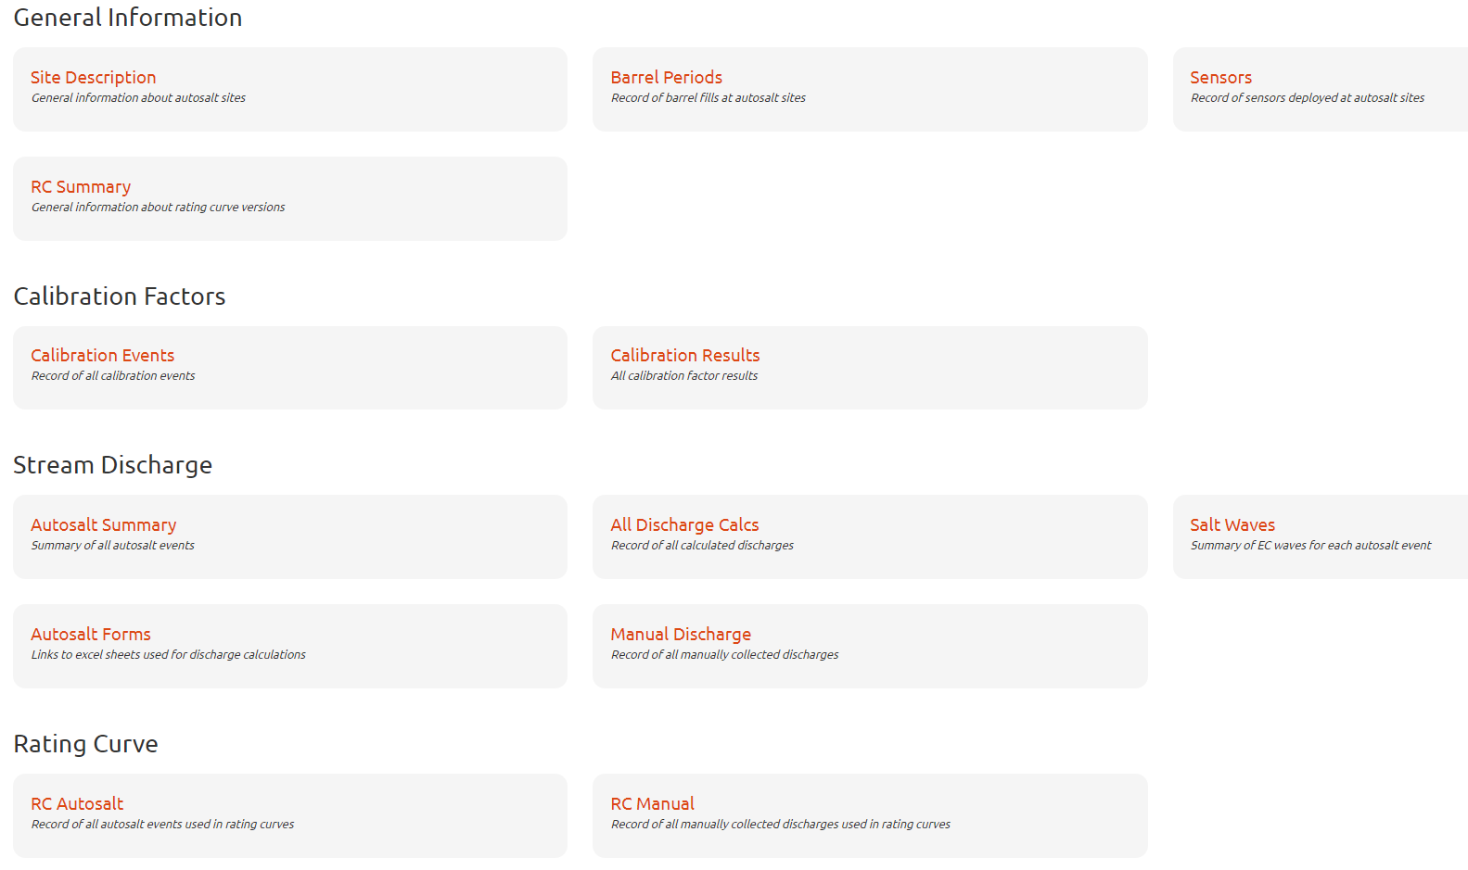
Updated by user
Updated by code

Slide 10
New Google Drive Folder
https://drive.google.com/drive/u/0/folders/1HHfxw2NKOeJUl1oyfWgMPt5B6HwsI9rE
KEEP IT CLEAN! The last folder got very overwhelming
Lots of database links that connect to files in the google folder so be careful of deleting files (may cause broken links)
Do not change folder structure or else code may no longer run

Slide 11
Next Steps
Work with the code and workflow to see what needs to be changed and updated!
Questions:
Is there any important components you would like to see added to the database or workflow?
field work notes?
How does the code work? Are there any other scripts that would be useful to have in the GitHub page?
Is the workflow smooth?
Does the website work well for your needs?
I want to walk through with people individually or in small groups how to do certain tasks within the new workflow!!
Notes:
Need to make point that the first time you work with it I will help you!!

