Slide 1

AIPI
Tech Entity and Investor Support
8230 Leesburg Pike, Vienna, VA, 22182, USA
143 Hills Road, Cambridge, CB2 8RA, UK
March 2026
INNOVATE AND THRIVE

Slide 2



Making Tech Entities Investable and Facilitating Growth
AiPi delivers a host of services that:
Provide Funding
AiPi and its investor network invest in a wide range of early-stage tech entities, and are requested by our customers to communicate with a variety of other outside investors including high net-worth individuals, family offices and institutional investors. Investments are facilitated by AiPi’s unique ability to:
Prove and expand tech differentiators
Obtain meaningful patents to prevent developed tech from being hijacked and otherwise provide a financial safety net
Improve and implement revenue models
Initiate and Scale Revenue
AiPi’s expertise allows us to:
Improve minimum viable and next gen product/service designs
Facilitate manufacturing and/or delivery of products/services
Initiate customer outreach and manage customer relationships
Facilitate US Market Entry
AiPi’s resources enable overseas entities to effectively access the larger and less regulated US market by:
Managing logistical issues including legal and regulatory
Finding US customers
Identifying US channel partner relationships
AiPi LLC | www.AiPiSolutions.com | Confidential

Slide 3
Partnering with Investment Entities and Accelerators
Perform Unique Technical Due Diligence
Optimize Outcomes of Portfolio Companies
AiPi’s proprietary AI platforms show competitors’ commercialization efforts and patent rights in an industry sector, and then overlay that landscape with a tech entity’s planned product/service. The resulting analyses enable AiPi to:
Prove and create differentiators for the purpose of enhancing investment decisions
Confirm whether AiPi can create monetizable strategic patent portfolios to act as a safety net for investments
AiPi’s proprietary AI platforms and experience allow us to:
Improve minimum viable and next gen product/service designs
Create and monetize patent portfolios, and otherwise avoid the patent rights of others
Enhance sales and new business unit creation
Facilitate owner/investor exit
AiPi LLC | www.AiPiSolutions.com | Confidential

Slide 4
AiPi’s Unique Approach – How We Get to Goal
AiPi is able to get to goal based on:
Our AI Platforms
Created in-house based on our expertise in platform development and sophistication in business/finance
Provide a clear and reliable sense of where customers’ tech fits into the relevant industry landscape
Enhance business and revenue modeling
AiPi’s Professional Expertise
Tech/Scientific expertise for identifying/creating differentiators, optimizing minimum viable and next gen products/services, and creating strategic patent portfolios
Business development skills for identifying customers and managing relationships
US market sophistication for initiating and expanding US sales/revenue
AiPi LLC | www.AiPiSolutions.com | Confidential

Slide 5
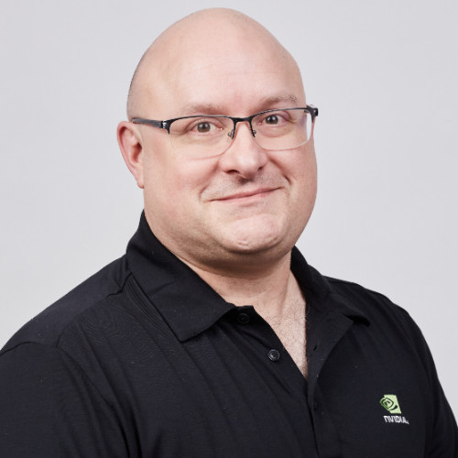


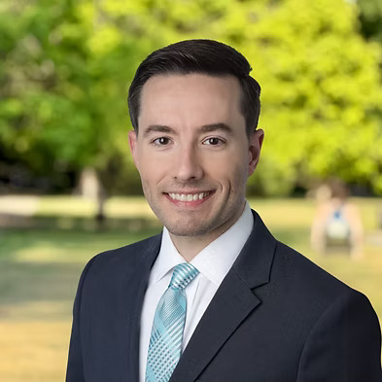
AiPi’s Leadership Team
Joe Eaton
Eric Morehouse
Patents and Services
Technology and Business Leadership
Mete Ozmen
Drew Davis
Finance and Business Operations
Business Development and Customer Support
AiPi LLC | www.AiPiSolutions.com | Confidential

