Slide 1

Pennon Group Water Demand Analysis
Strategic Assessment 2024-2050
Prepared by Jayanth Vorsu | May 2026
Data Source: Ofwat WCPR 2024-25 | Data covers 2019-20 to 2024-25

Slide 2
The Challenge: Where Are We Now
Across all three Pennon companies, per capita consumption remains at 146–148 litres per day — significantly exceeding the Environment Act 2021 benchmark of 110 l/p/d set for 2050
At 107.8 Ml/day, South West Water’s leakage rate approaches nearly twice the 2050 target of 61.75 Ml/day
The 2020-21 demand surge driven by COVID-19 temporarily undid years of reduction efforts, exposing the susceptibility of demand projections to unforeseen external disruptions
Source: Ofwat WCPR 2024-25 | Visualised using Microsoft Power BI
Notes:
Source : Ofwat WCPR 2024-25 | Visualised using Microsoft Power BI

Slide 3
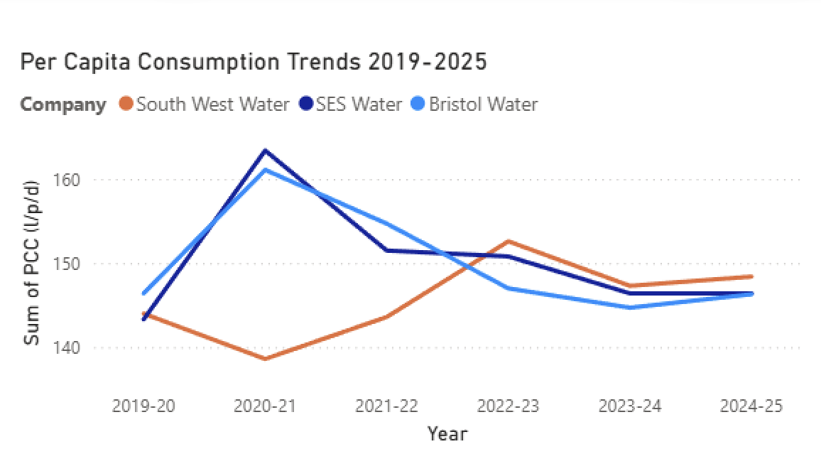
Per Capita Consumption: Trend Analysis 2019-2025
All three companies show a general downward PCC trend, but the 2020-21 COVID spike demonstrates how quickly progress can be reversed
At the current rate of reduction, no company will reach the 110 l/p/d target without significantly accelerating demand management activity in AMP8
Source: Ofwat WCPR 2024-25 | Data covers 2019-20 to 2024-25 | Visualised using Microsoft Power BI
Notes:
Source: Ofwat WCPR 2024-25 | Data covers 2019-20 to 2024-25 | Visualised using Microsoft Power BI

Slide 4
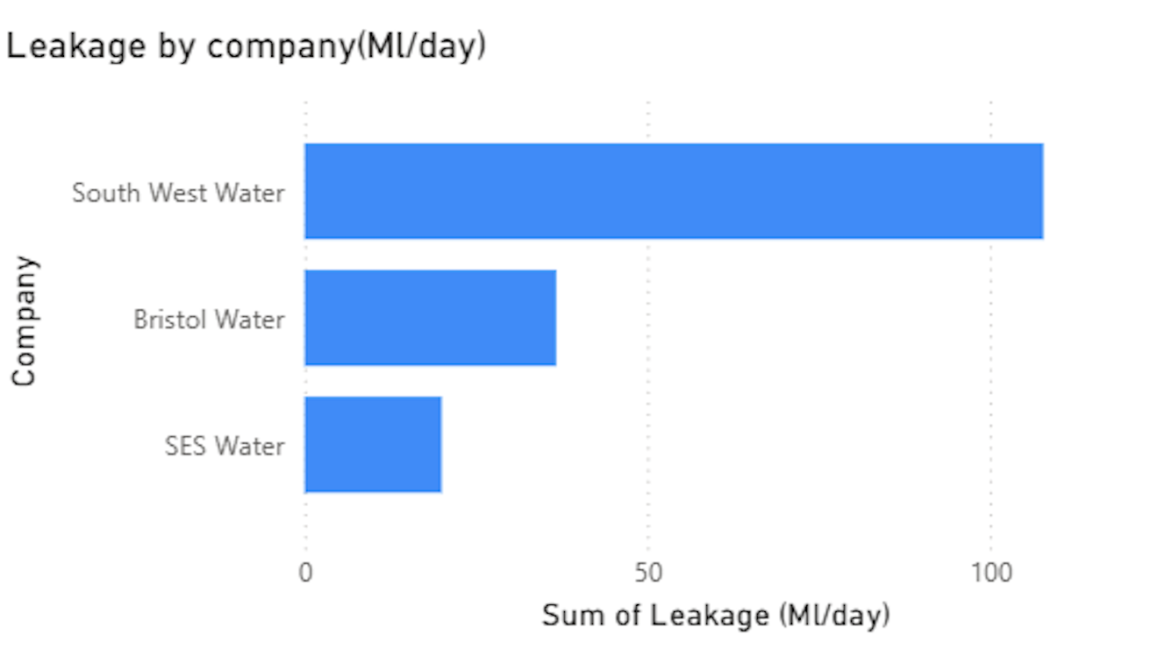
Leakage Performance: Progress and Challenges
South West Water’s leakage of 107.8 Ml/day remains the group’s most significant challenge — nearly double its 2050 target of 61.75 Ml/day. Significant and sustained reduction is required throughout AMP8 and beyond
SES Water is the group’s leakage success story — reducing from 24.8 Ml/day in 2019-20 to 20.0 Ml/day in 2024-25, already meeting its AMP7 leakage commitment
Source: Ofwat WCPR 2024-25 | Data covers 2019-20 to 2024-25 | Visualised using Microsoft Power BI
Notes:
Source: Ofwat WCPR 2024-25 | Data covers 2019-20 to 2024-25 | Visualised using Microsoft Power BI

Slide 5
SES Water: The Priority Region for AMP8
SES Water joined the Pennon Group through acquisition, bringing a separate data infrastructure and customer base that requires dedicated demand management focus
Despite strong leakage performance — already meeting its AMP7 target at 20.0 Ml/day — SES household PCC has remained stubbornly above 146 l/p/d with no meaningful reduction in recent years
A targeted smart metering roll-out across the SES region would provide real-time household consumption data, enabling identification of high users and driving PCC reduction of an estimated 5–8 l/p/d within three years
Source: Ofwat WCPR 2024-25 | Environment Act 2021
Notes:
Source: Ofwat WCPR 2024-25 | Environment Act 2021

Slide 6
Three Recommendations for AMP8 Delivery
1
2
3
Smart Metering in SES Region
Roll out smart metering across SES Water as a priority. Targeted at households with highest consumption, this programme could reduce SES PCC by 5–8 l/p/d within three years at relatively low cost given the region’s smaller customer base
Expand the Business Innovation Fund
The current £15,000 grant ceiling may be excluding larger industrial applicants. A tiered structure of £15,000 for SMEs and up to £50,000 for larger businesses could unlock projects saving an estimated 5–10 Ml/year in additional water savings
Unified Demand Data Platform
Build a consolidated Power BI platform pulling live data from SWW, Bristol and SES. This would enable real-time cross-regional performance comparison, faster regulatory reporting and more accurate WRMP modelling across the group
Analysis by Jayanth Vorsu | May 2026 | Source: Ofwat WCPR 2024-25
Notes:
Analysis by Jayanth Vorsu | May 2026 | Source: Ofwat WCPR 2024-25

Slide 7
Thank You
Pennon Group Water Demand Analysis | Strategic Assessment 2024–2050
Jayanth Vorsu
Customer Service Representative — Billing, South West Water
jayanth.vorsu@gmail.com

