Slide 1
Logic Control Chart
Ladder Control Chart: A Better Visual Language
Presented By: M.A.S.c Candidate FanFan Huang

Slide 2
Presentation Outline
Introduction to The Thesis.
Background Information.
  PLC's and their evolution.
  Ladder Logic.
Ladder Logic Visual Language.
  Quick intro and some examples.
  What we are hoping to do better.

Slide 3
Presentation Outline
Logic Control Chart
  The basics of our language.
  Demo of the tool (Drawing / Compile / Simulate)
  Logic Control Chart Primitives
Logic Control Chart Comparison Demos
  Simple Blinking Light
  Stepper Motor Controller

Slide 4
Presentation Outline
Hardware Abstraction
  Hardware Support Framework
  Intermediate Language
Summary
  Entire system and project overview.
Questions

Slide 5
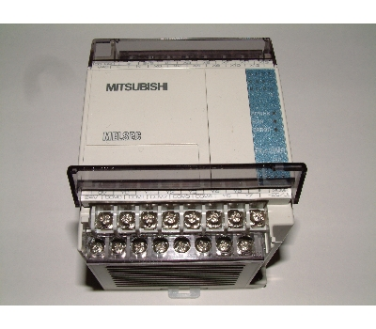
Introduction to PLC's
Programmable Logic Controllers have existed for over 30 years.
Used widely in the manufacturing industry.

Slide 6
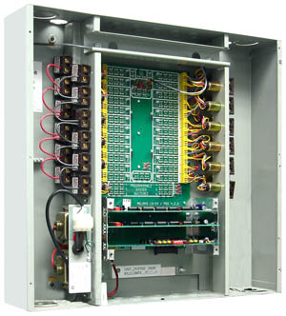
Introduction to PLC's
PLC's started life as a relay cabinet.
Noisy.
Failed often.
Took long to physically rewire.
Difficult to isolate worn out relay.

Slide 7
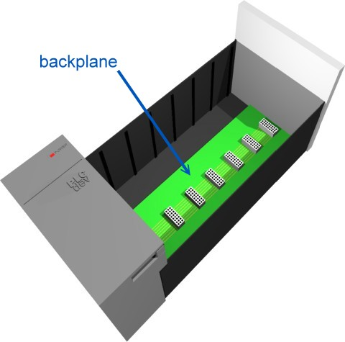
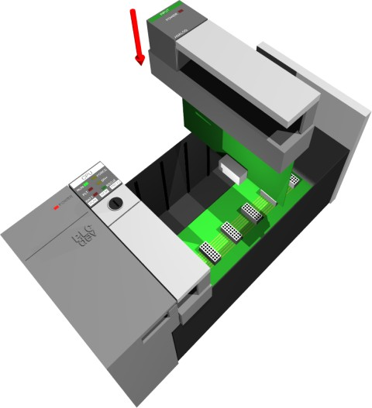
Modern PLC's

Slide 8
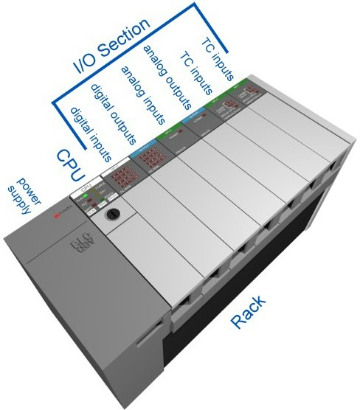
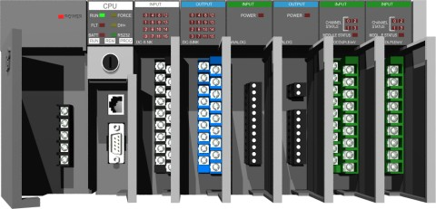
Modern PLC's

Slide 9
Modern PLC's
Use ladder logic as the visual programming language.
Hardened environmentally.
Execution in scans.
Simulates concurrent behaviour.
Self-Test
Input Scan
Logic Solve
Output Scan

Slide 10
Ladder Logic Background
Ladder logic is an analogy to physical circuits.
The left most and right most lines are power rails.
Each circuit is wired on a horizontal “rung”.
A circuit consists of series loads and exactly one output.
Loads can be thought of as inputs and can be physical or logical.

Slide 11
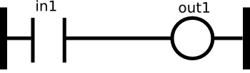
Elements of Ladder Logic
1
in1
0
1
out1
0

Slide 12
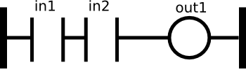
Elements of Ladder Logic
in1
in1
1
out1
0

Slide 13
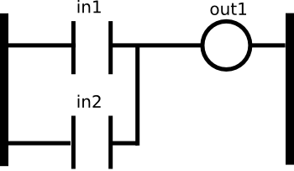
Elements of Ladder Logic
in1
in1
1
out1
0

Slide 14
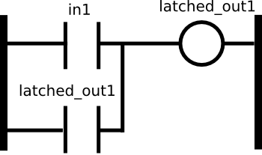
Elements of Ladder Logic

Slide 15
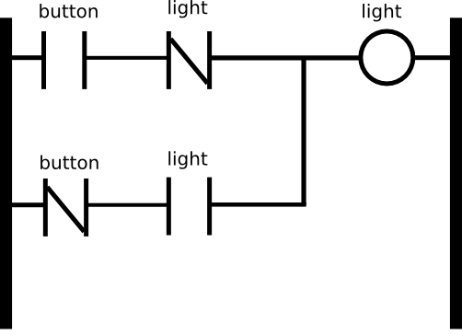
Elements of Ladder Logic

Slide 16
Logic Control Chart
A visual metaphor based on State Machines
Reads like a flow chart
Based on UML2 specification for State Machine Diagrams
Easy to understand
Easy to trace
UI designed to mimic popular flow charting software like Microsoft Visio, and Open Office Draw.

