Slide 1
A.I.E.A
Artificial Intelligence Enabled Ambulance

Slide 2


Slide 3
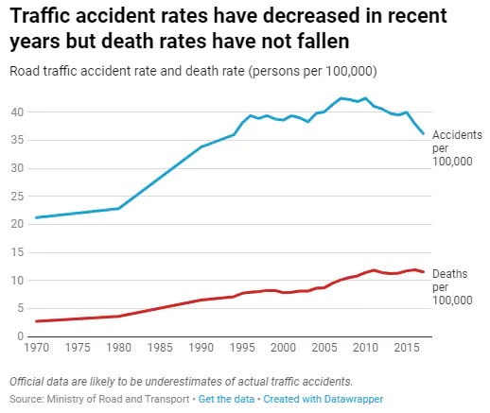
The Problem :-
In 2019 alone, the country reported around 151 thousand fatalities due to road accidents. Roughly around 17 accident-related deaths occur across India every hour.
Many of these lives could have been saved if they would have got the required medical treatment on time.

Slide 4
The Solution:-
We’ve designed a solution which detects an accident the instant it takes place and automatically intimates the near hospital or healthcare facility.
This way, by reducing the response time can eliminate any unnecessary time wastage and ensure the victim gets access to healthcare as quickly as possible.

Slide 5
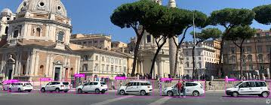
Working Of The Prototype :-
Real time footage is broken down into frames every ‘x’ seconds using OpenCV Module in Python.
Image is sent to IBM Watson Cloud using ibm-watson API and is classified into Accident or Non-Accident.
Estimated Time of Arrival (from accident) of every Hospital is
acquired and compared to get closest
hospital using TomTom API.

Slide 6
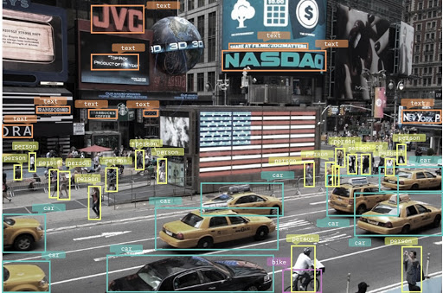
Working Of The Prototype:-
Once we know the closest hospital we will send a mail/whatsapp message to the respective hospital.
The mail/message will contain a google maps link which helps them to send an ambulance quickly to the accident site.

Slide 7











Components of the code:-
This Photo by Unknown Author is licensed under CC BY-SA

Slide 8
Making India Better:-
Helps in increasing the GDP of India by helping in decreasing the deaths caused due to road accident.
Increases the survival rate of people who met with a car accident.
It decreases the amount of time the patient has to wait before the ambulance reaches him/her and increases the amount of time the doctor has, to treat.
These few extra minutes could make a difference between life and death!!

