Slide 1
VORTEX · SIMX · BRANCH DTCU · CGO27_MOTIVATION
Where the accelerators attach, and how each GEMM path uses them
Figure export, 2026-08-28. Document of record: docs/260807_dtcu_figures.html — commentary, audit trail and withdrawn claims live there. Every number here is labelled with the regime it belongs to; do not quote one without it.

Slide 2
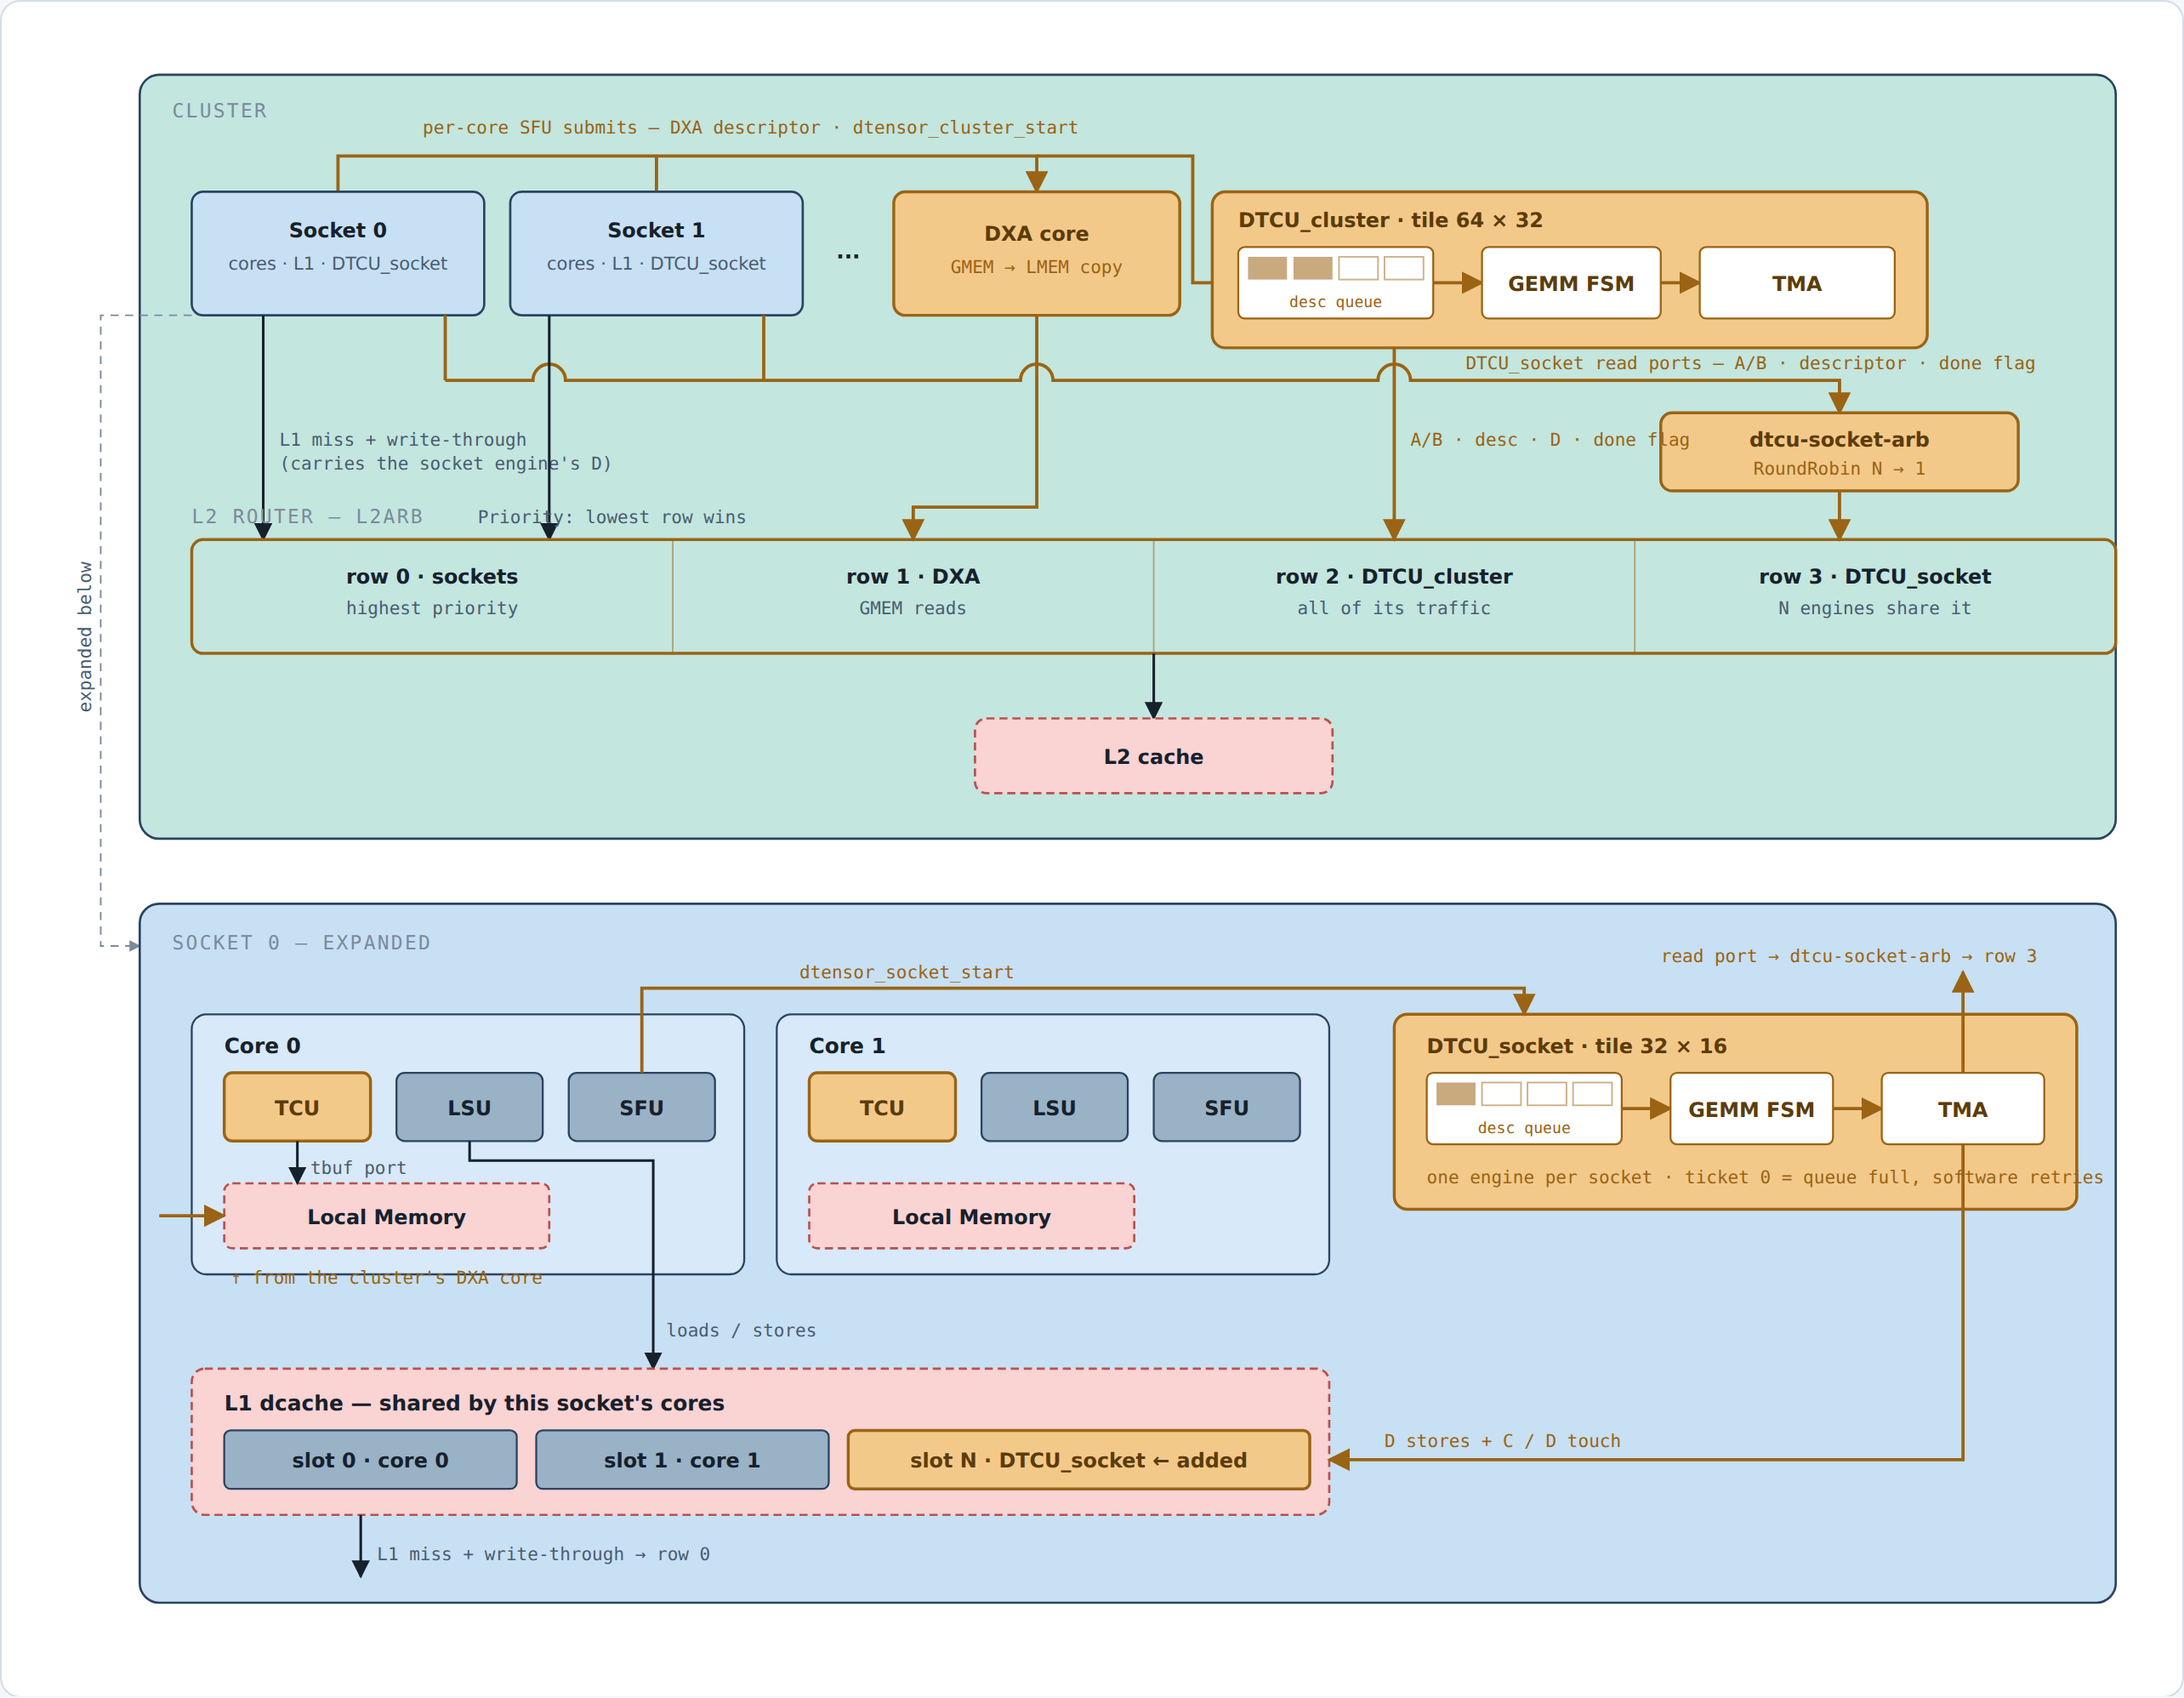
FIG 1 Module placement, submit path, and wiring
Amber marks what this work adds. Both DTCU variants read operands from L2; they differ only in where D lands — the cluster engine writes it to L2, the socket engine into its own socket's L1 through an added requester slot.

Slide 3
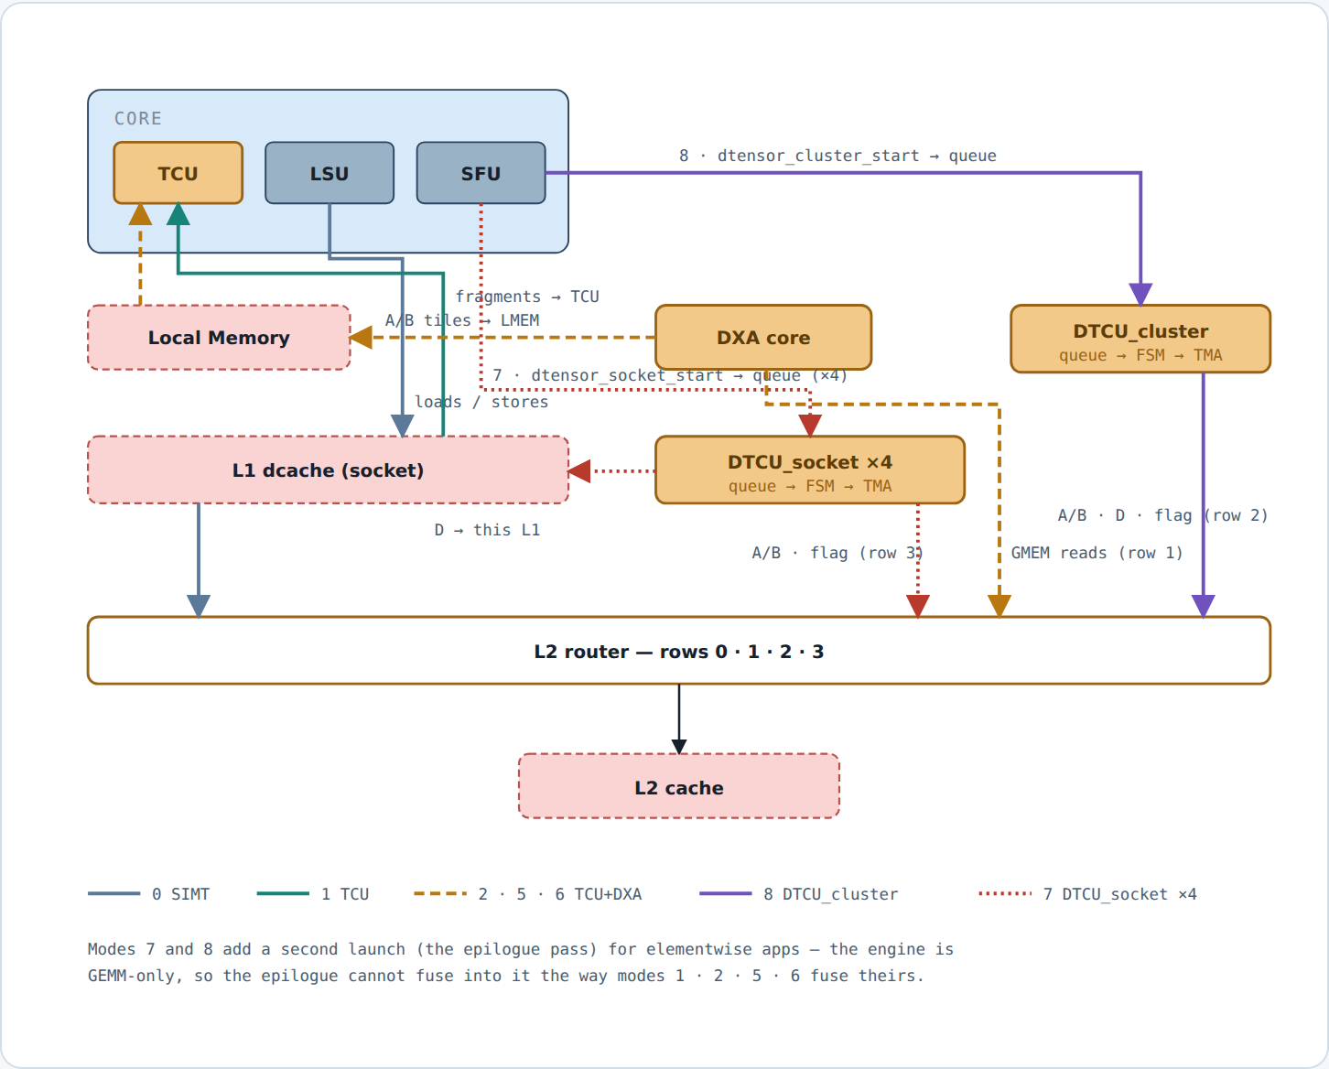
FIG 2 How each cgo27_motivation mode flows
Modes 7 and 8 add a second launch (the epilogue pass) for elementwise apps — the engine is GEMM-only, so the epilogue cannot fuse into it the way modes 1 · 2 · 5 · 6 fuse theirs.

Slide 4
CFG Machine — one cluster
symbol | meaning | value
#cluster | clusters in the processor | 1
NC | cores per cluster | 4
NS | sockets per cluster (SOCKET_SIZE 1) | 4
NW | warps per core | 16
NT | threads per warp | 32
NR | architectural regs per thread | 32
issue | issue width per core | 4
LMEM | Local Memory, per core | 64 KB
L1 | dcache, per socket | 32 KB
L2 | per cluster, 1 bank | 1 MB
line | L1 / L2 / DRAM block | 64 B

Slide 5
MODES Modes and where D lands
id | name | what it does | D lands
0 | SIMT | scalar MAC, software fp16→fp32 | dcache
1 | TCU | in-core WMMA, fragments by LSU load | dcache
2 | TCU + DXA | DXA stages A/B into LMEM — 1 buffer | dcache
3 | TCU workgroup + DXA | multi-warp CTA shares one staged tile; warp 0 is the producer; wgmma reads smem | dcache
4 | TCU workgroup, SW copy | same geometry, the CTA copies its own tiles — the DXA control for 3 | dcache
5 | TCU workgroup + DXA, A resident | CTA sweeps 4 column tiles against A staged once for the whole K — N-axis reuse | dcache
6 | TCU wg + DXA, A resident, single B buffer | same A reuse and CTA geometry as 5; synchronous schedule isolates buffering | dcache
7 | DTCU_socket | 4 engines, tile 32×16, one descriptor per socket | socket L1
8 | DTCU_cluster | 1 engine, tile 64×32, one descriptor per core | L2
9·10·11 | hetero | cores + engine(s) on one GEMM — numbered, not built | —
14 | DTCU_socket pipeline | one producer warp and N consumer warps per core | socket L1
15 | DTCU_cluster pipeline | core 0 warp 0 is the sole producer; N consumer warps on every core | L2
Modes 2 and 4 are controls, 3 is 5 without A-residency — arguments, not candidates, so they stay out of the headline table.

Slide 6
TABLE Measured, app 1 — three GEMM shapes on the same machine (MAC = M·N·K)
mode | units | 128×64×32 | MAC/cyc | /unit | 256×128×64 | MAC/cyc | /unit | 512×256×128 | MAC/cyc | /unit
0 SIMT | 4 cores | 142,952 | 1.83 | 0.46 | skipped |  |  | skipped
1 TCU | 4 cores | 23,513 | 11.15 | 2.79 | 96,244 | 21.79 | 5.45 | 386,994 | 43.35 | 10.84
5 TCU wg + DXA, A res. | 4 cores | 22,820 | 11.49 | 2.87 | 66,521 | 31.53 | 7.88 | 305,878 | 54.85 | 13.71
7 DTCU_socket | 4 engines | 11,728 | 22.35 | 5.59 | 49,152 | 42.66 | 10.67 | 303,303 | 55.31 | 13.83
8 DTCU_cluster | 1 engine | 49,472 | 5.30 | 5.30 | 160,420 | 13.07 | 13.07 | 1,111,970 | 15.09 | 15.09
Bold = best in column (and anything within 2 % of it). Mode 0 is skipped above the smallest shape by policy — no engine, no staging, no knob; recorded values are 1,145,460 and 9,581,708.

Slide 7
REGIME 1 Attention-shaped: K = head_dim = 64 fixed, M = N = seqlen swept — memory-bound at every size
mode | units | M=N=128 | 256 | 512 | 1024
0 SIMT | 4 cores | 560,994 | skipped | skipped | skipped
1 TCU | 4 cores | 50,875 | 187,473 | 762,659 | —
5 TCU wg + DXA, A res. | 4 cores | 41,666 | 123,228 | — | —
7 DTCU_socket | 4 engines | 25,826 | 87,782 | 344,451 | 1,523,464
8 DTCU_cluster | 1 engine | 148,094 | 300,810 | 1,194,150 | 4,863,334
7 vs 1 — the lead grows |  | 1.97× | 2.14× | 2.21× | —
— is a run that did not complete, not a skip. Every number shown verified PASSED, errors = 0.

Slide 8
REGIME 2 Scale all three dimensions — where the engine stops winning
shape | 1 TCU | 5 A-resident | 7 DTCU_socket | 7 vs 1 | 1 MAC/cyc | 7 MAC/cyc
128 × 64 × 32 | 23,513 | 22,820 | 11,728 | 2.00× | 11.2 | 22.4
256 × 128 × 64 | 96,244 | 66,521 | 49,152 | 1.96× | 21.8 | 42.7
512 × 256 × 128 | 386,994 | 305,878 | 303,303 | 1.28× | 43.4 | 55.3
768 × 384 × 192 | 918,488 | — | 1,002,507 | 0.92× | 61.7 | 56.5
1024 × 512 × 256 | 1,739,671 | 2,287,740 | 2,286,325 | 0.76× | 77.2 | 58.7
The crossover sits between 512×256×128 and 768×384×192: the core keeps climbing (latency hidden by parallelism) while the engine flattens against its 64 MAC/cyc ceiling at 92 % of modelled peak.

Slide 9
STAGING What operand staging needs before a copy engine pays — modes 3 / 4, fused epilogue
measurement | 3 DXA 128×64×32 | 4 SW | 3 DXA 256×128×64 | 4 SW | 3 DXA 512×256×128 | 4 SW
measured — whole kernel, D = epi(C + A·B) | 25,386 | 32,583 | 103,400 § | 152,677 | 454,165 | ‡
measured — C read compiled out (-DMOTI_WG_NO_C, wrong on purpose) | 22,979 | 25,795 | 98,637 | 104,133 | 423,127 | 497,215
derived — reading C alone | 2,407 | 6,788 | 4,763 | 48,544 | 31,038 | —
what DXA is worth (4 ÷ 3, full kernel) | 1.28× |  | 1.48× |  | —
§ measured at -a 6 (the identity, byte-identical to -a 1); the -a 1 non-termination is unexplained and lives below the kernel. ‡ mode 4 at the largest shape finishes at no app tested.

Slide 10
SWEEP ⚠ Engine width sweep at 512 × 256 × 128 — SUPERSEDED, measured on the combined binary
MACS / ACC_BANKS / SMEM_BANKS | 7 cycles | 7 MAC/cyc | vs 1× | 8 cycles | 8 MAC/cyc | vs 1×
1× (16 / 2 / 2, default) | 324,469 | 51.71 | — | 1,140,573 | 14.71 | —
2× (32 / 4 / 4) | 243,869 | 68.80 | 1.33× | 663,865 | 25.27 | 1.72×
4× (64 / 8 / 8) | 223,977 | 74.91 | 1.45× | 411,997 | 40.72 | 2.77×
⚠ Absolute cycles predate the per-mode device programs and do not survive; the ratios (between builds differing only in engine width) do. Re-run on the isolated programs before quoting.

Slide 11
2026-08-27 Mode 3 / mode 5 cycles after the rollover repair (selected controls)
shape | baseline | GELU | softmax | column mean
r8 | 1,271,236 / 771,276 | 1,206,215 / 934,264 | 3,380,091 / 2,894,187 | 1,411,349 / 911,445
r16 | 4,922,450 / 3,167,132 | 4,553,521 / 3,901,604 | 13,152,718 / 11,389,887 | 5,320,533 / 3,565,268
s256 | 669,466 / 422,363 | 627,081 / 528,061 | 1,943,037 / 1,674,336 | 739,935 / 492,876
s1024 | 9,845,019 / 6,116,052 | 8,814,271 / 7,202,122 | 27,077,567 / 23,321,603 | 10,615,767 / 6,883,131
Cells are mode 3 / mode 5. All 112 shape × epilogue × mode points now finish with errors = 0; the old timeouts were a TCU tile-buffer tag rollover, not DTCU/L2 arbitration. Full data: result/260827_data/exp1_m3_m5_final_20260827.csv. Mode 3 is the no-A-residency control for candidate mode 5; this table does not redefine the placement winner set.

