Slide 1


Volt Compiler Pipeline
Shinnung Jeong
Georgia Tech
MICRO Vortex Tutorial 2026

Slide 2
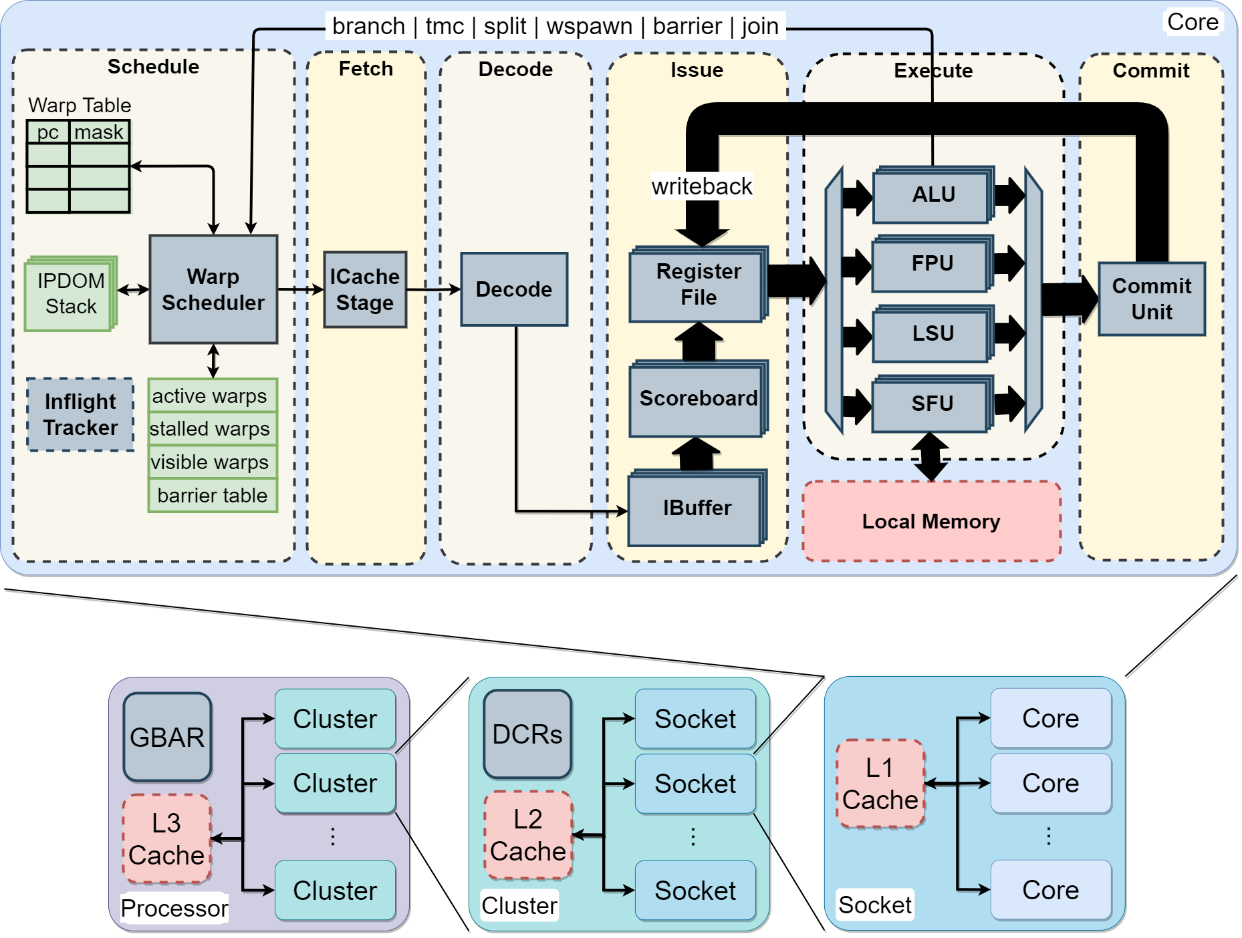
Program Execution on the Vortex GPU
__kernel void foo(){
tid = get_global_id(0);
…
barrier(…);
}
__host int main(){
…
cl_mem A_clmem = clCreateBuffer(context, …);
clEnqueueNDRangeKernel(command_queue, …);
…
}
Program
Kernel code with control flow & special func
Host code with device communication
Vortex GPU
Kernel binary using the Vortex GPU ISA
Host executable using the Vortex driver

Slide 3

Expanding GPU Variants on Vortex
__kernel void foo(){
tid = get_global_id(0);
…
barrier(…);
}
SkyBox
Tensor Core
__host int main(){
…
cl_mem A_clmem = clCreateBuffer(context, …);
clEnqueueNDRangeKernel(command_queue, …);
…
}
Tapeout
SparseWeaver
Vortex 3.0
Program
Kernel code with control flow & special func
Host Code with device communication
Vortex GPU Variant
Kernel binary using the Extended Vortex GPU ISA
Host executable using the Extended Vortex driver
HW-Side Consideration
Flexible Hardware & Microarchitecture &
Number of HW Component
Flexible ISA & Runtime

Slide 4


Programs from Diverse Frontends
SkyBox
Tensor Core
Tapeout
Triton
SparseWeaver
Vortex 3.0
Program with Diverse Frontends
Kernel code with Frontend-specific semantics
Host Code with Frontend-specific runtimes
Vortex GPU Variant
Kernel binary using the Extended Vortex GPU ISA
Host executable using Extended Vortex driver
HW-Side Consideration
Flexible Hardware & Microarchitecture &
Number of HW Component
Flexible ISA & Runtime

Slide 5
Key Challenges in Designing VOLT
Challenge 1: Make SIMT-aware code generation and optimizations portable
  How can we preserve SIMT-aware code generation and optimizations
  while remaining portable across Vortex variants and potentially other open GPUs?
Challenge 2: Support multiple frontends with minimal maintenance overhead
  How can we design the compiler so that new frontends and GPU variants
  can be added with minimal refactoring?

Slide 6



Vortex-Optimized Lightweight Toolchain (VOLT)
Design Choice 1
  Hierarchical compiler design
  Centralize fundamental SIMT-related analyses and optimizations in the middle-end
Design Choice 2
  Leverage existing open-source components as much as possible
Front-end Compilers
CuPBoP
Middle-end Compiler
Back-end Compiler
Hierarchical Compiler Design

Slide 7

Front-end Compiler
GPU Host Code
Front-end Compiler
CuPBoP
Handles both host and kernel code
Host Code
  Compiled for the host hardware
  Translates frontend-specific host functions using the target runtime library
Host Code Compilation
Semantic Analyzer
Host Runtime for HW Target Translator
Runtime Lib Linking
Host Binary
Blue boxes indicate components extended or implemented for the Vortex GPU

Slide 8
Front-end Compiler
GPU Kernel Code
Front-end Compiler
CuPBoP
Handles Both Host and Kernel Code
Kernel Code
  Performs semantics-aware code optimizations
  Transforms special functions using built-in libraries
  Inserts thread scheduling and spawning code for device initialization
IR Generator
Semantic-aware Code Optimization
Memory Structure Handling
Function Call Analysis
Built-in library
Built-in Library Linking
Thread Scheduling Code Generation
Thread Scheduling and Spawn Code Insertion
LLVM module
Blue boxes indicate components extended or implemented for the Vortex GPU

Slide 9
Middle-end Compiler
LLVM module
Target-independent optimizations
Minimal target-specific logic
Treats thread divergence management as a first-class concern
  Uniformity Analysis
  Divergence Optimization
Middle-end Compiler
General Code Optimizations
Divergence Management
Uniformity Analysis
Divergence Tracker
Optimization and Transformation
Divergence Management Function Insertion
LLVM module
Blue boxes indicate components extended or implemented for the Vortex GPU

Slide 10
Middle-end Compiler
Uniformity Analysis
  Divergence Tracker
    Find divergent instructions and always uniform instructions
    Marks function arguments, return values, and atomic operations as divergent
    Marks control and status register information as uniform
    Propagates uniformity information
  Annotation Analysis
    Identifies divergent and always-uniform instructions
    Leverage annotation information from the user or the front-end compiler
  Function Argument Analysis
    Determine the uniformity of each function’s arguments

Slide 11
Middle-end Compiler
Divergence Optimization
  Code Simplification
    Simplifies and canonicalizes control flow for subsequent divergence handling
  Control-Flow Structurization
    Transforms the CFG into a structured form to provide stable join points
    Essential for IPDOM-based divergence and reconvergence handling
  Control-Flow Reconstruction
    Selectively duplicates basic blocks to reduce predicate computation
  Divergence Operation Lowering
    Normalizes divergence operations by rewriting them into equivalent branch-based control flow
Reconstruction
A
A
A
B
C
J1
B
B
C
D
C
J2
D
D`
D``
E
E
E
Structurization
Original CFG
Structurized CFG
Reconstructed CFG

Slide 12
Middle-end Compiler
LLVM module
Divergence Intrinsic Insertion
  Split and Join Insertion
    Handles divergent branches using vx_split and vx_join instructions
  Loop Predicate Insertion
    Handling divergent loops with vx_pred
Middle-end Compiler
General Code Optimizations
Divergence Management
Uniformity Analysis
Divergence Tracker
Optimization and Transformation
Divergence Management Function Insertion
LLVM module
Blue boxes indicate components extended or implemented for the Vortex GPU

Slide 13

Back-end Compiler
Target-specific optimizations and final code generation
  Built on the RISC-V target compiler
  Extends the ISA table with Vortex-specific ISA extensions
  Generates binaries for Vortex GPUs
LLVM module
Back-end Compiler
Target Code Generation and Optimization
Vortex ISA Table
Vortex Binary
Blue boxes indicate components extended or implemented for the Vortex GPU

Slide 14
VOLT for Vortex 3.0
New version v1.1 is released in Git repo.
Our tool is available in our Git repository
  https://github.com/vortexgpgpu/Volt
CUDA 12.1 and OpenCL 3.0
Provides an end-to-end PoCL / CuPBoP / LLVM compilation pipeline

Slide 15
CuPBoP Support for Vortex 3.0
Support vortex v3.0 + tools-v3.0.1
  Same CUDA front end. The kernel launch path, toolchain usage and ISA assumptions were updated for Vortex 3.0 SimX and RTL simulation
Expose 3.0 hardware exposed to CUDA programs
  Tensor Core Unit: mma.sync / wmma / ldmatrix → TCU instructions, with a software fallback.
  Types: f16 (f16/f32 accumulate), bf16, tf32, int8, fp8, f64
  wgmma (sm_90a) kernels, with TMA-style tile loads mapped to the DXA engine
  cp.async (synchronous copy), mbarrier and bulk copy under the 1:1 mapping
CI suite
  about 40 CUDA applications (Rodinia-style + TCU/DXA/wgmma samples) × CuPBoP schedules, plus
  warp, named-barrier and async test suites

Slide 16
Guide for VOLT Extensions
Tutorial 1: Extending kernel functions
Tutorial 2: Extending host functions
Tutorial 3: Extending memory support with the Vortex memory hierarchy
Tutorial 4: Extending CuBBoP support with Tensor Cores, wgmma and DXA on Vortex 3.0
All tutorials include documentation under /Docs
Runnable examples are available under /Tests

Slide 17
Tutorial 1: Extending Kernel Functions
Expose GPU-specific kernel operations through existing compiler extension points
PoCL / OpenCL
CuPBoP / CUDA
pocl_vx_shfl_up(...) → Vortex shfl.up
__reduce_add_sync(...) → warp reduction
1 Declare in _clang_opencl.h
1 Match NVVM reduction intrinsic
llvm.nvvm.redux.sync.add
2 Implement Vortex built-in library
2 Redirect to a runtime helper
3 Link into the OpenCL kernel
3 Use 5× vx_shfl_bfly
./run.sh --baseline [build fails] ./run.sh [both examples PASS]
Source: Volt v1.1 · docs/7.1.tutorial_kernel_extension.md
17

Slide 18
Tutorial 2: Extending Host Functions
CUDA application code is unchanged; CuPBoP adapts runtime and launch semantics
Existing CUDA host APIs
New API: cudaMemGetInfo
cudaMemcpy(dst, src, n, kind)
cudaMemGetInfo(&free, &total)
Host staging → vx_copy_to_dev
vx_mem_info(device, &free, &used)
cudaMemcpyToSymbol(...)
total = free + used
Record bytes → launch args → wrapper
Only host runtime + header; no kernel translator edit
./run.sh --baseline [link fails] ./run.sh [memory checks PASS]
Source: Volt v1.1 · docs/7.2.tutorial_host_extension.md
18

Slide 19
Tutorial 3: Extending Memory Lowering
The same CUDA __shared__ variable can use different Vortex memory resources
Select the lowering policy (SCHEDULE=2)
Where to extend
LOCALMEM=0
Global memory
cached by L1 / L2
memory_hierarchy.cpp
Add mem_share2auto_sche_2
LOCALMEM=1
Local memory
per-core LMEM
init.cpp
LOCALMEM=2
Size-aware
≤ 16 KB → local
Select the pass with the LOCALMEM flag
./run.sh [compare LOCALMEM 0 / 1 / 2] BUDGET=32768 ./run.sh nw
Source: Volt v1.1 · docs/7.3.tutorial_shared_memory.md
19

Slide 20
Tutorial 4: Tensor Cores, WGMMA and DXA
CuPBoP translates tensor computation and tile movement to Vortex 3.0 hardware
WMMA → TCU
WGMMA → TCU
DXA → Tile Copies
CUDA wmma helpers
Hopper wgmma.mma_async
Host descriptor programming
Runtime wmma_context
Synchronous lowering
2-D global → local
Descriptor + layout conversion
TCU matrix multiply
expect_tx + barrier
./run.sh [TCU + DXA SimX GEMM experiments E1 / E2 / E3]
Source: Volt v1.1 · docs/7.4.tutorial_tensor_core.md
20

Slide 21
2026 Publications
Inside VOLT: Designing an Open-Source GPU Compiler
  Shinnung Jeong, Chihyo Ahn, Huanzhi Pu, Jisheng Zhao, Hyesoon Kim, Blaise Tine
  The ACM SIGPLAN 2026 International Conference on Compiler Construction (CC), Feb 2026
FastTrackGPU: Static-Analysis–Guided Analytical Modeling for Softcore GPUs
  Chihyo Ahn, Shinnung Jeong, Liam Paul Cooper, Ruobing Han, Huanzhi Pu, Nicholas Parnenzini, Jisheng Zhao, Blaise Tine, Hyesoon Kim
  IEEE Computer Architecture Letters (CAL), 2026
Toward End-to-End ML Support on Vortex
  Shinnung Jeong, Chihyo Ahn, Sai Hemanth Reddy Bheemreddy,Liam Cooper, Krishil Gandhi, Chulhyung Park, Vincent Pham, Huanzhi Pu, Saurabh Singh, Mitul Tandon, Jisheng Zhao, and Hyesoon Kim
  Open-Source Computer Architecture Research (OSCAR), 2026
CuLifter: Lifting GPU Binaries to Typed IR
  Jisheng Zhao*, Huanzhi Pu*, Shinnung Jeong, Chihyo Ahn, and Hyesoon Kim
  59th IEEE/ACM International Symposium on Microarchitecture® (MICRO), 2026

Slide 22
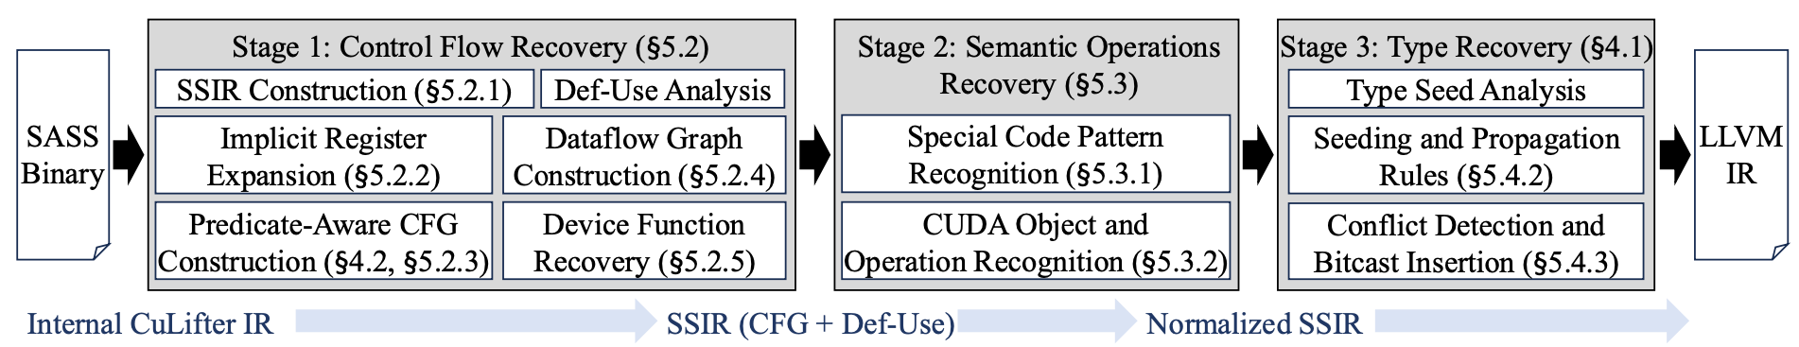
CuLifter (Micro26, Day 2 Session 6A)
GPU Binary Type Recovery
  Identify type recovery as the central challenge of GPU binary lifting
SIMT-Aware Structure Reconstruction
  Recover control flow and SSA from SASS, handling SIMT-specific constructs and multi-instruction patterns
End-to-End SASS-to-LLVM IR Lifting
  Support multiple GPU generations (SM75–SM120), enabling compiler analysis and cross-platform
Comprehensive Evaluation
  11,977 kernels across 8 benchmark suites, achieving 96.3% exe correctness among 3,584 kernels

Slide 23
Thank you https://github.com/vortexgpgpu/Volt

