Slide 1
GPGPU Background
Hyesoon Kim

Slide 2
CPU pipeline
CPU pipeline
Increasing the performance in the execution units
Increase the issue width (superscalar)
Multi-threading
Front-end
Decode
Rename
Schedule
Execution
Write-back
Memory
F
D
S
E
W
F
D
S
E
W
F
D
S
E
W
F
D
S
E
W
F
D
S
E
W
F
D
S
E
W
F
D
S
E
W
F
D
S
E
W
F
D
S
E
W
F
D
S
E
W
F
D
S
E
W
F
D
S
E
W
F
D
S
E
W
F
D
S
E
W
F
D
S
E
W
F
D
S
E
W
5-stage pipeline
F
D
S
E
W
F
D
S
E
W
F
D
S
E
W
F
D
S
E
W
Multi-threading
Superscalar

Slide 3
GPU pipeline
Warp/Wave-front execution model
SPMD programming model (Single Program Multiple Data)
…
Tn
T4
Inst 1
T
T
T
T
T
T
T
T
T
T
T
T
T
T
T
T3
T
T1
T2
Inst 2
Inst 3
One warp
One warp
Inst 1
Inst 2
Inst 3
Fetch 1 instruction and each instruction has multiple threads are associated.
The group of instruction is called warp/wave-front
All threads have the same program

Slide 4
GPGPU Programming
Become popular with CUDA (Compute Unified Device Architecture)
CUDA (Based on Nvidia architectures)
Portland Group Compiler supports CUDA → x86
OpenCL

Slide 5
Quick Summary of CUDA Programming Model
SIMD or SIMT
Single instruction multiple data or single instruction multiple thread
Unified Memory space (global memory space)
Program hierarchy
Thread, block, kernel

Slide 6
Execution Model
Thread & Block
Block
Block
Inst 1
T
T
T
T
T
T
T
T
T
T
T
T
T
T
T
T
T
T
T
T
T
T
T
T
Inst 2
Inst 3
warp
warp
warp
warp
warp
warp
SM
SM
Kernel
Shared Memory
Shared Memory
SP
SP
SP
SP
SP
SP
SP
SP
Sing instruction multiple thread
Block = a group of thread which share “the shared memory space”
Warp
[the slide is from Hong&Kim ISCA’09]

Slide 7
Memory Data Indexing
SIMT-execution model
Use thread id and block id to index data
Let’s assume N=16, blockDim=4 → 4 blocks
0
1
2
3
4
5
6
7
8
9
10
11
12
13
14
15
+
0
1
2
3
4
5
6
7
8
9
10
11
12
13
14
15
+
+
+
+
blockIdx.x = 0
blockDim.x = 4
threadIdx.x = 0,1,2,3
Idx= 0,1,2,3
blockIdx.x = 1
blockDim.x = 4
threadIdx.x = 0,1,2,3
Idx= 4,5,6,7
blockIdx.x = 2
blockDim.x = 4
threadIdx.x = 0,1,2,3
Idx= 8,9,10,11
blockIdx.x = 3
blockDim.x = 4
threadIdx.x = 0,1,2,3
Idx= 12,13,14,15

Slide 8
1D, 2D, 3D data structures
A kernel is executed as a grid of thread blocks
Threads and blocks have IDs
So each thread can decide what data to work on
Block ID: 1D or 2D
Thread ID: 1D, 2D, or 3D
Loop index in sequential loop
Use thread ids, block ids
1D array index= c1*threadId.x + c2*block Id.x
2D array index = c1*threadId.x+c2*blockId.x+c3*threadId.y+c4*blockId.y
CPU code
for (ii = 0; ii < 100; ++ii) {
C[ii] = A[ii] + B[ii];
}
CUDA code
// there are 100 threads
__global__ void KernelFunction(…) {
int tid = blockDim.x * blockIdx.x + threadIdx.x;
int varA = aa[tid];
int varB = bb[tid];
C[tid] = varA + varB;
}

Slide 9
Memory Space
Thread, block, and kernel have different memory spaces
 | Space | ~= CPU
Local Memory | Within Threads | Stack
Shared Memory | Within Blocks | Distributed memory space
Global Memory | All | Centralized storage
Constant Memory | All | Centralized read-only storage (very small)
Texture Memory | All | Centralized read-only storage (medium size, 2D- cache)

Slide 10
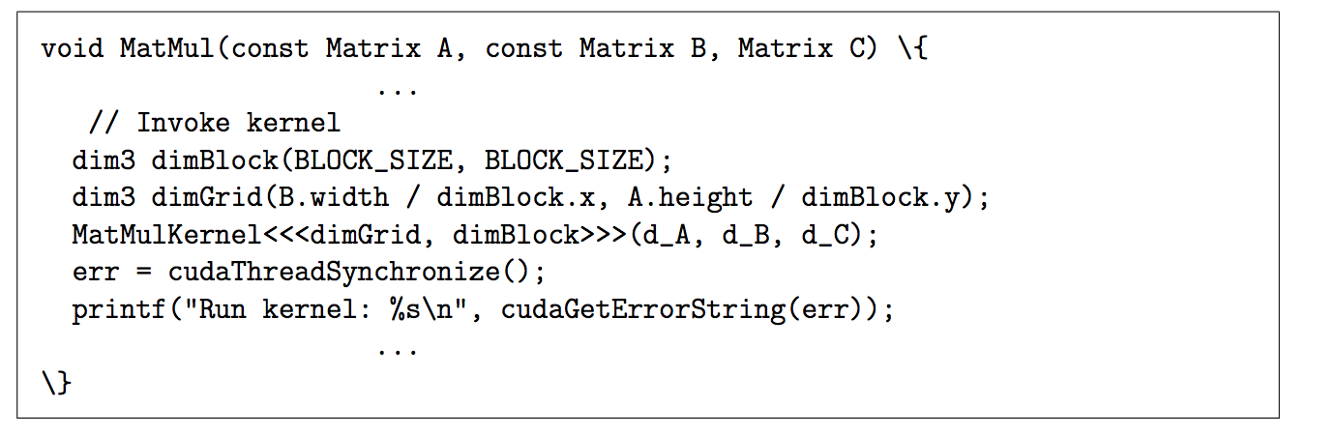
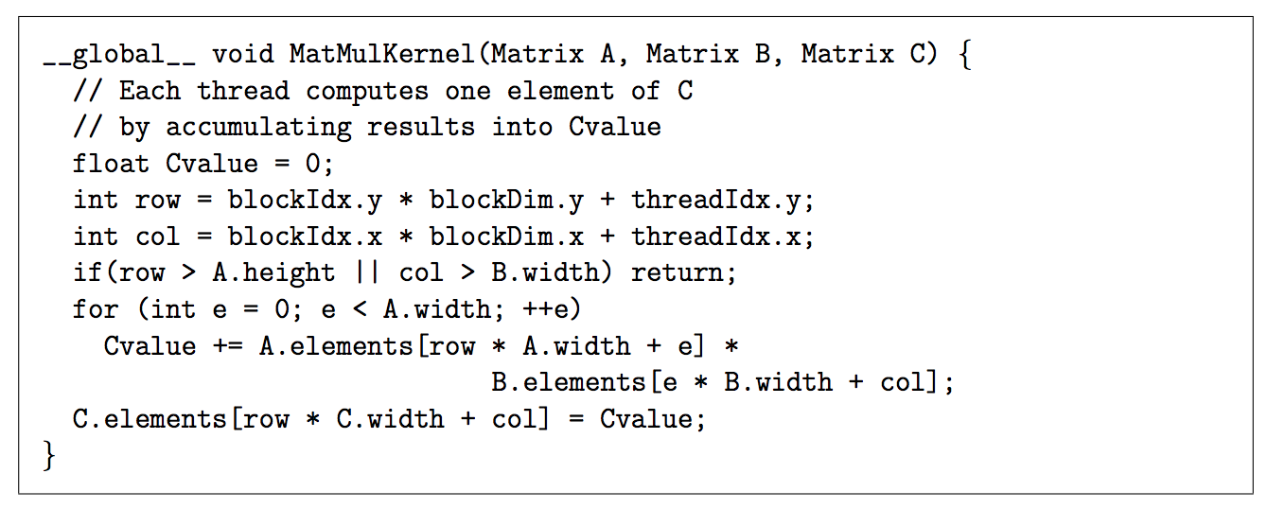
CUDA Program Example

Slide 11
Number of Threads Per CUDA Block
Host sets the number of threads per CUDA block. E.g., threadsPerBlock
Set up at the kernel launch time
# of registers per CUDA block
Compiler sets how many architecture registers are needed for each CUDA block (Will be covered later part of the course)
Typical CPU ISAs, # of registers per thread is fixed (e.g., 32), but in CUDA, this is flexible
Shared memory size is determined from the code
E.g., __shared__ int sharedMemory[1000]; → 4B*1000 = 4000B
kernelName<<<numBlocks, threadsPerBlock>>>(arguments);

Slide 12
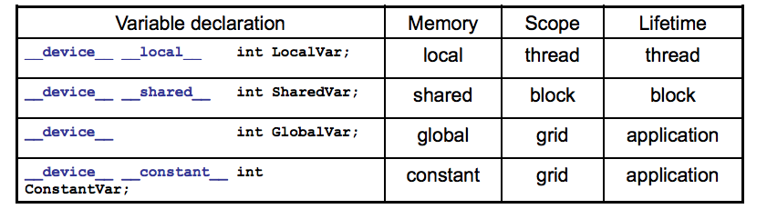
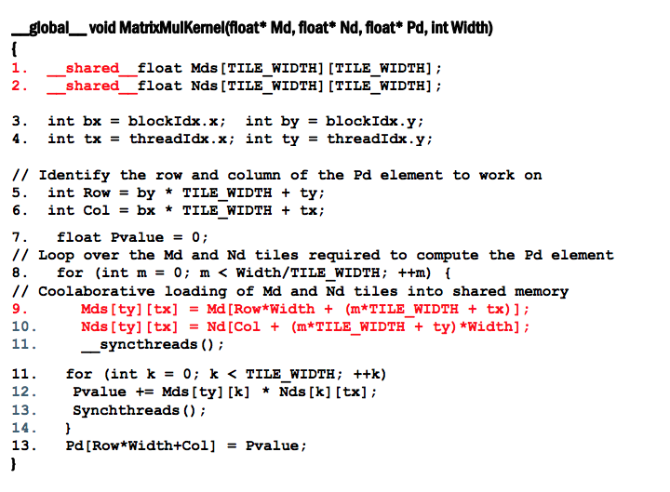
Shared Memory
From: http://accel.cs.vt.edu/files/lecture10.pdf

Slide 13
Synchronization Model
Bulk-Synchronous Parallel (BSP) program (Valiant [90])
Synchronization within blocks using explicit barrier
Implicit barrier across kernels
Kernel 1 → Kernel 2
C.f.) Cuda 3.x
Kernel1
Block
Block
barrier
barrier
Block
barrier
barrier
Barrier
Kernel2
Block
Block
barrier
barrier

Slide 14
OpenCL vs. CUDA
 | OpenCL | CUDA
Execution Model | Work-groups/work-items | Block/Thread
Memory model | Global/constant/local/private | Global/constant/shared/local + Texture
Memory consistency | Weak consistency | Weak consistency
Synchronization | Synchronization using a work-group barrier (between work-items) | Using synch_threads Between threads

Slide 15
GPU Pipeline
Scheduler
Active bit mask vectors/
score boarding
Fetch
One instruction for each warp
Multiple PC registers exist to support multi-threaded architecture
Round-robin scheduler
Wide execution width
I-cache
Fetch unit
Decoder
Register
Scheduler (Score boarding)
Lane 0
Lane 1
. . . . . .
Lane N-1
Memory
Memory access unit
Lane 0
Lane 1
. . . . . .
Lane N-1
Writeback

Slide 16
GPU Register Files
To accommodate a large number of active threads, a large number of register files are essential.
e.g.) 128 threads, 64 registers = 128X64 = 8KB
NVIDIA G80 architecture: 64KB registers (16KB cache)
Vortex: 32x # of threads per warp x # of warps x # or cores
Register read BW
1Tflop/s peak performance (2 read, 1 write)
-2T * 32B/s = 64TB/s register read BW
Highly banked register files

Slide 17
Register File Structures: Multiple Banks
Th 0
…
Th N-1
Warp 0’s reg file
. . . . . .
Warp ID.Reg ID
. . . . . .
. . .
Register files
Warp M-1’s reg file
. . . . . .
Lane 0
Lane 1
. . . . . .
Lane N-1
Writeback
All threads in a warp read the register values in parallel.
Register is indexed with register ID, warp ID
Multiple banks (Narasiman’s figure)

Slide 18
Handling Branch Instructions
A reduction example
What about other threads?
What about different paths?
0
1
2
3
4
5
6
7
If (threadId.x%==2)
0
2
4
6
If (threadId.x%==4)
0
4
If (threadId.x%==8)
0
A
If (threadid.x>2) {
do work B}
else {
do work C
}
B
C
Divergent branch!
D
From Fung et al. MICRO ‘07

Slide 19
Split/Join
Compiler inserts split/join
Split:
Put tmask in the ipdom stack (do work c part}
Put next PC in the stack (not-taken path. // do work c part )
Join
Pop from a stack
If (threadid.x>2)
// split
{
do work B
}
else {
// join
do work C
}

Slide 20
How Many CUDA Blocks on One Stream Multiprocessor?
Occupancy
3 to 1?
2 to 1?
Grid 0
SM
SM
SM
SM
Block (0,0)
Block (1,0)
Block (2,0)
SM
SM
SM
SM
Block (0,1)
Block (1,1)
Block (2,1)
Cache
SM
SM
SM
SM
SM
SM
SM
SM
How many CUDA blocks can run on one streaming multiprocessor?
Multiple blocks per SM

Slide 21
Occupancy
How many CUDA blocks can be executed on one SM is decided by following parameters
# of registers, shared memory, # of threads
Exact H/W configurations are varied by GPU microarchitecture
E.g., HW: each SM can execute 256 threads, 64K registers, 32 KB shared memory
SW: one CUDA block: 32 threads and 2KB shared memory and each thread has 64 registers
Constrain by running threads: 256/32 = 8 CUDA blocks
Constrain by register size = 64*1024/(64*32) = 32 CUDA blocks
Constrain by shared memory = 32KB/2KB = 16 CUDA blocks
Final answer: 8 CUDA blocks per SM

Slide 22
Why Do We Care about Occupancy?
Higher Occupancy means more parallelism.
Utilization: Utilizing more hardware resources generally leads to better performance.
Exceptional cases will be studied in later lectures.
Block
Block
Block
Block
Block
Block
Block
Block
Block
Block
Block
Block
SM
SM
SM
SM
SM
SM
SM
SM
Case (b): Each SM runs two CUDA block (4 threads per block)
Case (a): Each SM runs one CUDA block (6 threads per block)

Slide 23

GPU Pipeline (1)
add r1, r1, 1
12
I-cache
13
Front-end
Decode
RF
schedule
Execution
Write-back
14
add r1, r1, 1
add r1, r1, 1
add r1, r1, 1
Memory
15
 | PC value
#1 (b:1, T1-T4) | 0x8000
#2 (b:1, T5-T8) | 0x8004
#3 (b:2, T1-T4) | 0x8000
#4 (b:2, T5-T8) | 0x800A
Shared Memory
add r1, r1, 1
 | Src 1 |  | Src 2
W1 | v | r | v | r
W2 | v | r | v | r
W3 | v | r | v | r
W4 | v | r | v | r
 | Src 1 |  | Src 2
W1 | v | r | v | r
W2 | v | r | v | r
W3 | v | r | v | r
W4 | v | r | v | r
 | Src 1 |  | Src 2
W1 | v | r | v | r
W2 | v | r | v | r
W3 | v | r | v | r
W4 | v | r | v | r
 | Src 1 |  | Src 2
W1 | v | r | v | r
W2 | v | r | v | r
W3 | v | r | v | r
W4 | v | r | v | r
 | Th1 | Th2 | Th3 | Th4
R1 | 11 | 12 | 13 | 14
R2 | 2 | 2 | 2 | 2
R3 | 3 | 4 | 13 | 15
R4 | 23 | 24 | 32 | 33
11
1
12
1
13
1
14
1
add r1, r1, 1
0x8000 | add r1, r1, 1
0x8004 | sub r2, r,2,1
0x8008 | mov r1, tid.x
0x800A | mov r2, ctaid.x
0x8010 | ld.shared r1 [A]
tid.x: special register to store thread ID within a block
ctaid.x: special register to store block ID within a grid

Slide 24
GPU Pipeline (2)
sub r2, r2, 1
1
I-cache
1
Front-end
Decode
RF
schedule
Execution
Write-back
1
sub r2, r2, 1
sub r2, r2, 1
sub r2, r2, 1
Memory
1
 | PC value
#1 (b:1, T1-T4) | 0x8000
#2 (b:1, T5-T8) | 0x8004
#3 (b:2, T1-T4) | 0x8000
#4 (b:2, T5-T8) | 0x800A
Shared Memory
sub r2, r2, 1
One lane is not shown
 | Src 1 |  | Src 2
W1 | v | r | v | r
W2 | v | r | v | r
W3 | v | r | v | r
W4 | v | r | v | r
 | Src 1 |  | Src 2
W1 | v | r | v | r
W2 | v | r | v | r
W3 | v | r | v | r
W4 | v | r | v | r
 | Src 1 |  | Src 2
W1 | v | r | v | r
W2 | v | r | v | r
W3 | v | r | v | r
W4 | v | r | v | r
 | Th1 | Th2 | Th3 | Th4 | Th5 | Th6 | Th7 | Th8
R1 | 12 | 13 | 14 | 15 | 16 | 17 | 18 | 19
R2 | 3 | 3 | 3 | 3 | 2 | 2 | 2 | 2
R3 | 3 | 4 | 13 | 15 | 23 | 32 | 37 | 23
R4 | 23 | 24 | 32 | 33 | 11 | 7 | 8 | 5
2
1
2
1
2
1
0x8000 | add r1, r1, 1
0x8004 | sub r2, r,2,1
0x8008 | mov r1, tid.x
0x800A | mov r2, ctaid.x
0x8010 | ld.shared r1 [A]
tid.x: special register to store thread ID within a block
ctaid.x: special register to store block ID within a grid

Slide 25
GPU Pipeline (3)
mov r2, ctaid.x
2
I-cache
2
Front-end
Decode
RF
schedule
Execution
Write-back
2
Memory
2
 | PC value
#1 (b:1, T1-T4) | 0x8000
#2 (b:1, T5-T8) | 0x8004
#3 (b:2, T1-T4) | 0x8000
#4 (b:2, T5-T8) | 0x800A
Shared Memory
One lane is not shown
 | Src 1 |  | Src 2
W1 | v | r | v | r
W2 | v | r | v | r
W3 | v | r | v | r
W4 | v | r | v | r
 | Src 1 |  | Src 2
W1 | v | r | v | r
W2 | v | r | v | r
W3 | v | r | v | r
W4 | v | r | v | r
 | Src 1 |  | Src 2
W1 | v | r | v | r
W2 | v | r | v | r
W3 | v | r | v | r
W4 | v | r | v | r
 | Th1 | Th2 | Th3 | Th4 | Th5 | Th6 | Th7 | Th8
R1
R2
R3
R4
Block 2 register file
2
2
2
0x8000 | add r1, r1, 1
0x8004 | sub r2, r,2,1
0x8008 | mov r1, tid.x
0x800A | mov r2, ctaid.x
0x8010 | ld.shared r1 [A]
tid.x: special register to store thread ID within a block
ctaid.x: special register to store block ID within a grid

Slide 26
GPU Pipeline (4)
mov r2, ctaid.x
5
I-cache
6
Front-end
Decode
RF
schedule
Execution
Write-back
7
Memory
8
 | PC value
#1 (b:1, T1-T4) | 0x8000
#2 (b:1, T5-T8) | 0x8004
#3 (b:2, T1-T4) | 0x8000
#4 (b:2, T5-T8) | 0x8008
Shared Memory
One lane is not shown
 | Src 1 |  | Src 2
W1 | v | r | v | r
W2 | v | r | v | r
W3 | v | r | v | r
W4 | v | r | v | r
 | Src 1 |  | Src 2
W1 | v | r | v | r
W2 | v | r | v | r
W3 | v | r | v | r
W4 | v | r | v | r
 | Src 1 |  | Src 2
W1 | v | r | v | r
W2 | v | r | v | r
W3 | v | r | v | r
W4 | v | r | v | r
 | Th1 | Th2 | Th3 | Th4 | Th5 | Th6 | Th7 | Th8
R1
R2
R3
R4
Block 2 register file
6
7
8
0x8000 | add r1, r1, 1
0x8004 | sub r2, r,2,1
0x8008 | mov r1, tid.x
0x800A | mov r2, ctaid.x
0x8010 | ld.shared r1 [A]
tid.x: special register to store thread ID within a block
ctaid.x: special register to store block ID within a grid

Slide 27
Mask Bits
id | Mask bit
w1 | 1111
w2 | 1110
w3 | 0111
w4 | 1111
w5 | 1111
What if we do not need to execute all 4 threads?
Mask bits tell which threads are active.
 | Src 1 |  | Src 2
w1 | v | r | v | r
w2 | v | r | v | r
w3 | v | r | v | r
w4 | v | r | v | r
w5 | v | r | v | r
 | Src 1 |  | Src 2
w1 | v | r | v | r
w2 | v | r | v | r
w3 | v | r | v | r
w4 | v | r | v | r
w5 | v | r | v | r
 | Src 1 |  | Src 2
w1 | v | r | v | r
w2 | v | r | v | r
w3 | v | r | v | r
w4 | v | r | v | r
w5 | v | r | v | r
 | Src 1 |  | Src 2
w1 | v | r | v | r
w2 | v | r | v | r
w3 | v | r | v | r
w4 | v | r | v | r
w5 | v | r | v | r
V
V
V
V
V
V
V
V
V
V
V
V
V
V
V
V
V
V

Slide 28
Summary
GPUs execute many threads as a group (warp/wave front)
GPU provides features to handle multiple threads concurrently and also time multiplexing
Massive thread level parallelism → massive memory level parallelism

