Slide 1
Vortex Tutorial
Hyesoon Kim

Slide 2
Vortex
Open source H/W and S/W GPU
RISC-V extensions
Implemented/tested on Intel FPGA
Xilinix support is on-going
S/W stacks are relying on other open source platforms (LLVM, POCL, Yosys etc.)
OpenCL and a part of CUDA are supported
https://vortex.cc.gatech.edu/
https://github.com/vortexgpgpu/

Slide 3
Tutorial Schedule
8:00-8:20 | Introduction and GPU background | Hyesoon Kim
8:20-9:20 | Vortex Microarchitecture and Software stack | Blaise Tine
9:20-9:40 | Cupbop: Running OpenCL/ CUDA on Vortex | Chihyo (Mark) Ahn
9:40-10:00 | Q&A session
10:00-10:20 | Coffee Break
10:20-11:00 | Tutorial Assignments/Hands-on Exercise
11:00-12:00 | Vortex Workshop | 3 speakers, chair: Jaewon Lee

Slide 4
Running GPU programming on RISC-V Processors
RISC-V (or RISC-V Vector) vs. RISC-V GPUs (Vortex)
SIMD vs. SIMT
SIMD: Single instruction multiple data
SIMT: Single instruction multiple threads
Biggest hardware differences is how branches are handled.
Biggest software difference is ISA differences
SIMD: loop → vectorized → need to map to different vector/SIMD instructions
SIMT: loop → loop-body x # threads
RISC-V SIMT extension
SIMT Advantages:
ISA extensions are very limited
New compiler support is minimum

Slide 5
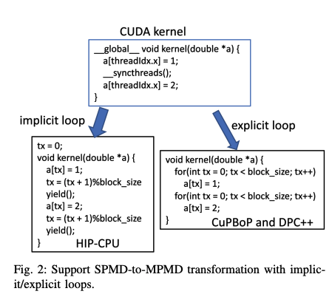
With RISC-V Vector
LLVM Vectorization:
Upgrading to the latest LLVM version is ongoing
Vulkan graphics kernels are vectorized using intrinsics and will be in the workshop
CUDA on CPU optimization will be presented in the main session 2B

Slide 6
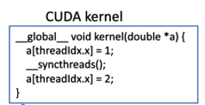
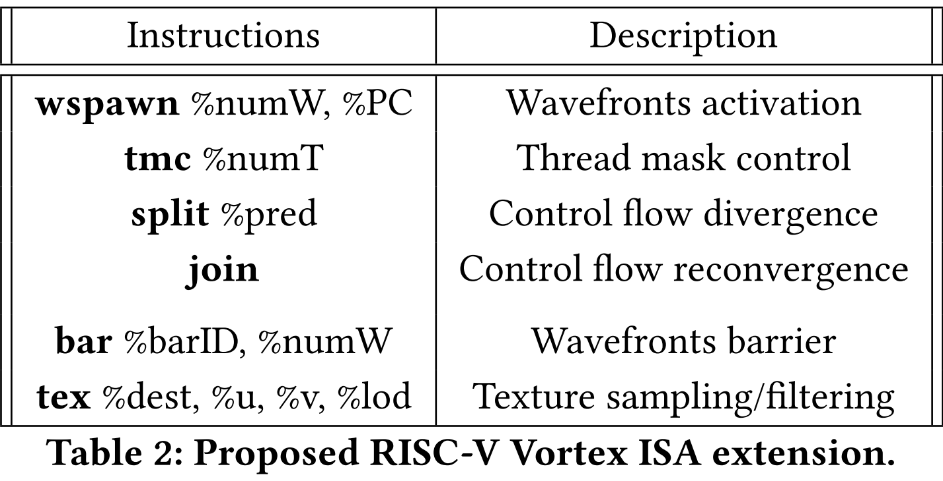

With RISC-V SIMT
RISC-V Threads
Preserve programming model
RISC-V GPU Vortex

Slide 7
Differences between RISC-V GPU and other GPUs
Vortex : SIMT based GPU architecture
split/join instructions to support divergent branches
# of registers per thread is fixed (32)
Host code launches kernel: discrete GPU based model
Kernel launch and memory interface is tightly coupled with FPGA design → strong dependency with vendor and FPGA designs
Command processor and memory interface between CPU and GPU are all combined
RISC-V CPU vs. RISC-V GPU
RISC-V GPU is still academic version. So require customized tool chains for LLVM, QEMU etc.
Host is needed. Run-time system is needed
Provide functional simulator, timing simulator, RTL simulation, FPGA tool chain (only specific FPGA models)

Slide 8

Remote access during Tutorial
Please fill out the form (need github id)
https://github.com/vortexgpgpu/vortex_tutorials/blob/main/REMOTE_ACCESS.md

