Slide 1


Vortex Software Stack
Blaise Tine
Notes:
Narration:
This poster presents Vortex, a reconfigurable and scalable RISC-V GPGPU accelerator.
Vortex’s main goal is to use RISC-V to utilize the advantages of SIMT execution model and provide a customizable design to facilitate architecture research.
In addition, we show that a minimal set of 5 instructions is enough to achieve a highly parallel execution model on RISC-V.
Single Instruction Multiple Threads execution model, or SIMT, has the advantage of having a scalar based programming model, which makes it easier to program on.
Through POCL, an open-source framework to implement the compiler and runtime software for OpenCL, we were able to execute unmodified OpenCL kernels on Vortex.
We achieved that by linking POCL with Vortex's runtime kernel, which provides warp and thread creation, warp barriers, and control divergence.
Vortex microarchitecture has two main configuration methods to scale for various application domains: increasing the number of parallel work-items and configuring the cache system. Each one of these methods has its own unique trade-offs, both in terms of performance for different applications and hardware and energy cost. The first method is to increase the parallel work-items in the design by either increasing the number of threads per warp, number of warps per core, number of cores per clusters, and the number of clusters. The second method is by configuring the cache system. Our L1, shared memory, L2, and L3 are all based on the same high-throughput banked design that supports a snoop protocol and prefetching.
We have evaluated our design both 15 nm educational library and Arria 10 Intel FPGA on a subset of Rhodina benchmarks and were able to achieve frequencies of 300 MHz and 192 MHz respectively.
In addition, we were able to fit a 2 cluster 8 core configuration with a total of 256 work units on Arria 10 Intel FPGA.
We also used the OPAE open-source accelerator API to be able to execute OpenCL kernels on the FPGA.

Slide 2
Agenda
Vortex Software Stack
PoCL for the Vortex
LLVM Compiler Extension
Notes:
The agenda looks like this.

Slide 3
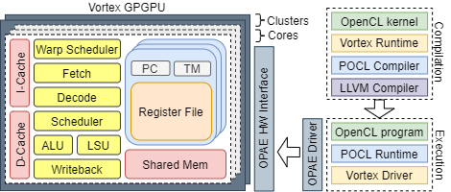
Motivation
__kernel void foo(){
tid = get_global_id(0);
…
barrier(…);
}
__host int main(){
…
cl_mem A_clmem = clCreateBuffer(context, …); clEnqueueNDRangeKernel(command_queue, foo, …); …
}
Software Support
Vortex GPU
GPU Application (OpenCL, CUDA … )
GPU capabilities query
Kernel and host code compilation
GPU buffer allocation
Kernel scheduling and execution
CPU-GPU communication
Kernel threads scheduling
Kernel execution
Notes:
People use GPU programming languages to develop GPU applications.
Many individuals employ languages like OpenCL and CUDA for writing their applications, and numerous applications have already been developed using these languages.
These two languages divide the program into two parts: code for the kernel and code for the host.
Kernel code requires access to runtime information, such as global IDs in OpenCL or thread IDs in CUDA.
kernel code also requires controlling program flow, including barriers and terminating executions.
On the other hand, host code needs to establish communication with the Vortex GPU, specifying commands for actions such as kernel launches and memory allocation.
Therefore, we require two types of methods: the first for accessing runtime information and controlling program flow, and the second for communication with the device.
On the Vortex side, programs must be written in Vortex ISA, not RISCV or any other instruction set.
Runtime information is stored in their local control and status registers.
Vortex uses the opae driver to configure, enumerate, open, and access FPGA accelerators.
However, there remains a significant gap between the programmer's code and the access to runtime information and communication.

Slide 4







Overview of the Vortex Software Stack
Supporting laungague
OpenCL (v3.0)
CUDA (v10.1)
Frontend compiler
Portable Computing Language (PoCL)
Extension of PoCL v5.0
Cuda for Parallelized and Broad-range Processors(CuPBoP)
Common Component
RISCV toolchain (gcc, build_utils, etc)
LLVM vortex
Extension of LLVM 18
CuPBoP
Vortex Binary
vortex
Open-GPU owned
repositories
Modified repositories
Notes:
The Vortex software stack provides support for two different programming languages: OpenCL and CUDA. Currently, we offer support for OpenCL 3.0 and CUDA 10.1.
To enable support for these two languages, we use the Portable Computing Language (PoCL) and CUDA for Parallelized and Broad-range Processors.
We have extended the PoCL open-source repositories to ensure compatibility with Vortex and have implemented our own project called CupBoP.
As our backend compiler, we utilize LLVM, specifically an extended version 16. To fully support the entire software stack, we also require the RISC-V toolchain, which includes essential components such as GCC and various build utilities. These components are integral to our comprehensive software stack.

Slide 5
Vortex Kernel & Runtime Stacks
GPU Kernel
Vortex Host Program
Language-specific Compiler
Language-specific Runtime library
Vortex Kernel library
Vortex Runtime library
Target Codegen Compiler
Program Execution Stack
Kernel Compilation Stack
Notes:
To bridge the gap between the GPU and the code, we have implemented a software stack.
This is the Overview of the vortex software stack, which comprises two distinct components: kernel compilation into the Vortex binary and program execution.
The GPU kernel is defined using languages such as OpenCL or CUDA.
Our process begins with the analysis of program semantics and the generation of intermediate representation (IR) for the program.
Subsequently, we link with libraries that contain pre-built kernels for accessing runtime information and controlling program flow.
Lastly, we generate target code that consists of Vortex ISA instructions.
The program execution stack is also defined by specific programming languages.
In this case, we link function calls to methods that align with Vortex operations, such as Vortex memory allocation.
The Vortex runtime library contains essential information for communicating with the Vortex hardware.

Slide 6
Vortex ISA Extension
Wavefront Activation
vx_wspawn %numW %func_ptr
Thread mask activation and Active thread modification
vx_tmc %tmask, vx_pred %cond %tmask
Control flow divergence and reconvergence
vx_split %pred, vx_join %stack_ptr
Wavefront synchronization
vx_barrier %barID %numW
If (threadid.x<2) {
work B
} else {
work C
}
Example Kernel
Start
vx_wspawn
A
vx_split
B
C
vx_join
D
vx_join
Control Flow Graph
Notes:
Now, I will provide a more detailed introduction to the libraries and ISA extensions of the Vortex.
In order to support GPU operations, we have extended the RISCV ISA.
Since GPUs follow a SIMT (Single Instruction, Multiple Threads) architecture, it is important to have an ISA that can effectively control operations in SIMT architecture.
vortex use terminology wavefront and thread.
A wavefront is a group of thread and threads within one wavefront are executed in parallel and in lock steps.
The Vortex ISA introduces instructions for wavefront activation, allowing the launch of a kernel across a specified number of warps with a function pointer.
To manage threads within a warp, we introduce two ISAs, namely vx_tmc and vx_thread. These ISAs are responsible for activating and altering the active threads.
One of the most important aspects of the Vortex ISA is the introduction of split and join instructions to handle control divergence.
For instance, consider the code snippet in the top-right corner, which executes "work b" when the thread ID is greater than 2, otherwise, it runs "work c."
This code can lead to control flow divergence like bottom right figure.
To address control flow divergence in vortex, the split instruction pushes information about the current state of the thread mask into a hardware-immediate post-dominator (IPDOM) stack.
Subsequently, the join instruction retrieves this information during reconvergence.
Additionally, we have incorporated instructions for synchronization purposes.

Slide 7
Vortex Kernel Library
Interface for accessing runtime information and controlling program flow
Schedule tasks on the parallel H/W
void vx_spawn_threads(dimension, grid_dim, block_dim, kernel_func, arg)
Query hardware configuration
vx_num_cores(), vx_num_warps(), vx_num_threads()
Query the current thread or wavefront
vx_thread_tid(), vx_warp_id()
Terminate program execution
vx_tmc();
Debug print to the console
vx_printf(format, …);
Other utility APIs
Notes:
The Vortex kernel libraries consist of a set of kernels designed for running applications on the Vortex hardware.
In order to retrieve information and query hardware status, we require an interface, called vortex kernel library.
This vortex kernel library needs to be provided during kernel compilation.

Slide 8
Vortex Runtime Library
Interface for communicating with the Vortex device
Perform memory-related operation?
vx_mem_alloc(…), vx_mem_free(…)
vx_copy_to_dev(…), vx_copy_from_dev(…)
Launch Kernel?
vx_start(…), vx_ready_wait(…)
Open and Close Device?
vx_dev_open(…), vx_dev_close(…)
Other Runtime Methods
Notes:
For host code, certain fundamental operations must be implemented for communicating vortex and host CPU.
These operations include memory copying, memory allocation, and kernel launching, and all of these functions should be incorporated into the Vortex Runtime library.

Slide 9
Vortex Program Compilation Flow
Host Code
Compiler
Host
Executable
Lower device communication functions with runtime library
Vortex Runtime
Kernel Code
Front-end compiler
Back-end compiler
Kernel Code
(IR)
Kernel executable
Built-in Library
(e,g. math functions)
Analyze program semantics
Lower functions with built-in library
Vortex
Kernel library
Vortex ISA
Lower IR to Vortex ISA using Vortex intrinsic
Perform vortex-specific optimization
Notes:
Now, I would like to provide a more detailed explanation of the Vortex compilation flow.
Compiler receive kernel code and host code as a input of compiler pipeline.
The kernel code undergoes initial analysis of program semantics through the front-end compiler, resulting in the generation of intermediate representation (IR). During this process, some functions are lowered using built-in libraries is performed.
Subsequently, the generated IR is transformed into a kernel executable by the backend compiler.
In this phase, the Vortex ISA is employed, and the Vortex Kernel library is linked.
On the other hand, the host code is responsible for creating the host executable through linkage with the runtime library.

Slide 10
Vortex Execution flow
Front-end runtime library
Vortex Runtime Library
Vortex Host interface
Command Processor
Vortex Processor
External
Bus
Internal
Bus
Host
Vortex GPU
Notes:
Now I will introduce the Vortex execution flow.
The commands required for device communication, as outlined in the host code, adhere to the following execution sequence:
First, they are linked with the frontend runtime library.
The frontend runtime library outlines how frontend methods can be executed using the Vortex runtime library.
The Vortex library carries out the operation using the Vortex host interface.
Vortex host interface, in turn, performs the operation on the Vortex processor, which is connected to the external bus via the Vortex host interface.

Slide 11
PoCL: Portable OpenCL Implementation
Key Insight
Use target-specific execution model
SIMT -> GPUs
MIMD, SIMD -> CPUs
Target-specific compiler transformations
Using LLVM
Key Features
A single interface with multiple target devices
Support x86, PTX, HASIL export
Support Custom accelerator support via TCE
OpenCL Program
PoCL
PoCL Built-in lib
PoCL Devices
(CUDA,TCE …)
Clang
PoCL software stack
Notes:
Now I will introduce the Vortex PoCL extension, which is designed to enable support for OpenCL programs on the Vortex platform.
PoCL is a project to support executing OpenCL programs on different hardware device.
It is built upon two fundamental insights: the adoption of a target-specific execution model and the implementation of target-specific compiler transformations using LLVM.
Based on key insight, they can support different execution model per device such as GPU and CPU, also they can optimize and generate binary code for specific target.
PoCL extends its support to several backend devices, including x86, NVIDIA GPUs, and custom accelerators.
To execute an opencl programs on a backend device.
First, POCL compiles the program, and link it with hardward dependent runtime library
and also PoCL’s builtin library such as math functions.
Then, the POCL runtime will use the devices runtime functions to control the devices.

Slide 12
Vortex OpenCL System Architecture
Compilation
Vortex Kernel Library
PoCL Compiler
Execution
Vortex Runtime
PoCL Runtime
Vortex Kernel
Vortex Runtime
Notes:
The vortex PoCL extension make available compile OpenCL kernel and execute them in the vortex GPU.
we need to care about the following parts: for compilation, we need to modify the POCL Compiler and provide a Vortex Runtime library.
For the Compilation, vortex have different interface as other devices.
thus, we have to modify the original pocl compiler to generate the programs with Vortex ISA.
We also use vortex kernel library in lowering process.
For execution, we need to provide a Vortex runtime for POCL runtime. To integrate a new device into POCL, we have to implement some basic operations, like memory copy, memory allocation and kernel launch and put all these functions into Vortex Runtime. POCL framework will use the Vortex Runitme to control and communicate with Vortex.

Slide 13
PoCL Vortex Extension
Kernel Scheduling
Kernel Invocation
Device Code Generation
RISC-V ISA, ABI
Vortex ISA Extension
Link kernel library
Vortex Runtime
GPU resource allocation
Kernel execution
OpenCL kernel
OpenCL Application
LLVM context Creation
OpenCL Runtime API
PoCL Runtime
BuiltIn library linking
Common Device Interface
CPU & Pthread
PTX
HSA
TCE
Accel
Vortex
Runtime
Workgroup Generation
Work Schedule Generation
CPU
GPU
TCE Device
Accel Device
Vortex
GPU
Device Kernel Translation
Device Code Generation
PoCL Compiler
Notes:
In summary, vortex software stack need to be integrated into PoCL.
In the right figure, we marked Vortex extension as a orange box.
First, PoCL compiler receive OpenCL kernel and generate program context for target execution model.
Based on the execution model, we insert kernel scheduling code to program context.
we link the vortex kernel library during the device kernel translation
And translate kernel to generate vortex binary.
After got the generated program binary, pocl Runtime uses vortex runtime to offload the kernel to vortex and launch it.

Slide 14
Compilation and Execution Process
OpenCL kernel
OpenCL Application
Input: OpenCL programs (host&&kernel)
Step1: Compile OpenCL Host Program and link with Vortex Runtime
Step2: Execute OpenCL Host Program, trigger online kernel compilation.
Step3: Compile OpenCL kernel and link with kernel library.
Step4: Execute compiled kernel on GPU
LLVM context Creation
OpenCL Runtime API
PoCL Runtime
BuiltIn library linking
Common Device Interface
CPU & Pthread
PTX
HSA
TCE
Accel
Vortex
Runtime
Workgroup Generation
Work Schedule Generation
CPU
GPU
TCE Device
Accel Device
Vortex
GPU
Device Kernel Translation
Device Code Generation
PoCL Compiler
Notes:
Then, we Manually edit the host OpenCL programs, to load risc-v binary as kernel.

Slide 15
Compilation and Execution Process
OpenCL kernel
OpenCL Application
Input: OpenCL programs (host&&kernel)
Step1: Compile OpenCL Host Program and link with Vortex Runtime
Step2: Execute OpenCL Host Program, trigger online kernel compilation.
Step3: Compile OpenCL kernel and link with kernel library.
Step4: Execute compiled kernel on GPU
LLVM context Creation
OpenCL Runtime API
PoCL Runtime
BuiltIn library linking
Common Device Interface
CPU & Pthread
PTX
HSA
TCE
Accel
Vortex
Runtime
Workgroup Generation
Work Schedule Generation
CPU
GPU
TCE Device
Accel Device
Vortex
GPU
Device Kernel Translation
Device Code Generation
PoCL Compiler
Notes:
Finally, we just execute the compiled host programs. It will load the risc-v binary kernel and execute it on Vortex devices by communicating with Vortex driver.

Slide 16
Compilation and Execution Process
OpenCL kernel
OpenCL Application
Input: OpenCL programs (host&&kernel)
Step1: Compile OpenCL Host Program and link with Vortex Runtime
Step2: Execute OpenCL Host Program, trigger online kernel compilation.
Step3: Compile OpenCL kernel and link with kernel library.
Step4: Execute compiled kernel on GPU
LLVM context Creation
OpenCL Runtime API
PoCL Runtime
BuiltIn library linking
Common Device Interface
CPU & Pthread
PTX
HSA
TCE
Accel
Vortex
Runtime
Workgroup Generation
Work Schedule Generation
CPU
GPU
TCE Device
Accel Device
Vortex
GPU
Device Kernel Translation
Device Code Generation
PoCL Compiler
Notes:
Here is the steps to execute OpenCL.
In this first step, we have to compile the kernel part into risc-v binary. We will use modied POCL compiler in this step.
Since PoCL does not support riscv structure we need to modify pocl compiler to generate binary.

Slide 17
Compilation and Execution Process
OpenCL kernel
OpenCL Application
Input: OpenCL programs (host&&kernel)
Step1: Compile OpenCL Host Program and link with Vortex Runtime
Step2: Execute OpenCL Host Program, trigger online kernel compilation.
Step3: Compile OpenCL kernel and link with kernel library.
Step4: Execute compiled kernel on GPU
LLVM context Creation
OpenCL Runtime API
PoCL Runtime
BuiltIn library linking
Common Device Interface
CPU & Pthread
PTX
HSA
TCE
Accel
Vortex
Runtime
Workgroup Generation
Work Schedule Generation
CPU
GPU
TCE Device
Accel Device
Vortex
GPU
Device Kernel Translation
Device Code Generation
PoCL Compiler
Notes:
After we generated the binary kernel for our host program. Host code is compiled with the PoCL runtime library which is used for host programs to communicate with Vortex devices.

Slide 18
Mapping from OpenCL Kernel to Vortex
OpenCL processing model
Work-Item
Work-Group
Kernel instance
Total Hardware Threads
Cores x Wavefronts x Threads
Work-Item
Work-Group
…
Kernel Instance
Notes:
While compile program for the vortex, one the most important parts is scheduler.
How to map computation to hardware is critical for achieving high performance.
The OpenCL processing model using three terms for specifying processing model, work-item, work-group, and kernel instance.
The work-item specifying the minimal unit of program. The work-group specifying the minimal group of program that processing in the one processing unit.
Instead of work-item and work-group, vortex use wavefront and thread to schedule.
A wavefront is a group of thread and threads within one wavefront are executed in parallel and in lock steps.
In Vortex, we use wavefront as. the unit for scheduling.
The goal of the scheduling is that high-level users can directly execute Vortex without worry about scheduling.
So, we generate scheduling in the compilation process.

Slide 19
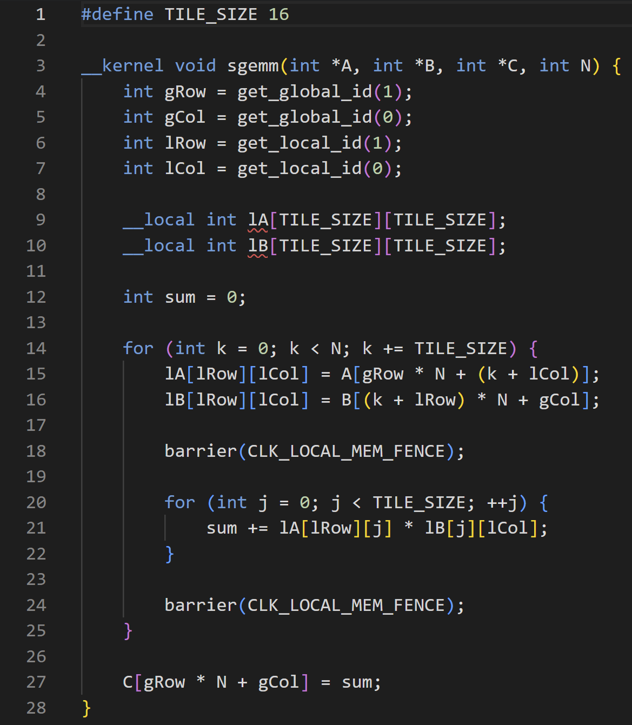
Mapping from OpenCL Kernel to Vortex
LLVM Compiler Passes
Kernel Arguments Translation
Work-item coordinates Translation
Local Memory Allocation
Barriers Allocation
SpawnThreads Insertion
Sgemm Kernel
Notes:
With this work-group function, we can simply execute program on the vortex, called thread mapping.
Every thread execute workgroup function, which means mapping one work-group to one hw thread.
The workgroup is distribute among all threads.
Using the given mapping, it is possible that the number of work-groups is not a multiple of the number of threads in a wavefront.
To execute the remaining work-groups, we make the program flow as shown in the right figure, add additional wavefront for dealing remaining work-group.

Slide 20
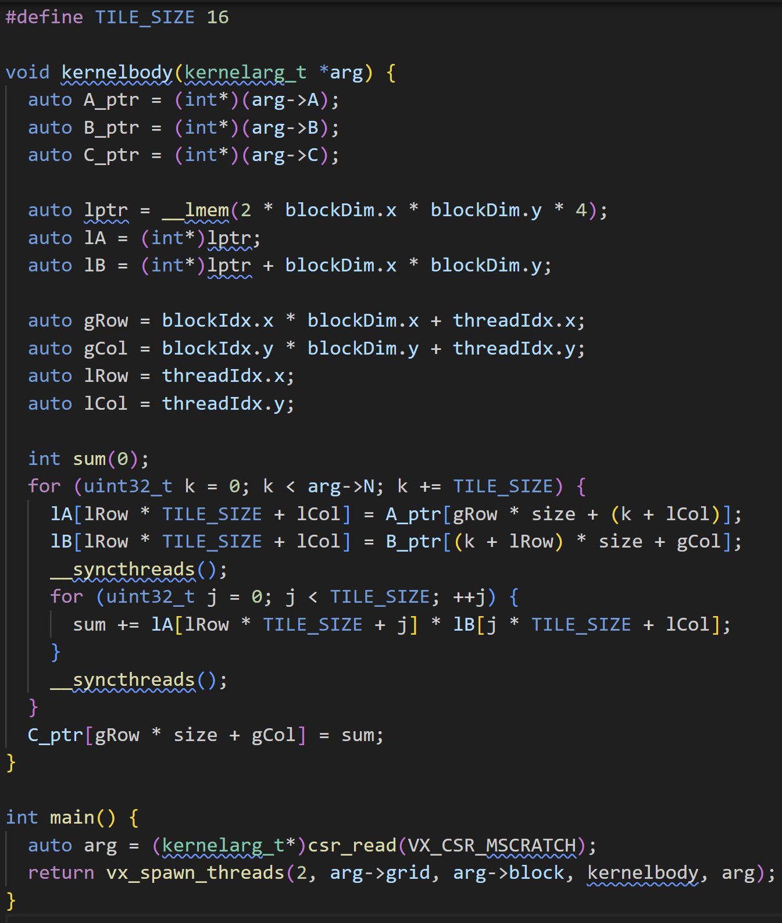
Mapping from OpenCL Kernel to Vortex
SpawnThreads Insertion
Notes:
With this work-group function, we can simply execute program on the vortex, called thread mapping.
Every thread execute workgroup function, which means mapping one work-group to one hw thread.
The workgroup is distribute among all threads.
Using the given mapping, it is possible that the number of work-groups is not a multiple of the number of threads in a wavefront.
To execute the remaining work-groups, we make the program flow as shown in the right figure, add additional wavefront for dealing remaining work-group.

Slide 21
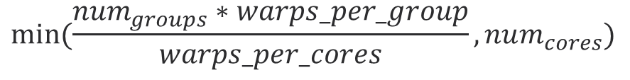
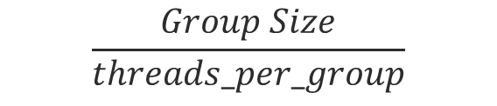
Mapping from OpenCL Kernel to Vortex
SpawnThread Execution
Warps per Group
Calculation
$$\frac{Group Size}{threads_per_group}$$
Active Cores
Calculation
$$min⁡(\frac{num_{groups}∗warps_per_group}{warps_per_cores}, num_{cores})$$
Workgroups to Active Cores Assignment
(group_offset, num_groups)
Warp Iterations Calculation
(remaining groups)
Spawn Warps
(warps execution)
Notes:
With this work-group function, we can simply execute program on the vortex, called thread mapping.
Every thread execute workgroup function, which means mapping one work-group to one hw thread.
The workgroup is distribute among all threads.
Using the given mapping, it is possible that the number of work-groups is not a multiple of the number of threads in a wavefront.
To execute the remaining work-groups, we make the program flow as shown in the right figure, add additional wavefront for dealing remaining work-group.

Slide 22
LLVM Compiler Extension
New RISCV target feature to identify Vortex
Toolchain integration
GCC toolchain
Kernel runtime
Assembler/Disassembler
GPGPU ISA Extension
wspawn, tmc, split,join, bar, tex
Optimization Pass
Divergence Analysis Pass
Divergence Instrumentation Pass
Split/Join insertion
Notes:
Furthermore, we have extended the LLVM compiler to generate Vortex ISA code.
Additionally, we integrated the GCC toolchain and kernel runtime into LLVM, and we have enhanced the assembler and disassembler to provide full support for Vortex ISA.
Moreover, we have introduced an optimization pass to manage thread divergence. This pass effectively inserts split and join instructions into regions where divergence occurs.

Slide 23
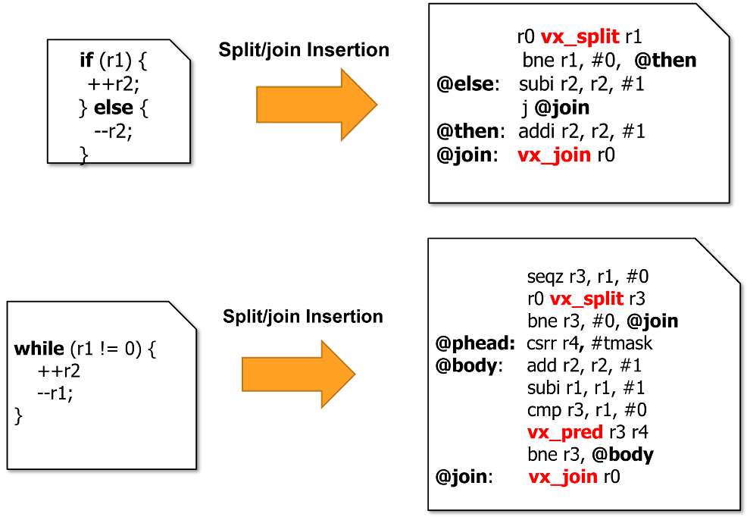
Vortex Divergence Control
Handling divergent control-flow
Divergence analysis
Mark divergent instructions
Divergence management
Insert Split and Join instruction
Handling loops is more complex
Use vx_pred to disable threads on conditional
Handling Divergence
Divergent If/else statement
Divergent Loops
A
Divergent branch!
B
If (threadid.x<2) {
work B
} else {
work C
}
C
D
Notes:
To effectively manage divergence, we have introduced both a divergence analysis pass and a management pass.
Through the analysis pass, the optimization pass identify and mark divergent instructions and regions.
Subsequently, the pass strategically insert split and join instructions to handle divergence.
Handling loops bring more complexity when compared to managing divergences compare to other divergence such as if/else constructs.
To address this challenge, we have introduced the vx_pred, allowing us to modify the thread mask based on specified conditions.
The figure in the lower-right corner, it demonstrate how if/else statements can be transformed into split and join instructions based on conditions.
Similarly, when dealing with loops, optimization pass insert split and join instructions at the start and end of the loop while adding vx_pred for condition changes within the loop body.

Slide 24
Supported OpenCL benchmarks
Upgrade PoCL version as 4.0
Support OpenCL 3.0
Using llvm vortex based on llvm v18
17 Benchmarks available in codebase
vecadd, sgemm, psort, saxpy, sfilter, conv3, oclprintf
nearn, gaussian, dotproduct, kmeans, spmv, bfs,
stencil, lbm, blackscholes, transpose
Notes:
Using this entire opencl pipeline, we can support 17 benchmarks in the rodinia benchmark set.
Currently we use pocl 4.0 with opencl version 3.0 and llvm 16 vortex extension.

Slide 25
Thank You!
https://github.com/vortexgpgpu/pocl/tree/main
https://github.com/vortexgpgpu/llvm/tree/vortex
https://github.com/vortexgpgpu/vortex

