Slide 1
Vortex Tutorial
Hyesoon Kim

Slide 2
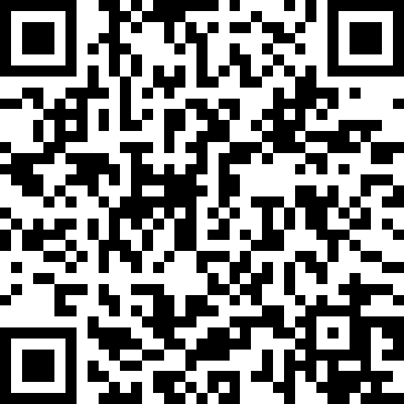
Vortex Developer Meetings
Every 1st Wed ET 8:00/PT 5:00
The zoom link will be posted on the day at github
Please fill out this form to receive the developer meeting information
https://forms.gle/zGtXDVETZp4zaStDA

Slide 3
How to contribute to Vortex
Master branch is the working branch
Minor issues: just submit a pull request
New feature additions: Please come to the discussion meeting.
Generate a pull request or ask for a branch
Add test cases and knob to turn on/off the new features

Slide 4
Known Vortex User Groups
GT/UCLA
University of Columbia : integration with ESP
Berkely: Graphis component
Purdue: undergraduate projects
Wisconsin, NCSU, KAIST, LLNL
IMEC (Belgium), BSC (Spain) and University of Toulouse (France).
Start-ups (Silicon arts,)
Please add the list here!

Slide 5
On-going projects
Vector code commit (code-review)
More documentations
Docker supports
ML support was slowed down due to the lack of open CuDNN support
Triton support on Vortex is in progress
Comparisons between vector and SIMT are ongoing
Improvements to additional features in Vortex are underway
Enhancing the Cupbop framework and release for Vortex support
Submission of the RISC-V SIMT ISA proposal
ASIC design space

Slide 6
Acknowledgement
Blaise Tine (UCLA)
Ruobing Han
Chihyo Ahn
Jisheng Zhao
Shinnung Jeong (Yonsei)
Liam Cooper
Martin Troiber
Eric Lorimer
Jaewon Lee
Jacob Levinson (UCLA)
Past Vortex Team members
Sponsors: Samsung, AMD, BAH, NSF, Intel, LPS, Oak Ridge, Sandia, LLNL, Siliconarts

