Slide 1
GPGPU Background
Hyesoon Kim

Slide 2
GPU pipeline
Warp/Wave-front execution model
SPMD programming model (Single Program Multiple Data)
…
Tn
T4
Inst 1
T
T
T
T
T
T
T
T
T
T
T
T
T
T
T
T3
T
T1
T2
Inst 2
Inst 3
One warp
One warp
Inst 1
Inst 2
Inst 3
Fetch 1 instruction and each instruction has multiple threads are associated.
The group of instruction is called warp/wave-front
All threads have the same program

Slide 3
Execution Model
Thread & Block
Block
Block
Inst 1
T
T
T
T
T
T
T
T
T
T
T
T
T
T
T
T
T
T
T
T
T
T
T
T
Inst 2
Inst 3
warp
warp
warp
warp
warp
warp
SM
SM
Kernel
Shared Memory
Shared Memory
SP
SP
SP
SP
SP
SP
SP
SP
Sing instruction multiple thread
Block = a group of thread which share “the shared memory space”
Warp
[the slide is from Hong&Kim ISCA’09]

Slide 4
Memory Data Indexing
SIMT-execution model
Use thread id and block id to index data
Let’s assume N=16, blockDim=4 → 4 blocks
0
1
2
3
4
5
6
7
8
9
10
11
12
13
14
15
+
0
1
2
3
4
5
6
7
8
9
10
11
12
13
14
15
+
+
+
+
blockIdx.x = 0
blockDim.x = 4
threadIdx.x = 0,1,2,3
Idx= 0,1,2,3
blockIdx.x = 1
blockDim.x = 4
threadIdx.x = 0,1,2,3
Idx= 4,5,6,7
blockIdx.x = 2
blockDim.x = 4
threadIdx.x = 0,1,2,3
Idx= 8,9,10,11
blockIdx.x = 3
blockDim.x = 4
threadIdx.x = 0,1,2,3
Idx= 12,13,14,15

Slide 5
1D, 2D, 3D data structures
A kernel is executed as a grid of thread blocks
Threads and blocks have IDs
So each thread can decide what data to work on
Block ID: 1D or 2D
Thread ID: 1D, 2D, or 3D
Loop index in sequential loop
Use thread ids, block ids
1D array index= c1*threadId.x + c2*block Id.x
2D array index = c1*threadId.x+c2*blockId.x+c3*threadId.y+c4*blockId.y
CPU code
for (ii = 0; ii < 100; ++ii) {
C[ii] = A[ii] + B[ii];
}
CUDA code
// there are 100 threads
__global__ void KernelFunction(…) {
int tid = blockDim.x * blockIdx.x + threadIdx.x;
int varA = aa[tid];
int varB = bb[tid];
C[tid] = varA + varB;
}

Slide 6
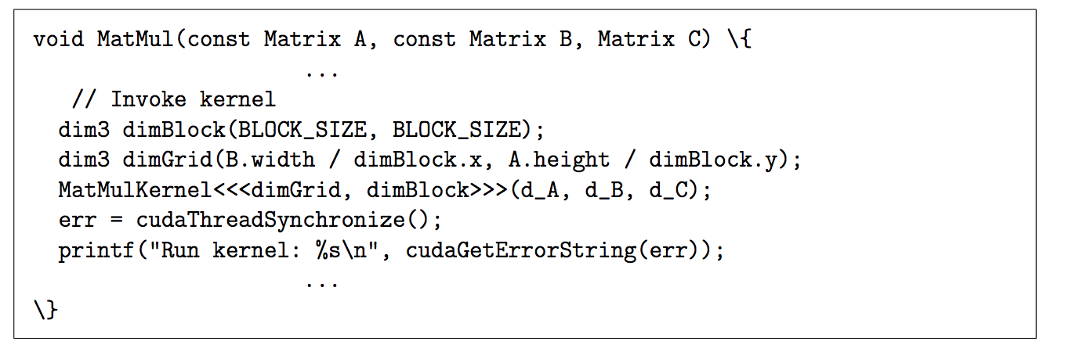
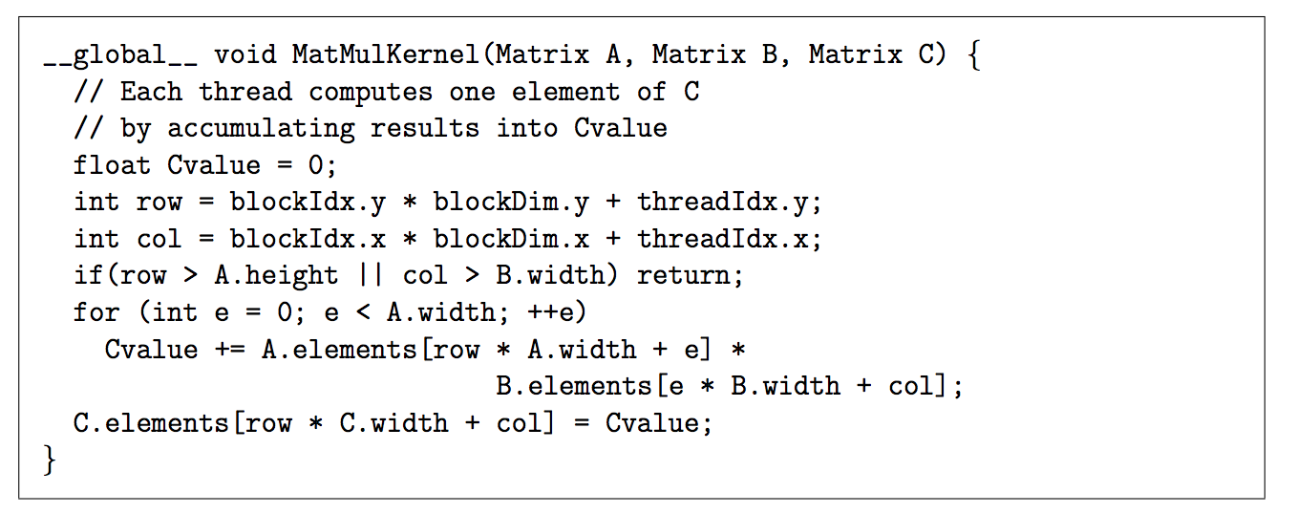
CUDA Program Example

Slide 7
OpenCL vs. CUDA
 | OpenCL | CUDA
Execution Model | Work-groups/work-items | Block/Thread
Memory model | Global/constant/local/private | Global/constant/shared/local + Texture
Memory consistency | Weak consistency | Weak consistency
Synchronization | Synchronization using a work-group barrier (between work-items) | Using synch_threads Between threads

Slide 8
GPU Pipeline
Scheduler
Active bit mask vectors/
score boarding
Fetch
One instruction for each warp
Multiple PC registers exist to support multi-threaded architecture
Round-robin scheduler
Wide execution width
I-cache
Fetch unit
Decoder
Register
Scheduler (Score boarding)
Lane 0
Lane 1
. . . . . .
Lane N-1
Memory
Memory access unit
Lane 0
Lane 1
. . . . . .
Lane N-1
Writeback

Slide 9
Handling Branch Instructions
A reduction example
What about other threads?
What about different paths?
0
1
2
3
4
5
6
7
If (threadId.x%==2)
0
2
4
6
If (threadId.x%==4)
0
4
If (threadId.x%==8)
0
A
If (threadid.x>2) {
do work B}
else {
do work C
}
B
C
Divergent branch!
D
From Fung et al. MICRO ‘07

Slide 10
Split/Join
Compiler inserts split/join
Split:
Put tmask in the ipdom stack (do work c part}
Put next PC in the stack (not-taken path. // do work c part )
Join
Pop from a stack
If (threadid.x>2)
// split
{
do work B
}
else {
// join
do work C
}

Slide 11

GPU Pipeline (1)
add r1, r1, 1
12
I-cache
13
Front-end
Decode
RF
schedule
Execution
Write-back
14
add r1, r1, 1
add r1, r1, 1
add r1, r1, 1
Memory
15
 | PC value
#1 (b:1, T1-T4) | 0x8000
#2 (b:1, T5-T8) | 0x8004
#3 (b:2, T1-T4) | 0x8000
#4 (b:2, T5-T8) | 0x800A
Shared Memory
add r1, r1, 1
 | Src 1 |  | Src 2
W1 | v | r | v | r
W2 | v | r | v | r
W3 | v | r | v | r
W4 | v | r | v | r
 | Src 1 |  | Src 2
W1 | v | r | v | r
W2 | v | r | v | r
W3 | v | r | v | r
W4 | v | r | v | r
 | Src 1 |  | Src 2
W1 | v | r | v | r
W2 | v | r | v | r
W3 | v | r | v | r
W4 | v | r | v | r
 | Src 1 |  | Src 2
W1 | v | r | v | r
W2 | v | r | v | r
W3 | v | r | v | r
W4 | v | r | v | r
 | Th1 | Th2 | Th3 | Th4
R1 | 11 | 12 | 13 | 14
R2 | 2 | 2 | 2 | 2
R3 | 3 | 4 | 13 | 15
R4 | 23 | 24 | 32 | 33
11
1
12
1
13
1
14
1
add r1, r1, 1
0x8000 | add r1, r1, 1
0x8004 | sub r2, r,2,1
0x8008 | mov r1, tid.x
0x800A | mov r2, ctaid.x
0x8010 | ld.shared r1 [A]
tid.x: special register to store thread ID within a block
ctaid.x: special register to store block ID within a grid

Slide 12
GPU Pipeline (2)
sub r2, r2, 1
1
I-cache
1
Front-end
Decode
RF
schedule
Execution
Write-back
1
sub r2, r2, 1
sub r2, r2, 1
sub r2, r2, 1
Memory
1
 | PC value
#1 (b:1, T1-T4) | 0x8000
#2 (b:1, T5-T8) | 0x8004
#3 (b:2, T1-T4) | 0x8000
#4 (b:2, T5-T8) | 0x800A
Shared Memory
sub r2, r2, 1
One lane is not shown
 | Src 1 |  | Src 2
W1 | v | r | v | r
W2 | v | r | v | r
W3 | v | r | v | r
W4 | v | r | v | r
 | Src 1 |  | Src 2
W1 | v | r | v | r
W2 | v | r | v | r
W3 | v | r | v | r
W4 | v | r | v | r
 | Src 1 |  | Src 2
W1 | v | r | v | r
W2 | v | r | v | r
W3 | v | r | v | r
W4 | v | r | v | r
 | Th1 | Th2 | Th3 | Th4 | Th5 | Th6 | Th7 | Th8
R1 | 12 | 13 | 14 | 15 | 16 | 17 | 18 | 19
R2 | 3 | 3 | 3 | 3 | 2 | 2 | 2 | 2
R3 | 3 | 4 | 13 | 15 | 23 | 32 | 37 | 23
R4 | 23 | 24 | 32 | 33 | 11 | 7 | 8 | 5
2
1
2
1
2
1
0x8000 | add r1, r1, 1
0x8004 | sub r2, r,2,1
0x8008 | mov r1, tid.x
0x800A | mov r2, ctaid.x
0x8010 | ld.shared r1 [A]
tid.x: special register to store thread ID within a block
ctaid.x: special register to store block ID within a grid

Slide 13
Mask Bits
id | Mask bit
w1 | 1111
w2 | 1110
w3 | 0111
w4 | 1111
w5 | 1111
What if we do not need to execute all 4 threads?
Mask bits tell which threads are active.
 | Src 1 |  | Src 2
w1 | v | r | v | r
w2 | v | r | v | r
w3 | v | r | v | r
w4 | v | r | v | r
w5 | v | r | v | r
 | Src 1 |  | Src 2
w1 | v | r | v | r
w2 | v | r | v | r
w3 | v | r | v | r
w4 | v | r | v | r
w5 | v | r | v | r
 | Src 1 |  | Src 2
w1 | v | r | v | r
w2 | v | r | v | r
w3 | v | r | v | r
w4 | v | r | v | r
w5 | v | r | v | r
 | Src 1 |  | Src 2
w1 | v | r | v | r
w2 | v | r | v | r
w3 | v | r | v | r
w4 | v | r | v | r
w5 | v | r | v | r
V
V
V
V
V
V
V
V
V
V
V
V
V
V
V
V
V
V

Slide 14
Summary
GPUs execute many threads as a group (warp/wave front)
GPU provides features to handle multiple threads concurrently and also time multiplexing
Massive thread level parallelism → massive memory level parallelism

Slide 15
A few links:
Tutorial Homepage:
https://github.com/vortexgpgpu/vortex_tutorials/
https://github.com/vortexgpgpu/vortex_tutorials/blob/main/REMOTE_ACCESS.md
Please use the form to submit your Github ID to reserve a slot to use for the duration of the tutorial

