Slide 1
Vortex GPU with Agents
Hyesoon Kim
MICRO-59 Vortex Tutorial · November 1, 2026
Notes:
20-minute slot (9:30-9:50), after the VOLT talk and before the hands-on assignment. Plan: about 4 min on why agents and why Vortex, 9 min on VortexSynth, 5 min on results, 2 min on lessons.

Slide 2
Using Agents with Vortex
[1] Workload generations with Agents
[2] Hardware coding with Agents

Slide 3
Recap: VOLT, Source to Vortex
FROM THE PREVIOUS TALK · VOLT COMPILER PIPELINE
OpenCL
PoCL
VOLT front-end Semantics-aware optimization, built-in libraries, thread spawn code
Vortex binary
Runs on SimX, RTL or FPGA
CUDA 12.1
CuPBoP
VOLT middle-end Uniformity analysis, CFG structurization, vx_split / vx_join / vx_pred
HIP · Vulkan · …
more front ends
VOLT back-end RISC-V code generation plus the Vortex ISA table
For Vortex 3.0
CuPBoP maps mma.sync / wmma to the TCU and wgmma + TMA-style loads to DXA. About 40 CUDA apps run in CI.
The precondition
Every route through VOLT starts from kernel source code. What if there is none?

Slide 4
The Workload Gap
WHY VORTEXSYNTH · THE WORKLOAD GAP
What we can run today
Benchmarks with source: Rodinia-style apps plus TCU, DXA and wgmma samples (about 40 CUDA apps in CI)
More ML workloads
Limitation | Why VOLT alone cannot close it
No source | PyTorch dispatches to cuBLAS, cuDNN and CUTLASS binaries chosen at run time; there is nothing to compile.
Hardware differences | Even with source, tensor-core and async-copy code often needs manual adaptation to Vortex.
Simulation budget | One full-model inference in simulation can take days; studies need single hot kernels at real shapes.
Moving targets | New models, operators and number formats keep changing which kernels matter.
Complementary route for binaries: CuLifter lifts SASS to LLVM IR (MICRO’26, Day 2, Session 6A).

Slide 5
VortexSynth: Overview
CASE STUDY · VORTEXSYNTH
STEP 1 Profile
Pick hot kernels; record shapes, dtypes and a profile signature
OUTPUT
Benchmark
Locked Vortex kernel + CUDA proxy + reference profile
STEP 2 Synthesize
LLM writes a CUDA and a Vortex candidate in a sandbox
STEP 3 Verify
Outputs must match the framework op and each other
STEP 4 Refine
Keep changes that shrink the profile distance D
H. Pu*, C. Park*, C. Ahn, R. Hadidi, H. Kim. VortexSynth: Profile-guided benchmark reconstruction for GPU architecture research. arXiv:2610.12661
No original source needed. The goal is a benchmark that behaves like the observed kernel, not one that only computes the same function.

Slide 6
Vortex Benchmark Synthesization
https://arxiv.org/html/2610.12661v1

Slide 7
VX-Robotics: 26 Kernel Pairs
RESULT · VX-ROBOTICS SUITE
26
benchmarks: linear, matmul, conv1d, conv2d
26/26
pass both output checks
157
single-axis revisions (90 H200, 67 Orin)
0.10
median final D (0.037–0.250)
Type | Kernels | Workloads · libraries
Linear | 12 | ACT, π0 · cuBLAS, cuBLAS-Lt, CUTLASS
Matmul | 4 | π0 · CUTLASS WMMA, cuBLAS (BF16 tensor core)
Conv2d | 4 | ACT, Diffusion Policy · cuDNN
Conv1d | 6 | Diffusion Policy · cuDNN (incl. transposed)
Precision: 9 FP32, 10 BF16, 7 TF32 → FP16
Max CUDA ↔ Vortex error: 9.5e-2 relative (TF32 → FP16)
Platforms: 13 kernels each from H200 and Jetson AGX Orin

Slide 8
Agent Workflow for a Change
IN THE VORTEX REPO · HOW AN AGENT MAKES A CHANGE
Step | What the agent does
1 Orient | Read AGENTS.md, then docs/designs/<area>.md for the unit being changed
2 Build | mkdir build && cd build && ../configure --xlen=32 && make -s
3 Change | Edit SimX and RTL together: any change that moves RTL cycles updates the SimX timing model
4 Smoke | ./ci/blackbox.sh --driver=simx --app=sgemm --args="-n10"
5 Parity | Add a model_parity case: simx vs rtlsim, exact instruction count, cycles within 5%
6 Gates | pytest ci -m "…": perf_gate ±2%, fpga_gate / asic_gate ±5%
7 Stuck? | SimX as oracle: matching CSV traces from both sides, diff, first divergence is the bug
Every step is a command or a rule in the repo, so the agent’s work can be checked the same way a human’s is.

Slide 9
AGENTS.md: Rules for Agents
IN THE VORTEX REPO · github.com/vortexgpgpu/vortex
Since v3.0, AGENTS.md is the entry point for human contributors and AI coding agents alike, and agents are expected to keep it current.
Doc map
34 design docs in docs/designs: tensor core, DXA, VM, command processor, SimX, CI
Build rules
Out-of-tree build/; re-configure after any .toml edit; VX_config.toml is the single source of truth
Bug-fix rules
Fix root causes; no fallback paths or legacy shims; label an unavoidable patch
Test rules
Run from build/; CONFIGS must match app and driver; ci/regression.sh lists tested configs
Design rules
Follow CUDA / HIP / OpenCL / Vulkan conventions; SimX modules talk only through channels
Golden data
Perf and synthesis baselines are never hand-edited; only a human regenerates them

Slide 10
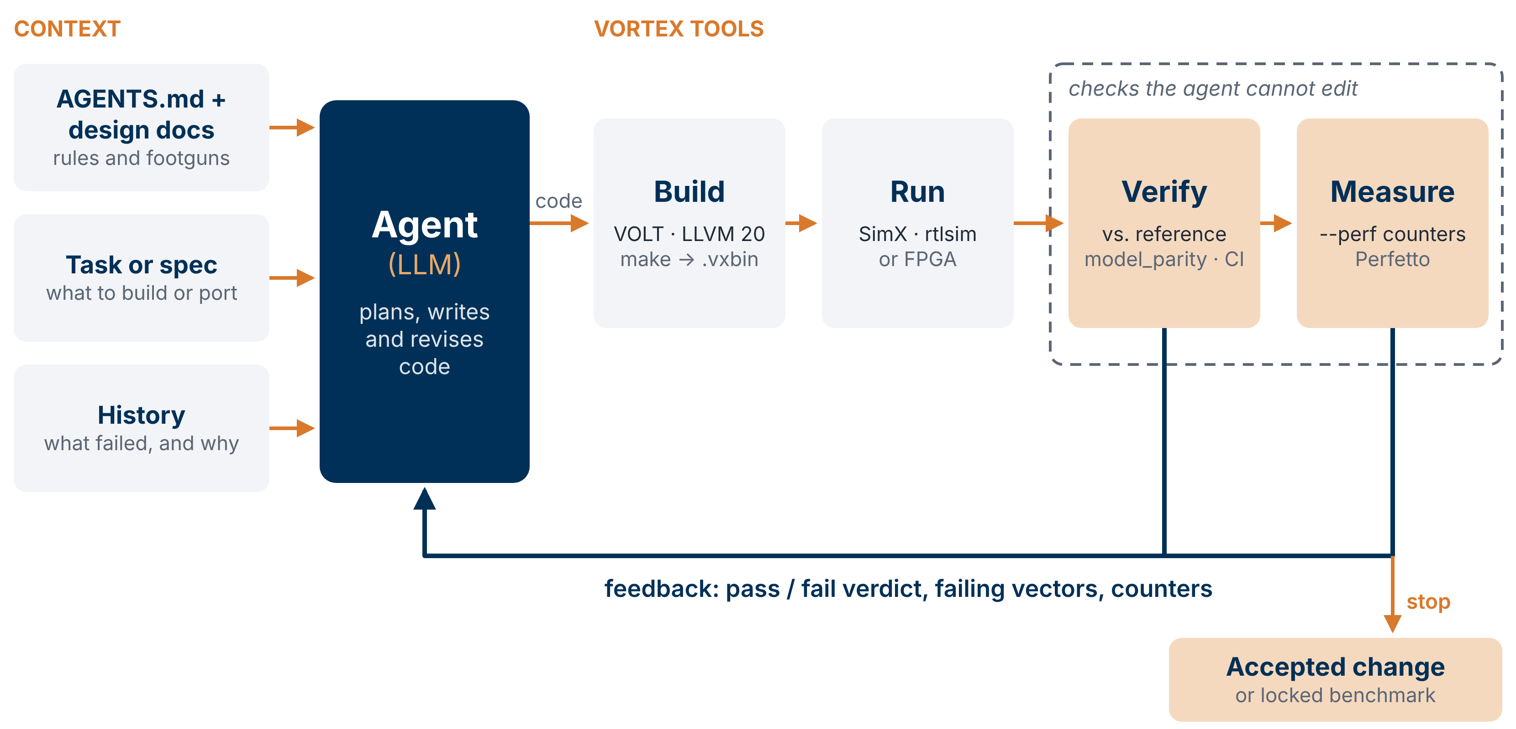
The Agent Loop on Vortex
AGENT IN THE LOOP
Notes:
The general picture. The agent gets context: AGENTS.md and the design docs, the task, and the history of what failed. It writes code, and every step after that is an open Vortex tool: VOLT builds it, SimX, rtlsim or an FPGA runs it, and checks plus perf counters judge it. The dashed box is the important part: the agent cannot edit the checks. Feedback goes back to the agent until the checks pass and the metrics stop improving.

Slide 11
Try It on the Vortex Repo
TRY IT · PROMPTS FOR YOUR AGENT IN THE VORTEX REPO
UNDERSTAND
“Read AGENTS.md and docs/designs/dxa_async_copy_multicast.md. Explain how a DXA copy completes a barrier.”
PORT
“Port this CUDA kernel to tests/regression/<name> with vx_spawn2.h and run it on simx with blackbox.sh.”
EXPLORE
“Sweep cores, warps and threads for sgemm with ci/roofline.py and report the best-IPC configuration.”
EXTEND
“Add a perf counter to SimX and RTL, plus a model_parity case that exercises it.”
Next, 9:50: Vortex tutorial assignment. Materials: github.com/vortexgpgpu/vortex_tutorials. VortexSynth and VX-Robotics will be released as open source.
Notes:
Backup (hidden). Robotics is the evaluation domain: ACT, Diffusion Policy and pi0, profiled at batch size one. Properties encoded by undocumented naming conventions are left for the search to find. Each hot kernel is reconstructed at its profiled shape, which keeps it inside a simulation budget.

Slide 12
Thank You
VortexSynth: arXiv:2610.12661 · VOLT: github.com/vortexgpgpu/Volt
github.com/vortexgpgpu/vortex · vortexgpu@cc.gatech.edu
Notes:
The profile signature is the behavioral target. Groups map to what an experiment would vary. Percent metrics use absolute difference over their range; the two rate metrics use a log ratio so a factor of two counts the same both ways. Atomics and active-lane fraction use the direct difference. A SIMT-only candidate against a tensor-core reference keeps its zero tensor MFU on purpose.

