Slide 1

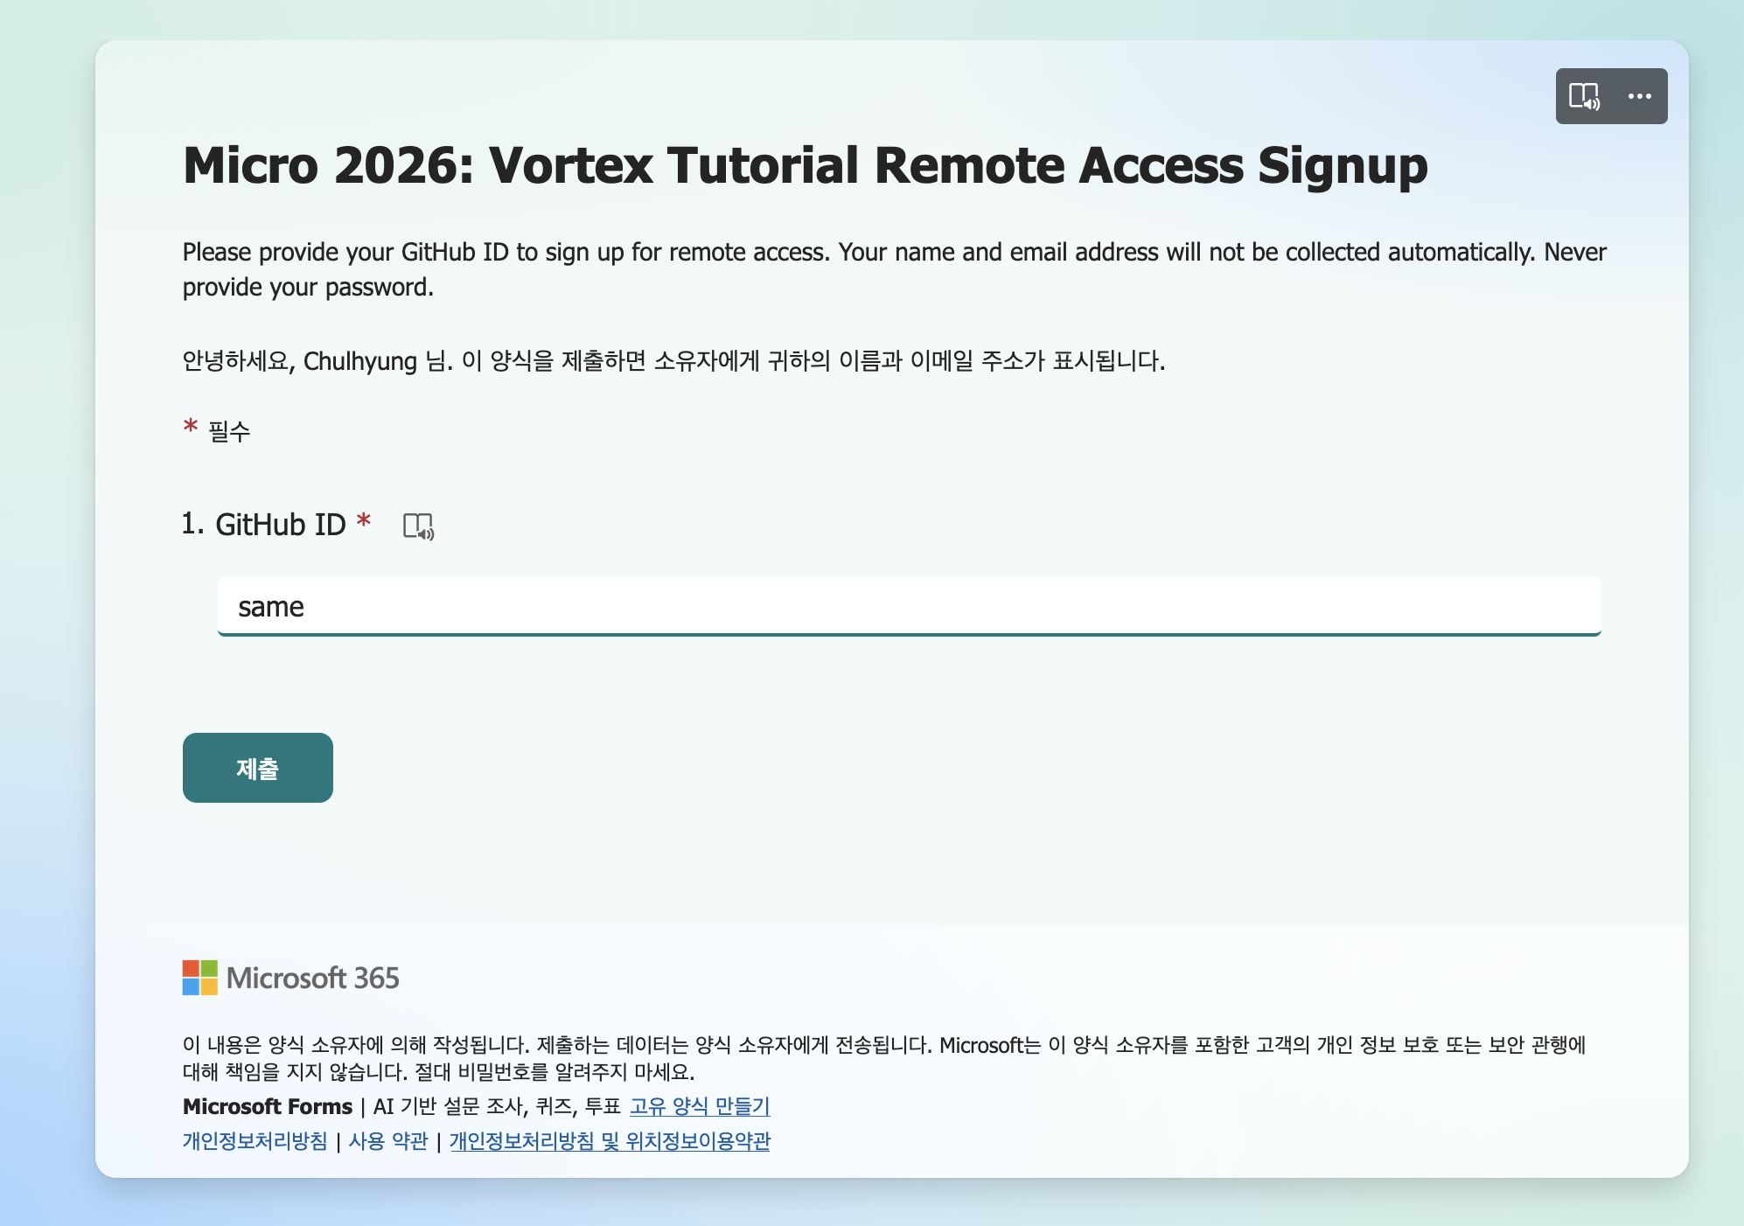
Vortex tutorial Server Access Request
Make sure submit your GitHub ID. Check your email and accept the invitation. If you don’t get an invitation, please let one of us know! The form URL is also available in REMOTE_ACCESS.md
SignUp Form

Slide 2
Tutorial Assignments (1/2)
12 HANDS-ON ASSIGNMENTS FOR VORTEX v3.0 · PICK ONE BY INTEREST
# | Assignment | You build | Models
Microarchitecture
1 | Scoreboard stall attribution | Stall counters per functional unit | SimX + RTL
2 | Software prefetching | vx_prefetch + cache prefetch counters | SimX + RTL
3 | VX_DOT8 | int8 dot-product instruction (+ ASIC) | SimX + RTL
4 | FP6 tensor format | New TCU input format: OCP-MX e2m3 | SimX + RTL
5 | Warp issue policy | Configurable GTO / round-robin arbiter | SimX + RTL
Debug and performance tools
6 | Bug hunt: SimX oracle | Fix a planted RTL bug via trace diffs | RTL
7 | Perfetto analysis | Fix SIMT divergence from a timeline | SimX
SimX + RTL: build the feature in SimX first (Part A), then in the SystemVerilog RTL (Part B), checked against Part A with Verilator. Each new hardware configuration is a 5–15 min Verilator build.
Notes:
Twelve self-contained assignments; pick a category that matches your interests, or follow the numbers. The first five extend the microarchitecture: each is built first in SimX, then in the RTL, checked against SimX with Verilator. Six and seven are about tools: using SimX as an oracle to find a planted RTL bug, and reading a Perfetto timeline to find a divergence problem.

Slide 3
Tutorial Assignments (2/2)
github.com/vortexgpgpu/vortex_tutorials · Exercises/
# | Assignment | You build | Models
Programming models
8 | One kernel, four stacks | Softmax in C++, OpenCL, HIP, Vulkan | SimX
9 | CUDA via CuPBoP | Add missing CUDA math: normcdff() | SimX
Accelerators and graphics
10 | Async tile staging with DXA | sgemm with async copies + barriers | SimX
11 | Ray-tracing unit study | BVH width and RTU sizing | SimX
12 | Neural texture on TCU | MLP decodes the Mona Lisa | SimX
Setup (all assignments)
git clone --branch v3.0 --recursive \
https://github.com/vortexgpgpu/vortex.git
cd vortex && mkdir build32 && cd build32
../configure --xlen=32 --tooldir=$HOME/tools
./ci/toolchain_install.sh --all && make -s
Tips
Patches: git apply Exercises/patches/…
Re-configure after .toml / Makefile edits
Exit 0 can still fail: look for PASSED!
A11 needs Vortex master @ 50cb174
Notes:
Programming models: write the same softmax kernel for four stacks and compare, or add a missing CUDA math function to CuPBoP. Accelerators and graphics: stage sgemm tiles with DXA and async barriers, study the ray-tracing unit, or decode a neural texture on the tensor core. Setup is the same for all; remember to re-run configure after touching any .toml or Makefile, and check for PASSED!, not the exit code.

Slide 4

Coming soon
Vortex Robotics workload
ASIC flow and power model
Vortex+Mangoboost FPGA
Open source GPU community building efforts
  Governance
  APIs to connect vortex and others
Please join mailing list by filling out the form

