Slide 1


Vortex 3.0 Architecture
Blaise Tine
MICRO-59 Tutorial · November 2026

Slide 2
Agenda
  Platform and what changed in v3.0
  Core pipeline: issue, atomics, FPU, caches, virtual memory
  Control plane: command processor, KMU, CTA dispatch, barriers
  Tensor cores: TFR fused dot product, sparsity, WGMMA; DXA copy engine
  Graphics and ray-tracing units
  Synthesis: what the CI goldens say

Slide 3
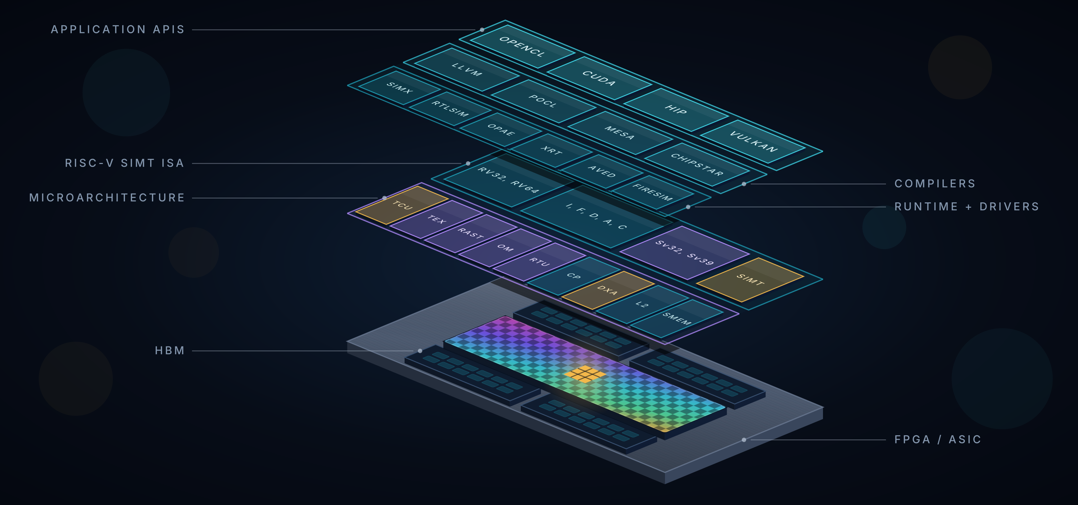
Vortex GPGPU Platform
Vortex 3.0 framework stack — docs/assets/img/vortex_framework_stack.svg (github.com/vortexgpgpu/vortex)
Notes:
The framework stack from the repository README. Hardware: configurable multi-core RISC-V GPU, RV32IMAFC / RV64IMAFDC, tensor cores with WGMMA and 2:4 sparsity, DXA copy engine, RASTER / TEX / OM graphics units and a ray-tracing unit, command processor, kernel management unit, MMU with Sv32 / Sv39. Software: OpenCL 1.2 (PoCL 7), Vulkan (Mesa), HIP (chipStar), CUDA (CuPBoP); VOLT (LLVM 20) underneath. Simulation: SimX v3, Verilator, gem5, SST, FireSim. FPGA: Arria 10, Stratix 10, Alveo U50/U55C/U250/U280, V80, VCK5000. ASIC: Yosys + OpenSTA (ASAP7), Synopsys DC (ASAP7 / SAED14 / NanGate15).

Slide 4
What's New in Vortex 3.0
Compute
Control plane
Graphics
• TFR tensor backend: FP8/BF8/TF32 (+fp16/bf16/i8/i4)
• 2:4 structured sparsity, WGMMA
• DXA async global→local copies + multicast
• Async barriers: arrive / wait / expect_tx
• In-house IEEE FPU, F32 + F64 (no FPnew)
• RISC-V A (atomics), C (RVC), Zicond, pack-loads
• Command Processor v3: host-resident ring
• KMU hardware kernel scheduler, CTA clustering
• vortex2.h async runtime: queues, events, modules
• Multi-kernel .vxbin (VXSYMTAB)
• Trap/exception foundation (ECALL/EBREAK/MRET)
• RASTER / TEX / OM fixed-function pipeline
• Ray-tracing unit (RTU): BVH traversal in HW
• Vulkan via Mesa Gallium driver vortexpipe
• OpenCL images on the TEX fast path
Memory
Software
Infrastructure
• Sectored L2/L3 (one tag per 2 blocks)
• Cache fill-forwarding (FILL_FORWARD)
• MMU v2: socket TLBs, cluster L2 TLB, 2-walker PTW
• LMEM and ALU/LSU/FPU scale with NT / issue width
• LLVM 20 (VOLT), POCL 7.0, chipStar HIP (rv32+rv64)
• Rodinia + atomics benchmarks in CI
• SDK install layout, $VORTEX_PATH + pkg-config
• TOML build config, VX_CFG_ namespace
• SimX v3 TLM, multi-threaded, functional mode
• gem5, SST, FireSim (U55C), Alveo V80 (aved)
• Yosys+OpenSTA & DC multi-PDK ASIC flows
• CI gates: parity, perf, FPGA, ASIC · Perfetto · AGENTS.md
Notes:
v3.0 (tagged 2026-10-07) is the largest release since the MICRO-54 paper. Group the additions by theme: compute, control plane, graphics, memory, software, infrastructure. Everything on this slide gets its own session later.

Slide 5
GPU Hierarchy in v3.0
Processor
  CP: command ring → DMA / DCR / launch / events
  KMU: grid walk, launch-bus tree (VX_kmu_bus_arb)
  Global barrier arbiter, DCR bus, optional L3
Cluster
  Shared L2 (sectored), DXA core, RASTER + OM
  Cluster L2 TLB + 2-walker PTW (VM)
Socket
  L1 I/D caches (shared by SOCKET_SIZE cores)
  TEX core, RTU core, dMMU / iMMU
Core
  6-stage SIMT pipeline, LMEM, bar unit
  CTA dispatcher (per-core slots), TCU blocks
Processor
Command Processor (CP)
KMU + launch bus
GBAR / DCR
L3 cache (opt.)
Cluster (× NUM_CLUSTERS)
L2 cache (sectored)
DXA core
RASTER
OM
L2 TLB + PTW
Socket (× NUM_SOCKETS)
L1 I$ / D$
TEX core + tcache
RTU core + rtcache
dMMU / iMMU
Core 0
Core 1
Core …
SIMT pipeline
ALU · FPU · LSU · SFU
TCU blocks
LMEM (banked)
bar unit · CTA dispatch
decompressor · traps
SIMT pipeline
ALU · FPU · LSU · SFU
TCU blocks
LMEM (banked)
bar unit · CTA dispatch
decompressor · traps
SIMT pipeline
ALU · FPU · LSU · SFU
TCU blocks
LMEM (banked)
bar unit · CTA dispatch
decompressor · traps
Notes:
Same three levels as before — cores in sockets sharing L1, sockets in clusters sharing L2, clusters in a processor with an optional L3 — but every level gained units. Processor: CP, KMU, global barrier arbiter, DCR bus, L3. Cluster: L2, DXA core, RASTER, OM, cluster TLB + page walker. Socket: L1 caches, TEX core, RTU core, dMMU/iMMU. Core: SIMT pipeline, LMEM, bar unit, CTA dispatcher, TCU.

Slide 6
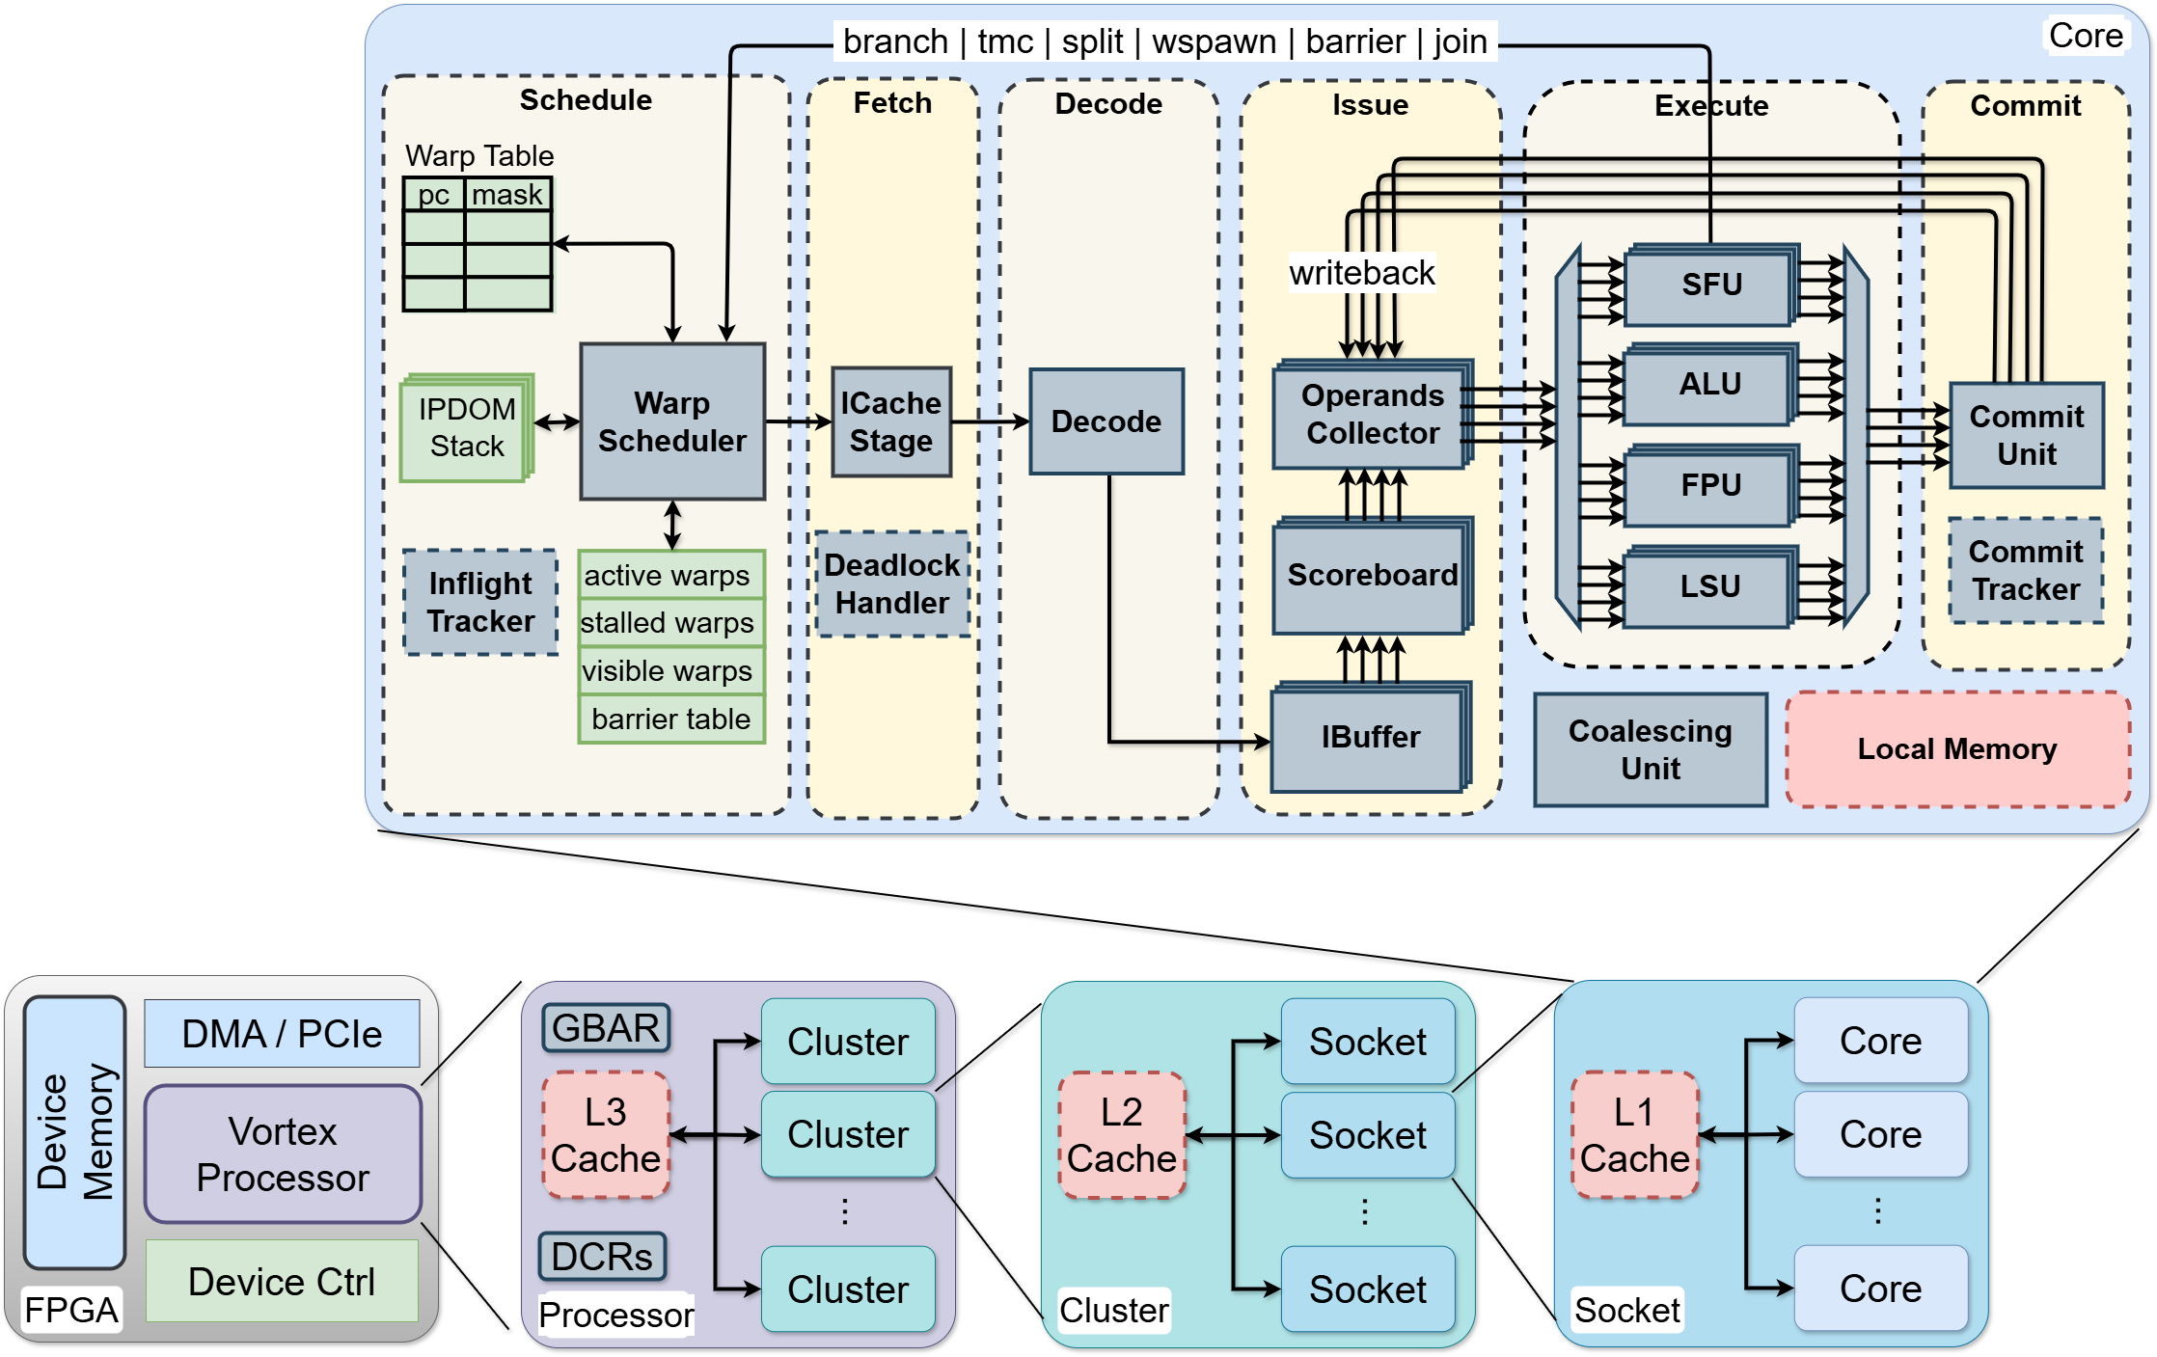
Core Pipeline: What Changed in v3.0
Schedule
GTO warp select · ibuffer-capacity gate · CTA dispatcher · per-warp trap CSRs
Fetch
RVC decompressor (VX_decompressor) · follow-request for straddling 32-bit ops
Decode
Zicond, A-ext, pack-load, TCU/DXA/RTU/TEX/OM opcodes · rd/wr XREGS masks
Issue
uop sequencer (TCU, PACKLD, GFX) · scoreboard XREGS + fu_lock · bank-conflict-free TCU reads
Execute
VX_fpu_std F32/F64 · AMO path · TCU with WGMMA/2:4 · DXA/TEX/RTU issue via SFU
Commit
async bar unit release · txbar completions from DXA · LSU drain before __syncthreads
Figure: Vortex core pipeline (unchanged topology). Colors: schedule/fetch/decode (yellow), issue (green), execute (blue), commit (pink).
Notes:
The six-stage in-order-issue / out-of-order-commit pipeline is unchanged in shape. New or reworked blocks: RVC decompressor between icache and decode; per-warp uop sequencer for TCU, pack-load and graphics macro-ops; GTO issue arbiter; scoreboard with an XREGS plane and FU locks; async barrier unit; CTA dispatcher in the scheduler; per-warp machine-mode trap CSRs. Session 2 covers each.

Slide 7
Scoreboard Planes and the Macro-op Sequencer
Scoreboard
  inuse_xregs plane: fflags / frm; decode emits rd_xregs / wr_xregs masks
  fu_lock on first uop, fu_unlock on last: no other warp issues to that FU
  set by VX_tcu_uops for WGMMA; single-uop ops lock nothing
VX_uop_sequencer (per warp)
  expander slots: UOP_PACKLD · UOP_TCU · UOP_GFX (RTU windows + fragment export share one)
  one uop / cycle; macro never commits; ⌈registers ÷ 3⌉ uops per register window
  VX_opc_unit operand collector reads banked registers; TCU offsets permuted → zero bank conflicts
Pack-load intrinsics
  vx_packlb_f (4 × byte) / vx_packlh_f (2 × half) → N LSU uops, eff_rs1 = rs1 + rs2 × uop_idx
  used by vx_tensor.h for tile-row packing
macro-op in IBuffer (e.g. WGMMA, PACKLB, TRACE)
VX_uop_sequencer: expander slot by opcode class
uop 0
fu_lock
uop 1
uop 2
…
uop n
fu_unlock
scoreboard: GPR + XREGS planes, FU lock table
VX_opc_unit → FU (locked to this warp until unlock)
Macro | uops
RTU TRACE: 1 GP word + f0–f7 | 4 = 1 + ⌈8÷3⌉
WGMMA, NT=32, NRC=32 | 64 compute uops (+1 setup)
PACKLB | 4 LSU uops
Notes:
Two scoreboard changes: a second dependency plane for FPU special registers, and fu_lock/fu_unlock flags so a uop sequence holds a functional unit across a multi-uop macro — WGMMA depends on this because interleaved warps would corrupt per-block A registers and the accumulator. The per-warp uop sequencer expands macro-ops one uop per cycle; it back-pressures the ibuffer and the macro itself never commits.

Slide 8
Hardware Atomics: RISC-V A Extension
Ops
  LR / SC · AMOADD, SWAP, XOR, OR, AND, MIN(U), MAX(U) · .W / .D · Zacas AMOCAS (optional)
  opcode 0x2F; aq/rl captured, no ordering effect
Datapath
  decode → LSU slice attaches amo_req_t {hart_id, op, unsigned, cmp}, rw = 0, no_merge
  VX_lmem_switch → local-memory bank (3-cycle RMW) or dcache → … → LLC bank
LLC commit stage (VX_cache_amo, IS_LLC)
  amo_hit = atomic ∧ hit ∧ core_req; sc_fail = SC ∧ ¬res_check
  VX_amo_alu (combinational) → writeback queue → 2-cycle settling → synthetic store
Reservations (VX_amo_unit)
  direct-mapped stations {valid, hold credit, hart_id, tag}
  foreign LR refused up to 63× at LLC (7× in LMEM) → LR/SC forward progress
Config
  VX_CFG_EXT_A_ENABLE · VX_CFG_AMO_RS_SIZE = max(NW, NC×NW / L2 banks)
Decode 0x2F → LSU slice (amo_req_t, rw=0, no_merge)
VX_lmem_switch
VX_local_mem bank
read (= response)
→ capture / reservation
→ write back (3 cycles)
dcache → L2 → LLC bank
commit: amo_hit, sc_fail
VX_amo_alu → wb queue
→ settling → store
VX_amo_unit (≤ 4 stations)
VX_amo_unit
reservation stations
Response old value / SC result → rd. Width is derived from byteen popcount (4 → .W, 8 → .D); Zacas widens every memory request by XLEN, so it is off by default.
Notes:
An atomic is a load that also writes, committed at the LLC bank (or the local-memory bank). Decode attaches an amo_req_t sideband per lane and forces rw=0; the fabric steers by address class and never merges atomic lanes. The LLC bank runs the ALU, keeps reservation stations for LR/SC with holder protection, and writes back through a settling queue. Response returns the old value or the SC outcome.

Slide 9
In-House FPU: VX_fpu_std (F32 + F64)
Front end (VX_fpu_unit)
  lane dispatch → tag store (FPU_QUEUE_SIZE = 2·SIMD/lanes) → frm resolve (DYN → warp fcsr)
  op[3:2] selects the core; flags OR-ed across packets; results in completion order
Four cores, PE-serialized
  FMA: separate fma32 (23, 8) and fma64 (52, 11), selected by fmt[0]
  DIV/SQRT: merged radix-2 non-restoring, one carry-save datapath
  CVT: I2F / F2I / F2F incl. FCVT.S.D subnormals
  NCP: sign-inject, min/max, compare, class, move (NaN-box check)
Backends (VX_CFG_FPU_TYPE)
  STD = VX_fpu_std · DSP (Vivado/Quartus IP) · DPI (rtlsim default) · FPNEW (optional)
Building blocks (hw/rtl/libs)
  VX_wallace_mul / VX_fold_mul · VX_ks_adder (Kogge-Stone) · VX_fp_rounding · VX_fp_classifier
VX_fpu_unit: VX_lane_dispatch → tag store → frm resolve
request switch by op[3:2]
FMA
fma32 ∥ fma64
DIV / SQRT
merged
CVT
merged
NCP
merged
response arbiter → tag restore, flag OR
VX_lane_gather → commit
FMA stages: INI → MUL → ALN (1 F32 / 2 F64) → ACC → NRM → RND1 → RND2 — min latency 7 (F32), 8 (F64). Transcendentals (rcp, rsqrt, ex2, lg2, sinpi, cospi, tanh) run on the MUFU in the SFU, not here.
Notes:
A shared front end over four per-operation cores: FMA, DIV/SQRT, CVT, NCP. Four interchangeable backends behind the same op encoding: STD (ours, ASIC and sim), DSP (FPGA vendor IP), DPI (rtlsim default), FPNEW (optional). Only FMA is duplicated per format — a 24-bit multiplier is a fifth of a 53-bit one — so enabling D does not slow or grow the F32 path. DIV/SQRT, CVT and NCP are merged-format units.

Slide 10
Cache Changes in v3.0
Threads | Word | Dcache banks | MLP (banks × MSHR 16)
1 / 2 | 4 / 8 B | 1 | 16
4 / 8 | 8 / 16 B | 2 | 32
16 / 32 | 16 / 32 B | 4 | 64
64 | 32 B | 8 | 128
Sectored L2 / L3
  line = 2 × MEM_BLOCK, sector = MEM_BLOCK (VX_CFG_{L2,L3}_SECTOR_SIZE)
  one tag per line, fills/evictions per sector → half the LLC tags
Word-size dcache banking
  NUM_BANKS = NUM_REQS = footprint / word from the coalescer word
  MLP scales with NT without shrinking the line
Fill forwarding (FILL_FORWARD)
  leading run of reads served from the staged fill sector
  first write/AMO falls back to replay (keeps program order)
  sgemm −2.7% · sgemv −5.0% · sgemm-mc −2.2% cycles
Also
  LMEM window decode compares address bits above the window (no end address)
  SimX cache-flush parity: fans out to i/d/t/r/o caches like the RTL
Default | icache | dcache | L2 | L3
size | 16 KB | 16 KB | 1 MB | 2 MB
ways | 4 | 4 | 8 | 8
MSHR | 16 | 16 | 16 | 16
line / sector | 64 / 64 | 64 / 64 | 128 / 64 | 128 / 64
latency | 2+ | 2+ | 4+ | 4+
write-back | — | if LLC & 1 core | if LLC & 1 cluster | if LLC
Notes:
Three structural changes. Sectored L2/L3: the line is 2×MEM_BLOCK with a MEM_BLOCK sector, so one tag spans two blocks while fills and evictions move at bus granule — halving LLC tags. Dcache banking now derives from the coalescer word size, so memory-level parallelism tracks thread count without shrinking the line. Fill forwarding gives sgemm −2.7%, sgemv −5.0%, sgemm-mc −2.2% cycles.

Slide 11
Virtual Memory: MMU v2 (Sv32 / Sv39)
Placement
  socket level, after the coalescer: dMMU (SOCKET_SIZE × DCACHE_NUM_REQS lanes), iMMU (fetch)
  lane-parallel hit-under-miss; VPN dedup: one walk per page
L1 TLB (VX_tlb_l1)
  CAM: DTLB 16, ITLB 8 · MSHR 4 × 2 tokens · hit = 1 registered stage
  permission check at hit/replay: U ∧ (¬W∨W) ∧ (¬X∨X) …
Cluster L2 TLB (VX_tlb_l2)
  512 entries 4-way (4 KB pages) + 8-entry megapage CAM · depth 4 · MSHR 8 × 4
PTW
  2 walkers, 16-entry walk cache keyed on the upper VPN → single leaf fetch on hit
  walker FSM IDLE → REQ → WAIT → RESP; PTE reads are cached L2 reads
Control
  DCR SATP_LO/HI (HI commits + flushes), FAULT_VA, FAULT_INFO; faults kill + report
  bypass for IO / OM / flush; graphics masters and RTU issue PAs
Socket
cores
coalescer
dMMU
CAM 16
L1 D$
fetch
iMMU
CAM 8
L1 I$
VX_tlb_bus (narrow miss fabric)
Cluster
VX_tlb_l2
512 × 4-way + 8 megapages
MSHR 8 × 4
VX_ptw
2 walkers + 16-entry walk cache
VX_mmu_dcr: satp, flush, faults
L2 cache (PTE reads) → memory
Notes:
Translation sits at the socket, after the coalescer, between cores and L1: one dMMU serves all data lanes of the socket, one iMMU serves fetch. L1 TLBs are CAMs with a small miss station; misses ride a narrow TLB bus — not the memory bus — to a shared cluster L2 TLB with a megapage CAM, then to a two-walker PTW with a walk cache whose PTE reads go through the L2 cache. The translation root is a DCR pair; the SATP_HI write commits, flushes all TLBs and arms fault reporting.

Slide 12
Command Processor v3: Architecture
Host memory
VX_cp_core (hw/rtl/cp, 17 files)
Device
command ring
64 KiB, 64 B lines
(RING_SIZE_LOG2 = 16)
VX_cp_axil_regfile ← AXI-Lite
axi_host
DMA
(axi_dev)
device memory
(axi_dev)
VX_cp_fetch
(64 B AR)
VX_cp_unpack
(≤ 5 cmds / line)
VX_cp_engine × N
DECODE→BID→WAIT→RETIRE
4 × RR
arbiter
head slot
VX_cp_completion
per-source latch
→ drain FIFO (2 × queues)
→ 8 B seqnum write
to cmpl_addr (axi_host)
VX_cp_launch
VX_cp_gpu_slice
cp_gpu_if:
dcr_req / dcr_rsp
start / busy
→ Vortex
VX_cp_dma
Vortex
KMU · DCR bus
caches
completion slot (seqnum)
seqnum
VX_cp_dcr_proxy
VX_cp_event_unit
Compile-time: VX_CP_NUM_QUEUES = 1 · VX_CP_RING_SIZE_LOG2 = 16 · VX_CP_MAX_CMDS_PER_CL = 5 · AXI TID width 6. DMA: dual-port, ≤ 4 KB INCR chunks, read-fully-then-write.
Notes:
VX_cp_core: one command engine per queue, four round-robin arbiters, four shared units. The ring lives in host memory and is fetched over a dedicated AXI host port; completions are written back over the same port. DMA has a second AXI port to device memory. The CP knows nothing about DCR meanings — those live in VX_types.toml. 17 RTL files, about 2,900 lines.

Slide 13
Kernel Management Unit (KMU)
Inputs (DCRs 0x010–0x023)
  PC, entry, param, grid_dim[3], block_dim[3], cluster_dim[3], LMEM size
  host precomputes WARP_STEP (NT % block[0], …) → no divider in hardware
Grid walk (two-level)
  intra_offset[i] wraps at cluster_dim[i]; on group_complete group_origin[i] += cluster_dim[i]
  block_idx = group_origin + intra_offset; is_first_of_cluster marks member 0
kmu_req_t
  envelope {kind, PC, entry, param, ctx_id (8-bit, bumped per start), aligned_lmem_size}
  COMPUTE {grid, block_idx, block_dim, block_size, warp_step, cluster_size, is_first}
  FRAGMENT {stamps[NUM_THREADS], count} — pushed by RASTER
  no cta_id on the bus: VX_CSR_CTA_ID is the local dispatcher slot
Liveness
  busy tree: VX_cta_dispatch → scheduler → core → socket → cluster → Vortex
  grid-less start = delegated draw launch (busy = running | raster_start)
host → KMU DCRs (0x010 … 0x023) → start pulse
VX_kmu.sv: grid walker
intra_offset (cluster) → group_origin (grid) → kmu_req_t
0
1
4
5
grid 4 × 4, cluster_dim 2 × 2
message 0 = CTAs {0,1,2,3}
message 1 = {4,5,6,7} …
each message: K CTAs,
eop on the last member
2
3
6
7
8
9
12
13
10
11
14
15
SimX mirror: sim/simx/kmu/kmu.cpp iterates intra-cluster offsets first; LAUNCH_CREDITS = 4 per core.
Notes:
One KMU per processor. The host writes the KMU DCRs 0x010–0x023 and pulses start; the KMU walks the grid two-level — intra-cluster offsets first, then the group origin advances by cluster_dim — and emits one message per cluster of K CTAs onto the launch bus. The bus also carries fragment waves pushed by the rasterizer. Messages are the unit of arbitration: a router locks from the first beat to eop.

Slide 14
Per-Core CTA Dispatcher (VX_cta_dispatch)
Slots and local memory
  NUM_CTA_SLOTS = NUM_WARPS; fixed stride = aligned_lmem_size
  usable_slots = max m : m·stride ≤ LMEM_SIZE (comparator tree, registered)
  lmem_addr = VX_MEM_LMEM_BASE_ADDR | slot·stride
FSM
  IDLE: ready = admit_ok ∧ ¬rem_warps_write ∧ ¬frag_inflight
  DISPATCH: one warp per cycle until is_last_warp; CTA expands in ⌈N / NT⌉ cycles
Context
  cta_ctx_ram per slot: block/grid dims, entry, param, lmem_addr, cluster_size
  cta_warp_ram per warp: cta_rank, lane_launch[NT] (TID ripple 2 lanes/cycle)
Retirement & reuse
  warp_done = tmc_valid ∧ tmask == 0 (3-stage, write forwarding)
  rewind: warp_pcs = cta_PC or PC − 20 (5 instructions) on reuse
CTA CSR | Addr
CTA_ID · CTA_RANK · CTA_SIZE | 0xCD0 – 0xCD2
CTA_THREAD_ID_{X,Y,Z} | 0xCD3 – 0xCD5
CTA_BLOCK_ID_* · BLOCK_DIM_* · GRID_DIM_* | 0xCD6 – 0xCDE
CTA_LMEM_ADDR · CTA_CLUSTER_SIZE · CTA_ENTRY | 0xCDF – 0xCE1
FRAG_POS · FRAG_PID (fragment CTAs) | 0xCE2 – 0xCE3
Local memory, fixed-stride slots (stride = launch LMEM size)
slot 0
slot 1
slot 2
slot 3
slot 4
slot 5
← cluster of K = 4 contiguous slots →
member r at issuer_base + r·stride — the contiguity DXA multicast relies on
get_cluster_rank() = CTA_ID % CTA_CLUSTER_SIZE
matches NVIDIA/AMD occupancy and Hopper cluster peer_base = base + rank·stride
Notes:
A child of the scheduler. NUM_CTA_SLOTS = NUM_WARPS. Local memory is carved in fixed strides: slot i owns [i·stride, (i+1)·stride) with stride = the launch's aligned LMEM size, so occupancy is floor(LMEM/stride) with no wrap waste and no carry chain. The FSM accepts one CTA in IDLE and emits one warp per cycle in DISPATCH; context tables behind the CTA CSRs are two dual-port RAMs; warp retirement is a 3-stage pipeline keyed on tmc with an empty mask.

Slide 15
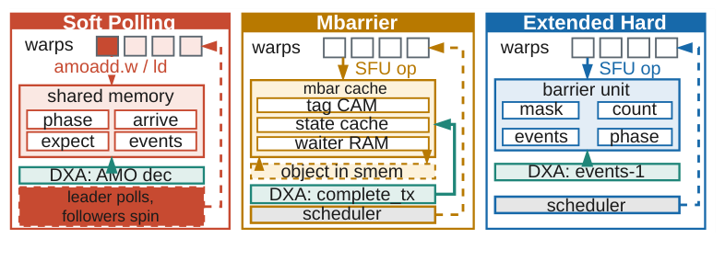
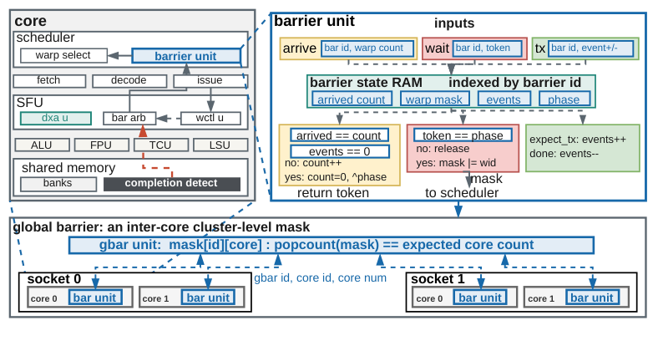
Barrier Unit: the Hardware Table
Row state (per CTA slot × index)
  W-bit stalled-warp mask · arrival count · pending events · phase bit
  table ≤ W × N rows; nothing to allocate, initialize or refill
Operations
  arrive: count++, compare with expected; wait: return at once if phase flipped
  expect_tx: events += n; completion: events−−
  release: mask → scheduler in the same cycle
Measured (RTL, 4 warps × 4 threads)
  one generation of the probe: HARD 70 cycles / 24 instrs · MBAR 80.5 / 28 · SOFT 245 / 82
  seven kernels: MBAR 1.03× (1.00–1.14), SOFT 1.56× (1.06–3.03) the cycles of HARD
  equal capacity: table 3.5× smaller at 4 warps, 1.6× at 32; 0.6–14% faster than an mbarrier cache
Global barrier
  VX_gbar_arb (stream dispatch/fork/join) — a row reports to a cluster-level mask with one bit per core
Top: soft polling vs mbarrier object vs extended hardware table. Bottom: bar unit, barrier state RAM, global barrier mask.
Notes:
VX_bar_unit extends the scheduler barrier table: a row per CTA slot and barrier index holds a warp mask of stalled warps, the arrival count, pending completion events and the phase. An arrival advances the count and compares it with the carried expected count; an expectation adds pending events, a completion removes one; when all have arrived and nothing is pending the unit releases the stalled warps to the scheduler in the same cycle. We compare this against polled shared-memory atomics (SOFT) and an mbarrier-style cached object (MBAR): MBAR costs 1.03× the cycles of HARD, SOFT 1.56×; at equal capacity the table is 1.6–3.5× smaller and 0.6–14% faster.

Slide 16
Tensor Core Unit Architecture
VX_tcu_unit (Q = NUM_TCU_BLOCKS = issue width; two blocks shown)
Per block
  TCU_LD → VX_tcu_agu: one warp-wide fetch, lane T loads word T
  VX_tcu_meta: warp-indexed RAM; rd[4]=0 sparse validity by column group, rd[4]=1 MX scales A/B
  VX_tcu_core: operand select → lane conditioning → FEDP grid → landing queue
WGMMA additions
  VX_tcu_abuf per block: one k-stripe (M_STEPS A blocks), key {descriptor, step_k}, refetched on the first compute uop of every WGMMA
  VX_tcu_bbuf per unit: the bank row holding block (k, n), broadcast to all Q cores
  VX_tcu_lockstep: cta_conflict defers other CTAs until the resident warpgroup drains
Shared port
  Q + 1 readers arbitrated onto one bank-parallel LMEM port; DXA writes are priority 0, TCU reads priority 1
VX_lane_dispatch — issue slots → blocks, SIMD lanes → FEDP lanes; uops from VX_tcu_uops (k outer, n, m inner)
block 0
block 1
VX_tcu_agu
TCU_LD → LSU client 1
VX_tcu_meta
sparse validity · MX scales
VX_tcu_agu
TCU_LD → LSU client 1
VX_tcu_meta
sparse validity · MX scales
VX_tcu_core
operand select (RF / abuf / bbuf)
→ sp_mux · mx_scale · dsm
→ FEDP grid TC_M × TC_N (TFR 4-cycle) → landing queue
VX_tcu_core
operand select (RF / abuf / bbuf)
→ sp_mux · mx_scale · dsm
→ FEDP grid TC_M × TC_N (TFR 4-cycle) → landing queue
VX_tcu_abuf
(one k-stripe of A)
VX_tcu_abuf
(one k-stripe of A)
Q+1 → 1 LMEM port
arbiter (DXA idx 0)
VX_tcu_bbuf (1)
B bank row, broadcast
VX_tcu_lockstep
one CTA owns bbuf
VX_lane_gather
→ commit
B is read once per warpgroup and broadcast to all blocks; A buffers are per block. Metadata writes are broadcast to every block's meta RAM.
Notes:
VX_tcu_unit holds Q = NUM_TCU_BLOCKS blocks, one per issue slot. Per block: a TCU_LD path through VX_tcu_agu (client 1 of the LSU scheduler on block 0) into VX_tcu_meta, and the compute path VX_tcu_core. WGMMA adds per-block A buffers, one shared B buffer broadcast to all blocks, a lockstep gate so one CTA owns the B buffer at a time, and an arbiter putting Q+1 readers on one bank-parallel LMEM port shared with DXA.

Slide 17
TFR Backend: the Fused Dot-Product Unit
A[0..K−1] · B[0..K−1] · C (TF32 / FP16 / BF16 / FP8 / BF8 / INT8 / INT4 lanes)
Stage 1 — MULTIPLY
  class-wise shared Wallace multipliers: 11-bit (TF32/FP16/BF16), 2×4-bit + 24-bit KSA (FP8/BF8), INT8/INT4 lanes
  exponent add + bias conversion; (N−1)² pairwise difference matrix (upper triangle only)
  IEEE exception flags computed up front; sparse lane mask
Stage 2 — ALIGN
  max exponent by reduction OR of the one-hot mask; shift amounts reuse the difference matrix
  significands aligned with 2 guard bits + per-lane sticky
Stage 3 — ACCUMULATE
  addend C joins the products (no second normalize/round)
  bit-invert negatives, +1 corrections folded into one popcount operand
  CSA tree (4:2 compressors; MOD-4 grouping for ≥ 7 operands) → Kogge-Stone adder
Stage 4 — NORMALIZE & ROUND
  leading-zero anticipation, RNE, canonical NaN/Inf override; INT32 result = {C_HI + overflow, low 25 bits}
Formats
  TF32 · FP16 · BF16 · FP8 (e4m3) · BF8 (e5m2) · INT8 · INT4 → FP32 / INT32; MX: MXFP8/BF8/FP4, NVFP4 via per-lane scale compensation
1 MULTIPLY
class-shared Wallace multipliers · exponent add
pairwise exponent-difference matrix · exception flags · sparse lane mask
2 ALIGN
max exponent (one-hot OR) · shifts from the difference matrix
2 guard bits + per-lane sticky
3 ACCUMULATE (C joins here)
invert negatives, +1 corrections in one popcount operand
CSA tree (4:2, MOD-4 grouping) → Kogge-Stone adder
4 NORMALIZE & ROUND
leading-zero anticipation · RNE · canonical NaN / Inf
D = Σ aᵢ·bᵢ + C → FP32 / INT32
one shared FP/INT pipeline, 4 cycles (5 on FPGA); C enters stage 3
Notes:
TFR is the in-house, fully synthesizable FEDP (the tensor-arithmetic work from our lab): integer and floating point share one 4-cycle pipeline — multiply, align, accumulate, normalize & round. Class-wise shared multipliers (one 11×11 Wallace tree for TF32/FP16/BF16, two 4×4 for FP8/BF8), a difference-matrix maximum-exponent finder, carry-save reduction with a MOD-4 grouping tree, Kogge-Stone final adds. The addend C enters at stage 1, which is what lets MX scale factors be applied per lane. Bit-exact against RTX 4090 / RTX 5080 tensor-core outputs across 1M+ randomized vectors.

Slide 18
2:4 Structured Sparsity
Dense-over-sparse speedup, 128×128×K warp-level (RTL)
Datapath
  VX_tcu_sp_mux: 2 of every 4 B candidates per A row, one selector per FEDP (rows keep different positions)
  VX_tcu_sp_meta / VX_tcu_meta: metadata SRAM per block, written by TCU_LD, read by (m, k) step
  sparse WGMMA reads B K-major from SMEM, sparse WMMA N-major from RF — distinct gather formulas
Asymmetric vs symmetric
  NT ∈ {8, 32}: xtileK and ksteps halve → micro-ops 32 → 16 with every FEDP active
  NT ∈ {4, 16}: tcN halves, nsteps doubles, half the FEDPs masked → same uop count
Measured (RTL, 128×128×K, warp-level)
  asymmetric 1.24–1.78× dense-over-sparse; symmetric below both asymmetric cells in 11 of 12 rows
  NT = 4 loses (0.71–0.83×); NT = 16 gains modestly (0.91–1.45×)
vs NVIDIA (64×64×K FP16)
  speedup rises with K but stays below 2×: bound 1/(1 − f/2) with halvable share f
  f = 69.7% RTX 5080 (bound 1.53×) · 78.5% Vortex @ 32 thr (1.65×) · 54.4% H100 (1.37×)
  sparsity halves the math and the A load, not B or metadata; 17 shapes differ by a median 6.2% (32 thr) / 9.0% (8 thr)
K | NT 4 (sym) | NT 8 (asym) | NT 16 (sym) | NT 32 (asym)
TF32 128 | 0.71 | 1.45 | 1.14 | 1.37
TF32 1024 | 1.05 | 1.78 | 1.12 | 1.61
BF16 128 | 0.72 | 1.32 | 0.91 | 1.31
BF16 1024 | 1.06 | 1.66 | 1.16 | 1.68
FP8 128 | 0.80 | 1.25 | 1.01 | 1.24
FP8 1024 | 0.83 | 1.63 | 1.27 | 1.63
Sparse speedup bound = 1 / (1 − f/2), f = halvable share (64×64×K FP16)
GPU | halvable share f | bound | measured @ K=512
H100 (warp-level) | 54.4% | 1.37× | ≈ 1.3×
RTX 5080 | 69.7% | 1.53× | ≈ 1.5×
Vortex, 32 thr | 78.5% | 1.65× | ≈ 1.6×
Vortex, 8 thr | 50.7% | 1.34× | ≈ 1.3×
Sparsity halves only the math and the A load — not B, metadata or the epilogue — so speedup stays below 2× on every GPU and falls as tiles widen.
Notes:
A is stored compressed with 2-of-4 metadata; B stays dense. The kernel issues one TCU_LD that brings the per-warp metadata into the TCU SRAM of every block; a scoreboard bit orders the sparse MMA behind it. The sparse mux array selects, per row of A, the two B candidates of every four that match the kept positions, so each FEDP computes as many products as a dense micro-op but covers twice the K positions. Only asymmetric configurations halve the micro-ops: at NT = 8 or 32 the doubled B block fits the one B register the micro-op already names; symmetric layouts halve tcN instead and keep the uop count.

Slide 19
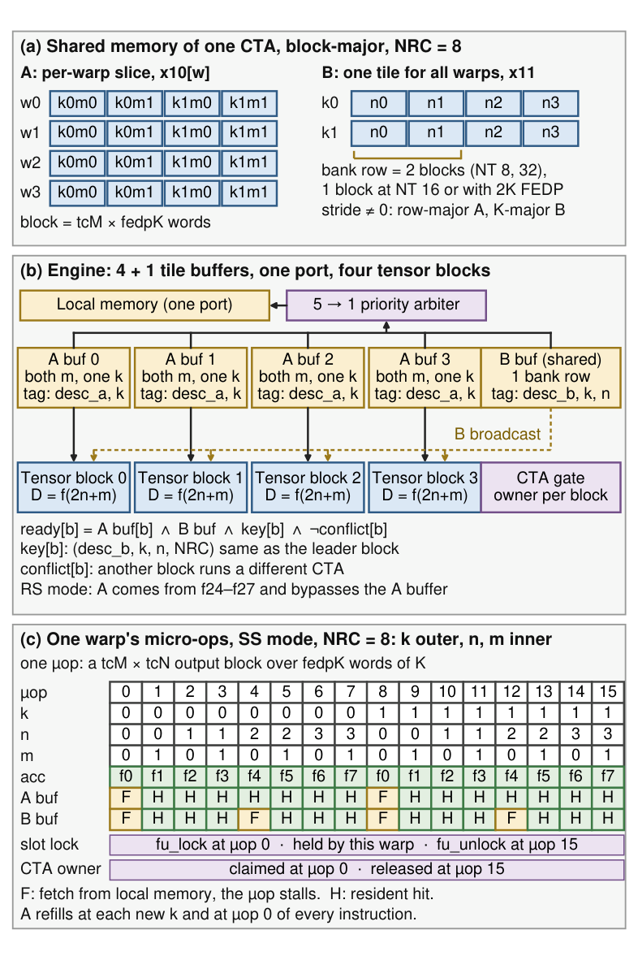
Warpgroup MMA (WGMMA)
Warpgroup = issue width
  CTA of IW warps; warp w owns rows 2w·tcM … ; all warps read the same B
  NT = 32, IW = 4: 64×16×16 tile (NRC = 8, 16 uops / warp) … 64×64×16 (NRC = 32, 64 uops)
Operands
  SMEM descriptor (x10 = A, x11 = B): [15:0] offset, [31:16] row stride; stride 0 = block-major
  row-major A / K-major B = the layout DXA writes (incl. its K-major transpose)
  RS mode: A in f24–f27, NRC ≤ 16 · SS mode: NRC up to 32 (fills the FP register file)
Tile buffers, one LMEM port
  A buffer per block (one k-stripe, refilled per k and per instruction) · one B buffer broadcast to all blocks
  SS step reads one B tile per warpgroup (1.00 at IW = 4); IW+1 buffers → fixed-priority arbiter → one bank-row port
Consistency without a barrier
  issue-slot lock (first→last uop) · single-CTA gate (VX_tcu_lockstep) · B-key {desc_b, k, n, NRC} match with the leader block
Scoreboard
  fu_lock / fu_unlock keep a warpgroup's uops atomic on one FU instance
Block-major SMEM layout, tile-buffer engine, and the 16 micro-ops of one warp (NT = 32, NRC = 8)
Notes:
The warps that issue together — one per issue slot — form a warpgroup; each runs on its own tensor block and owns 2·tcM output rows, all reading the same B tile, so the warpgroup tile grows in M with the issue width (64 rows at NT = 32, IW = 4). B always comes from shared memory through a 32-bit descriptor: 16-bit offset, 16-bit row stride, stride 0 meaning block-major; A from shared memory (SS) or f24–f27 (RS). Warps are not lockstepped cycle by cycle; three checks keep shared state consistent: issue-slot lock, single-CTA gate, and a B-key match against the leader block.

Slide 20
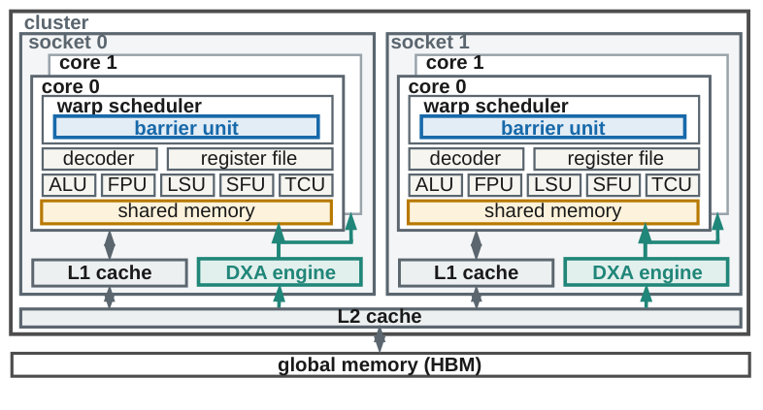
DXA: Asynchronous Tiled Copies (TMA-style)
ISA
  custom-0, funct7 = 0x03 (INST_SFU_DXA), MISA bit 10, VX_CFG_EXT_DXA_ENABLE
  lanes via vx_wgather: lane0 smem addr · lane1 meta = (bar << 4) | desc_slot · lane2 coords · lane3 cta_mask
  GMEM-read / LMEM-write only; no software → global path
Descriptor (DCR block 0x100, 16 slots)
  base_addr · meta {DIM 3b, ELEMSZ 2b, LAYOUT row-major / K-major} · tile0..4 · size0..4 (OOB bounds) · stride0..3 · cfill · smem_stride
Operations
  tiled copy rank 1–5 with OOB clamp + constant fill
  multicast: popcount(cta_mask) > 1 → read GMEM once, replay LMEM writes to issuer + r·smem_stride
  K-major transpose (rank ≤ 2): smem[i0·tile1 + i1], one element per beat — consumed by WGMMA B
Config
  NUM_DXA_UNITS = max(1, ⌈cores/8⌉) workers per cluster · queue 16 · ≤ 8 in flight · DXA_MEM_PORTS = min(units, sockets × L1 ports)
Perf CSRs (class 16)
  transfers · gmem_reads · gmem_dedup · lmem_writes · gmem_latency · noslot_stalls
// host: once per operand
vortex::dxa::program_2d(dev, slot, base,
rows, cols, stride, tileM, tileK, fill);
set_layout(slot, Layout::KMajor);
// kernel: per tile, producer warp
bar.expect_tx(1);
vx_dxa_issue_2d_wg(smem_tile, slot, x, y, bar.id());
// … warp continues; consumers bar.wait(ph)
Barrier unit per core, DXA engine shared per socket / cluster
Notes:
DXA is a cluster-shared engine that executes one warp instruction as an asynchronous, descriptor-driven, tiled global-to-local copy: ranks 1–5, out-of-bounds clamp with a constant fill, optional multicast to co-resident CTAs, and a K-major transpose that feeds the WGMMA B path directly. The host programs what is constant for an operand into one of 16 descriptors over DCRs; the kernel supplies what changes per tile — descriptor, coordinates, destination, barrier — in one instruction whose four lanes are packed with vx_wgather. The warp is freed at issue; completion goes to the named barrier.

Slide 21
Fixed-Function Graphics Stack
On-device front end
(SIMT: setup_k, binning_k)
RASTER (cluster)
← rcache
launch msg (quad stamps)
Unit | DCRs | MPM class
TEX | 0x040 – 0x056 | 13
RASTER | 0x060 – 0x069 | 12
OM | 0x080 – 0x097 | 14
RTU | 0x0A0 – 0x0A6 | 15
SIMT core
fragment shader (1-warp CTA)
early-Z reads committed depth
vx_tex
(scoreboarded rd)
RTU (socket)
← rtcache
OM (cluster)
↔ ocache
TEX (socket)
← tcache
vx_om_export (posted)
Fragment dispatch v2 (push)
  in-launch delivery: VX_cta_dispatch writes stamps into launch-register RAM before activation
  wave = NUM_THREADS / 4 quads; one lane = one pixel incl. helper lanes
  draw = grid-less KMU launch (delegated draw); gfx_busy keeps the device busy until drained
Early-Z (optional)
  VX_raster_earlyz reads committed depth from ocache, read-only
  armed only for monotone LESS/LEQUAL, no stencil (OM_EARLYZ_SAFE)
  strict-behind cull: image-identical to ROP-only
Units and placement
  RASTER (cluster, rcache) · TEX (socket, tcache) · OM (cluster, ocache) · RTU (socket, rtcache); MISA bits TEX 6 · RASTER 7 · OM 8
ISA under custom-1 (0x2B), by funct3
  3 vx_om_export (R4, aperture store) · 5 vx_tex (R4, texel in rd) · 6 / 7 RTU · RASTER has no kernel op — it pushes
Interface law
  FF ↔ SIMT values travel only in scoreboarded registers or launch messages — no shared mutable side band
Invariants
  no floating-point datapath in any FF unit; unrepresentable state → on-device SIMT fallback, never the host
  FF AXI masters bypass the MMU (VX_MEM_PHYS from a pinned slab)
Notes:
Three fixed-function units plus the ray-tracing unit, all exposed as RISC-V extensions under custom-1 and advertised through MISA bits 6–8. RASTER and OM live at cluster level, TEX and RTU at socket level, each with its own read-only or coherent cache. The interface law: every value crossing between a fixed-function unit and SIMT is handed through a scoreboarded register or a launch message; no shared mutable side band outlives the operation. The rasterizer pushes fragment waves as 1-warp CTAs through the KMU launch bus — the root fix for the dropped-draw-call class of multi-core bugs.

Slide 22
RTU Core: Traversal Engine
VX_rtu_core (socket)
Bus and binding
  VX_rtu_bus_if channels arm / req / win; VX_rtu_bus_arb binds cores to RTUs statically
VX_rtu_core
  staging RAM per {src, wid} → fill engine → slot pool (NUM_SLOTS = SOCKET_SIZE / NUM_RTU_CORES, NUM_CTX = slots × NT)
  VX_rtu_scheduler: SELECT → ALIGN → EXEC, ~30-state context FSM, wake bits, 1 micro-step/cycle
  commit engine → window store; barrier walker runs finalise and resume
  short stack RTU_STACK_DEPTH = 16 + rank-path restart (exact ≤ 63 levels); 16-entry box collector, insertion-sorted
PEs (FP32, FPU cores reused, no subnormals)
  VX_rtu_box_pe (slab, 1 child/cycle) · VX_rtu_tri_pe (Woop/Benthin/Wald watertight, 1 tri/cycle)
  VX_rtu_xform (18 FMA, world→object matrix stored) · VX_rtu_recip (LUT + Newton, or DSP seed)
RTCache
  8 KB, 1 bank, 2 ways, 16 MSHRs; CW-BVH4 node = one 64 B line
SIMT core
VX_rtu_unit (SFU PE)
hit window BRAM
parked-WAIT table
arm (may block)
VX_rtu_
bus_arb
(static
binding)
staging RAM {src, wid}
req: RAY beats, CONTINUE
fill engine → slot pool
win: slot writes, STATUS last
scheduler: SELECT → ALIGN → EXEC
RTCache: 8 KB, 1 bank, 2 ways, 16 MSHRs — CW-BVH4 node = one 64 B line
PEs: box · tri · xform · recip
commit → window (STATUS last)
Per-ray traversal state machine
TRACE
TRAVERSE
INSTANCE_HIT
xform → BLAS
FINISHED
→ MS /
CHS
queue
TRIANGLE_HIT
any-hit → AHS queue
PROCEDURAL_HIT
intersection → IS queue
RESTART
restart trail
miss / closest hit
shader callback suspends; CONTINUE / COMMIT resumes
Notes:
A socket RTU core serves SOCKET_SIZE / NUM_RTU_CORES cores over a three-channel bus: arm (may block), req (ray beats and CONTINUE, always ready), win (slot writes, STATUS last); core-to-RTU binding is static so a CONTINUE always reaches the RTU that owns its TRACE. Three structures: staging (one entry per {source, warp} — the single home of a ray), a slot pool whose fill engine launches lane by lane, and a context-pool scheduler: a three-stage SELECT → ALIGN → EXEC walker over a context-indexed BRAM with a ~30-state per-context FSM, wake-bit events and no stall network, one micro-step per cycle. Per-context state lives as an address into plain BRAMs, not a mux. A 16-entry short stack plus a rank-path restart from root is exact to 63 levels; PEs: box slab test (1 child/cycle), watertight triangle test (1 tri/cycle), 18-FMA transform, LUT+Newton reciprocal.

Slide 23
What the Gates Protect: Current Goldens
DUT | configs (abridged) | U55C target / Fmax | LUT | FF | BRAM | DSP | ASAP7 target / Fmax | cell area µm² | power mW
cache | EXT_A | 300 / 302 | 28,369 | 24,689 | 32 | 0 | 800 / 1,228 | 48,726 | 126
core | NT 16, NW 16, EXT_C (ASAP7: 8×8) | 300 / 298 | 171,712 | 153,567 | 247 | 96 | 400 / 587 | 84,624 | 352
top | NT 4, NW 4, 2 cores | 250 / 251 | 136,762 | 145,017 | 80 | 48 | 400 / 621 | 187,230 | 126
tcu | TFR fp16 fp8 i8 i4 tf32 sparse wgmma | 300 / 292 | 117,377 | 43,377 | 0 | 768 | 500 / 855 | 74,407 | 205
tensor | NT 16, NW 16 (ASAP7 8×8) | 250 / 251 | 239,260 | 153,880 | 173 | 265 | 400 / 977 | 104,438 | 122
dxa | NT 16, NW 16 | 300 / 303 | 10,102 | 7,560 | 10 | 7 | 800 / 1,069 | 12,449 | 34
raster | NT 16, NW 16 | 300 / 339 | 8,346 | 9,160 | 10 | 14 | 800 / 1,227 | 10,527 | 51
tex | NT 16, NW 16 (ASAP7 8×8) | 300 / 293 | 61,245 | 31,268 | 0 | 528 | 800 / 1,163 | 61,159 | 275
om | NT 16, NW 16 | 300 / 359 | 2,618 | 3,853 | 5 | 22 | 800 / 986 | 5,926 | 23
rtu | NT 16, NW 16 | 300 / 298 | 67,881 | 95,516 | 53 | 146 | 400 / 903 | 98,965 | 361
gfx | NT 16, NW 16 (ASAP7 4×4) | 250 / 250 | 204,871 | 221,979 | 165 | 752 | 400 / 850 | 242,203 | 624
vm | NT 16, NW 16, 2 cores (ASAP7 8×8) | 250 / 250 | 119,695 | 113,304 | 180 | 0 | 400 / 1,029 | 146,445 | 185
mufu | NT 16, NW 16 | 300 / 318 | 2,030 | 1,105 | 1 | 3 | 800 / 1,040 | 2,073 | 17
ci/baselines/synthesis/xilinx/*.json (Vivado post-implementation) and yosys/*.json (sv2v → Yosys 0.69 → ABC → OpenSTA 3.1.0, ASAP7 RVT TT); SRAM area excluded from cell area
Reading the ASIC column: ABC maps to the target period, so cell area is the sensitive metric; Fmax is what OpenSTA reports after that mapping.
Notes:
The numbers in ci/baselines/synthesis are the goldens the FPGA and ASIC gates compare against. On the U55C the core at 16 warps × 16 threads with RVC closes at 298 MHz in 172k LUTs; the TFR tensor unit with every format, sparsity and WGMMA at 292 MHz in 117k LUTs and 768 DSPs. On ASAP7 through the open flow the cache bank reaches 1.23 GHz and the core 587 MHz.

Slide 24
Takeaways
Core
  GTO issue, scoreboard XREGS + FU locks, uop sequencer; RVC, Zicond, A-ext committed at the LLC; in-house F32/F64 FPU; sectored L2/L3; MMU v2
Control plane
  host-resident CP ring → KMU grid walk → message-locked launch bus → per-core CTA dispatcher with stride-contiguous clusters
Barriers
  arrive / wait(phase) / expect_tx on a scheduler table row; engines complete barriers directly (1.03× vs mbarrier-style, 1.56× vs software)
Tensor
  TFR FEDP: one 4-cycle FP/INT pipeline, TF32 … INT4 + MX, 2.7–7.9× HardFloat / DSP / FPnew throughput; 2:4 sparsity; WGMMA with a shared B buffer; 16 threads/warp is the sweet spot
DXA
  cluster-shared TMA-style copy engine: 16 descriptors, ≤ 8 lines in flight, multicast over cluster slots, K-major transpose; 1.85× over load–store
Graphics / RT
  RASTER pushes 1-warp fragment CTAs; TEX and OM behind a scoreboard-or-store law; stateful RTU with parked WAIT and CW-BVH4; 1.5 GHz on ASAP7

Slide 25
Thank You!
https://github.com/vortexgpgpu/vortex
https://github.com/vortexgpgpu/vortex/releases/tag/v3.0
docs/designs/*.md · CHANGELOG.md · AGENTS.md

