Slide 1




Apache Lucene a simple Spring Boot
application
Perficient Tech Talk 04-26-2019
Danimae Vossen
https://github.com/vossenv/lucene_hibernate_demo

Slide 2
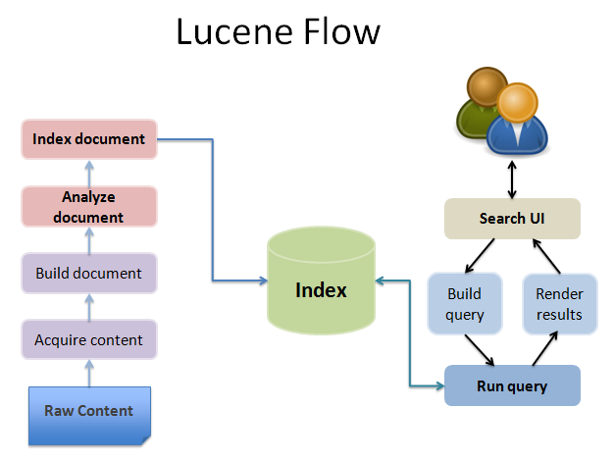
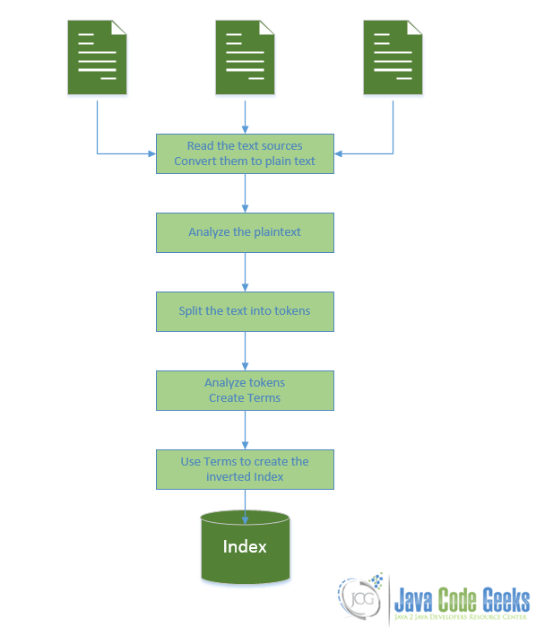
http://www.knstek.com/full-text-search-using-apache-lucene-part-iii/
https://www.javacodegeeks.com/2015/09/introduction-to-lucene.html

Slide 3
“In case we’re already using Hibernate and JPA for ORM, we’re only one step away from Hibernate Search.
Hibernate Search integrates Apache Lucene, a high-performance and extensible full-text search-engine library written in Java.
This combines the power of Lucene with the simplicity of Hibernate and JPA.
Simply put, we just have to add some additional annotations to our domain classes, and the tool will take care of the things like database/index synchronization.”
https://www.baeldung.com/hibernate-search

Slide 4
dependencies {
// Basic spring boot api dependencies implementation 'org.springframework.boot:spring-boot-starter' // ???? implementation 'org.springframework.boot:spring-boot-starter-data-jpa' // Hibernate implementation 'org.springframework.boot:spring-boot-starter-hateoas' // HATEOAS implementation 'org.springframework.boot:spring-boot-starter-validation' // 2-4-6-8 VALIDATE
// Hibernate search implementation 'org.hibernate:hibernate-search-orm:5.11.1.Final' // Hibernate Search implementation 'org.hibernate:hibernate-core:5.4.2.Final' // Hibernate Search
implementation 'org.projectlombok:lombok:1.18.6' // Getter/Setter/Data // Other dependencies omitted }

Slide 5
dependencies {
// Basic spring boot api dependencies implementation 'org.springframework.boot:spring-boot-starter' // ???? implementation 'org.springframework.boot:spring-boot-starter-data-jpa' // Hibernate implementation 'org.springframework.boot:spring-boot-starter-hateoas' // HATEOAS implementation 'org.springframework.boot:spring-boot-starter-validation' // 2-4-6-8 VALIDATE
// Hibernate search implementation 'org.hibernate:hibernate-search-orm:5.11.1.Final' // Hibernate Search implementation 'org.hibernate:hibernate-core:5.4.2.Final' // Hibernate Search
implementation 'org.projectlombok:lombok:1.18.6' // Getter/Setter/Data // Other dependencies omitted }

Slide 6
Analyzing "A Quick Brown Fox jumped over the Lazy Dog"
StandardAnalyzer:
[quick] [brown] [fox] [jumped] [over] [lazy] [dog]
SimpleAnalyzer:
[a] [quick] [brown] [fox] [jumped] [over] [the] [lazy] [dog]
StopAnalyzer:
[quick] [brown] [fox] [jumped] [over] [lazy] [dog]
Default (lower case) filter:
[a] [quick] [brown] [fox] [jumped] [over] [the] [lazy] [dog]
Stop words filter:
[quick] [brown] [fox] [jumped] [over] [lazy] [dog]
Short words filter:
[quick] [brown] [fox] [jumped] [over] [the] [lazy] [dog]
Analyzing "XY&Z Corporation - xyz@example.com"
StandardAnalyzer:
[xy&z] [corporation] [xyz@example.com]
SimpleAnalyzer:
[xy] [z] [corporation] [xyz] [example] [com]
StopAnalyzer:
[xy] [z] [corporation] [xyz] [example] [com]
Default (lower case) filter:
[xy] [z] [corporation] [xyz] [example] [com]
Stop words filter:
[xy] [z] [corporation] [xyz] [example] [com]
Short words filter:
[xy] [corporation] [xyz] [example] [com]

Slide 7
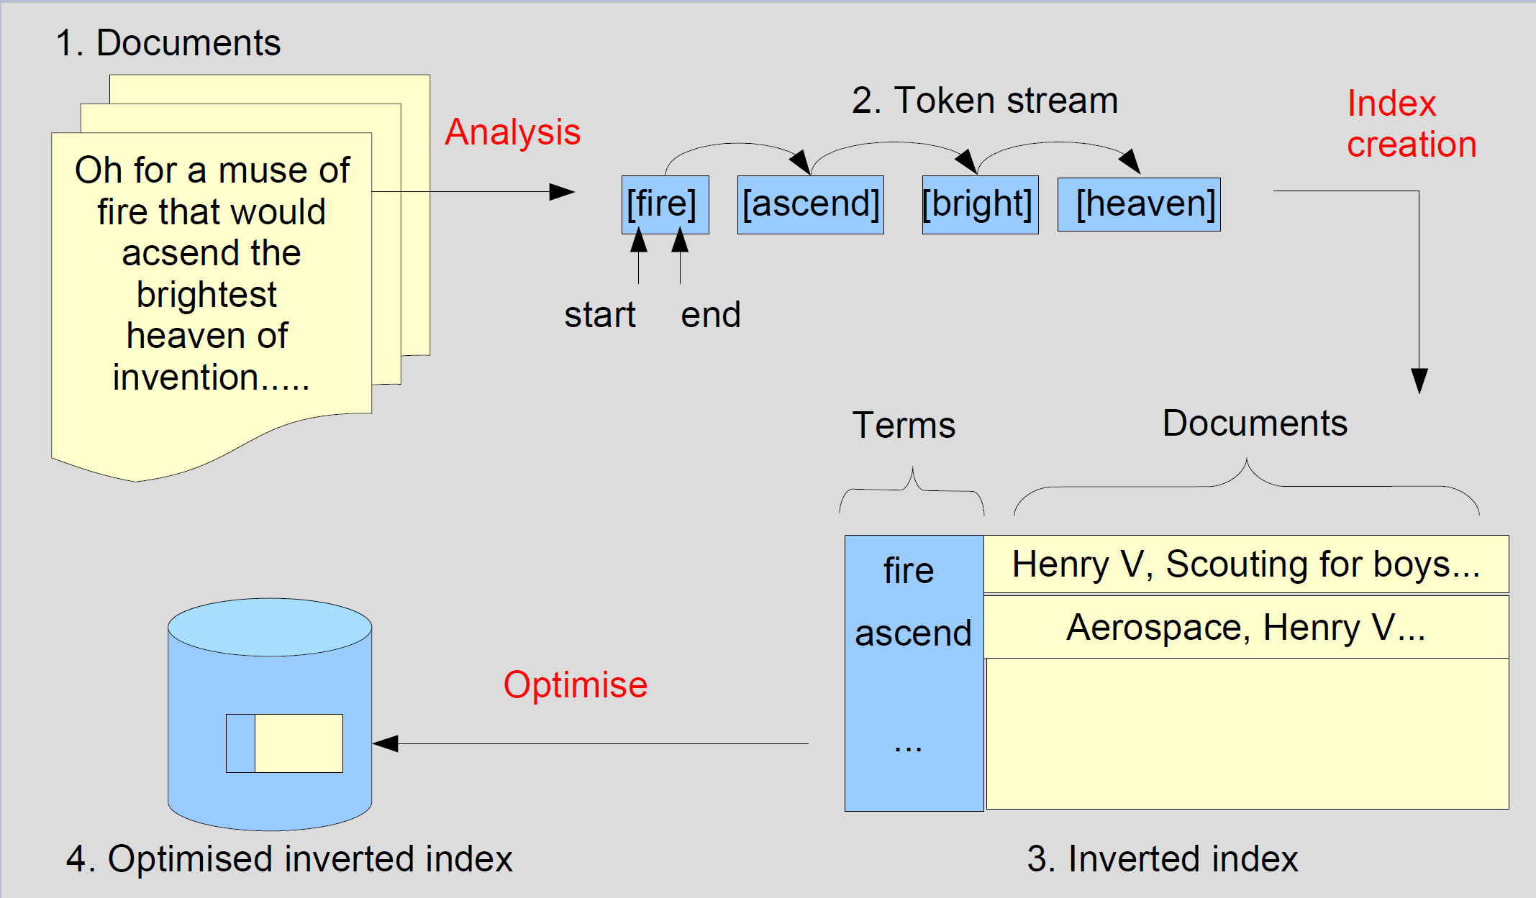
https://www.slideshare.net/phpcodemonkey/search-lucene

