Slide 1




Apache Lucene a simple Spring Boot
application
Perficient Tech Talk 04-26-2019
Danimae Vossen
https://github.com/vossenv/lucene_hibernate_demo

Slide 2
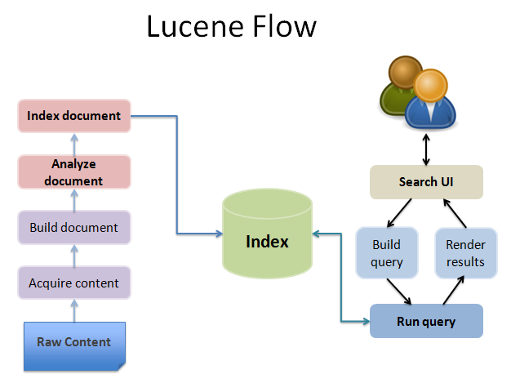
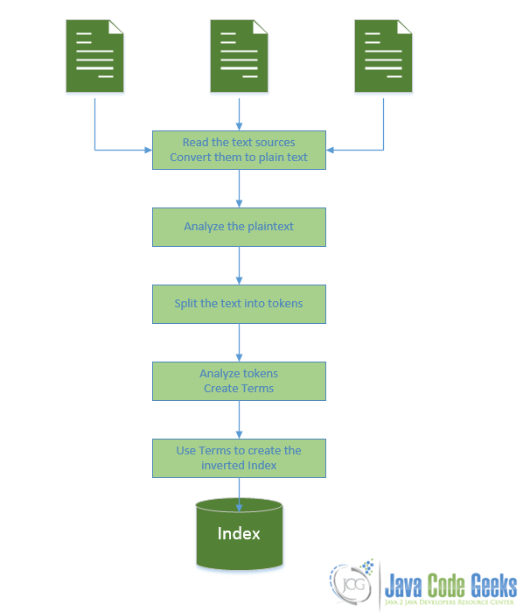
http://www.knstek.com/full-text-search-using-apache-lucene-part-iii/
https://www.javacodegeeks.com/2015/09/introduction-to-lucene.html

Slide 3
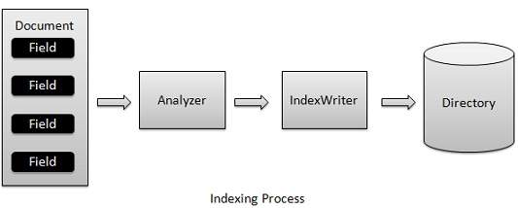
Hibernate / Lucene index
Indexing process is one of the core functionality provided by Lucene.
Hibernate Search will transparently index every entity each time it’s persisted, updated or removed through Hibernate ORM.
Its mission is to keep the index and your database in sync, allowing you to forget about this problem.

Slide 4
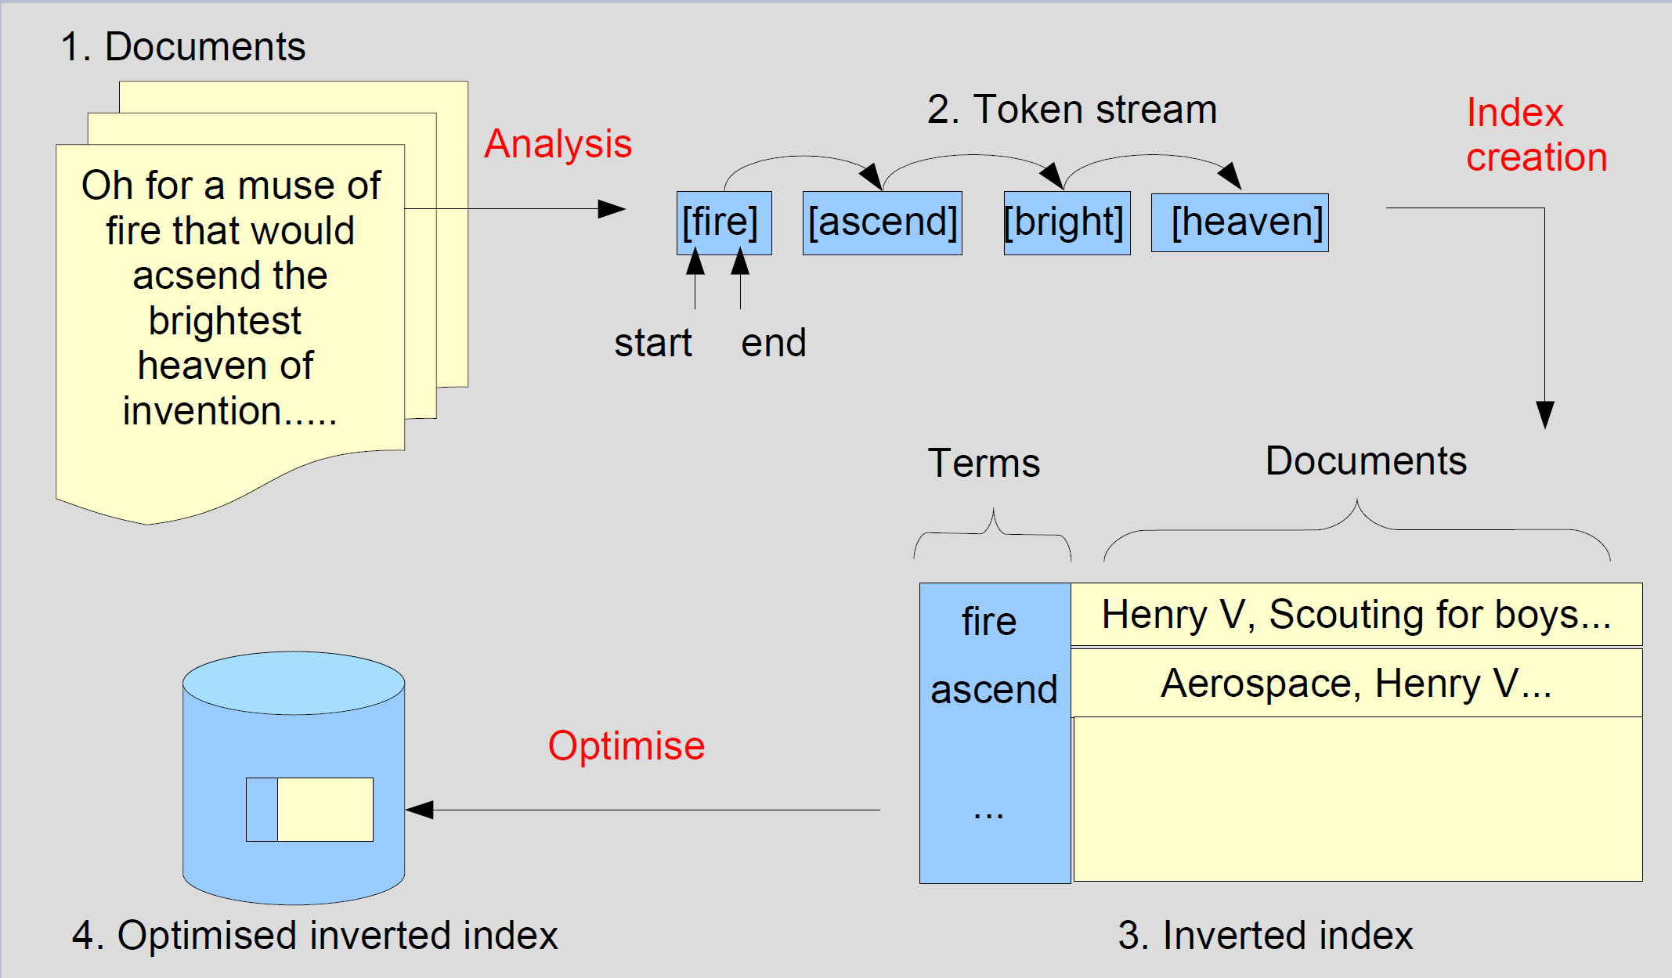
https://www.slideshare.net/phpcodemonkey/search-lucene

Slide 5
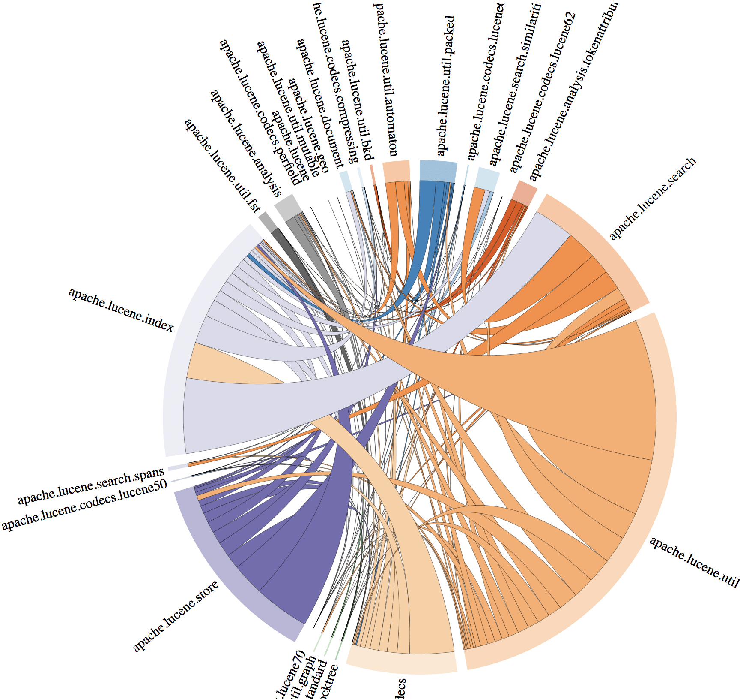
“In case we’re already using Hibernate and JPA for ORM, we’re only one step away from Hibernate Search.
Hibernate Search integrates Apache Lucene, a high-performance and extensible full-text search-engine library written in Java.
This combines the power of Lucene with the simplicity of Hibernate and JPA.
Simply put, we just have to add some additional annotations to our domain classes, and the tool will take care of the things like database/index synchronization.”
https://www.baeldung.com/hibernate-search

Slide 6
SCI FI SEARH Application Structure
Movie Entity
Application
[Primary fields]
movieId
Title
description
url
cover
catchPhrase
producer
genre
country
avatar
rating
[Inherited fields]
createdDate
lastModifiedDate
enabled
[Basic MVC architecture]
Single entity (movie)
Hibernate ORM
Hibernate Search
No relational mapping
Sample data set ~1000 items
Single page search UI
[Hibernate Search]
Lucene indexer
Entity field mappings
Tokenizing rules
Filter rules for fields
Custom field bridges
Language processor
Paging enabled
Search / Query generator
Fulltext JPA Query

Slide 7
build.gradle
dependencies {
// Basic spring boot api dependencies implementation 'org.springframework.boot:spring-boot-starter' // ???? implementation 'org.springframework.boot:spring-boot-starter-data-jpa' // Hibernate implementation 'org.springframework.boot:spring-boot-starter-hateoas' // HATEOAS implementation 'org.springframework.boot:spring-boot-starter-validation' // 2-4-6-8 VALIDATE
// Hibernate search implementation 'org.hibernate:hibernate-search-orm:5.11.1.Final' // Hibernate Search implementation 'org.hibernate:hibernate-core:5.4.2.Final' // Hibernate Search
implementation 'org.projectlombok:lombok:1.18.6' // Getter/Setter/Data // Other dependencies omitted }
application.properties
spring.jpa.properties.hibernate.search.default.directory_provider = filesystem spring.jpa.properties.hibernate.search.default.indexBase = indexpath spring.jpa.properties.hibernate.search.default.locking_strategy = none

Slide 8
Lucene Index
Hibernate Search will transparently index every entity each time it’s persisted, updated or removed through Hibernate ORM.
Its mission is to keep the index and your database in sync, allowing you to forget about this problem.
Indexing can also be done at runtime (shown here)
@Configuration public class LuceneIndexConfiguration { private final EntityManager entityManager; @Autowired public LuceneIndexConfiguration(final EntityManagerFactory entityManagerFactory) { this.entityManager = entityManagerFactory.createEntityManager(); } @PostConstruct public void onApplicationEvent() throws InterruptedException { FullTextEntityManager fullTextEntityManager = Search.getFullTextEntityManager(entityManager); fullTextEntityManager.createIndexer().startAndWait(); } }

Slide 9
Entity analysis
Entities must be annoted with @Indexed to be indexed
Each field (except the id) should be marked with an @Field annotation.
Non – standard fields (such as a UUID) may require custom bridges, demonstrated by @FieldBridge
Finally, one may specify which lucene analyzer to use with @Analyzer. Best practice is to specify this at the entity level (not shown), and override where needed.
@Data @Entity @Indexed @Table(name = "movie") public class Movie extends EntityBase<String> { @Id @Type(type = "uuid-char") @GeneratedValue(generator = "UUID", strategy = GenerationType.AUTO) @GenericGenerator( Omitted ) @Column(name = "movieid") @FieldBridge(impl = UUIDFieldBridge.class) @Analyzer(impl = KeywordAnalyzer.class) private UUID movieId; @Field @NotNull(message = "Title cannot be blank") @Size(min = 1, message = "Question must be more than 1 characters") @Column(name = "title", columnDefinition = "TEXT") private String title;

Slide 10
Analyzers
The best way to manage the analyzer is to create a custom analyzer with @AnalyzeDef
Field Analyzer: examines the text of fields and generates a token stream. Analyzers may be a single class or they may be composed of a series of tokenizer and filter classes.
Tokenizer: breaks field data into lexical units, or tokens.
Filter: examines a stream of tokens and keep them, transform or discard them, or create new ones. Tokenizers and filters may be combined to form pipelines, or chains, where the output of one is input to the next.
@AnalyzerDef( name = "customanalyzer", tokenizer = @TokenizerDef(factory = ClassicTokenizerFactory.class), filters = { @TokenFilterDef(factory = LowerCaseFilterFactory.class), @TokenFilterDef(factory = StopFilterFactory.class), @TokenFilterDef(factory = EnglishPossessiveFilterFactory.class), @TokenFilterDef(factory = SynonymFilterFactory.class, params = { @Parameter(name = "synonyms", value = "synonyms.txt"), @Parameter(name = "ignoreCase", value = "true")}) } )

Slide 11
Executing a search
org.hibernate.search.jpa.FullTextQuery
Simplest possible search
Create a QueryBuilder
Using the QueryBuild qb, we can construct various kinds of query.
The query takes the form of a FullTextQuery from jpa (org.hibernate.search.jpa .FullTextQuery)
The resulting query can be conveniently executed like any other JPA query!!
private List<Movie> search (SearchParameters parameters) { String query = parameters.getQuery(); Pageable p = parameters.getPageable(); QueryBuilder qb = fullTextEm.getSearchFactory()
.buildQueryBuilder().forEntity(Movie.class).get(); Query luceneQuery = qb .simpleQueryString() .onFields("title", "description", "catchPhrase", "producer", "genre", "country", "rating") .matching(query) .createQuery(); FullTextQuery jpaQuery = fullTextEm.createFullTextQuery(luceneQuery, Movie.class); List<Movie> results = jpaQuery.getResultList();
return results; }

Slide 12
Executing a search
Keyword: Here, keyword() specifies that we are looking for one specific word, onField() tells Lucene where to look and matching() what to look for.
Fuzzy: work like keyword queries, except that we can define a limit of “fuzziness”, above which Lucene shall accept the two terms as matching. (0 to 2 range)
Wildcard: For this, we can use “?” for a single character, and “*” for any character sequence
More: phrase, range, more like this, combining queries
… Query luceneQuery = qb .keyword() .onField("description”) .matching(query) .createQuery();
Query luceneQuery = qb .keyword()
.fuzzy() .onField("description”) .matching(query) .createQuery();
Query luceneQuery = qb .keyword()
.wildcard () .onField("description”) .matching(“science*”) .createQuery(); …
…
Query luceneQuery = qb .range() .onField(“rating”) .from(5)
.to(10) .createQuery();
Query combinedQuery = qb .must(qb.keyword() .onField("productName").matching("apple") .createQuery()) .should(qb.phrase() .onField("description").sentence("face id") .createQuery()) .must(qb.keyword() .onField("productName").matching("samsung") .createQuery()) .createQuery();
…

Slide 13
A better way?
Lucene: MultiFieldQueryParser We can use the apache lucene classes directly, bypassing the (rather simple) hibernate search builder.
By using the query parser, we can leverage the full power of Lucene’s term analysis: https://lucene.apache.org/core/2_9_4/queryparsersyntax.html
This is a much more “free form” way to search. All we need to do is get the user’s input and pass it in for analysis
try {
Class entityType = Movie.class;
queryParser = new MultiFieldQueryParser(
getEntityFields(entityType),
fullTextEm.getSearchFactory().getAnalyzer(entityType)
);
Query r = queryParser.parse(query); FullTextQuery jpaQuery = fullTextEm.createFullTextQuery(r, entityType); } catch (ParseException e) { throw new SearchFailedException(); }

Slide 14
One last piece
QueryParser is not perfect. While powerful, it’s highly syntax sensitive.
It’s not reasonable for to expect users to know the proper syntax, so we must provide some language processing before handing the query to Lucene
There are tools which help with this aspect – the user-to-lucene path. Widely used for this with Lucene is SOLR – though SOLR does much more than this! It is outside the scope of this presentation. Here, we use a simple custom processor.
try {
…
query = new LanguageProcessor(parameters.getFuzziness()).format(query); query = (!filter.trim().isEmpty()) ? "(" + query + ") AND " + filter : query;
Query r = queryParser.parse(query); FullTextQuery jpaQuery = fullTextEm.createFullTextQuery(r, entityType); } catch (ParseException e) { throw new SearchFailedException(); }

Slide 15
Simple Language Processor [code not shown]
"\\ + - ! { } [ ] ^ ? /"
In this case, a simple custom language processor was created to translate from user to lucene syntax
The goal was to provide the user with a “google-like” experience, without needing to think hard about syntax.
This supports booleans (AND/OR/NOT), keywords, quoted strings, wildcards, and parenthetical combinations
In addition, terms are made “flexible” by adopting the fuzzy syntax “~” from lucene parser.
Escape or drop the other lucene syntax: “\ + - ! { } [ ] ^ ? /” so that can be part of queries
[Example Translations]
science fiction -> science~ fiction~
science AND fiction OR -> science~ AND fiction~
science AND (fiction OR fact) ->
science~ AND (fiction~ OR fact~)
“the meaning of life” -> "the meaning of life"~
producer: “George Lucas” ->
producer:"George Lucas"~
“George “someone Lucas”” ->
"George "someone Lucas""~
Scie?nce + fiction {alien} ->
scie\?nce~ ficton~ \{alien\}

