Slide 2
Medical equipment

Slide 3
8 well PCR tube strip

Slide 4
Syringes

Slide 5
Blood test (1)

Slide 6
Blood test (2)
Serum
Translucide gel
Red blood cells
Centrifugal blood tube

Slide 7
Analysis flasks
Urine test
Stool culture

Slide 8
Bags

Slide 9
Perfusion

Slide 10
Tensiometers

Slide 11
Central pressure
53
55

Slide 12
Stethoscope and otoscope

Slide 13
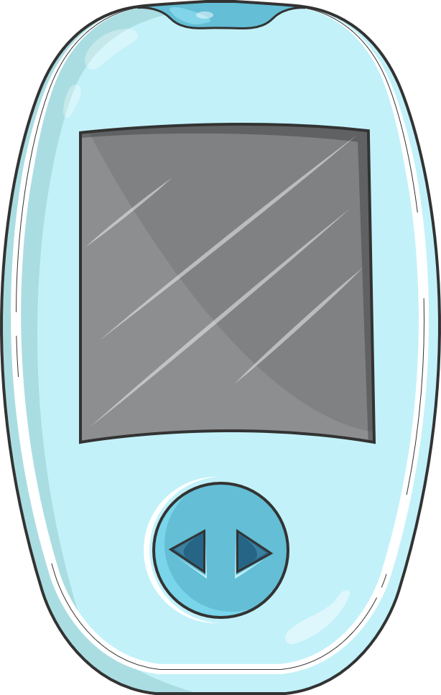
Glucometer

Slide 14
Smartphone

Slide 15
Tablet

Slide 16
Anuscope

Slide 17
Phlebology stepladder

Slide 18
Monofilament

Slide 19
Bathroom scales and clinical thermometer

Slide 20
Height gauge

Slide 21
Compression stocking

Slide 22
Orthopedics (1)

Slide 23
Orthopedics (2)

Slide 24
Hospital bed

Slide 25
Dialysis

Slide 26
Doctor’s office

Slide 27
Buildings

Slide 28
Pain rating scale

