Slide 1
Observing The Air Quality
Professor: Mrudula Mukadam
Students:
1. Tam Van Vo - 610746
2. Minh Tuan Bui - 610582
3. Bao Nguyen Nguyen - 610116

Slide 2

Outline
Introduction to Dataset
Study Usecase
Streaming data from Agent to Kafka
Streaming data from Kafka to Hbase
Spark SQL read/write Hbase using Jupyter
Data Visualization
Demo
Q & A
Appendix: DataFrame vs DataSet

Slide 3
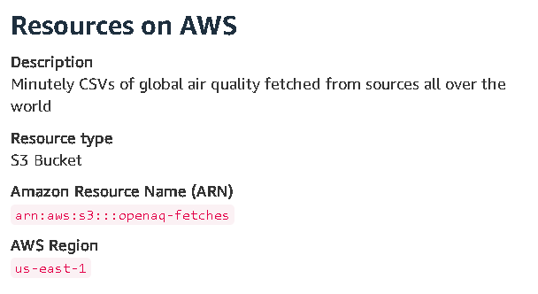
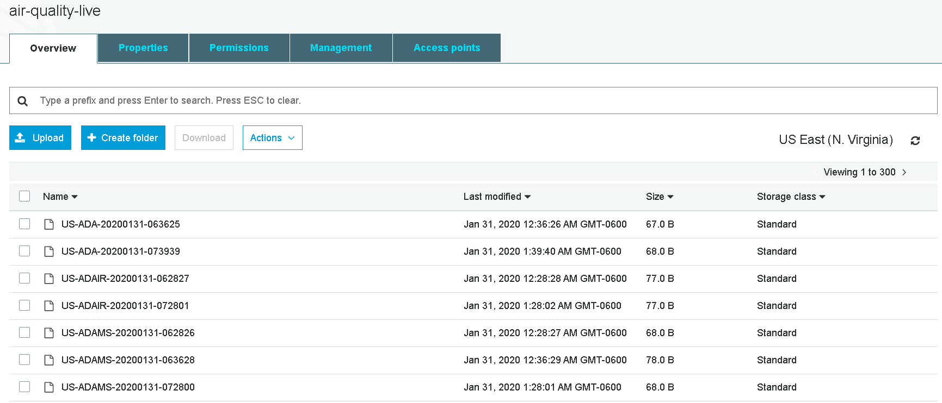
Dataset: OpenAQ
Global, aggregated physical air quality data from public data sources provided by government, research-grade and other sources.
Minutely CSVs of global air quality fetched from sources all over the world
Size: 6.6 mb each fetched into separate records

Slide 4
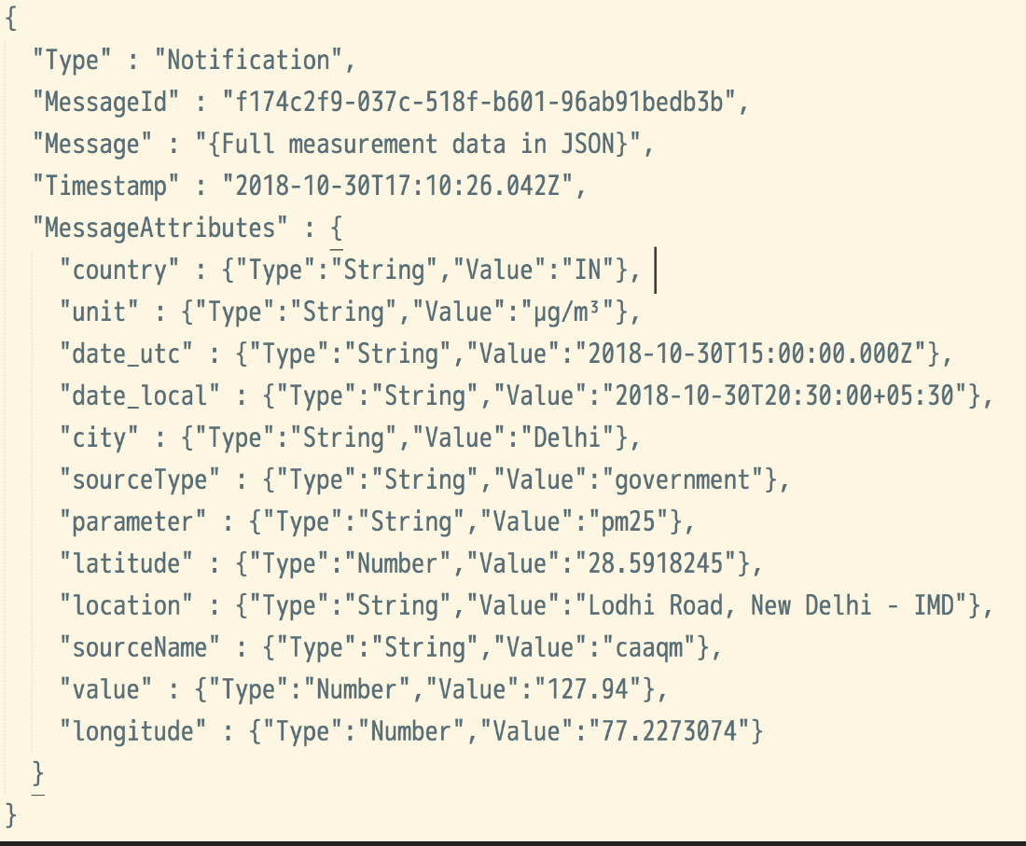
Dataset: OpenAQ
Sample Data

Slide 5
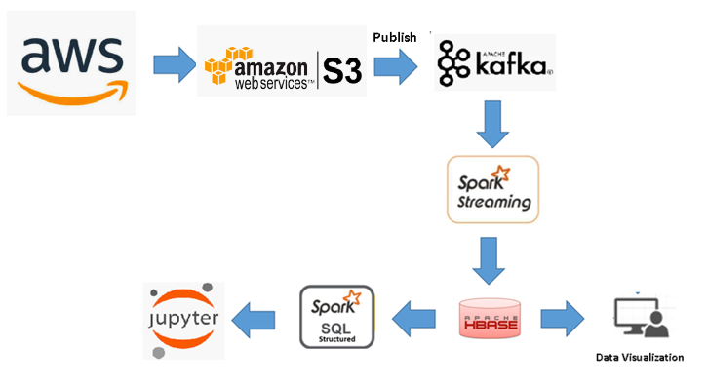
Beta -Usecase

Slide 6
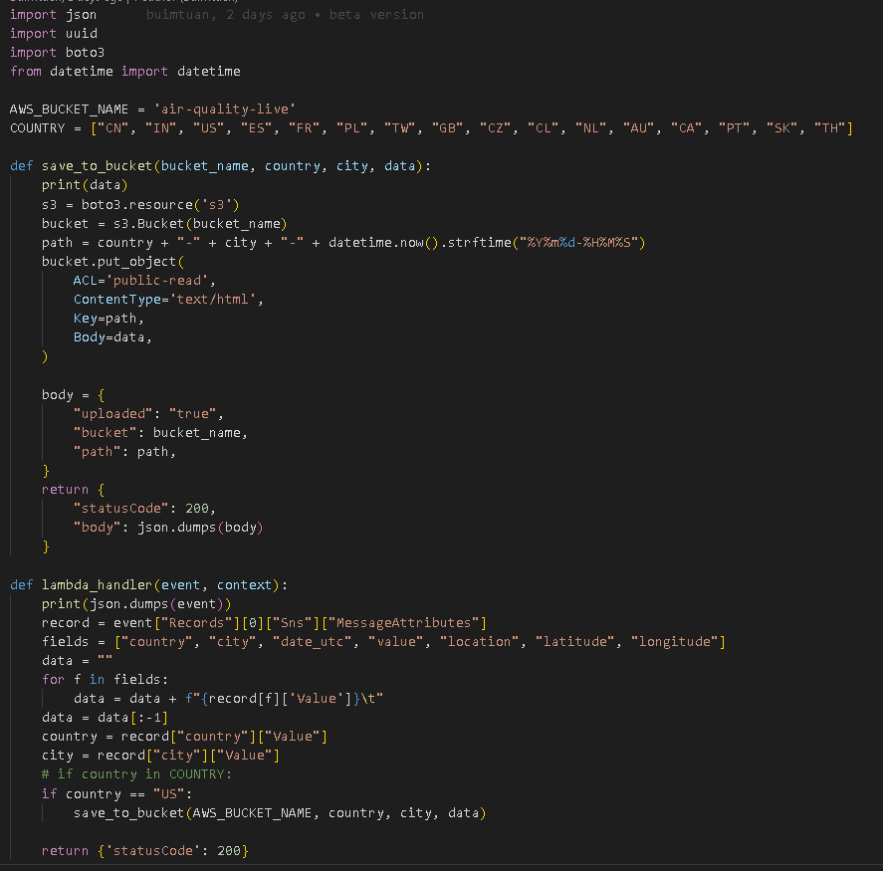
Beta Streaming: DS -> AWS Lambda -> S3

Slide 7
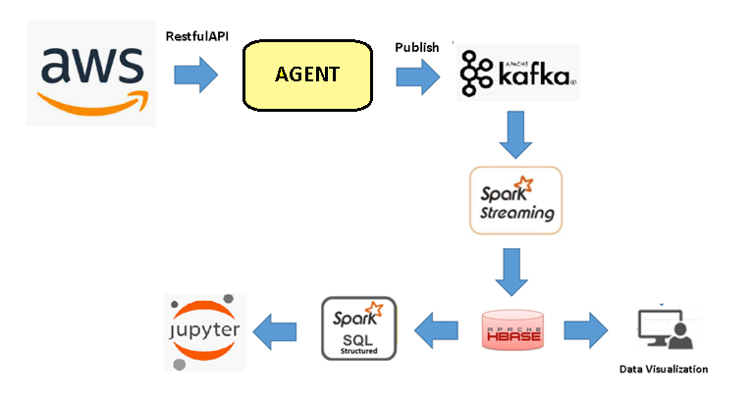
Usecase

Slide 8
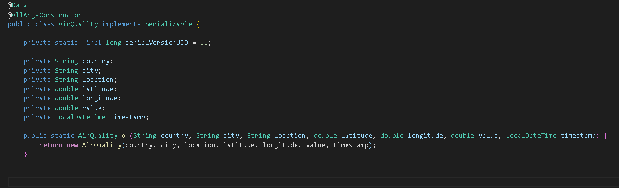
Model:

Slide 9
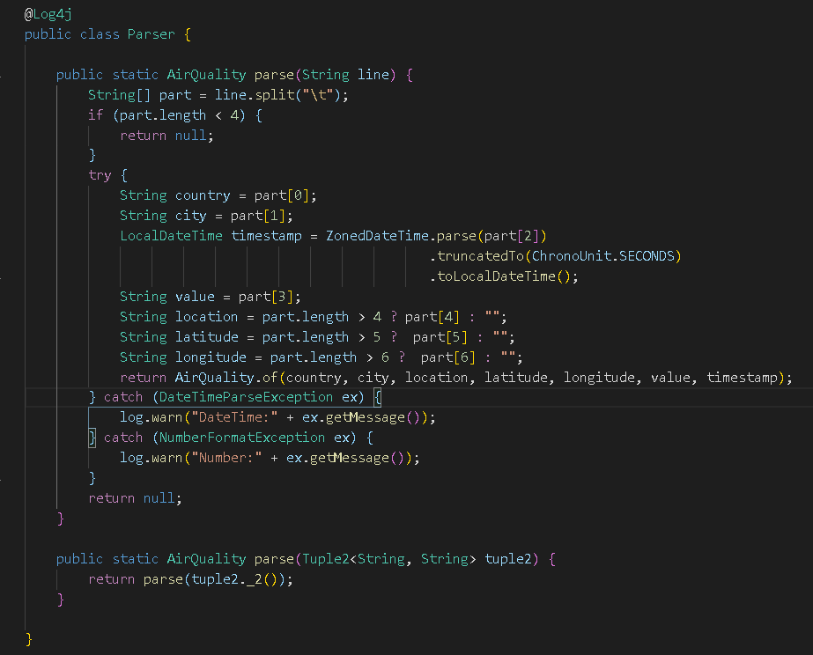
Parser:

Slide 10
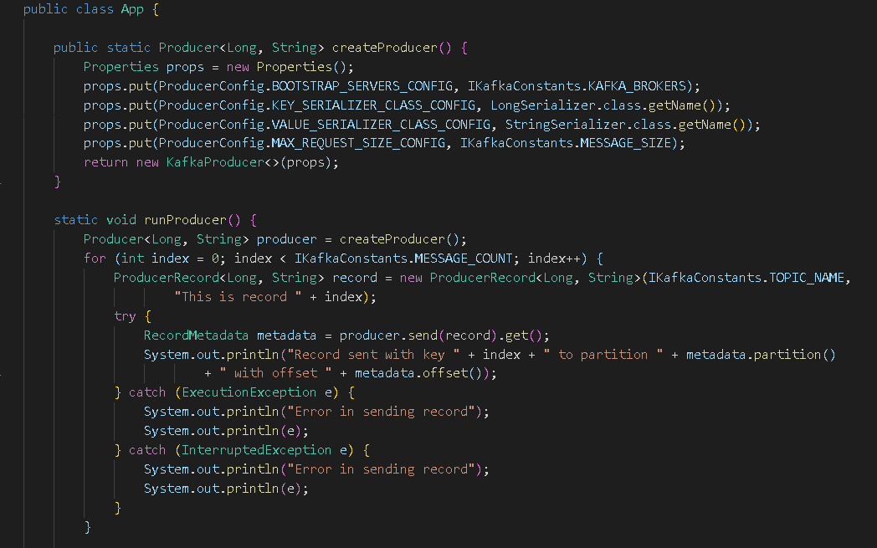
Streaming: to Kafka
The Agent will get data from AWS Dataset through Restful API and then publish to Kafka

Slide 11
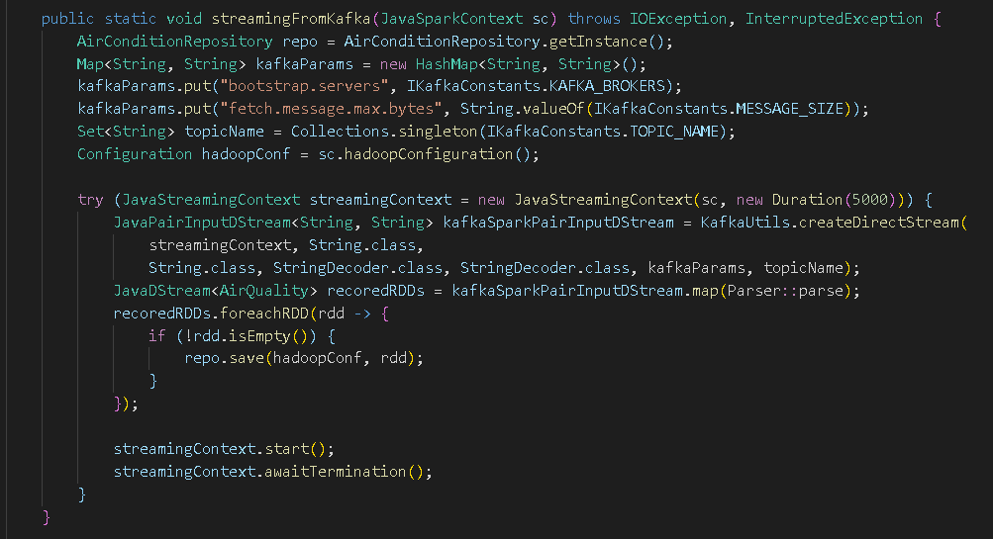
Streaming: Kafka -> HBase

Slide 12
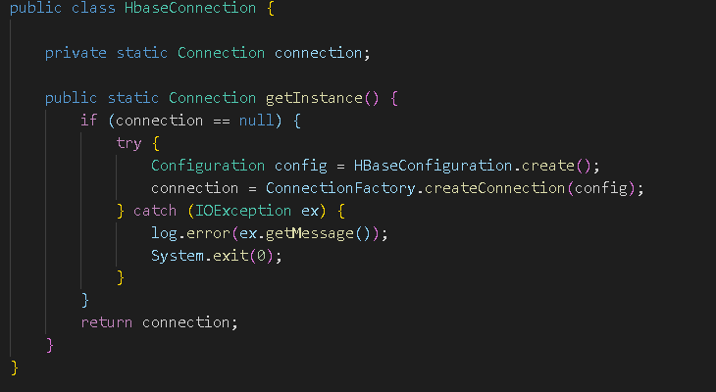
Hbase: Connection

Slide 13
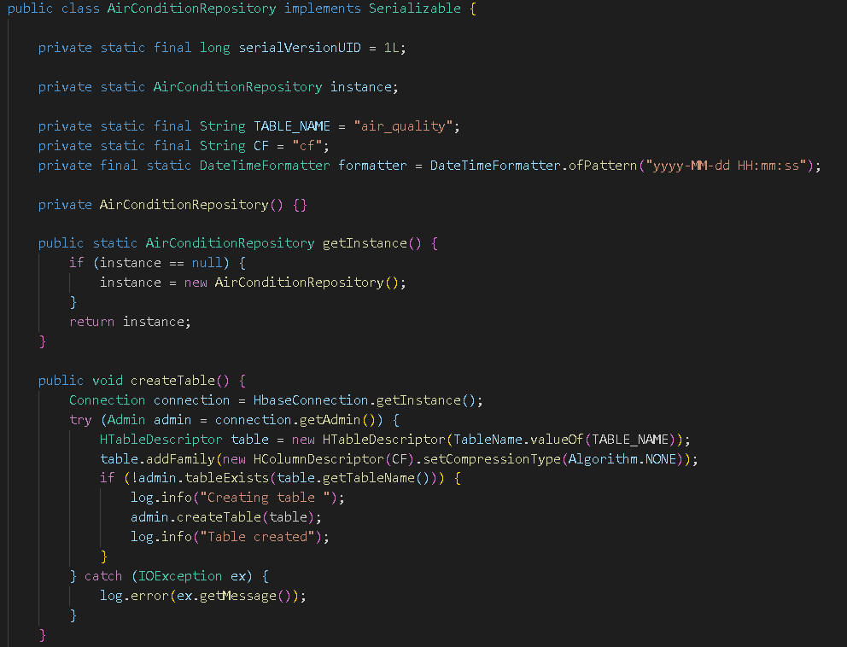
Hbase: Repository

Slide 14
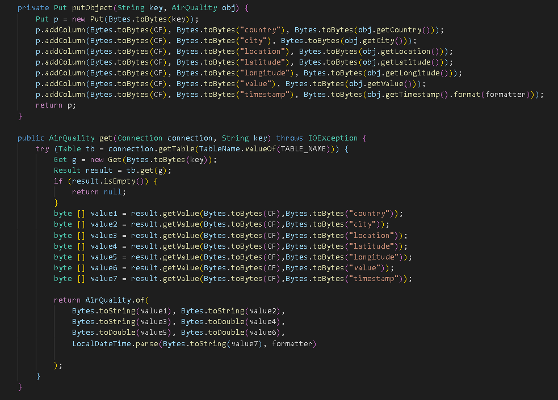
Hbase: Repository

Slide 15
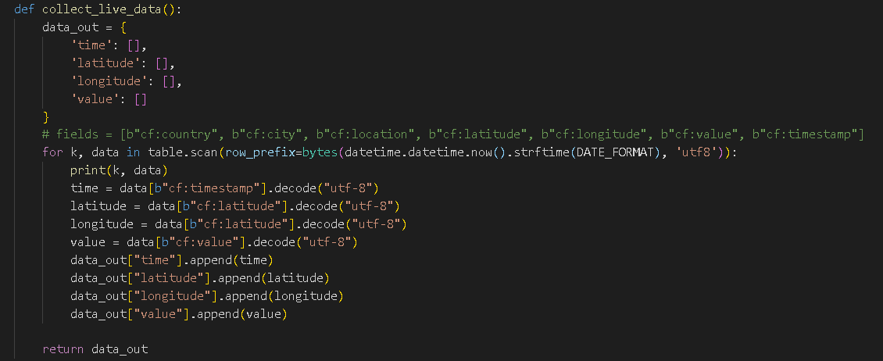
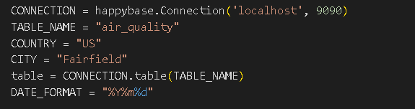
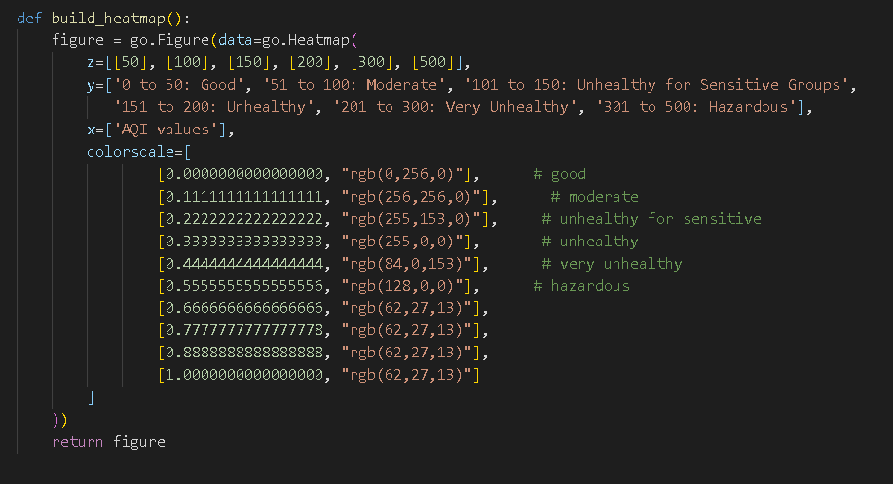
Data Visualization

Slide 16
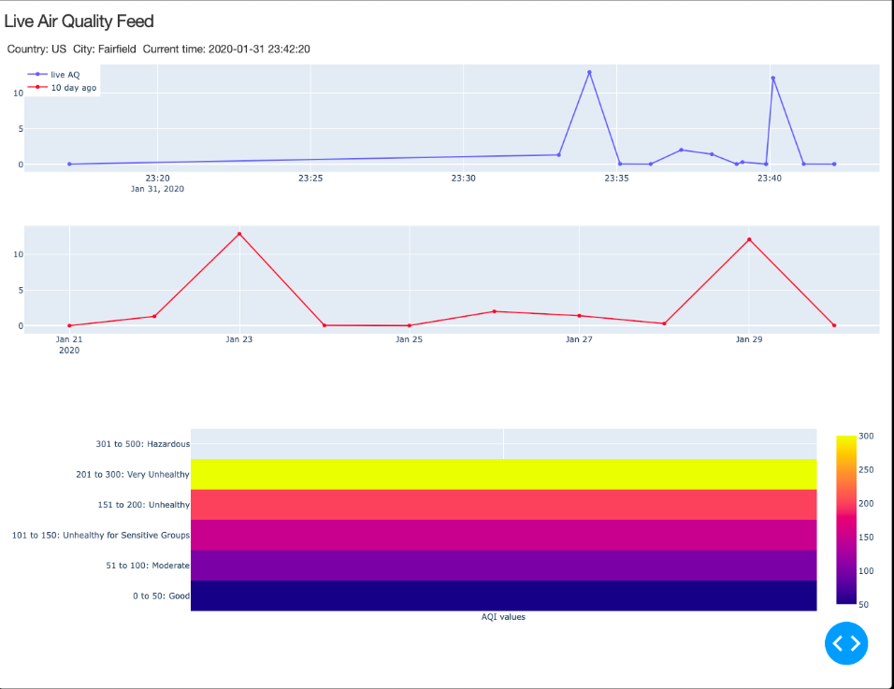
Data Visualization

Slide 17
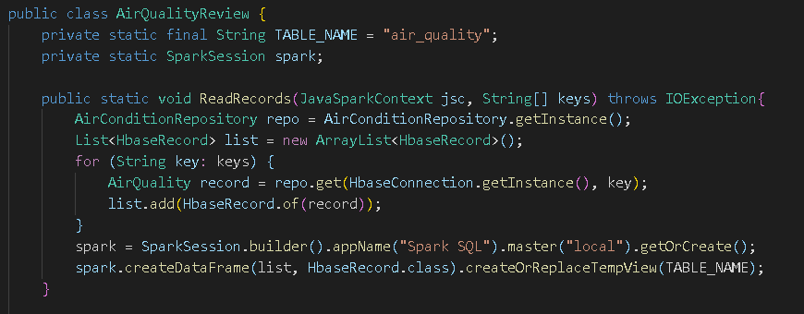
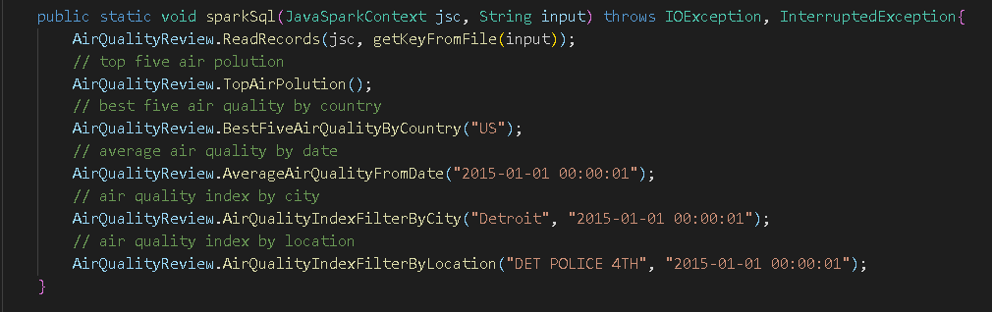
Spark SQL

Slide 18
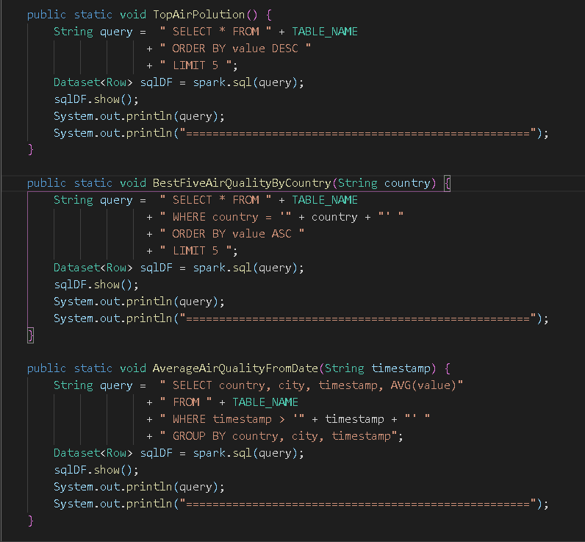
Spark SQL

Slide 19
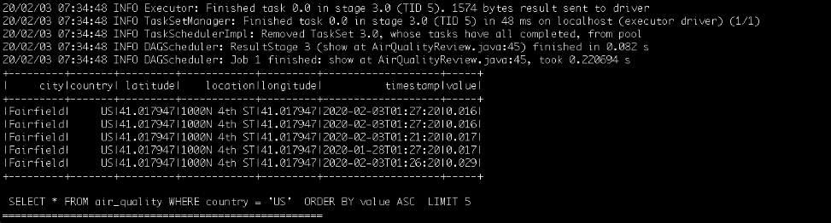
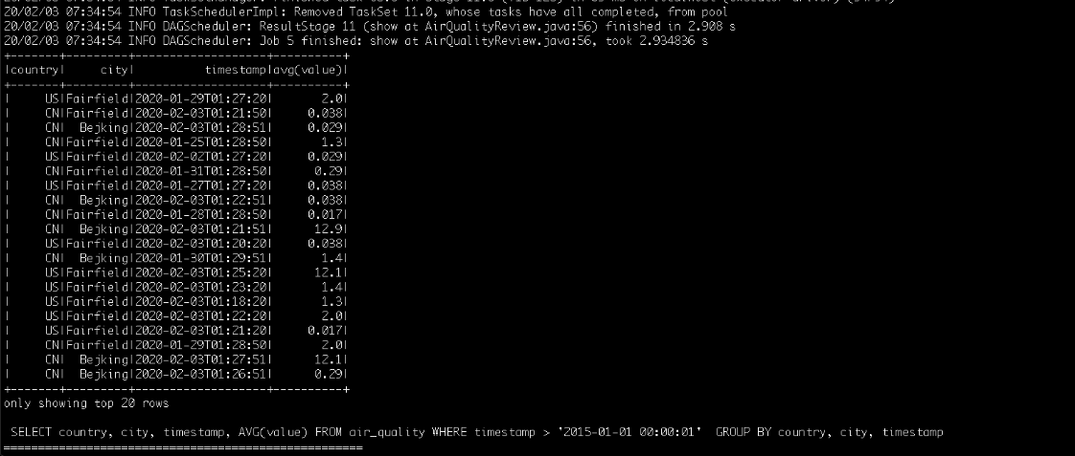
Spark SQL

Slide 20
Some Issues
- AWS S3 has a limitation on requests (2000 requests / month for free account)
- Cloudera quick-start virtual machine is not fully updated with latest version and therefore, causes many bugs.
E.g: Spark 2.4 is not compatible with Hbase 1.2 and need to upgrade Hbase
- Lack of admin experiences with Cloudera Ecosystem

Slide 21
Future Improvement
Improve data and server (config more clusters )to support data for all countries
Create different type of charts to increase user experience

Slide 22
Demo

Slide 23
Q & A

Slide 24
Appendix: DataFrame vs DataSet
 | Dataframe | Dataset
Data Representation | - is a distributed collection of data organized into named columns - It is conceptually equal to a table in a relational database. | - is an extension of DataFrame API - Is represented by a user-defined object so that you can refer to an individual column as a member variable of that object -> provide compile-type safety
Data Format | - It works only on structured and semi-structured data -> It organizes the data in the named column | - It also efficiently processes structured and unstructured data -> It represents data in the form of JVM objects of row or a collection of row object
Data Source API | - Data source API allows Data processing in different formats (AVRO, CSV, JSON, and storage system HDFS, HIVE tables, MySQL) | - Dataset API of spark also support data from different sources.
Immutability | - After transforming into DataFrame one cannot regenerate a domain object | - Datasets allow you to convert your existing RDD and DataFrames into Datasets.
Compile-time type safety | - If you are trying to access the column which does not exist in the table in such case Dataframe APIs does not support compile-time error - It detects attribute error only at runtime. | - It provides compile-time type safety.

Slide 25
Appendix: DataFrame vs DataSet
Use DataFrame to make use of the data format of DataFrame, which support the structured data

