Slide 1



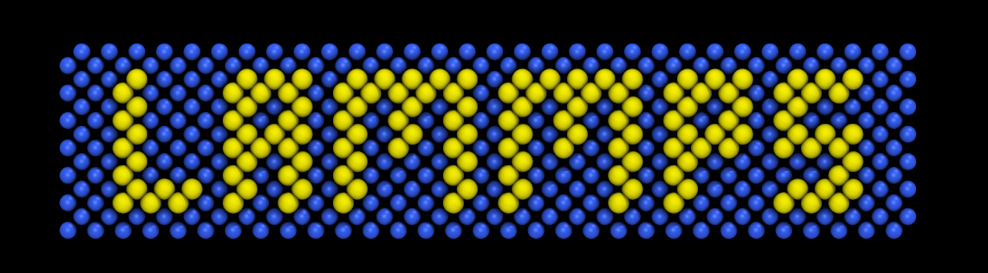
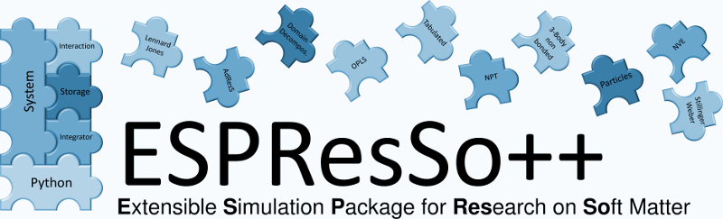
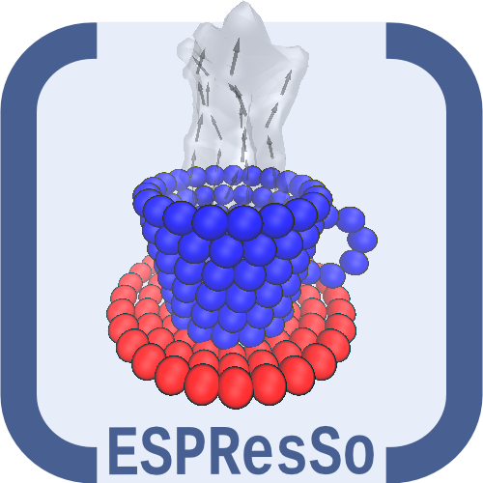

Versatile Object-oriented Toolkit for Coarse graining and energy transport Applications
VOTCA-CSG
VOTCA-XTP
MD Topology Reader
MD Trajectory Reader (new: H5MD format)
Mapping of coordinates/forces
Structure based coarse graining (new: Iterative Integral Equation method)
Relative entropy
Force matching
DFT
Many-Body Green‘s Function
Bethe-Salpeter Equation
Quantum classical embedding
CUDA support
OpenMP parallelization
Python binding (PyXTP)
TOOLS
Linear Algebra
Wrappers

